Slide 1
Bi-criteria Approximation for a Multi-Origin Multi-Channel Auto-Scaling Live Streaming Cloud
Chang, Zhangyu
Supervised by Prof. Gary Chan
19 April 2025

Slide 2
Contents
Introduction and Related Work
Problem Formulation and Its NP-hardness
COCOS: Bi-criteria Approximation Algorithm
Illustrative Experimental Results
Conclusion

Slide 3



Live Video Broadcasting Trends
Bandwidth dedicated to video traffic is expected to jump to 82% of the total traffic by 2022.
Live Internet video will account for 17% of Internet video traffic by 2022. Live video will grow 15-fold from 2017 to 2022.
Surveillance: 2%; Live Video: 17%; Long-form VoD: 62%; Short-Form VoD: 18%
(Cisco’s Annual Internet Report, Updated: March 9, 2020)
Sports Games
News Broadcasting
Online Education
Seminar/Lecture

Slide 4
Live Video Based on Auto-scaling Cloud
Live video streaming
Auto-scaling cloud
Sports Games, News Broadcasting, Online Education etc.
A significant component of Internet traffic
Traffic varies significantly over a day
Require considerable and flexible network resource
Geo-dispersed users with heterogeneous access pattern
Infrastructure as a Service (IaaS): No permanent investment for content providers (CP).
Globally geo-distributed auto-scaling data centers: Easy to deploy a global service.
Pay-as-you-go feature: Auto-scaling servers (e.g., virtual servers) and link capacities (dedicated link between servers) on demand with minimal standby cost.
On-the-fly resource allocation: Avoid cost of over-provisioning due to user dynamics.
Notes:
Be careful not to talk about flash crowd. It cannot be solved by auto-scaling cloud so responsively.

Slide 5
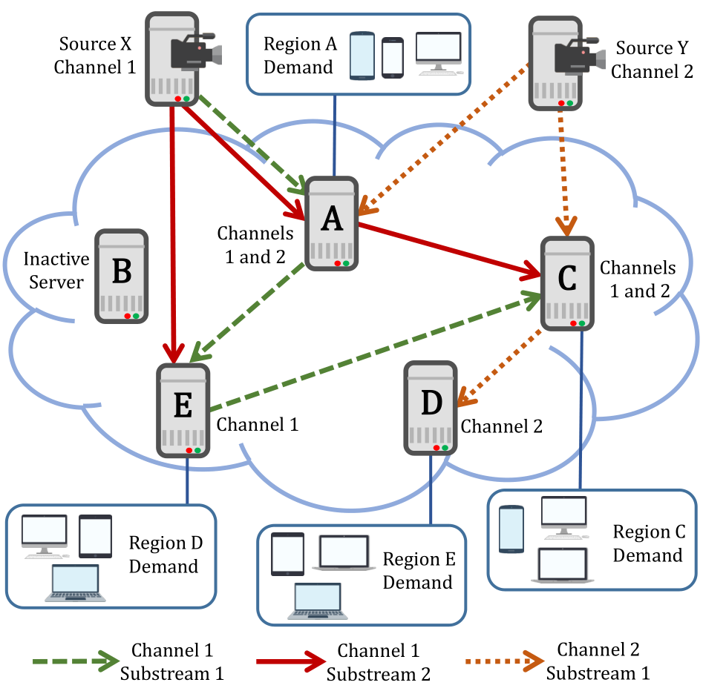
Multi-Origin Multi-Channel Live Video Cloud
Major Components in a Live Video Cloud
Origin Server | Origin of live video channels.
End Server | Stream the live content to its associated local users. (e.g., a CDN node, server farm, data center, etc.)
Channel | Multiple streaming rates; a channel may be split into n substreams.
Substream | Same bitrate; each substream is delivered to the servers through a delivery tree.
Server requests channels based on local demand and serves its local users.
Servers (with user demands) help each other in streaming contents.
Substreams are pushed from the origins to the end servers.
A server needs all the substreams to recover the original video.

Slide 6
An Example of Streaming Delivery
Origin | X & Y originate Channel 1 & 2 respectively.
Channel | Channel 1 has 2 substreams and Channel 2 has only 1 substream.
End Server | Servers receive streams either from origin or other end servers.
Server A | Receives both Channel 1 and Channel 2 from the origins.
Server C | Receives Channel 2 from source but Channel 1 from A and E.
Server D | Receives Channel 2 from Server C.
Server E | Receives one substream of Channel 1 from source and the other from A.
Server B & Some Links | Not used, therefore no cost is from them.

Slide 7
Bi-criteria Objectives: Deployment Cost and Source-to-end Delay
Minimize Source-to-end Delay
Minimize Deployment Cost
Source-to-end delay, an important Quality-of-Experience (QoE) measure, consists of Propagation delay and Scheduling delay.
Propagation delay: The time for a signal to travel from one server to the next over the overlay, given by half of the round-trip time (RTT)
Scheduling delay: The worst-case elapsed time from a server having fully received a video segment to the instant that the segment fully departs the server for the next server.
Deployment cost consists of Server Cost and Link Cost.
Server Cost: Due to the servers allocating its uploading capacity to the other servers.
Link Cost: Depends on the pairwise link capacity allocated between servers
Both server and link capacities are shared with all the channels.
The capacity to serve the local demand is fixed given the local user demand (not an optimization parameter).

Slide 8
Cost to Deploy a Live Video Service on an Auto-scaling Cloud
Cost to deploy the service on an auto-scaling cloud
Server Cost: CP allocates auto-scaling servers from cloud service providers at geo-dispersed locations.
Link Cost: CP allocates link capacities between the data centers.
Pay-as-you-go: Cost only based on the resource allocated for the service
Usually billed on certain interval (e.g., hourly basis)
CP can reallocate the resource based on actual and predicted user demand

Slide 9
Optimizing the Bi-criteria Problem
The bi-criteria problem is equivalently to minimizing deployment cost subject to a certain maximum source-to-end delay constraint of each substream.
The decision variables for this bi-criteria optimization are:
Overlay construction: The construction of the delivery tree of each substream, namely, to what servers and what substreams an auto-scaling server should forward.
Resource allocation: The allocation (purchase) of server and link capacities.
Overlay construction and resource allocation are inter-dependent decisions , have the comparable time scale for readjustment, and hence they need to be jointly optimized.

Slide 10
Contributions
Bi-criteria problem formulation and complexity analysis
We give comprehensive and realistic model: Multi-source multi-channel overlay live streaming Captures various cost and streaming delay components Minimizes the total deployment cost while meeting QoE constraints We prove the NP-hardness of this problem
COCOS: A novel bi-criteria approximation algorithm
Cost-Optimized Multi-Source Multi-Channel Overlay Streaming Linear-programming based solution Proven approximation ratio by manipulating the LP solution Strictly meets the QoE constraints
Extensive trace-driven experimental results
Trace-driven experimental studies using real-world data (from a leading Chinese video service provider) Substantially outperform the state-of-the-art schemes Cutting the cost significantly (in general by more than 50%)

Slide 11
Related Work
Single-source single-channel
Cannot be extended to multi-source multi-channel live streaming due to bandwidth sharing [Tran et al. ICISA’ 17, Ha et al. MTA’16, Wichtlhuber et al. IFIP’14, Roverso et al. MMSys’15]
Multi-source multi-channel
VoD based approaches cannot be extended to live streaming due to delay consideration [Ma et al. NOSSDAV '16, Hu et al. IEEE JSAC’17, Chen et al. IEEE JSAC’17, Liu et al. IEEE TMM’16] [Kondo et al. NETWORKS’14, Liu et al. ICCCN’13, Meskill et al. LCN’11, Liu et al. GLOBECOM’15, H. K. Yarnagula et al. IEEE TMM ’19, I. Irondi et al. IEEE TMM ’19]
Live streaming works mainly focus on different objectives
Effective delivery of live contents from a CDN server to its local audience [R.-X. Zhang et al. MM’20, R.-X. Zhang et al. NOSSDAV’19, F. Haouari et al. ICC’19] Maximizing bandwidth or minimizing source load [Detti et al. Computer Networks’15, Wang et al. INFOCOM’10, Wu et al. INFOCOM’09, Chen et al. Peer-to-Peer Netw. Appl.’17, Wang et al. GLOBECOM’10, Kuo et al. Peer-to-Peer Netw. Appl’15, S. Budhkar et al. Peer-to-Peer Netw. Appl’19]
None above has proven approximation ratio

Slide 12
Contents
Introduction and Related Work
Problem Formulation and Its NP-hardness
COCOS: Bi-criteria Approximation Algorithm
Illustrative Experimental Results
Conclusion

Slide 13
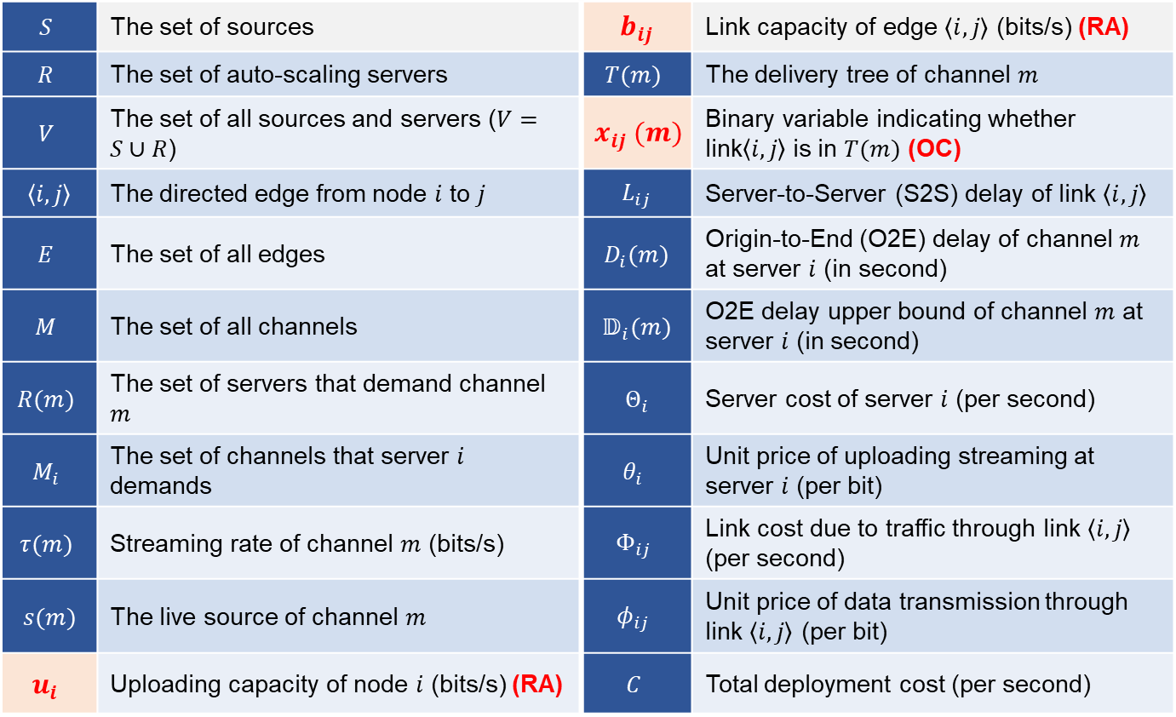
Major Symbol Used in Formulation
$$S$$ | The set of sources | $$b_{ij}$$ | Link capacity of edge $\left\langle i, j\right\rangle$ (bits/s) (RA)
$$R$$ | The set of auto-scaling servers | $$T(m)$$ | The delivery tree of channel $m$
$$V$$ | The set of all sources and servers ($V=S∪R$) | $$x_{ij} (m)$$ | Binary variable indicating whether link$\left\langle i, j\right\rangle$is in $T(m)$ (OC)
$$\left\langle i, j\right\rangle$$ | The directed edge from node $i$ to $j$ | $$L_{ij}$$ | Server-to-Server (S2S) delay of link $\left\langle i, j\right\rangle$
$$E$$ | The set of all edges | $$D_{i}(m)$$ | Origin-to-End (O2E) delay of channel $m$ at server $i$ (in second)
$$M$$ | The set of all channels | $$𝔻_{i}(m)$$ | O2E delay upper bound of channel $m$ at server $i$ (in second)
$$R(m)$$ | The set of servers that demand channel $m$ | $$Θ_{i}$$ | Server cost of server $i$ (per second)
$$M_{i}$$ | The set of channels that server $i$ demands | $$θ_{i}$$ | Unit price of uploading streaming at server $i$ (per bit)
$$τ(m)$$ | Streaming rate of channel $m$ (bits/s) | $$Φ_{ij}$$ | Link cost due to traffic through link $\left\langle i, j\right\rangle$ (per second)
$$s(m)$$ | The live source of channel $m$ | $$φ_{ij}$$ | Unit price of data transmission through link $\left\langle i, j\right\rangle$ (per bit)
$$u_{i}$$ | Uploading capacity of node $i$ (bits/s) (RA) | $$C$$ | Total deployment cost (per second)

Slide 14
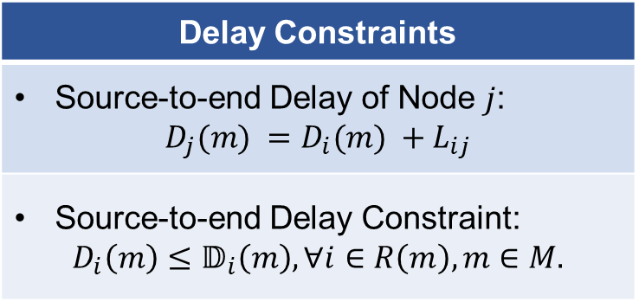
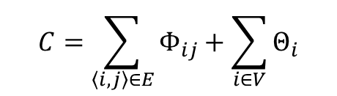
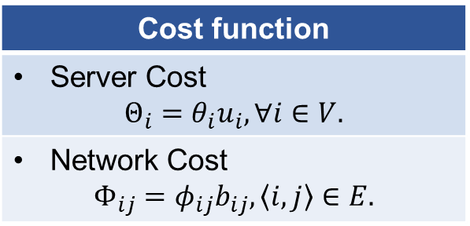
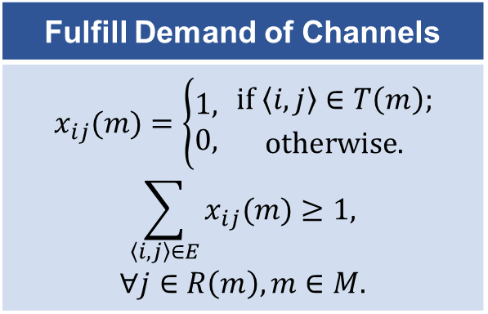
Comprehensive Model as an NP-Hard Problem: Minimum Cost Streaming with Delay Constraints
Delay Constraints
Source-to-end Delay of Node $j$: $$D_{j}(m) =D_{i}(m) +L_{ij}$$
Source-to-end Delay Constraint: $$D_{i}\left(m\right)≤𝔻_{i}\left(m\right), ∀i∈R\left(m\right), m∈M.$$
Minimize the total deployment cost :
$$C=\sum_{\left\langle i, j\right\rangle ∈E}{Φ_{ij}}+\sum_{i∈V}{Θ_{i}}$$
Cost function
Server Cost $$Θ_{i}=θ_{i}u_{i}, ∀i∈V.$$
Network Cost $$Φ_{ij}=φ_{ij}b_{ij},\left\langle i, j\right\rangle ∈E.$$
Fulfill Demand of Channels
$$x_{ij}(m)=\left\{\begin{aligned}1, \\ 0,\end{aligned} {if \left\langle i, j\right\rangle ∈T\left(m\right); \atop otherwise.}\right.$$ $$\sum_{\left\langle i, j\right\rangle ∈E}{x_{ij}(m)}≥1,$$ $$∀j∈R\left(m\right), m∈M.$$
NP-complete Restricted Shortest Path Problem (RSP) is reducible to our problem. It is NP-Hard!

Slide 15
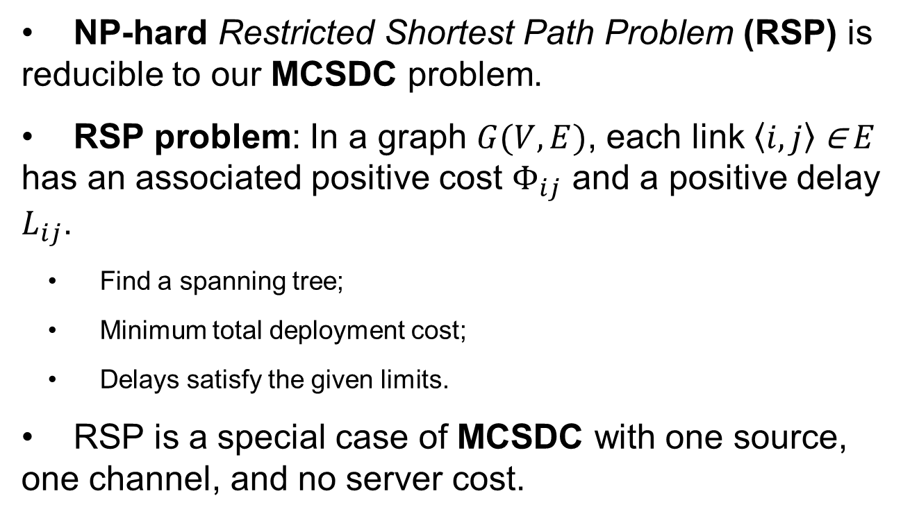
NP-Hardness
NP-hard Restricted Shortest Path Problem (RSP) is reducible to our MCSDC problem.
RSP problem: In a graph $G(V,E)$, each link $\left\langle i, j\right\rangle \text{∈} E$ has an associated positive cost $Φ_{ij}$ and a positive delay $L_{ij}$.
Find a spanning tree;
Minimum total deployment cost;
Delays satisfy the given limits.
RSP is a special case of MCSDC with one source, one channel, and no server cost.

Slide 16
Contents
Introduction and Related Work
Problem Formulation and Its NP-hardness
COCOS: Bi-criteria Approximation Algorithm
Illustrative Experimental Results
Conclusion

Slide 17
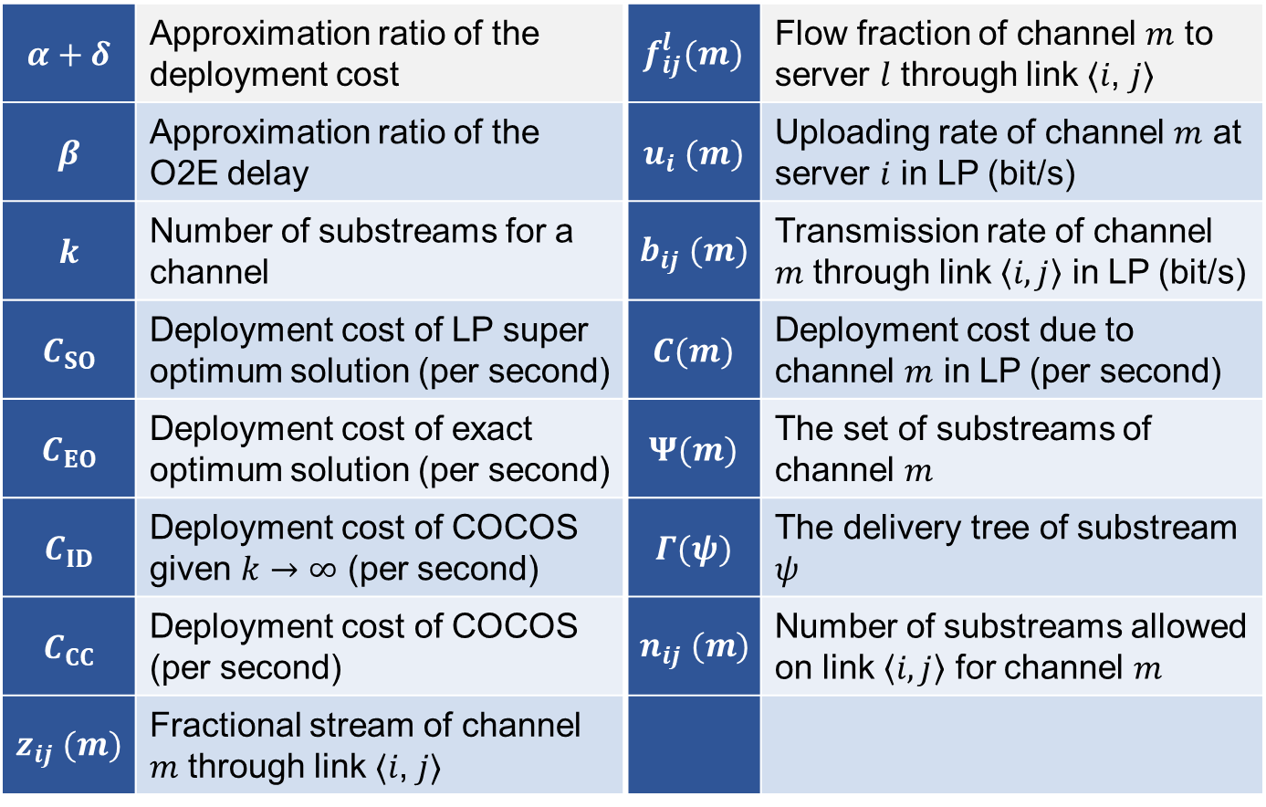
Major Symbol Used in COCOS Algorithm
$$α+δ$$ | Approximation ratio of the deployment cost | $$f_{ij}^{l}(m)$$ | Flow fraction of channel $m$ to server $l$ through link ⟨𝑖, 𝑗⟩
$$β$$ | Approximation ratio of the O2E delay | $$u_{i} (m)$$ | Uploading rate of channel $m$ at server $i$ in LP (bit/s)
$$k$$ | Number of substreams for a channel | $$b_{ij} (m)$$ | Transmission rate of channel $m$ through link $\left\langle i, j\right\rangle$ in LP (bit/s)
$$C_{SO}$$ | Deployment cost of LP super optimum solution (per second) | $$C(m)$$ | Deployment cost due to channel $m$ in LP (per second)
$$C_{EO}$$ | Deployment cost of exact optimum solution (per second) | $$Ψ(m)$$ | The set of substreams of channel $m$
$$C_{ID}$$ | Deployment cost of COCOS given $k→∞$ (per second) | $$Γ(ψ)$$ | The delivery tree of substream $ψ$
$$C_{CC}$$ | Deployment cost of COCOS (per second) | $$n_{ij} (m)$$ | Number of substreams allowed on link $\left\langle i, j\right\rangle$ for channel $m$
$$z_{ij} (m)$$ | Fractional stream of channel $m$ through link ⟨𝑖, 𝑗⟩

Slide 18
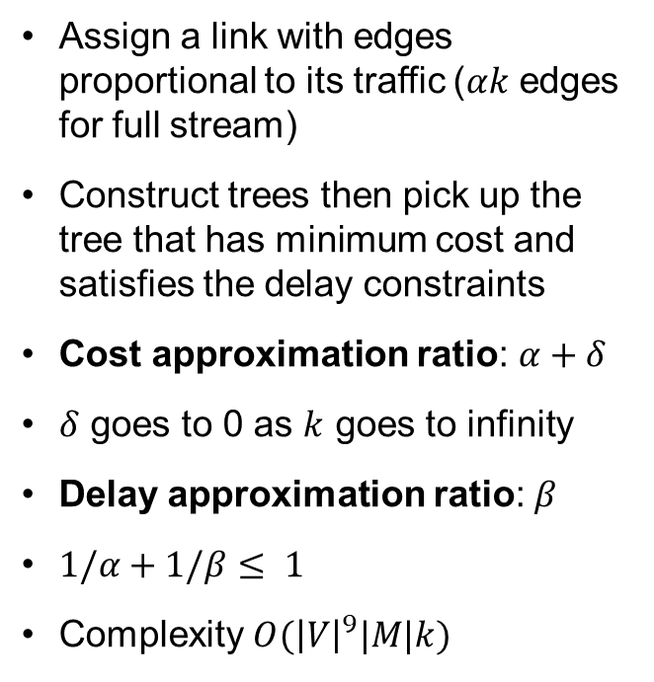
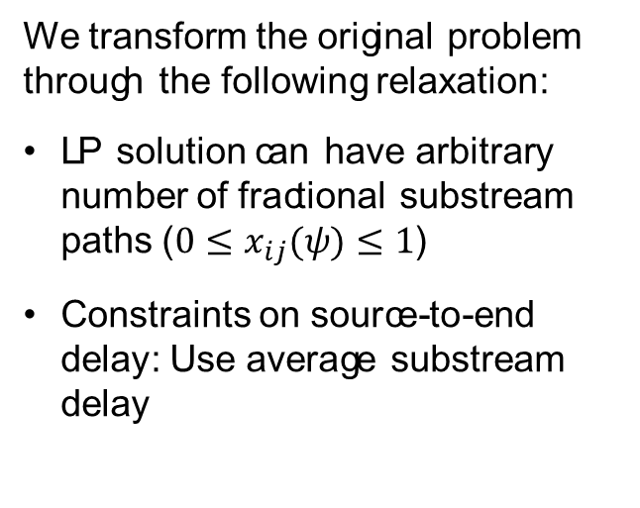
Overlay Construction and Resource Allocation
Relaxed to a LP problem
Topology construction
We transform the original problem through the following relaxation:
LP solution can have arbitrary number of fractional substream paths ($0≤x_{ij}(ψ)≤1$)
Constraints on source-to-end delay: Use average substream delay
Assign a link with edges proportional to its traffic ($αk$ edges for full stream)
Construct trees then pick up the tree that has minimum cost and satisfies the delay constraints
Cost approximation ratio: $α+δ$
$δ$ goes to 0 as $k$ goes to infinity
Delay approximation ratio: $β$
$1/α+1/β≤ 1$
Complexity $O({\left|V\right|}^{9}|M|k)$

Slide 19
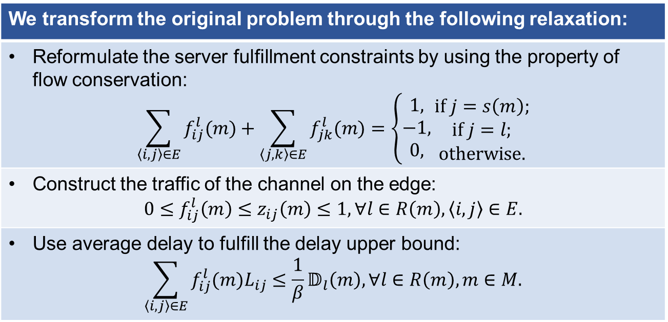
Relax the Formulation to a Linear Program
We transform the original problem through the following relaxation:
Reformulate the server fulfillment constraints by using the property of flow conservation: $$\sum_{\left\langle i, j\right\rangle ∈E}{f_{ij}^{l}(m)}+\sum_{\left\langle j, k\right\rangle ∈E}{f_{jk}^{l}(m)}=\left\{\begin{aligned}1, \\ −1, \\ 0,\end{aligned}\right.\begin{matrix}if j=s\left(m\right); \\ if j=l; \\ otherwise.\end{matrix}$$
Construct the traffic of the channel on the edge: $$0≤f_{ij}^{l}\left(m\right)≤z_{ij}\left(m\right)≤1, ∀l∈R\left(m\right),\left\langle i, j\right\rangle ∈E.$$
Use average delay to fulfill the delay upper bound: $$\sum_{\left\langle i, j\right\rangle ∈E}{f_{ij}^{l}(m)L_{ij}}≤\frac{1}{β}𝔻_{l}\left(m\right),∀l∈R\left(m\right), m∈M.$$

Slide 20
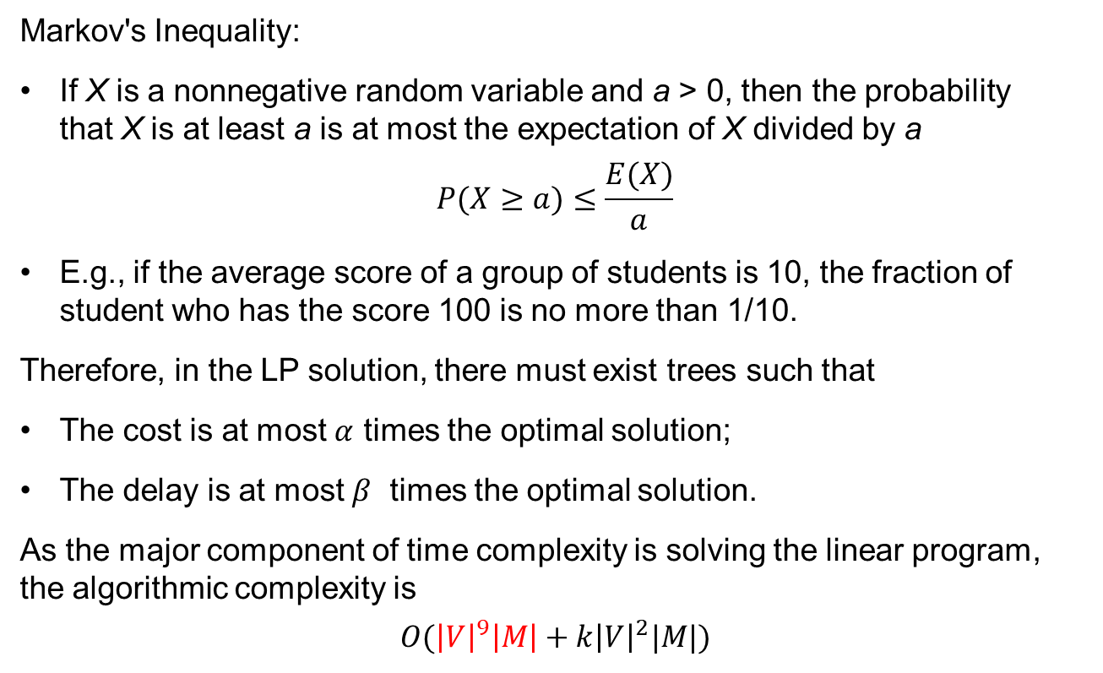
Approximation Ratio and Algorithmic Complexity
Markov's Inequality:
If X is a nonnegative random variable and a > 0, then the probability that X is at least a is at most the expectation of X divided by a
$$P(X≥a)≤\frac{E(X)}{a}$$
E.g., if the average score of a group of students is 10, the fraction of student who has the score 100 is no more than 1/10.
Therefore, in the LP solution, there must exist trees such that
The cost is at most $α$ times the optimal solution;
The delay is at most $β$ times the optimal solution.
As the major component of time complexity is solving the linear program, the algorithmic complexity is
$$O({\left|V\right|}^{9}\left|M\right|+k{\left|V\right|}^{2}|M|)$$

Slide 21
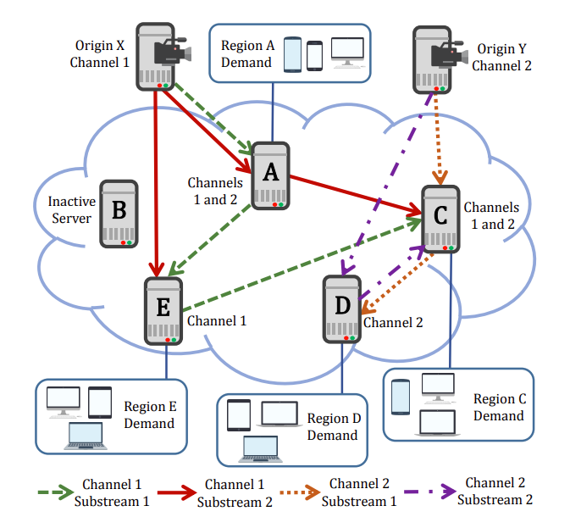

Example of substream solution for $k=2$

Slide 22
Contents
Introduction and Related Work
Problem Formulation and Its NP-hardness
COCOS: Bi-criteria Approximation Algorithm
Illustrative Experimental Results
Conclusion

Slide 23
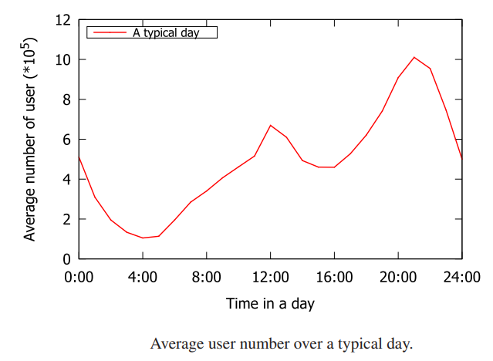
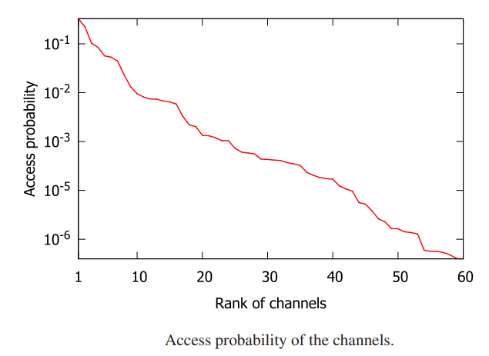
Experimental Setup
Performance Metrics
Deployment cost Server cost Link cost Delay
Comparison Schemes
Nearest Peer [27] Consider local popularity No cooperative replication Prim [28] Minimum cost tree Modified to meet delay constraints Super-optimal Relaxed LP solution

Slide 24
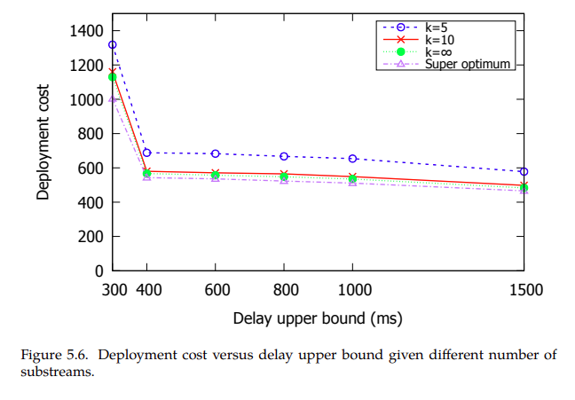
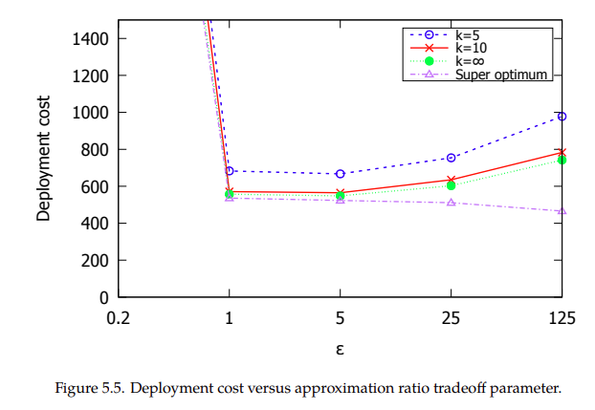



Good Tradeoff for humble $k$ and $β$
$$α=1+ε$$
$$β=1+1/ε$$

Slide 25
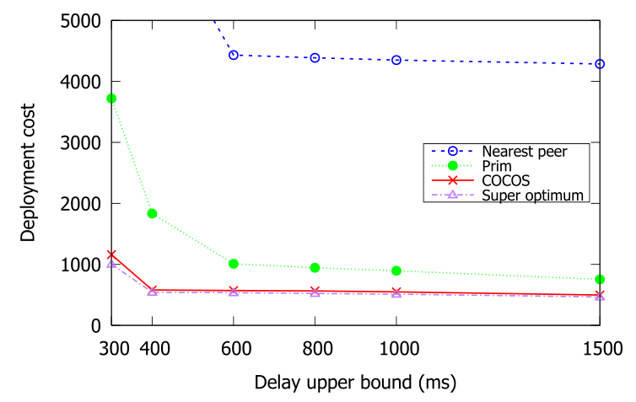
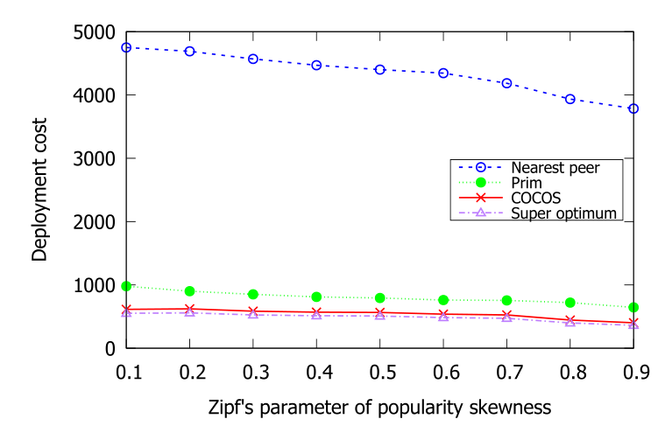
Near-Optimal Performance
Real-world data trace:
From a leading video service website in China (Tencent) over 2 weeks
Near-optimal performance:
Outperform state-of-the-art schemes
Synthetic data:
Verify the performance given difference video popularity
Stable performance:
Given different video popularity

Slide 26
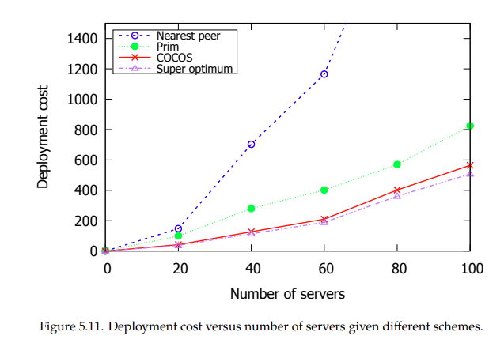
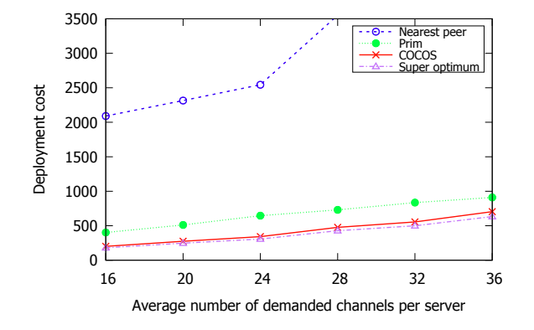
Scalable Scheme
Better performance for a larger system

Slide 27
Contents
Introduction and Related Work
Problem Formulation and Its NP-hardness
COCOS: Bi-criteria Approximation Algorithm
Illustrative Experimental Results
Conclusion

Slide 28
Conclusion
Bi-criteria problem formulation and complexity analysis | Comprehensive model: Various cost components Streaming constraints for QoE NP-hardness proof
COCOS: A novel bi-criteria approximation algorithm | Meet the QoE constraints tightly LP-based solution Polynomial time algorithmic complexity Proven approximation ratio
Extensive trace-driven experimental results | Outperform the state-of-the-art schemes Reduce the optimality gap by multiple times

Slide 29
Thank You!
Any Questions?

