Slide 1
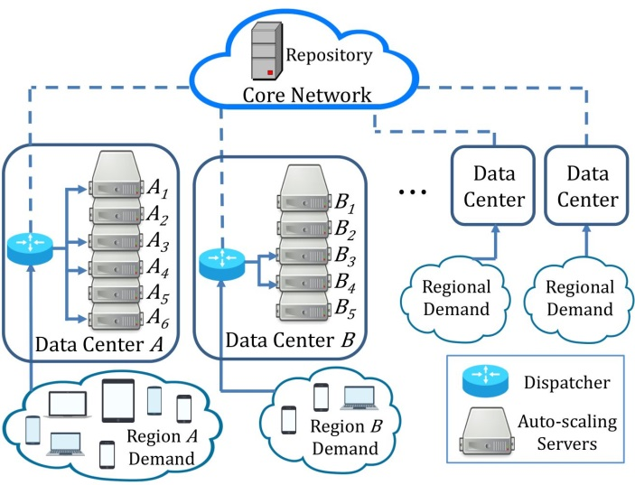
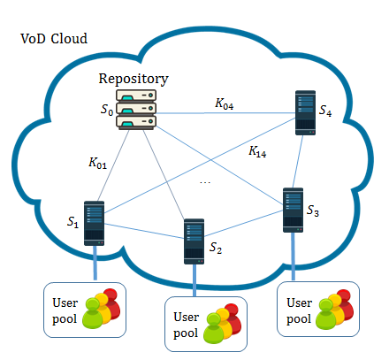
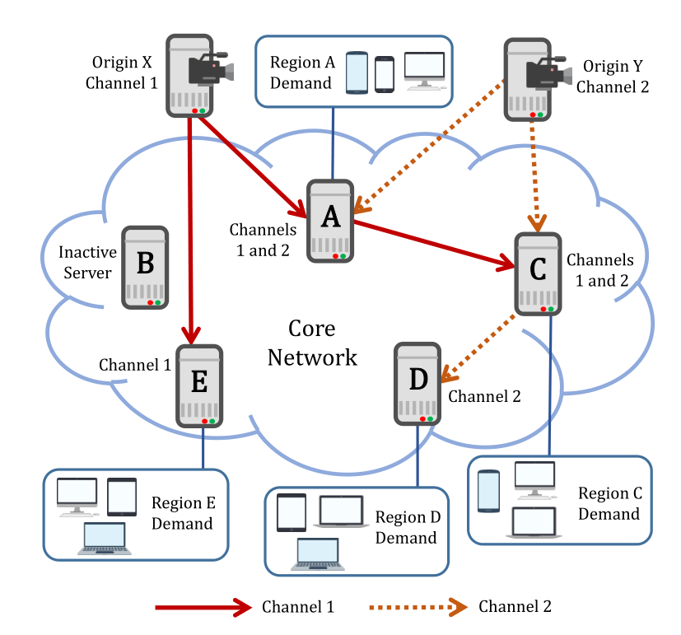

Approximation Algorithms for Auto-Scaling Video Cloud
Ph.D. Thesis Examination
Chang, Zhangyu
Supervised by Prof. Gary Chan
21 December 2023

Slide 2
Contents
Introduction
AVARDO: Optimizing an Auto-Scaling VoD Data Center
RAVO: Optimizing a Geo-Distributed VoD Cloud
COCOS: Optimizing an Auto-Scaling Live Streaming Cloud
Conclusion

Slide 3
Background: Video-on-Demand and Live Streaming
 | Video-on-Demand (VoD) | Live Streaming
Features | Pre-recorded Users can access the video content anytime/anywhere. | Created in real-time Geo-dispersed users access the video as it is being created.
Examples | TV shows, movies on Netflix(13.7%), Disney+(4.2%), Amazon Prime, Hulu, iQiyi, Tencent Video, etc. | Live broadcasting of sports games, concerts, news, online education (lectures), etc.
Resource Required | Storage (VoD only)
 | Server Processing Network Link No less than the video streaming rate for any request
Notes:
Not focusing on UGC

Slide 4
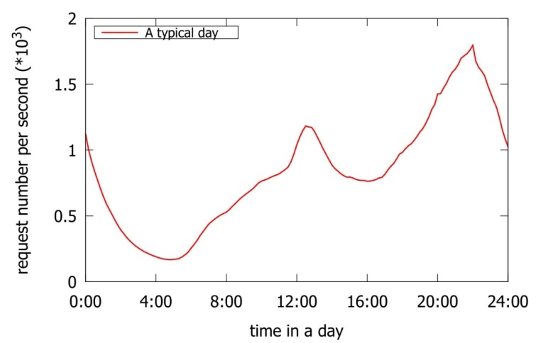
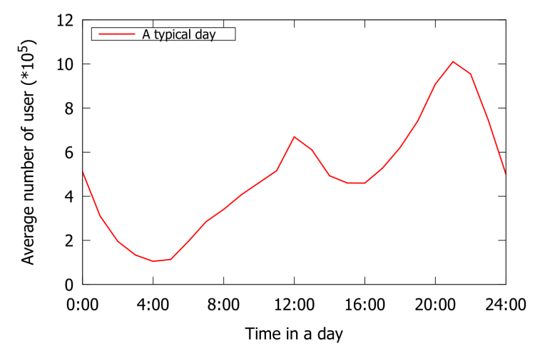
Background: Video Traffic’s Huge Volume and Dynamic Daily Pattern
Video Traffic: Huge Volume
Global Internet Report (Sandvine '23 [1])
2022 video traffic: As the percentage of total Internet traffic (excluding video calls/conferencing) | 66%
2022 video traffic growth rate (compared to Year 2021) | 24%
Daily Pattern: Volatile Traffic & Stable Popularity
Surveys indicate: Traffic varies by more than an order of magnitude over merely hours (Liu et al. TOMM '14 [2]) Video popularities are stable and predictable over several days (Cha et al. Trans. Netw. '09 [3])
VoD: User requests over a day
Live streaming: Average user number over a day
Data source of the plots: Tencent Video

Slide 5



Benefit of Auto-Scaling: Allocate Geo-Dispersed Resources on the Fly
Auto-Scaling Data Center
Rescale system resources elastically: Deploy geo-dispersed servers on the fly to support local audience Activated or deactivate servers in a timely manner
Traditional Static Provisioning (For Comparison)
Fixed number of servers Not cost-effective due to daily traffic pattern Inevitable overprovisioning to ensure quality of service
…
Auto-Scaling Servers
Desired Capacity
Scale out as needed
An auto-scaling data center

Slide 6

Problem 1: Optimizing an Auto-Scaling VoD Data Center
System Settings
Servers can be activated or deactivated in a short time A traffic dispatcher distributes request to an active server with the video
Major Objectives
Cost-effectiveness: Minimize the number of active servers Quality of service: Allocate enough resource to serve users
Contributions
Simple but efficient approximation algorithm AVARDO: Auto-Scaling Video Allocation and Request Distribution Optimization
A video cloud consisting of auto-scaling VoD data centers.
Notes:
If not optimized: some server is too busy; some server do nothing.

Slide 7
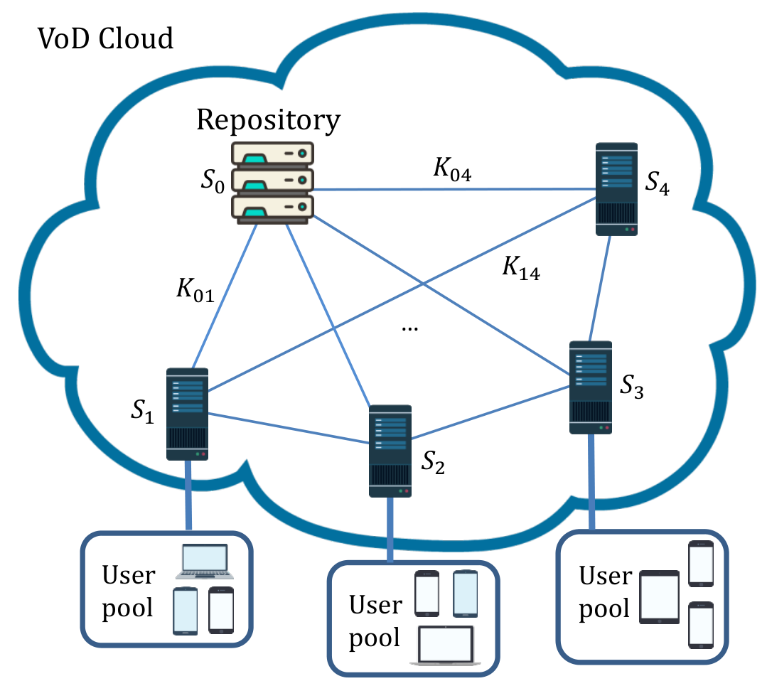
Problem 2: Optimizing a Geo-Distributed VoD Cloud
System Settings
Repository: complete video replication Local server: partial replication to save storage Collaboratively serve the users to reduce cost
Major Objectives
Decide where to store and access the videos Satisfy quality-of-service (QoS) constraints Minimize total deployment cost
Contributions
Approximation algorithm based on linear programming RAVO: Resource Allocation and Video Management Optimization
A distributed and cooperative cloud architecture for VoD service
Notes:
Store some video locally, retrieve the rest of the video from other servers.

Slide 8
Problem 3: Optimizing an Auto-Scaling Live Cloud
System Settings
Geo-dispersed auto-scaling servers Push each channel stream as a tree Cover servers demanding the channel
Major Objectives
Construct overlay trees to deliver channels Bi-Criteria objective: Minimize deployment cost Minimize origin-to-end delays
Contributions
Bi-Criteria approximation algorithm based on linear programming COCOS: Cost-Optimized Multi-Origin Multi-Channel Overlay Streaming
A multi-origin multi-channel live streaming cloud.
Notes:
Servers: get channels to serve its regional demand, help other servers

Slide 9
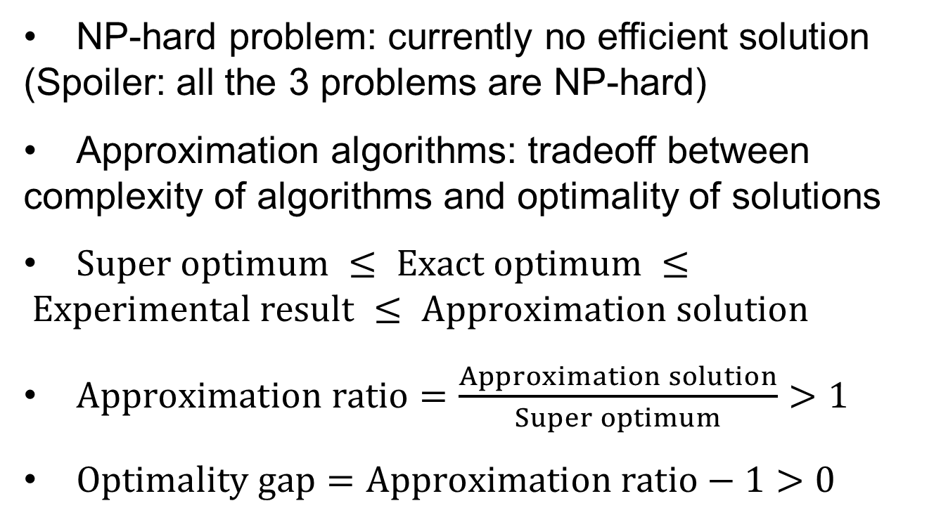
Basic Concepts: Approximation Algorithms
NP-hard problem: currently no efficient solution (Spoiler: all the 3 problems are NP-hard)
Approximation algorithms: tradeoff between complexity of algorithms and optimality of solutions
$Super optimum ≤ Exact optimum ≤ Experimental result ≤ Approximation solution$
$Approximation ratio=\frac{Approximation solution}{Super optimum}>1$
$Optimality gap=Approximation ratio−1>0$
Notes:
Analogy: build a computer

Slide 10
Contents
Introduction
AVARDO: Optimizing an Auto-Scaling VoD Data Center
RAVO: Optimizing a Geo-Distributed VoD Cloud
COCOS: Optimizing an Auto-Scaling Live Streaming Cloud
Conclusion
Publication:
Z. Chang and S.-H. Chan, "An Approximation Algorithm to Maximize User Capacity for an Auto-scaling VoD System," IEEE Transactions on Multimedia, Vol. 23, pp. 3714-3725, October 2021.

Slide 11
Background: A Typical Auto-scaling VoD Cloud
Auto-scaling Server
Auto-scaling Server can be activated or deactivated in a short time Homogeneous Server has same storage and streaming capacity
Traffic Dispatcher
Distribute request to an active server with the video Otherwise to core network
Video Block
Only for management purpose (cf. DASH segments) Blocks have the same size Partition large video into blocks
A video cloud consisting of auto-scaling VoD data centers.
Notes:
Independently consider a data center

Slide 12
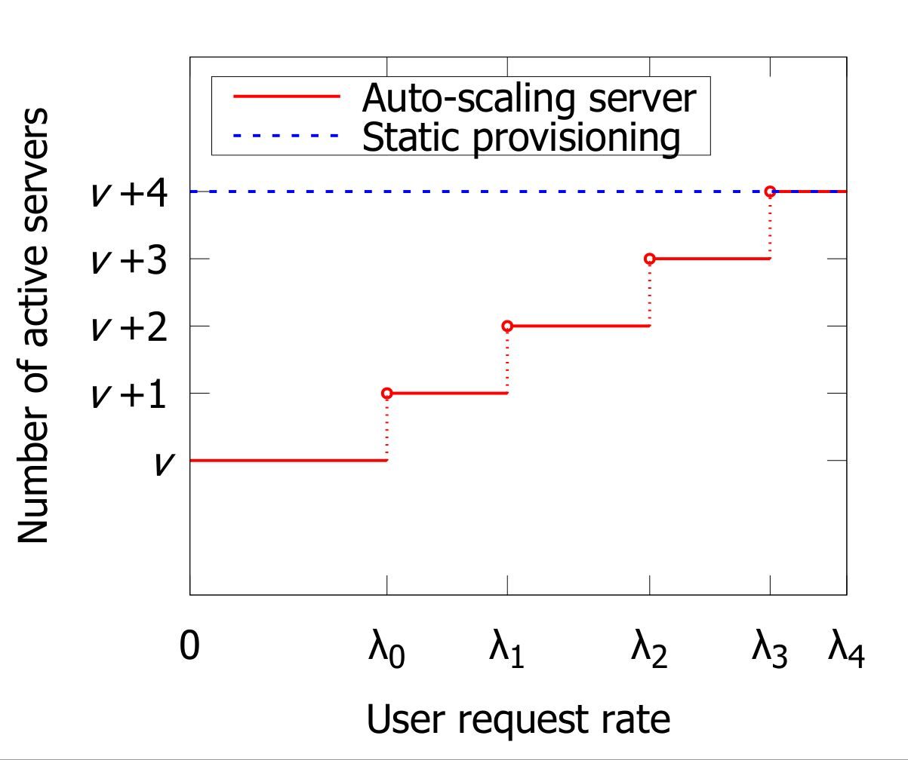

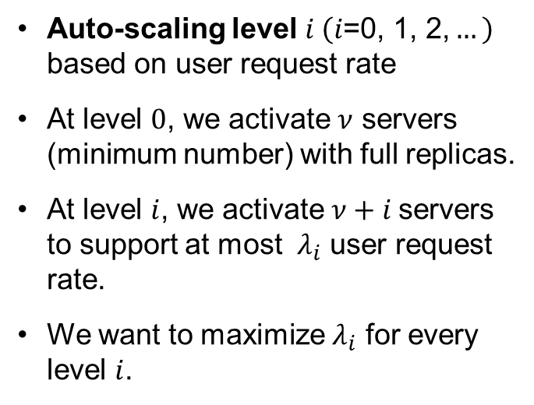
Objective: Maximizing the User Request Rate Threshold $λ_{i}$
Auto-scaling level $i \left(i\text{=0, 1, 2,}…\right)$ based on user request rate
At level $0$, we activate $ν$ servers (minimum number) with full replicas.
At level $i$, we activate $ν+i$servers to support at most $λ_{i}$ user request rate.
We want to maximize $λ_{i}$ for every level $i$.
Notes:
Climbing the steps

Slide 13
Optimization Parameters
 | Block Allocation (BA) | Server Selection (SS) | Request Dispatching (RD)
Question | Which blocks should be allocated in each server? | Which servers should be activated for current traffic? | Which server for a request?
Constraints | Number of blocks a server can store | In active servers: At least one replica for each block Popular blocks in enough servers | Avoid overload of any active servers
Timescale | In day or week | In hour | In second
Dependency | Pre-allocated Videos for SS and RD | Based on BA | Based on BA and SS
Major challenge: optimize one BA to fit multiple SS and RD
Notes:
On-the-fly BA is not necessary due to the relatively stable popularity.

Slide 14
Related Work
 | Related Work | AVARDO
Cloud-based VoD resource provisioning | Data center as a black box Yet to consider features inside the data center (Yang et al. Infosys '14 [4]) | Investigating from a more detailed point of view
Content replication in traditional and cloud-based VoD | Static provisioning (Yang et al. IEEE TMM’ 18 [5]) Assume no change of storage and only optimize processing capacity (Bourtsoulatze et al. IEEE TMM '18 [6], Sheganaku et al. Future Gener. Comput. Syst. ‘23 [7]) | Optimize for every auto-scaling levels
Cloud resources auto-scaling mechanism | Predict the user demand (Zhao et al. Multimedia Tools Appl '19 [8], Luo et al. SoCC '22 [9]) A video is served by only one server (Du et al. IEEE TMM '16 [10]) | Considers BA, SS, and RD

Slide 15
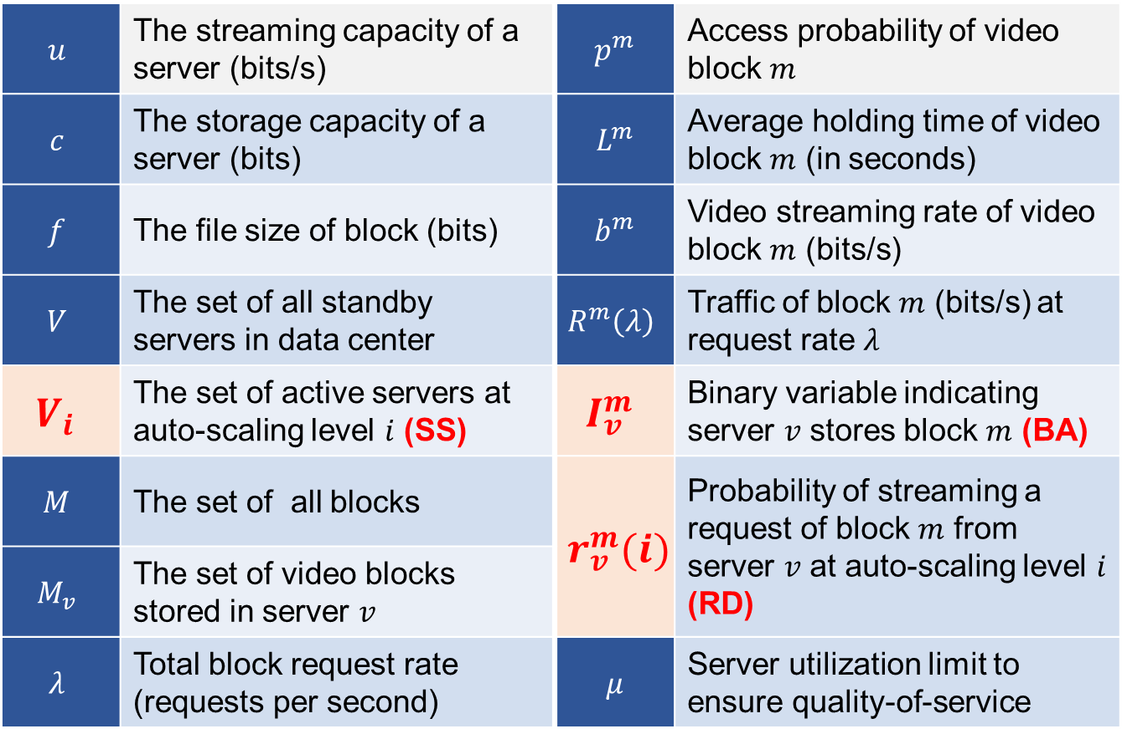
Problem Formulation: Major Symbol Used in AVARDO
$$u$$ | The streaming capacity of a server (bits/s) | $$p^{m}$$ | Access probability of video block $m$
$$c$$ | The storage capacity of a server (bits) | $$L^{m}$$ | Average holding time of video block $m$ (in seconds)
$$f$$ | The file size of block (bits) | $$b^{m}$$ | Video streaming rate of video block $m$ (bits/s)
$$V$$ | The set of all standby servers in data center | $$R^{m}\left(λ\right)$$ | Traffic of block $m$ (bits/s) at request rate $λ$
$$V_{i}$$ | The set of active servers at auto-scaling level $i$ (SS) | $$I_{v}^{m}$$ | Binary variable indicating server $v$ stores block $m$ (BA)
$$M$$ | The set of all blocks | $$r_{v}^{m}(i)$$ | Probability of streaming a request of block $m$ from server $v$ at auto-scaling level $i$ (RD)
$$M_{v}$$ | The set of video blocks stored in server $v$
$$λ$$ | Total block request rate (requests per second) | $$μ$$ | Server utilization limit to ensure quality-of-service

Slide 16
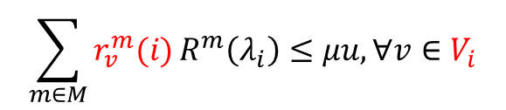

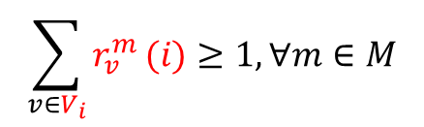


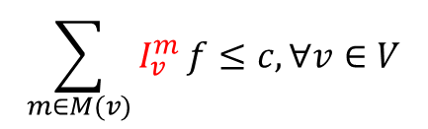
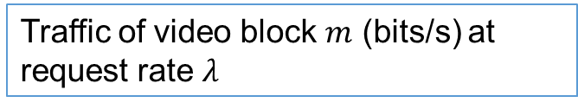
Comprehensive Model as an NP-Hard Problem: Auto-scaling Video Allocation and Request Dispatching
Objective
$$\max{(λ_{0},λ_{1},…λ_{n})}$$
Maximize request rate threshold
Subject to
Traffic of video block $m$ (bits/s) at request rate $λ$
$$R^{m}\left(λ\right)={λp}^{m}L^{m}b^{m},∀m∈M$$
Storage
$$\sum_{m∈M(v)}{I_{v}^{m}}f≤c,∀v∈V$$
Storage limit of each server (BA)
Streaming
$$r_{v}^{m}\left(i\right)≤I_{v}^{m},∀v∈V_{i}, m∈M$$
Server only serve the video it has (SS)
$$\sum_{v∈V_{i}}{r_{v}^{m}}(i)≥1,∀m∈M$$
User request shall be served (RD)
QoS
$$\sum_{m∈M}{r_{v}^{m}(i)}R^{m}\left(λ_{i}\right)≤μu,∀v∈V_{i}$$
Utilization limit of each server (RD)
Multi-Objective Mixed Integer Programming
The NP-complete Partition Problem is reducible to our problem. It is NP-hard!

Slide 17
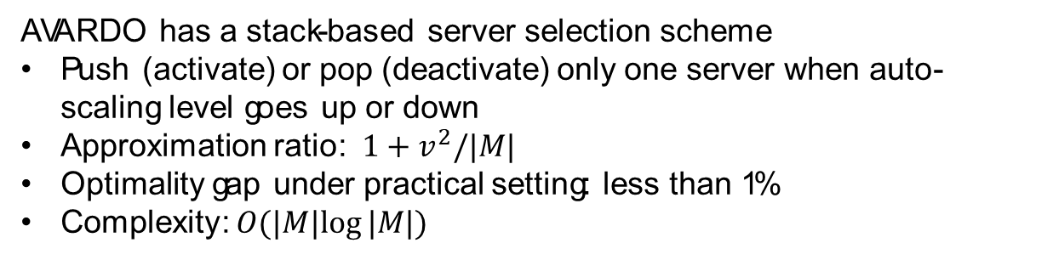
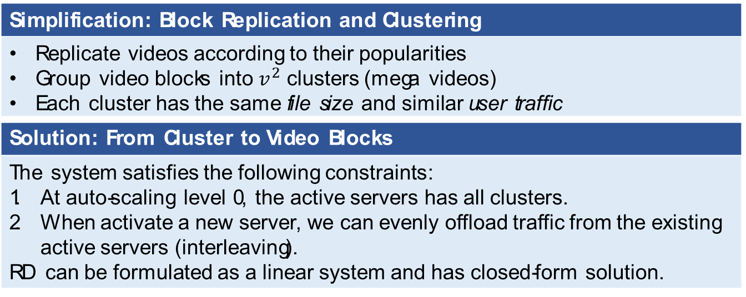
AVARDO: Approximation Algorithm for an Auto-scaling Video-on-Demand System
Simplification: Block Replication and Clustering
Replicate videos according to their popularities Group video blocks into $v^{2}$ clusters (mega videos) Each cluster has the same file size and similar user traffic
Solution: From Cluster to Video Blocks
The system satisfies the following constraints: At auto-scaling level 0, the active servers has all clusters. When activate a new server, we can evenly offload traffic from the existing active servers (interleaving). RD can be formulated as a linear system and has closed-form solution.
AVARDO has a stack-based server selection scheme
Push (activate) or pop (deactivate) only one server when auto-scaling level goes up or down
Approximation ratio: $1+v^{2}/|M|$
Optimality gap under practical setting: less than 1%
Complexity: $O(|M|log⁡|M|)$

Slide 18
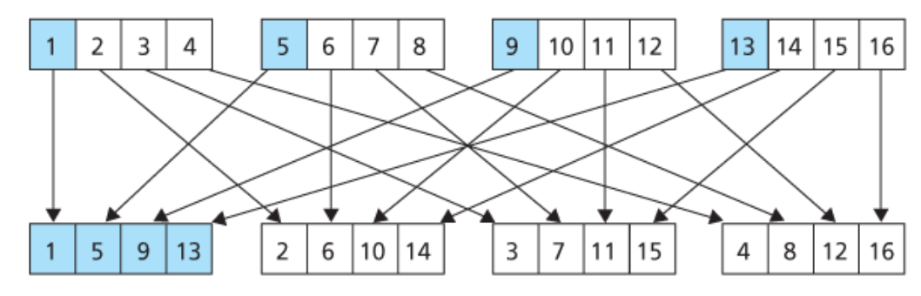
Example of Interleaving

Slide 19
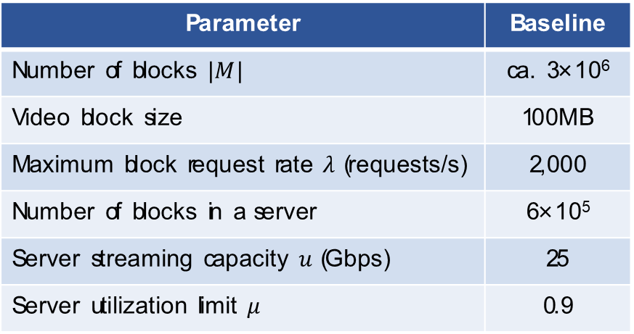
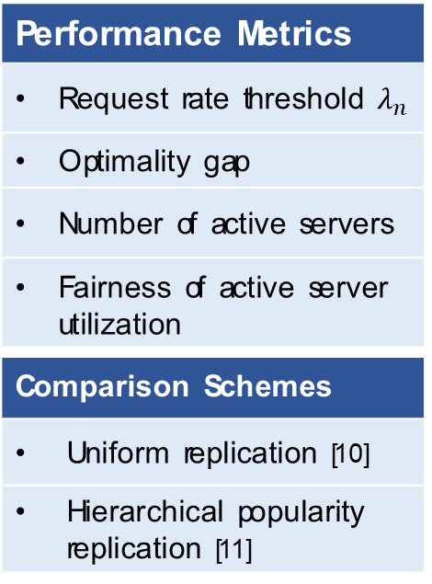
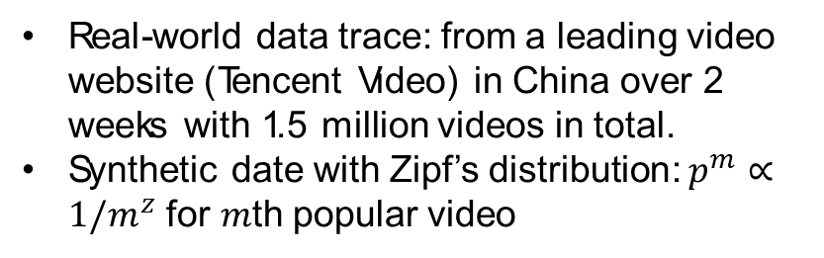
Experimental Setup
Parameter | Baseline
Number of blocks $|M|$ | ca. 3×10⁶
Video block size | 100MB
Maximum block request rate $λ$ (requests/s) | 2,000
Number of blocks in a server | 6×10⁵
Server streaming capacity $u$ (Gbps) | 25
Server utilization limit $μ$ | 0.9
Performance Metrics
Request rate threshold $λ_{n}$
Optimality gap
Number of active servers
Fairness of active server utilization
Comparison Schemes
Uniform replication [10]
Hierarchical popularity replication [11]
Real-world data trace: from a leading video website (Tencent Video) in China over 2 weeks with 1.5 million videos in total.
Synthetic date with Zipf’s distribution: $p^{m}∝1/m^{z}$ for $m$th popular video
Notes:
Uniform replication:
Every video has the same number of replicas. The videos are randomly stored in the servers.
Hierarchical popularity replication:
2 types of server: repository and cache. Repository servers collaboratively store all. Caches only store popular videos.
Super optimum:
Serves as the theoretical performance bound. We assume that a video can be partitioned infinitesimally (i.e., $f→0$).

Slide 20
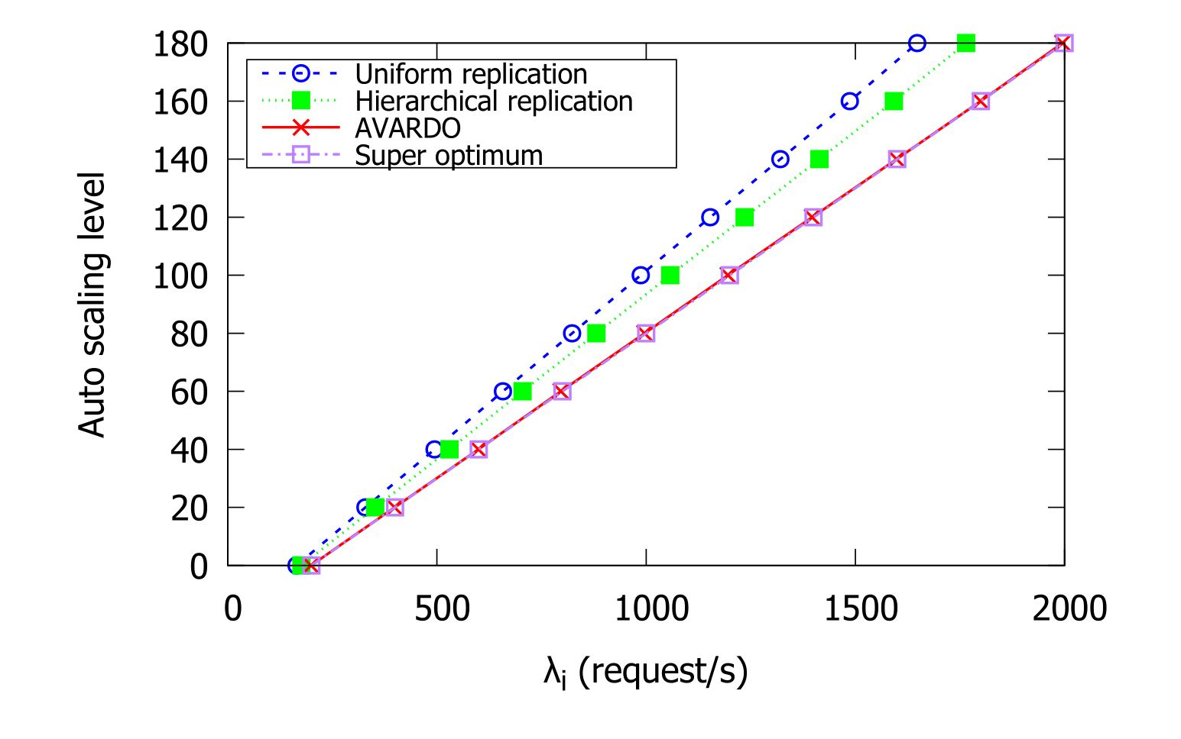
Near Optimal Performance (Real-World Data )

Slide 21
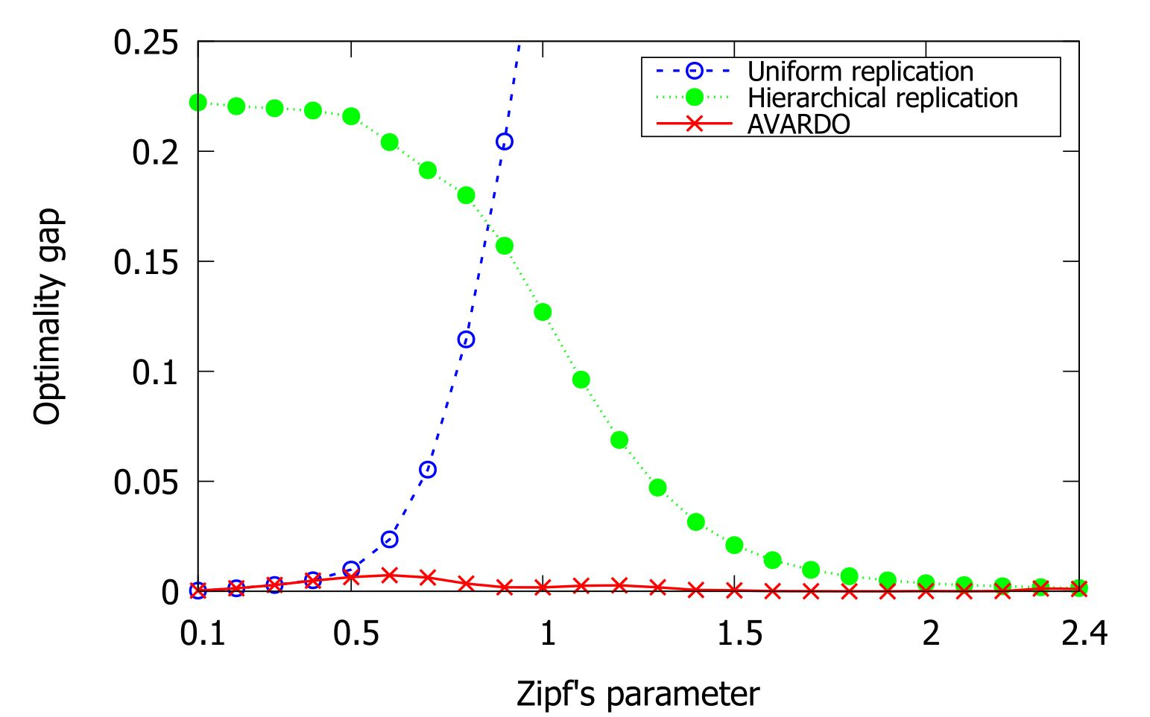
Outperform State-of-the-art Schemes (Synthetic data)
Notes:
Why do you say they are state-of-the-art?
Tell us how you translate lambda into optimality gap.

Slide 22
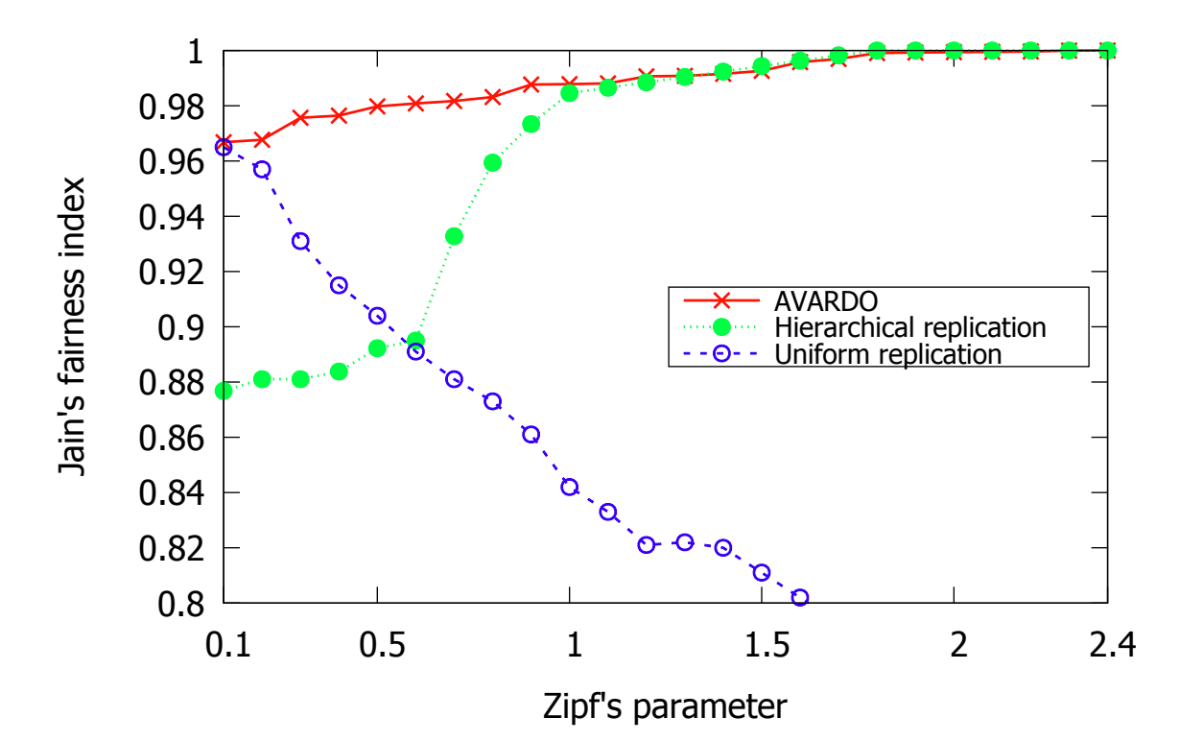
Better Load Balancing (Synthetic data)

Slide 23
Contents
Introduction
AVARDO: Optimizing an Auto-Scaling VoD Data Center
RAVO: Optimizing a Geo-Distributed VoD Cloud
COCOS: Optimizing an Auto-Scaling Live Streaming Cloud
Conclusion
Publication:
Z. Chang and S.-H. Chan, "Video Management and Resource Allocation for a Large-scale VoD Cloud," ACM Transactions on Multimedia Computing, Communication and Applications (TOMM) Special Issue on Multimedia Big Data: Networking, Vol. 12, No. 5s, pp. 72:1-72:21, Sept 2016.

Slide 24


Background: A Geo-Distributed Auto-Scaling VoD Cloud
 | Repository: Complete video replication
 | Local cloud server: Auto-scaling data centers to serve their user pool
 | User pool: Heterogeneous video popularities
Geographic Heterogeneity of Video Popularities
Local servers have partial video replication to save storage Reduce network load through collaboration among local servers
A distributed and cooperative cloud architecture for VoD service

Slide 25
Objectives and Tradeoff
Store Video Locally
+ Less delay Less link & processing cost Better collaboration - More storage cost
Access Video Remotely
+ Less storage cost - More delay More link & processing cost Less collaboration
Objectives:
Satisfy the quality-of-service constraints
Minimize total deployment cost

Slide 26
Optimization Parameters
Video Management (VM)
Storage (content replication) What video to store at each server? Planned on a longer time scale (days) Retrieval (server selection) Which servers to stream the missing video from? Decided when a request comes
Resource Allocation (RA)
Server Resource Total storage and processing capacity at a server Link Resource Link capacity reserved between pairs of servers

Slide 27
Related Work
Fundamental difference:
RAVO is an approximation algorithm
 | Related Work | RAVO
Traditional resource allocation | Based on heuristic approach The optimality gap is not clear (Adhikari et al. Infocom '12 [12]) | Discretized from LP solution Proven approximation ratio
Content Storage and Retrieval for VoD | Need resource allocation result Static resource provisioning (Applegate et al. Co-NEXT '10 [13], Minowa et al. NBiS '22 [14]) | One-step algorithm for both resource allocation and content management Auto-scaling feature
Current resource allocation for cloud service | Assume full replication Only consider link capacity allocation (Lin et al. Infocom '11 [15], Liu et al. Mathematics '23 [16]) | Flexible replication to reduce the storage cost Servers help each other to fully utilize the resource

Slide 28
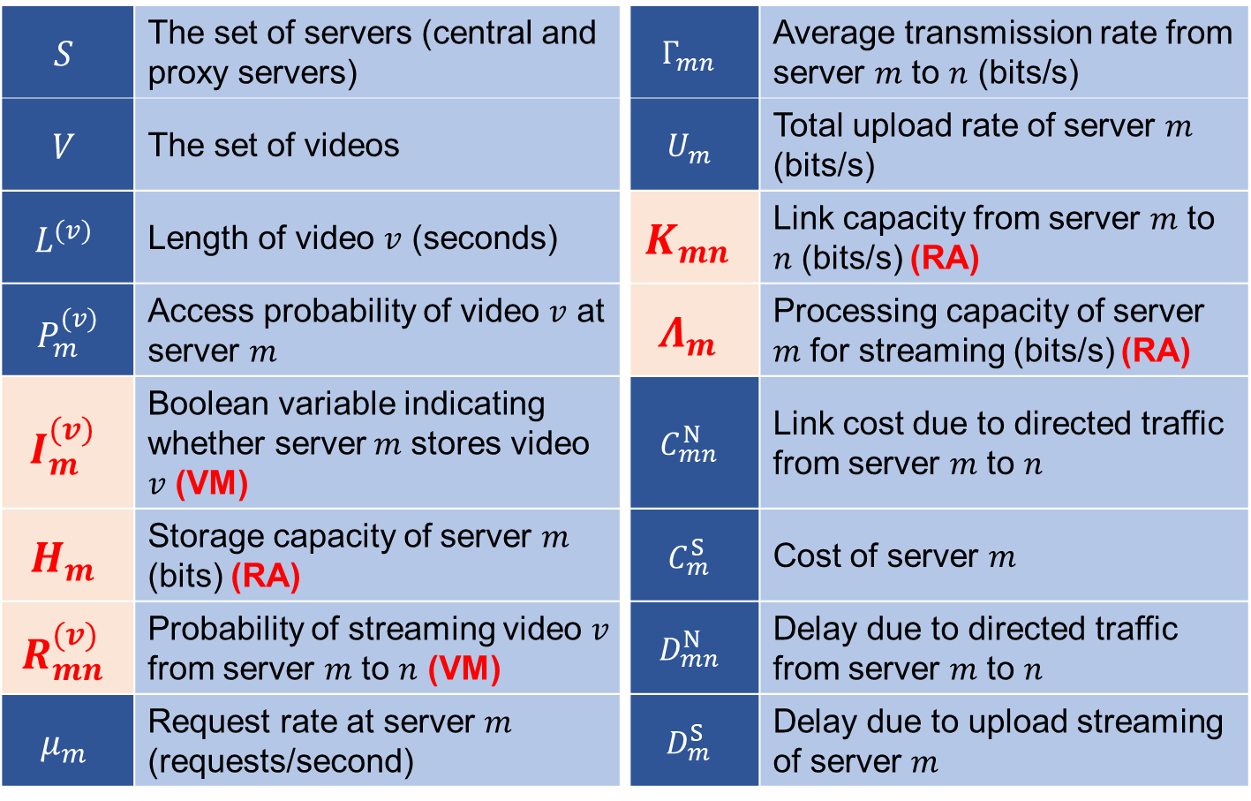
Problem Formulation: Major Symbols Used in RAVO
$$S$$ | The set of servers (central and proxy servers) | $$Γ_{mn}$$ | Average transmission rate from server $m$ to $n$ (bits/s)
$$V$$ | The set of videos | $$U_{m}$$ | Total upload rate of server $m$ (bits/s)
$$L^{(v)}$$ | Length of video $v$ (seconds) | $$K_{mn}$$ | Link capacity from server $m$ to $n$ (bits/s) (RA)
$$P_{m}^{(v)}$$ | Access probability of video $v$ at server $m$ | $$Λ_{m}$$ | Processing capacity of server $m$ for streaming (bits/s) (RA)
$$I_{m}^{(v)}$$ | Boolean variable indicating whether server$m$ stores video $v$ (VM) | $$C_{mn}^{N}$$ | Link cost due to directed traffic from server $m$ to $n$
$$H_{m}$$ | Storage capacity of server $m$ (bits) (RA) | $$C_{m}^{S}$$ | Cost of server $m$
$$R_{mn}^{(v)}$$ | Probability of streaming video $v$ from server $m$ to $n$ (VM) | $$D_{mn}^{N}$$ | Delay due to directed traffic from server $m$ to $n$
$$μ_{m}$$ | Request rate at server $m$ (requests/second) | $$D_{m}^{S}$$ | Delay due to upload streaming of server $m$

Slide 29
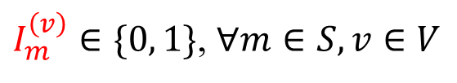
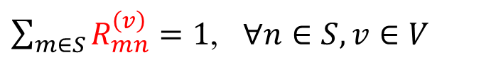
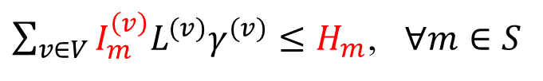
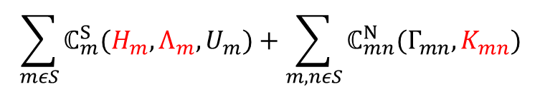
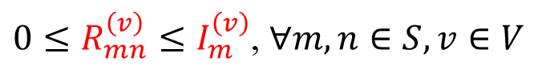
Comprehensive Model as an NP-Hard Problem: Joint Optimization on Video Management and Resource Allocation
Server cost
Link cost
$$\sum_{mεS}{ℂ_{m}^{S}(H_{m},Λ_{m},U_{m})}+\sum_{m,nεS}{ℂ_{mn}^{N}(Γ_{mn},K_{mn})}$$
minimize
System deployment cost
Storage
Processing
Capacity
Access bandwidth (consumed)
Subject to
$I_{m}^{\left(v\right)}∈\{0, 1\}$, $∀m∈S, v∈V$
Store a video as a whole
Storage
Retrieval
${0≤R}_{mn}^{\left(v\right)}≤I_{m}^{\left(v\right)}$, $∀m,n∈S, v∈V$
Only retrieve video from a server with it
$\sum_{v∈V}{I_{m}^{\left(v\right)}L^{(v)}γ^{(v)}}≤H_{m}$, $∀m∈S$
Server storage constraint
$\sum_{m∈S}{R_{mn}^{\left(v\right)}}=1$, $∀n∈S, v∈V$
User request must be served
$Γ_{mn}=\sum_{v∈V}{p_{n}^{\left(v\right)}ε_{n}^{\left(v\right)}μ_{n}R_{mn}^{\left(v\right)}L^{(v)}γ^{(v)}}$, $∀m,n∈S$
Remote traffic
QoS
$𝔻_{mn}^{N}\left(Γ_{mn},K_{mn}\right)+𝔻_{m}^{S}\left(U_{m},Λ_{m}\right)≤\overline{D},$ $∀m,n∈S$
Delay
Mixed Integer Programming
The NP-complete Dominating Set Problem is reducible to our problem. It is NP-Hard!

Slide 30
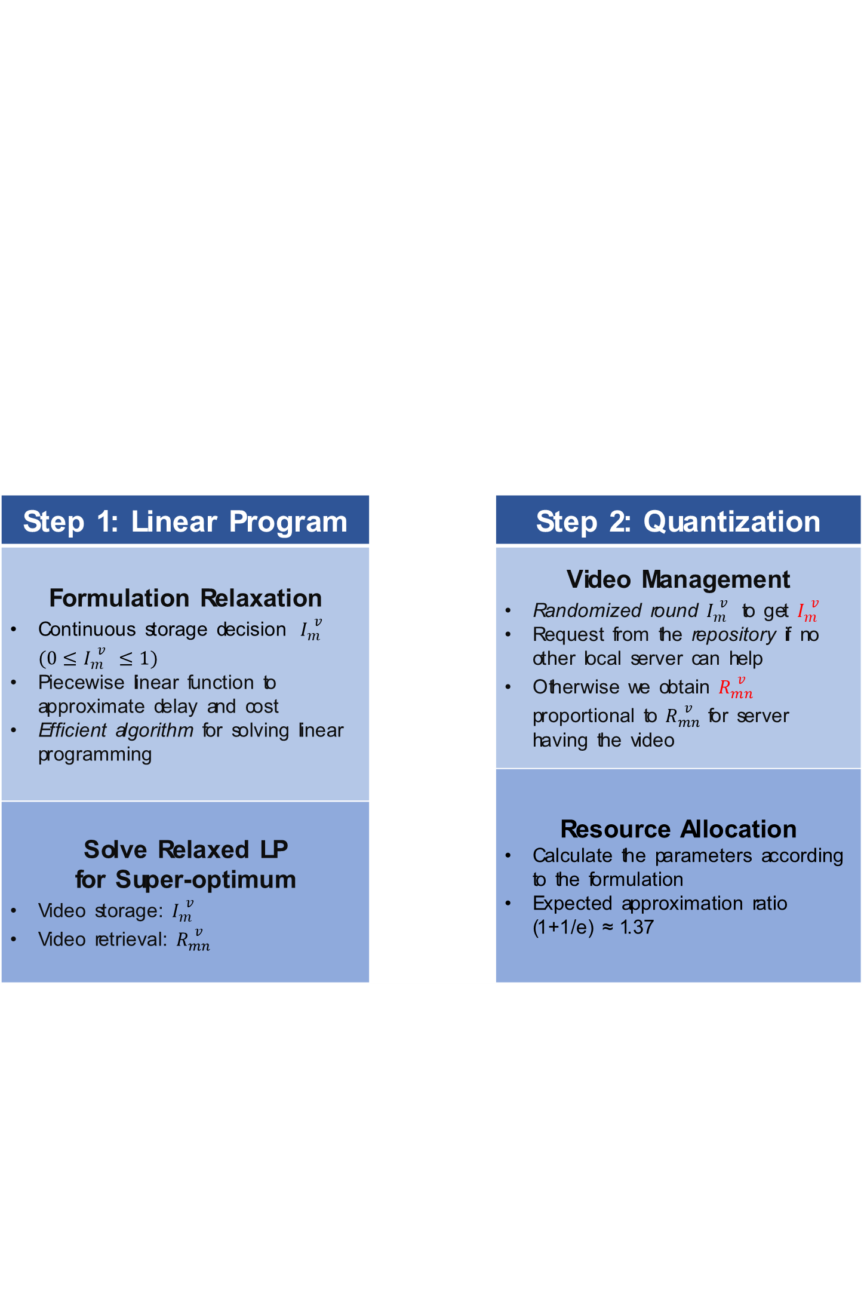
RAVO: Relaxing the Joint Formulation as a Linear Program and Quantization of the Solution
Step 1: Linear Program |  | Step 2: Quantization
Formulation Relaxation Continuous storage decision ${\hat{I}}_{m}^{\left(v\right)} (0≤{\hat{I}}_{m}^{\left(v\right)}≤1)$ Piecewise linear function to approximate delay and cost Efficient algorithm for solving linear programming |  | Video Management Randomized round ${\hat{I}}_{m}^{\left(v\right)}$ to get $I_{m}^{\left(v\right)}$ Request from the repository if no other local server can help Otherwise we obtain $R_{mn}^{\left(v\right)}$ proportional to ${\hat{R}}_{mn}^{\left(v\right)}$ for server having the video
 |  | Resource Allocation Calculate the parameters according to the formulation Expected approximation ratio (1+1/e) ≈ 1.37
Solve Relaxed LP for Super-optimum Video storage: ${\hat{I}}_{m}^{\left(v\right)}$ Video retrieval: ${\hat{R}}_{mn}^{\left(v\right)}$

Slide 31
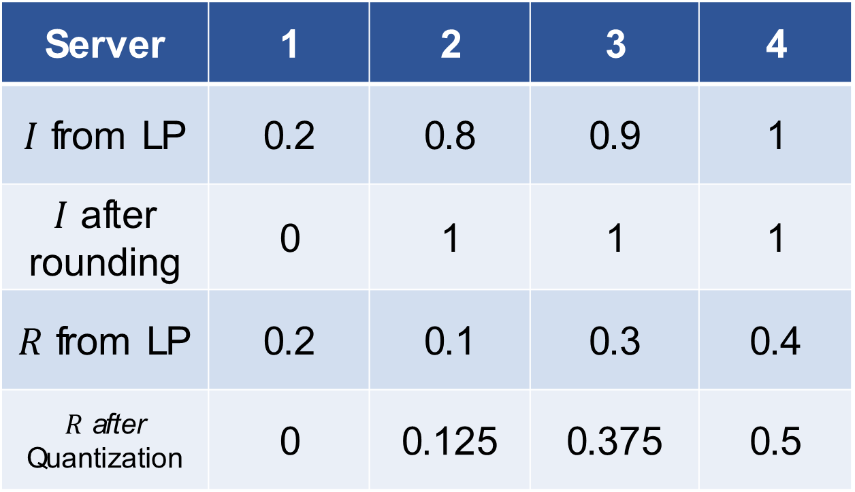
Example of Quantization
Server | 1 | 2 | 3 | 4
$I$ from LP | 0.2 | 0.8 | 0.9 | 1
$I$ after rounding | 0 | 1 | 1 | 1
$R$ from LP | 0.2 | 0.1 | 0.3 | 0.4
$R$ after Quantization | 0 | 0.125 | 0.375 | 0.5

Slide 32
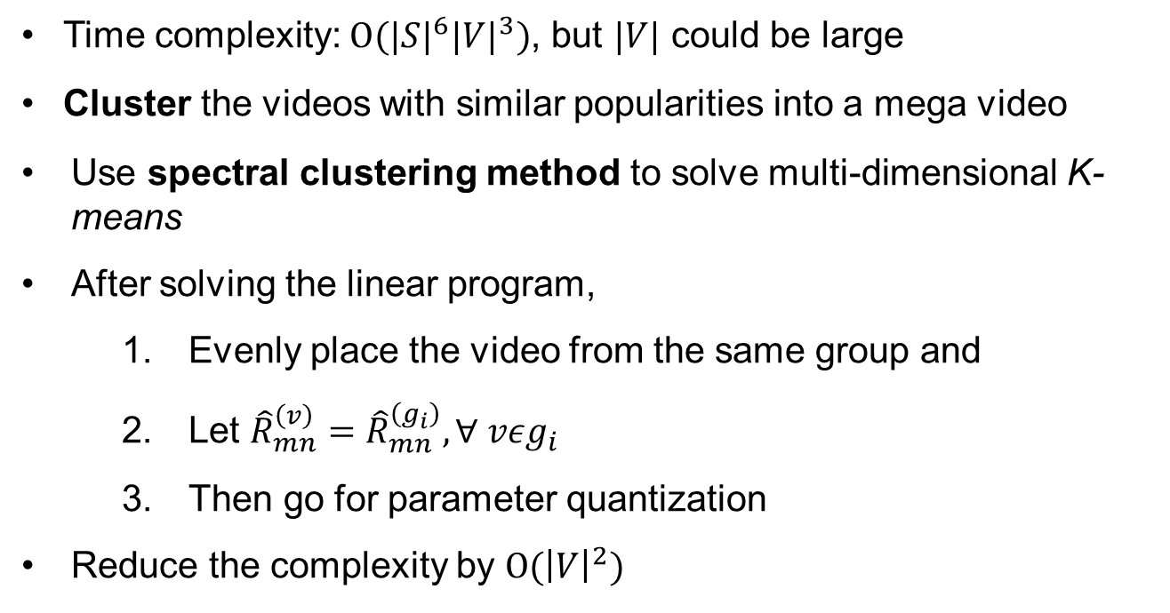
Reducing the Algorithmic Time Complexity: Spectral Clustering for Video Group
Time complexity: $O{(|S|}^{6}{|V|}^{3})$, but $|V|$ could be large
Cluster the videos with similar popularities into a mega video
Use spectral clustering method to solve multi-dimensional K-means
After solving the linear program,
Evenly place the video from the same group and
Let ${\hat{R}}_{mn}^{\left(v\right)}={\hat{R}}_{mn}^{\left(g_{i}\right)},∀ vεg_{i}$
Then go for parameter quantization
Reduce the complexity by $O({\left|V\right|}^{2})$

Slide 33
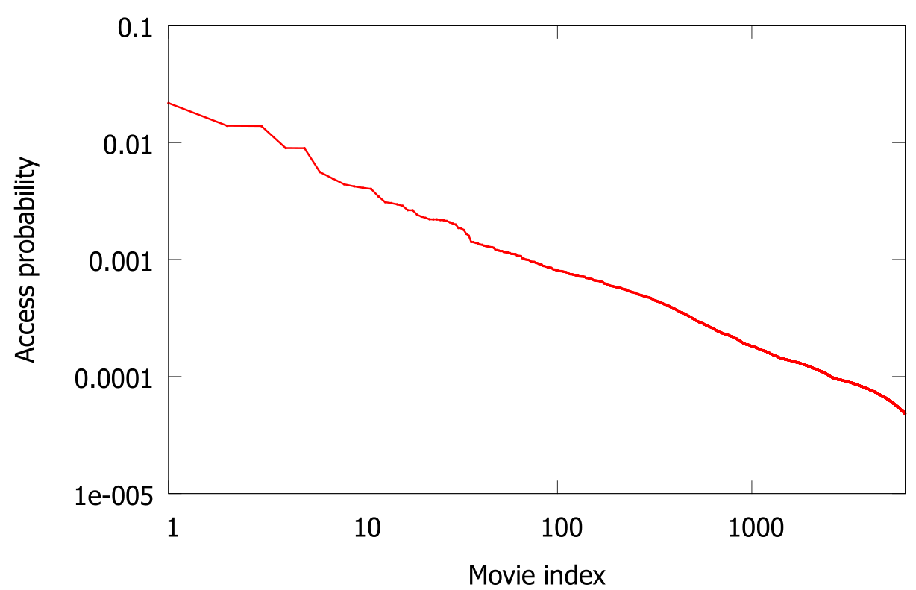
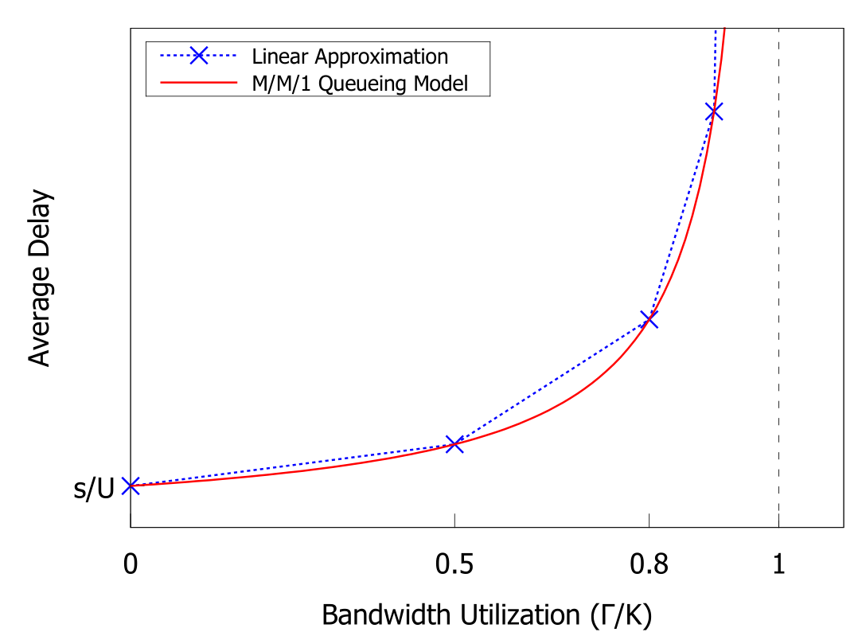
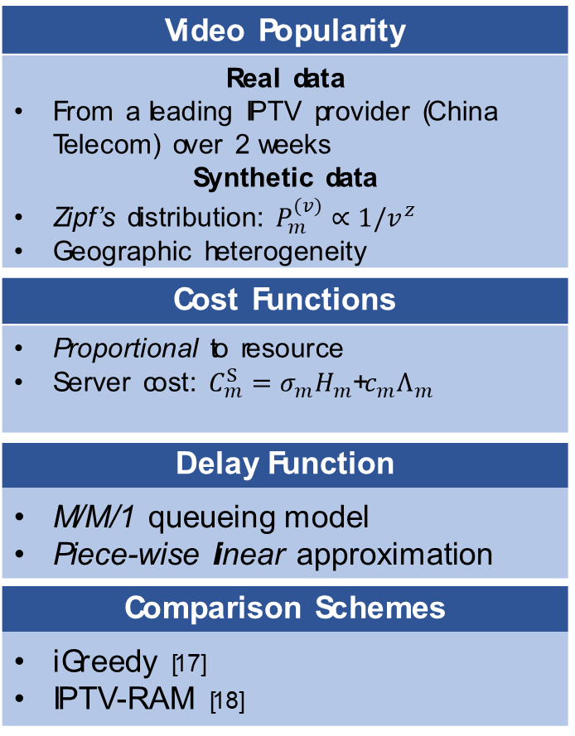
Experimental Setup
Video Popularity
Real data From a leading IPTV provider (China Telecom) over 2 weeks Synthetic data Zipf’s distribution: $P_{m}^{(v)}∝1/v^{z}$ Geographic heterogeneity
Cost Functions
Proportional to resource Server cost: $C_{m}^{S}=σ_{m}H_{m}$+$c_{m}Λ_{m}$ Link cost: $C_{mn}^{N}=c_{mn}K_{mn}$
Delay Function
M/M/1 queueing model Piece-wise linear approximation
Comparison Schemes
iGreedy [17] IPTV-RAM [18]
Notes:
iGreedy: only considers local popularity, no collaboration
IPTV-RAM: video has 2 categories, globally popular ones and unpopular ones (i.e., RAVO with 2 cluster numbers)

Slide 34
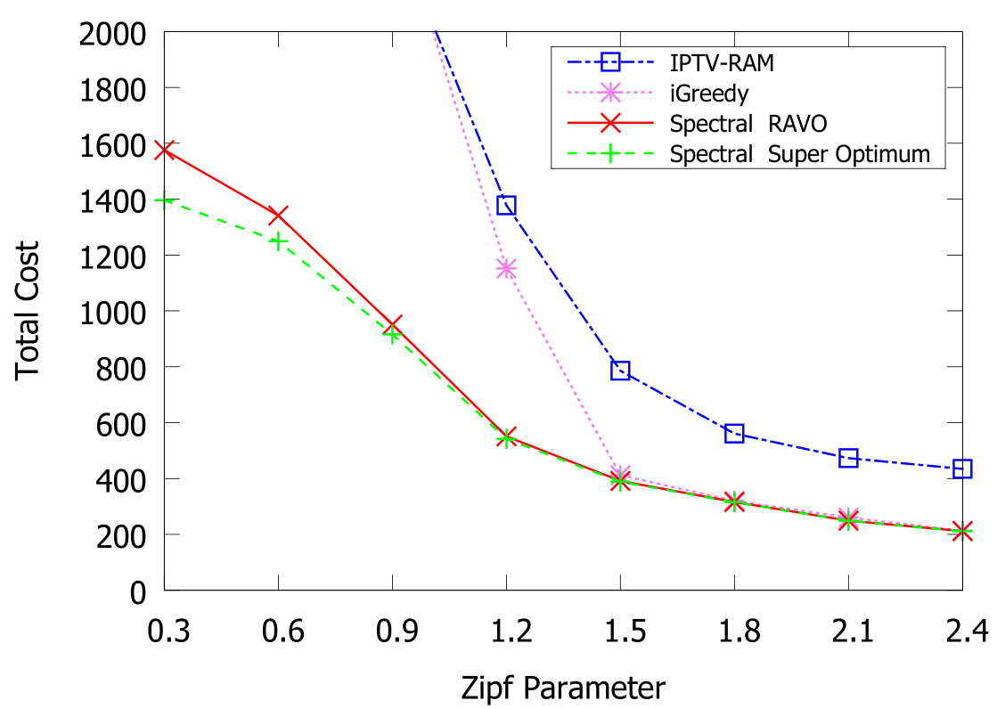
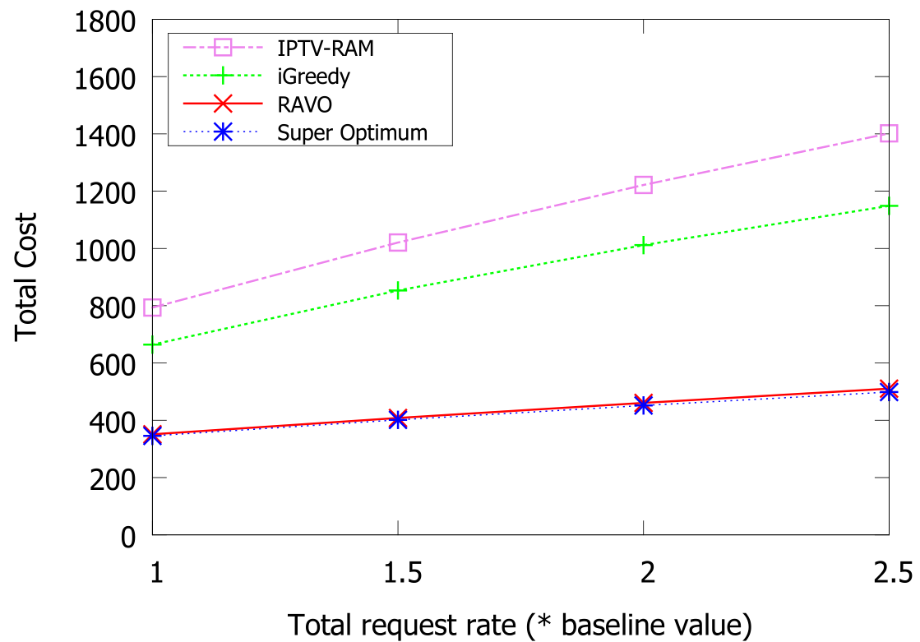
Near-Optimal Performance
Synthetic Data
Real Data
RAVO outperforms the comparison schemes with large margin
Close to the super optimum
Notes:
iGreedy with optimal resource allocation
Consider local popularity
No cooperative replication
IPTV-RAM with optimal content management
2 video categories based on global popularity
Super-optimal
LP solution before quantization

Slide 35
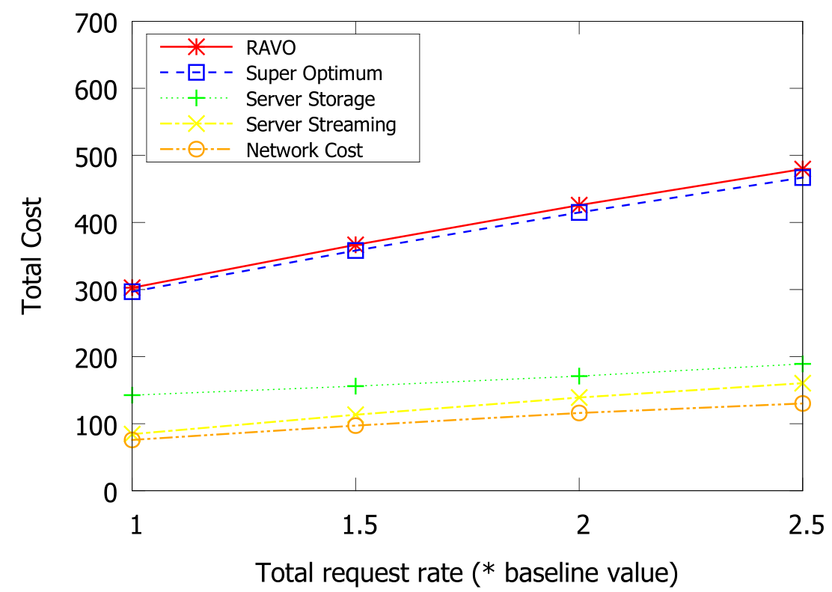
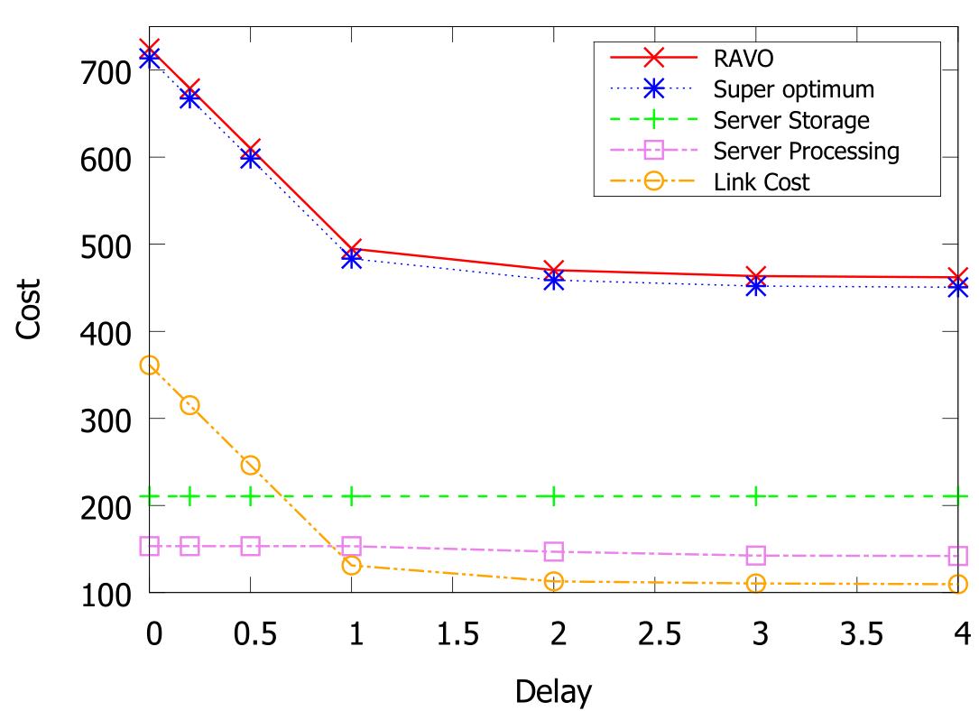
Effective Use of Resources
Deployment cost given different request rate
Cost versus Delay Requirement
The change of cost is distributed into all the components

Slide 36
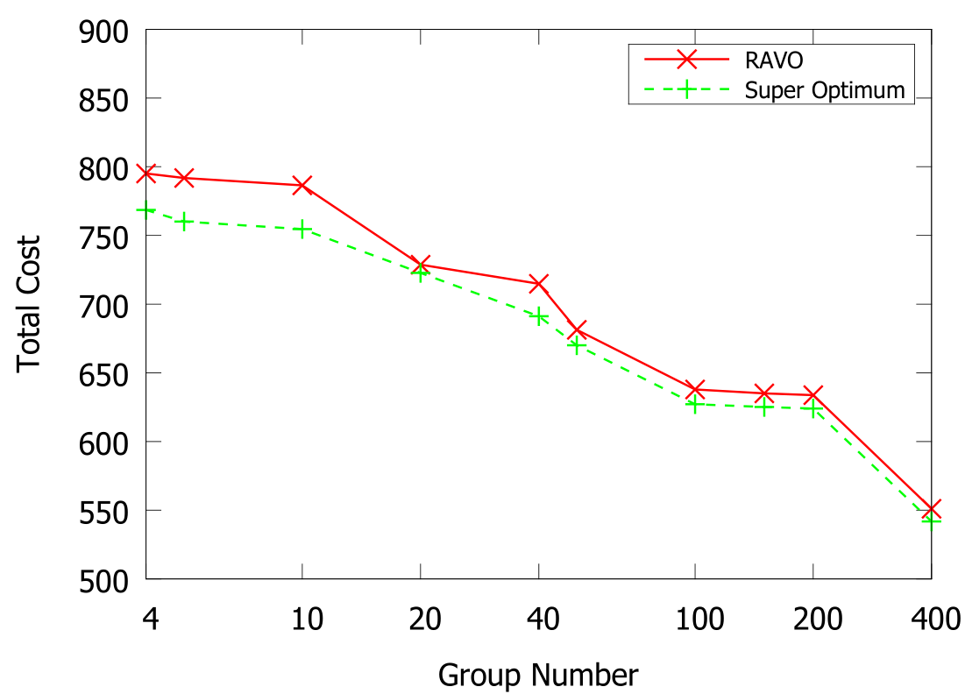
Effective Clustering Method
The cost decreases with more groups (and more computation time)

Slide 37
Contents
Introduction
AVARDO: Optimizing an Auto-Scaling VoD Data Center
RAVO: Optimizing a Geo-Distributed VoD Cloud
COCOS: Optimizing an Auto-Scaling Live Streaming Cloud
Conclusion
Publication:
Z. Chang and S.-H. Chan, "Bi-Criteria Approximation for a Multi-Origin Multi-Channel Auto-Scaling Live Streaming Cloud," IEEE Transactions on Multimedia, Vol. 25, pp. 2839-2850, July 2023.

Slide 38
Background: Multi-source Multi-channel Live Streaming Cloud
Major Components in a Live Streaming Cloud
Origin Server | Source of video channels
End Server | Stream the live content to its local users. (e.g., a CDN node, server farm, data center, etc.)
Channel | Multiple streaming rates
An end server requests channels based on local demand and serves its local users.
End servers (with user demands) help each other in streaming contents.
Channels are pushed from the sources to the servers.

Slide 39
Bi-criteria Objectives: Deployment Cost and Source-to-end Delay
Minimize Origin-to-End Delay
Server-to-Server (S2S) Delay: Time to travel through a link Origin-to-End (O2E) Delay: Delay from the origin server to an end server demanding the channel Sum of the S2S delays of links forming the path
Minimize Deployment Cost
Deployment cost consists of Server Cost and Link Cost Server Cost: Due to the servers allocating its processing capacity to serve the other servers Link Cost: Due to the pairwise link capacity allocated between servers

Slide 40
Optimizing the Bi-criteria Problem
Equivalently to
Minimizing deployment cost
Subject to source-to-end delay constraint
Overlay construction (OC):
How to build the delivery tree of each channel？
To what servers and what channel should a server forward？
Resource Allocation (RA)
Regularly re-optimize the overlay when parameter changes

Slide 41
Related Work
Fundamental difference:
COCOS is an approximation algorithm
 | Related Work | COCOS
Traditional P2P live streaming | Reduce server load (Tan et al. IEEE TON '13 [19], Yun et al. P2P Netw. Appl. '14 [20]) | Minimize both cost and delay
Crowdsourced live streaming | Deliver contents from an end server to local audience (Yarnagula et al. IEEE TMM '19 [21], Irondi et al. IEEE TMM '19 [22], Li et al. SIGCOMM '22 [23]) | Orthogonal to our problem
Live streaming works focus on other objectives | Predict QoS (Zhang et al. MM '20 [24]) Maximize delivered channels or minimizing inter-ISP traffic (Budhkar et al. P2Pr Netw. Appl '19 [25], Sun et al. Internet Things J. '22 [26]) | Different objective

Slide 42
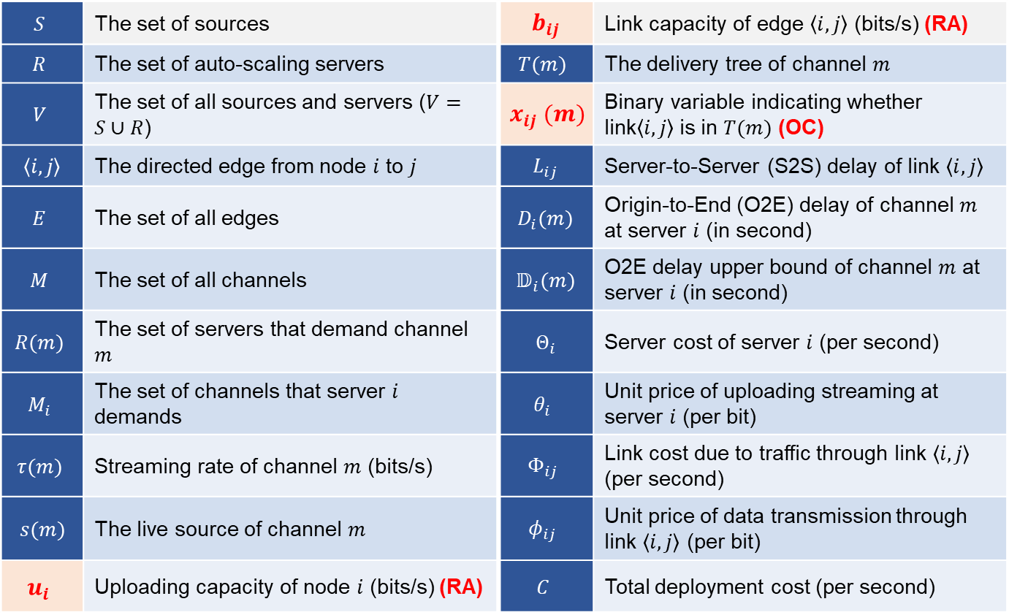
Problem Formulation: Major Symbols Used in COCOS
$$S$$ | The set of sources | $$b_{ij}$$ | Link capacity of edge $\left\langle i, j\right\rangle$ (bits/s) (RA)
$$R$$ | The set of auto-scaling servers | $$T(m)$$ | The delivery tree of channel $m$
$$V$$ | The set of all sources and servers ($V=S∪R$) | $$x_{ij} (m)$$ | Binary variable indicating whether link$\left\langle i, j\right\rangle$is in $T(m)$ (OC)
$$\left\langle i, j\right\rangle$$ | The directed edge from node $i$ to $j$ | $$L_{ij}$$ | Server-to-Server (S2S) delay of link $\left\langle i, j\right\rangle$
$$E$$ | The set of all edges | $$D_{i}(m)$$ | Origin-to-End (O2E) delay of channel $m$ at server $i$ (in second)
$$M$$ | The set of all channels | $$𝔻_{i}(m)$$ | O2E delay upper bound of channel $m$ at server $i$ (in second)
$$R(m)$$ | The set of servers that demand channel $m$ | $$Θ_{i}$$ | Server cost of server $i$ (per second)
$$M_{i}$$ | The set of channels that server $i$ demands | $$θ_{i}$$ | Unit price of uploading streaming at server $i$ (per bit)
$$τ(m)$$ | Streaming rate of channel $m$ (bits/s) | $$Φ_{ij}$$ | Link cost due to traffic through link $\left\langle i, j\right\rangle$ (per second)
$$s(m)$$ | The live source of channel $m$ | $$φ_{ij}$$ | Unit price of data transmission through link $\left\langle i, j\right\rangle$ (per bit)
$$u_{i}$$ | Uploading capacity of node $i$ (bits/s) (RA) | $$C$$ | Total deployment cost (per second)

Slide 43
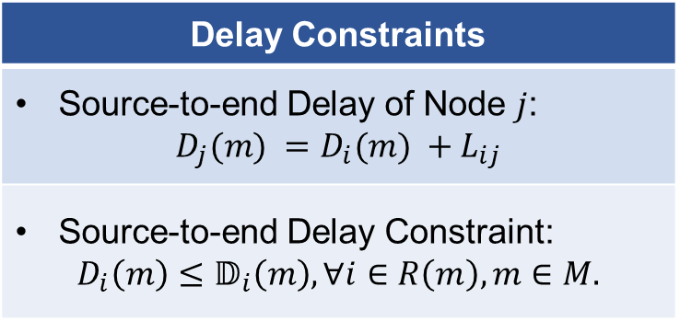
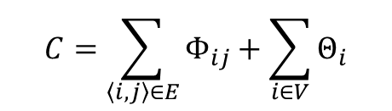
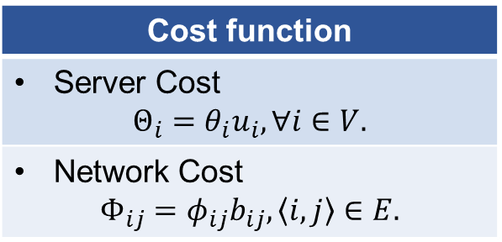
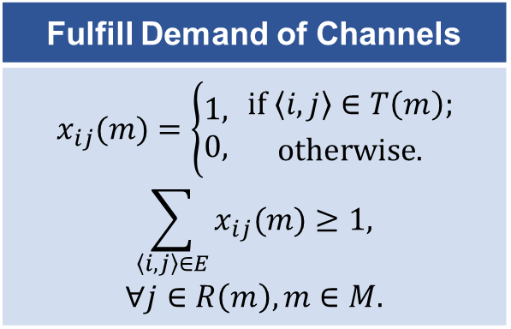
Comprehensive Model as an NP-Hard Problem: Minimum Cost Streaming with Delay Constraints
Delay Constraints
Source-to-end Delay of Node $j$: $$D_{j}(m) =D_{i}(m) +L_{ij}$$
Source-to-end Delay Constraint: $$D_{i}\left(m\right)≤𝔻_{i}\left(m\right), ∀i∈R\left(m\right), m∈M.$$
Minimize the total cost:
$$C=\sum_{\left\langle i, j\right\rangle ∈E}{Φ_{ij}}+\sum_{i∈V}{Θ_{i}}$$
Cost function
Server Cost $$Θ_{i}=θ_{i}u_{i}, ∀i∈V.$$
Network Cost $$Φ_{ij}=φ_{ij}b_{ij},\left\langle i, j\right\rangle ∈E.$$
Fulfill Demand of Channels
$$x_{ij}(m)=\left\{\begin{aligned}1, \\ 0,\end{aligned} {if \left\langle i, j\right\rangle ∈T\left(m\right); \atop otherwise.}\right.$$ $$\sum_{\left\langle i, j\right\rangle ∈E}{x_{ij}(m)}≥1,$$ $$∀j∈R\left(m\right), m∈M.$$
NP-complete Restricted Shortest Path Problem (RSP) is reducible to our problem. It is NP-Hard!

Slide 44
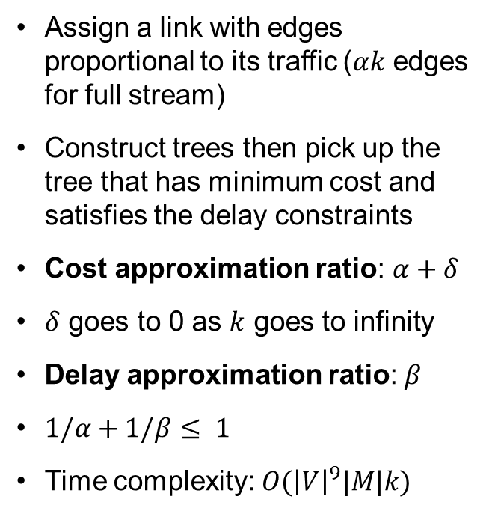
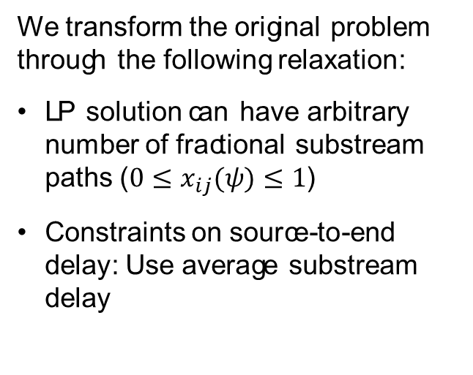
Overlay Construction and Resource Allocation
Relaxed to a LP problem
Topology construction
We transform the original problem through the following relaxation:
LP solution can have arbitrary number of fractional substream paths ($0≤x_{ij}(ψ)≤1$)
Constraints on source-to-end delay: Use average substream delay
Assign a link with edges proportional to its traffic ($αk$ edges for full stream)
Construct trees then pick up the tree that has minimum cost and satisfies the delay constraints
Cost approximation ratio: $α+δ$
$δ$ goes to 0 as $k$ goes to infinity
Delay approximation ratio: $β$
$1/α+1/β≤ 1$
Time complexity: $O({\left|V\right|}^{9}|M|k)$

Slide 45
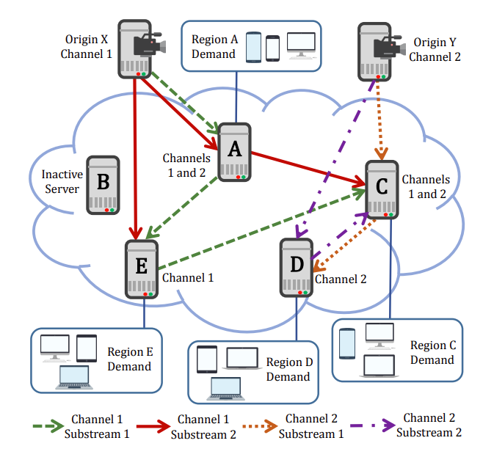

Example of substream solution for $k=2$

Slide 46
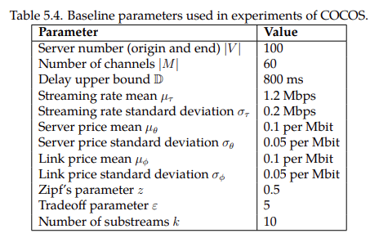
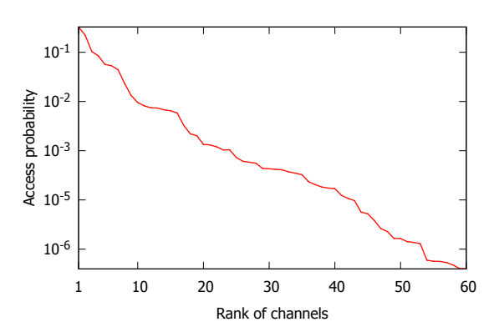
Experimental Setup
Performance Metrics
Deployment cost Server cost Link cost Delay
Comparison Schemes
Nearest Peer [27] Consider local popularity No cooperative replication Prim [28] Minimum cost tree Modified to meet delay constraints Super-optimal Relaxed LP solution

Slide 47





Good Tradeoff for humble $k$ and $β$
$$α=1+ε$$
$$β=1+1/ε$$

Slide 48


Near-Optimal Performance
Real-world data trace:
From a leading video service website in China (Tencent) over 2 weeks
Near-optimal performance:
Outperform state-of-the-art schemes
Synthetic data:
Verify the performance given difference video popularity
Stable performance:
Given different video popularity

Slide 49


Scalable Scheme
Better performance for a larger system

Slide 50
Contents
Introduction
AVARDO: Optimizing an Auto-Scaling VoD Data Center
RAVO: Optimizing a Geo-Distributed VoD Cloud
COCOS: Optimizing an Auto-Scaling Live Streaming Cloud
Conclusion

Slide 51
Conclusion
Motivations | Video traffic: Huge volume and dynamic daily pattern Auto-scaling: Rescale the resource elastically
Objective | Minimize the deployment cost Ensure the user experience
Contribution | VoD data center AVARDO: Stack-based approximation algorithm Geo-distributed VoD cloud RAVO: LP-based approximation Video clustering to reduce the complexity Multi-origin multi-channel live cloud COCOS: Bi-criteria approximation algorithm
Future Work | Auto-scaling clouds for video data analytics Auto-scaling clouds for emerging applications Sustainable video services

Slide 52
References
[1] Sandvine Corporation. 2023 Global internet phenomena report, 2023.
[2] Ning Liu, Huajie Cui, S.-H. Gary Chan, Zhipeng Chen, and Yirong Zhuang. Dissecting user behaviors for a simultaneous live and VoD IPTV system. ACM Transactions on Multimedia Computing, Communications and Applications, 10(3):23:1 – 23:16, April 2014.
[3] M. Cha, H. Kwak, P. Rodriguez, Y. Y. Ahn, and S. Moon. Analyzing the Video Popularity Characteristics of Large-Scale User Generated Content Systems. IEEEACM Trans. Netw., 17(5):1357–1370, October 2009.
[4] Jingqi Yang, Chuanchang Liu, Yanlei Shang, Bo Cheng, Zexiang Mao, Chunhong Liu, Lisha Niu, and Junliang Chen. A cost-aware auto-scaling approach using the workload prediction in service clouds. Information Systems Frontiers, 16(1):7–18, Mar 2014.
[5] J. Yang, Z. Yao, B. Yang, X. Tan, Z. Wang, and Q. Zheng. Software-defined multimedia streaming system aided by variable-length interval in-network caching. IEEE Transactions on Multimedia, 21(2):494–509, Feb 2019.
[6] E. Bourtsoulatze, N. Thomos, J. Saltarin, and T. Braun. Content-aware delivery of scalable video in network coding enabled named data networks. IEEE Transactions on Multimedia, 20(6):1561–1575, June 2018.
[7] Gerta Sheganaku, Stefan Schulte, Philipp Waibel, and Ingo Weber. Cost-efficient auto-scaling of container-based elastic processes. Future Generation Computer Systems, 138:296–312, 2023.
[8] Hui Zhao, Jing Wang, Quan Wang, and Feng Liu. Queue-based and learningbased dynamic resources allocation for virtual streaming media server cluster of multi-version VoD system. Multimedia Tools and Applications, 78:21827–21852, Apr 2019.
[9] Shutian Luo, Huanle Xu, Kejiang Ye, Guoyao Xu, Liping Zhang, Guodong Yang, and Chengzhong Xu. The power of prediction: Microservice auto scaling via workload learning. In Proceedings of the 13th Symposium on Cloud Computing, SoCC ’22, page 355–369, New York, NY, USA, 2022. ACM.
[10] J. Du, C. Jiang, Y. Qian, Z. Han, and Y. Ren. Resource allocation with video traffic prediction in cloud-based space systems. IEEE Transactions on Multimedia, 18(5):820–830, May 2016.
[11] Fei Chen, Haitao Li, Jiangchuan Liu, Bo Li, Ke Xu, and Yuemin Hu. Migrating big video data to cloud: A peer-assisted approach for VoD. Peer-to-Peer Netw. Appl., 11:1060–1074, July 2018.
[12] Vijay Kumar Adhikari, Yang Guo, Fang Hao, Matteo Varvello, Volker Hilt, Moritz Steiner, and Zhi-Li Zhang. Unreeling netflix: Understanding and improving multi-cdn movie delivery. In INFOCOM, 2012 Proceedings IEEE, pages 1620–1628, Orlando, FL, USA, 2012. IEEE, IEEE.
[13] David Applegate, Aaron Archer, Vijay Gopalakrishnan, Seungjoon Lee, and Kadangode K Ramakrishnan. Optimal content placement for a large-scale vod system. In Proc. The 6th International Conference (Co-NEXT ’10), page 4, Philadelphia, USA, 2010. ACM, ACM.

Slide 53
References (Cont’d)
[14] Kaku Minowa and Tomoki Yoshihisa. Pre-cache methods for accommodating more clients in edge-assisted video-on-demand systems. In Leonard Barolli, Hiroyoshi Miwa, and Tomoya Enokido, editors, Advances in Network-Based Information Systems, pages 289–297, Cham, 2022. Springer International Publishing.
[15] Minghong Lin, Adam Wierman, Lachlan LH Andrew, and Eno Thereska. Dynamic right-sizing for power-proportional data centers. In INFOCOM, 2011 Proceedings IEEE, pages 1098–1106, Shanghai, China, 2011. IEEE, IEEE.
[16] Haitao Liu, Qingkui Chen, and Puchen Liu. An optimization method of large-scale video stream concurrent transmission for edge computing. Mathematics, 11(12), 2023.
[17] Nikolaos Laoutaris, Vassilios Zissimopoulos, and Ioannis Stavrakakis. On the optimization of storage capacity allocation for content distribution. Computer Networks, 47(3):409–428, 2005.
[18] Mingfu Li and Chun-Huei Wu. A cost-effective resource allocation and management scheme for content networks supporting IPTV services. Computer Communications, 33(1):83–91, 2010.
[19] Bo Tan and Laurent Massoulie. Optimal content placement for peer-to-peer video-on-demand systems. IEEE/ACM Transactions on Networking, 21(2):566–579, April 2013.
[20] Sunghyun Yun, Heuiseok Lim, and Kyungyong Chung. The biometric signature delegation scheme to balance the load of digital signing in hybrid P2P networks. Peer-to-Peer Networking and Applications, pages 1–10, 2014.
[21] Hema Kumar Yarnagula, Parikshit Juluri, Sheyda Kiani Mehr, Venkatesh Tamarapalli, and Deep Medhi. QoE for mobile clients with segment-aware rate adaptation algorithm (SARA) for DASH video streaming. ACM Transactions on Multimedia Computing Communications and Applications, 15(2):1–23, June 2019.
[22] Iheanyi Irondi, Qi Wang, Christos Grecos, Jose M. Alcaraz Calero, and Pablo Casaseca-De-La-Higuera. Efficient QoE-Aware scheme for video quality switching operations in dynamic adaptive streaming. ACM Transactions on Multimedia Computing Communications and Applications, 15(1):1–23, February 2019.
[23] Jinyang Li, Zhenyu Li, Ri Lu, Kai Xiao, Songlin Li, Jufeng Chen, Jingyu Yang, Chunli Zong, Aiyun Chen, Qinghua Wu, Chen Sun, Gareth Tyson, and Hongqiang Harry Liu. Livenet: A low-latency video transport network for large-scale live streaming. In Proceedings of the ACM SIGCOMM 2022 Conference, SIGCOMM ’22, pages 812–825, New York, NY, USA, 2022. ACM.
[24] Rui-Xiao Zhang, Ming Ma, Tianchi Huang, Hanyu Li, Jiangchuan Liu, and Lifeng Sun. Leveraging QoE heterogenity for large-scale livecaset scheduling. In Proceedings of the 28th ACM International Conference on Multimedia, MM ’20, pages 3678–3686, New York, NY, USA, 2020. Association for Computing Machinery.

Slide 54
References (Cont’d 2)
[25] Shilpa Budhkar and Venkatesh Tamarapalli. An overlay management strategy to improve QoS in CDN-P2P live streaming systems. Peer-to-Peer Networking and Applications, pages 1–17, 2019.
[26] Hui Sun, Qiyuan Li, Kewei Sha, and Ying Yu. Elastic-edge: An intelligent elastic edge framework for live video analytics. IEEE Internet of Things Journal, 9(22):23031–23046, 2022.
[27] Scalable and reliable live streaming service through coordinating CDN and P2P. In Parallel and Distributed Systems (ICPADS), 2011 IEEE 17th International Conference on, pages 581–588. IEEE, 2011.
[28] Rosario Giuseppe Garroppo, Stefano Giordano, Stella Spagna, Saverio Niccolini, and Jan Seedorf. Design and evaluation of an optimized overlay topology for a single operator video streaming service. In Proceedings of the 2010 ACM Workshop on Advanced Video Streaming Techniques for Peer-to-Peer Networks and Social Networking, AVSTP2P ’10, pages 49–54, New York, NY, USA, 2010. Association for Computing Machinery.

Slide 55
List of Related Publications
Journal publications
Z. Chang and S.-H. Chan, "Bi-Criteria Approximation for a Multi-Origin Multi-Channel Auto-Scaling Live Streaming Cloud," IEEE Transactions on Multimedia, Vol. 25, pp. 2839-2850, July 2023.
Z. Chang and S.-H. Chan, "An Approximation Algorithm to Maximize User Capacity for an Auto-scaling VoD System," IEEE Transactions on Multimedia, Vol. 23, pp. 3714-3725, October 2021.
Z. Chang and S.-H. Chan, "Video Management and Resource Allocation for a Large-scale VoD Cloud," ACM Transactions on Multimedia Computing, Communication and Applications (TOMM) Special Issue on Multimedia Big Data: Networking, Vol. 12, No. 5s, pp. 72:1-72:21, Sept 2016.
Z. Chang and S.-H. Chan, "Bucket-Filling: An Asymptotically Optimal VoD Network with Source Coding," IEEE Transactions on Multimedia, Vol. 17, No. 5, pp. 723-735, May 2015.
Conference publications
J. Dai, Z. Chang and S.-H. Chan, "Delay Optimization for Multi-source Multi-channel Overlay Live Streaming," in Proceedings of IEEE ICC 2015 - Communications Software, Services and Multimedia Applications Symposium (ICC'15), (London, United Kingdom), pp. 8587-92, 8-12 June 2015.

Slide 56
Thank You!
Any Questions?

