Slide 1


Managing bibliography in MTrec with Zotero
Chang, Zhangyu (zchang@cse.ust.hk)
Monday, October 12, 2020

Slide 2
Why Bibliography Management
Install Zotero with Better BibTeX
Add a New Bibliography Item
Export Items From Zotero to BibTeX
Better BibTeX & Duplicated Items
Online Tutorial Videos
Contents

Slide 3
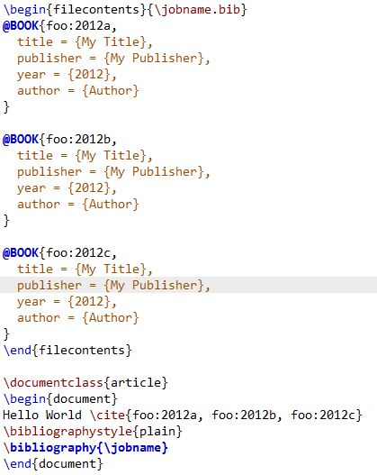
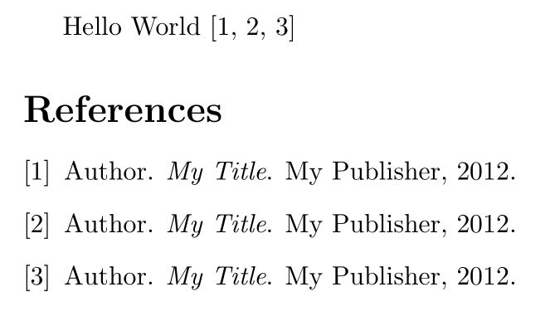
Why Bibliography Management?
Source:
Output:
Duplicated References may come from the following reason:
Carelessness
Collaboration
Extension of an existing work
LaTeX cannot detect them

Slide 4
Why Bibliography Management
Install Zotero with Better BibTeX
Add a New Bibliography Item
Export Items From Zotero to BibTeX
Better BibTeX & Duplicated Items
Online Tutorial Videos
Contents

Slide 5
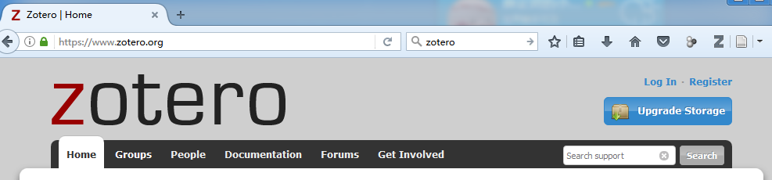
Register for a Zotero Account
You have to create an account first in order to use Zotero and join our group
Go to the URL https://www.zotero.org/
Click the register link
Follow the instructions to finish the registration

Slide 6
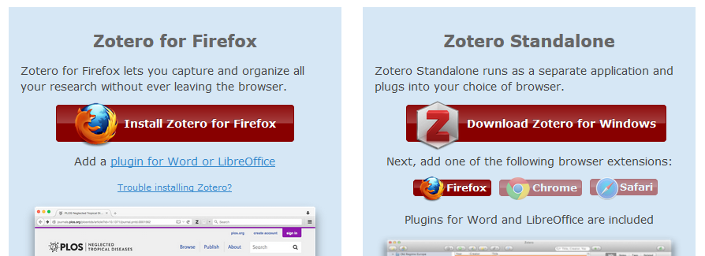
Install Zotero
The downloading page is https://www.zotero.org/download/
Zotero has the Standalone software and plug-ins for web browsers. I suggest you install all of them.

Slide 7
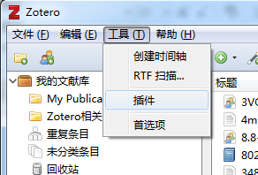
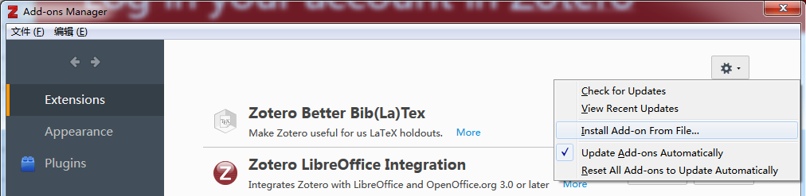
Install better BibTeX Plug-in (Important)
For backward compatibility, you have to install better BibTeX so the item keys in previous BibTeX management website are consistent with the keys in Zotero (otherwise Zotero generates its own keys).
The URL is https://github.com/retorquere/zotero-better-bibtex
The latest release is https://github.com/retorquere/zotero-better-bibtex/releases/latest
The installation file is a Firefox plug-in. Firefox ought to start installation by double clicking.
For standalone Zotero, do the following:
In the main menu go to Tools > Add-ons
Select 'Extensions'
Click on the gear in the top-right corner and choose 'Install Add-on From File...'
Choose .xpi that you've just downloaded, click 'Install'
Restart Zotero
Tools
Add-ons
The complete installation instructions can be found at
http://retorque.re/zotero-better-bibtex/installation/

Slide 8
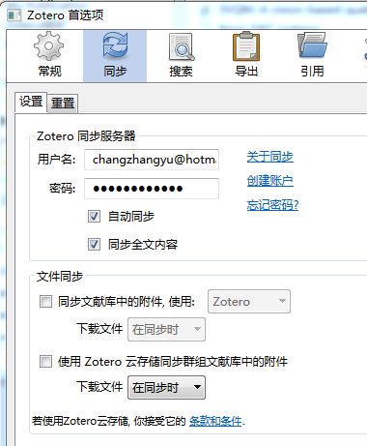
Log in Your Account in Zotero
There are several ways to use Zotero. You need to log in them respectively.
For the website, go to the log in page directly.
For the standalone version as well as the browser plug-in, you need to select the Preferences and go to the Sync tag. Then enter your username and password.
The sync function can upload the PDF file automatically and you have 300MB free space for your own.
Uncheck the uploading function for Group if you do not want to pay for extra space (USD 200 for a year).
Preferences
Sync
User
Password
Cloud Storage

Slide 9
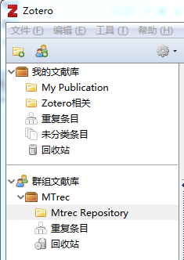
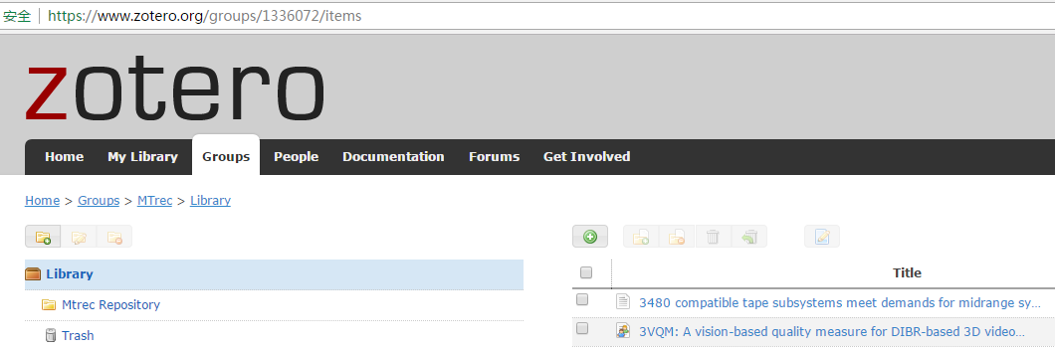
Join MTrec Group
Group
Bibliography
Tell me your username and I will invite you to our group (MTrec).
Afterwards you can visit our group on the webpage or on the client side.
You can ADD, EDIT and REMOVE items. Be careful when you do this because the other users in this group will also be affected.

Slide 10
Group Item and Your Personal Item
Only the items in the group bibliography will be uploaded to the cloud.
To share your bibliography items, simple drag the item from your directory to the group directory.
Similarly, to download items from our group, simple drag the items from the group directory to your own directory.
My
Bibliography
Group
Bibliography

Slide 11
Why Bibliography Management
Install Zotero with Better BibTeX
Add a New Bibliography Item
Export Items From Zotero to BibTeX
Better BibTeX & Duplicated Items
Online Tutorial Videos
Contents

Slide 12
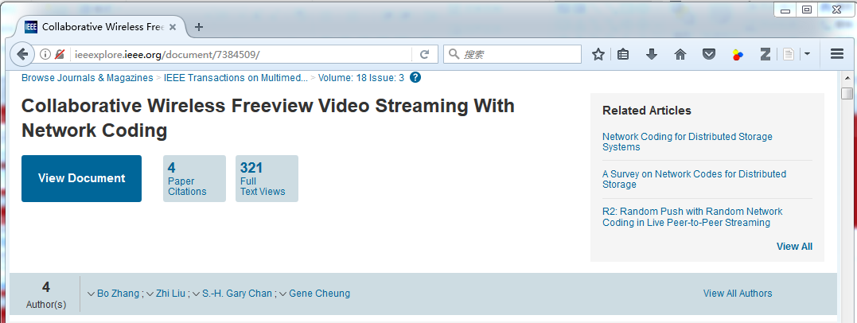
Add a New Item from Browser
You can manually add items, but I strongly suggest you use the plug-in to avoid mistakes.
Simply go to the related webpage of the paper (e.g. IEEExplore or ACM digital library) and click the save button.

Slide 13
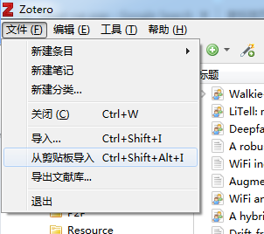
Add New Items from a BibTeX File
File
Import
Import from Clipboard
Method 1: Go to File -> Import and follow the instructions.
Method 2: Copy the text from the file (i.e., Ctrl + C) and choose File -> Import from Clipboard.

Slide 14
Why Bibliography Management
Install Zotero with Better BibTeX
Add a New Bibliography Item
Export Items From Zotero to BibTeX
Better BibTeX & Duplicated Items
Online Tutorial Videos
Contents

Slide 15
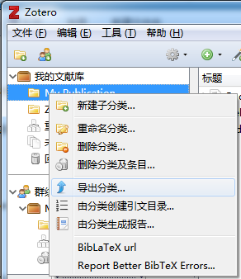
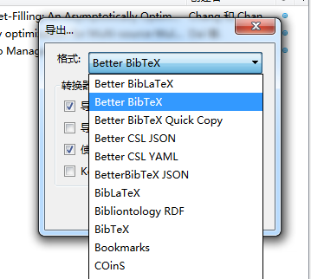
Export items from Zotero to BibTeX
Export
style
Export
If you are preparing references for a paper, create a new directory for the paper and drag the related work into it.
Right click the directory and choose Export option. In the style option choose Better BibTeX option instead of BibTeX.

Slide 16
Why Bibliography Management
Install Zotero with Better BibTeX
Add a New Bibliography Item
Export Items From Zotero to BibTeX
Better BibTeX & Duplicated Items
Online Tutorial Videos
Contents

Slide 17
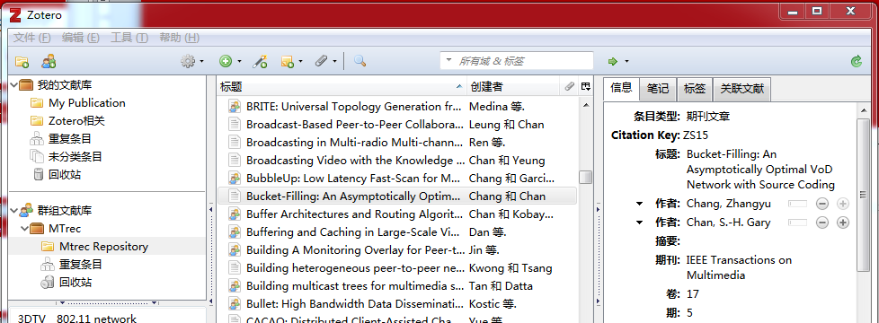
Citation Key & Duplicated Items
duplicated items
Zotero cannot save the BibTeX key. To fix this, better BibTeX store the key in the extra field in the form bibtex:[key].
Zotero can automatically find the duplicated items. You can check them in the directory and merge them if necessary.
Papers may happens to have same name (e.g., conference versus journal). Be careful!

Slide 18
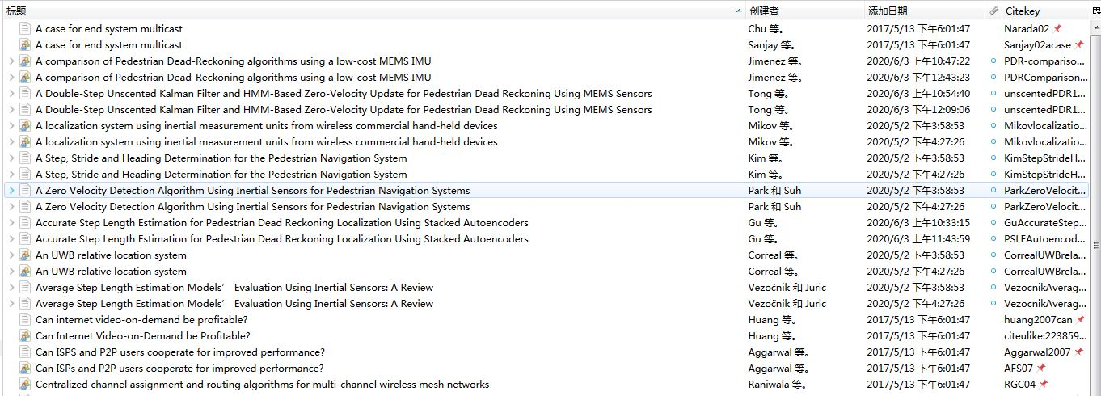
Duplicated Items (Cont’d)
Zotero can automatically find the duplicated items. You can check them in the directory and merge them if necessary.
Papers may happens to have same name (e.g., conference versus journal). Be careful!

Slide 19
Citation Key Management (Important)
Rules to add items into our group library
If you are the first one that add the item, you have the right to decide the citation key. If you do not give a key, the system will automatically generate one for you.
If you add a new item (or a batch of items), always check the duplicated items. If the item already exists, you are responsible to remove your duplicated items.
You have make sure that the citation key of your paper in our SVN is consistent with the citation key in our group library.

Slide 20
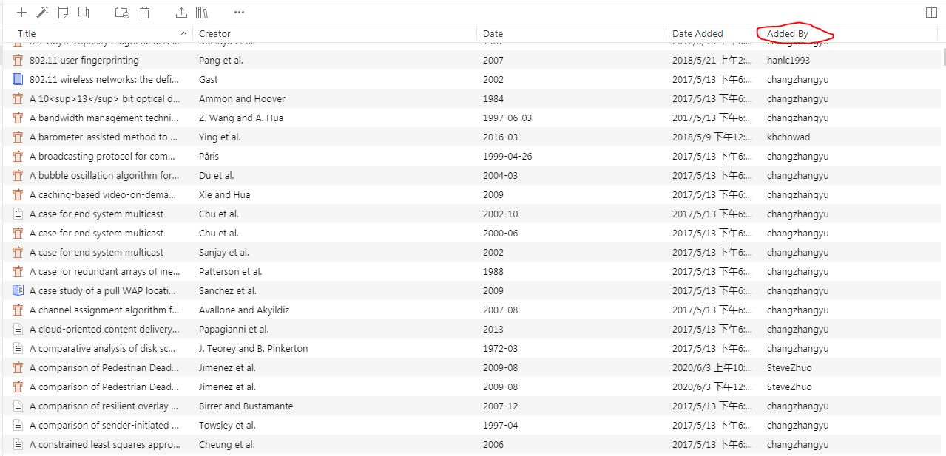
We have record on who adds the item

Slide 21
Why Bibliography Management
Install Zotero with Better BibTeX
Add a New Bibliography Item
Export Items From Zotero to BibTeX
Better BibTeX & Duplicated Items
Online Tutorial Videos
Contents

Slide 22
Online Tutorial Videos
Installing Zotero Standalone: https://www.youtube.com/watch?v=H8UTehdF92s
Installing the Firefox Extension: https://www.youtube.com/watch?v=SDjFzX2kdHc
Synchronization: https://www.youtube.com/watch?v=3lFqEvNMXuM
Using Zotero: https://www.youtube.com/watch?v=mP5AzJHXfIA
Zotero Group Library: https://www.youtube.com/watch?v=3QKF25nmnds
Better BibTeX: https://www.youtube.com/watch?v=GAVXVkcpbG0

