Slide 1
An Approximation Algorithm to Maximize User Capacity for an Auto-scaling VoD System
Chang, Zhangyu
Supervised by Prof. Gary Chan
9 September 2019

Slide 2
Contents
Introduction and Related Work
Problem Formulation and its NP-hardness
AVARDO: An Approximation Algorithm
Illustrative Trace-driven Experimental Results
Conclusion

Slide 3

User Request Pattern for Blockbuster Videos: Stable Popularity, Volatile Traffic
Blockbuster video service (e.g., Netflix) to a large group of audience
Video access popularity: rather stable and predictable over days or weeks User request traffic: may vary by an order of magnitude in hours
Statically allocates a fixed number of servers is not efficient. Auto-scaling can meet the demand in a timely and cost-effective manner.
Notes:
Be direct in the presentation
Succinct (brief & clear) + not to digress too much from the main idea
强调重点 分清轻重 (sort things out)

Slide 4
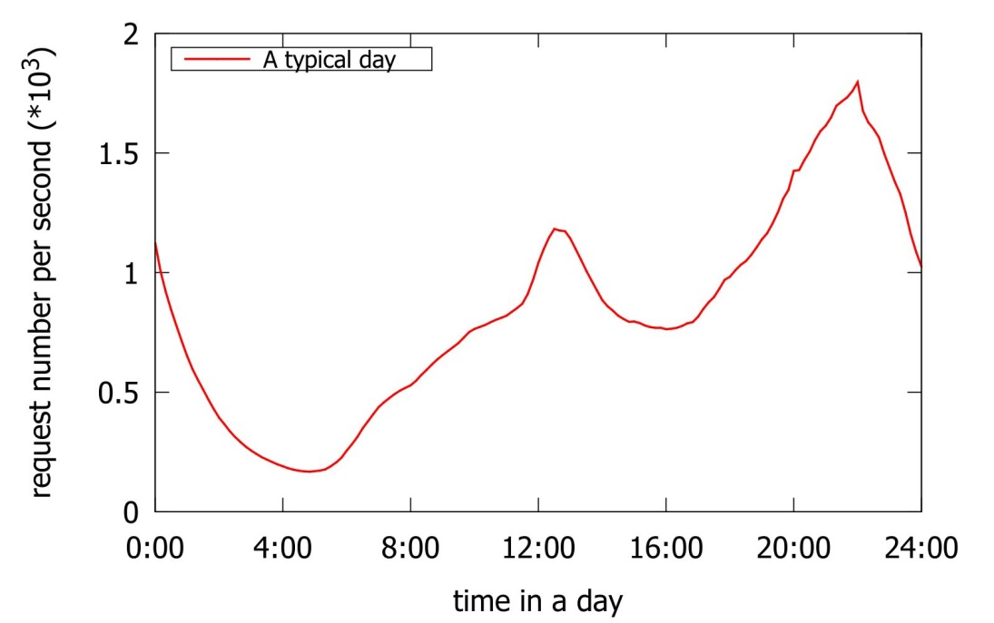
Request Rate Over a Typical Day
Blockbuster videos have rather stable and predictable over days or weeks (cf. UGC).
Popularity remains quite stable (varies less than 10%) over a day.
Request traffic may vary by an order of magnitude over merely hours.
Auto-scaling is a solution to meet demand in a timely and cost-effective manner.
User request of a leading video service website in China over a day

Slide 5
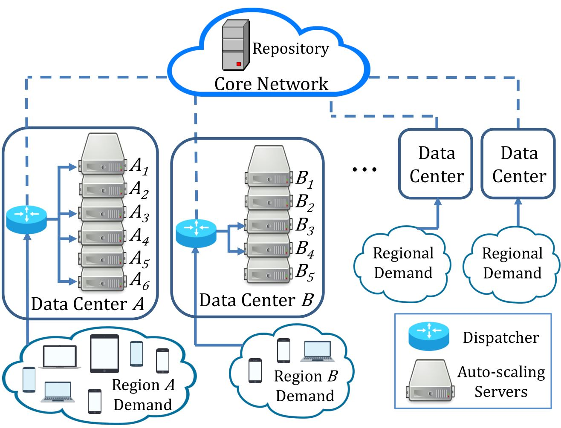
A Typical Auto-scaling VoD Cloud
Auto-scaling Server
Server has a certain storage and streaming capacity Server can be activated or deactivated in a short time Homogeneous servers Activating server according to incoming traffic
Traffic Dispatcher
Distribute request to an active server with the video Otherwise to core network
Video Block
Blocks have the same size Partition large video into blocks Video block is only for management purpose (cf. DASH segments)
A video cloud consisting of auto-scaling VoD data centers.

Slide 6
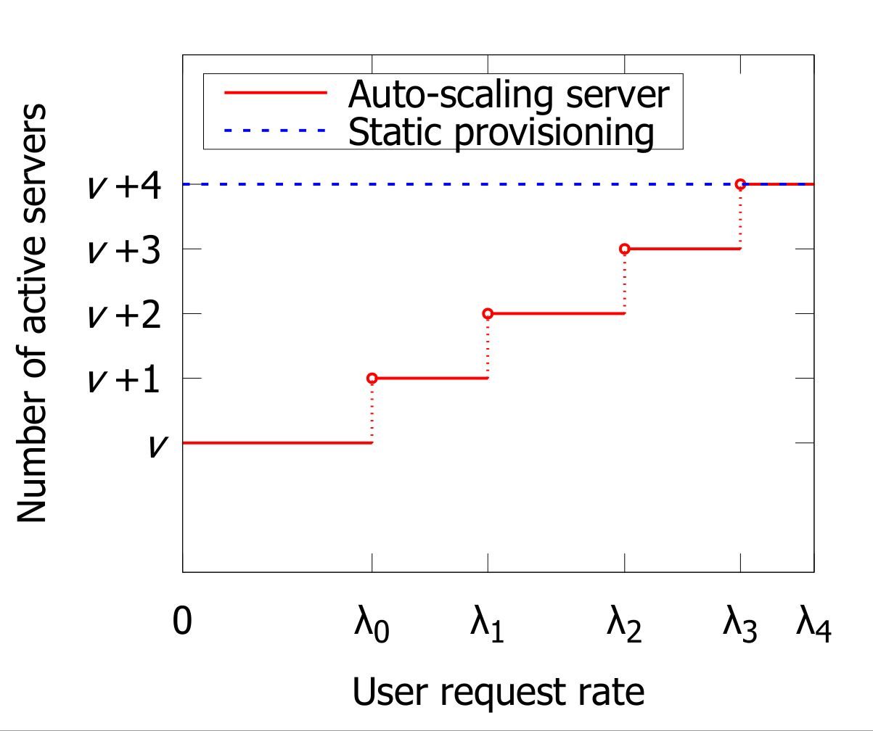
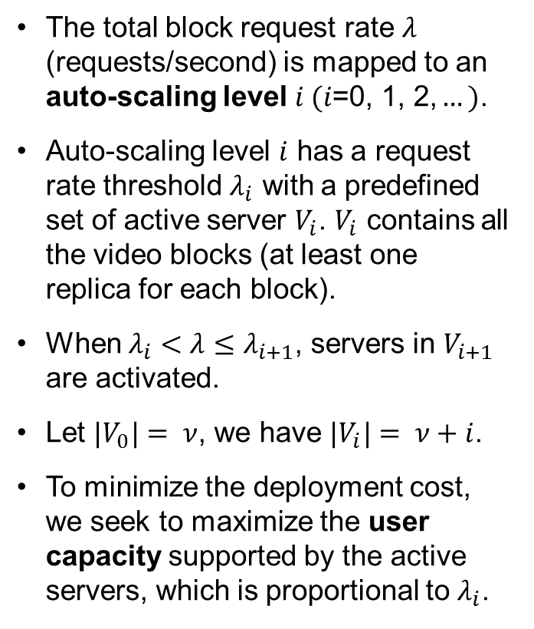
Maximizing the User Request Rate Threshold
The total block request rate $λ$ (requests/second) is mapped to an auto-scaling level $i (i\text{=0, 1, 2,}…)$.
Auto-scaling level $i$ has a request rate threshold $λ_{i}$ with a predefined set of active server $V_{i}$. $V_{i}$ contains all the video blocks (at least one replica for each block).
When $λ_{i}<λ≤λ_{i+1}$, servers in $V_{i+1}$ are activated.
Let ${|V}_{0}|= ν$, we have ${|V}_{i}|= ν+i$.
To minimize the deployment cost, we seek to maximize the user capacity supported by the active servers, which is proportional to $λ_{i}$.
Request rate | Increase | Decrease
Auto-scaling level | Increase | Decrease
Active servers | More | Less

Slide 7
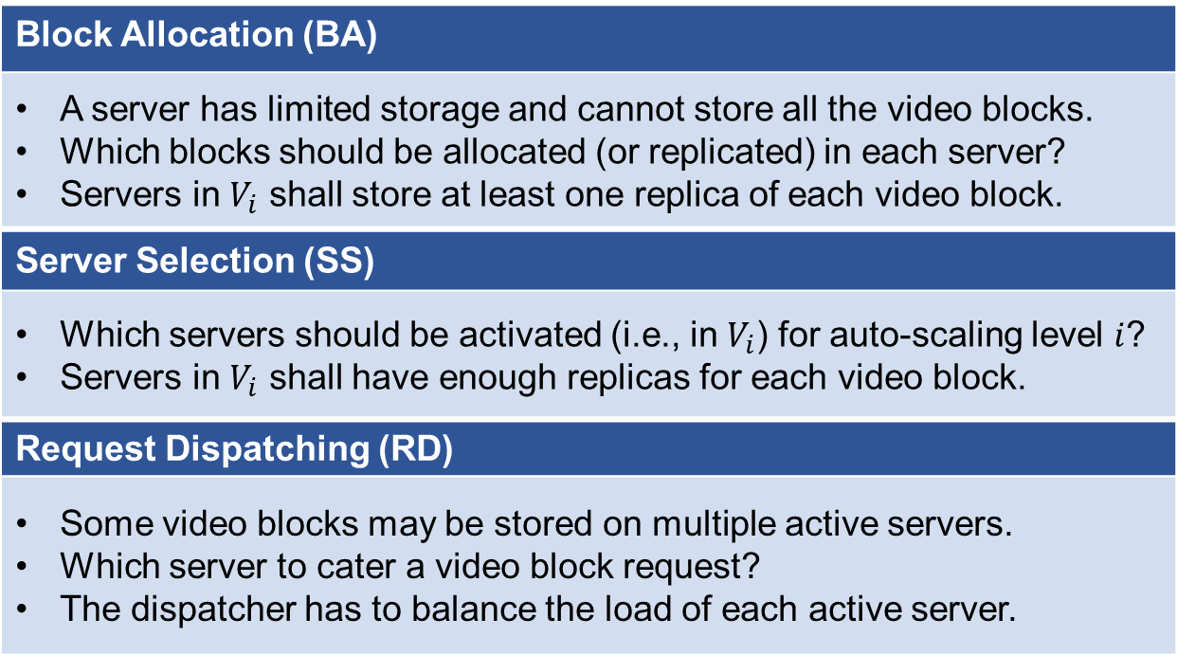
Optimizing Following Inter-dependent Dimensions
Block Allocation (BA)
A server has limited storage and cannot store all the video blocks. Which blocks should be allocated (or replicated) in each server? Servers in $V_{i}$ shall store at least one replica of each video block.
Server Selection (SS)
Which servers should be activated (i.e., in $V_{i}$) for auto-scaling level $i$? Servers in $V_{i}$ shall have enough replicas for each video block.
Request Dispatching (RD)
Some video blocks may be stored on multiple active servers. Which server to cater a video block request? The dispatcher has to balance the load of each active server.

Slide 8
Challenges: Timescale and Interdependence
Block Allocation (BA)
Timescale: in day or week Videos are pre-allocated (preloaded) in all the servers for SS and RD On-the-fly BA is not necessary due to the relatively stable popularity
Server Selection (SS)
Timescale: in hour SS decision should be based on a given BA
Request Dispatching (RD)
Timescale: in second RD decision should be based on a given BA and SS
We shall jointly optimize these 3 interdependent dimensions.

Slide 9
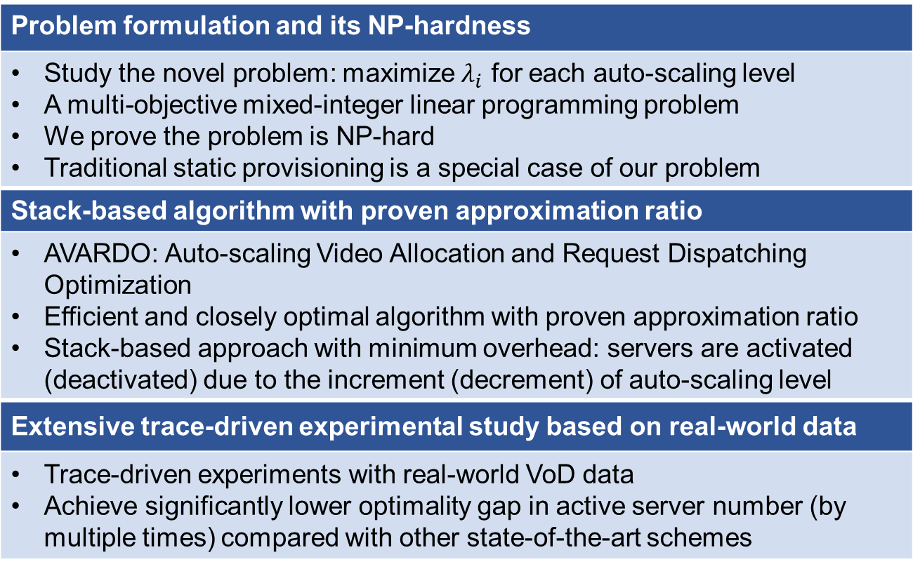
Contributions
Problem formulation and its NP-hardness
Study the novel problem: maximize $λ_{i}$ for each auto-scaling level A multi-objective mixed-integer linear programming problem We prove the problem is NP-hard Traditional static provisioning is a special case of our problem
Stack-based algorithm with proven approximation ratio
AVARDO: Auto-scaling Video Allocation and Request Dispatching Optimization Efficient and closely optimal algorithm with proven approximation ratio Stack-based approach with minimum overhead: servers are activated (deactivated) due to the increment (decrement) of auto-scaling level
Extensive trace-driven experimental study based on real-world data
Trace-driven experiments with real-world VoD data Achieve significantly lower optimality gap in active server number (by multiple times) compared with other state-of-the-art schemes

Slide 10
Related Work
Cloud-based VoD architecture resource provisioning
Yet to consider some important features inside the data center due to model abstraction [1], [2], [3] AVARDO complements to these studies by investigating from a more detailed point of view
Content replication in traditional and cloud-based VoD data centers
Assumes no dynamics within the data center: the server configurations and bandwidth reservation are rarely changed [4] Not considered the change of storage and video replication of the auto-scaling servers [5] AVARDO optimize for every possible auto-scaling levels
Cloud resources auto-scaling mechanism
Predict the user demand and improves the performance in the online phase [6], [7] Each request or task considered in the problems is served by only one server [8]-[10] AVARDO considers BA and RD as some videos are too popular to be served by one server

Slide 11
Contents
Introduction and Related Work
Problem Formulation and its NP-hardness
AVARDO: An Approximation Algorithm
Illustrative Trace-driven Experimental Results
Conclusion

Slide 12
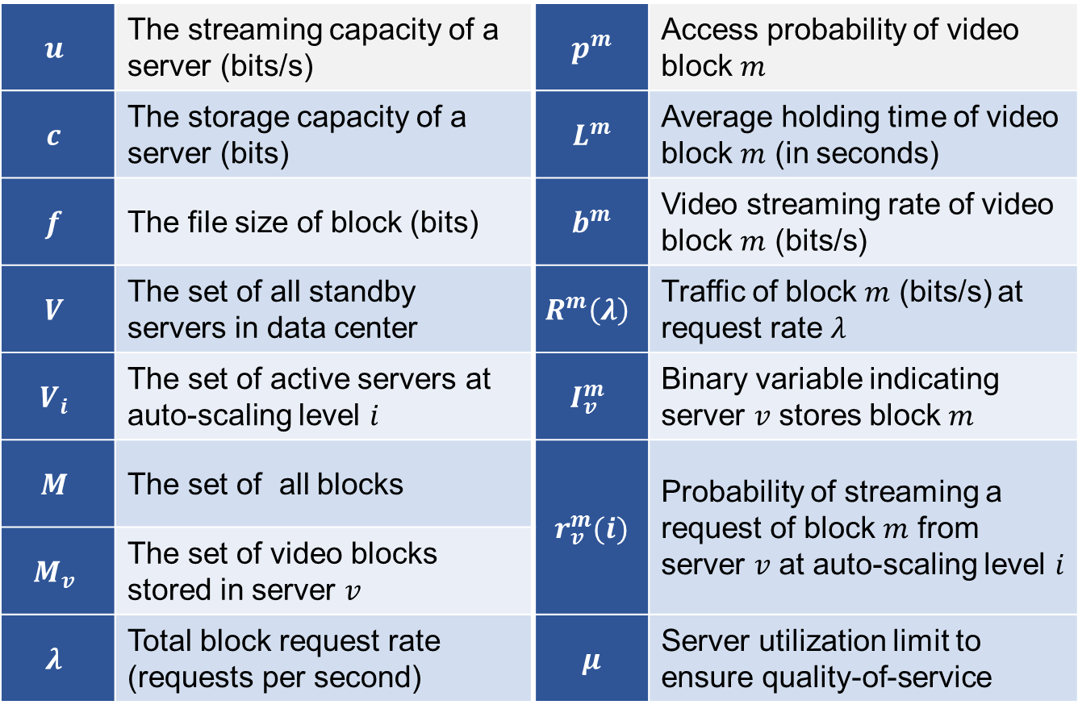
Symbol Used in Formulation
$$u$$ | The streaming capacity of a server (bits/s) | $$p^{m}$$ | Access probability of video block $m$
$$c$$ | The storage capacity of a server (bits) | $$L^{m}$$ | Average holding time of video block $m$ (in seconds)
$$f$$ | The file size of block (bits) | $$b^{m}$$ | Video streaming rate of video block $m$ (bits/s)
$$V$$ | The set of all standby servers in data center | $$R^{m}\left(λ\right)$$ | Traffic of block $m$ (bits/s) at request rate $λ$
$$V_{i}$$ | The set of active servers at auto-scaling level $i$ | $$I_{v}^{m}$$ | Binary variable indicating server $v$ stores block $m$
$$M$$ | The set of all blocks | $$r_{v}^{m}(i)$$ | Probability of streaming a request of block $m$ from server $v$ at auto-scaling level $i$
$$M_{v}$$ | The set of video blocks stored in server $v$
$$λ$$ | Total block request rate (requests per second) | $$μ$$ | Server utilization limit to ensure quality-of-service

Slide 13
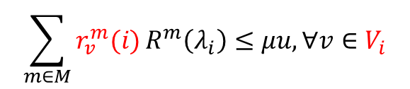

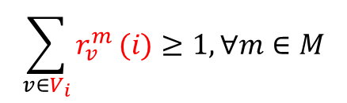


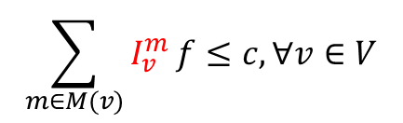
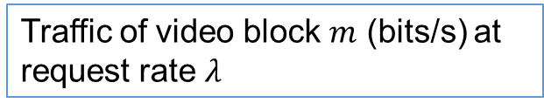
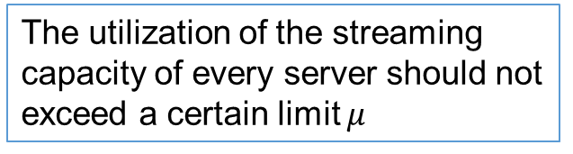
Problem Formulation of AVARD: Auto-scaling Video Allocation and Request Dispatching
Objective
$$\max{(λ_{0},λ_{1},…λ_{n})}$$
User request rate threshold
Subject to
Traffic of video block $m$ (bits/s) at request rate $λ$
$$R^{m}\left(λ\right)={λp}^{m}L^{m}b^{m},∀m∈M$$
Storage
$$\sum_{m∈M(v)}{I_{v}^{m}}f≤c,∀v∈V$$
Server cannot store video blocks beyond its storage
Streaming
Server can serve the traffic of a block only if it has this block
$$r_{v}^{m}\left(i\right)≤I_{v}^{m},∀v∈V_{i}, m∈M$$
$$\sum_{v∈V_{i}}{r_{v}^{m}}(i)≥1,∀m∈M$$
All the user request for each video block shall be served
QoS
$$\sum_{m∈M}{r_{v}^{m}(i)}R^{m}\left(λ_{i}\right)≤μu,∀v∈V_{i}$$
The utilization of the streaming capacity of every server should not exceed a certain limit $μ$

Slide 14
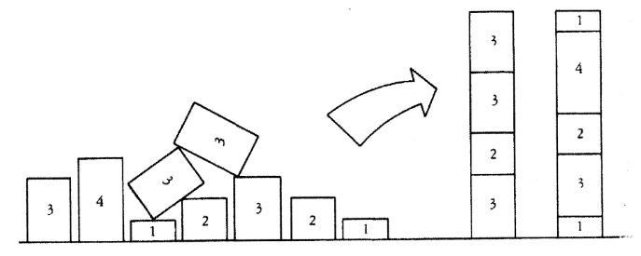
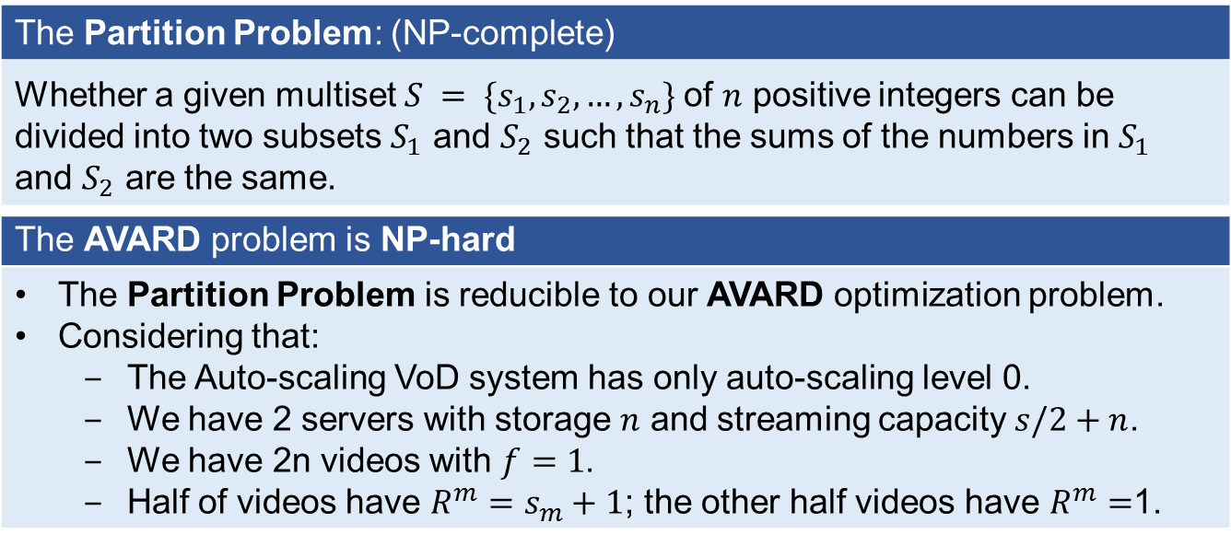
NP-Hardness of AVARD Problem
The Partition Problem: (NP-complete)
Whether a given multiset $S = \{s_{1},s_{2}, …,s_{n}\}$of $n$ positive integers can be divided into two subsets $S_{1}$ and $S_{2}$ such that the sums of the numbers in $S_{1}$ and $S_{2}$ are the same.
The AVARD problem is NP-hard
The Partition Problem is reducible to our AVARD optimization problem. Considering that: The Auto-scaling VoD system has only auto-scaling level 0. We have 2 servers with storage $n$ and streaming capacity $s/2+n$. We have 2n videos with $f=1$. Half of videos have $R^{m}=s_{m}+1$; the other half videos have $R^{m}=$1.

Slide 15
Contents
Introduction and Related Work
Problem Formulation and its NP-hardness
AVARDO: An Approximation Algorithm
Illustrative Trace-driven Experimental Results
Conclusion

Slide 16
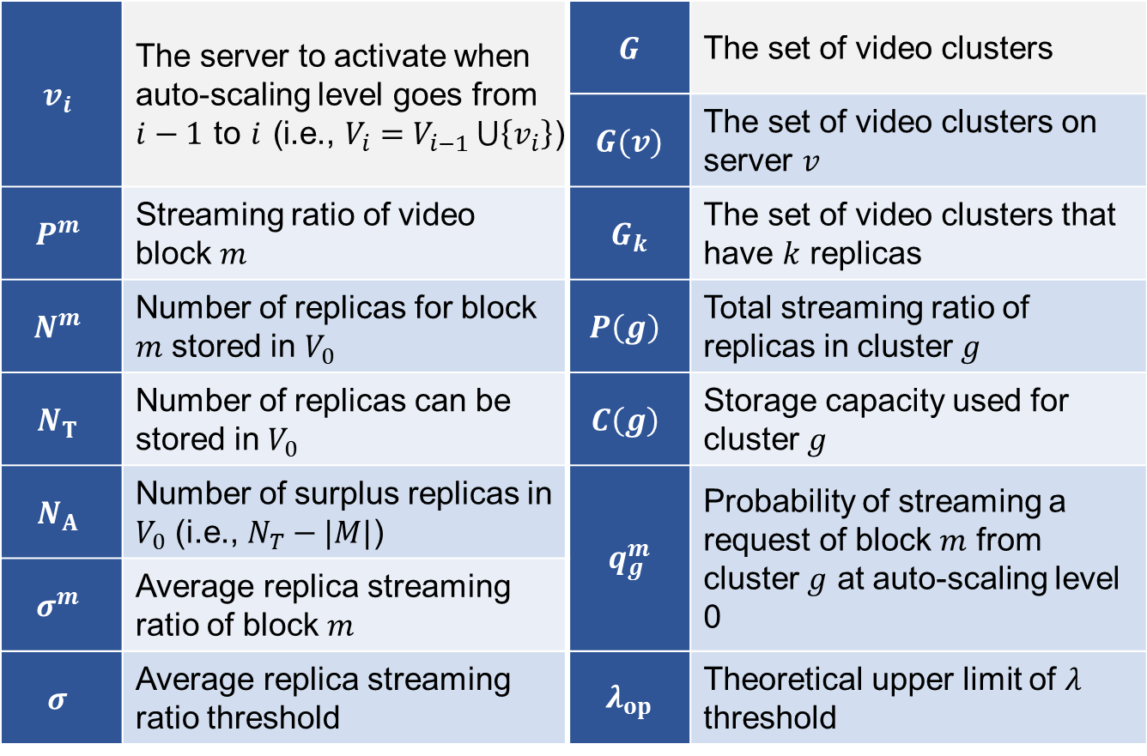
Additional Symbol Used in Algorithm
$$v_{i}$$ | The server to activate when auto-scaling level goes from $i−1$ to $i$ (i.e., $V_{i}=V_{i−1 }⋃\left\{v_{i}\right\}$) | $$G$$ | The set of video clusters
 |  | $$G(v)$$ | The set of video clusters on server $v$
$$P^{m}$$ | Streaming ratio of video block $m$ | $$G_{k}$$ | The set of video clusters that have $k$ replicas
$$N^{m}$$ | Number of replicas for block $m$ stored in $V_{0}$ | $$P\left(g\right)$$ | Total streaming ratio of replicas in cluster $g$
$$N_{T}$$ | Number of replicas can be stored in $V_{0}$ | $$C\left(g\right)$$ | Storage capacity used for cluster $g$
$$N_{A}$$ | Number of surplus replicas in $V_{0}$ (i.e., $N_{T}−|M|$) | $$q_{g}^{m}$$ | Probability of streaming a request of block $m$ from cluster $g$ at auto-scaling level 0
$$σ^{m}$$ | Average replica streaming ratio of block $m$
$$σ$$ | Average replica streaming ratio threshold | $$λ_{op}$$ | Theoretical upper limit of $λ$ threshold

Slide 17
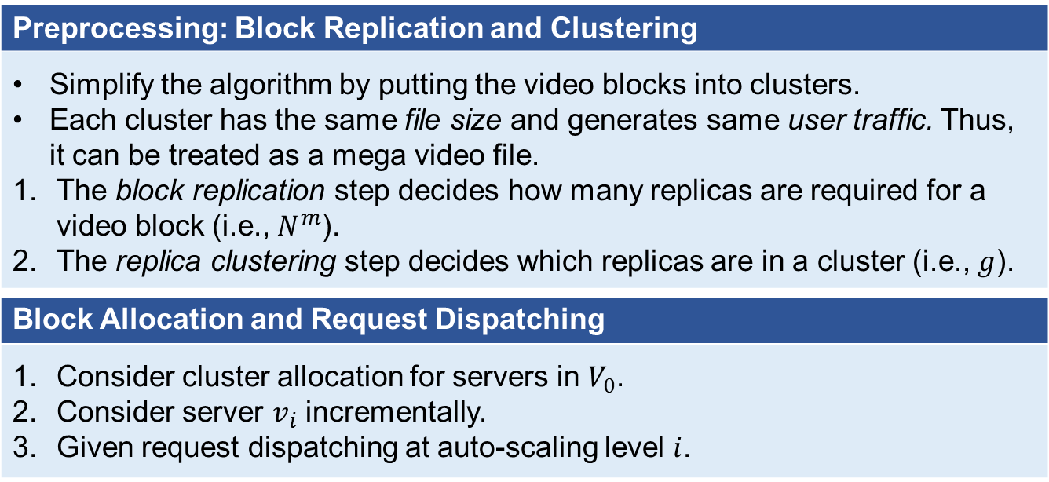
AVARDO: Approximation Algorithm for an Auto-scaling Video-on-Demand System
Auto-scaling Video Allocation and Request Dispatching Optimization
Jointly optimize Video Allocation, Server Selection, and Request Dispatching
AVARDO has a stack-based server selection scheme
Consider the set of active servers as a stack
Push (activate) or pop (deactivate) a server in an orderly sequence
Preprocessing: Block Replication and Clustering
Simplify the algorithm by putting the video blocks into clusters. Each cluster has the same file size and generates same user traffic. Thus, it can be treated as a mega video file. The block replication step decides how many replicas are required for a video block (i.e., $N^{m}$). The replica clustering step decides which replicas are in a cluster (i.e., $g$).
Block Allocation and Request Dispatching
Consider cluster allocation for servers in $V_{0}$. Consider server $v_{i}$ incrementally. Given request dispatching at auto-scaling level $i$.

Slide 18
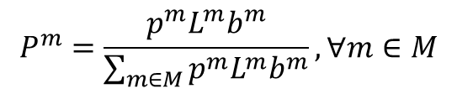
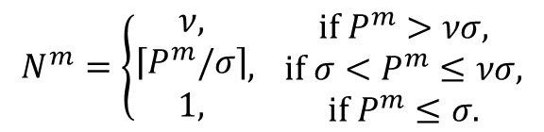
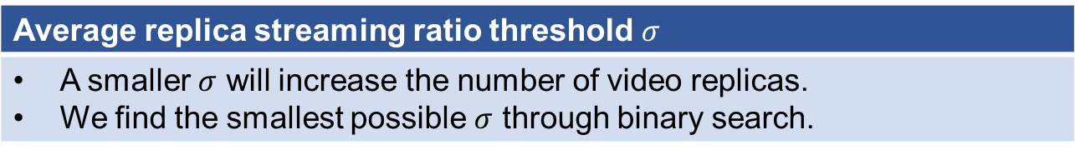
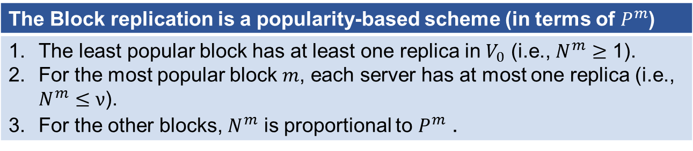
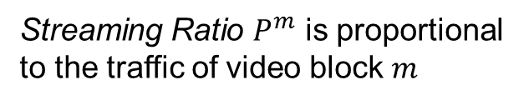
Preprocessing Stage: Block Replication
$$P^{m}=\frac{p^{m}L^{m}b^{m}}{\sum_{m∈M}{p^{m}L^{m}b^{m}}}, ∀m∈M$$
Streaming Ratio $P^{m}$ is proportional to the traffic of video block $m$
The Block replication is a popularity-based scheme (in terms of $P^{m}$)
The least popular block has at least one replica in $V_{0}$ (i.e., $N^{m}≥\text{1}$). For the most popular block $m$, each server has at most one replica (i.e., $N^{m}≤ν$). For the other blocks, $N^{m}$ is proportional to $P^{m}$ .
$$N^{m}=\left\{\begin{aligned}ν, \\ \left\lceil P^{m}/σ\right\rceil \\ 1,\end{aligned},\right. \begin{matrix}if P^{m}>νσ, \\ if {σ<P}^{m}≤νσ, \\ if{ P}^{m}≤σ.\end{matrix}$$
fully replicated blocks
partially replicated blocks
Average replica streaming ratio threshold $σ$
A smaller $σ$ will increase the number of video replicas. We find the smallest possible $σ$ through binary search.

Slide 19
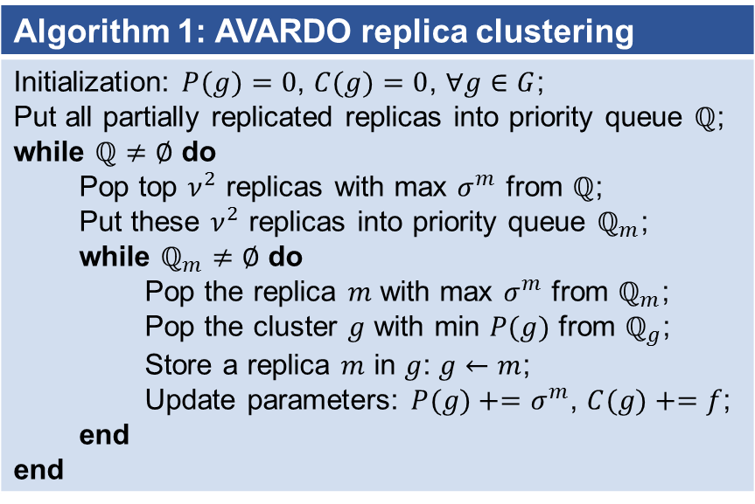
Preprocessing Stage: Replica Clustering
Algorithm 1: AVARDO replica clustering
Initialization: $P(g)=0$, $C(g)=0$, $∀g∈G$; Put all partially replicated replicas into priority queue $ℚ$; while $ℚ≠∅$ do Pop top $ν^{2}$ replicas with max $σ^{m}$ from $ℚ$; Put these $ν^{2}$ replicas into priority queue $ℚ_{m}$; while $ℚ_{m}≠∅$ do Pop the replica $m$ with max $σ^{m}$ from $ℚ_{m}$; Pop the cluster $g$ with min $P(g)$ from $ℚ_{g}$; Store a replica $m$ in $g$: $g←m$; Update parameters: $P(g)+=σ^{m}$, $C(g)+=f$; end end
A
B
C
D
E
F
G
H
L
H
A
K
I
J
E
I
J
K
L
Objective: Each cluster has the same file size and generates similar user traffic.
G
F
B
C
D

Slide 20
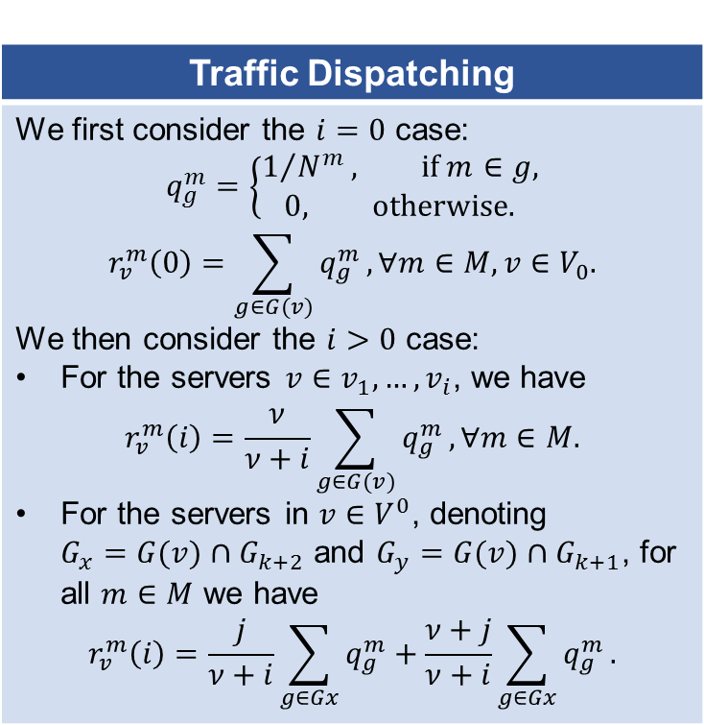
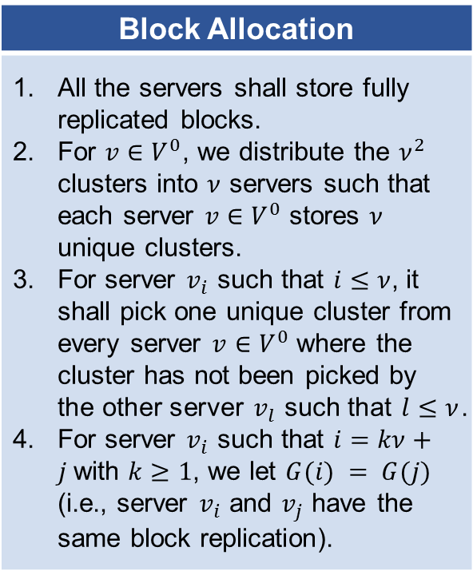
Block Allocation and Request Dispatching
For auto scaling level $i>0$, we write $i=kν+j$ such that $k≥0$ and $1≤j≤ν$.
Block Allocation
All the servers shall store fully replicated blocks. For $v{∈V}^{0}$, we distribute the $ν^{2}$ clusters into $ν$ servers such that each server $v{∈V}^{0}$ stores $ν$ unique clusters. For server $v_{i}$ such that $i≤ν$, it shall pick one unique cluster from every server $v{∈V}^{0}$ where the cluster has not been picked by the other server $v_{l}$ such that $l≤ν$. For server $v_{i}$ such that $i=kν+j$with $k≥1$, we let $G(i) = G(j)$ (i.e., server $v_{i}$ and $v_{j}$ have the same block replication).
Traffic Dispatching
We first consider the $i=0$ case: $$q_{g}^{m}=\left\{\begin{aligned}1/{N^{m}}, \text{if} m∈g, \\ &0, \text{otherwise}\text{.}\end{aligned}\right.$$ $$r_{v}^{m}\left(0\right)=\sum_{g∈G(v)}{q_{g}^{m}},∀m∈M, v∈V_{0}.$$ We then consider the $i>0$ case: For the servers $v∈v_{1},…,v_{i}$, we have $$r_{v}^{m}\left(i\right)=\frac{ν}{ν+i}\sum_{g∈G(v)}{q_{g}^{m}},∀m∈M.$$ For the servers in $v{∈V}^{0}$, denoting $G_{x}=G(v)∩G_{k+2}$ and $G_{y}=G(v)∩G_{k+1}$, for all $m∈M$ we have $$r_{v}^{m}\left(i\right)=\frac{j}{ν+i}\sum_{g∈Gx}{q_{g}^{m}}+\frac{ν+j}{ν+i}\sum_{g∈Gx}{q_{g}^{m}}.$$

Slide 21
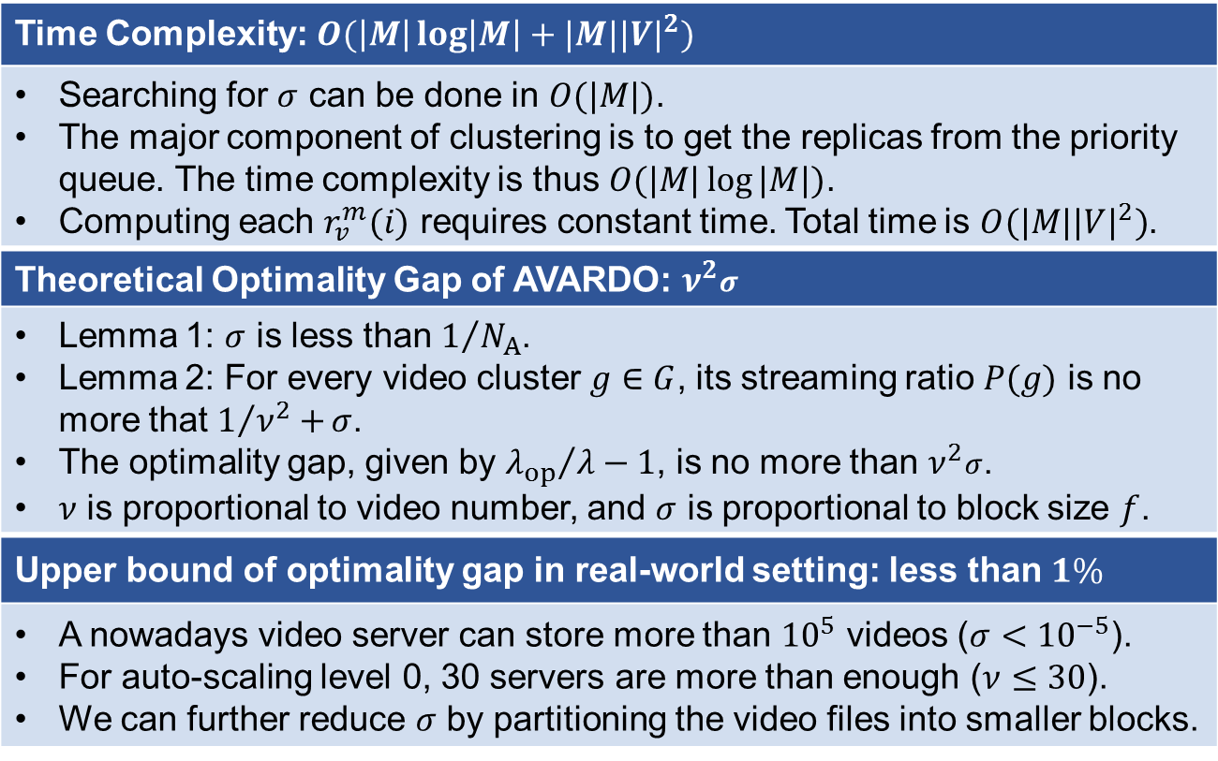
Optimality and Time Complexity
Time Complexity: $O(\left|M\right|\log\left|M\right|+|M|{|V|}^{2})$
Searching for $σ$ can be done in $O(|M|)$. The major component of clustering is to get the replicas from the priority queue. The time complexity is thus $O(|M|\log{|M|})$. Computing each $r_{v}^{m}(i)$ requires constant time. Total time is $O(|M|{|V|}^{2})$.
Theoretical Optimality Gap of AVARDO: $ν^{2}σ$
Lemma 1: $σ$ is less than $1/{N_{A}}$. Lemma 2: For every video cluster $g∈G$, its streaming ratio $P(g)$ is no more that $1/{ν^{2}+}σ$. The optimality gap, given by ${λ_{op}}/λ−1$, is no more than $ν^{2}σ$. $ν$ is proportional to video number, and $σ$ is proportional to block size $f$.
Upper bound of optimality gap in real-world setting: less than $1\%$
A nowadays video server can store more than ${10}^{5}$ videos ($σ<{10}^{−5}$). For auto-scaling level 0, 30 servers are more than enough ($ν≤30$). We can further reduce $σ$ by partitioning the video files into smaller blocks.

Slide 22
Contents
Introduction and Related Work
Problem Formulation and its NP-hardness
AVARDO: An Approximation Algorithm
Illustrative Trace-driven Experimental Results
Conclusion

Slide 23
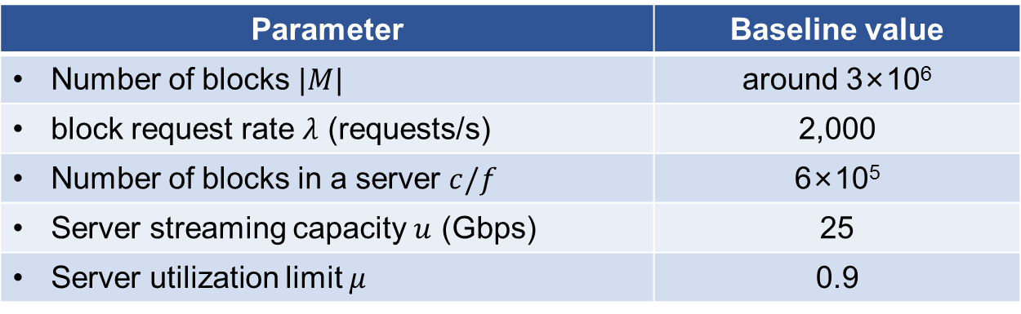
Simulation Environment
Parameter | Baseline value
Number of blocks $|M|$ | around 3×10⁶
block request rate $λ$ (requests/s) | 2,000
Number of blocks in a server $c/f$ | 6×10⁵
Server streaming capacity $u$ (Gbps) | 25
Server utilization limit $μ$ | 0.9
The real-world data trace is from a leading video service website in China over 2 weeks.
We partition the videos into the blocks of the same size of 100MB.
When a video has multiple resolutions and bit rates, we treat them as multiple video files.

Slide 24
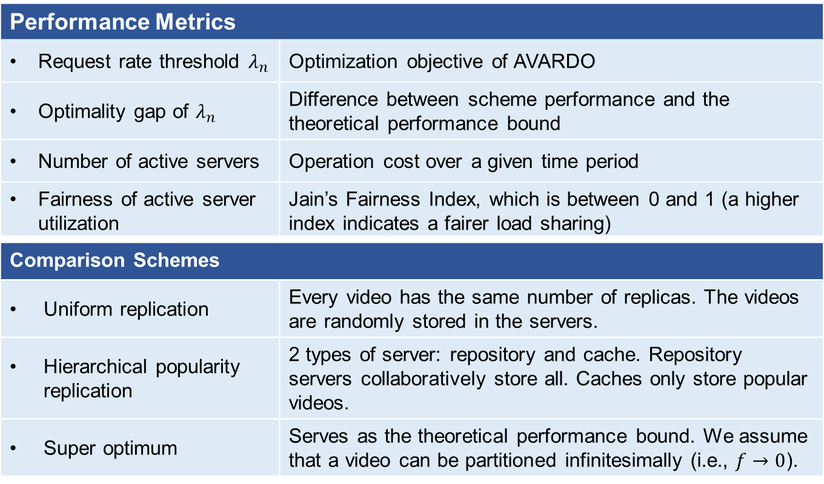
Performance Metrics
Performance Metrics
Request rate threshold $λ_{n}$ | Optimization objective of AVARDO
Optimality gap of $λ_{n}$ | Difference between scheme performance and the theoretical performance bound
Number of active servers | Operation cost over a given time period
Fairness of active server utilization | Jain’s Fairness Index, which is between 0 and 1 (a higher index indicates a fairer load sharing)
Comparison Schemes
Uniform replication | Every video has the same number of replicas. The videos are randomly stored in the servers.
Hierarchical popularity replication | 2 types of server: repository and cache. Repository servers collaboratively store all. Caches only store popular videos.
Super optimum | Serves as the theoretical performance bound. We assume that a video can be partitioned infinitesimally (i.e., $f→0$).
Notes:
Cite the comparison schemes in the related work

Slide 25
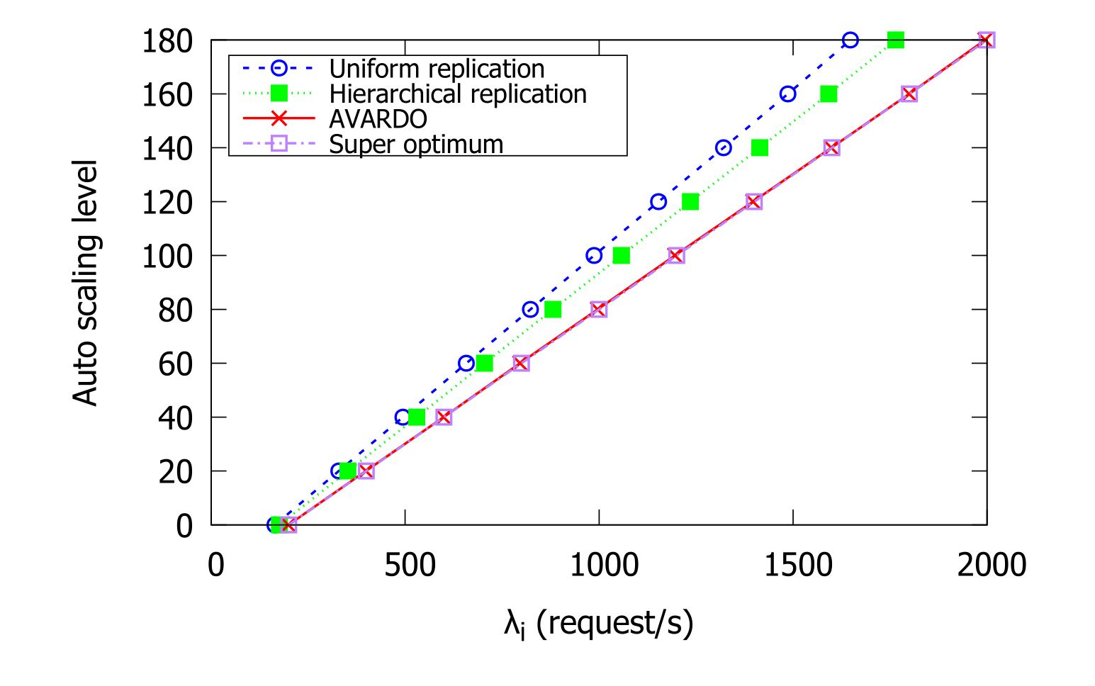
Asymptotic Optimality

Slide 26
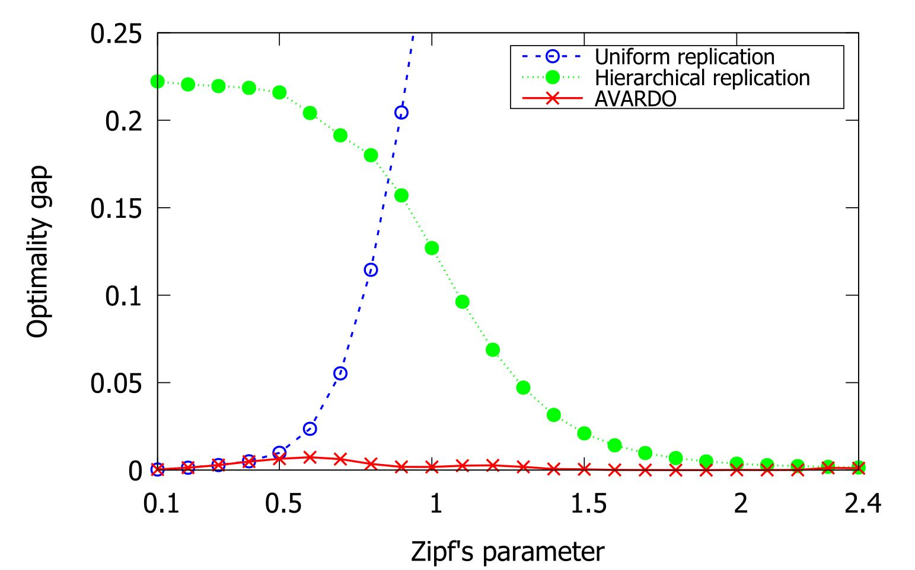
Outperform State-of-the-art Schemes
Notes:
Why do you say they are state-of-the-art?
Tell us how you translate lambda into optimality gap.

Slide 27
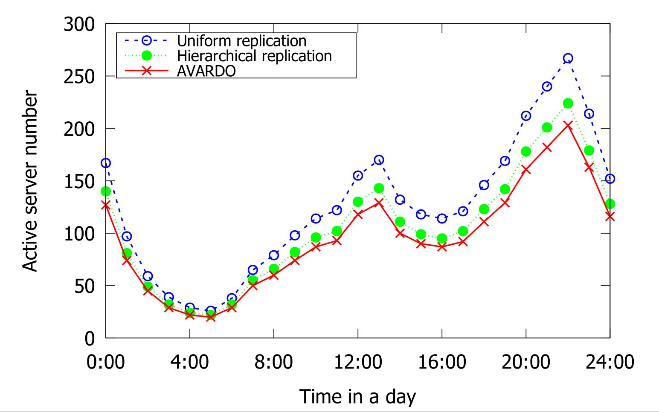
Closely Optimal Over a Typical Day

Slide 28
Contents
Introduction and Related Work
Problem Formulation and its NP-hardness
AVARDO: An Approximation Algorithm
Illustrative Trace-driven Experimental Results
Conclusion

Slide 29
Conclusion
Problem Formulation and NP-hard analysis | Formulation the problems as multi-objective mixed-integer linear programming Prove that AVARD problem is NP-hard
Stack-based approximation algorithm with provable performance | AVARDO: Auto-scaling Video Allocation and Request Dispatching Optimization A novel and closely-optimal approximation algorithm with proven optimality gap Stack-based approach to minimize overhead
Extensive trace-driven experimental results | Real-world VoD data traces Outperform the state-of-the-art schemes Significantly lower optimality gap (often 1/20)

Slide 30
Selected References
[1] J. Yang, Z. Yao, B. Yang, X. Tan, Z. Wang, and Q. Zheng, “Software-defined multimedia streaming system aided by variable-length interval in-network caching,” IEEE Transactions on Multimedia, vol. 21, no. 2, pp. 494–509, Feb 2019.
[2] E. Bourtsoulatze, N. Thomos, J. Saltarin, and T. Braun, “Content-aware delivery of scalable video in network coding enabled named data networks,” IEEE Transactions on Multimedia, vol. 20, no. 6, pp. 1561– 1575, June 2018.
[3] J. Tang, X. Tang, and J. Yuan, “Traffic-optimized data placement for social media,” IEEE Transactions on Multimedia, vol. 20, no. 4, pp. 1008–1023, April 2018.
[4] H. Zhao, Q. Zheng, W. Zhang, B. Du, and H. Li, “A segment-based storage and transcoding trade-off strategy for multi-version VoD systems in the cloud,” IEEE Transactions on Multimedia, vol. 19, no. 1, pp. 149–159, Jan 2017.
[5] G. Gao, Y. Wen, W. Zhang, and H. Hu, “Cost-efficient and QoS-aware content management in media cloud: Implementation and evaluation,” in Proc. International Conference On Communications (ICC). IEEE, 2015, pp. 6880–6886.
[6] L. De Cicco, S. Mascolo, and V. Palmisano, “QoE-driven resource allocation for massive video distribution,” Ad Hoc Networks, 2019.
[7] W. Iqbal, A. Erradi, and A. Mahmood, “Dynamic workload patterns prediction for proactive auto-scaling of web applications,” Journal of Network and Computer Applications, vol. 124, pp. 94 – 107, 2018.
[8] C. Valliyammai and R. Mythreyi, “A dynamic resource allocation strategy to minimize the operational cost in cloud,” in Emerging Technologies in Data Mining and Information Security, A. Abraham, P. Dutta, J. K. Mandal, A. Bhattacharya, and S. Dutta, Eds. Springer Singapore, 2019, pp. 309–317.
[9] J. Nino-Mora, “Resource allocation and routing in parallel multi-server ˜ queues with abandonments for cloud profit maximization,” Computers and Operations Research, vol. 103, pp. 221 – 236, 2019.
[10] H. Zhao, J. Wang, Q. Wang, and F. Liu, “Queue-based and learning-based dynamic resources allocation for virtual streaming media server cluster of multi-version VoD system,” Multimedia Tools and Applications, Apr 2019.

Slide 31
Thank You!
Any Questions?

