Slide 1
Delay Optimization for Multi-source Multi-channel Overlay Live Streaming
Jie Dai
Department of Computer Science and Engineering, HKUST
Part of this work is published in Proc. IEEE ICC, London, UK, pp. 8587-92, 8-12 June 2015
Notes:
It is a pleasure to have your attendance today.

Slide 2
Outline
Introduction
Problem Formulation
COMMOS: A heuristic for collaborative multi-source multi-channel overlay streaming
Simulation Results
Q & A

Slide 3
A Live Streaming Cloud
Live streaming services
11.4 % of the network traffic contributes to live streaming services in 2014
Live streaming traffic grew 47% in 2014 and will continue to grow at a rapid pace, increasing fourfold by 2019
It is expected to reach 14% in 2019 [Cisco et al. The Zettabyte Era—Trends and Analysis’15]
To serve geo-dispersed users, a content provider often deploys a content distribution network (CDN)

Slide 4


CDN for Live Streaming
Multiple sources
Each source originates one or more video channels
Multiple video channels
Heterogeneous streaming rate
Each channel stream is divided into multiple substreams of a certain bit-rate
Better utilization of network bandwidth as compared with the single-stream approach
Source 1
Channel 1
Source 2
Channel 2
A
B
C
D
Subscribes to
Channel 1
Subscribes to
Channels 1, 2
Subscribes to
Channel 1
Subscribes to
Channel 2
Notes:
Source is not a server:
we may split the node into two parts,
One being the “source” with all the channels and the other being the “server” subscribing to the channels.
The two parts are then connected by a link of infinite bandwidth capacity and zero delay.

Slide 5
CDN for Live Streaming
Multiple servers
A server subscribes to a subset of channels for its local user pool
It has to collect all the substreams of its subscribed channels
A server may help relay un-subscribed channel substreams
Increase the availability of network bandwidth
Provide rich path diversity
Each substream is pushed from the source to the servers via a delivery tree
Source 1
Channel 1
Source 2
Channel 2
A
B
C
D
Subscribes to
Channel 1
Subscribes to
Channels 1, 2
Subscribes to
Channel 1
Subscribes to
Channel 2
Notes:
Source is not a server:
we may split the node into two parts,
One being the “source” with all the channels and the other being the “server” subscribing to the channels.
The two parts are then connected by a link of infinite bandwidth capacity and zero delay.

Slide 6

Optimizer in the CDN
Servers are connected by subscribed links
Forming a mesh network
Bandwidth is limited
Each source or server has limited uploading capacity
End-to-end link capacity between any pair of nodes is limited
Bandwidth is shared among all the channels
An optimizer computes streaming topology
Sources and servers send their network information to the optimizer
The optimizer computes substream trees and informs the servers of the optimized topology
Optimizer
Source 1
Channel 1
Source 2
Channel 2
Notes:
With the improvement in edge bandwidth, we consider that the bandwidth between servers and users is not the bottleneck
Optimizer down:
- orthogonal
Server down:
- re-trigger the re-optimization
Optimization is performed periodically or subject to certain major changes
e.g. server down, some subscribing status change
We mainly focus on the optimization for asingle instance

Slide 7
An illustration on substream trees
Channel 1 is of 2 substreams, Channel 2 is of 1 substream
Substream 1 of channel 1
Source 1
Channel 1
Source 2
Channel 2
Substream 2 of channel 1
Substream 1 of channel 2
A
B
C
D
Subscribes to
Channel 1
Subscribes to
Channel 1, 2
Subscribes to
Channel 1
Subscribes to
Channel 2

Slide 8
Source-to-End Delay
The delay from the source to the subscribing servers is an important QoS measure in live streaming
The construction of substream trees affects the delay from the source to the subscribing servers
Given by the longest path from the source to the subscribing servers via different substream trees

Slide 9
Packet Delay Components
Propagation delay
The time that a packet travels from one server to the next over a physical connection
Usually reflected by the round-trip time (RTT)
Scheduling delay at a parent to dispatch packets to its children
Due to round-robin scheduling of packets at the parent to its children
The delay between the instant the parent fully receives a packet to the instant that the packet fully departs from the node for its child
Total source-to-end delay
The summation of propagation delay and scheduling delay from the source to the end nodes

Slide 10



An illustration of scheduling delay
Scheduling Delay
Packet 1 | Packet 2 | Packet 3
$$d_{ab}$$
$$d_{ab}+d_{ac}$$
$$d_{ab}+d_{ac}+d_{ad}$$
3
2
1
a
1
3
2
b
c
d
Some packets arrive at the node sequentially initially
Before the packet is sent out, it has to wait for the other packets departing from the node

Slide 11
Research Objective and Methodology
Construct trees for all the substreams to minimize the maximum delay of all the channels
Min max source-to-end delay
Constraints:
The server uploading capacity
The end-to-end link capacity between pairs of nodes

Slide 12
Contributions
Problem formulation and NP-hardness proof
Capturing all the essential network parameters and delay components
Travelling salesman problem is reducible to the problem in polynomial time
A novel algorithm: COMMOS
Collaborative multi-source multi-channel overlay streaming
Minimize the maximum channel delay
Extensive simulation results
Based on real Internet topologies
Our algorithm significantly reduces the total delay

Slide 13
Related Works
Single-source single-channel [Azarpira et al. IST’12, Zhuang et al. ISPA’11, Magharei et al. TON’09, Ren et al. TMM’09]
Cannot be extended to multi-source multi-channel live streaming due to bandwidth sharing
Multi-source multi-channel work
VoD based approaches cannot be extended to live streaming due to delay consideration [Zhao et al. INFOCOM’14, Tan et al. NET’13, Wu et al. PDS’12, Li et al. ICACT’10]
No consideration on the use of helpers [Kondo et al. NETWORKS’14, Liu et al. ICCCN’13, Meskill et al. LCN’11, Wu et al. INFOCOM’07]
Other live streaming works mainly focus on different objectives, such as maximizing bandwidth or minimizing source load [Wu et al. NET’11, Wang et al. INFOCOM’10, Wu et al. INFOCOM’09, Wu et al. INFOCOM’08, Wang et al. GLOBECOM’10, Wu et al. PDS’08]

Slide 14
Outline
Introduction
Problem Formulation
COMMOS: A heuristic for collaborative multi-source multi-channel overlay streaming
Simulation Results
Q & A

Slide 15

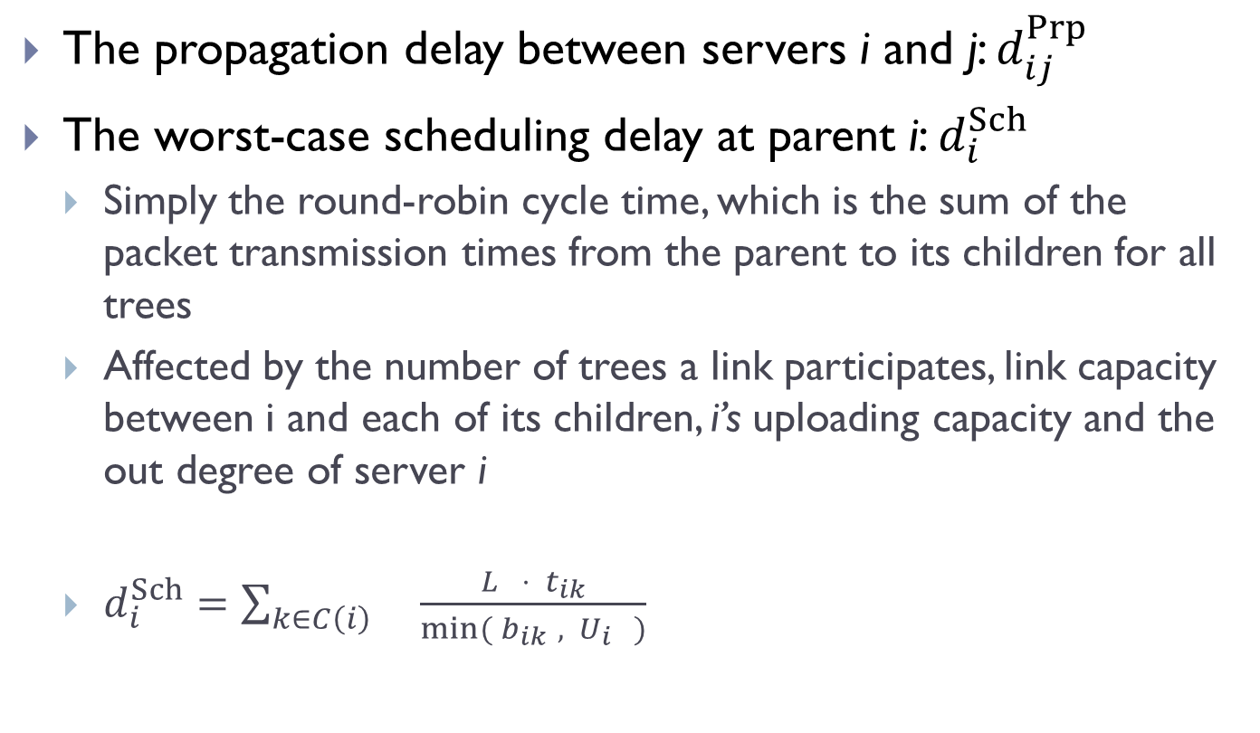



Modeling Delay Components
The propagation delay between servers i and j: $d_{ij}^{Prp}$
The worst-case scheduling delay at parent i: $d_{i}^{Sch}$
Simply the round-robin cycle time, which is the sum of the packet transmission times from the parent to its children for all trees
Affected by the number of trees a link participates, link capacity between i and each of its children, i’s uploading capacity and the out degree of server i
$d_{i}^{Sch}=\sum_{k∈C\left(i\right) }{\frac{L ⋅{ t}_{ik}}{min⁡({ b}_{ik }, { U}_{i} )}}$
Packet size
Number of trees that edge $\left\langle i,k\right\rangle$ participates
Uploading capacity of node $i$
The set of all children of node $i$ in all trees
Link capacity of edge $\left\langle i,k\right\rangle$

Slide 16
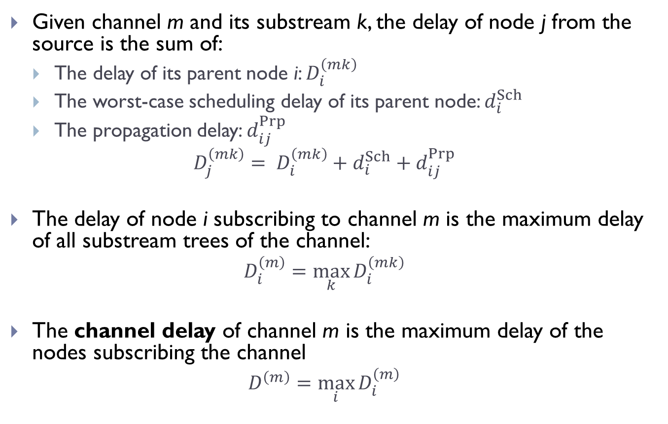
Maximum Channel Delay in the Network
Given channel m and its substream k, the delay of node j from the source is the sum of:
The delay of its parent node i: $D_{i}^{\left(mk\right)}$
The worst-case scheduling delay of its parent node: $d_{i}^{Sch}$
The propagation delay: $d_{ij}^{Prp}$
$$D_{j}^{\left(mk\right)}= D_{i}^{\left(mk\right)}+d_{i}^{Sch}+d_{ij}^{Prp}$$
The delay of node i subscribing to channel m is the maximum delay of all substream trees of the channel:
$$D_{i}^{\left(m\right)}=\max_{k}{D_{i}^{\left(mk\right)}}$$
The channel delay of channel m is the maximum delay of the nodes subscribing the channel
$$D^{\left(m\right)}=\max_{i}{D_{i}^{\left(m\right)}}$$

Slide 17
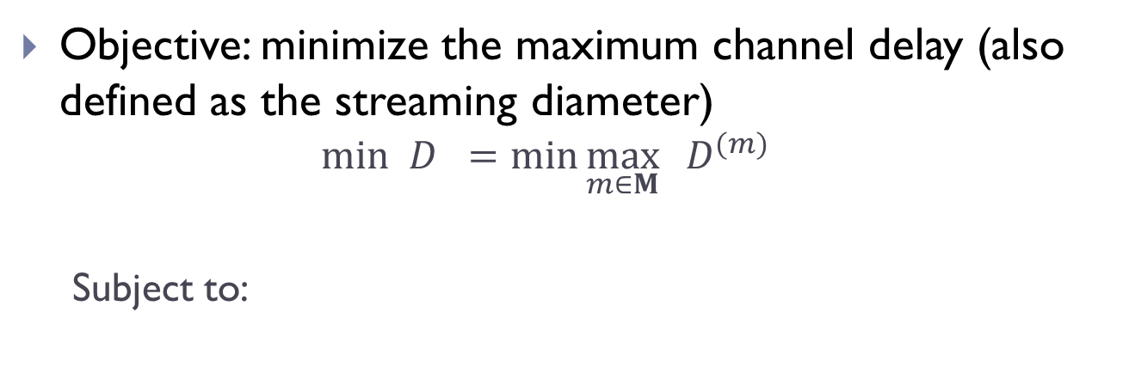
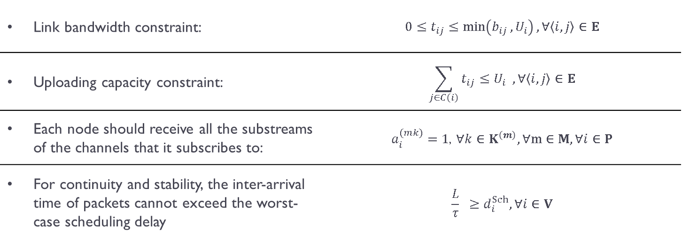
Minimum-Delay Streaming with Server Collaboration (MDSSC)
Objective: minimize the maximum channel delay (also defined as the streaming diameter)
$$min D =\min{\max_{m∈M}{{ D}^{(m)}}}$$
Subject to:
Streaming diameter
Channel delay of channel m
Link bandwidth constraint: | $$0≤t_{ij}≤\min\left(b_{ij }, U_{i}\right), ∀\left\langle i, j\right\rangle ∈E$$
Uploading capacity constraint: | $$\sum_{j∈C\left(i\right)}{t_{ij}≤U_{i} ,}∀\left\langle i, j\right\rangle ∈E$$
Each node should receive all the substreams of the channels that it subscribes to: | $$a_{i}^{(mk)}=1\text{,} ∀k∈K^{\left(m\right)}, ∀m∈M, ∀i∈P$$
For continuity and stability, the inter-arrival time of packets cannot exceed the worst-case scheduling delay | $$\frac{L}{τ} ≥d_{i}^{Sch}, ∀i∈V$$
An indicator variable indicates whether node $i$ is in tree $T^{\left(mk\right)}$
Streaming rate of each substream

Slide 18
MDSSC is NP-hard
The Travelling Salesman Problem (TSP) is reducible to MDSSC problem in polynomial time
TSP is a well-known NP-hard problem
Considering:
Only one source
Only one channel with 1 unit streaming rate
The uploading capacity of each node is 1 unit and the bandwidth capacity of each link is 1 unit
Add a node with zero uploading capacity and edges from all nodes to it.
The TSP instance is thus reduced to a MDSSC instance
The delay at the last node is the maximum delay of the network. Such delay is minimum if and only if the delay in the Hamiltonian cycle is minimum.

Slide 19
Outline
Introduction
Problem Formulation
COMMOS: A heuristic for collaborative multi-source multi-channel overlay streaming
Simulation Results
Q & A

Slide 20
COMMOS Overview
Initialization
Each delivery tree is initialized to contain only the source
The streaming diameter is initialized as zero
Add one server into one delivery tree in a way that such connection greedily minimizes the diameter increment of the overlay
For each node not included into the trees, compute the diameter of the network if it were to join
Choose the node and the corresponding delivery tree so that the increment of streaming diameter is the minimum
Use helper to relay the substream whenever necessary
Until each server has joined all the delivery trees that it subscribes to

Slide 21
Adding a node into a delivery tree
We consider two ways:
1. Directly connect an existing node in the delivery tree
2. Indirectly connect to an existing node through a helper
Choose the connection such that the increase in streaming diameter is minimum

Slide 22
1. Directly connect a parent in the delivery tree
Calculate the delay of the new node in the tree
The connection incurs an extra scheduling-delay to its parent
Recalculate the delays of all the descendents of the parent
Calculate the increase in streaming diameter
Iterate through all the nodes in the delivery tree and select the parent such that the increment delay is the minimum

Slide 23
2. Use a helper to relay the substream from the parent
Iterate through all the nodes that are not included into the delivery tree
Let the node be the helper
The helper relays the substream from the parent to this new node
Calculate the source-to-end delay of the helper and the new node
The connection incurs an extra scheduling-delay to both the parent and the helper
Recalculate the delays of all the descendants of the parent and the helper
Calculate the increase in streaming diameter
Iterate through all the parent nodes in the delivery tree and select the parent-helper pair such that the increment delay is the minimum

Slide 24
1. Directly connect to an existing node in the delivery tree
Source 1
Channel 1
Source 2
Channel 2
Currently there are three partial delivery trees
One server is to be added into the one delivery tree
Iterate through all possible direct connections
Calculate the increase of the streaming diameter correspondingly
A
B
C
D
Subscribes to
Channel 1
Subscribes to
Channels 1, 2
Subscribes to
Channel 1
Subscribes to Channel 2
Substream 1 of channel 1
Substream 1 of channel 2
Substream 2 of channel 1
Possible connection

Slide 25
2. Considering using a helper to relay the stream
Source 1
Channel 1
Source 2
Channel 2
Iterate through all possible connections when a helper is used to relay the substream
Calculate the increase of streaming diameter of all such connections
A
B
C
D
Subscribes to
Channel 1
Subscribes to
Channel 1, 2
Subscribes to
Channel 1
Subscribes to Channel 2
Substream 1 of channel 1
Substream 1 of channel 2
Substream 2 of channel 1
Possible connection

Slide 26
Choose the server and substream with minimum increment in diameter
Source 1
Channel 1
Source 2
Channel 2
Add the server into the corresponding delivery tree
Continue adding servers until all the streams are fulfilled
A
B
C
D
Subscribes to
Channel 1
Subscribes to
Channel 1, 2
Subscribes to
Channel 1
Subscribes to Channel 2
Substream 1 of channel 1
Substream 1 of channel 2
Substream 2 of channel 1

Slide 27
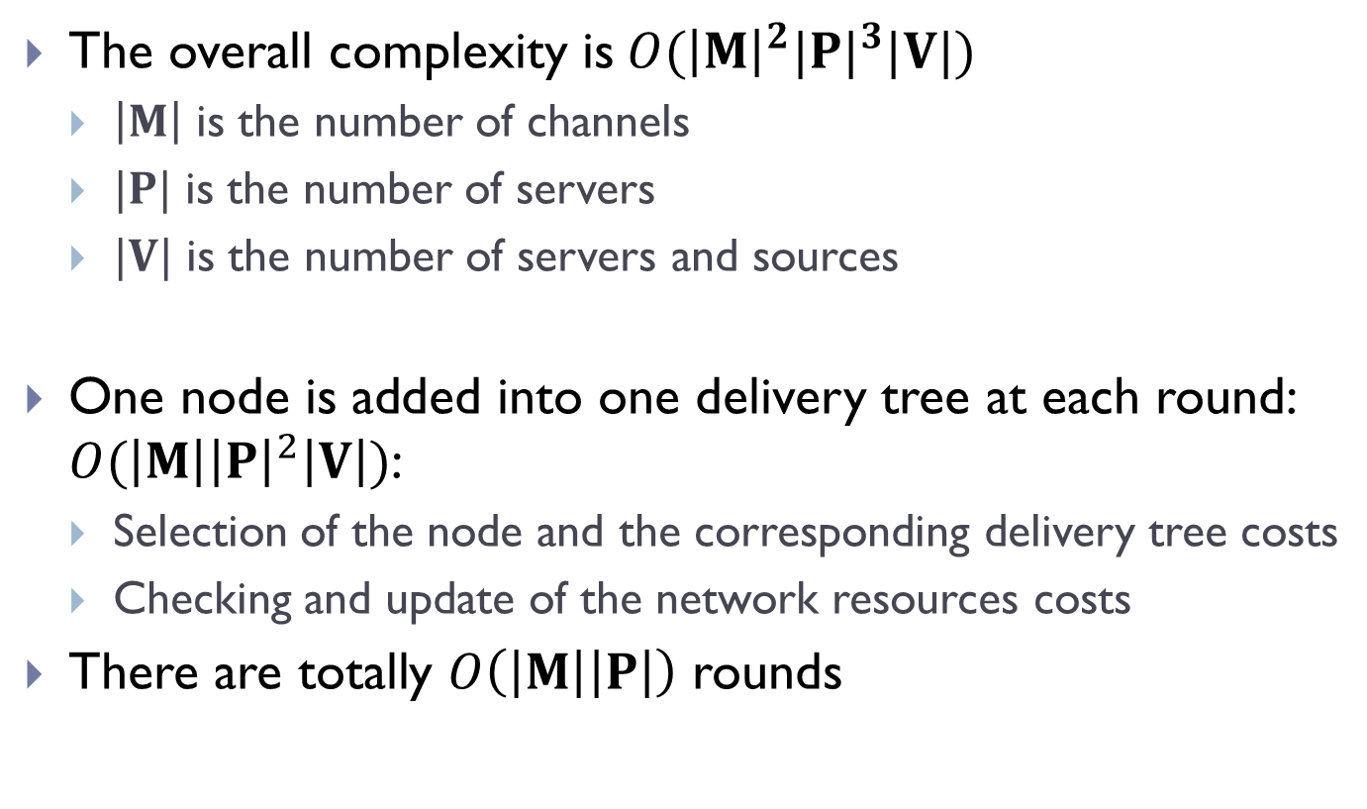
Complexity Analysis
The overall complexity is$O({\left|M\right|}^{2}|{P|}^{3}|V|)$
$\left|M\right|$ is the number of channels
$|P|$ is the number of servers
$|V|$ is the number of servers and sources
One node is added into one delivery tree at each round: $O(\left|M\right|{\left|P\right|}^{2}\left|V\right|)$:
Selection of the node and the corresponding delivery tree costs
Checking and update of the network resources costs
There are totally $O\left(\left|M\right|\left|P\right|\right)$ rounds

Slide 28
Outline
Introduction
Problem Formulation
COMMOS: A heuristic for collaborative multi-source multi-channel overlay streaming
Simulation Results
Q & A

Slide 29
Simulation Setting
Real Internet topology provided by CAIDA
Sources and servers are randomly attached to the routers
Link capacity is generated by normal distribution
Accepting only the positive values
Each server subscribes a channel based on the Zipf’s law
Parameters | Baseline Value
Number of servers | 150
Number of channels | 20
Streaming rate | 1.2 Mbps
Substream rate | 400 kbps
Segment size | 100 Kbits
Server upload capacity | Mean = 6.5 Mbps Standard deviation = 2 Mbps
Link capacity | Mean = 4 Mbps Standard deviation = 2 Mbps
Zipf Parameter | 0.4

Slide 30
Comparison Schemes
Constrainted Server Chaining (CSC) [Zhuang et al. ISPA’11]
Minimize the source-to-end delay
No helper is involved in this scheme
Video-Upload Decoupling (VUD) [Wu et al. INFOCOM’ 09]
Focus on P2P multi-channel overlay
Each node subscribes to channels independent of the requests of other nodes
In COMMOS, each node subscribes to the channels with the objective of minimizing the delays of the network
Notes:
VUD:
A server receives and provides channels independent of what it subscribes to

Slide 31
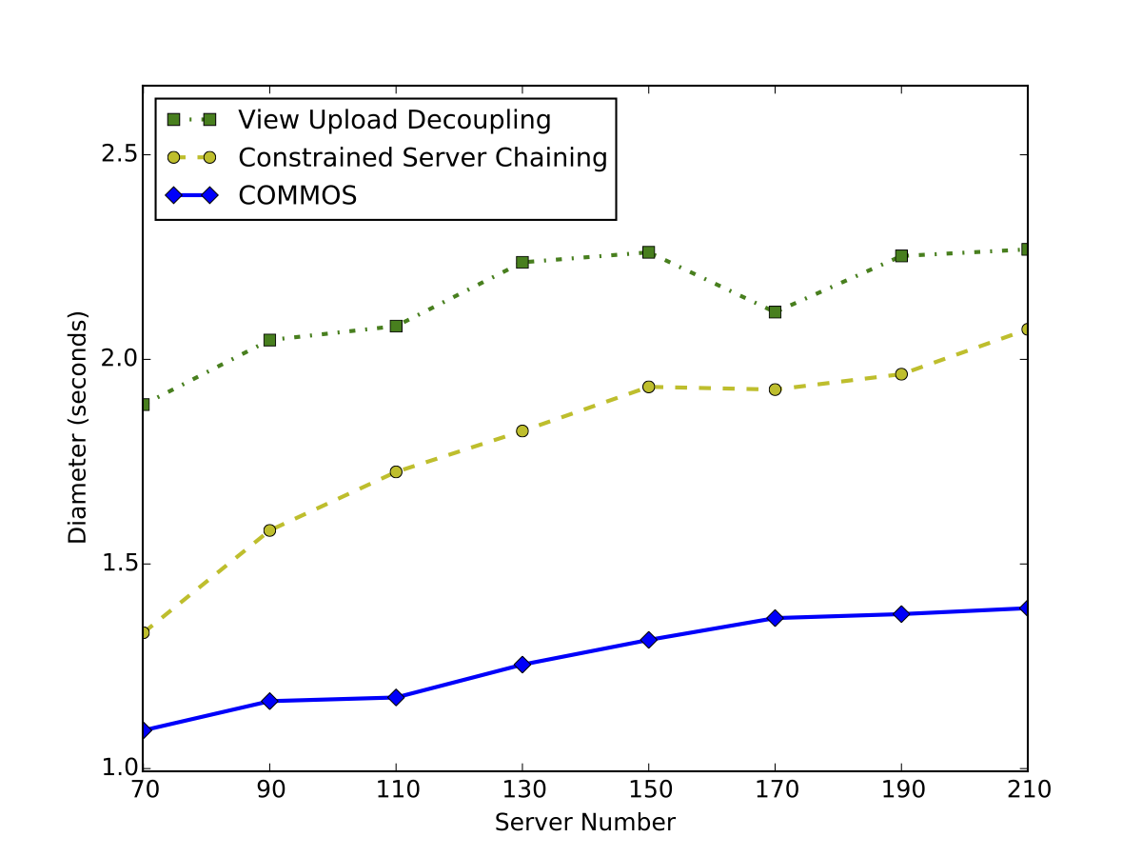
COMMOS achieves the lowest network diameter

Slide 32
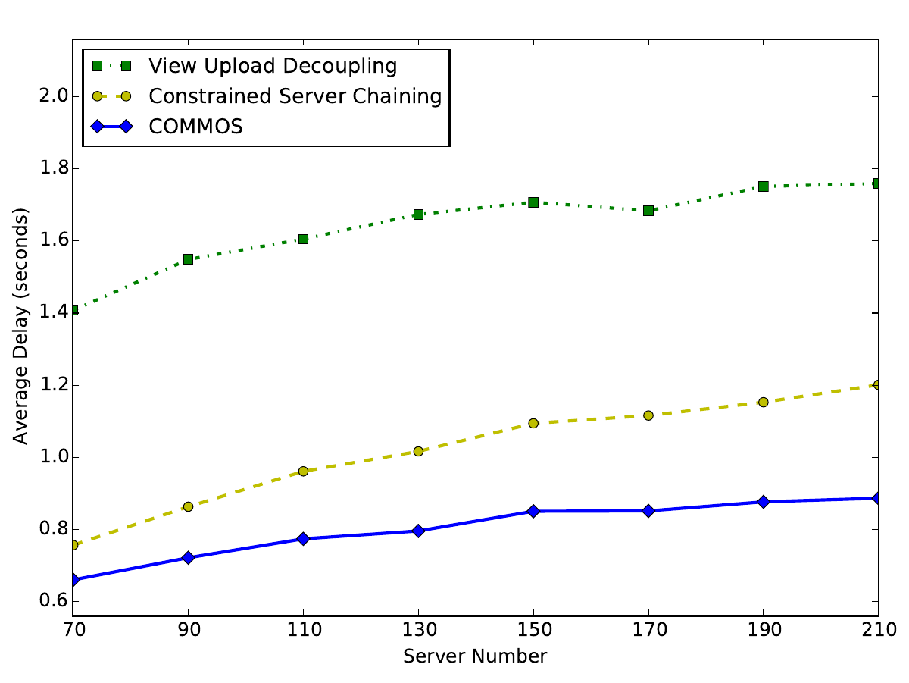
COMMOS achieves the lowest average delay

Slide 33
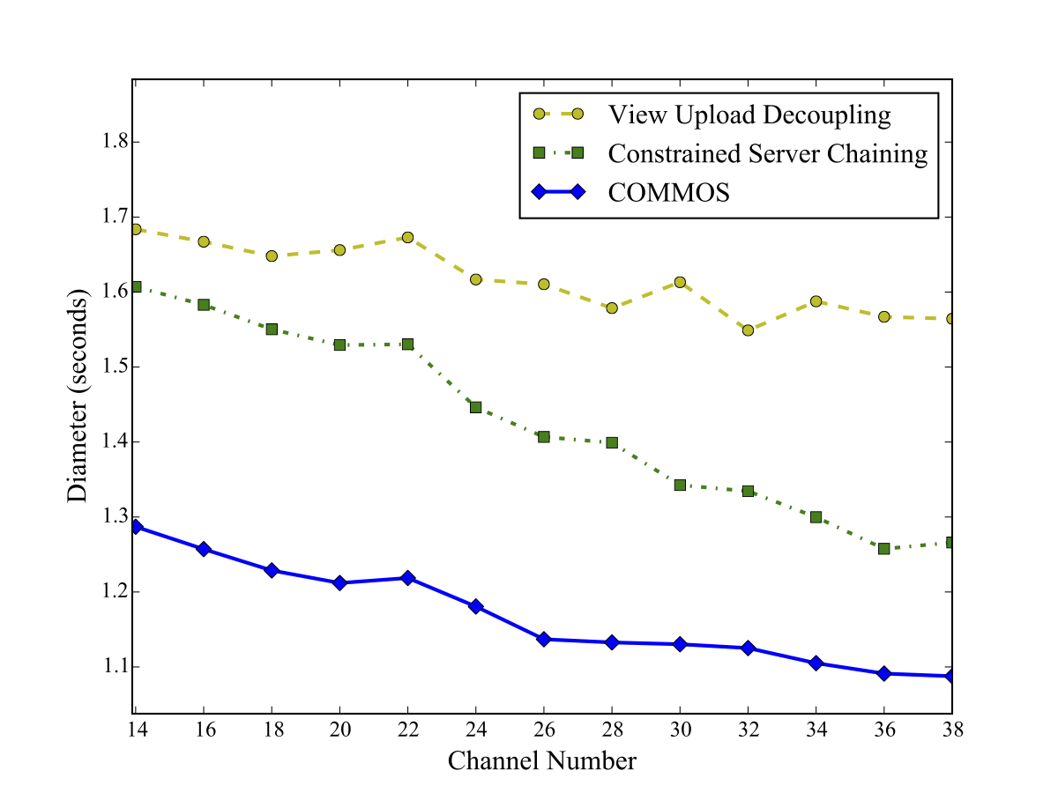
Diameter versus channel number
The number of subscription to each channel declines with rise of channel number
The total subscription to all the channels is fixed
The depth of each tree and the streaming diameter also decreases
COMMOS enjoys more performance improvement with fewer channels

Slide 34
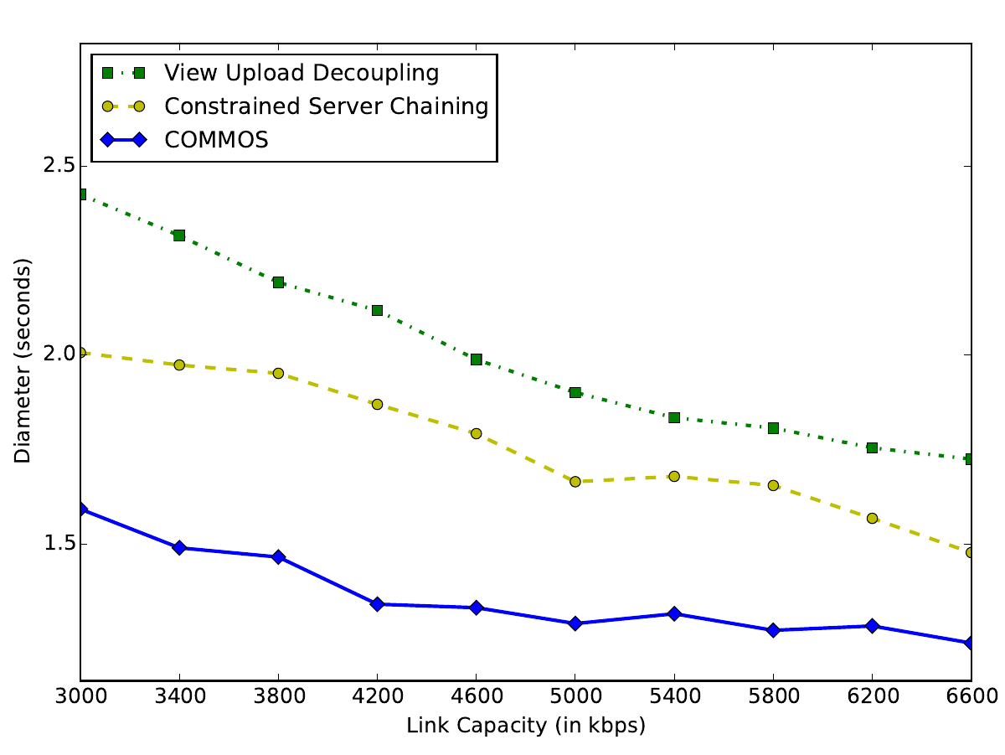
Diameter decreases with link capacity

Slide 35
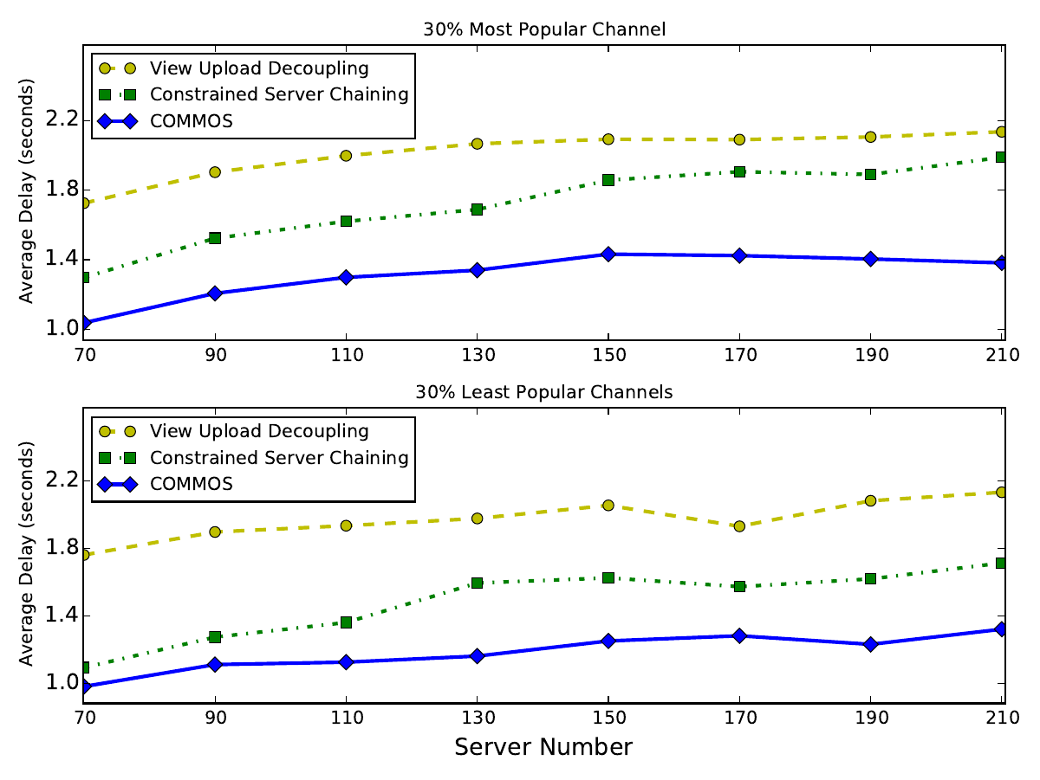
COMMOS performs the best irrespective of channel popularity

Slide 36
Conclusions
Delay optimization for multi-source multi-channel live overlay streaming
Minimizing the streaming diameter of the network
Novel problem formulation and complexity analysis
COMMOS: a simple and efficient heuristic
Simulation results validate the performance of COMMOS

Slide 37
Reference List
[Cisco et al. The Zettabyte Era—Trends and Analysis’15] Cisco,. 'The Zettabyte Era—Trends And Analysis'. N.p., 2015.
[Azarpira et al. IST’12] Hamed Azarpira and Saleh Yousefi. On optimal topology in hierarchical P2P live video streaming networks. In Sixth International Symposium on Telecommunications (IST), pages 644–649. IEEE, 2012.
[Zhuang et al. ISPA’11] Zhenyun Zhuang and Chun Guo. Optimizing CDN infrastructure for live streaming with constrained server chaining. In 9th International Symposium on Parallel and Distributed Processing with Applications (ISPA), pages 183–188. IEEE, 2011.
[Magharei et al. TON’09] Nazanin Magharei and Reza Rejaie. Prime: Peer-to-peer receiver-driven mesh-based streaming. IEEE/ACM Transactions on Networking (TON), 17(4):1052–1065, 2009.
[Ren et al. TMM’09] Dongni Ren, Y.-T. Hillman Li, and S.-H. Gary Chan. Fast-mesh: A low-delay highbandwidth mesh for peer-to-peer live streaming. IEEE Transactions on Multimedia, 11(8):1446–1456, December 2009.
[Zhao et al. INFOCOM’14] Yuhong Zhao, Hong Jiang, Ke Zhou, Zhijie Huang, and Ping Huang. Meeting service level agreement cost-effectively for video-on-demand applications in the cloud. In INFOCOM, 2014 Proceedings IEEE, pages 298–306, April 2014.
[Tan et al. NET’13] Bo Tan and Laurent Massouli´e. Optimal content placement for peer-to-peer videoon-demand systems. IEEE/ACM Trans. Netw., 21(2):566–579, April 2013.
[Wu et al. PDS’12] Weijie Wu and John Lui. Exploring the optimal replication strategy in p2p-vod systems: Characterization and evaluation. Transactions on Parallel and Distributed Systems, 23(8):1492–1503, 2012.
[Li et al. ICACT’10] Xia Li, Rua Zou, Xinchao Zhao, and Fangchun Yang. A grouping algorithm of helpers in peer-to-peer video-an-demand systems. In Proceedings of the 12th international conference on Advanced communication technology, ICACT’10, pages 497–501, Piscataway, NJ, USA, 2010. IEEE Press.
[Kondo et al. NETWORKS’14] D. Kondo, Y. Hirota, A. Fujimoto, H. Tode, and K. Murakami. P2p live streaming system for multi-view video with fast switching. In Telecommunications Network Strategy and Planning Symposium (Networks), 2014 16th International, pages 1–7, Sept 2014.
[Liu et al. ICCCN’13] Jiayi Liu and Gwendal Simon. Fast near-optimal algorithm for delivering multiple live video channels in CDNs. In 22nd International Conference on Computer Communications and Networks (ICCCN), pages 1–7. IEEE, 2013.
[Meskill et al. LCN’11] B. Meskill, A. Davy, and B. Jennings. Server selection and admission control for ip-based video on demand using available bandwidth estimation. In Local Computer Networks (LCN), 2011 IEEE 36th Conference on, pages 255–258, Oct 2011.
[Wu et al. INFOCOM’07] Chuan Wu and Baochun Li. Strategies of conflict in coexisting streaming overlays. In INFOCOM 2007. 26th IEEE International Conference on Computer Communications. IEEE, pages 481–489, May 2007.
[Wu et al. NET’11] Chuan Wu, Baochun Li, and Shuqiao Zhao. On dynamic server provisioning in multichannel P2P live streaming. IEEE/ACM Trans. Netw., 19(5):1317–1330, Oct 2011.
[Wang et al. INFOCOM’10] Miao Wang, Lisong Xu, and B. Ramamurthy. Linear programming models for multichannel p2p streaming systems. In INFOCOM, 2010 Proceedings IEEE, pages 15, March 2010.
[Wu et al. INFOCOM’09] D. Wu, Y. Liu, and K. W. Ross. Queuing network models for multi-channel live streaming systems. In INFOCOM, 2009.
[Wu et al. INFOCOM’08] Chuan Wu, Baochun Li, and Shuqiao Zhao. Multi-channel live P2P streaming: Refocusing on servers. In The 27th Conference on Computer Communications (INFOCOM). IEEE, 2008.
[Wang et al. GLOBECOM’10] Zhi Wang, Chuan Wu, Lifeng Sun, and Shiqiang Yang. Strategies of collaboration in multi-channel P2P VoD streaming. In IEEE Global Telecommunications Conference (GLOBECOM), pages 1–5. IEEE, 2010.
[Wu et al. PDS’08] Chuan Wu, Baochun Li, and Zongpeng Li. Dynamic bandwidth auctions in multioverlay P2P streaming with network coding. IEEE Transactions on Parallel and Distributed Systems, 19(6):806–820, June 2008.

Slide 38
Thanks
Q & A

