Slide 1
Video Management and Resource Allocation for a Large-Scale VoD Cloud
Chang, Zhangyu
Supervised by Prof. Gary Chan
September 28, 2017

Slide 2
Contents
Introduction and Related Work
Problem Formulation and Its NP-hardness
RAVO: Efficient LP-based Solution
Efficient Computation for Large Video Pool
Illustrative Simulation Results
Conclusion

Slide 3
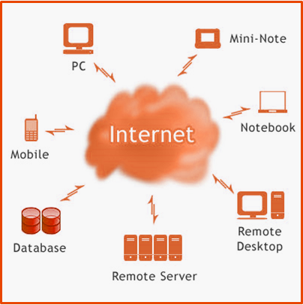
Video-on-Demand (VoD) Cloud
Video-on-Demand
Essential Internet service for people’s daily life nowadays Require huge amount of resource & network traffic
Cloud Computing
Infrastructure as a service (IaaS) Reduce the cost on accessing distributed servers Reduce the risk of resource over-provisioning
A Typical VoD Cloud Service

Slide 4












Cloud Resources as Utility Service
Content Provider (CP) can rent service from Cloud Service Provider
Content Provider can dynamically adjust the resource deployment
VoD Cloud
Repository
$$S_{0}$$
$$K_{04}$$
$$S_{4}$$
$$K_{01}$$
$$K_{14}$$
…
$$S_{3}$$
Cloud service enables great flexibility on resource allocation:
Scale up storage & streaming capacities timely Flexible resource allocation and provisioning Reduced maintenance cost
$$S_{1}$$
$$S_{2}$$
User
pool
User
pool
User
pool
A distributed and cooperative cloud architecture for VoD service

Slide 5





Deployment of a Distributed VoD Streaming Cloud
 | Repository: Complete video replication
 | Local cloud service: Cluster of servers to serve the associated clients
 | Clients: Geographically heterogeneous video popularities from clients
VoD Cloud
Repository
$$S_{0}$$
$$K_{04}$$
$$S_{4}$$
$$K_{01}$$
$$K_{14}$$
…
$$S_{1}$$
$$S_{3}$$
$$S_{2}$$
User
pool
User
pool
Geographic Heterogeneity of Clients’ Video Popularities
Local servers may have partial video storage to save storage cost Reduce network load through co-operation among servers
User
pool
A distributed and cooperative cloud architecture for VoD service

Slide 6
Video Management & Resource Allocation
Video Management
Video popularity: relatively stable and predictable in a Netflix-like VoD system Can be planned on a longer time scale (days) Storage (content replication) What video to store at each server Retrieval (server selection) Which servers to stream the missing video from
Resource Allocation
Server Cost Storage Capacity Processing Capacity Cost due to the total storage and processing capacity at a server Link Cost Link Capacity Bandwidth Utilization Cost due to the bandwidth capacity reserved and data transmitted between pairs of servers to serve the misses

Slide 7
Deployment Cost vs. Quality-of-Service (QoS)
Deployment Cost
Server Cost Storage capacity Processing capacity Link Cost Link capacity Bandwidth utilization
Quality-of-Service
Total Delay Due to server utilization Due to link utilization
Trade-off between Cost and Delay
Satisfy the quality-of-service constraints
Minimize total deployment cost

Slide 8
Bad Examples: 2 Extreme Scenarios
Full Replication
Full video storage among all local servers + Minimum delay No network cost - Maximum storage cost Cost much on cold video
Repository Only
Only video storage at the repository + Minimum storage cost - Maximum network cost Huge end-to-end delay Heavy load for repository
Neither scenarios is efficient
Both video management and resource allocation matters
A joint optimization on comprehensive mode is required

Slide 9
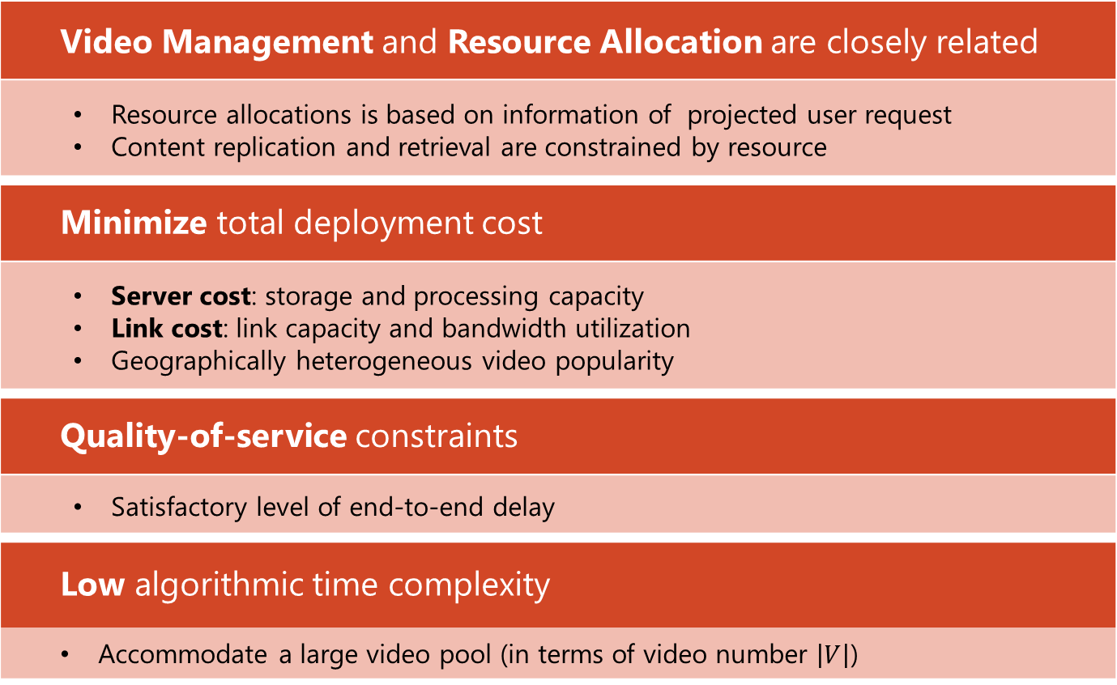
Objective
Video Management and Resource Allocation are closely related
Resource allocations is based on information of projected user request Content replication and retrieval are constrained by resource
Minimize total deployment cost
Server cost: storage and processing capacity Link cost: link capacity and bandwidth utilization Geographically heterogeneous video popularity
Quality-of-service constraints
Satisfactory level of end-to-end delay
Low algorithmic time complexity
Accommodate a large video pool (in terms of video number $\left|V\right|$)

Slide 10
Approach
Relaxed Linear Programming
Consider the video stored in each server as continuous variable Formulate and solve a linear programming (LP) problem
Quantization from Super Optimum
Solution of the relaxed linear programming as the super-optimum Randomized rounding for video storage decision Probabilistic video retrieval decision Resource allocation decision based on QoE constraints
Video Clustering for Large Video Pool
Group videos by Spectral Clustering to reduce the algorithmic complexity

Slide 11
Contributions
1 | Joint optimization formulation based on a comprehensive VoD cloud model | Video Management Server selection & content replication Resource allocation Server cost (storage, processing) & link cost Geographically heterogeneous popularity
2 | RAVO: LP solution with quantization algorithm | Efficient optimization algorithm No extra encoding scheme Applicable for current system Proven optimality
3 | Video clustering method | Reduce the algorithmic time complexity Little compromise on deployment cost

Slide 12
Related Work
Fundamental difference:
Truly JOINT optimization algorithm
 | Related Work | RAVO
Traditional resource allocation | Based on heuristic approach The optimality gap is not clear | Discretized from LP solution Closely optimal
Content Storage and Retrieval for VoD | Need resource allocation result first Rigid setting, less flexibility | One-step offline algorithm for both resource allocation and content management Easy to deploy in the real scenario
Current resource allocation for cloud service | Assume full replication Only consider bandwidth allocation | Partial replication to lower the storage cost Servers help each other to fully utilize the resource

Slide 13
Contents
Introduction and Related Work
Problem Formulation and Its NP-hardness
RAVO: Efficient LP-based Solution
Efficient Computation for Large Video Pool
Illustrative Simulation Results
Conclusion

Slide 14
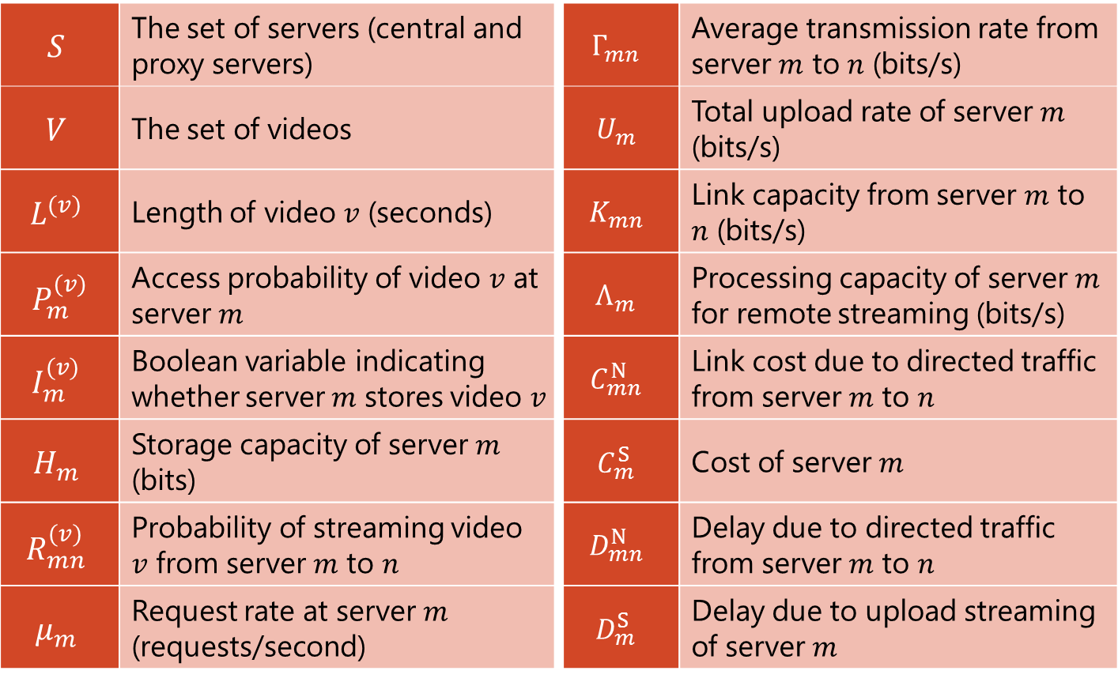
Major Symbols Used
$$S$$ | The set of servers (central and proxy servers) | $$Γ_{mn}$$ | Average transmission rate from server $m$ to $n$ (bits/s)
$$V$$ | The set of videos | $$U_{m}$$ | Total upload rate of server $m$ (bits/s)
$$L^{(v)}$$ | Length of video $v$ (seconds) | $$K_{mn}$$ | Link capacity from server $m$ to $n$ (bits/s)
$$P_{m}^{(v)}$$ | Access probability of video $v$ at server $m$ | $$Λ_{m}$$ | Processing capacity of server $m$ for remote streaming (bits/s)
$$I_{m}^{(v)}$$ | Boolean variable indicating whether server$m$ stores video $v$ | $$C_{mn}^{N}$$ | Link cost due to directed traffic from server $m$ to $n$
$$H_{m}$$ | Storage capacity of server $m$ (bits) | $$C_{m}^{S}$$ | Cost of server $m$
$$R_{mn}^{(v)}$$ | Probability of streaming video $v$ from server $m$ to $n$ | $$D_{mn}^{N}$$ | Delay due to directed traffic from server $m$ to $n$
$$μ_{m}$$ | Request rate at server $m$ (requests/second) | $$D_{m}^{S}$$ | Delay due to upload streaming of server $m$

Slide 15
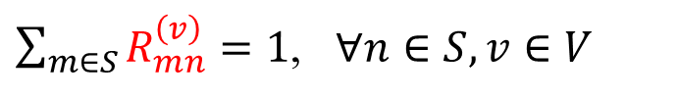

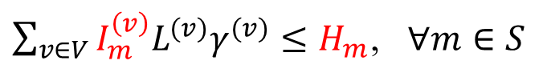

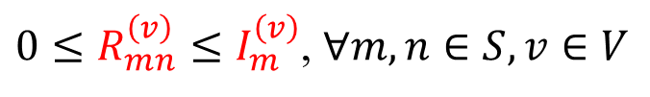
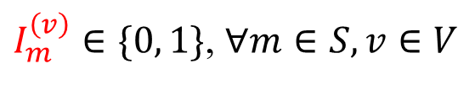
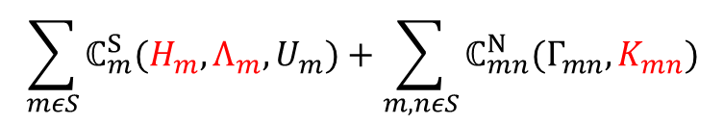
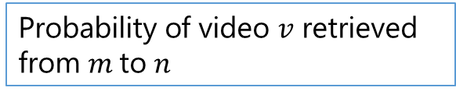
The Problem of Joint Optimization on Video Management and Resource Allocation
Server cost
Link cost
$$\sum_{mεS}{ℂ_{m}^{S}(H_{m},Λ_{m},U_{m})}+\sum_{m,nεS}{ℂ_{mn}^{N}(Γ_{mn},K_{mn})}$$
minimize
System deployment cost
Storage
Processing
Capacity
Access bandwidth (consumed)
Subject to
$I_{m}^{\left(v\right)}∈\{0, 1\}$, $∀m∈S, v∈V$
Whether video $v$ stored at $m$
Storage
Retrieval
${0≤R}_{mn}^{\left(v\right)}≤I_{m}^{\left(v\right)}$, $∀m,n∈S, v∈V$
Probability of video $v$ retrieved from $m$to $n$
$\sum_{v∈V}{I_{m}^{\left(v\right)}L^{(v)}γ^{(v)}}≤H_{m}$, $∀m∈S$
Storage constraint at $m$
$\sum_{m∈S}{R_{mn}^{\left(v\right)}}=1$, $∀n∈S, v∈V$
A video shall be retrieved
$Γ_{mn}=\sum_{v∈V}{p_{n}^{\left(v\right)}ε_{n}^{\left(v\right)}μ_{n}R_{mn}^{\left(v\right)}L^{(v)}γ^{(v)}}$, $∀m,n∈S$
Remote traffic
QoS
$𝔻_{mn}^{N}\left(Γ_{mn},K_{mn}\right)+𝔻_{m}^{S}\left(U_{m},Λ_{m}\right)≤\overline{D},$ $∀m,n∈S$
Delay

Slide 16
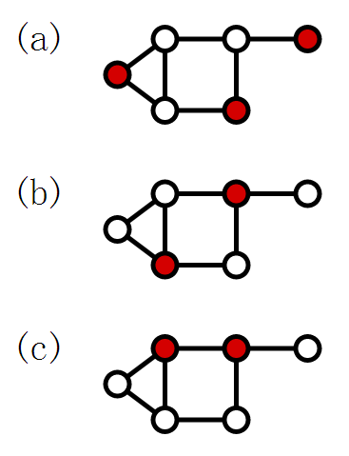
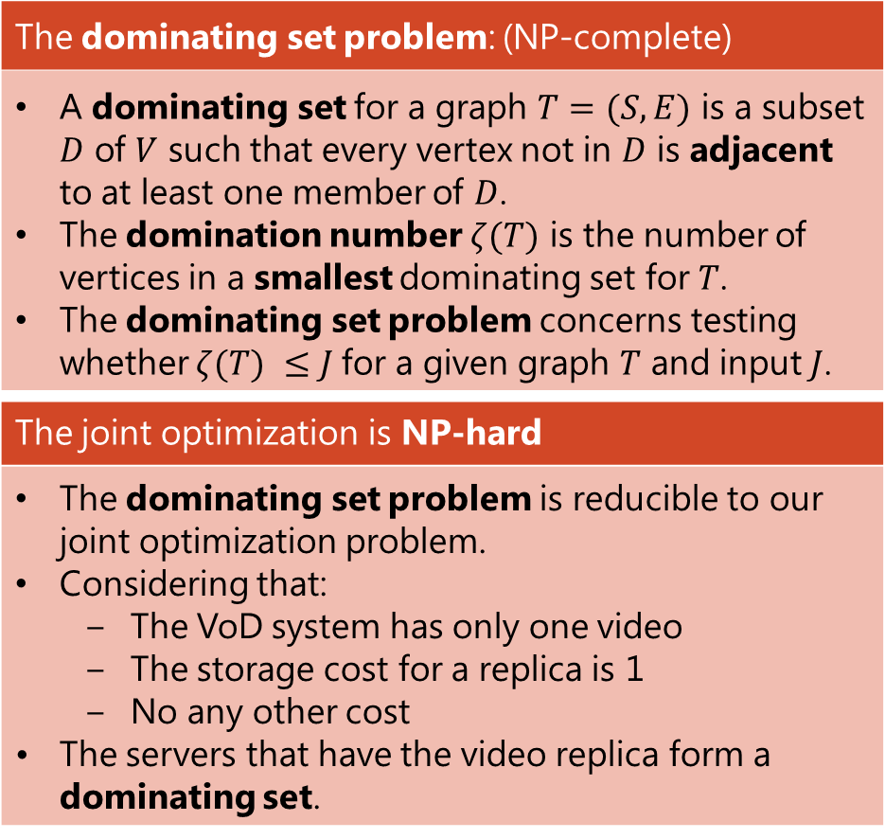

NP-hardness of Integer Programming: $I_{m}^{\left(v\right)}=\{0, 1\}$
The dominating set problem: (NP-complete)
A dominating set for a graph $T=(S, E)$ is a subset $D$ of $V$ such that every vertex not in $D$ is adjacent to at least one member of $D$. The domination number $ζ(T)$ is the number of vertices in a smallest dominating set for $T$. The dominating set problem concerns testing whether $ζ(T) ≤J$for a given graph $T$ and input $J$.
The joint optimization is NP-hard
The dominating set problem is reducible to our joint optimization problem. Considering that: The VoD system has only one video The storage cost for a replica is 1 No any other cost The servers that have the video replica form a dominating set.
Dominating sets (red vertices)

Slide 17
Contents
Introduction and Related Work
Problem Formulation and Its NP-hardness
RAVO: Efficient LP-based Solution
Efficient Computation for Large Video Pool
Illustrative Simulation Results
Conclusion

Slide 18
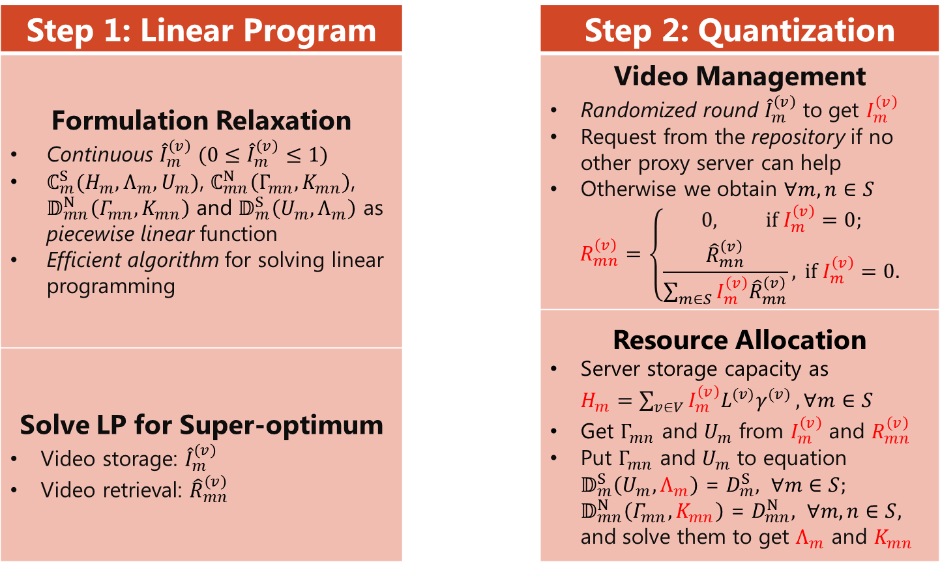
RAVO: Relaxing the Joint Formulation as a Linear Program and Quantization of the Solution
Step 1: Linear Program |  | Step 2: Quantization
Formulation Relaxation $\text{Continuous}$ ${\hat{I}}_{m}^{\left(v\right)} (0≤{\hat{I}}_{m}^{\left(v\right)}≤1)$ $ℂ_{m}^{S}(H_{m},Λ_{m},U_{m})$, $ℂ_{mn}^{N}\left(Γ_{mn},K_{mn}\right)$, $𝔻_{mn}^{N}\left(Γ_{mn},K_{mn}\right)$ and $𝔻_{m}^{S}\left(U_{m},Λ_{m}\right)$ as piecewise linear function Efficient algorithm for solving linear programming |  | Video Management Randomized round ${\hat{I}}_{m}^{\left(v\right)}$ to get $I_{m}^{\left(v\right)}$ Request from the repository if no other proxy server can help Otherwise we obtain $∀m,n∈S$ $$R_{mn}^{\left(v\right)}=\left\{\begin{aligned}0, \text{if} I_{m}^{\left(v\right)}=0; \\ \frac{{\hat{R}}_{mn}^{\left(v\right)}}{\sum_{m∈S}{I_{m}^{\left(v\right)}{\hat{R}}_{mn}^{\left(v\right)}}}, \text{if} I_{m}^{\left(v\right)}=0.\end{aligned}\right.$$
 |  | Resource Allocation Server storage capacity as $H_{m}=\sum_{v∈V}{{I_{m}^{\left(v\right)}L}^{(v)}γ^{(v)}}, ∀m∈S$ Get $Γ_{mn}$ and $U_{m}$ from $I_{m}^{\left(v\right)}$ and $R_{mn}^{\left(v\right)}$ Put $Γ_{mn}$ and $U_{m}$ to equation $𝔻_{m}^{S}\left(U_{m},Λ_{m}\right)$ = $D_{m}^{S}, ∀m∈S;$ $𝔻_{mn}^{N}\left(Γ_{mn},K_{mn}\right)$ = $D_{mn}^{N}, ∀m,n∈S,$ and solve them to get $Λ_{m}$ and $K_{mn}$
Solve LP for Super-optimum Video storage: ${\hat{I}}_{m}^{\left(v\right)}$ Video retrieval: ${\hat{R}}_{mn}^{\left(v\right)}$

Slide 19


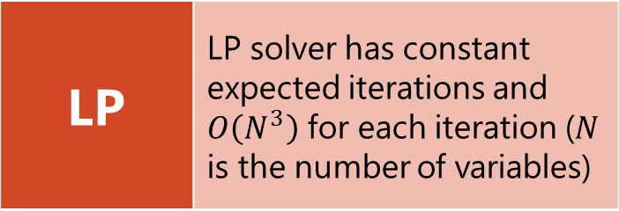
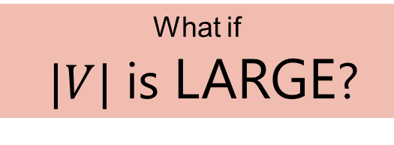

Algorithmic Complexity
LP | LP solver has constant expected iterations and $O\left(N^{3}\right)$ for each iteration ($N$ is the number of variables)
|S| | Number of servers
|V| | Number of videos
Dominate
$$O{(|S|}^{6}{|V|}^{3})$$
What if
$|V|$ is LARGE?
Discretize
Video
Storage
Discretize
Video
Retrieval
$$O(\left|S\right|\left|V\right|)$$
$$O{(|S|}^{2}\left|V\right|)$$

Slide 20
Contents
Introduction and Related Work
Problem Formulation and Its NP-hardness
RAVO: Efficient LP-based Solution
Efficient Computation for Large Video Pool
Illustrative Simulation Results
Conclusion

Slide 21
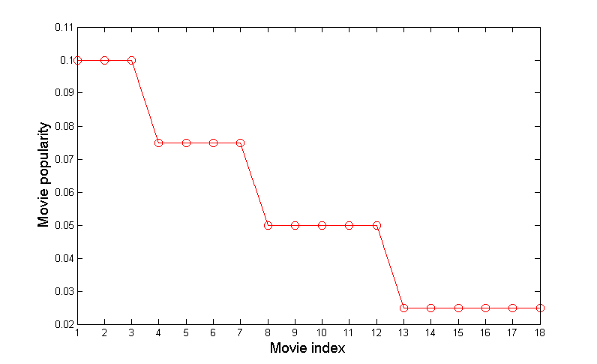
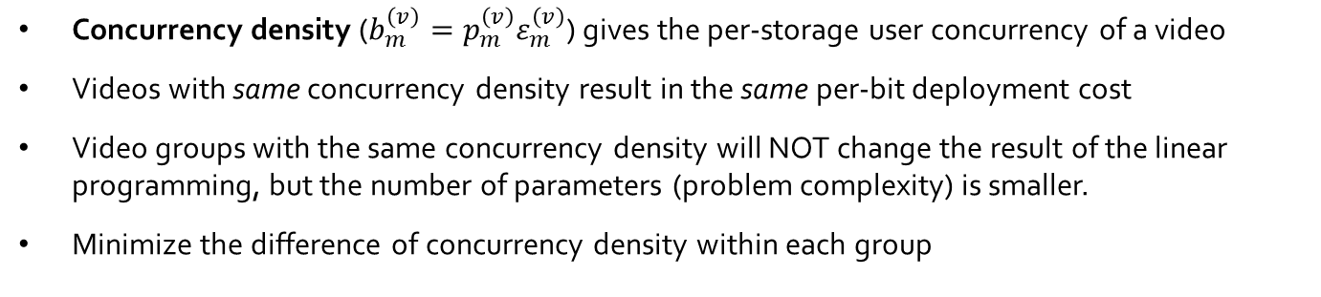
Observation on Concurrency Density
Concurrency density ($b_{m}^{\left(v\right)}=p_{m}^{\left(v\right)}ε_{m}^{\left(v\right)}$) gives the per-storage user concurrency of a video
Videos with same concurrency density result in the same per-bit deployment cost
Video groups with the same concurrency density will NOT change the result of the linear programming, but the number of parameters (problem complexity) is smaller.
Minimize the difference of concurrency density within each group
Geographic Heterogeneity
A video has different popularity in each server
How to Group?

Slide 22
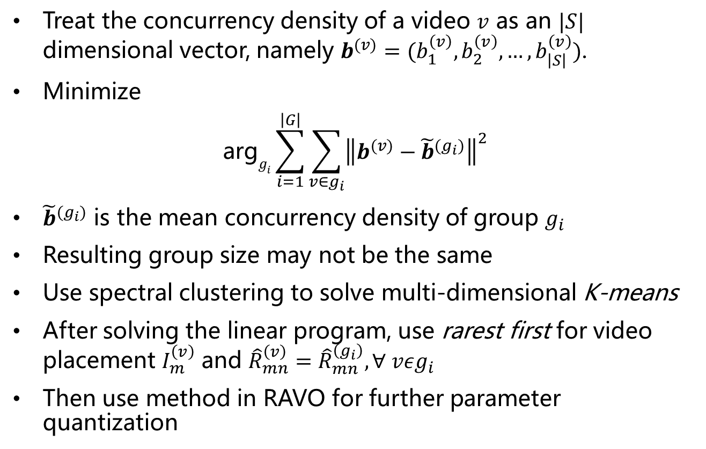
Spectral Clustering for Video Group
Treat the concurrency density of a video $v$ as an $|S|$ dimensional vector, namely $b^{(v)}=(b_{1}^{\left(v\right)},b_{2}^{\left(v\right)},…,b_{\left|S\right|}^{\left(v\right)})$.
Minimize
$$\text{arg}g_{i}\sum_{i=1}^{\left|G\right|}{\sum_{v∈g_{i}}{{\left\|b^{(v)}−{\tilde{b}}^{(g_{i})}\right\|}^{2}}}$$
${\tilde{b}}^{(g_{i})}$ is the mean concurrency density of group $g_{i}$
Resulting group size may not be the same
Use spectral clustering to solve multi-dimensional K-means
After solving the linear program, use rarest first for video placement $I_{m}^{\left(v\right)}$ and ${\hat{R}}_{mn}^{\left(v\right)}={\hat{R}}_{mn}^{\left(g_{i}\right)},∀ vεg_{i}$
Then use method in RAVO for further parameter quantization

Slide 23

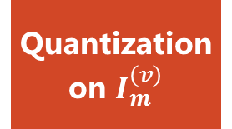

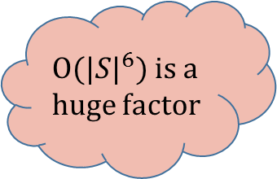
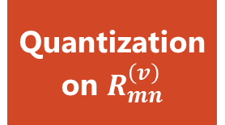
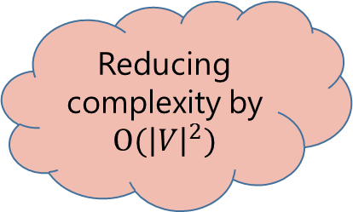
Algorithmic Complexity Reduction
LP | LP solver has constant expected iterations and $O\left(N^{3}\right)$ for each iteration ($N$ is the number of variables)
|S| | Number of servers
|V| | Number of videos
|G| | Number of groups
$$O{(|S|}^{6}{|G|}^{3})$$
$O{(|S|}^{6})$ is a huge factor
Reducing complexity by $O({\left|V\right|}^{2})$
Quantization
on $I_{m}^{\left(v\right)}$
Quantization
on $R_{mn}^{\left(v\right)}$
Spectral
Clustering
$$O(\left|S\right|\left|V\right|)$$
$$O{(|S|}^{2}\left|V\right|)$$
$$O(\left|S\right||V|)$$

Slide 24
Contents
Introduction and Related Work
Problem Formulation and Its NP-hardness
RAVO: Efficient LP-based Solution
Efficient Computation for Large Video Pool
Illustrative Simulation Results
Conclusion

Slide 25
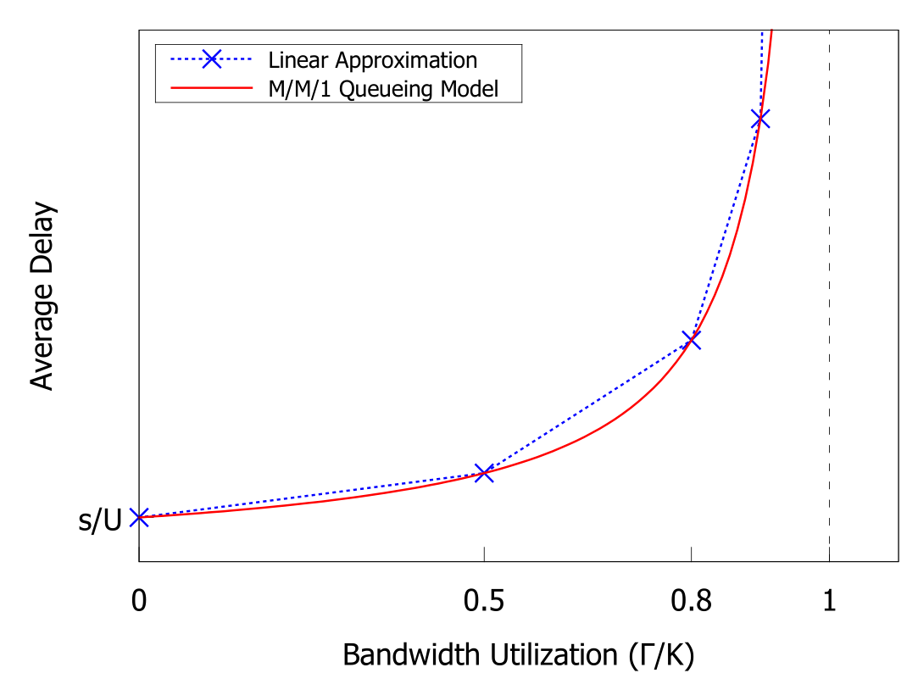
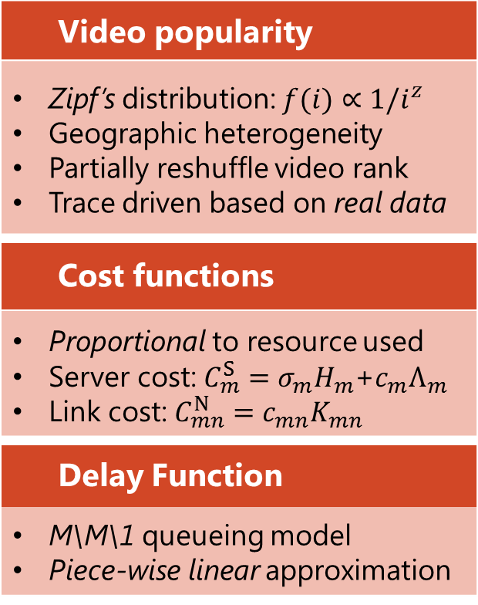
Simulation Environment
Video popularity
Zipf’s distribution: $f(i)∝1/i^{z}$ Geographic heterogeneity Partially reshuffle video rank Trace driven based on real data
Cost functions
Proportional to resource used Server cost: $C_{m}^{S}=σ_{m}H_{m}$+$c_{m}Λ_{m}$ Link cost: $C_{mn}^{N}=c_{mn}K_{mn}$
Delay Function
M\M\1 queueing model Piece-wise linear approximation

Slide 26
Performance Metrics & Comparison Schemes
Performance Metrics
Total cost & components Server storage cost Server processing cost Link cost Delay Caused by links Caused by servers Running time Algorithmic running time
Comparison Schemes
iGreedy with optimal resource allocation Consider local popularity No cooperative replication IPTV-RAM with optimal content management 2 video categories based on global popularity Super-optimal LP solution before quantization

Slide 27
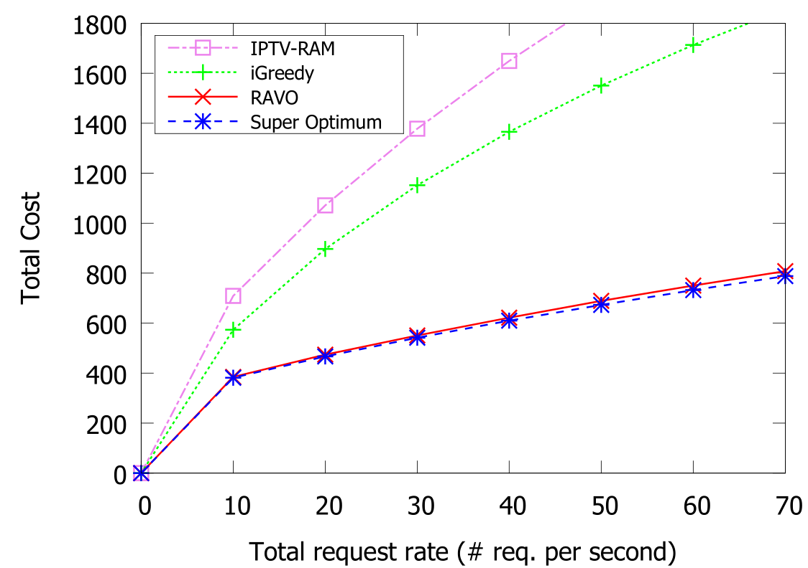
Close to optimal performance (Cost versus Request Rate)

Slide 28
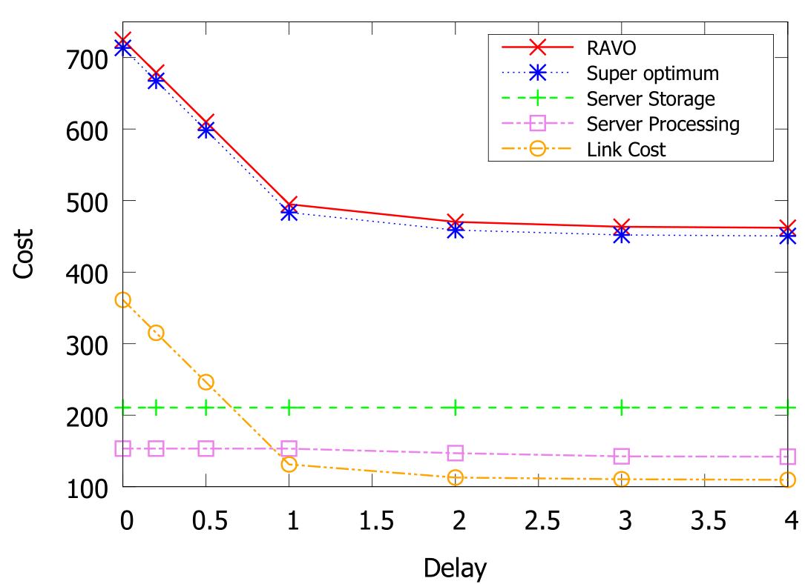
Close to optimal performance (Cost versus Delay Requirement)

Slide 29
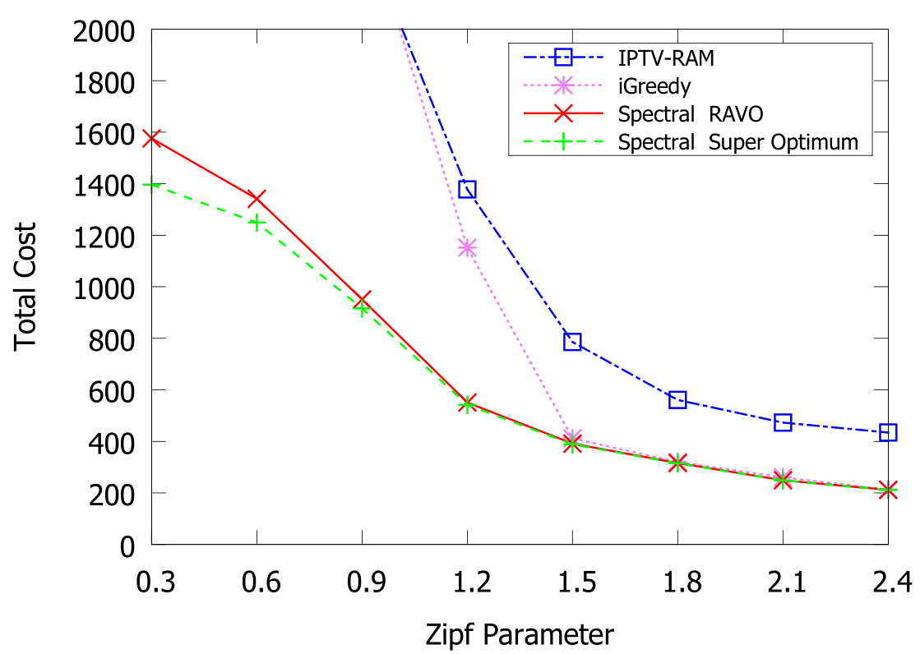
Effective Clustering Method (Cost versus Zipf Parameter)
Skewness of video popularity has greater impact
RAVO can better utilize cheap resource

Slide 30
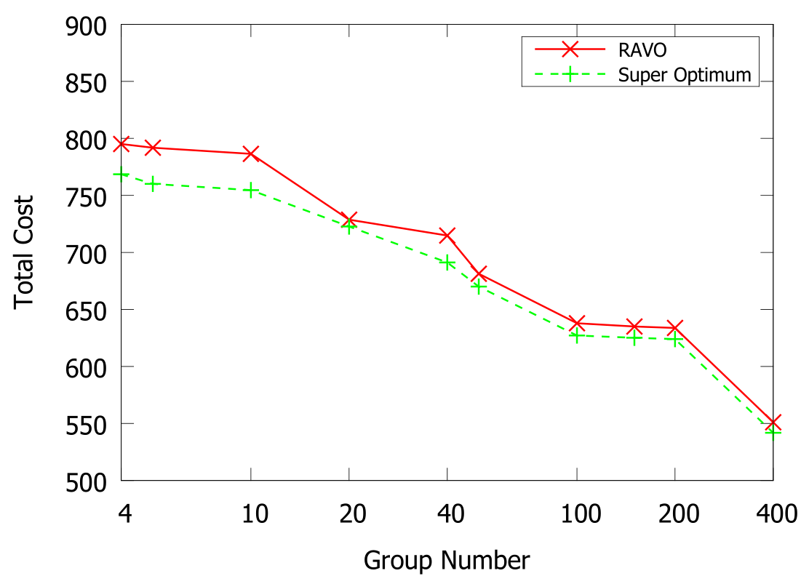
Effective Clustering Method (Cost versus Group Number)
Longer running time for better optimality

Slide 31
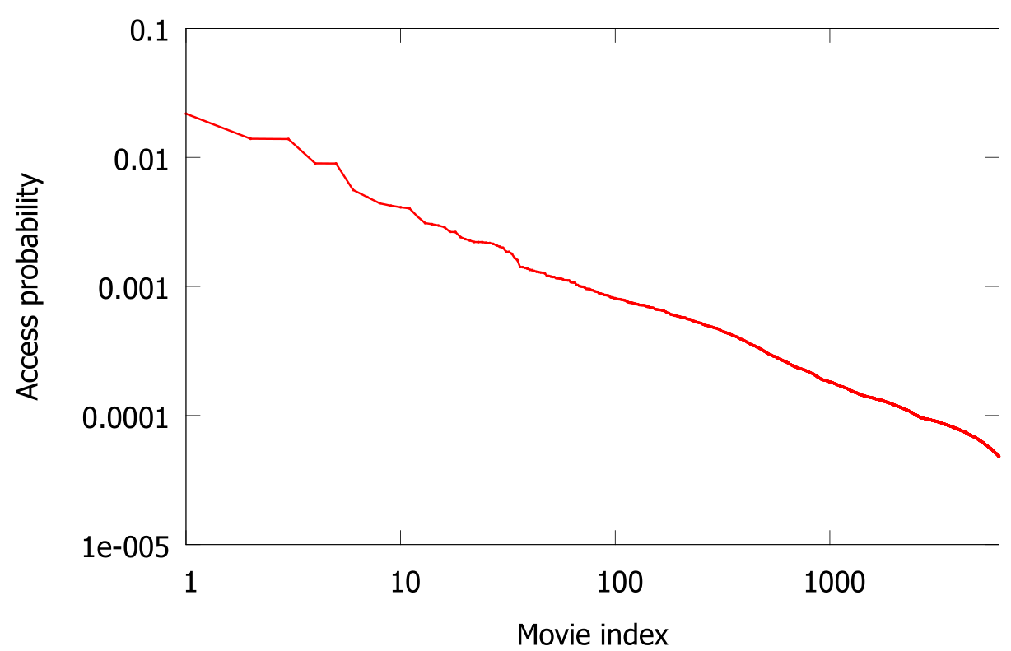
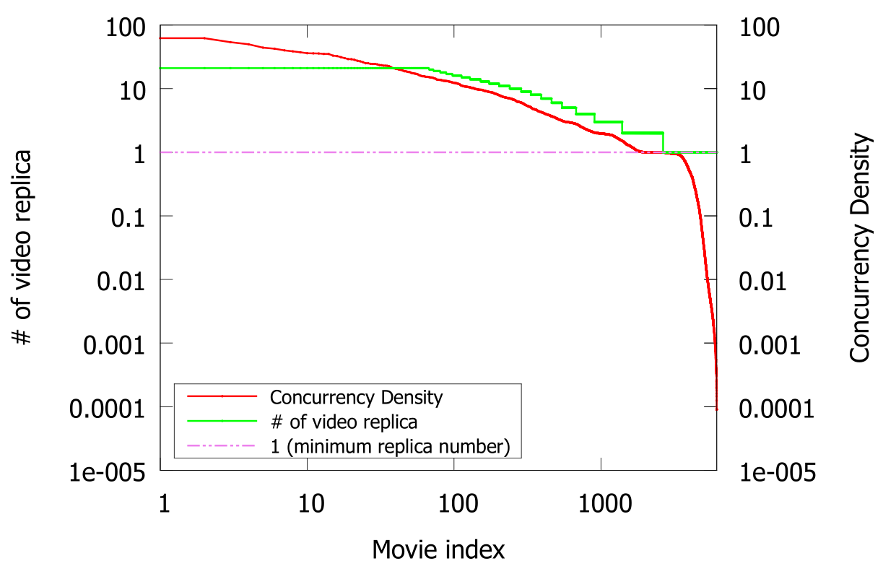
Trace-driven Simulation: Video Popularity
Movie access probability in descending order
Concurrency density and replica number versus movie index
The video access probability follows Zipf’s distribution
Videos with higher concurrency density have more replicas on the cloud

Slide 32
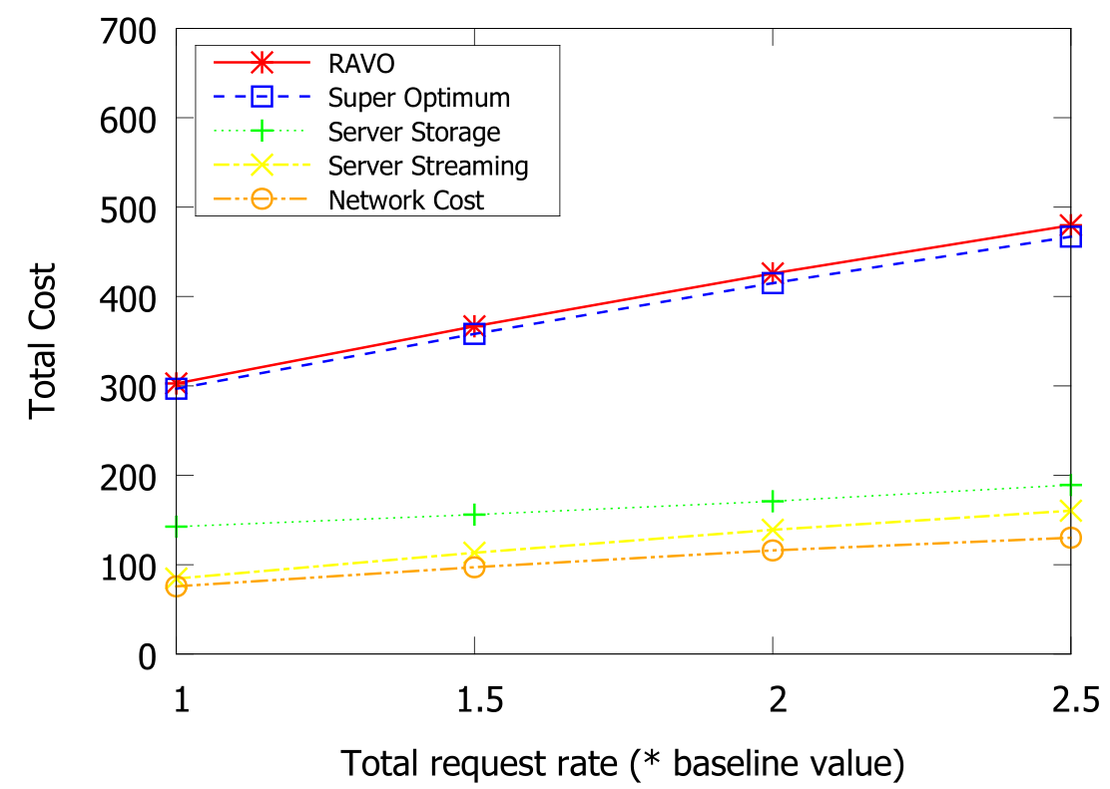
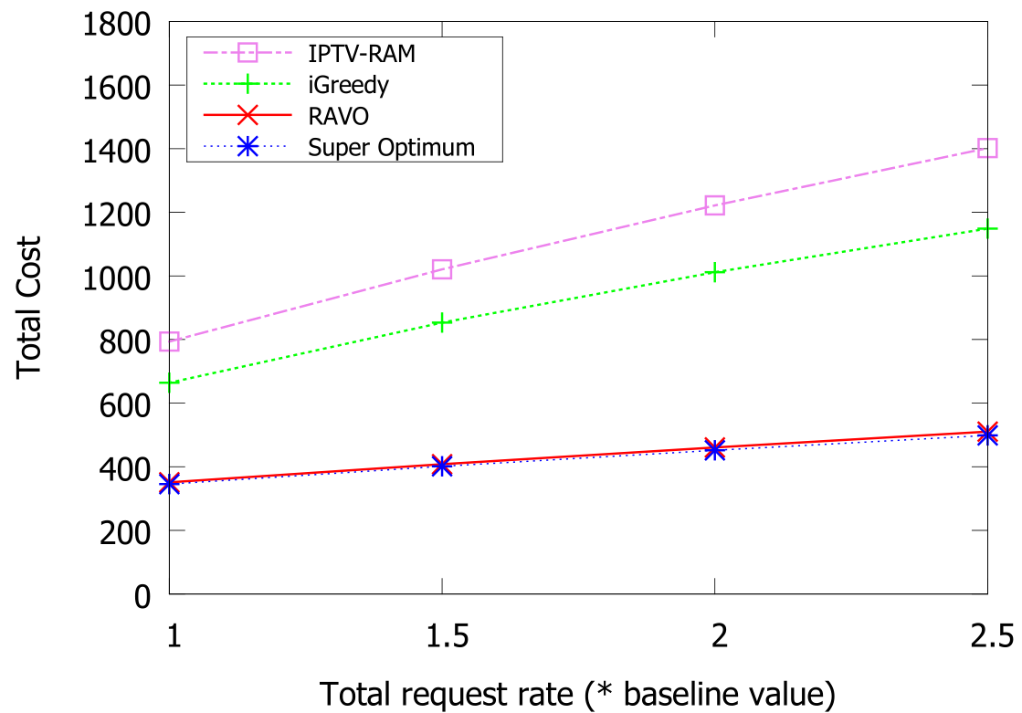
Trace-driven Simulation: Performance
Deployment cost given different request rate
Deployment and component cost given different request rate
RAVO outperform the comparison schemes with large margin
Storage cost increases slower than the other components due to cold video

Slide 33
Contents
Introduction and Related Work
Problem Formulation and Its NP-hardness
RAVO: Efficient LP-based Solution
Efficient Computation for Large Video Pool
Illustrative Simulation Results
Conclusion

Slide 34
Conclusion
Comprehensive Model for VoD Cloud | Minimize total cost: Server + Link Video management & Resource allocation Quality-of-service (delay) constraints Geographic heterogeneity
RAVO Efficient Algorithm | LP formulation → super optimum Randomized rounding Probabilistic video retrieval
Video Grouping Spectral Clustering | Efficient computation Little performance Loss Significant time complexity reduction Geographic heterogeneity
Extensive Simulation Study | Close-to-optimum performance Outperform the comparison scheme Trace-driven simulation based on real data

Slide 35
Thank You!
Any Questions?
Notes:
在 “幻灯片放映”模式，单击箭头进入 PowerPoint 入门中心。

