Slide 1
Bucket-Filling: An Asymptotically Optimal VoD Network with Source Coding
Published on IEEE TRANSACTIONS ON MULTIMEDIA, VOL. 17, NO. 5, MAY 2015
Chang, Zhangyu
Supervised by Prof. Gary Chan
18 February 2019

Slide 2
Contents
Introduction and Related Work
Problem Formulation as a Linear Program
Bucket-filling: Efficient Symbol Storage & Retrieval
Efficient Clustering & Online Re-optimization
Illustrative Simulation Results
Conclusion

Slide 3

Video-on-demand as cloud service
Video-on-Demand
Anytime & anywhere Timely content delivery Resource consuming Most (over 50%) of the Internet traffic
Distributed Cloud
Bandwidth and Storage at geo-dispersed servers Servers cooperatively store and retrieve movies
A Typical Distributed VoD Cloud Service
Notes:
VoD advantage:
anytime & anywhere
Timely delivery
Multiple devices: phone, PC, tablet
However resource consuming, most traffic: video
Deployment:
Place distributed servers closer to the user pool
Supply finite server storage and bandwidth
Reduce network load
Scale up streaming & storage capacity

Slide 4
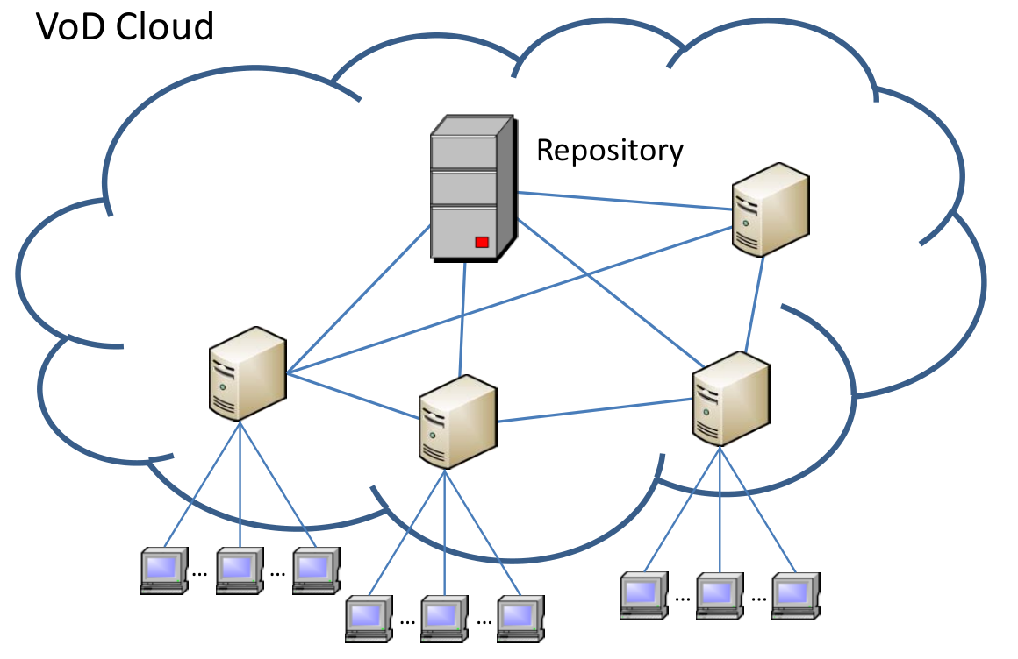
Deployment of a VoD cloud
Repository
Complete movie storage
Proxy server
Distributed server to serve users cooperatively
User
Each user is associated with a local (home) server
Notes:
We show in the figure a typical distributed and cooperative VoD network consisting of a central server (or repository) storing all the movies and proxy servers placed close to user pools.
While the central server stores all the movies, the proxy servers are of possibly heterogeneous storage which may be able to replicate only a fraction of the movies. Each user has a home (or local) server to serve his request.
For example, …
If the request is a hit, the home server directly streams to the users. Otherwise
(a miss), the home server pulls the content from a remote server (either a proxy server or the central server) to serve the request. In other words, the bandwidth of the servers are used to stream not only its own home users (if any), but also remote servers requesting their contents.

Slide 5

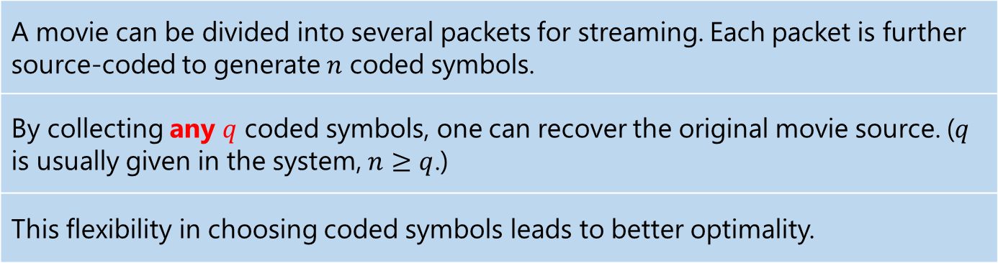
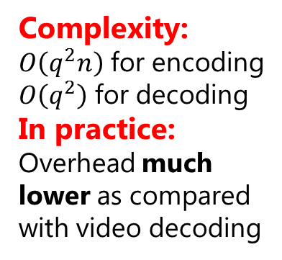
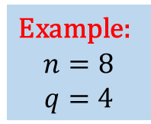
“Bucket-filling” with source coding
A movie can be divided into several packets for streaming. Each packet is further source-coded to generate $n$ coded symbols.
By collecting any $q$ coded symbols, one can recover the original movie source. ($q$ is usually given in the system, $n≥q$.)
This flexibility in choosing coded symbols leads to better optimality.
Example:
$$n=8$$
$$q=4$$
Complexity:
$O\left(q^{2}n\right)$ for encoding
$O\left(q^{2}\right)$ for decoding
In practice:
Overhead much lower as compared with video decoding
Encoding
Decoding
$$k=4$$
Notes:
We propose a novel movie storage and retrieval algorithm called: bucket-filling
In a VoD system

Slide 6
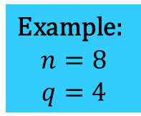
Symbol distribution and retrieval
Central server (Repository):
Complete movie storage
Example:
$$n=8$$
$$q=4$$
3 more
needed
Flexible retrieval to achieve better optimality
(limited storage)
Notes:
We give an example

Slide 7

Major challenge: Storage, Retrieval & Complexity
Cloud parameters
Movie streaming rate, popularity, price, etc.
Storage
How many symbols to store at each server
Retrieval
Which servers to stream the rest symbols
Complexity
Running time for large movie pool

Slide 8
Objective
Total
deployment /running
cost
Server cost
Storage
Bandwidth utilization
Network cost
streaming among servers to serve the misses
Minimize total deployment/running cost
Low running time complexity

Slide 9
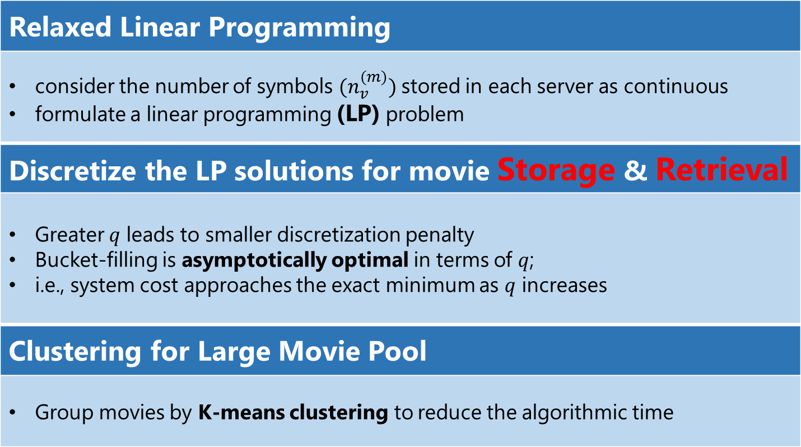
Approach
Relaxed Linear Programming
consider the number of symbols $(n_{v}^{(m)})$stored in each server as continuous formulate a linear programming (LP) problem
Discretize the LP solutions for movie Storage & Retrieval
Greater $q$ leads to smaller discretization penalty Bucket-filling is asymptotically optimal in terms of $q$; i.e., system cost approaches the exact minimum as $q$ increases
Clustering for Large Movie Pool
Group movies by K-means clustering to reduce the algorithmic time

Slide 10
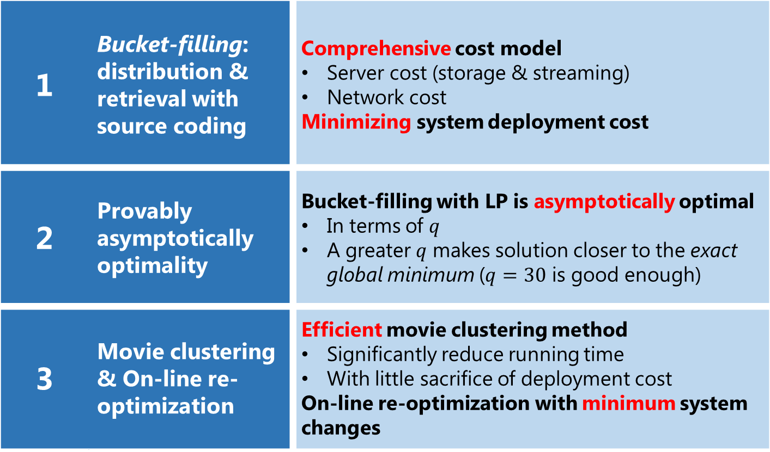
Contributions
1 | Bucket-filling: distribution & retrieval with source coding | Comprehensive cost model Server cost (storage & streaming) Network cost Minimizing system deployment cost
2 | Provably asymptotically optimality | Bucket-filling with LP is asymptotically optimal In terms of $q$ A greater $q$ makes solution closer to the exact global minimum ($q=30$ is good enough)
3 | Movie clustering & On-line re-optimization | Efficient movie clustering method Significantly reduce running time With little sacrifice of deployment cost On-line re-optimization with minimum system changes

Slide 11
Related work
 | Related Work | Bucket-filling
Heuristics: S. Borst et al. INFOCOM'10 A. Nimkar et al. IMSAA'09 S. Zaman et al. TPDS'11 etc. | Not clear how far they are from the optimum | Provably asymptotical optimality in q
Cost optimization: Y. R. Choe et al. ACMMM'07 D. Wu et al. CSVT'13 D. Niu et al. INFOCOM'12 etc. | Consider cost only partially | Comprehensively capture network access cost, storage constraint & bandwidth utilization
P2P VoD: Y. Zhou et al. INFOCOM'12 Y. Zhou et al. ToN'13 B. Tan et al. ToN'13 etc. | Maximize the sharing of peers to ofﬂoad the server load | Minimize the deployment cost

Slide 12
Contents
Introduction and Related Work
Problem Formulation as a Linear Program
Bucket-filling: Efficient Symbol Storage & Retrieval
Efficient Clustering & Online Re-optimization
Illustrative Simulation Results
Conclusion

Slide 13
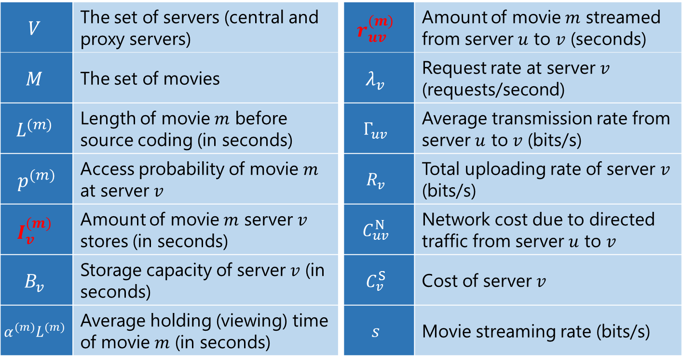
Major Symbols Used
$$V$$ | The set of servers (central and proxy servers) | $$r_{uv}^{(m)}$$ | Amount of movie $m$ streamed from server $u$ to $v$ (seconds)
$$M$$ | The set of movies | $$λ_{v}$$ | Request rate at server $v$ (requests/second)
$$L^{(m)}$$ | Length of movie $m$ before source coding (in seconds) | $$Γ_{uv}$$ | Average transmission rate from server $u$ to $v$ (bits/s)
$$p_{}^{(m)}$$ | Access probability of movie $m$ at server $v$ | $$R_{v}$$ | Total uploading rate of server $v$ (bits/s)
$$I_{v}^{(m)}$$ | Amount of movie $m$ server $v$ stores (in seconds) | $$C_{uv}^{N}$$ | Network cost due to directed traffic from server $u$ to $v$
$$B_{v}$$ | Storage capacity of server $v$ (in seconds) | $$C_{v}^{S}$$ | Cost of server $v$
$$α_{}^{(m)}L^{(m)}$$ | Average holding (viewing) time of movie $m$ (in seconds) | $$s$$ | Movie streaming rate (bits/s)
Notes:
Key symbol: I and r

Slide 14

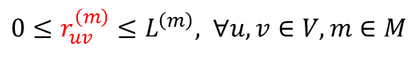
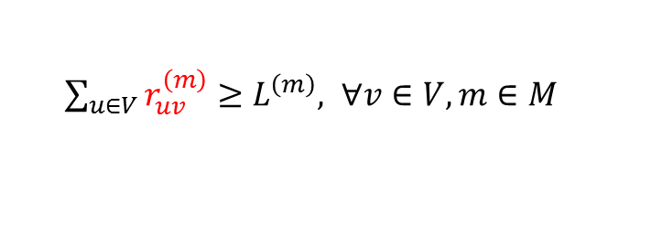
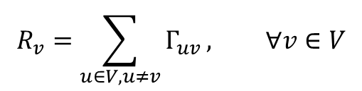
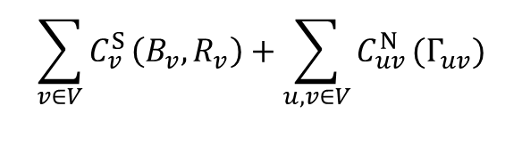
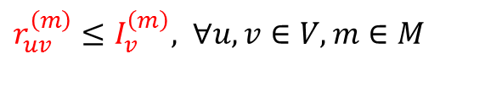
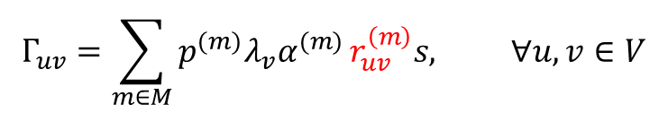
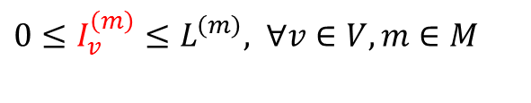

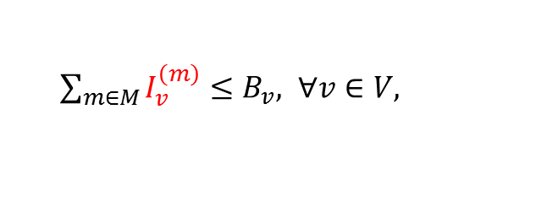
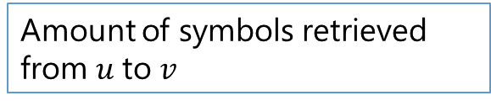
JOSR: Joint Optimization on Movie Storage & Retrieval
Server Cost
Network Cost
Minimize
$$\sum_{v∈V}{C_{v}^{S}}\left(B_{v}, R_{v}\right)+\sum_{u,v∈V}{C_{uv}^{N}}(Γ_{uv})$$
Total system deployment cost
Subject to
Storage
Bandwidth utilization
Access bandwidth (consumed)
Storage
$0≤I_{v}^{\left(m\right)}≤L_{}^{\left(m\right)}, ∀v∈V, m∈M$
Amount of symbols stored at $v$
$0≤r_{uv}^{\left(m\right)}≤L_{}^{\left(m\right)}, ∀u,v∈V, m∈M$
Amount of symbols retrieved from $u$to $v$
Retrieval
$\sum_{m∈M}{I_{v}^{\left(m\right)}}≤B_{v}, ∀v∈V,$
Storage constraint at $v$
$r_{uv}^{\left(m\right)}≤I_{v}^{\left(m\right)}, ∀u,v∈V, m∈M$
Supply only the amount stored
$\sum_{u∈V}{r_{uv}^{\left(m\right)}}≥L_{}^{\left(m\right)}, ∀v∈V, m∈M$
A movie shall be retrieved
$$Γ_{uv}=\sum_{m∈M}{p^{(m)}λ_{v}α^{(m)}}r_{uv}^{\left(m\right)}s, ∀u,v∈V$$
$$R_{v}=\sum_{u∈V, u≠v}{Γ_{uv}}, ∀v∈V$$

Slide 15
Contents
Introduction and Related Work
Problem Formulation as a Linear Program
Bucket-filling: Efficient Symbol Storage & Retrieval
Efficient Clustering & Online Re-optimization
Illustrative Simulation Results
Conclusion

Slide 16
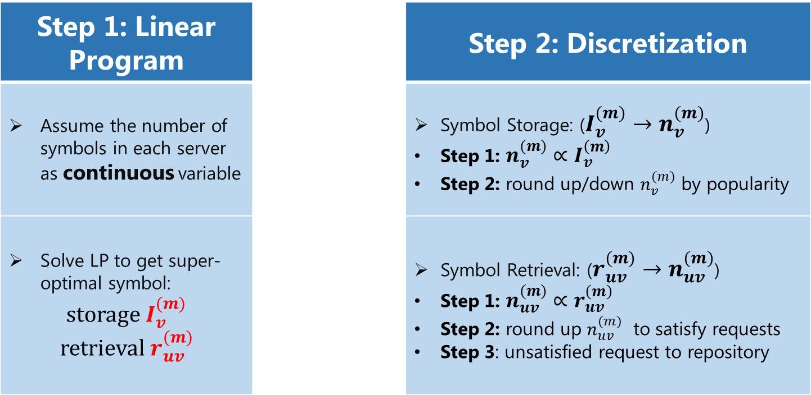
Parameter discretization to achieve asymptotic optimum
Step 1: Linear Program |  | Step 2: Discretization
Assume the number of symbols in each server as continuous variable |  | Symbol Storage: ($I_{v}^{(m)}→n_{v}^{(m)}$) Step 1: $n_{v}^{(m)}∝I_{v}^{\left(m\right)}$ Step 2: round up/down $n_{v}^{(m)}$ by popularity
Solve LP to get super-optimal symbol: storage $I_{v}^{(m)}$ retrieval $r_{uv}^{(m)}$ |  | Symbol Retrieval: ($r_{uv}^{(m)}→n_{uv}^{(m)}$) Step 1: $n_{uv}^{(m)}∝r_{uv}^{\left(m\right)}$ Step 2: round up $n_{uv}^{(m)}$ to satisfy requests Step 3: unsatisfied request to repository

Slide 17
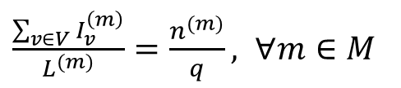
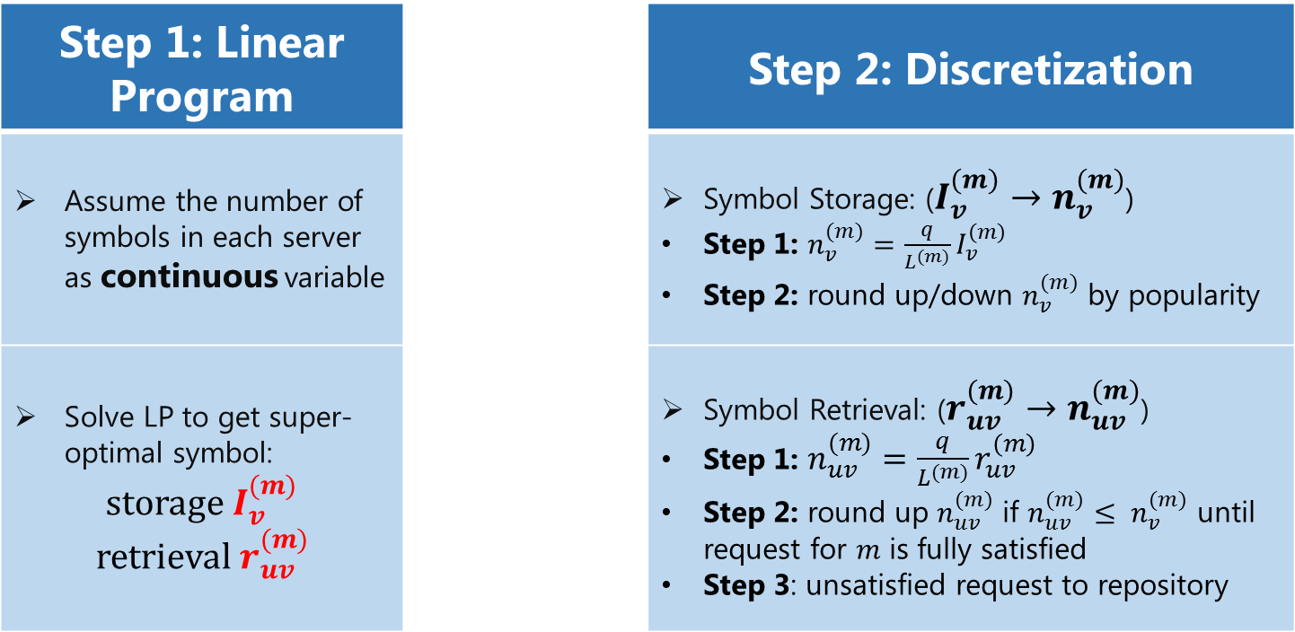
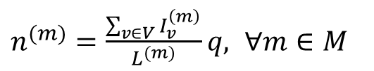

Parameter discretization to achieve asymptotic optimum
Step 1: Linear Program |  | Step 2: Discretization
Assume the number of symbols in each server as continuous variable |  | Symbol Storage: ($I_{v}^{(m)}→n_{v}^{(m)}$) Step 1: $n_{v}^{(m)}=\frac{q}{L^{(m)}}I_{v}^{\left(m\right)}$ Step 2: round up/down $n_{v}^{(m)}$ by popularity
Solve LP to get super-optimal symbol: storage $I_{v}^{(m)}$ retrieval $r_{uv}^{(m)}$ |  | Symbol Retrieval: ($r_{uv}^{(m)}→n_{uv}^{(m)}$) Step 1: $n_{uv}^{(m)}=\frac{q}{L^{(m)}}r_{uv}^{\left(m\right)}$ Step 2: round up $n_{uv}^{(m)}$ if $n_{uv}^{(m)}≤ n_{v}^{(m)}$ until request for $m$ is fully satisfied Step 3: unsatisfied request to repository
$\frac{\sum_{v∈V}{I_{v}^{\left(m\right)}}}{L^{(m)}}=\frac{n^{(m)}}{q}, ∀m∈M$
$n^{(m)}=\frac{\sum_{v∈V}{I_{v}^{\left(m\right)}}}{L^{(m)}}q, ∀m∈M$
$$→$$

Slide 18
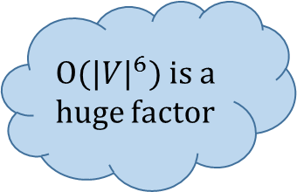




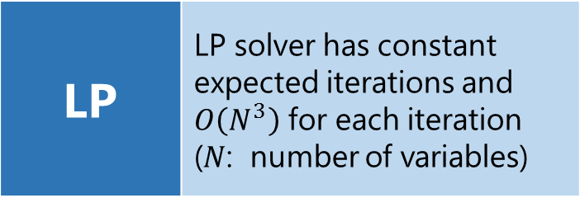

Algorithmic complexity
LP | LP solver has constant expected iterations and $O\left(N^{3}\right)$ for each iteration ($N$: number of variables)
|V| | Number of servers
|M| | Number of movies
What if
$\left|M\right|$ is large?
Asymptotically optimal
Linear
Program
Discretize
Symbol
Storage
Discretize
Symbol
Retrieval
$O{(|V|}^{6})$ is a huge factor
$$O{(|V|}^{6}{|M|}^{3})$$
$$O(|V||M|)$$
$$O{(|V|}^{2}\left|M\right|)$$
Overall time complexity:
$$O{(|V|}^{6}{|M|}^{3})$$

Slide 19
Contents
Introduction and Related Work
Problem Formulation as a Linear Program
Bucket-filling: Efficient Symbol Storage & Retrieval
Efficient Clustering & Online Re-optimization
Illustrative Simulation Results
Conclusion

Slide 20
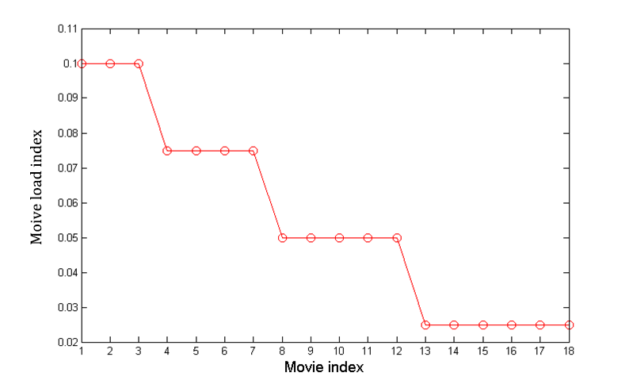
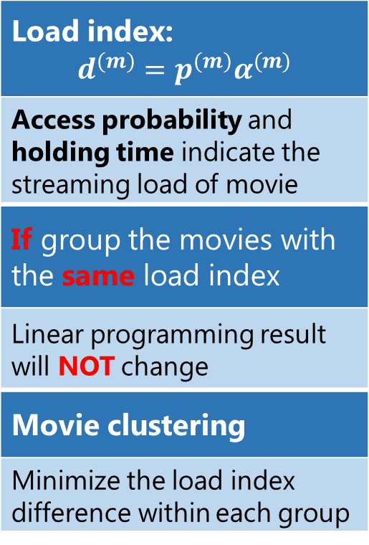
Motivation of movie clustering
Load index: $$d^{(m)}=p^{(m)}α^{(m)}$$
Access probability and holding time indicate the streaming load of movie
If group the movies with the same load index
Linear programming result will NOT change
Movie clustering
Minimize the load index difference within each group

Slide 21
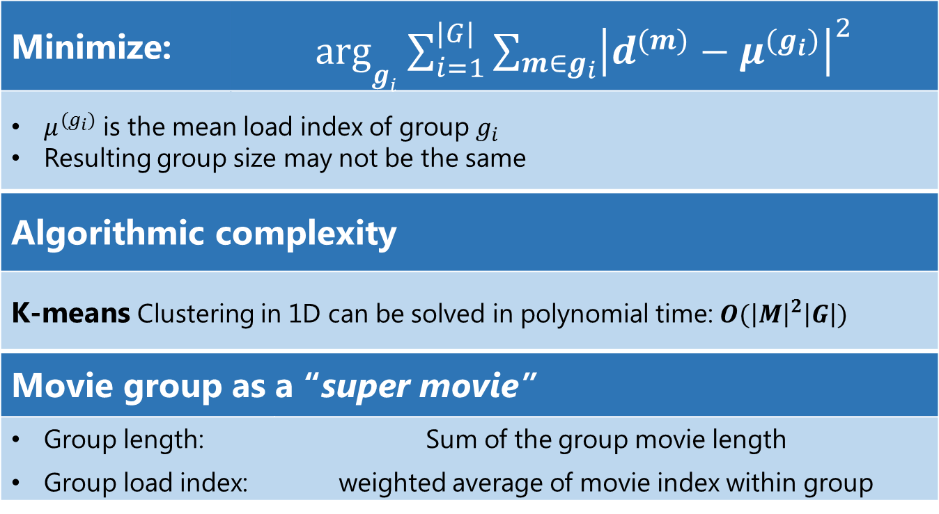
K-means clustering for movie grouping
Minimize: | arg$g_{i}$ $\sum_{i=1}^{|G|}{\sum_{m∈g_{i}}{{\left|d^{(m)}−μ^{(g_{i})}\right|}^{2}}}$
$μ^{(g_{i})}$ is the mean load index of group $g_{i}$ Resulting group size may not be the same
Algorithmic complexity
K-means Clustering in 1D can be solved in polynomial time: $O({\left|M\right|}^{2}\left|G\right|)$
Movie group as a “super movie”
Group length: |  | Sum of the group movie length
Group load index: |  | weighted average of movie index within group
K-means
|G| | Number of groups
|M| | Number of movies

Slide 22
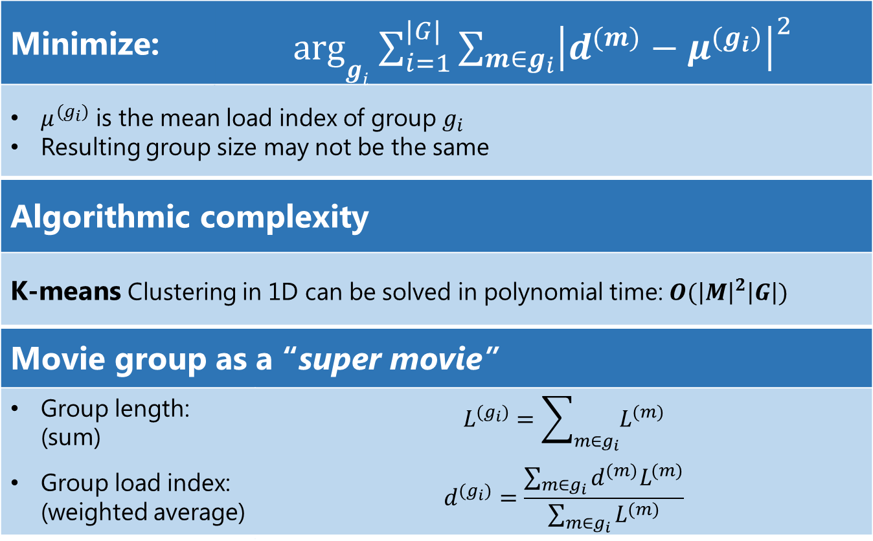
K-means clustering for movie grouping
Minimize: | arg$g_{i}$ $\sum_{i=1}^{|G|}{\sum_{m∈g_{i}}{{\left|d^{(m)}−μ^{(g_{i})}\right|}^{2}}}$
$μ^{(g_{i})}$ is the mean load index of group $g_{i}$ Resulting group size may not be the same
Algorithmic complexity
K-means Clustering in 1D can be solved in polynomial time: $O({\left|M\right|}^{2}\left|G\right|)$
Movie group as a “super movie”
Group length: (sum) |  | $$L^{(g_{i})}=\sum_{m∈g_{i}}{L^{(m)}}$$
Group load index: (weighted average) |  | $$d^{(g_{i})}=\frac{\sum_{m∈g_{i}}{d^{(m)}L^{(m)}}}{\sum_{m∈g_{i}}{L^{(m)}}}$$

Slide 23
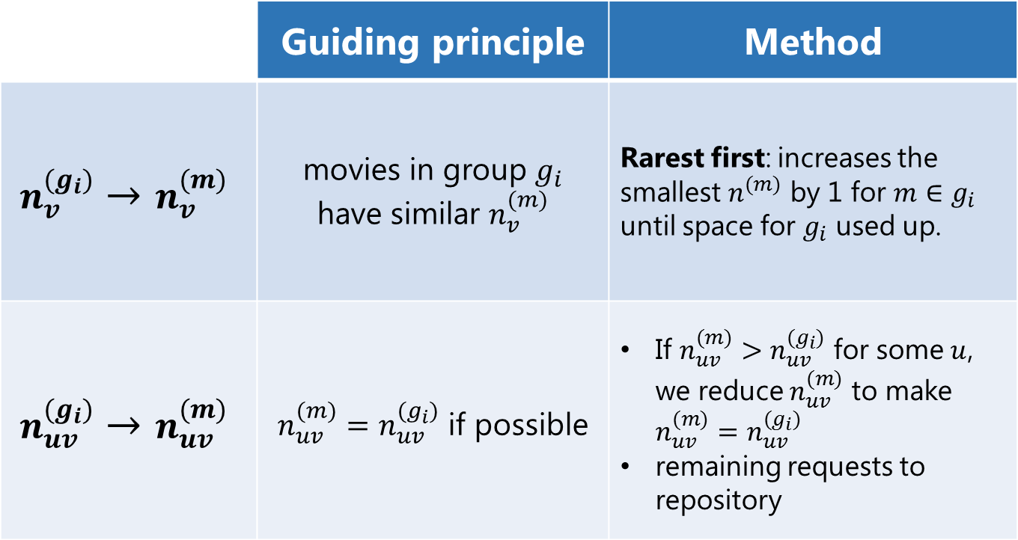
Parameter discretization from group to movie
 | Guiding principle | Method
$$n_{v}^{(g_{i})}→n_{v}^{(m)}$$ | movies in group $g_{i}$ have similar $n_{v}^{(m)}$ | Rarest first: increases the smallest $n_{}^{(m)}$ by 1 for $m∈g_{i}$ until space for $g_{i}$ used up.
$$n_{uv}^{(g_{i})}→n_{uv}^{(m)}$$ | $n_{uv}^{(m)}=n_{uv}^{(g_{i})}$ if possible | If $n_{uv}^{(m)}>n_{uv}^{(g_{i})}$ for some $u$, we reduce $n_{uv}^{(m)}$ to make $n_{uv}^{(m)}=n_{uv}^{(g_{i})}$ remaining requests to repository

Slide 24
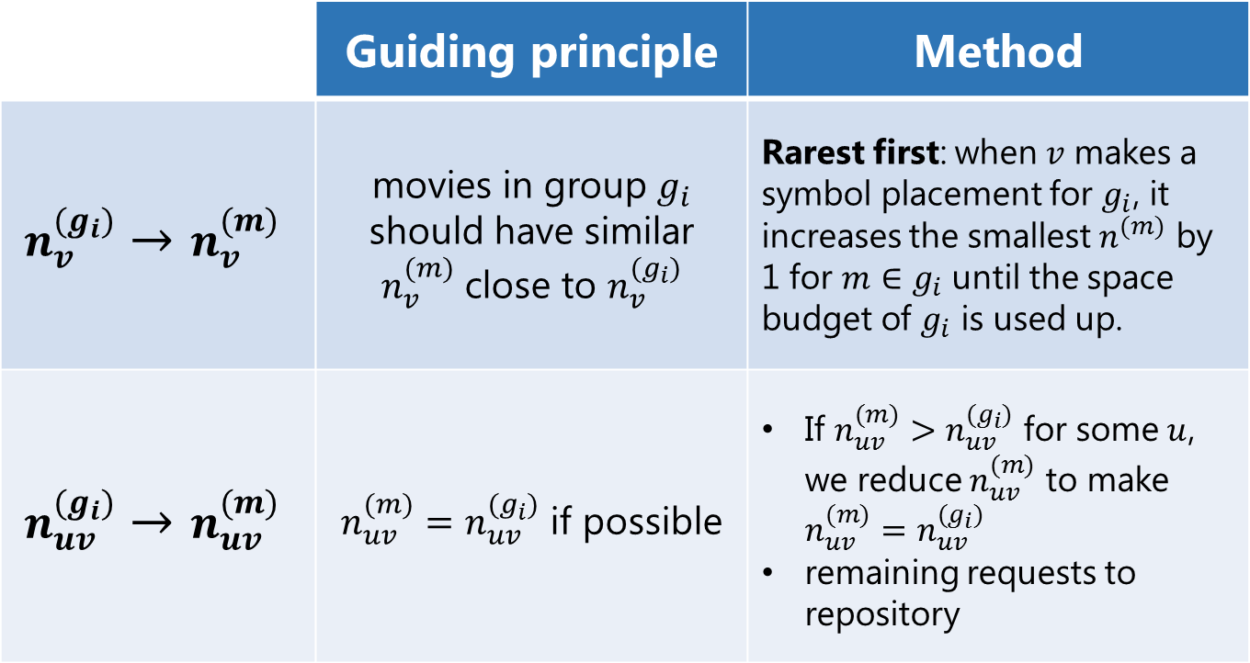
Parameter discretization from group to movie
 | Guiding principle | Method
$$n_{v}^{(g_{i})}→n_{v}^{(m)}$$ | movies in group $g_{i}$ should have similar $n_{v}^{(m)}$ close to $n_{v}^{(g_{i})}$ | Rarest first: when $v$ makes a symbol placement for $g_{i}$, it increases the smallest $n_{}^{(m)}$ by 1 for $m∈g_{i}$ until the space budget of $g_{i}$ is used up.
$$n_{uv}^{(g_{i})}→n_{uv}^{(m)}$$ | $n_{uv}^{(m)}=n_{uv}^{(g_{i})}$ if possible | If $n_{uv}^{(m)}>n_{uv}^{(g_{i})}$ for some $u$, we reduce $n_{uv}^{(m)}$ to make $n_{uv}^{(m)}=n_{uv}^{(g_{i})}$ remaining requests to repository

Slide 25
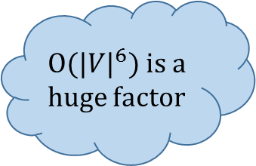

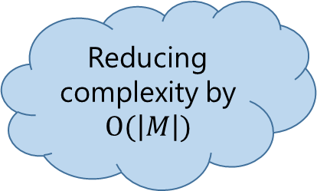


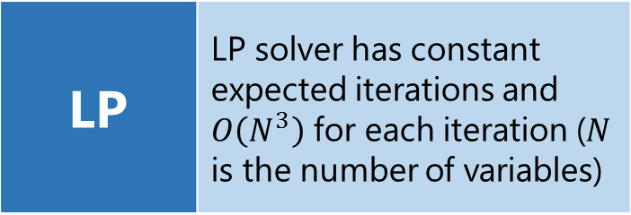


Time complexity reduction
LP | LP solver has constant expected iterations and $O\left(N^{3}\right)$ for each iteration ($N$ is the number of variables)
|V| | Number of servers
|M| | Number of movies
|G| | Number of clusters
$$O{(|V|}^{6}{|G|}^{3})$$
Without Clustering:
$O{(|V|}^{6})$ is a huge factor
$$O{(|V|}^{6}{|M|}^{3})$$
Reducing complexity by $O(\left|M\right|)$
Discretize
Symbol
Storage
Discretize
Symbol
Retrieval
K-means
Clustering
$$O(\left|V\right|\left|M\right|)$$
$$O{(|V|}^{2}\left|M\right|)$$
$$O{(|M|}^{2}\left|G\right|)$$

Slide 26

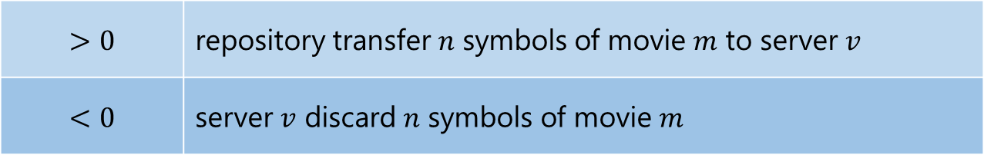

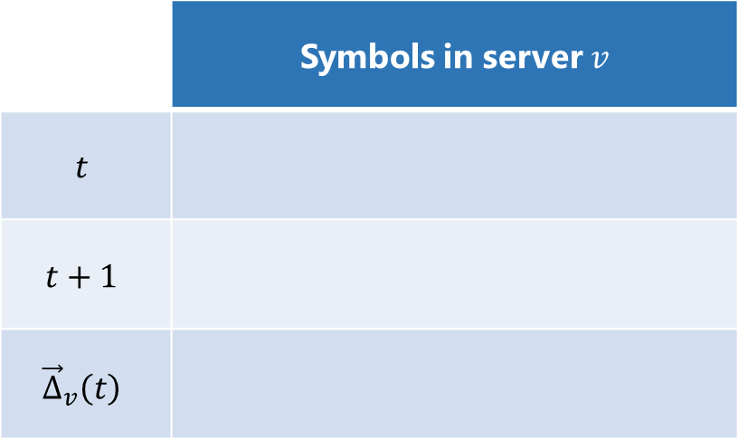




On-line re-optimization
System Changes
Movie Changes
Server Changes
Network Changes
 | Symbols in server $v$
$$t$$
$$t+1$$
$${\vec{Δ}}_{v}\left(t\right)$$
Re-Optimize
$$+1$$
$$−1$$
$$−3$$
$$+3$$
Symbol changes
$$>0$$ | repository transfer $n$ symbols of movie $m$ to server $v$
$$<0$$ | server $v$ discard $n$ symbols of movie $m$
$$+n$$
$$−n$$

Slide 27
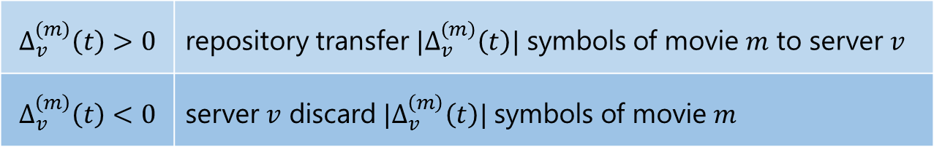
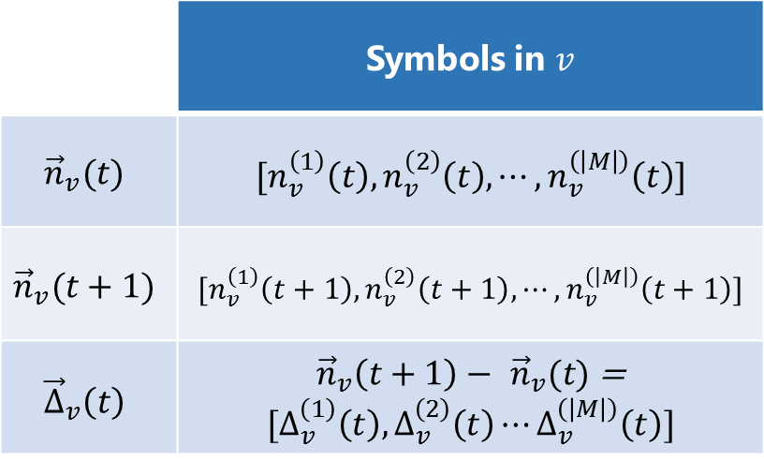
On-line re-optimization
System Changes
Movie Changes
Server Changes
Network Changes
 | Symbols in $v$
$${\vec{n}}_{v}(t)$$ | $$[n_{v}^{\left(1\right)}\left(t\right),n_{v}^{\left(2\right)}\left(t\right),⋯,n_{v}^{\left(\left|M\right|\right)}\left(t\right)]$$
$${\vec{n}}_{v}(t+1)$$ | $$[n_{v}^{\left(1\right)}\left(t+1\right),n_{v}^{\left(2\right)}\left(t+1\right),⋯,n_{v}^{\left(\left|M\right|\right)}\left(t+1\right)]$$
$${\vec{Δ}}_{v}\left(t\right)$$ | ${\vec{n}}_{v}\left(t+1\right)− {\vec{n}}_{v}(t)$ = $$[Δ_{v}^{\left(1\right)}\left(t\right),Δ_{v}^{\left(2\right)}\left(t\right)⋯Δ_{v}^{\left(\left|M\right|\right)}\left(t\right)]$$
Re-Optimize
Symbol changes
$$Δ_{v}^{\left(m\right)}\left(t\right)>0$$ | repository transfer $|Δ_{v}^{\left(m\right)}\left(t\right)|$ symbols of movie $m$ to server $v$
$$Δ_{v}^{\left(m\right)}\left(t\right)<0$$ | server $v$ discard $|Δ_{v}^{\left(m\right)}\left(t\right)|$ symbols of movie $m$

Slide 28
Contents
Introduction and Related Work
Problem Formulation as a Linear Program
Bucket-filling: Efficient Symbol Storage & Retrieval
Efficient Clustering & Online Re-optimization
Illustrative Simulation Results
Conclusion

Slide 29
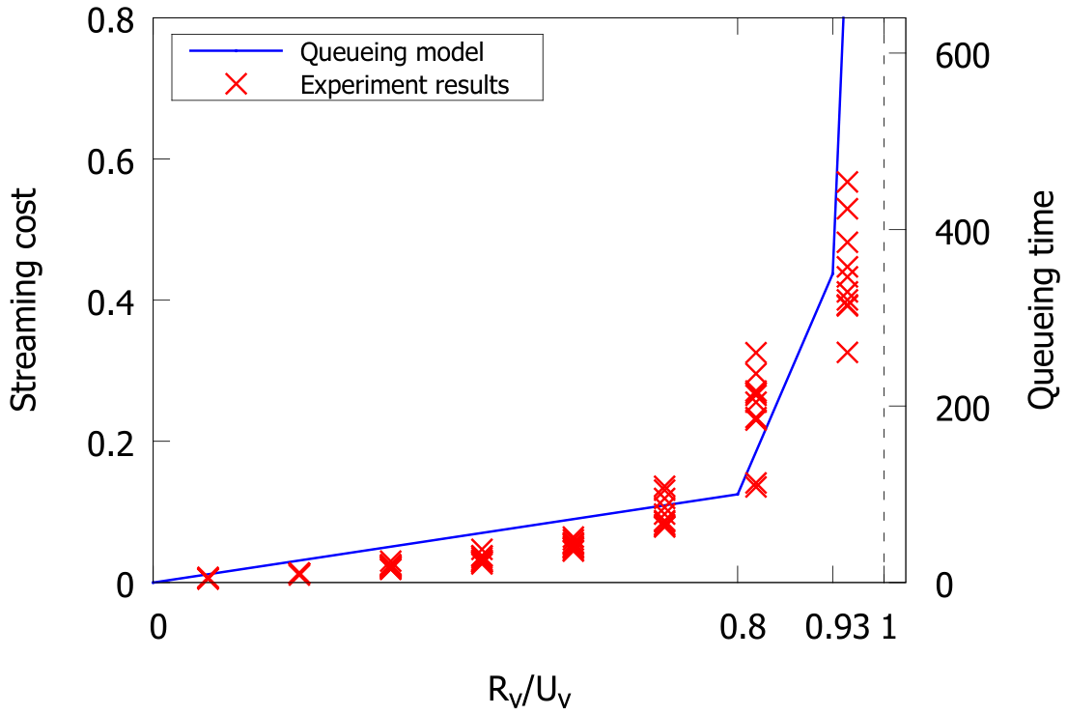
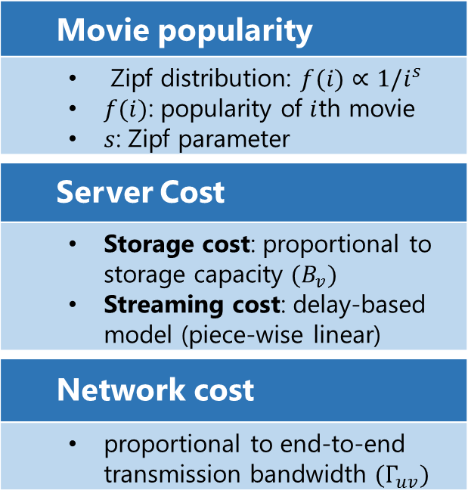
Environment setup
Movie popularity
Zipf distribution: $f(i)∝1/i^{s}$ $f(i)$: popularity of $i$th movie $s$: Zipf parameter
Server Cost
Storage cost: proportional to storage capacity $(B_{v}^{})$ Streaming cost: delay-based model (piece-wise linear)
Network cost
proportional to end-to-end transmission bandwidth ${(Γ}_{uv}^{})$
Delay-based Streaming cost model
Increase sharply
Bandwidth utilization percentage

Slide 30
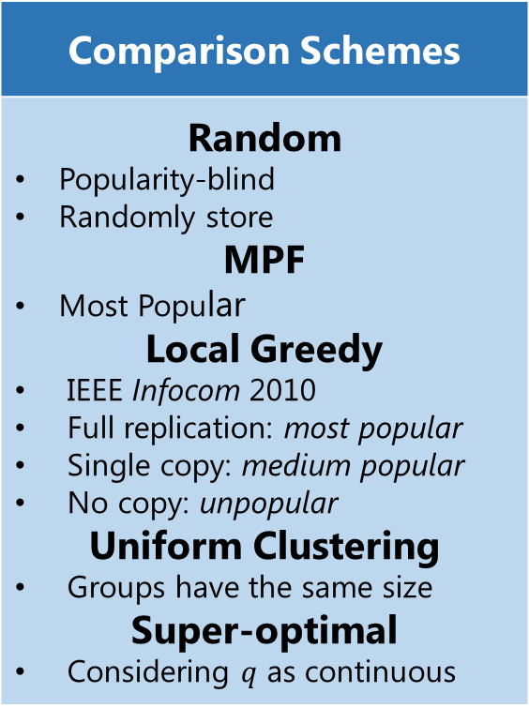
Performance metrics & comparison schemes
Performance Metrics
Total cost & components Server Storage cost Server streaming cost Network cost Running time Time to obtain results by running algorithm
Comparison Schemes
Random Popularity-blind Randomly store MPF Most Popular Local Greedy IEEE Infocom 2010 Full replication: most popular Single copy: medium popular No copy: unpopular Uniform Clustering Groups have the same size Super-optimal Considering $q$ as continuous

Slide 31
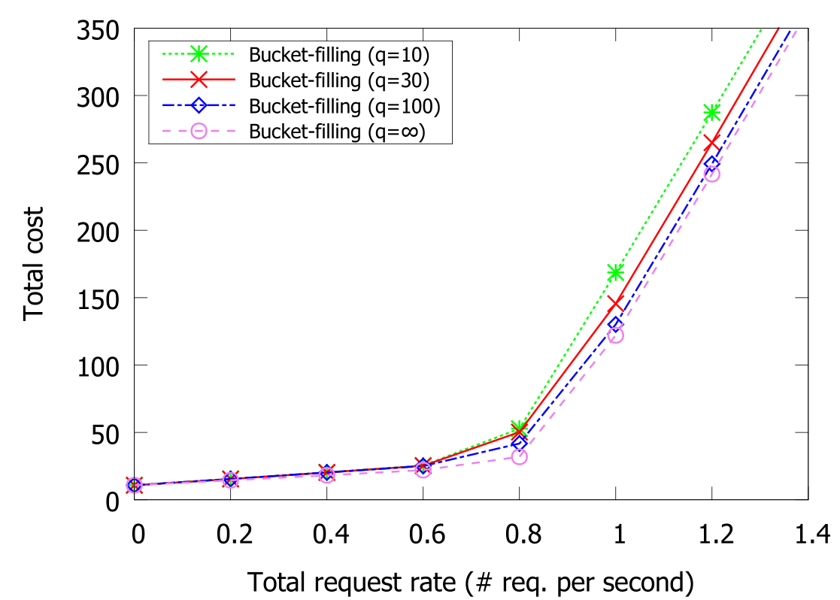
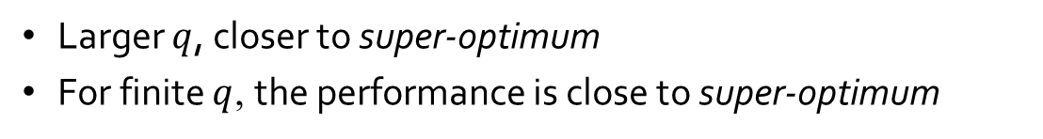
Asymptotically optimal
Larger $q$, closer to super-optimum
For finite $q$, the performance is close to super-optimum

Slide 32
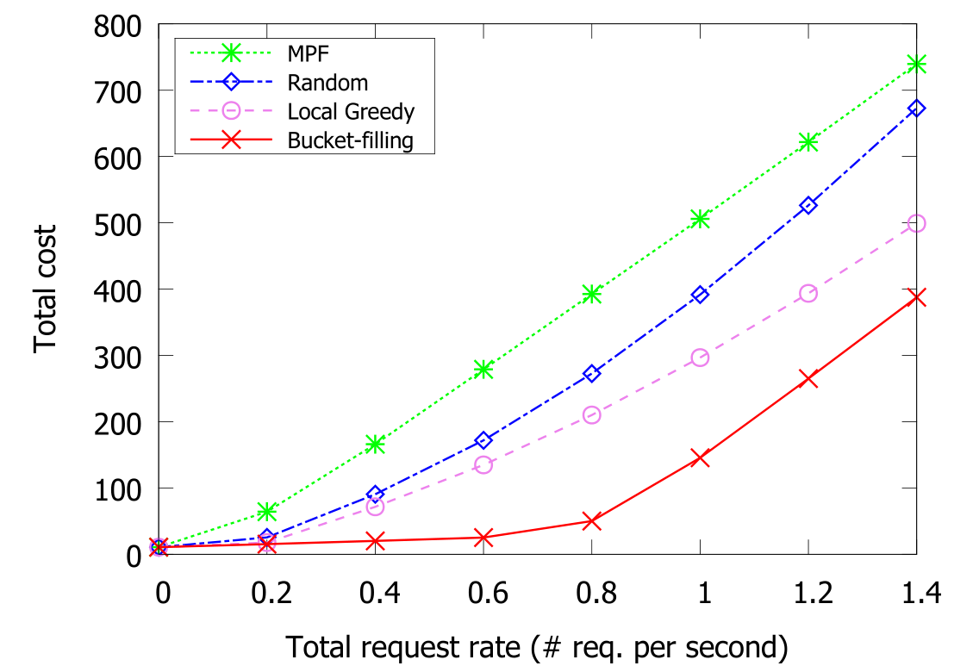
Substantially low cost
Outperform by a wide margin

Slide 33
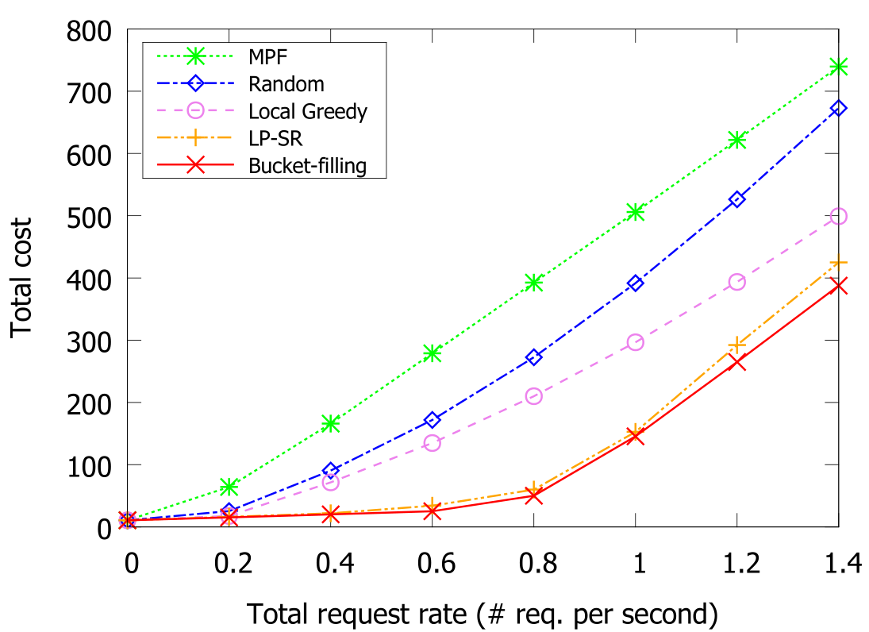
Substantially low cost
Outperform by a wide margin

Slide 34
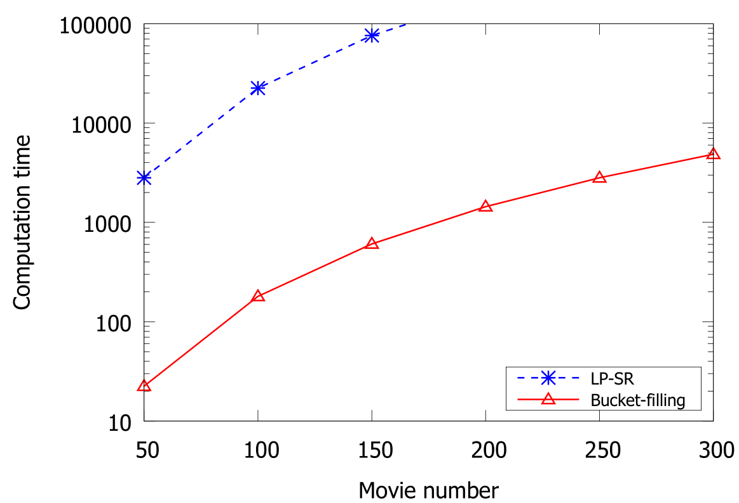
Substantially low running time
LP-SR has a much higher complexity

Slide 35
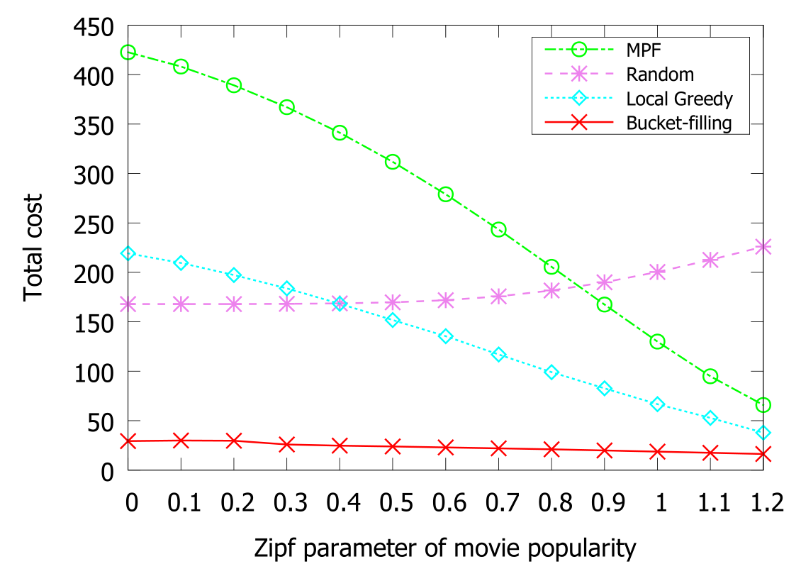
Insensitive to popularity skewness
Better utilize the proxy servers (Versus MPF)
Cooperatively store (Versus Local-Greedy)
Low miss rate (Versus Random)

Slide 36
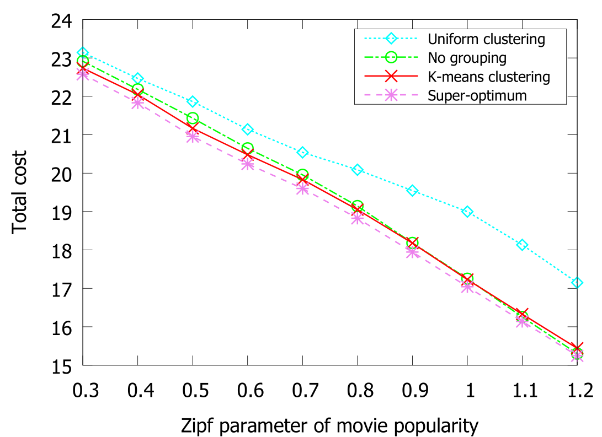
Closely optimal grouping
Still near optimum when grouped
K-means Clustering outperforms more for larger skewness
K-means even outperform the ungrouping method for small Zipf parameters
Smaller Zipf parameter leads to smaller grouping error; ungrouping method has larger round-off error.

Slide 37
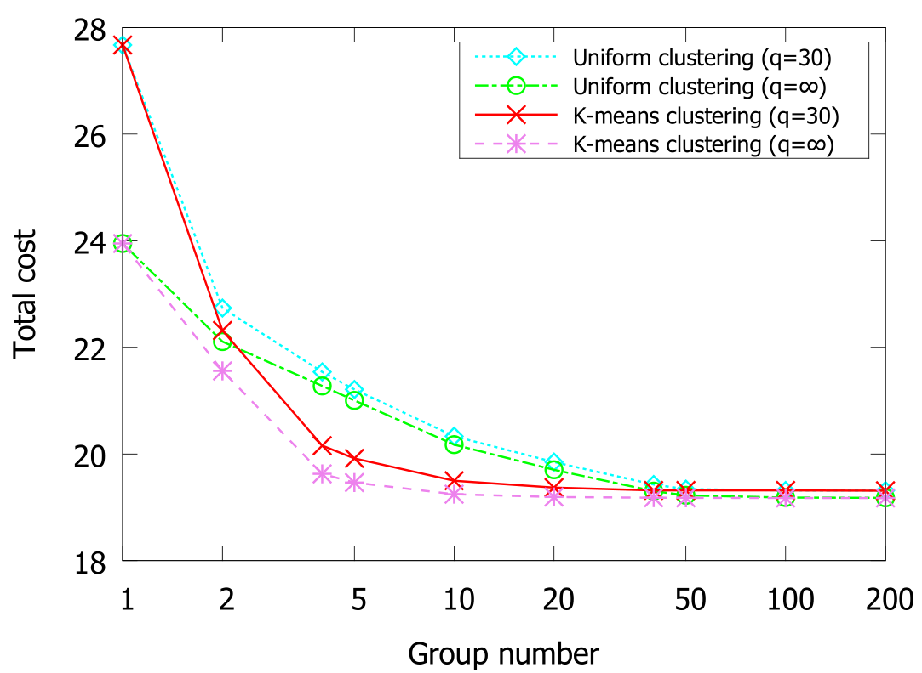

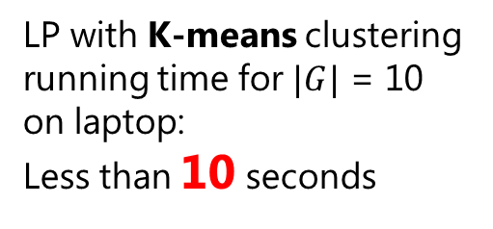
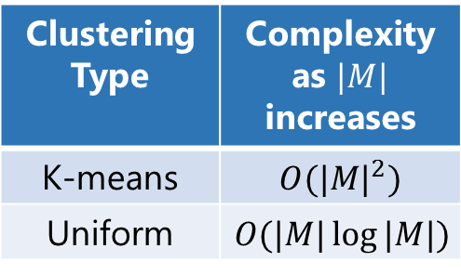
Perform well for large movie pool
Group number does not need to be large
$$|M| = 10,000$$
Clustering Type | Complexity as $|M|$ increases
K-means | $$O({|M|}^{2})$$
Uniform | $$O(|M|\log{|M|})$$
LP with K-means clustering running time for $|G|$ = 10 on laptop:
Less than 10 seconds
Notes:
impossible to calculate the super-optimum.
The total cost decreases with the total number of groups. It is
because, with more groups, the load indices in the same group
are closer to each other. For K-means clustering, the total cost
achieves satisfactory level even with a small group number
(g=5 ) and K-means clustering outperforms with a 10%
margin compared with uniform clustering. As the group number
increases, both K-means clustering and uniform clustering
converge to the same value given by the case

Slide 38
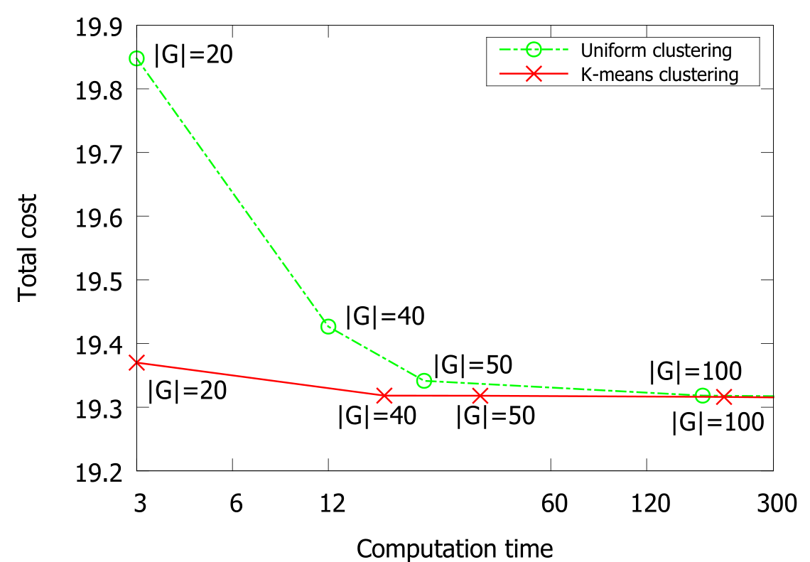

Good tradeoff for small group number
Group number does not need to be large
To achieve nearly optimal, K-means clustering requires only several seconds ($|G|=20$)
Time is not a bottleneck for bucket-filling.

Slide 39

Efficient On-line re-optimization
The transmission of symbols increases sub-linearly

Slide 40
Contents
Introduction and Related Work
Problem Formulation as a Linear Program
Bucket-filling: Efficient Symbol Storage & Retrieval
Efficient Clustering & Online Re-optimization
Illustrative Simulation Results
Conclusion

Slide 41
Conclusion
Comprehensive Cost Model | Minimize total deployment cost Server cost : storage & streaming Network cost Content replication & Server selection
Bucket-filling Asymptotically optimal | LP formulation → super optimum solution Symbol storage & retrieval Asymptotically optimal discretization
Movie Grouping K-means Clustering | Efficient computation Little performance Loss Polynomial time complexity reduction Efficient online re-optimization
Extensive Simulation Study | Close to optimum performance Outperform by multiple times

Slide 42
Selected References
S. Borst, V. Gupta, and A. Walid, “Distributed caching algorithms for content distribution networks,” in Proc. IEEE INFOCOM , Mar. 2010, pp. 1–9.
A. Nimkar, C. Mandal, and C. Reade, “Video placement and disk load balancing algorithm for VoD proxy server,” in Proc. IEEE Int. Conf. Internet Multimedia Services Archit. Appl., Dec. 2009, pp. 1–6.
S. Zaman and D. Grosu, “A distributed algorithm for the replica placement problem,” IEEE Trans. Parallel Distrib. Syst., vol. 22, no. 9, pp. 1455–1468, Sep. 2011.
Y. R. Choe, D. L. Schuff, J. M. Dyaberi, and V. S. Pai, “Improving VoD server efficiency with bittorrent,” in Proc. MULTIMEDIA ’07: 15th Int. Conf. Multimedia, New York, NY, USA, 2007, pp. 117–126.
D. Wu, J. He, Y. Zeng, X. Hei, and Y. Wen, “Towards optimal deployment of cloud-assisted video distribution services,” IEEE Trans. Circuits Syst. Video Technol., vol. 23, no. 10, pp. 1717–1728, Oct. 2013.
D. Niu, H. Xu, B. Li, and S. Zhao, “Quality-assured cloud bandwidth auto-scaling for video-on-demand applications,” in Proc. IEEE INFOCOM, Mar. 2012, pp. 460–468.
Y. Zhou, T. Z. J. Fu, and D. M. Chiu, “A unifying model and analysis of P2P VoD replication and scheduling,” in Proc. IEEE INFOCOM, Mar. 2012, pp. 1530–1538.
Y. Zhou, T. Z. J. Fu, and D. M. Chiu, “On replication algorithm in P2P VoD,” IEEE/ACM Trans. Netw., vol. 21, no. 1, pp. 233–243, Feb. 2013.
B. Tan and L. Massoulié, “Optimal content placement for peer-to-peer video-on-demand systems,” IEEE/ACM Trans. Netw., vol. 21, no. 2, pp. 566–579, Apr. 2013.

Slide 43
Thank You
Any Questions?

Slide 44

Appendix: An example of source coding
Suppose we want to code 3 numbers: $a=5, b=6,c=2013$ in to $n$ symbols.
We compute
$$s_{1}=a+b+c$$
$$s_{2}=a+2b+2^{2}c$$
$$s_{3}=a+3b+3^{2}c$$
$$……$$
$$s_{n}=a+nb+n^{2}c$$
Then, by taking any 3 of$s_{i}, iε\{1…n\}$, we formulate a linear system and solve it to get original $a, b, c$.

Slide 45


Appendix: $Z_{p}$ field algebra
To avoid overflow problem, we use $Z_{p}$ field algebra for computation
In $Z_{p}$ field algebra
$$a +_{p}b=(a+b)\operatorname{mod}{p}$$
$$a ∗_{p}b=(a∗b)\operatorname{mod}{p}$$
If $p$ is a prime number, for every number (except 0), we can find a multiplicative inverse
For example, in $Z_{5}$, 2 and 3 are multiplicative inverses to each other
$$a ∗_{5}2∗_{5}3=a$$

