Slide 1
Video Replication and Access over Fog-based Architecture
Chang, Zhangyu
Supervised by Prof. Gary Chan

Slide 2
Contents
Introduction
System Architecture and Comparison
Replication Schemes
Video Access Schemes
Case Studies
Conclusion and Future Directions

Slide 3
Impact of Video Traffic on Internet
Video contributes to most of the internet traffic
the weight is continuously increasing
73% in 2016 / 82% by 2021 (estimated)
Huge network resource demand for video service
Overall IP traffic grows 24% percent annually
Busy-hour Internet traffic is growing more (51% in 2016)
Traditional Approach:
Content Distribution Networks (CDNs): Not cost-effective
Peer-to-Peer Network (P2P): Not reliable
New paradigm to offload the demand

Slide 4
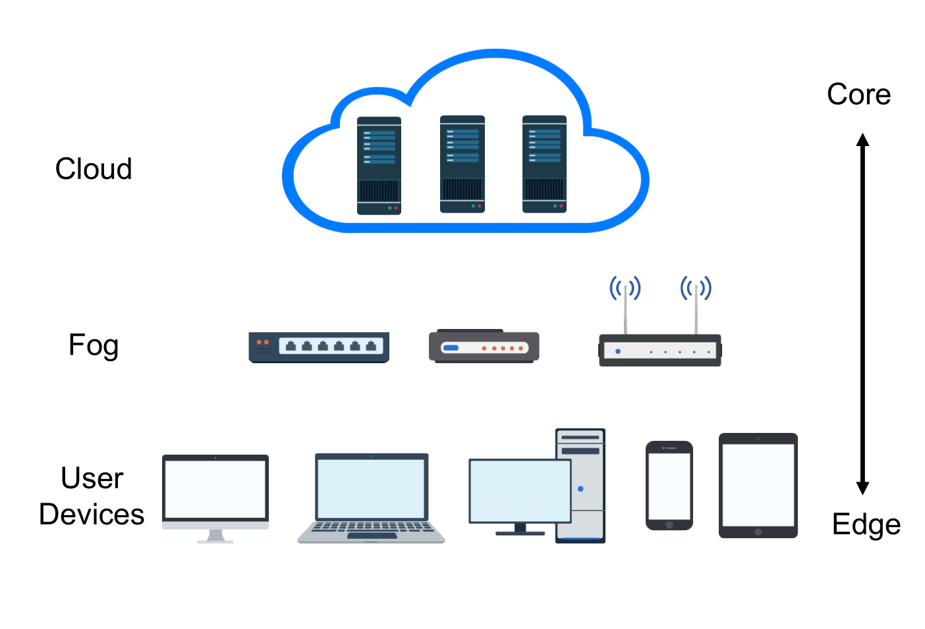
Video Service over Fog
Fog devices:
E.g., routers, Wi-Fi Aps, set-top boxes, base station
Lightweight but decent power
Ubiquitous and close-to-user
Fog-based distribution reduces:
Load of cloud server
Server-to-edge traffic
Inter ISP traffic

Slide 5
Video Popularity Characteristics
Popularity
Very skewed for both professionally generated content (PGC) and user generated content (UGC)
By storing only 10% of long-term popular videos, a cache can serve 80% of requests
Freshness
The popularity of hot videos decays very quickly
PGC: 90% of the most popular videos traffic are new each day
UGC: difficult to predict the popularity of new content
Daily Pattern
2 peaks: 2 P.M. and 10 P.M. every day
lowest at around 5 A.M.: good time to push new content

Slide 6
Challenges for Fog-based Schemes
Distributive
Fog devices are huge in number and have to collaboratively serve the users
Geography-aware
It is important to utilize the close-to-user feature to serve the neighbor
Popularity-aware
Global popular contents have to be pushed into the fog
Lightweight implementation
Fog device cannot match dedicated server on computation power

Slide 7
Major Problems
Video Replication
Video Access
Fog devices are huge in number, but each fog device has only limited storage size
Ephemeral: highly demanded video for a certain duration and then the demand fades
What to push and when to push the new contents
Uncoordinated versus Coordinated replication schemes
Uncoordinated: based on device’s demand
Coordinated: based on global popularity
A fog device cannot have full replication of all the videos
Many fog devices may have the same contents
Decision affects all users share the same resource
Wired versus Wireless fog
Wired: reduce the problem size
Wireless: choice of base stations

Slide 8
Solutions
Replication schemes
Uncoordinated: Variations of LRU / Score-Based Schemes
Coordinated: Popularity-Based / Division of Storage
Video access schemes
Wired Users: Clustering Methods / Game Theory Approaches
Wireless Users: Approximation Algorithm / Mathematical Programming
Case studies
Youku: CDN Based on Smart Routers
Thunder Crystal: Crowdsourcing Content Distribution

Slide 9
Contents
Introduction
System Architecture and Comparison
Replication Schemes
Video Access Schemes
Case Studies
Conclusion and Future Directions

Slide 10
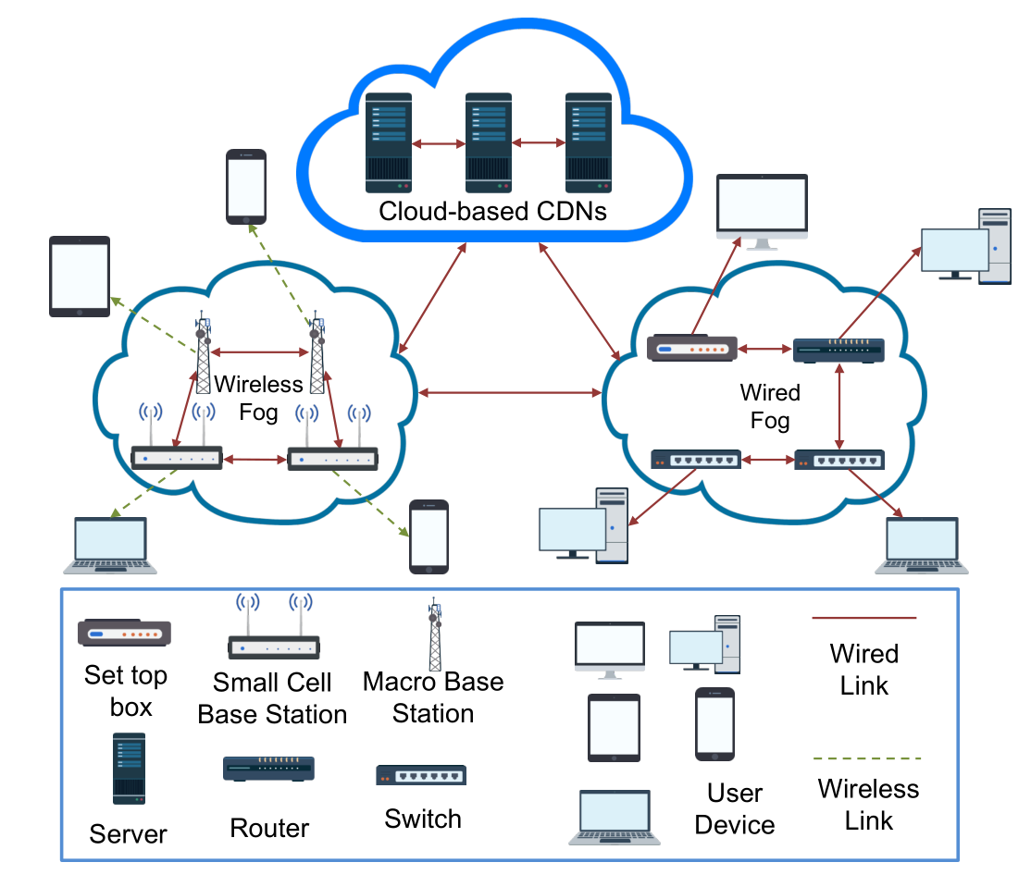
System Architecture of Fog-based Video Network
Cloud Layer (Level 1)
Push new videos to the fog
Reduced number of servers
Fog Layer (Level 2)
Backbone of the platform
Huge in number and close to the users
Owner and operator of the fog may not be same
Wired & Wireless fog for all the users
User Layer (Level 3)
Usually get served by fog devices
Cloud as the last resort

Slide 11
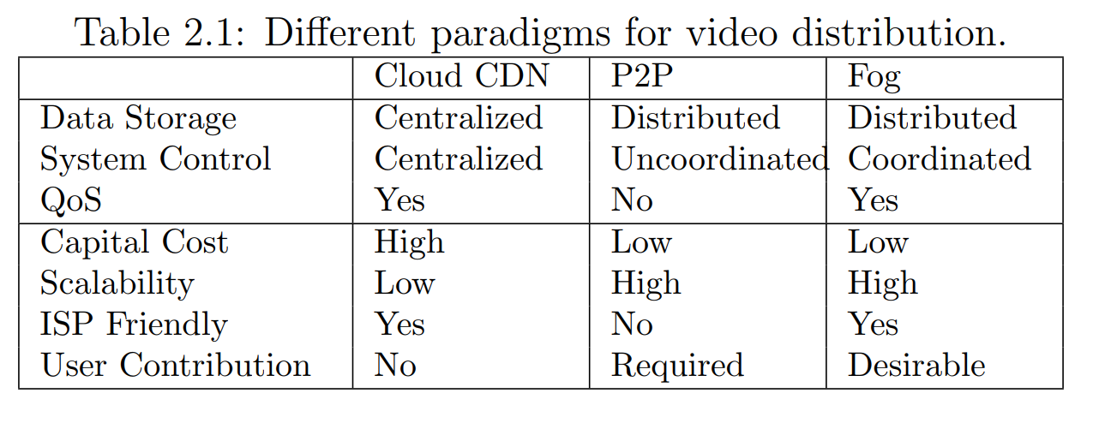
Comparison: versus CDN and P2P

Slide 12
Comparison: Merits of Fog
vs CDN | vs P2P
Better proximity Fog device close to the users Cloud only push to some fog devices | Service guarantees Full control over fog devices Stable network connections Reduce peer churns
Reduced cost Major cost: real estate, power, cooling and human resource Do not exist on fog | Coordinated topology More manageable topology Reduce the inter-ISP traffic Better Geography-awareness
User contribution Users are willing to buy fog devices for better service Expansion with little cost | Free-riding prevention Store the contents even the owner is not interested in them Owner has less turn-off incentive

Slide 13
Contents
Introduction
System Architecture and Comparison
Replication Schemes
Video Access Schemes
Case Studies
Conclusion and Future Directions

Slide 14
Replication Schemes
Replication scheme for fog must be distributive, responsive and easy to implement
Uncoordinated replication schemes
Each fog device only makes its own decision independently
Lack global popularity information
Optimality analysis relies on assumptions
Coordinated replication schemes
A central server will offer global information to each fog device in some way
Push the contents directly
May ignore the local preference

Slide 15
Uncoordinated Schemes
Variations of LRU
q-LRU: stores the new video content with a probability of q
k-LRU: Storage is divided into k hierarchical part, contents demoted step by step until removal
Better than LRU if the video popularity distribution follows the Zipf’s law
Assumptions for optimality: Poisson distribution of request & stead state
Score-Based Schemes
Age-Based Threshold (ABT): calculate a time to live based on access frequency
Information Centric Network: video has special index, frequency based score but the recent access has higher weight

Slide 16
Uncoordinated Schemes
Scheme | Objective | Parameter to optimize | Methodology | Comment
LRU-based | Maximize hit probability | Video stored in the device | Poisson Approximation | Assume Zipf’s Law
iProxy | Improve hit probability | Video stored in the device | Heuristics | New coding scheme
Age-based Threshold | Maximize hit probability | Video lifetime in the device | Poisson Approximation | Assume Zipf’s Law
Fog devices may not have enough processing power to handle all the hit

Slide 17
Coordinated Schemes
Popularity-Based Schemes:
Video content can be proportional to the video popularity
Deficit bandwidth performs better than proportional replication if fog devices has heterogeneous
Scheduler gives replication probability p or time to live t and broadcast this parameter to all the fog devices
New indices (geographic/propagation/social influence)
Division of Storage:
Divide the fog storage into 2 parts
Local/global popularity & PGC/UGC

Slide 18
Coordinated Schemes
Scheme | Objective | Parameter to optimize | Methodology | Comment
Global Popularity | Reduce server load | Video stored in the device | Mathematical modelling | Not consider bitrate/device capacity
Deficit Bandwidth | Reduce server load | Video stored in the device | Mathematical modelling | Consider device capacity
Last-mile Implementation | Reduce traffic cost | Probability to store a video | Primal-dual approach | Comprehensive model
Social Video Index | Improve hit probability | Video indices | Heuristics | Based on measurement
Division of Storage 1 | Maximize hit probability | Storage Division | Heuristics | Support Wired & Wireless users
Division of Storage 2 | Maximize social welfare | Storage Division | Supermodular game | Support social video

Slide 19
Contents
Introduction
System Architecture and Comparison
Replication Schemes
Video Access Schemes
Case Studies
Conclusion and Future Directions

Slide 20
Video Access Schemes
Video access decision is critical to effectively utilize fog network resources and avoid network congestion
Multiple replications for the same video content in several fog devices
Huge size of the problem to optimize the whole network
Number of both the videos and fog devices are huge
Facility Location Problem: NP-complete
Effectively Solution
Reduce the problem size (clustering/ divide and conquer)
Find the approximation algorithms

Slide 21
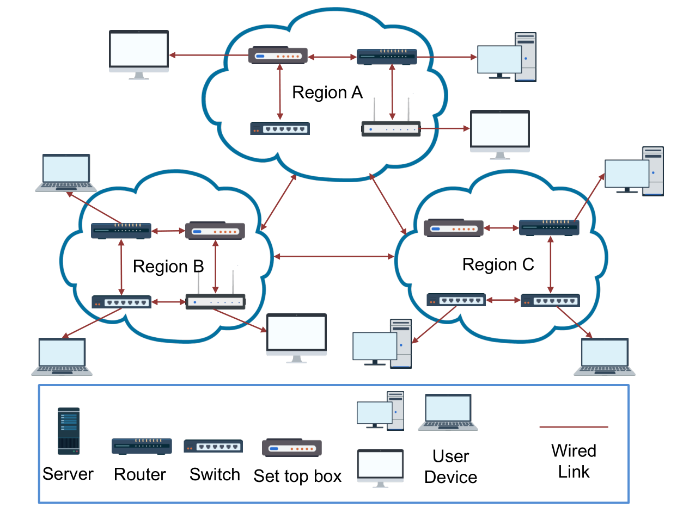
Wired User
Thousands of devices
NP-hard in nature
Divide and conquer
Brutal force for small-scale
Clustering Methods
Geographic location/ISP
Similarity of popularity
Auction-based method with each region
MCMF problem for inter-region traffic
Game Theory Approaches
Between device owners & operators (Stackelberg Game)
Between social friends (supermodular game)

Slide 22
Wired User
Scheme | Objective | Parameter to optimize | Methodology | Comment
Cluster fog devices 1 | Reduce server load | How to partition fog devices | Sampling & greedy algorithm | Based on measurement
Cluster fog devices 2 | Reduce server load | Traffic between clusters | Linear programing & Heuristics | 2 schemes can be combined
Game theory approach 1 | Total revenue | Price to use a fog device | Stackelberg Game | Fog owner and CP can cooperate
Game theory approach 2 | Maximize social welfare | From which friend to get video | Supermodular game | Assume friends share videos

Slide 23
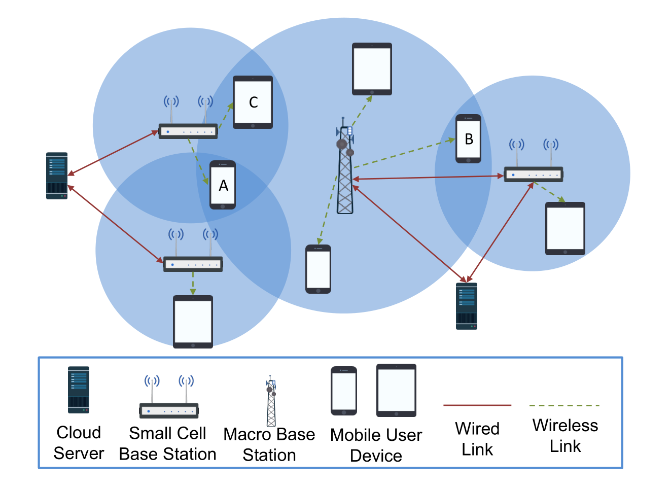
Wireless Users
Joint optimization of the replication and access problem
User may covered by multiple base stations
Relative small problem size
Approximation Algorithm
Facility location problem
Cluster user demand
Randomized method if user preference differs not much
Mathematical Programming
Allowing use has probability to get the video from different base stations
Use network coding to bypass the NP-hardness of integer linear programming

Slide 24
Wireless Users
Scheme | Objective | Parameter to optimize | Methodology | Comment
JRC-UR | Minimize server load | Replication & Access | Approximation of LBS | Approximation ratio given
BS assisted D2D | Minimize server load | Replication & Access | Monte Carlo optimization | Heuristics in nature
AP deployment | Minimize server load | Fog device deployment | Integer linear programming | With a greedy heuristics
An online algorithm | Minimize server load | Replication & Access | Convex programming | Allow user to access many APs
FemtoCaching | Minimize server load | Replication & Access | Linear Programming | Use coded content

Slide 25
Contents
Introduction
System Architecture and Comparison
Replication Schemes
Video Access Schemes
Case Studies
Conclusion and Future Directions

Slide 26
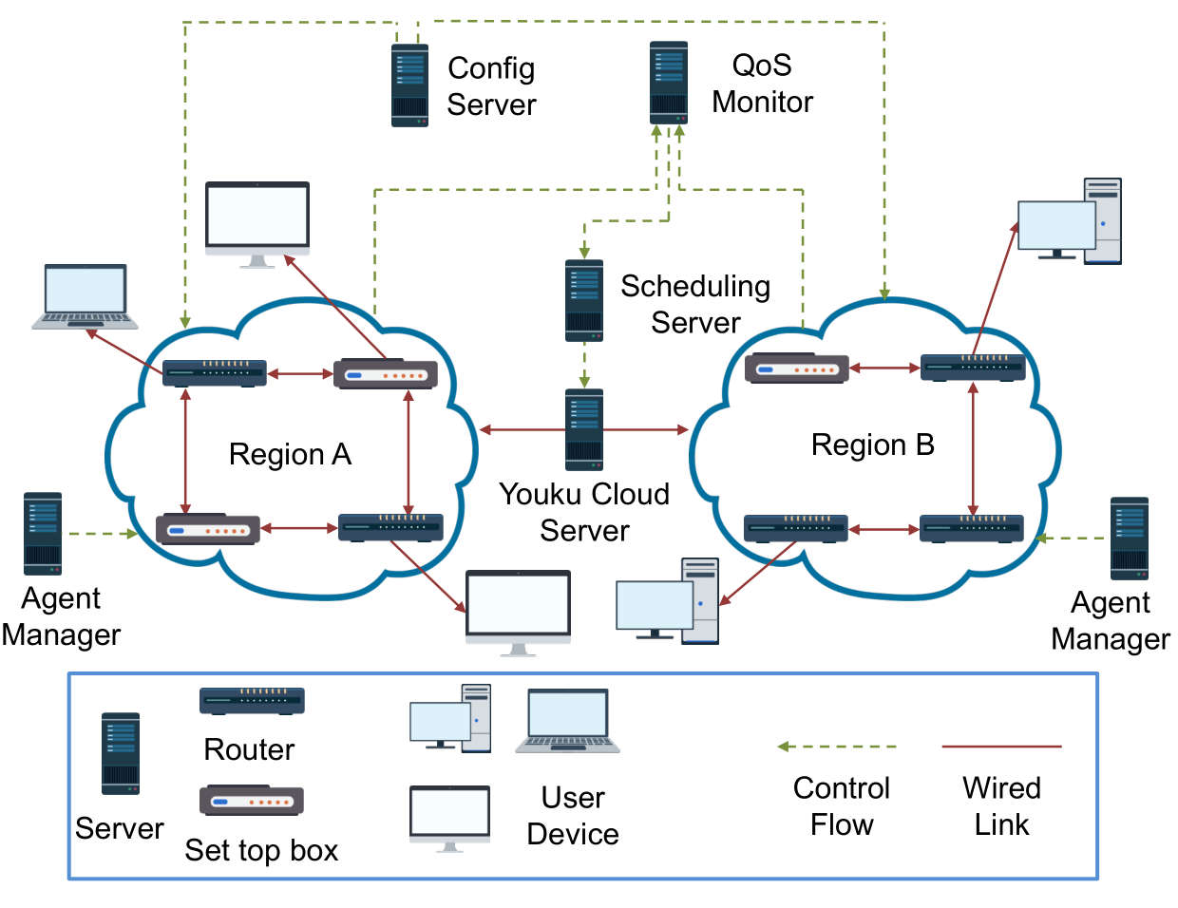
Youku: CDN Based on Smart Routers
Peer Video CDN based on Smart-routers :
Subsidized smart-routers
Centralized coordinating
4 kinds of servers to manage the smart routers
Combining caching with recommendation
Push and store home page contents (73%)
Push between 0 and 3 A.M. (daily pattern)
Do not care about local popularity

Slide 27
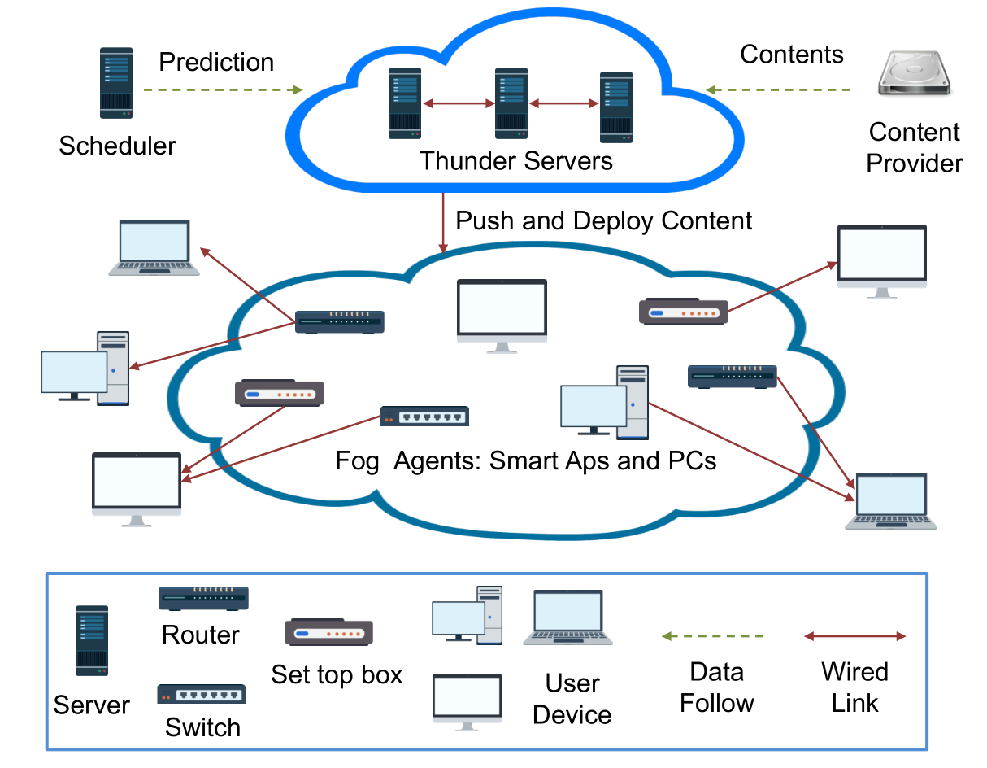
Thunder Crystal: Crowd-sourcing Content Distribution
Crowdsourcing Content Distribution
Crowdsourcing system
Device owner get monetary return
Central Managed Pushing
Push new content for content provider
Fixed cloud serve budget
Popularity decays exponentially
Indiscriminate policy
Random user access scheme
No geography awareness

Slide 28
Contents
Introduction
System Architecture and Comparison
Replication Schemes
Video Access Schemes
Case Studies
Conclusion and Future Directions

Slide 29
Conclusion
Fog-based content distribution:
Low operation cost and better quality-of-service
Replication:
Uncoordinated: simple but no global popularity
Coordinated: popularity aware but no preference
Video Access
Wired user: divide users into areas
Wireless user: jointly optimize replication & access
Case Studies
Youku: combining pushing with recommendation
Thunder: crowdsourcing with random pushing and access

Slide 30
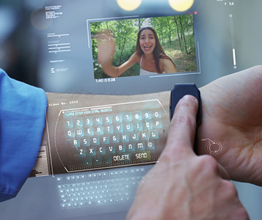
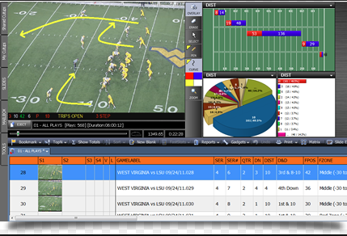

Future Directions
Augmented Reality
Combination of real-world and video
Location-based service
Fog devices for localization and video distribution
Video Data Analytics
Video from monitoring camera keeps increasing (7 times from 2016 to 2021)
Fog devices at the camera side can analyze the video and upload the results or features for less traffic
Blockchain
Manage the transactions over the Internet
Negotiation distributively on network control
Any databases can be saved distributively in the fog

Slide 31
Thank You!
Any Questions?

Slide 32
Comments
Survey title: VoD-Fog Approaches and data driven comparisons
Zhang Qian: Future work shall be consistent with the main problem
BB: How to differentiate between Fog & P2P? Many approaches have been used in P2P
Many devices (e.g., Set top box) in previous P2P can be regarded as Fog (End user heterogenity)
Fog: Large number of medium range devices & Reliable mid-layer for better tractability and billing
Presentation skills : needs more Passion

Slide 33








Comments (Cont’d)
P2P
Cloud
Fog

