Slide 1
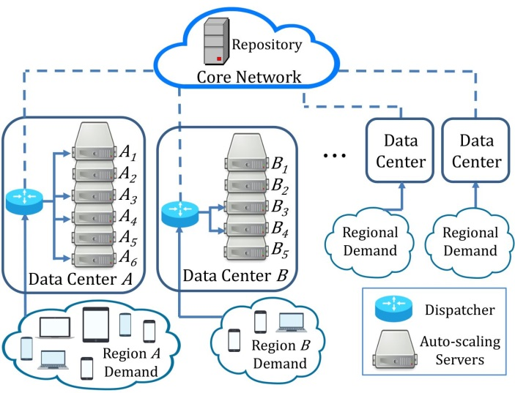
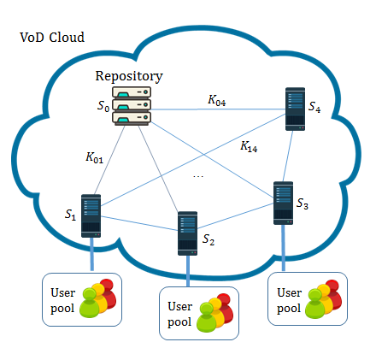
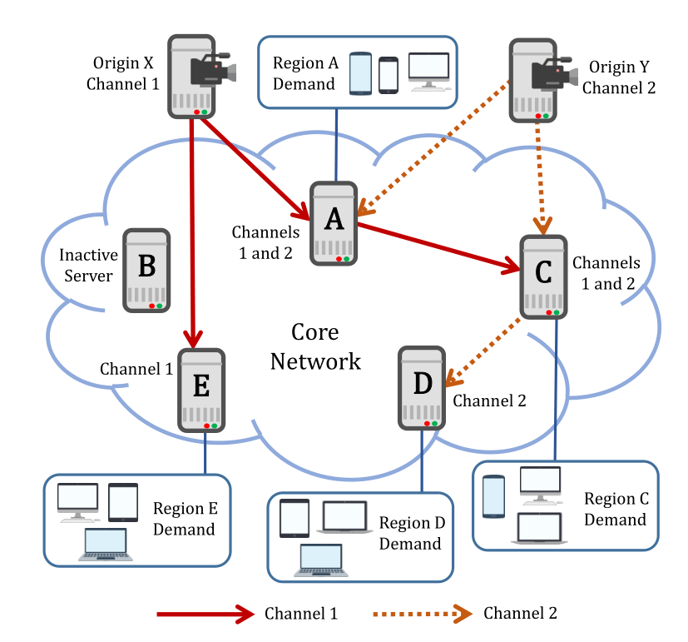

Approximation Algorithms for Auto-Scaling Video Cloud
Ph.D. Thesis Examination
Chang, Zhangyu
Supervised by Prof. Gary Chan
21 December 2023

Slide 2
Contents
Introduction
AVARDO: Optimizing an Auto-Scaling VoD Data Center
RAVO: Optimizing a Geo-Distributed VoD Cloud
COCOS: Optimizing an Auto-Scaling Live Streaming Cloud
Conclusion

Slide 3
Background: Video-on-Demand and Live Streaming
 | Video-on-Demand (VoD) | Live Streaming
Features | Pre-recorded Users can access the video content anytime/anywhere. | Created in real-time Geo-dispersed users access the video as it is being created.
Examples | TV shows, movies on Netflix(13.7%), Disney+(4.2%), Amazon Prime, Hulu, iQiyi, Tencent Video, etc. | Live broadcasting of sports games, news, online education (seminar/lecture), etc.
Resource Required | Storage (VoD only)
 | Server Processing Network Link No less than the aggregated video streaming rates

Slide 4
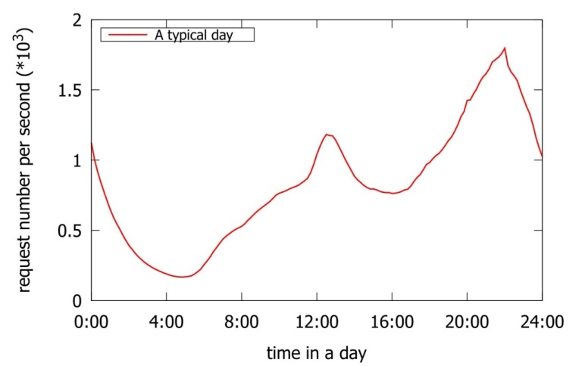
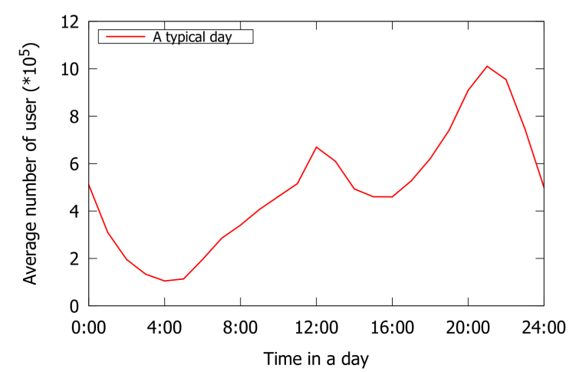
Background: Video Traffic’s Huge Volume and Dynamic Daily Pattern
Video Traffic: Huge Volume
Global Internet Report [Sandvine '23 ]
2022 video traffic: As the percentage of total Internet traffic (excluding video calls/conferencing) | 66%
2022 video traffic growth rate (compared to Year 2021) | 24%
Daily Pattern: Volatile Traffic & Stable Popularity
Surveys indicate: Traffic varies by more than an order of magnitude over merely hours Video popularities are stable and predictable over several days
VoD: User requests over a day
Live streaming: Average user number over a day
Data source of the plots: Tencent Video

Slide 5



Benefit of Auto-Scaling: Allocate Geo-Dispersed Resources on the Fly
Auto-Scaling Data Center
Rescale system resources elastically: Deploy geo-dispersed servers on the fly to support local audience Activated or deactivate a server in a timely manner
Traditional Static Provisioning (For Comparison)
Fixed number of servers Not cost-effective due to daily traffic pattern Inevitable overprovisioning to ensure quality of service
…
Auto-Scaling Servers
Desired Capacity
Scale out as needed
An auto-scaling data center

Slide 6

Challenge I: Optimizing an Auto-Scaling VoD Data Center
System Settings
Servers can be activated or deactivated in a short time A traffic dispatcher distributes request to an active server with the video
Major Tradeoff
Cost-effectiveness: Minimize the number of active servers Quality of service: Allocate enough resource to serve users
Contributions
Prove the NP-hardness Simple but efficient approximation algorithm AVARDO: Auto-Scaling Video Allocation and Request Distribution Optimization
A video cloud consisting of auto-scaling VoD data centers.
Notes:
If not optimized: some server is too busy; some server do nothing.

Slide 7
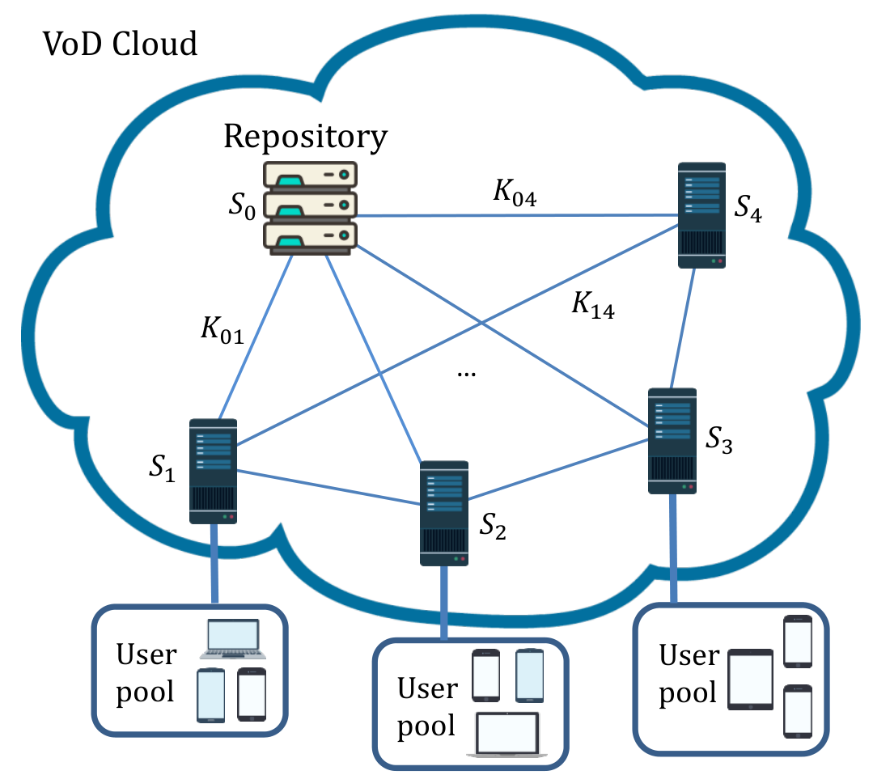
Challenge II: Optimizing a Geo-Distributed VoD Cloud
System Settings
Repository: complete video replication Local server: partial replication to save storage Collaboratively serve the users to reduce cost
Major Tradeoff
Store video locally: Less delay, better Quality of Experience (QoE) Higher storage cost Access video from a remote server: More delay More link/processing cost; less storage cost
Contributions
Prove the NP-hardness Efficient linear-programming based approximation algorithm RAVO: Resource Allocation and Video Management Optimization
A distributed and cooperative cloud architecture for VoD service
Notes:
Store some video locally, retrieve the rest of the video from other servers.

Slide 8
Challenge III: Optimizing an Auto-Scaling Live Cloud
System Settings
Geo-dispersed auto-scaling servers Push each channel stream as a tree Cover servers demanding the channel
Major Tradeoff
Bi-Criteria Objective: Minimize deployment cost Minimize origin-to-end delays
Contributions
Prove the NP-hardness Efficient linear-programming based approximation algorithm COCOS: Cost-Optimized Multi-Origin Multi-Channel Overlay Streaming
A multi-origin multi-channel live streaming cloud.

Slide 9
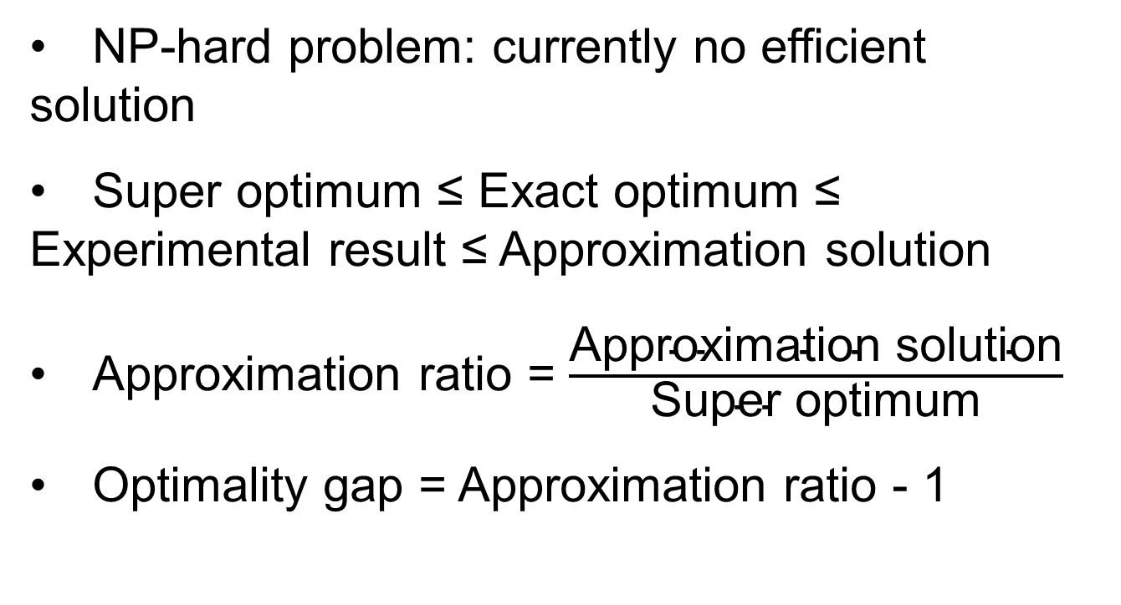
Basic Concepts: Approximation Algorithms
NP-hard problem: currently no efficient solution
Super optimum ≤ Exact optimum ≤ Experimental result ≤ Approximation solution
Approximation ratio = $\frac{\text{Approximation} \text{solution}}{\text{Super} \text{optimum}}$
Optimality gap = Approximation ratio - 1

Slide 10
Contents
Introduction
AVARDO: Optimizing an Auto-Scaling VoD Data Center
RAVO: Optimizing a Geo-Distributed VoD Cloud
COCOS: Optimizing an Auto-Scaling Live Streaming Cloud
Conclusion
Publication:
Z. Chang and S.-H. Chan, "An Approximation Algorithm to Maximize User Capacity for an Auto-scaling VoD System," IEEE Transactions on Multimedia, Vol. 23, pp. 3714-3725, October 2021.

Slide 11
Background: A Typical Auto-scaling VoD Cloud
Auto-scaling Server
Auto-scaling Server can be activated or deactivated in a short time Homogeneous Server has same storage and streaming capacity
Traffic Dispatcher
Distribute request to an active server with the video Otherwise to core network
Video Block
Only for management purpose (cf. DASH segments) Blocks have the same size Partition large video into blocks
A video cloud consisting of auto-scaling VoD data centers.

Slide 12
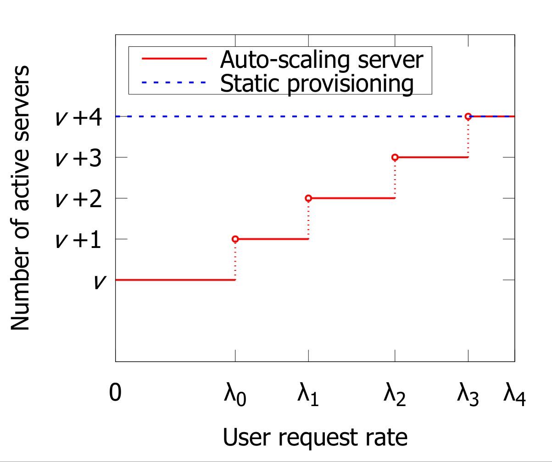

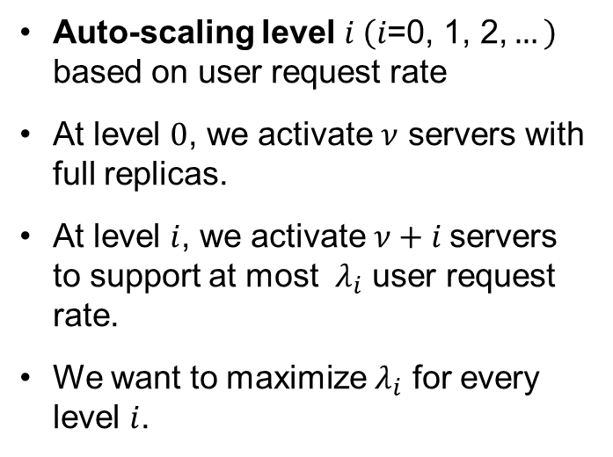
Objective: Maximizing the User Request Rate Threshold $λ_{i}$
Auto-scaling level $i \left(i\text{=0, 1, 2,}…\right)$ based on user request rate
At level $0$, we activate $ν$ servers with full replicas.
At level $i$, we activate $ν+i$servers to support at most $λ_{i}$ user request rate.
We want to maximize $λ_{i}$ for every level $i$.
Notes:
Climbing the steps

Slide 13
Optimization Parameters
 | Block Allocation (BA) | Server Selection (SS) | Request Dispatching (RD)
Question | Which blocks should be allocated in each server? | Which servers should be activated for current traffic? | Which server for a request?
Constraints | Number of blocks a server can store | In active servers: At least one replica for each block Popular blocks in enough servers | Avoid overload of any active servers
Timescale | In day or week | In hour | In second
Dependency | Pre-allocated Videos for SS and RD | Based on BA | Based on BA and SS
Major challenge: optimize one BA to fit multiple SS and RD
Notes:
On-the-fly BA is not necessary due to the relatively stable popularity.

Slide 14
Related Work
 | Related Work | AVARDO
Cloud-based VoD resource provisioning | Data center as a black box Yet to consider features inside the data center [Yang et al. Infosys ’14] | Investigating from a more detailed point of view
Content replication in traditional and cloud-based VoD | Static provisioning [Yang et al. IEEE TMM’ 18] Assume no change of storage [Bourtsoulatze et al. IEEE TMM ’18] | Optimize for every auto-scaling levels
Cloud resources auto-scaling mechanism | Predict the user demand and improve the online phase [Zhao et al. Multimedia Tools Appl ’19] A video is served by only one server [Du et al. IEEE TMM’ 16] | Considers both BA and RD

Slide 15
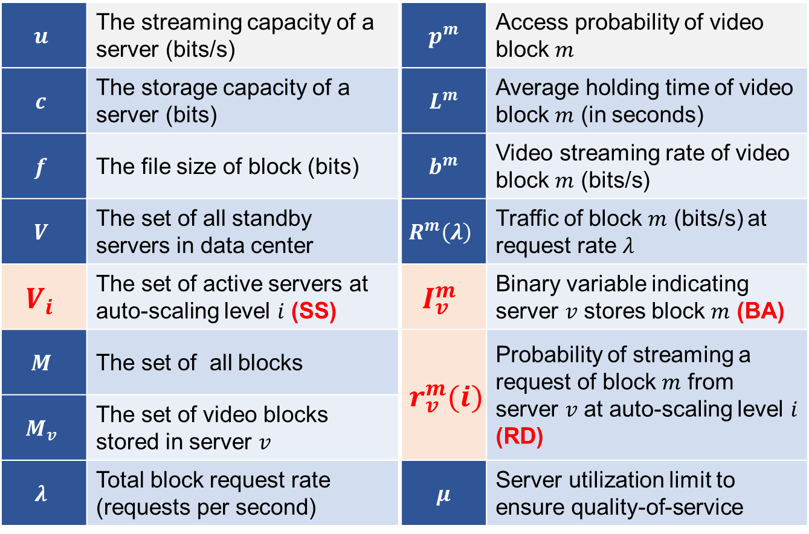
Problem Formulation: Major Symbol Used in AVARDO
$$u$$ | The streaming capacity of a server (bits/s) | $$p^{m}$$ | Access probability of video block $m$
$$c$$ | The storage capacity of a server (bits) | $$L^{m}$$ | Average holding time of video block $m$ (in seconds)
$$f$$ | The file size of block (bits) | $$b^{m}$$ | Video streaming rate of video block $m$ (bits/s)
$$V$$ | The set of all standby servers in data center | $$R^{m}\left(λ\right)$$ | Traffic of block $m$ (bits/s) at request rate $λ$
$$V_{i}$$ | The set of active servers at auto-scaling level $i$ (SS) | $$I_{v}^{m}$$ | Binary variable indicating server $v$ stores block $m$ (BA)
$$M$$ | The set of all blocks | $$r_{v}^{m}(i)$$ | Probability of streaming a request of block $m$ from server $v$ at auto-scaling level $i$ (RD)
$$M_{v}$$ | The set of video blocks stored in server $v$
$$λ$$ | Total block request rate (requests per second) | $$μ$$ | Server utilization limit to ensure quality-of-service

Slide 16
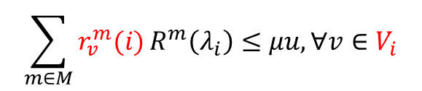

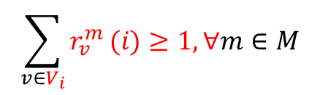


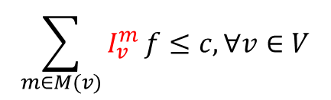
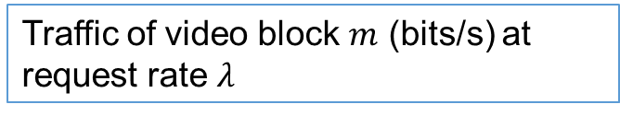
Modeling an NP-Hard Problem: Auto-scaling Video Allocation and Request Dispatching
Objective
$$\max{(λ_{0},λ_{1},…λ_{n})}$$
Maximize request rate threshold
Subject to
Traffic of video block $m$ (bits/s) at request rate $λ$
$$R^{m}\left(λ\right)={λp}^{m}L^{m}b^{m},∀m∈M$$
Storage
$$\sum_{m∈M(v)}{I_{v}^{m}}f≤c,∀v∈V$$
Storage limit of each server (BA)
Streaming
$$r_{v}^{m}\left(i\right)≤I_{v}^{m},∀v∈V_{i}, m∈M$$
Server only serve the video it has (SS)
$$\sum_{v∈V_{i}}{r_{v}^{m}}(i)≥1,∀m∈M$$
User request shall be served (RD)
QoS
$$\sum_{m∈M}{r_{v}^{m}(i)}R^{m}\left(λ_{i}\right)≤μu,∀v∈V_{i}$$
Utilization limit of each server (RD)
Multi-Objective Mixed Integer Programming
The NP-complete Partition Problem is reducible to our problem. It is NP-hard!

Slide 17
AVARDO: Approximation Algorithm for an Auto-scaling Video-on-Demand System
Simplification: Block Replication and Clustering
Replicate some very popular videos Group video blocks into clusters (mega videos). Each cluster has the same file size and similar user traffic.
Solution: From Cluster to Video Blocks
The system satisfies the following constraints: At auto-scaling level 0, the active servers has all clusters. When activate a new server, we can evenly offload traffic from the existing active servers. This can be formulated as a linear system, and has closed-form solution.
AVARDO has a stack-based server selection scheme
Push (activate) or pop (deactivate) a server when auto-scaling level goes up or down
Minimize the server selection overhead
Optimality gap under practical setting: less than 1%

Slide 18
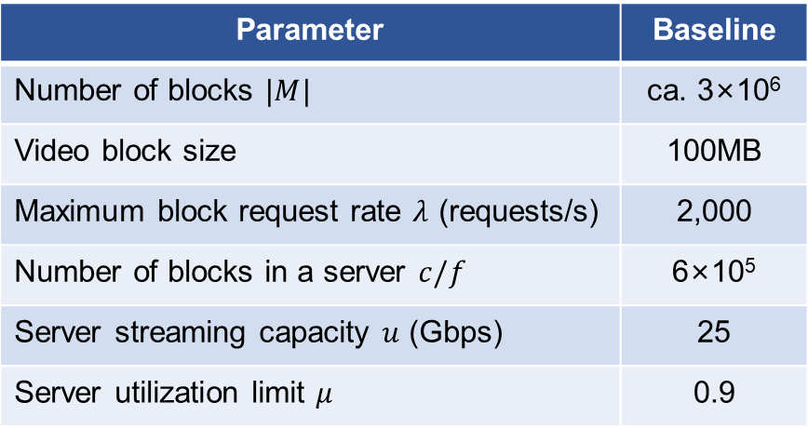
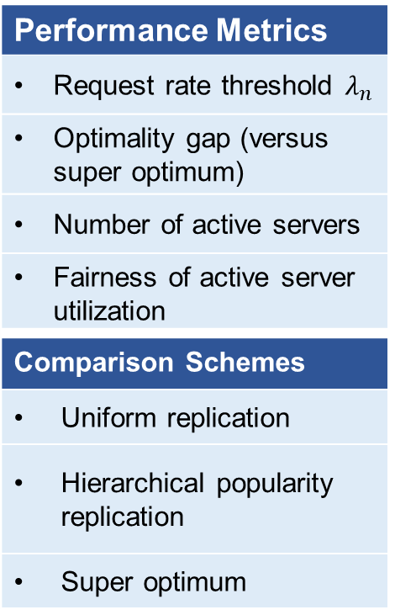
Experimental Setup
Parameter | Baseline
Number of blocks $|M|$ | ca. 3×10⁶
Video block size | 100MB
Maximum block request rate $λ$ (requests/s) | 2,000
Number of blocks in a server $c/f$ | 6×10⁵
Server streaming capacity $u$ (Gbps) | 25
Server utilization limit $μ$ | 0.9
Performance Metrics
Request rate threshold $λ_{n}$
Optimality gap (versus super optimum)
Number of active servers
Fairness of active server utilization
Comparison Schemes
Uniform replication
Hierarchical popularity replication
Super optimum
Real-world data trace is from a leading video website (Tencent Video) in China over 2 weeks with 1.5 million videos in total.
Synthetic date with Zipf’s distribution
Notes:
Uniform replication:
Every video has the same number of replicas. The videos are randomly stored in the servers.
Hierarchical popularity replication:
2 types of server: repository and cache. Repository servers collaboratively store all. Caches only store popular videos.
Super optimum:
Serves as the theoretical performance bound. We assume that a video can be partitioned infinitesimally (i.e., $f→0$).

Slide 19
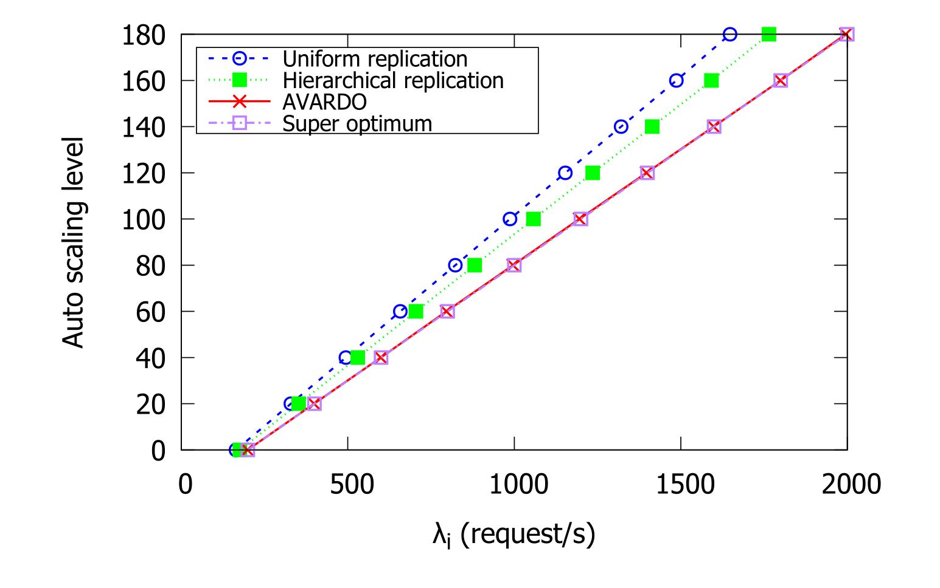
Near Optimal Performance

Slide 20
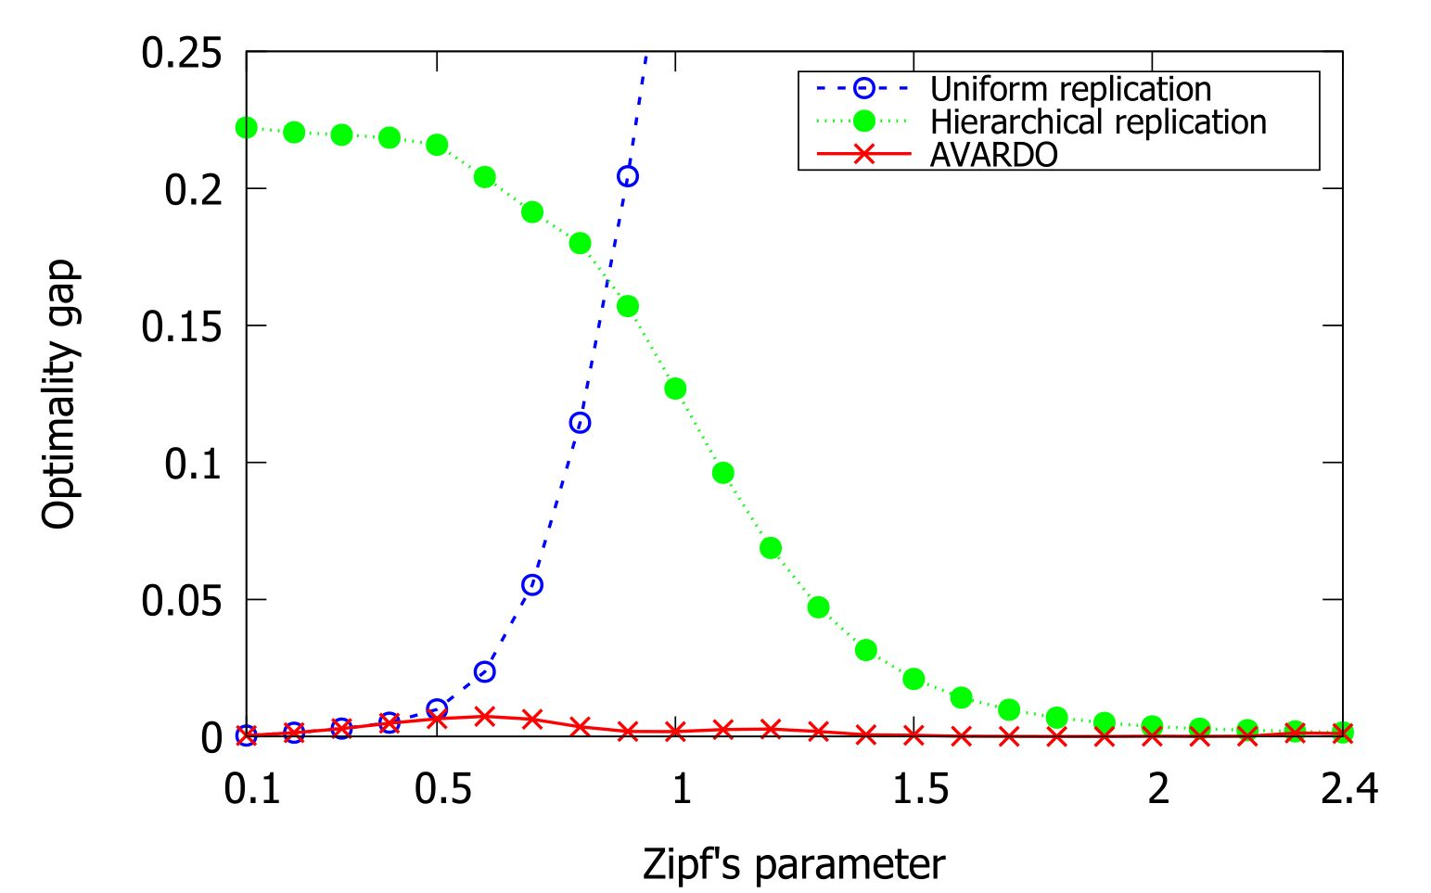
Outperform State-of-the-art Schemes
Notes:
Why do you say they are state-of-the-art?
Tell us how you translate lambda into optimality gap.

Slide 21
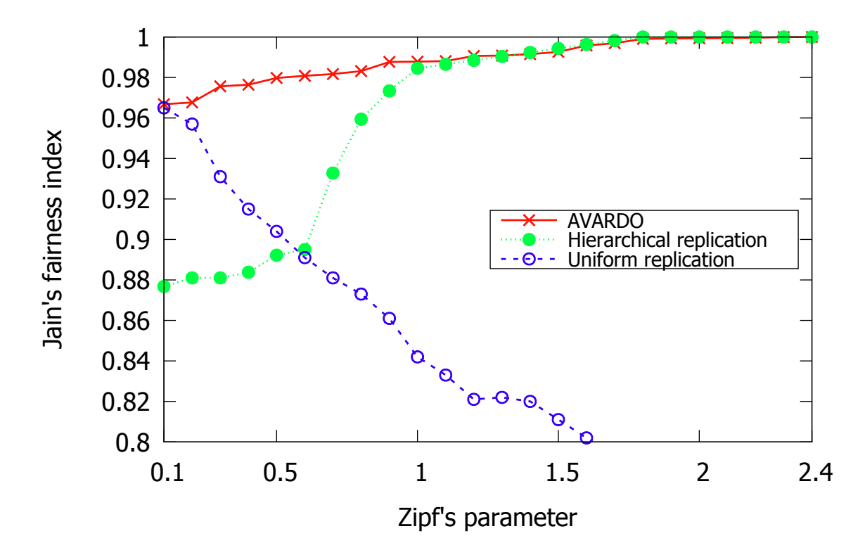
Better Load Balancing

Slide 22
Contents
Introduction
AVARDO: Optimizing an Auto-Scaling VoD Data Center
RAVO: Optimizing a Geo-Distributed VoD Cloud
COCOS: Optimizing an Auto-Scaling Live Streaming Cloud
Conclusion
Publication:
Z. Chang and S.-H. Chan, "Video Management and Resource Allocation for a Large-scale VoD Cloud," ACM Transactions on Multimedia Computing, Communication and Applications (TOMM) Special Issue on Multimedia Big Data: Networking, Vol. 12, No. 5s, pp. 72:1-72:21, Sept 2016.

Slide 23


Background: A Geo-Distributed Auto-Scaling VoD Cloud
 | Repository: Complete video replication
 | Local cloud server: Auto-scaling data centers to serve their user pool
 | User pool: Heterogeneous video popularities
Geographic Heterogeneity of Video Popularities
Local servers have partial video replication to save storage Reduce network load through co-operation among local servers
A distributed and cooperative cloud architecture for VoD service

Slide 24
Tradeoff: Deployment Cost vs. Quality-of-Service (QoS)
Store Video Locally
+ Less delay Less link & processing capacity Better collaboration - More storage capacity
Access Video Remotely
+ Less storage capacity - More delay More link & processing capacity Less collaboration
Objectives:
Satisfy the quality-of-service constraints
Minimize total deployment cost

Slide 25
Optimization Parameters
Video Management (VM)
Storage (content replication) What video to store at each server? Planned on a longer time scale (days) Retrieval (server selection) Which servers to stream the missing video from? Decided when a request comes
Resource Allocation (RA)
Server Resource Total storage and processing capacity at a server Link Resource Link capacity reserved between pairs of servers

Slide 26
Related Work
Fundamental difference:
RAVO is an approximation algorithm
 | Related Work | RAVO
Traditional resource allocation | Based on heuristic approach The optimality gap is not clear [Adhikari et al. Infocom’ 12] | Discretized from LP solution Proven approximation ratio
Content Storage and Retrieval for VoD | Need resource allocation result first Static resource provisioning [Applegate et al. Co-NEXT’10] | One-step algorithm for both resource allocation and content management Auto-scaling feature
Current resource allocation for cloud service | Assume full replication Only consider link capacity allocation [Lin et al. Infocom’ 11] | Flexible replication to reduce the storage cost Servers help each other to fully utilize the resource

Slide 27
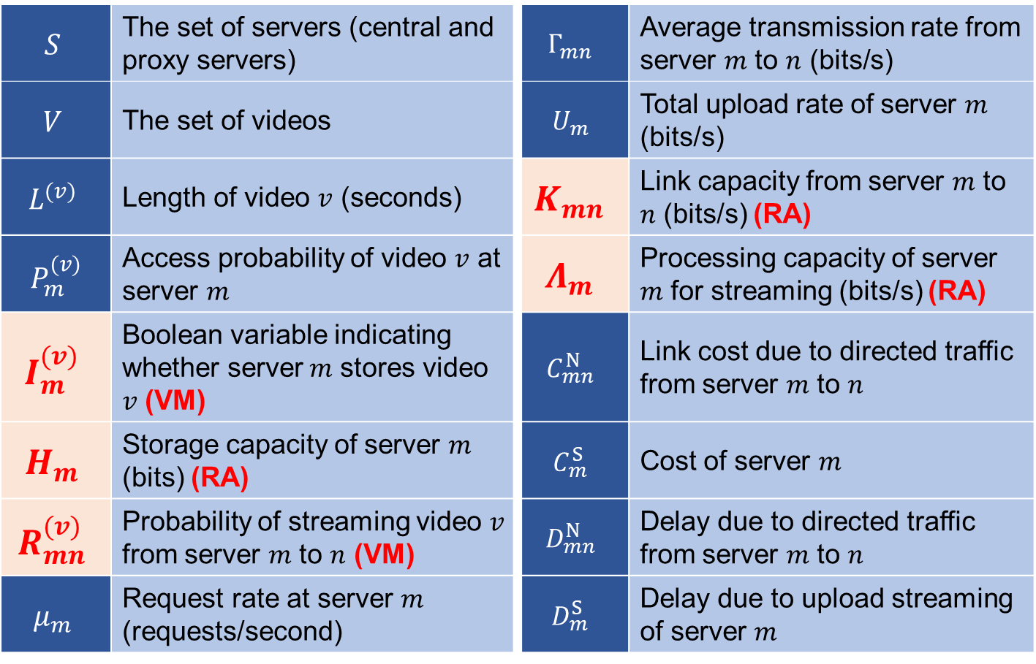
Problem Formulation: Major Symbols Used in RAVO
$$S$$ | The set of servers (central and proxy servers) | $$Γ_{mn}$$ | Average transmission rate from server $m$ to $n$ (bits/s)
$$V$$ | The set of videos | $$U_{m}$$ | Total upload rate of server $m$ (bits/s)
$$L^{(v)}$$ | Length of video $v$ (seconds) | $$K_{mn}$$ | Link capacity from server $m$ to $n$ (bits/s) (RA)
$$P_{m}^{(v)}$$ | Access probability of video $v$ at server $m$ | $$Λ_{m}$$ | Processing capacity of server $m$ for streaming (bits/s) (RA)
$$I_{m}^{(v)}$$ | Boolean variable indicating whether server$m$ stores video $v$ (VM) | $$C_{mn}^{N}$$ | Link cost due to directed traffic from server $m$ to $n$
$$H_{m}$$ | Storage capacity of server $m$ (bits) (RA) | $$C_{m}^{S}$$ | Cost of server $m$
$$R_{mn}^{(v)}$$ | Probability of streaming video $v$ from server $m$ to $n$ (VM) | $$D_{mn}^{N}$$ | Delay due to directed traffic from server $m$ to $n$
$$μ_{m}$$ | Request rate at server $m$ (requests/second) | $$D_{m}^{S}$$ | Delay due to upload streaming of server $m$

Slide 28
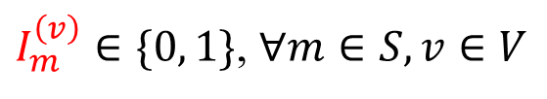
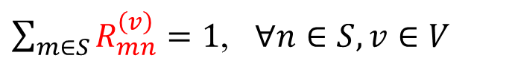
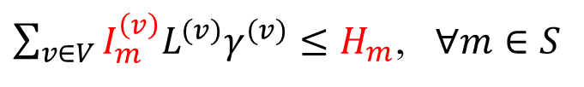
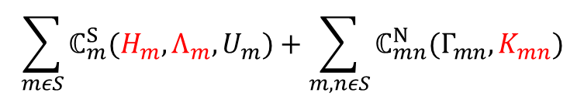
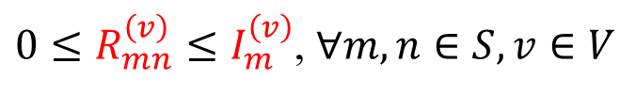
Modeling an NP-Hard Problem: Joint Optimization on Video Management and Resource Allocation
Server cost
Link cost
$$\sum_{mεS}{ℂ_{m}^{S}(H_{m},Λ_{m},U_{m})}+\sum_{m,nεS}{ℂ_{mn}^{N}(Γ_{mn},K_{mn})}$$
minimize
System deployment cost
Storage
Processing
Capacity
Access bandwidth (consumed)
Subject to
$I_{m}^{\left(v\right)}∈\{0, 1\}$, $∀m∈S, v∈V$
Store a video as a whole
Storage
Retrieval
${0≤R}_{mn}^{\left(v\right)}≤I_{m}^{\left(v\right)}$, $∀m,n∈S, v∈V$
Only retrieve video from a server with it
$\sum_{v∈V}{I_{m}^{\left(v\right)}L^{(v)}γ^{(v)}}≤H_{m}$, $∀m∈S$
Server storage constraint
$\sum_{m∈S}{R_{mn}^{\left(v\right)}}=1$, $∀n∈S, v∈V$
User request must be served
$Γ_{mn}=\sum_{v∈V}{p_{n}^{\left(v\right)}ε_{n}^{\left(v\right)}μ_{n}R_{mn}^{\left(v\right)}L^{(v)}γ^{(v)}}$, $∀m,n∈S$
Remote traffic
QoS
$𝔻_{mn}^{N}\left(Γ_{mn},K_{mn}\right)+𝔻_{m}^{S}\left(U_{m},Λ_{m}\right)≤\overline{D},$ $∀m,n∈S$
Delay
The NP-complete Dominating Set Problem is reducible to our problem. It is NP-Hard!

Slide 29
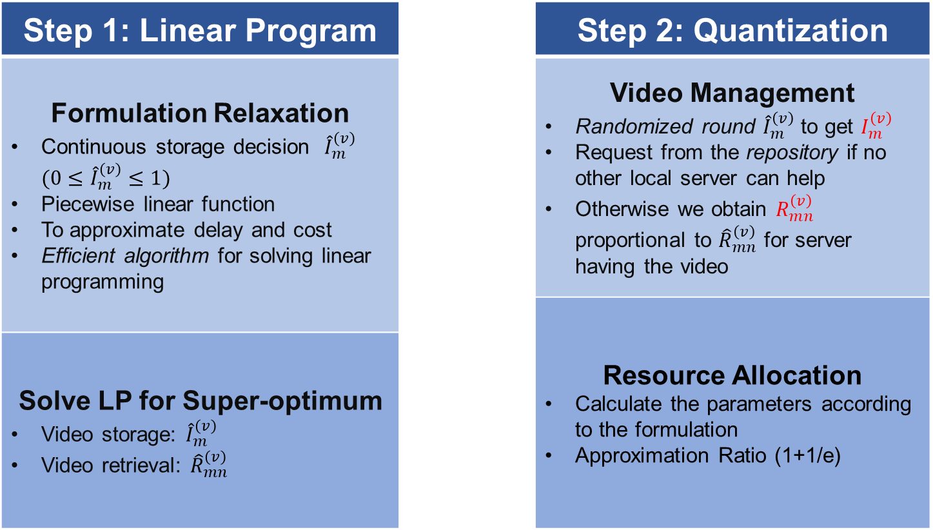
RAVO: Relaxing the Joint Formulation as a Linear Program and Quantization of the Solution
Step 1: Linear Program |  | Step 2: Quantization
Formulation Relaxation Continuous storage decision ${\hat{I}}_{m}^{\left(v\right)} (0≤{\hat{I}}_{m}^{\left(v\right)}≤1)$ Piecewise linear function To approximate delay and cost Efficient algorithm for solving linear programming |  | Video Management Randomized round ${\hat{I}}_{m}^{\left(v\right)}$ to get $I_{m}^{\left(v\right)}$ Request from the repository if no other local server can help Otherwise we obtain $R_{mn}^{\left(v\right)}$ proportional to ${\hat{R}}_{mn}^{\left(v\right)}$ for server having the video
 |  | Resource Allocation Calculate the parameters according to the formulation Approximation Ratio (1+1/e)
Solve LP for Super-optimum Video storage: ${\hat{I}}_{m}^{\left(v\right)}$ Video retrieval: ${\hat{R}}_{mn}^{\left(v\right)}$

Slide 30
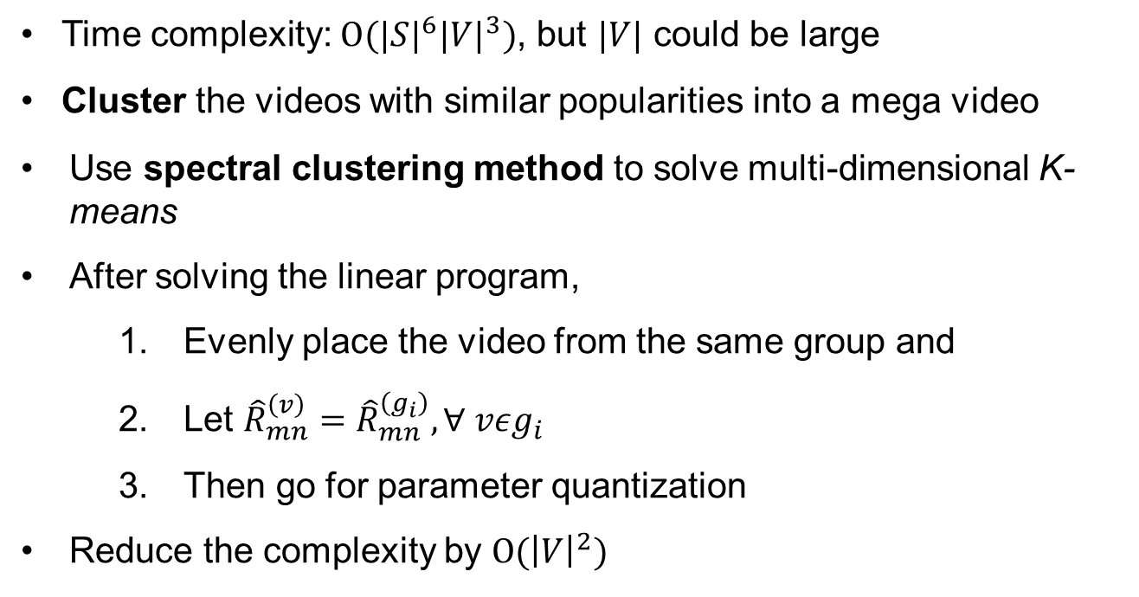
Reducing the Algorithmic Time Complexity: Spectral Clustering for Video Group
Time complexity: $O{(|S|}^{6}{|V|}^{3})$, but $|V|$ could be large
Cluster the videos with similar popularities into a mega video
Use spectral clustering method to solve multi-dimensional K-means
After solving the linear program,
Evenly place the video from the same group and
Let ${\hat{R}}_{mn}^{\left(v\right)}={\hat{R}}_{mn}^{\left(g_{i}\right)},∀ vεg_{i}$
Then go for parameter quantization
Reduce the complexity by $O({\left|V\right|}^{2})$

Slide 31
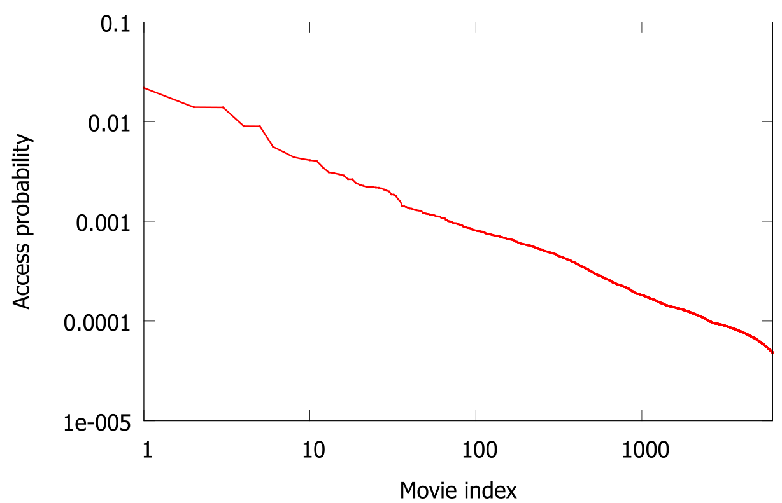
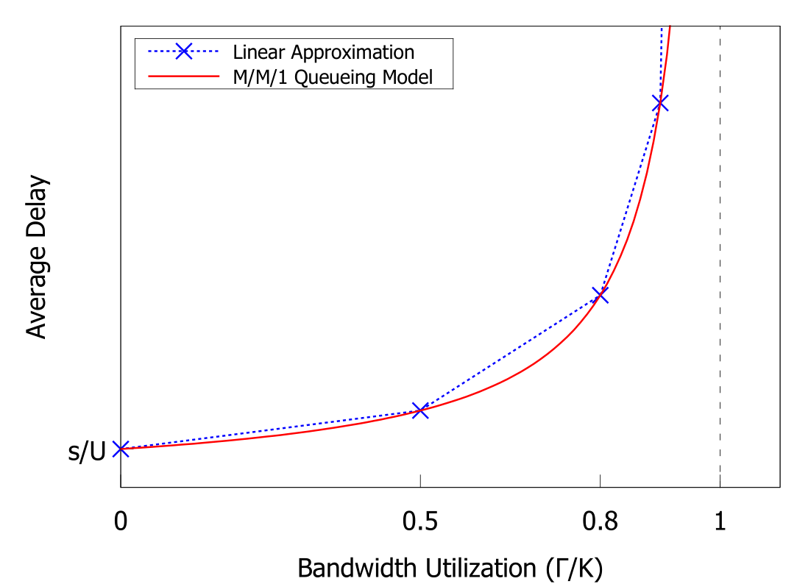
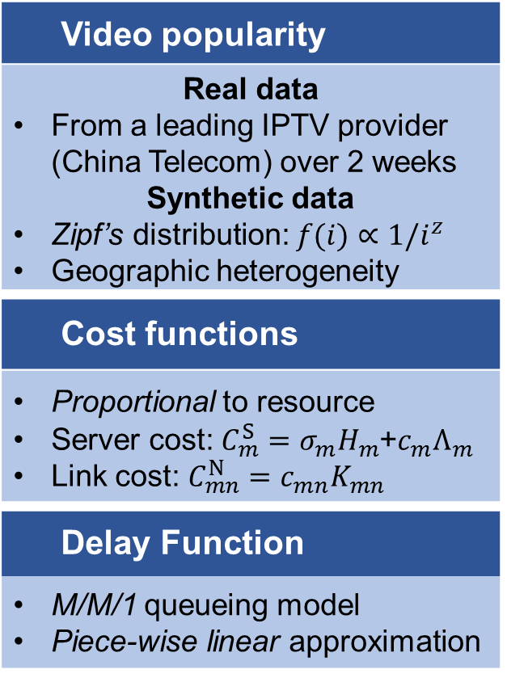
Experimental Setup
Video popularity
Real data From a leading IPTV provider (China Telecom) over 2 weeks Synthetic data Zipf’s distribution: $f(i)∝1/i^{z}$ Geographic heterogeneity
Cost functions
Proportional to resource Server cost: $C_{m}^{S}=σ_{m}H_{m}$+$c_{m}Λ_{m}$ Link cost: $C_{mn}^{N}=c_{mn}K_{mn}$
Delay Function
M/M/1 queueing model Piece-wise linear approximation

Slide 32
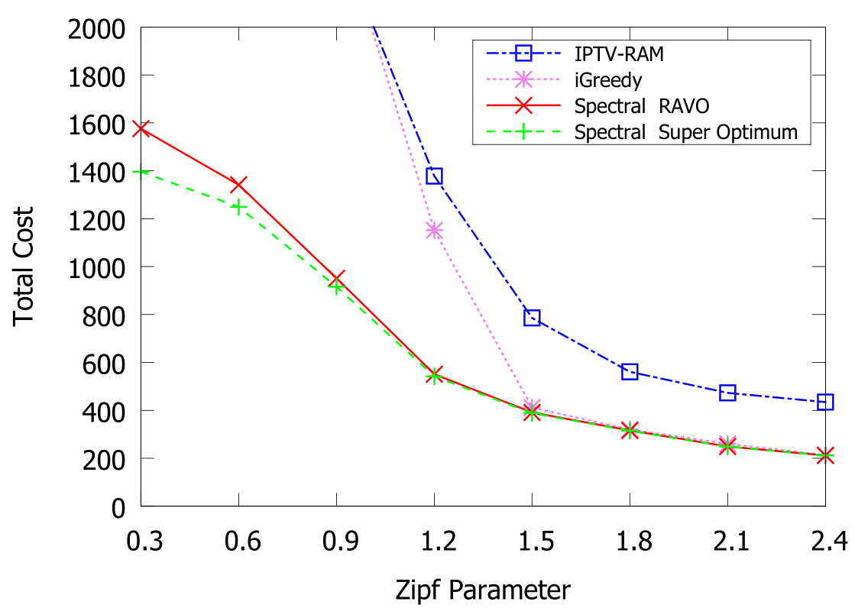
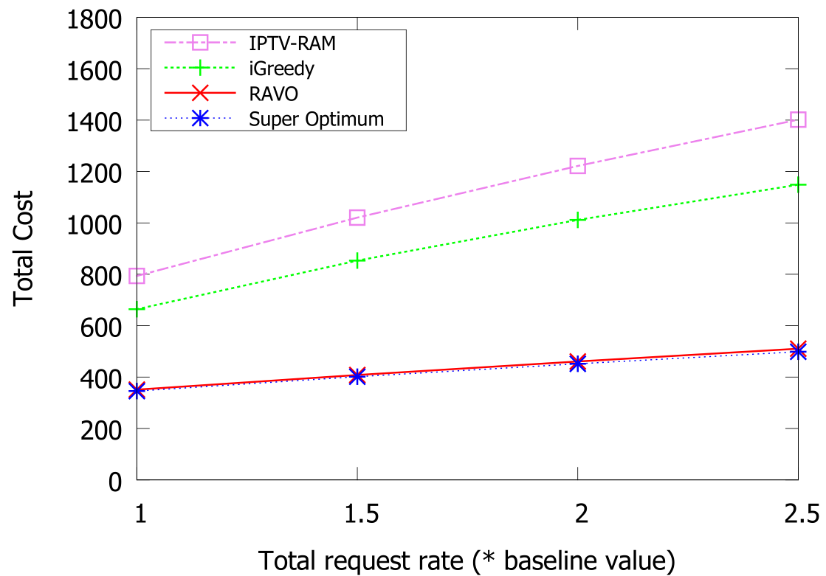
Near-Optimal Performance
Synthetic Data
Real Data
RAVO outperforms the comparison schemes with large margin
Close to the super optimum
Notes:
iGreedy with optimal resource allocation
Consider local popularity
No cooperative replication
IPTV-RAM with optimal content management
2 video categories based on global popularity
Super-optimal
LP solution before quantization

Slide 33
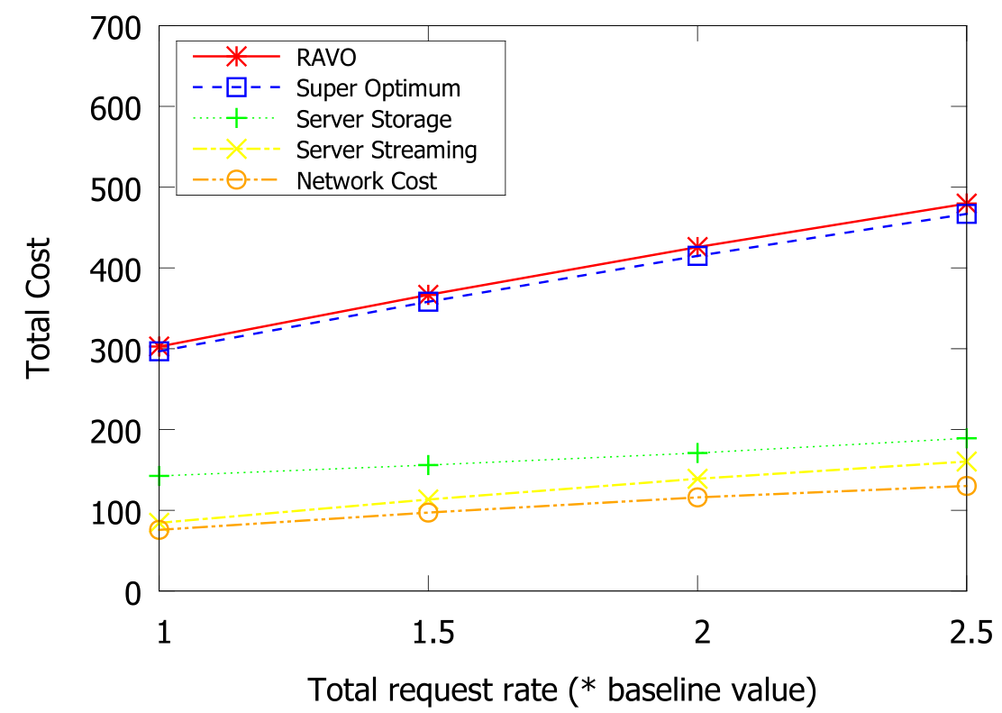
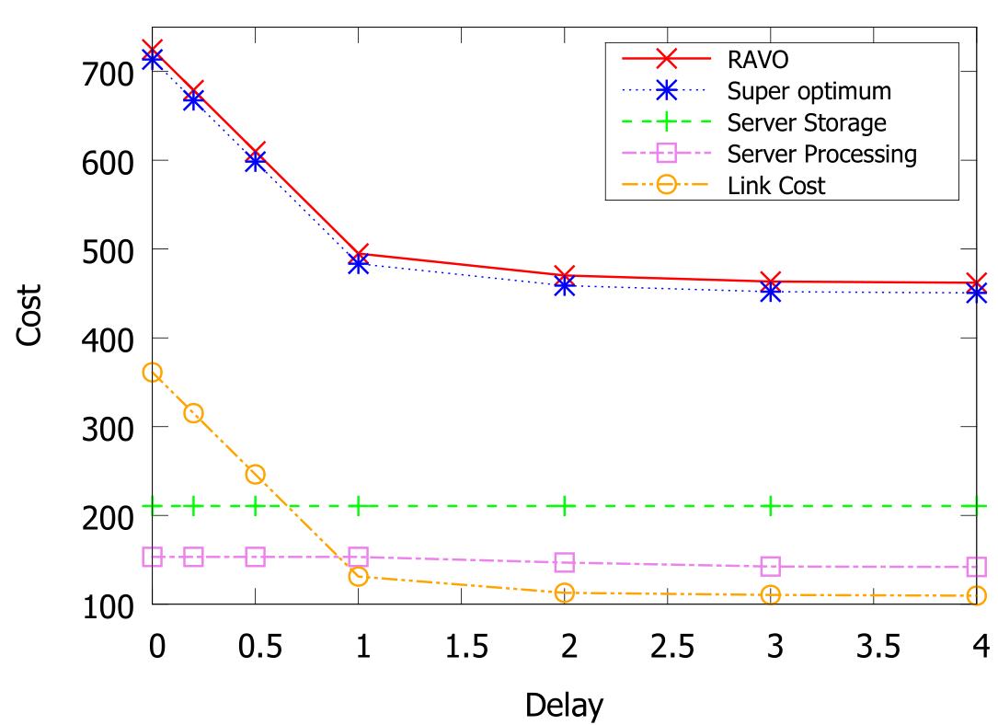
Effective Use of Resources
Deployment cost given different request rate
Cost versus Delay Requirement
The change of cost is distributed into all the components

Slide 34
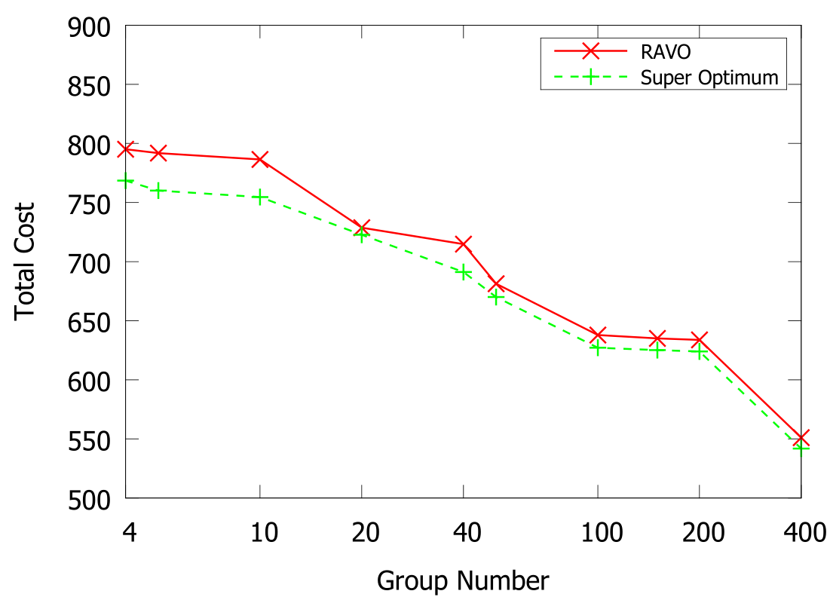
Effective Clustering Method
The cost decreases with more groups (and more computation time)

Slide 35
Contents
Introduction
AVARDO: Optimizing an Auto-Scaling VoD Data Center
RAVO: Optimizing a Geo-Distributed VoD Cloud
COCOS: Optimizing an Auto-Scaling Live Streaming Cloud
Conclusion
Publication:
Z. Chang and S.-H. Chan, "Bi-Criteria Approximation for a Multi-Origin Multi-Channel Auto-Scaling Live Streaming Cloud," IEEE Transactions on Multimedia, Vol. 25, pp. 2839-2850, July 2023.

Slide 36
Background: Multi-source Multi-channel Live Streaming Cloud
Major Components in a Live Streaming Cloud
Origin Server | Source of live video channels.
End Server | Stream the live content to its associated local users. (e.g., a CDN node, server farm, data center, etc.)
Channel | Multiple streaming rates
An end server requests channels based on local demand and serves its local users.
End servers (with user demands) help each other in streaming contents.
Channels are pushed from the sources to the servers.

Slide 37
Bi-criteria Objectives: Deployment Cost and Source-to-end Delay
Minimize Origin-to-End Delay
Server-to-Server (S2S) Delay: Time to travel through a link Origin-to-End (O2E) Delay: Delay from the origin server to an end server demanding the channel Sum of the S2S delays of links forming the path
Minimize Deployment Cost
Deployment cost consists of Server Cost and Link Cost Server Cost: Due to the servers allocating its uploading capacity to the other servers Link Cost: Due to the pairwise link capacity allocated between servers

Slide 38
Optimizing the Bi-criteria Problem
Equivalently to
Minimizing deployment cost
Subject to source-to-end delay constraint
Overlay construction (OC):
How to build the delivery tree of each channel？
To what servers and what channel should a server forward？
Resource Allocation (RA)
Regularly re-optimize the overlay when parameter changes

Slide 39
Related Work
Fundamental difference:
COCOS is an approximation algorithm
 | Related Work | COCOS
Traditional P2P live streaming | Different objective: reduce server load [Tran et al. ICISA’ 17, Ha et al. MTA’16, Roverso et al. MMSys’15] | Optimize cost and delay
Crowdsourced live streaming | Deliver contents from an end server to local audience [Hu et al. IEEE JSAC’17, H. K. Yarnagula et al. IEEE TMM ’19, I. Irondi et al. IEEE TMM ’19] | Orthogonal to our problem
Live streaming works focus on other objectives | Focus on QoS objectives [R.-X. Zhang et al. MM’20, R.-X. Zhang et al. NOSSDAV’19, F. Haouari et al. ICC’19] Maximizing bandwidth or minimizing source load [Chen et al. P2P Netw. Appl.’17, S. Budhkar et al. P2Pr Netw. Appl’19] | Different objective

Slide 40
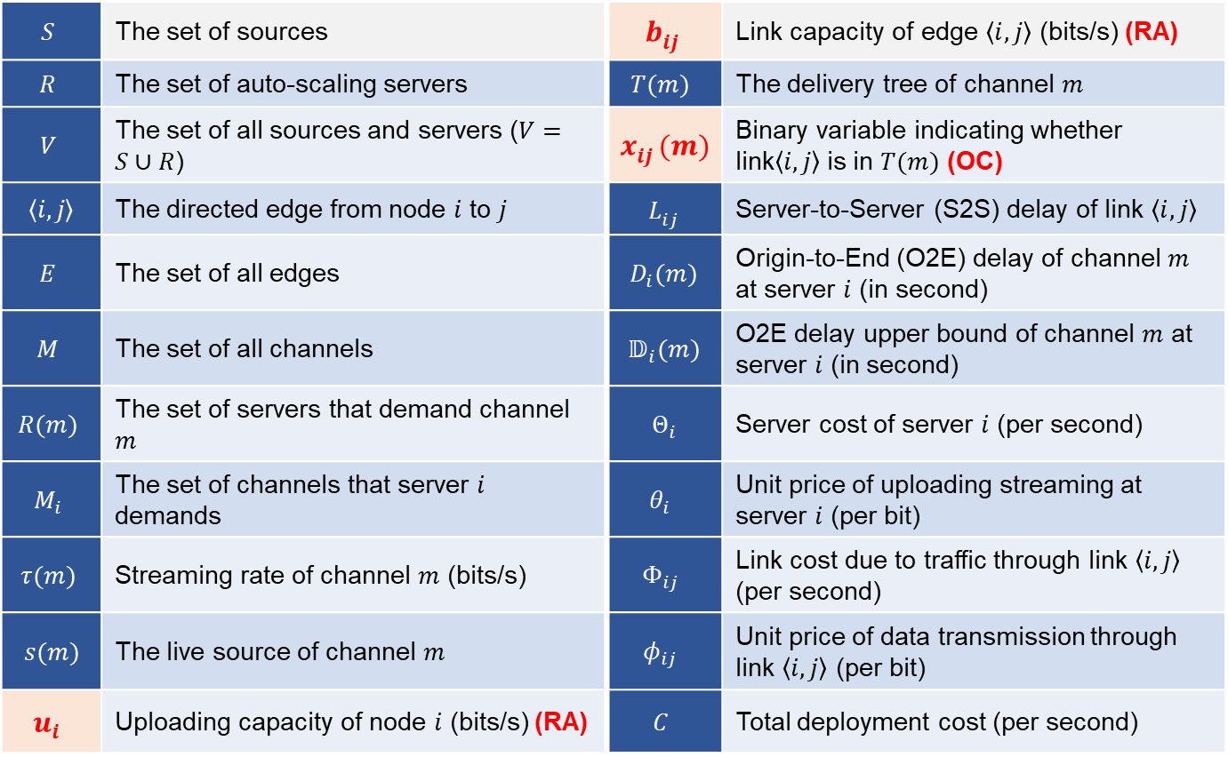
Problem Formulation: Major Symbols Used in COCOS
$$S$$ | The set of sources | $$b_{ij}^{}$$ | Link capacity of edge $\left\langle i, j\right\rangle$ (bits/s) (RA)
$$R$$ | The set of auto-scaling servers | $$T(m)$$ | The delivery tree of channel $m$
$$V$$ | The set of all sources and servers ($V=S∪R$) | $$x_{ij}^{}(m)$$ | Binary variable indicating whether link$\left\langle i, j\right\rangle$is in $T(m)$ (OC)
$$\left\langle i, j\right\rangle$$ | The directed edge from node $i$ to $j$ | $$L_{ij}^{}$$ | Server-to-Server (S2S) delay of link $\left\langle i, j\right\rangle$
$$E$$ | The set of all edges | $$D_{i}(m)$$ | Origin-to-End (O2E) delay of channel $m$ at server $i$ (in second)
$$M$$ | The set of all channels | $$𝔻_{i}(m)$$ | O2E delay upper bound of channel $m$ at server $i$ (in second)
$$R(m)$$ | The set of servers that demand channel $m$ | $$Θ_{i}$$ | Server cost of server $i$ (per second)
$$M_{i}$$ | The set of channels that server $i$ demands | $$θ_{i}$$ | Unit price of uploading streaming at server $i$ (per bit)
$$τ(m)$$ | Streaming rate of channel $m$ (bits/s) | $$Φ_{ij}$$ | Link cost due to traffic through link $\left\langle i, j\right\rangle$ (per second)
$$s(m)$$ | The live source of channel $m$ | $$φ_{ij}$$ | Unit price of data transmission through link $\left\langle i, j\right\rangle$ (per bit)
$$u_{i}$$ | Uploading capacity of node $i$ (bits/s) (RA) | $$C$$ | Total deployment cost (per second)

Slide 41
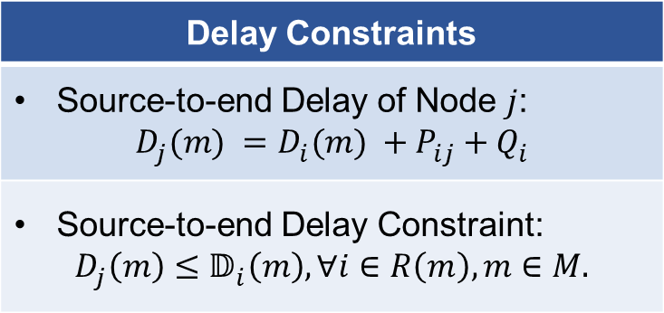
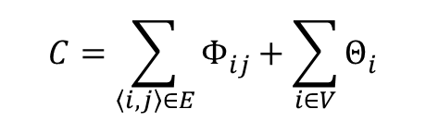
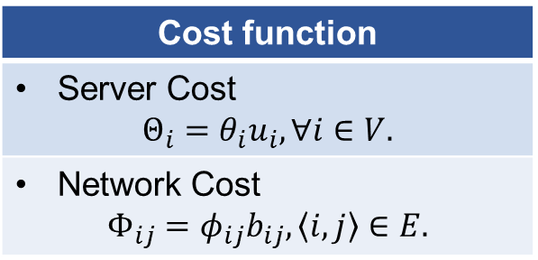
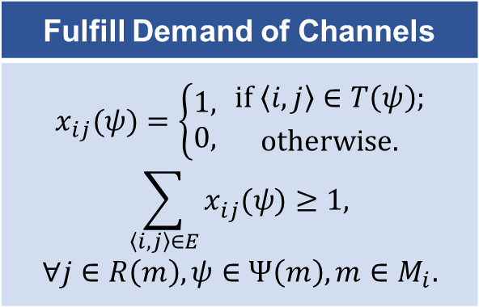
Modeling an NP-Hard Problem: Minimum Cost Streaming with Delay Constraints
Delay Constraints
Source-to-end Delay of Node $j$: $$D_{j}^{}(m) =D_{i}^{}(m) +P_{ij}^{}+Q_{i}^{}$$
Source-to-end Delay Constraint: $$D_{j}^{}\left(m\right)≤𝔻_{i}^{}\left(m\right), ∀i∈R\left(m\right), m∈M.$$
Minimize the total cost:
$$C=\sum_{\left\langle i, j\right\rangle ∈E}{Φ_{ij}^{}}+\sum_{i∈V}{Θ_{i}^{}}$$
Cost function
Server Cost $$Θ_{i}=θ_{i}u_{i}, ∀i∈V.$$
Network Cost $$Φ_{ij}=φ_{ij}b_{ij},\left\langle i, j\right\rangle ∈E.$$
Fulfill Demand of Channels
$$x_{ij}(ψ)=\left\{\begin{aligned}1, \\ 0,\end{aligned} {if \left\langle i, j\right\rangle ∈T\left(ψ\right); \atop otherwise.}\right.$$ $$\sum_{\left\langle i, j\right\rangle ∈E}{x_{ij}^{}(ψ)}≥1,$$ $$∀j∈R\left(m\right),ψ∈Ψ\left(m\right), m∈M_{i}.$$
NP-complete Restricted Shortest Path Problem (RSP) is reducible to our problem. It is NP-Hard!

Slide 42
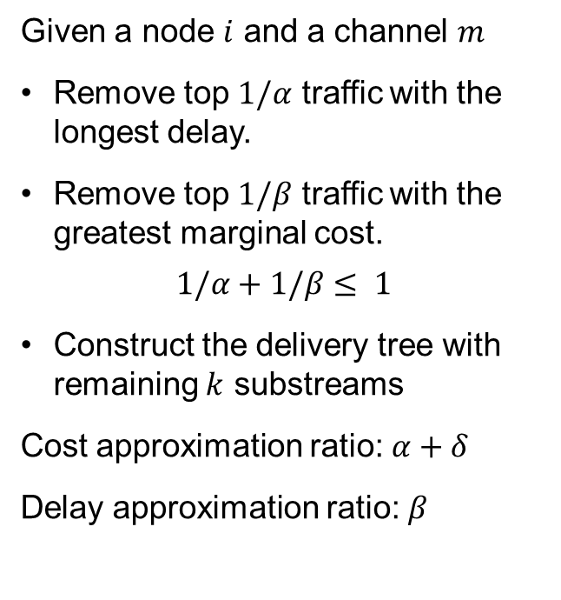
Overlay Construction and Resource Allocation
Relaxed to a LP problem
Topology construction
We transform the original problem through the following relaxation:
LP solution can have arbitrary number of substream paths
Each substream can have arbitrary bitrate
Constraints on source-to-end delay: Use average substream delay
Given a node $i$ and a channel $m$
Remove top $1/α$ traffic with the longest delay.
Remove top $1/β$ traffic with the greatest marginal cost.
$$1/α+1/β≤ 1$$
Construct the delivery tree with remaining $k$ substreams
Cost approximation ratio: $α+δ$
Delay approximation ratio: $β$

Slide 43
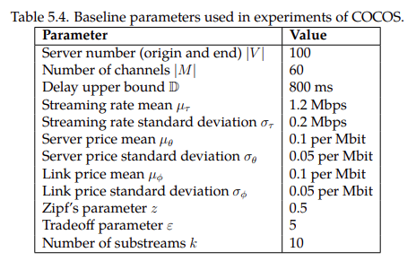
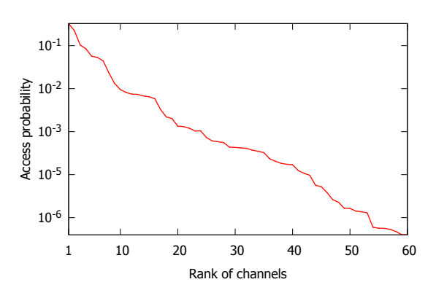
Experimental Setup
Performance Metrics
Deployment cost Server cost Link cost Delay
Comparison Schemes
Nearest Neighbor Consider local popularity No cooperative replication Prim Minimum cost tree Modified to meet delay constraints Super-optimal LP solution (performance bound)

Slide 44
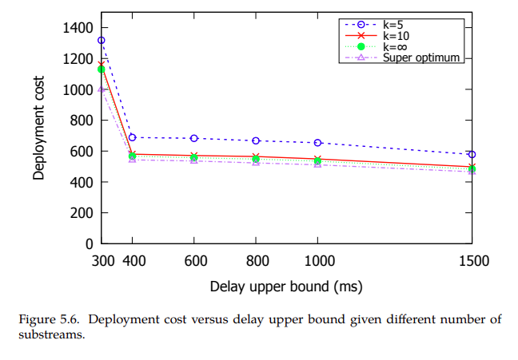
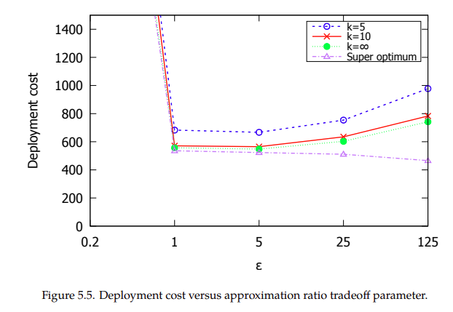


Good Tradeoff between Cost and Delay
$$α=1+ε$$
$$β=1+1/ε$$

Slide 45
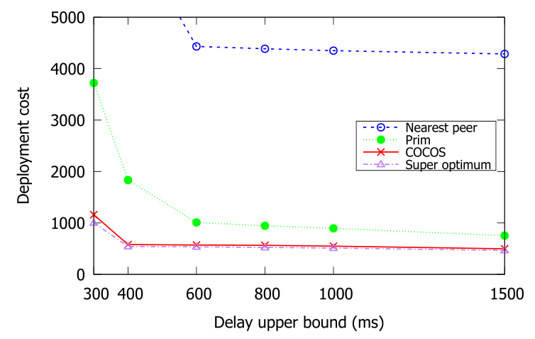
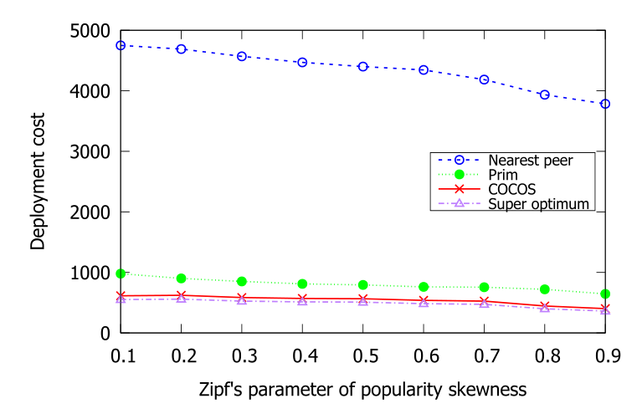
Near-Optimal Performance
Real-world data trace:
From a leading video service website in China (Tencent) over 2 weeks
Near-optimal performance:
Outperform state-of-the-art schemes
Synthetic data:
Verify the performance given difference video popularity
Stable performance:
Given different video popularity

Slide 46
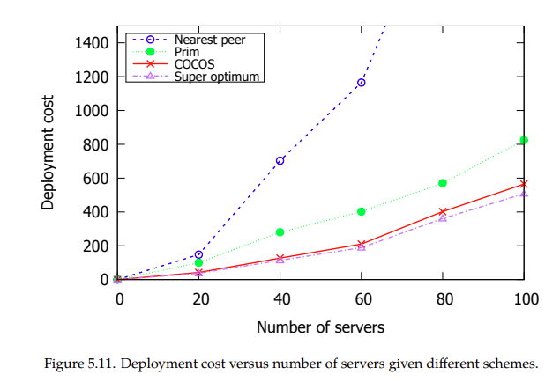
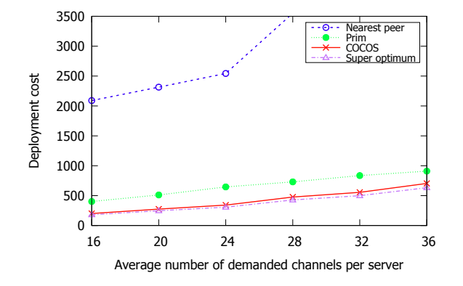
Scalable Scheme

Slide 47
Contents
Introduction
AVARDO: Optimizing an Auto-Scaling VoD Data Center
RAVO: Optimizing a Geo-Distributed VoD Cloud
COCOS: Optimizing an Auto-Scaling Live Streaming Cloud
Conclusion

Slide 48
Conclusion
Motivations | Video traffic: Huge volume and dynamic daily pattern Auto-scaling: Rescale the resource elastically
Objective | Minimize the deployment cost Ensure the user experience
Contribution | VoD data center AVARDO: Stack-based approximation algorithm Geo-distributed VoD cloud RAVO: LP-based approximation with video clustering Multi-origin multi-channel live cloud COCOS: Bi-criteria approximation algorithm
Future Work | Integrate fog devices into our cloud system

Slide 49
List of Publications
Journal publications
Z. Chang and S.-H. Chan, "Bi-Criteria Approximation for a Multi-Origin Multi-Channel Auto-Scaling Live Streaming Cloud," IEEE Transactions on Multimedia, Vol. 25, pp. 2839-2850, July 2023.
Z. Chang and S.-H. Chan, "An Approximation Algorithm to Maximize User Capacity for an Auto-scaling VoD System," IEEE Transactions on Multimedia, Vol. 23, pp. 3714-3725, October 2021.
Z. Chang and S.-H. Chan, "Video Management and Resource Allocation for a Large-scale VoD Cloud," ACM Transactions on Multimedia Computing, Communication and Applications (TOMM) Special Issue on Multimedia Big Data: Networking, Vol. 12, No. 5s, pp. 72:1-72:21, Sept 2016.
Z. Chang and S.-H. Chan, "Bucket-Filling: An Asymptotically Optimal VoD Network with Source Coding," IEEE Transactions on Multimedia, Vol. 17, No. 5, pp. 723-735, May 2015.
Conference publications
J. Dai, Z. Chang and S.-H. Chan, "Delay Optimization for Multi-source Multi-channel Overlay Live Streaming," in Proceedings of IEEE ICC 2015 - Communications Software, Services and Multimedia Applications Symposium (ICC'15), (London, United Kingdom), pp. 8587-92, 8-12 June 2015.

Slide 50
Thank You!
Any Questions?

