Slide 1
ISAAC Project Update
Schema, Portal, and Roadmap

Slide 2
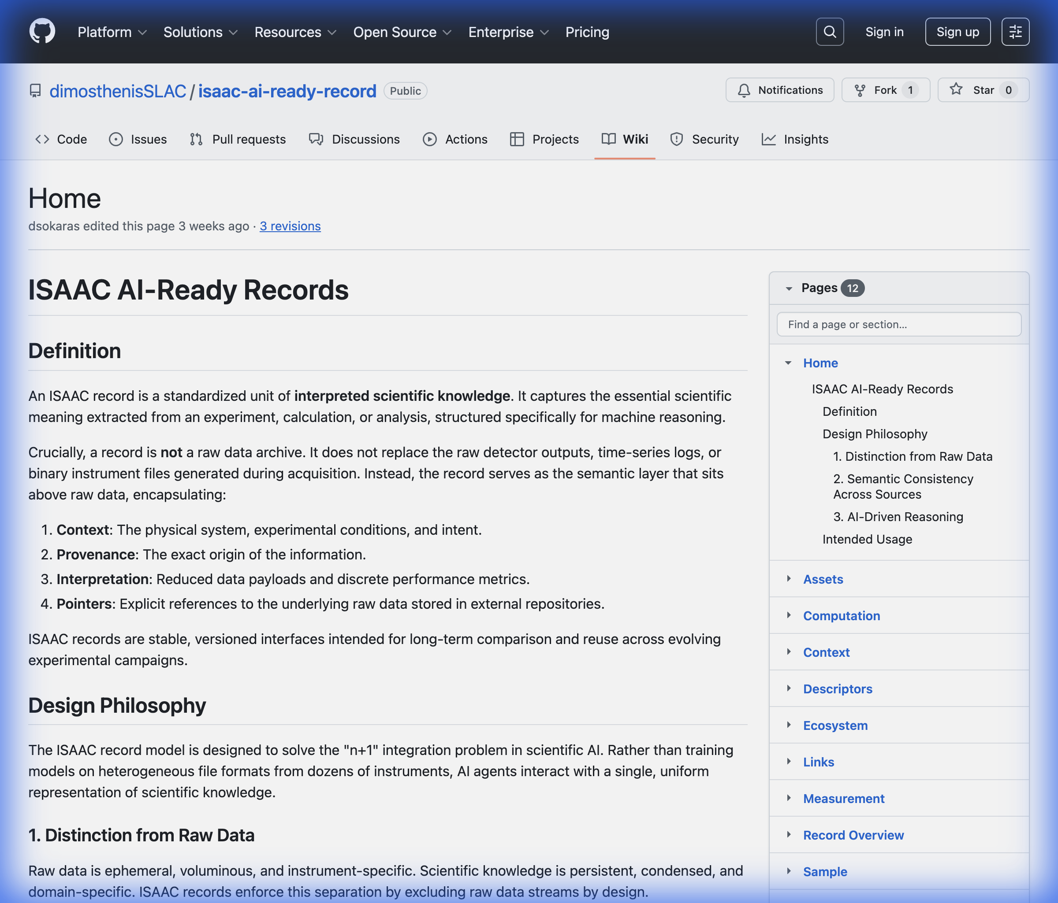
1. The Foundation: AI-Ready Schema
• Based on our GitHub Wiki: 'The Semantic Layer above Raw Data'.
• ISAAC Records capture meaning, not just bytes.
• Key Components defined in the Wiki:
- Context: Physical system & conditions.
- Provenance: Origin of the information.
- Interpretation: Reduced metrics (e.g., efficiency).
- Pointers: Links to raw data files.

Slide 3
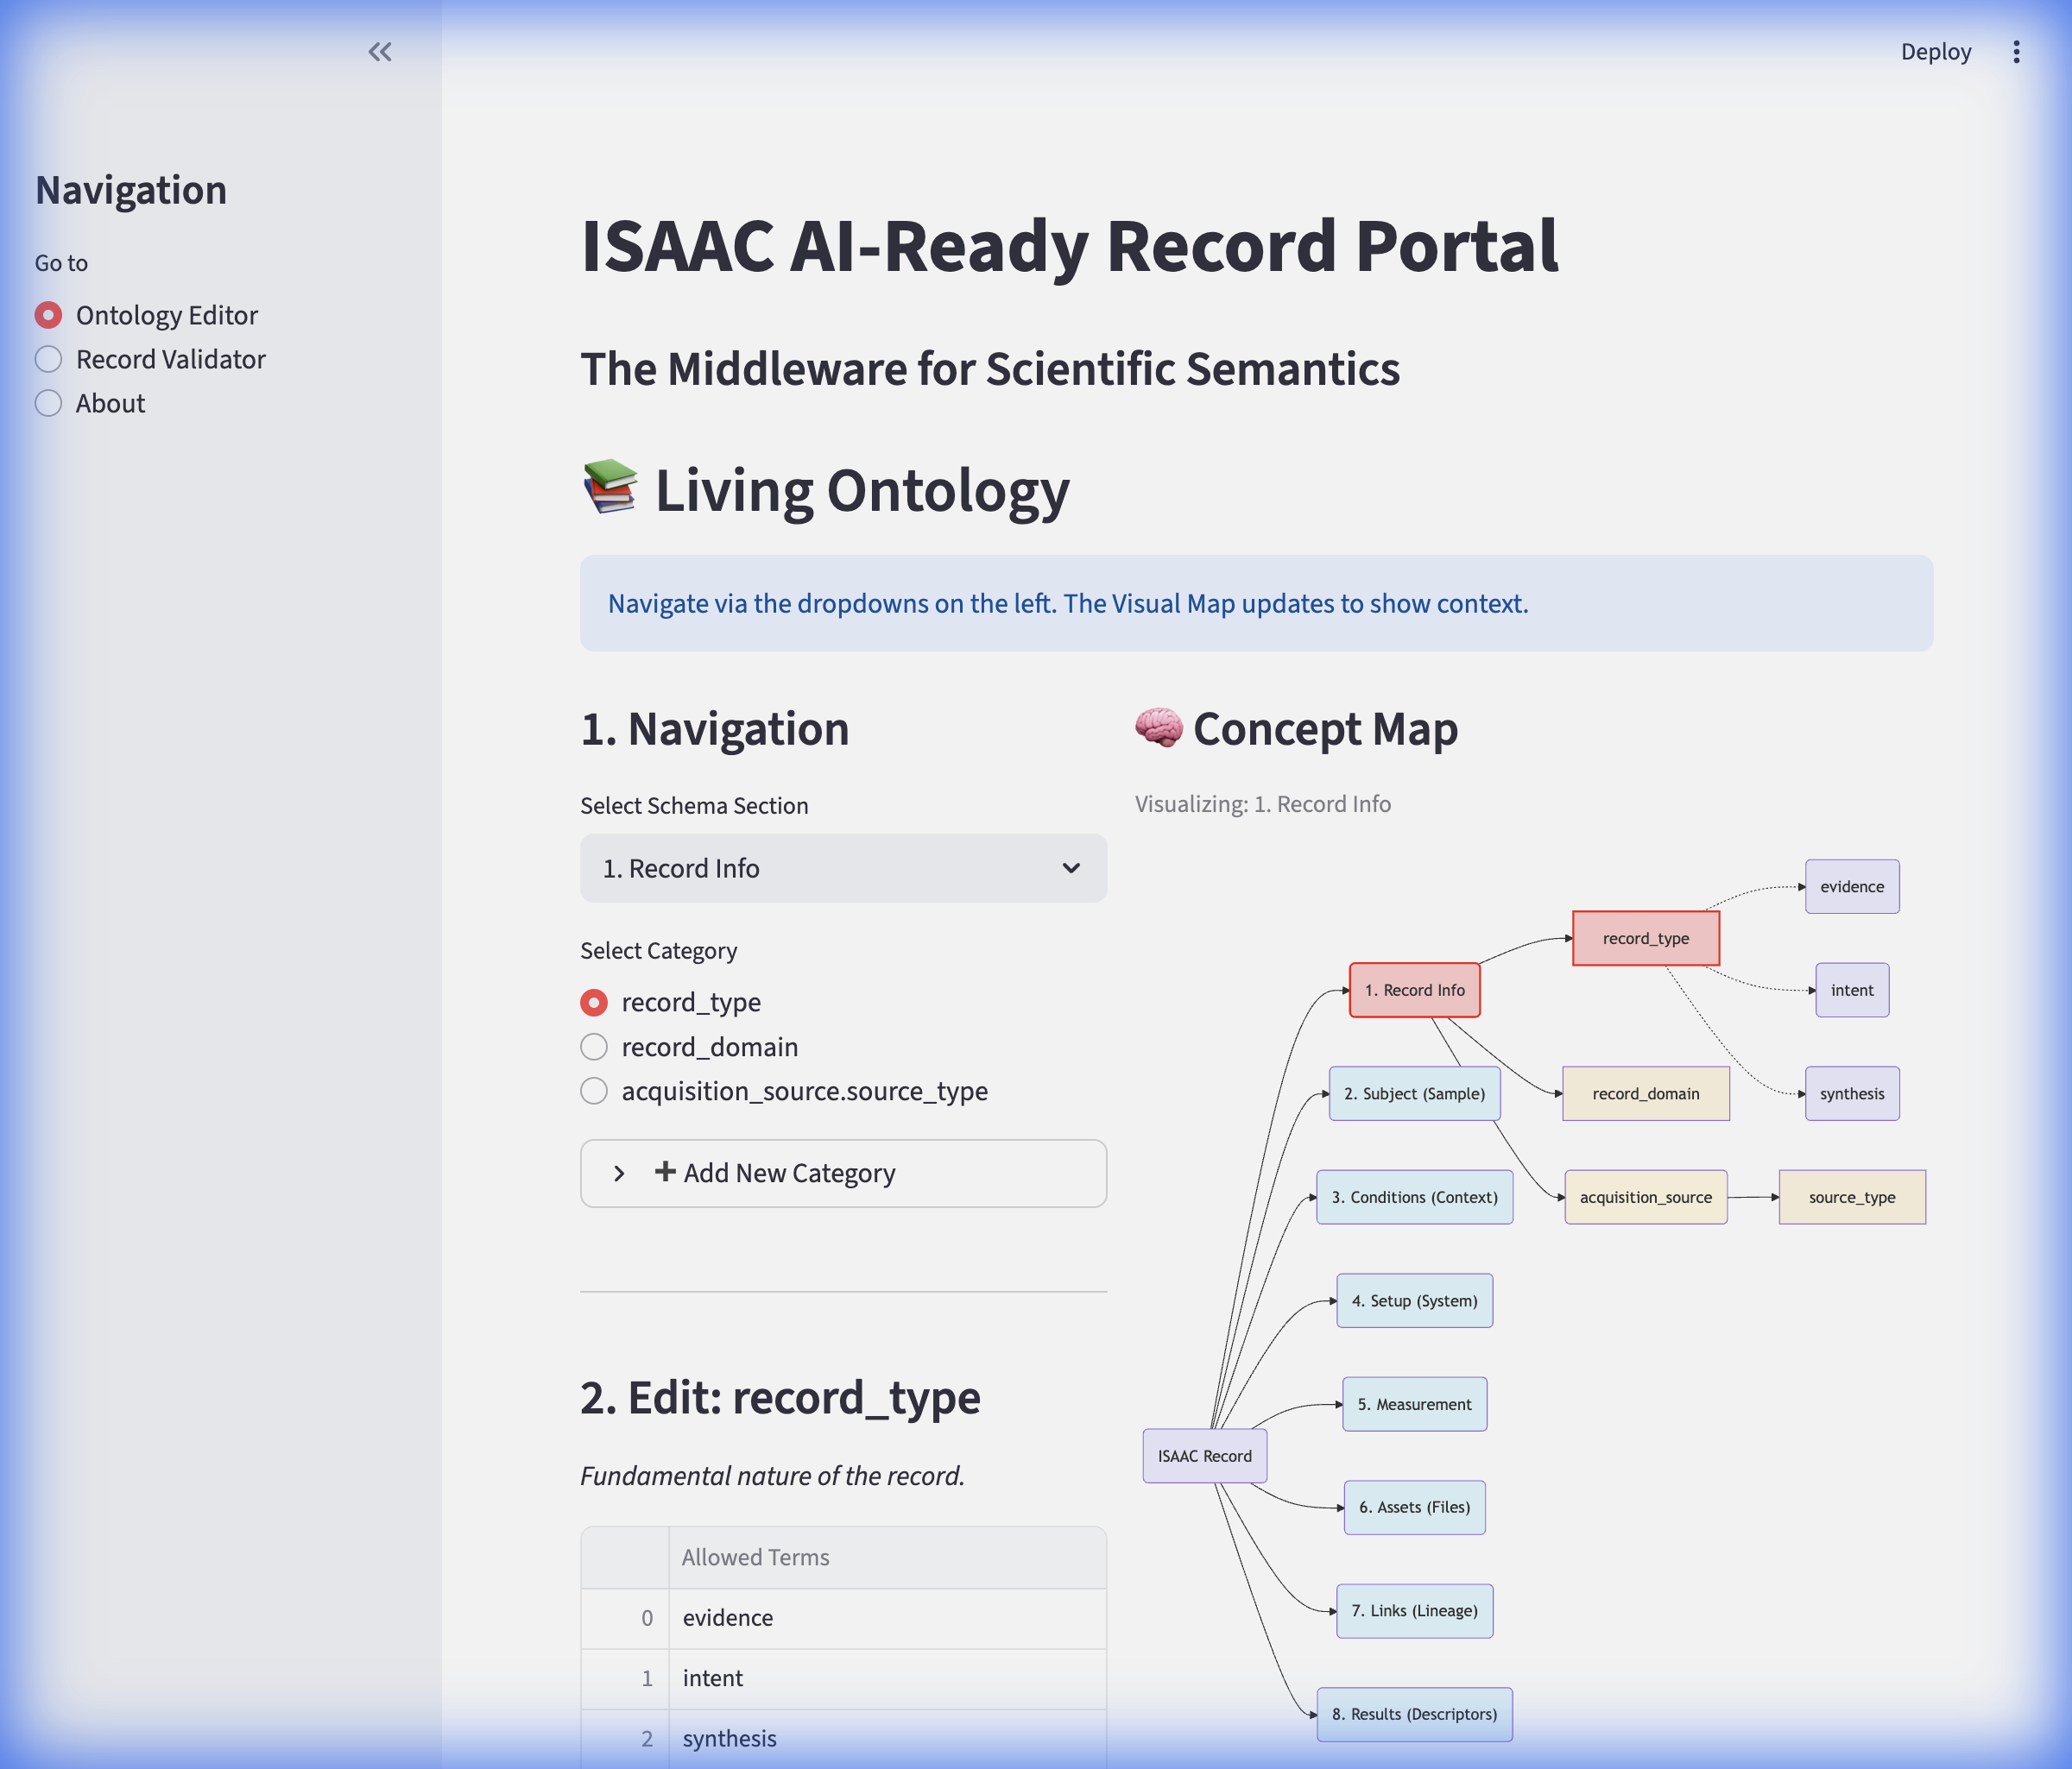
2. The New Ontology Portal
• We now have a live, dynamic website for the Schema.
• Acts as the 'Single Source of Truth' for all terms.
• 'What you see is what you document.'
• Features a visual explorer (Concept Map) and navigation.
• URL: http://localhost:8501 (Internal access only for now)

Slide 4
3. The Schema Strategy: 'Big Blocks'
• The Schema is structured into core 'Super-Blocks':
- System, Sample, Context, Measurement, Descriptor
• Approach: Add specificity *within* these blocks.
• Example: Adding 'viscosity' to 'Context' -> 'context.transport.viscosity'.
• Flexible: We can add properties without breaking the core structure.

Slide 5
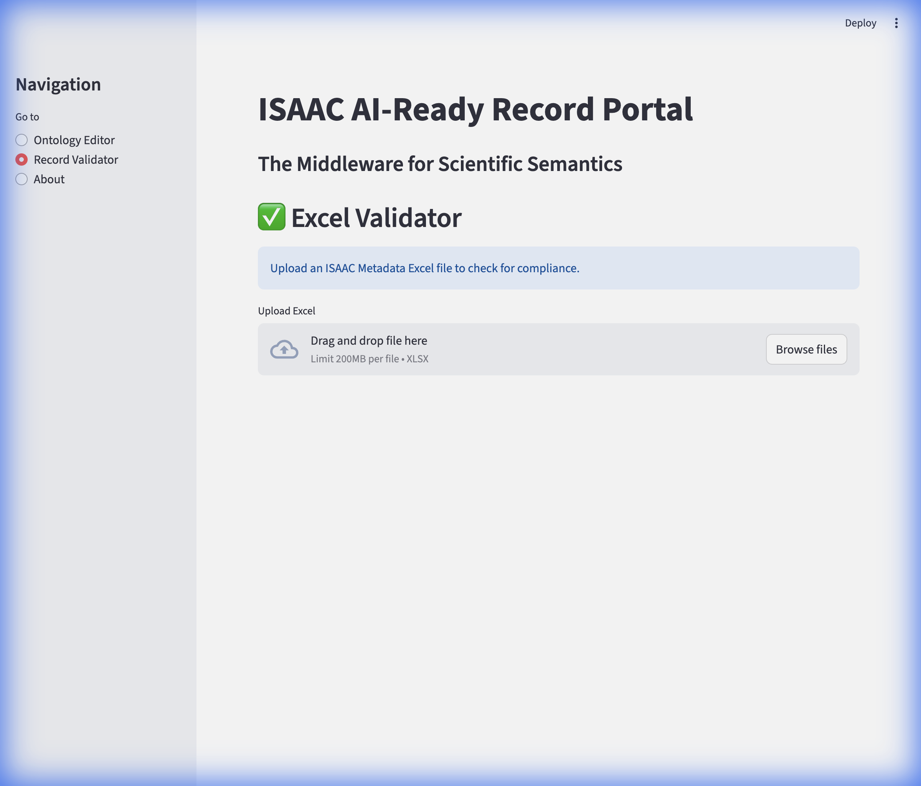
4. The Gatekeeper: Data Validator
• New quality control step BEFORE database ingestion.
• Users upload their metadata (Excel) to the Portal.
• Immediate feedback on:
- Required fields
- Correct terminology (from Ontology)
- Valid value ranges
• Ensures only 'AI-Ready' records enter the system.

Slide 6
5. Future: Authentication & Identity
• Developing 'KID' (Kernel Identity) for robust identification.
• Website Authentication:
- Moving from open access to role-based access.
- Controlling who can EDIT vs. VIEW the ontology.
- Secure API tokens for automated Agents.
• Goal: A secure, trusted environment for scientific knowledge.

