Slide 1
name
Cited by
name
code
Cited by
name
Keyword
Topic of
Paper
Published in
Venue
IPC
Related to
Patent
Belong to
Country
ID
Written by
year
ID
Applied by
date
Author
name
Applicant
name
APS
AIPatent

Slide 2




citation
authors
keywords
institutes

Slide 3
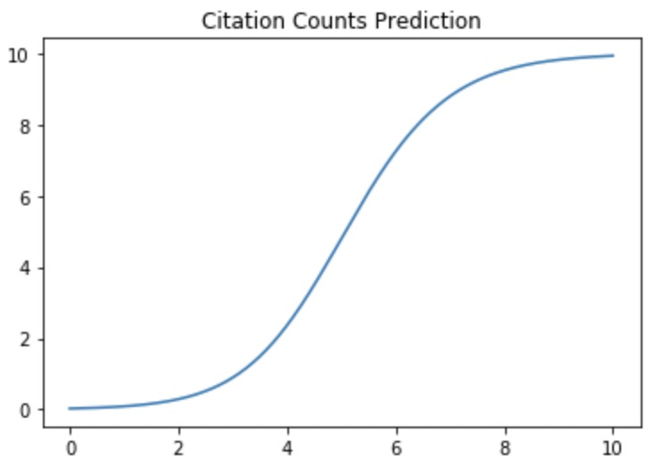
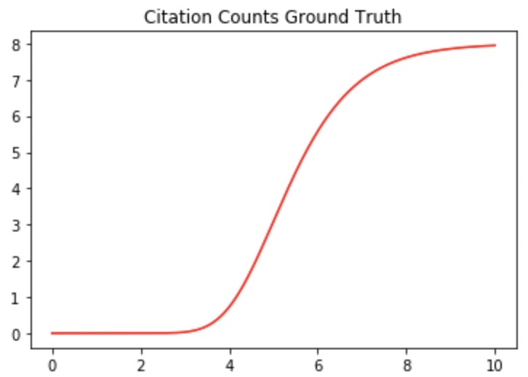






















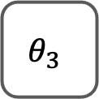



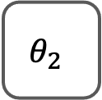






$$I^{T}(p)$$
$$W_{a}$$
A
$$W_{high}$$
$$I^{T}(O_{e})$$
Influence Aggregate
$$W_{p}$$
$$W_{low}$$
$$I^{T}(O_{e})$$
MLP
$$W_{c}$$
C
P
P
$$I^{T}(O_{e})$$
Fine-Grained
Influence
Representation
$$W_{i}$$
I
$$I^{T}(O_{e})$$
MLP1
MLP2
MLP3
MLP4
Bi-LSTMs for each node type
...
$$θ_{1}$$
$$θ_{2}$$
$$θ_{3}$$
$$ξ$$
$$t$$
...
...
Generalized Logistic Function
Learning-Based
Trajectory
Prediction
...
Predicted
Trajectory
Difference-
Preserved
Graph
Embedding
...
Loss
Function
$$𝓛$$
$$E(t_{1})$$
$$E(t_{2})$$
$$E(t_{T})$$
Observed
Trajectory
Normal
R-GCN
$$W_{t}$$
Diff-Preserved
R-GCN
$$W_{t}$$
...
$$W_{t}$$
Diff-Preserved R-GCN
$$G^{1}$$
$$G^{2}$$
$$G^{T}$$
I
$$G^{T+1}$$
$$G^{T+N}$$
I
P
P
A
A
C
A
C
A
C
P
C
P
C
P
P
A
...
C
P
P
A
...
...
C
P
P
A
C
I
I
I
I
I
I
I
P
$$t=1$$
$$t=2$$
...
$$t=T$$
$$t=T+1$$
...
$$t=T+N$$

Slide 4
APS Citation Trajectories
Citation counts
Years

Slide 5
AIPatent Citation Trajectories
Citation counts
Years

