Slide 1
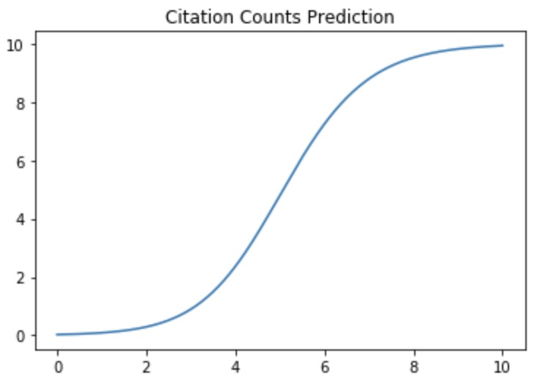
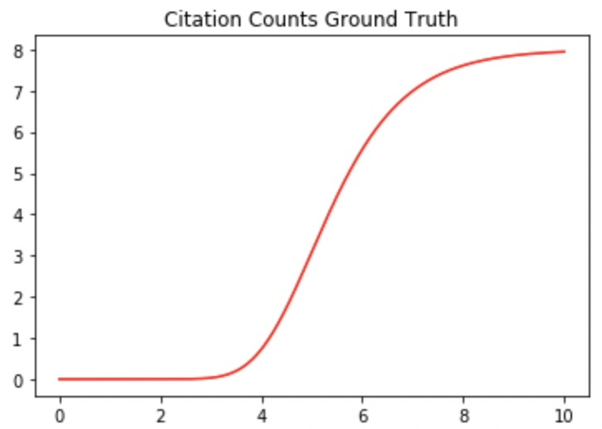

































(b)
(c)
$$I^{T}(p)$$
$$W_{a}$$
A
$$W_{high}$$
$$I^{T}(O_{e})$$
MLP
$$W_{p}$$
$$W_{low}$$
$$I^{T}(O_{e})$$
Influence
Aggregate
C
P
P
$$W_{c}$$
$$I^{T}(O_{e})$$
MLP1
MLP2
MLP3
MLP4
$$W_{i}$$
I
$$I^{T}(O_{e})$$
Bi-LSTMs for each type
$$θ_{1}$$
$$θ_{2}$$
$$θ_{3}$$
$$ξ$$
$$t$$
...
...
Generalized Logistic Function
...
...
Predicted
Trajectory
...
Loss
Function
$$𝓛$$
$$E(t_{1})$$
$$E(t_{2})$$
$$E(t_{T})$$
Observed
Trajectory
(a)
Normal
R-GCN
$$W_{t}$$
Diff-Preserved
R-GCN
$$W_{t}$$
...
$$W_{t}$$
Diff-Preserved
R-GCN
$$G^{1}$$
A
$$G^{2}$$
A
C
$$G^{T}$$
I
$$G^{T+1}$$
$$G^{T+N}$$
I
P
A
P
C
A
P
C
C
P
C
P
P
A
...
C
P
P
A
...
...
C
P
P
A
C
I
I
I
I
I
I
I
P
$$t=1$$
$$t=2$$
...
$$t=T$$
$$t=T+1$$
...
$$t=T+N$$

