Slide 1
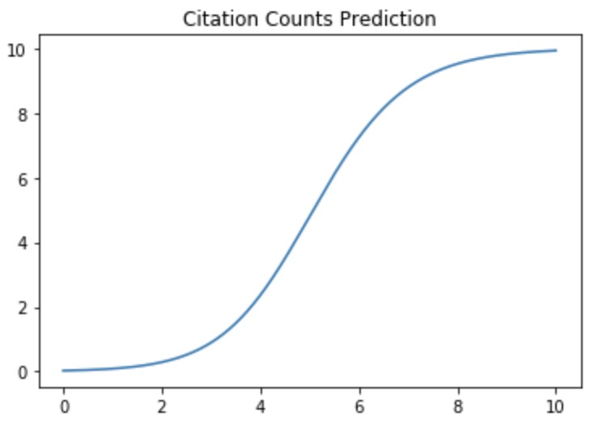
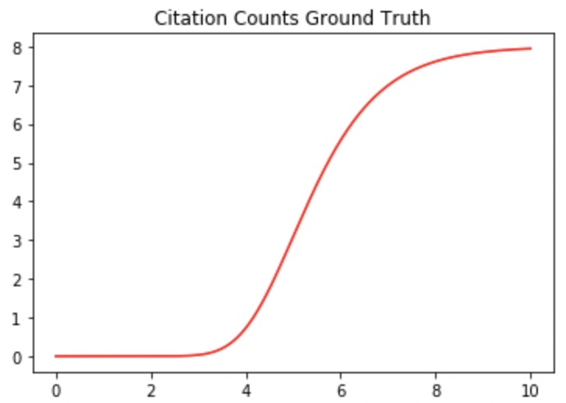






























(a)
$$E(t_{1})$$
(b)
$$I^{T}(p)$$
(c)
$$G^{1}$$
A
Normal
R-GCN
Influence
Aggregate
MLP
$$t=1$$
C
P
I
$$W_{t}$$
$$W_{i}$$
$$W_{a}$$
MLP1
MLP2
MLP3
MLP4
$$G^{2}$$
Diff-Preserved
R-GCN
$$E(t_{2})$$
$$W_{c}$$
$$W_{p}$$
A
C
Bi-LSTMs for each type
C
$$θ_{1}$$
$$θ_{2}$$
$$θ_{3}$$
$$ξ$$
$$t$$
$$t=2$$
C
P
P
A
...
I
I
...
I
P
A
Generalized Logistic Function
$$W_{t}$$
...
$$W_{high}$$
...
...
...
...
...
P
$$W_{low}$$
$$W_{t}$$
Predicted
Trajectory
$$G^{T}$$
I
Diff-Preserved
R-GCN
$$E(t_{T})$$
Loss
Function
$$𝓛$$
A
P
C
$$t=T$$
C
P
P
A
Observed
Trajectory
I
I
$$I^{T}(O_{e})$$
$$I^{T}(O_{e})$$
$$I^{T}(O_{e})$$
$$I^{T}(O_{e})$$
...
$$G^{T+1}$$
...
$$G^{T+N}$$

