Slide 1
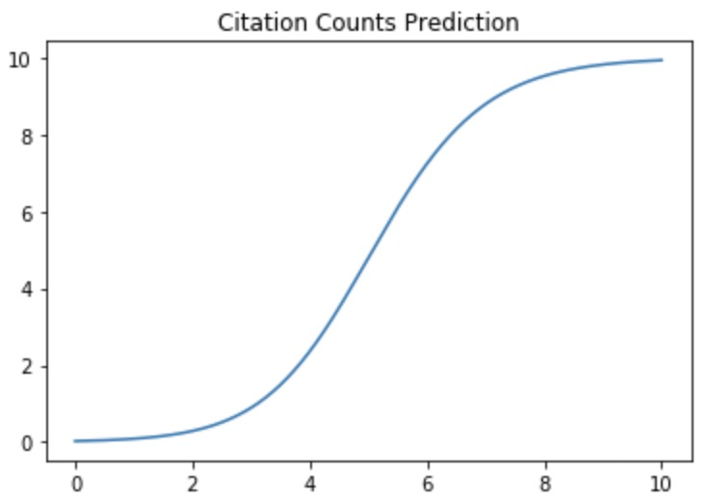
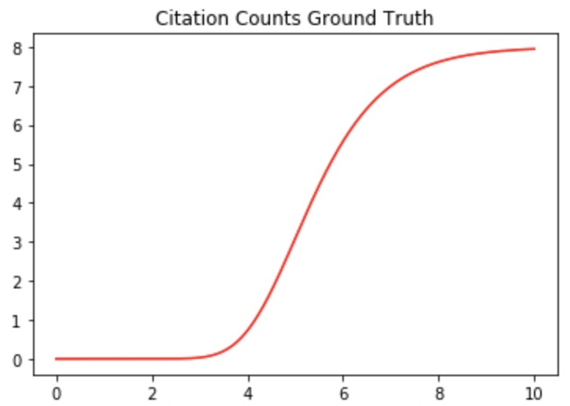
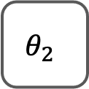






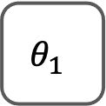















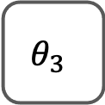








$$I^{T}(p)$$
$$W_{a}$$
A
$$W_{high}$$
$$I^{T}(O_{e}^{a})$$
Influence Aggregate
$$W_{p}$$
$$W_{low}$$
$$I^{T}(O_{e}^{p})$$
MLP
$$W_{c}$$
C
P
P
$$I^{T}(O_{e}^{c})$$
Fine-Grained
Influence
Representation
$$W_{i}$$
I
$$I^{T}(O_{e}^{i})$$
MLP1
MLP2
MLP3
MLP4
Bi-LSTMs for each node type
...
$$θ_{1}$$
$$θ_{2}$$
$$θ_{3}$$
$$ξ$$
...
...
Generalized Logistic Function
Learning-Based
Trajectory
Prediction
...
Prediction
Difference-
Preserved
Graph
Embedding
...
Loss
Function
$$𝓛$$
$$E(t_{1})$$
$$E(t_{2})$$
$$E(t_{T})$$
Ground Truth
Normal
R-GCN
$$W_{t}$$
Diff-Preserved
R-GCN
$$W_{t}$$
...
$$W_{t}$$
Diff-Preserved R-GCN
$$G^{1}$$
$$G^{2}$$
$$G^{T}$$
I
$$G^{T+1}$$
$$G^{T+N}$$
I
P
P
A
A
C
A
C
A
C
P
C
P
C
P
P
A
...
C
P
P
A
...
...
C
P
P
A
C
I
I
I
I
I
I
I
P
$$t=1$$
$$t=2$$
...
$$t=T$$
$$t=T+1$$
...
$$t=T+N$$

Slide 2
APS Citation Trajectories

Slide 3
AIPatent Citation Trajectories

