Slide 1

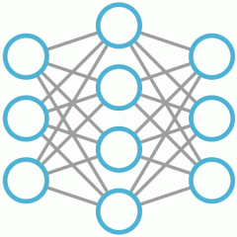
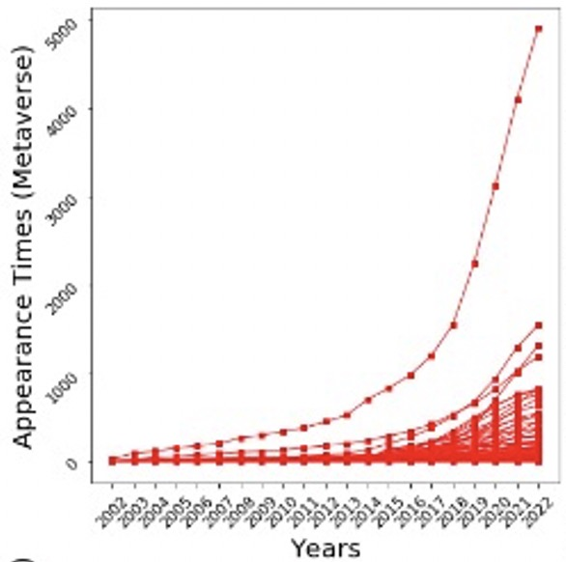
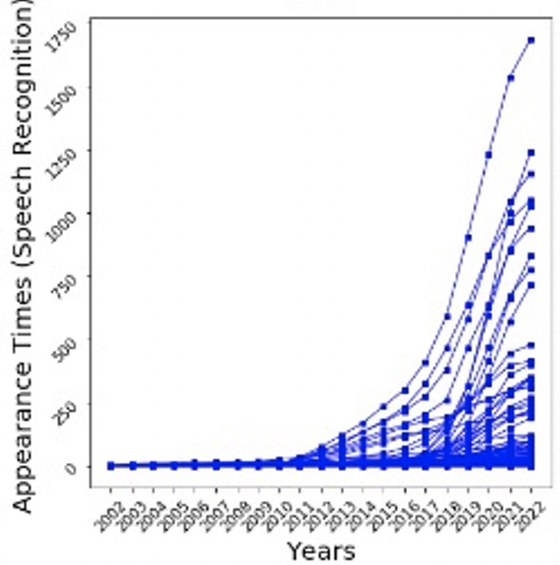
Dynamic Graphs
Target Edge
and Context
Node Embeddings
Total Loss
Node
Embeddings
×T
Positional
Encoding
+
KL Loss
BCE Loss
T
+
Mask
T
×T
×T
+
-
C
Analyst
Embedding Aggregation
×T
MLP Decoding
MLP Scoring
Feature Projection
Feature Aggregation
K
Q
V
Anomaly Behavior Analysis
Multi-Head Attention
Normal
Anomalous
Add & Norm
×T
+
-
Feed Forward
Negative Sampling
Two-Level Features
Add & Norm
CF
IF
×T
Mean Pooling
Two-Level Embeddings
Edge Embedding
(a) Spatial-Temporal Node Encoder
(b) Dynamic Graph Transformer
(c) Mixed Supervision Detector

