Slide 1
PROJECT 2022 FALL
PORTFOLIO
Designed by: Chanhee Kim
C: EST 441
E: chanhee.kim@stonybrook.edu
@portfolio_chanhee

Slide 2
NUMBER OF CLOSURE IN FOOD SERVICE INDUSTRY INCLUDING COFFEE SHOPS
PORTFOLIO
Designed by: Chanhee Kim
50 - 74%
80 - 95%
60%
Failure of restaurants within 1 year
(Binwise)
Failure of coffee shops within 2 year
(Bellissim)
Failure of coffee shops within 5 year
(FoodTruckEmpire)

Slide 3
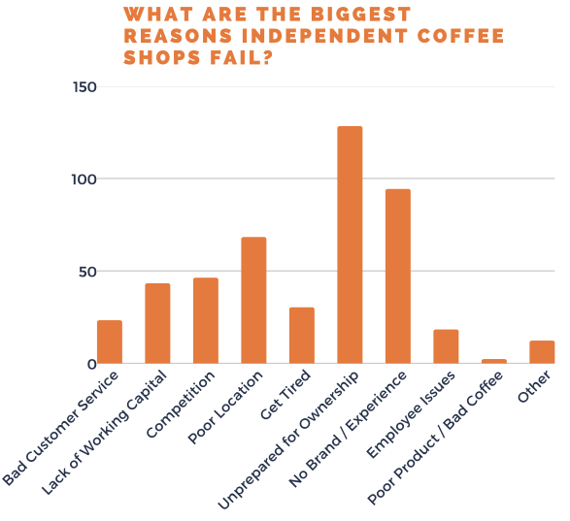
PAIN POINTS OF INDEPENDENT COFFEE SHOPS
PORTFOLIO
Designed by: Chanhee Kim
232 RESPONDENTS___
Unprepared for business ownership – 55%
No Distinct Brand / Experience – 40.5%
Poor location – 68 responses – 29.3%
.
.
.
9. Poor Product / Bad Coffee – 2 responses (< 1%)
10. Other – 12 responses
Source: FoodTruckEmpire

Slide 4
PORTFOLIO
Designed by: Chanhee Kim
Interior Design
?
Branding
Tax Affairs
Real Estate
(location)
AI-based location
recommendation system

Slide 5



PORTFOLIO
AI-based location
recommendation system
Designed by: Chanhee Kim
<Data>
<Data>
+
=
SELF
EMPLOYED
STRENGTHENS
AI BASED
CONSULTING
FOUNDERS
W/ PORTFOLIO
Public Open API
Café Data
(Revenue, Size, Rent, Initial Cost, etc.)

Slide 6
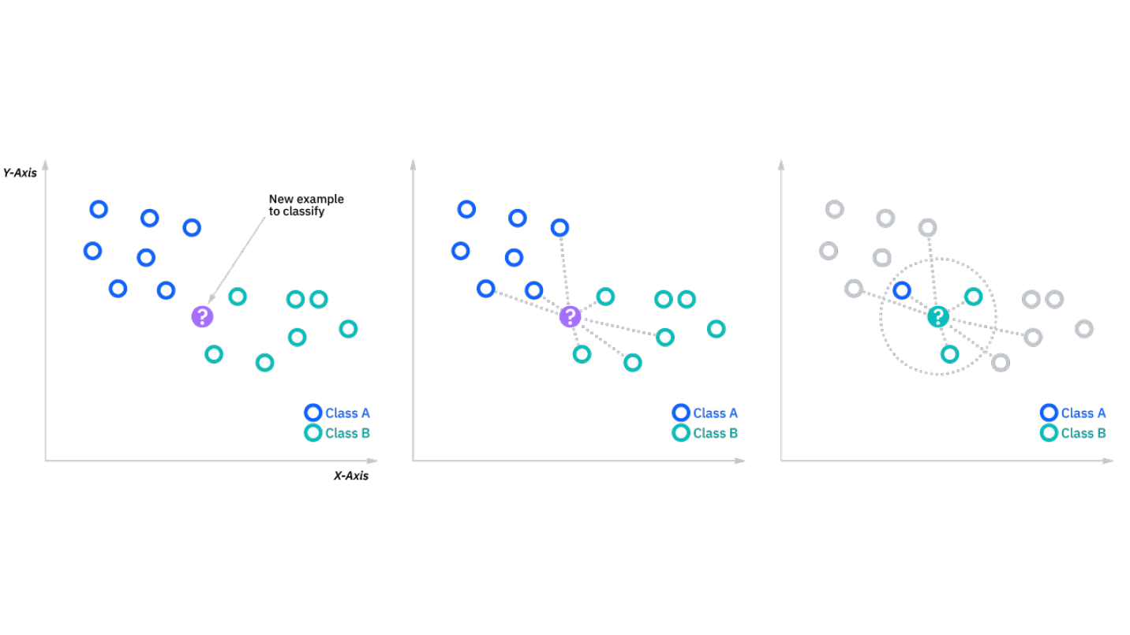
KNN Algorithm
(K-Nearest Neighbour)
PORTFOLIO
Designed by: Chanhee Kim

Slide 7


PORTFOLIO
Designed by: Chanhee Kim
With Portfolio
Without Portfolio
One-Stop Platform
Real Estate
Tax Affair
Interior Design
Branding
Blog, Magazine, Interviews

Slide 8

We help potential founders to begin writing their “portfolio” and build up their career further.
[PORTFOLIO] values every foundings and anticipates every step with courage.
Café accounts for a large portion of the start-up market, but it never is easy. This is why [PORTFOLIO] is here to assist, support and walk together the journey potential founders are about to begin.

Slide 9
FEATURES
STORIES
+
E-COMMERCE
CONSULTING
COMMUNITY

Slide 10
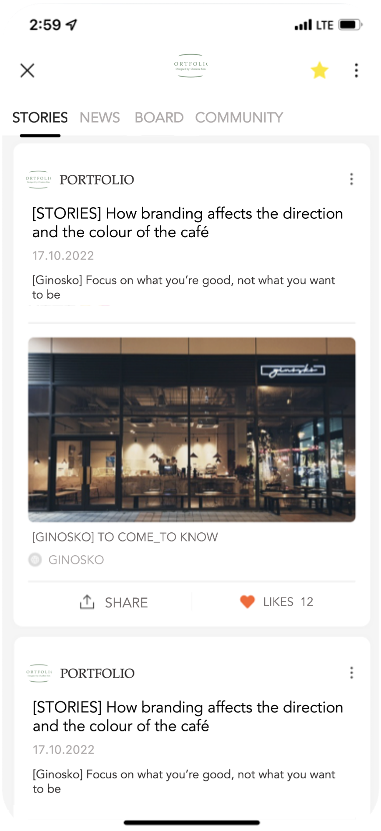
PORTFOLIO
Designed by: Chanhee Kim
STORIES
+ E-COMMERCE
EXPERIENCES
FAILURES
STORIES allows users to peek at many successes, failures and experiences of the existing coffee shop owners, thus guides potential founders to strengthen their motivation.

Slide 11
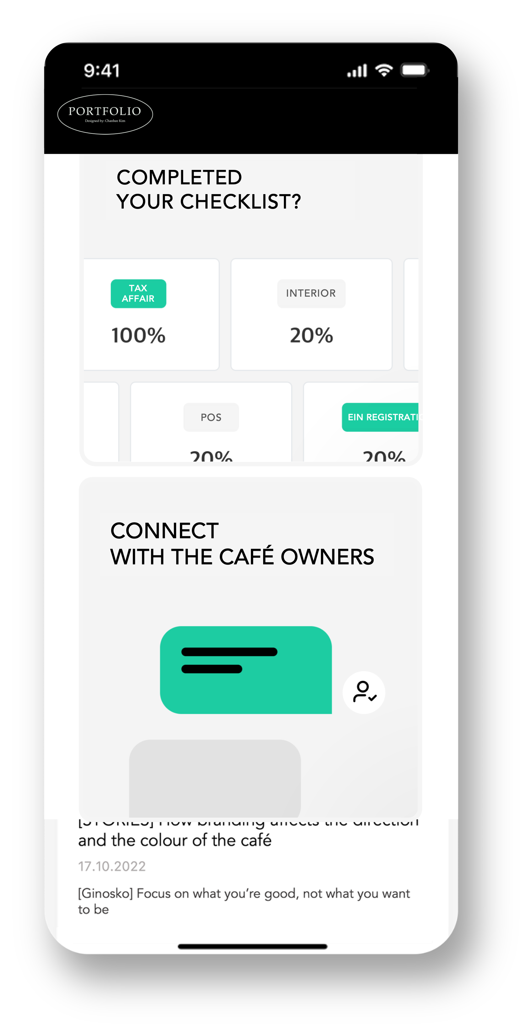
PORTFOLIO
Designed by: Chanhee Kim
CONSULTING
HAVE YOU
DOUBLE CHECKED?
CONSULTING connects potential founders to the existing cafe owners. Whatever real-world experiences you wonder, hear them out right here.

Slide 12
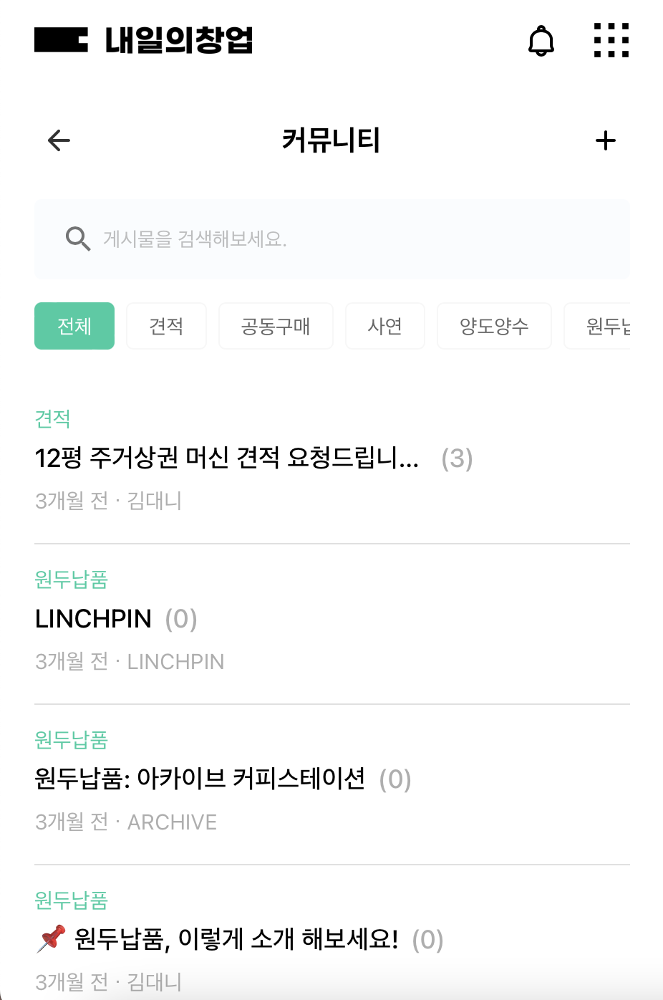
PORTFOLIO
Designed by: Chanhee Kim
COMMUNITY
STORIES
COMMUNITY
PORTFOLIO
WE CALL IT AN
ECOSYSTEM.
Searching something?
ALL
PRICE
ESTIMATE
Q&A
ALIENATION
BEAN
PRICE
(3)
COMMUNITY enables users to communicate themselves for Estimated Initial Cost, Coffee Shop Alienation, Bean Supply and other services within a single platform.
450m², Requesting coffee machi…
3 min · SBUeatiful
BEAN SUPPLY
(42)
47 min · LINCHPIN
ALIENATION
Contact me for café alienation
(31)
3 hour · ARCHAIVE STATION
BEAN SUPPLY
(34)

Slide 13
PORTFOLIO
Designed by: Chanhee Kim
BUSINESS MODEL?
CONSULTING & E-COMMERCE

Slide 14


PORTFOLIO
Designed by: Chanhee Kim
Existing
Café Owners
Universities
With
Coffee Major
PARTNER ORGANISATIONS

Slide 15
PORTFOLIO
Designed by: Chanhee Kim
University Students
Universities with Coffee Major
Potential Founders
Existing
Café Owners
PORTFOLIO
Existing
Café Owners
X

Slide 16
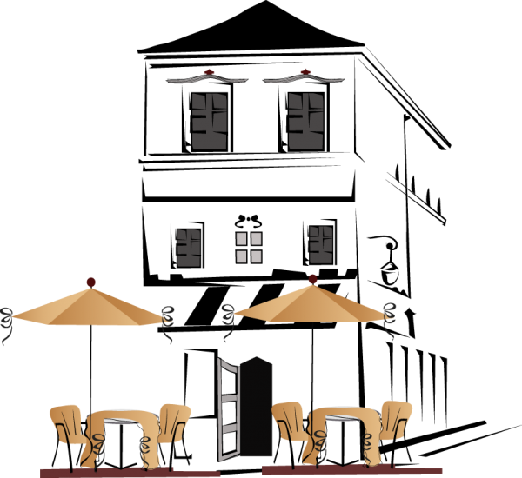
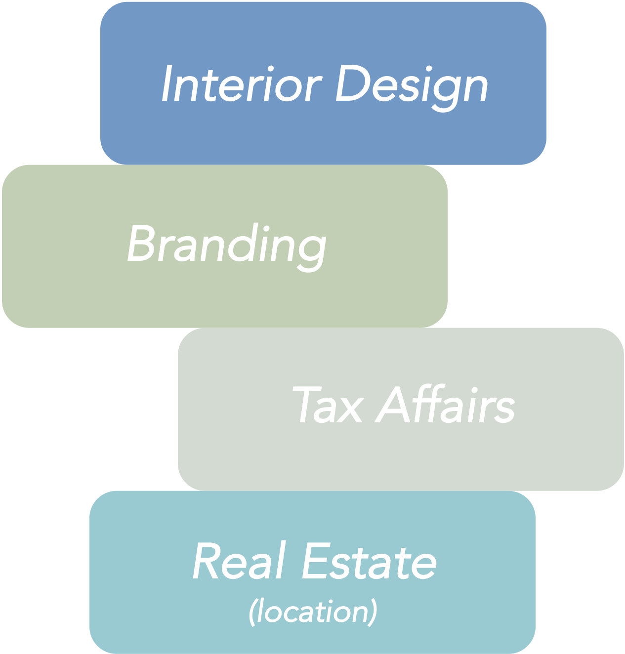
PORTFOLIO
Designed by: Chanhee Kim
Uni. Students
Uni. with Coffee Major
Potential Founders
Receives
Brokerage

Slide 17
PORTFOLIO
E-COMMERCE PRODUCTS
Designed by: Chanhee Kim
ESPRESSO MACHINE
COFFEE
GRINDER
CUPS,
PLATES &
CUTLERIES
TAMPER
BIODEGRA-DABLE PRODUCTS
TAKE OUT CUPS
BEANS
POS

Slide 18
PORTFOLIO
Designed by: Chanhee Kim
($40,000 (Espresso M) +
$3,000 (Coffee Grinder)) * 10%
$4,300 + α
(E-Commerce)
$15,000 * 10% / 49.6m²
$1,500
(Interior Design)
$4,000
(PORTFOLIO Consulting)
= $10,000 + α
per small coffee shop
= $15,000 + α
per medium coffee shop
= $20,000 + α
per large coffee shop

Slide 19




COMPETITORS
Conscious Bean
Real life experience
consulting
Leads to actual
founding

Slide 20
COMPETITORS
Conscious Bean
Real life experience
consulting
Leads to actual
founding

Slide 21
COMPETITORS
Conscious Bean
Real life experience
consulting
Leads to actual
founding

Slide 22
COMPETITORS
Conscious Bean
Real life experience
consulting
Leads to actual
founding

Slide 23
COMPETITORS
Conscious Bean
Real life experience
consulting
Leads to actual
founding

Slide 24
Thank you
for listening

