Slide 1
CS267
Lecture 2
Single Processor Machines:
Memory Hierarchies and Processor Features
Case Study: Tuning Matrix Multiply
James Demmel
http://www.cs.berkeley.edu/~demmel/cs267_Spr13/
Notes:
CS267 Lecture 2

Slide 2
Motivation
Most applications run at < 10% of the “peak” performance of a system
  Peak is the maximum the hardware can physically execute
Much of this performance is lost on a single processor, i.e., the code running on one processor often runs at only 10-20% of the processor peak
Most of the single processor performance loss is in the memory system
  Moving data takes much longer than arithmetic and logic
To understand this, we need to look under the hood of modern processors
  For today, we will look at only a single “core” processor
  These issues will exist on processors within any parallel computer
Notes:
CS267 Lecture 2

Slide 3
Possible conclusions to draw from today’s lecture
“Computer architectures are fascinating, and I really want to understand why apparently simple programs can behave in such complex ways!”
“I want to learn how to design algorithms that run really fast no matter how complicated the underlying computer architecture.”
“I hope that most of the time I can use fast software that someone else has written and hidden all these details from me so I don’t have to worry about them!”
All of the above, at different points in time

Slide 4
Outline
Idealized and actual costs in modern processors
Memory hierarchies
  Use of microbenchmarks to characterized performance
Parallelism within single processors
Case study: Matrix Multiplication
  Use of performance models to understand performance
  Attainable lower bounds on communication
Notes:
CS267 Lecture 2

Slide 5
Outline
Idealized and actual costs in modern processors
Memory hierarchies
  Use of microbenchmarks to characterized performance
Parallelism within single processors
Case study: Matrix Multiplication
  Use of performance models to understand performance
  Attainable lower bounds on communication
Notes:
CS267 Lecture 2

Slide 6
Idealized Uniprocessor Model
Processor names bytes, words, etc. in its address space
  These represent integers, floats, pointers, arrays, etc.
Operations include
  Read and write into very fast memory called registers
  Arithmetic and other logical operations on registers
Order specified by program
  Read returns the most recently written data
  Compiler and architecture translate high level expressions into “obvious” lower level instructions
  Hardware executes instructions in order specified by compiler
Idealized Cost
  Each operation has roughly the same cost
    (read, write, add, multiply, etc.)
Read address(B) to R1
Read address(C) to R2
R3 = R1 + R2
Write R3 to Address(A)
A = B + C ⇒
Notes:
CS267 Lecture 2

Slide 7
Uniprocessors in the Real World
Real processors have
  registers and caches
    small amounts of fast memory
    store values of recently used or nearby data
    different memory ops can have very different costs
  parallelism
    multiple “functional units” that can run in parallel
    different orders, instruction mixes have different costs
  pipelining
    a form of parallelism, like an assembly line in a factory
Why is this your problem?
    In theory, compilers and hardware “understand” all this and can optimize your program; in practice they don’t.
    They won’t know about a different algorithm that might be a much better “match” to the processor
In theory there is no difference between theory and practice. But in practice there is. -J. van de Snepscheut
Notes:
CS267 Lecture 2

Slide 8
Outline
Idealized and actual costs in modern processors
Memory hierarchies
  Temporal and spatial locality
  Basics of caches
  Use of microbenchmarks to characterized performance
Parallelism within single processors
Case study: Matrix Multiplication
  Use of performance models to understand performance
  Attainable lower bounds on communication
Notes:
CS267 Lecture 2

Slide 9
Memory Hierarchy
Most programs have a high degree of locality in their accesses
  spatial locality: accessing things nearby previous accesses
  temporal locality: reusing an item that was previously accessed
Memory hierarchy tries to exploit locality to improve average
processor
control
Second level cache (SRAM)
Main memory
(DRAM)
Secondary storage (Disk)
Tertiary storage
(Disk/Tape)
datapath
registers
on-chip cache
Speed | 1ns | 10ns | 100ns | 10ms | 10sec
Size | KB | MB | GB | TB | PB
Notes:
CS267 Lecture 2

Slide 10
Processor-DRAM Gap (latency)
Memory hierarchies are getting deeper
  Processors get faster more quickly than memory
1000
µProc
60%/yr.
CPU
“Moore’s Law”
100
Processor-Memory
Performance Gap:
(grows 50% / year)
Performance
10
DRAM
7%/yr.
DRAM
1
1980
1989
1981
1982
1983
1984
1985
1986
1987
1988
1990
1991
1992
1993
1994
1995
1996
1997
1998
1999
2000
Time
Notes:
CS267 Lecture 2
Y-axis is performance
X-axis is time
Latency
Cliché:
Not e that x86 didn’t have cache on chip until 1989

Slide 11
Approaches to Handling Memory Latency
Eliminate memory operations by saving values in small, fast memory (cache) and reusing them
  need temporal locality in program
Take advantage of better bandwidth by getting a chunk of memory and saving it in small fast memory (cache) and using whole chunk
  bandwidth improving faster than latency: 23% vs 7% per year
  need spatial locality in program
Take advantage of better bandwidth by allowing processor to issue multiple reads to the memory system at once
  concurrency in the instruction stream, e.g. load whole array, as in vector processors; or prefetching
Overlap computation & memory operations
  prefetching
Notes:
CS267 Lecture 2

Slide 12
Cache Basics
Cache is fast (expensive) memory which keeps copy of data in main memory; it is hidden from software
  Simplest example: data at memory address xxxxx1101 is stored at cache location 1101
Cache hit: in-cache memory access—cheap
Cache miss: non-cached memory access—expensive
  Need to access next, slower level of cache
Cache line length: # of bytes loaded together in one entry
  Ex: If either xxxxx1100 or xxxxx1101 is loaded, both are
Associativity
  direct-mapped: only 1 address (line) in a given range in cache
    Data stored at address xxxxx1101 stored at cache location 1101, in 16 word cache
  n-way: n ≥ 2 lines with different addresses can be stored
    Up to n ≤ 16 words with addresses xxxxx1101 can be stored at cache location 1101 (so cache can store 16n words)
Notes:
CS267 Lecture 2

Slide 13
Why Have Multiple Levels of Cache?
On-chip vs. off-chip
  On-chip caches are faster, but limited in size
A large cache has delays
  Hardware to check longer addresses in cache takes more time
  Associativity, which gives a more general set of data in cache, also takes more time
Some examples:
  Cray T3E eliminated one cache to speed up misses
  IBM uses a level of cache as a “victim cache” which is cheaper
There are other levels of the memory hierarchy
  Register, pages (TLB, virtual memory), …
  And it isn’t always a hierarchy
Notes:
CS267 Lecture 2
Victim cache: keep words evicted from higher level cache in a smaller, fully
associative memory. Avoid conflict misses on the (usually) few addresses
where such conflicts occur.

Slide 14
Experimental Study of Memory (Membench)
Microbenchmark for memory system performance
s
for array A of length L from 4KB to 8MB by 2x
for stride s from 4 Bytes (1 word) to L/2 by 2x
time the following loop
(repeat many times and average)
for i from 0 to L by s
load A[i] from memory (4 Bytes)
time the following loop
(repeat many times and average)
for i from 0 to L
load A[i] from memory (4 Bytes)
1 experiment
Notes:
CS267 Lecture 2

Slide 15
Membench: What to Expect
average cost per access
memory
time
size > L1
cache hit time
total size < L1
s = stride
Consider the average cost per load
  Plot one line for each array length, time vs. stride
  Small stride is best: if cache line holds 4 words, at most ¼ miss
  If array is smaller than a given cache, all those accesses will hit (after the first run, which is negligible for large enough runs)
  Picture assumes only one level of cache
  Values have gotten more difficult to measure on modern procs
Notes:
CS267 Lecture 2
Where is corner on blue curve where it starts dropping?

Slide 16
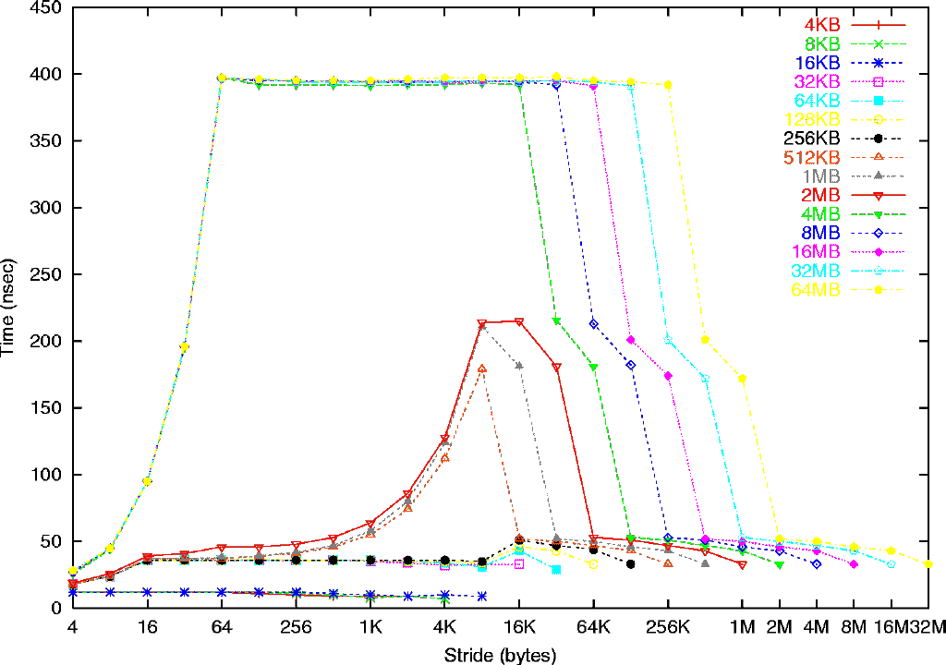
Memory Hierarchy on a Sun Ultra-2i
Sun Ultra-2i, 333 MHz
Array length
Mem: 396 ns
(132 cycles)
L2: 2 MB,
12 cycles (36 ns)
L1:
16 KB
2 cycles (6ns)
L1: 16 B line
L2: 64 byte line
8 K pages, 32 TLB entries
See www.cs.berkeley.edu/~yelick/arvindk/t3d-isca95.ps for details
Notes:
CS267 Lecture 2
Each symbol is an experiment, vertical axis is time/load
Experiments with same length array share symbol, color, joined by line
Such experiments differ only in stride in bytes (horizontal axis)
note that minimum stride = 4 bytes = 1 word
4) Main Observation 1: complicated, depending on array length and stride
5) Main Observation 2: time/load ranges from 6 ns to 396 ns, 66x difference – important!
6) Detail 1: bottom 3 lines (4KB to 16KB) take 6 ns = 2 cycles, but 32KB and larger take longer
deduce that L1 cache is 16 KB, takes 2 cycles/word (yes, according to hardware manual)
7) Detail 2: next 6 lines (32 KB to 1MB) take 36ns = 12 cycles for small stride (2MB a little more)
but 4MB takes much longer:
deduce that L2 cache is 2MB, takes 12 cycles/word (yes)
8) Detail 3: remaining lines take 396 ns = 132 cycles for medium stride,
deduce that main memory takes 132 cycles/word
9) Detail 4: look at 32KB to 1MB lines, speed halves from stride 4 to 8 to 16, then constant
deduce that L1 line size is 16 bytes
10) Detail 5: look at 4MB to 64MB lines, speed halves from stride 4 to 8 to … to 64, then constant
deduce that L2 line size is 64 bytes
11) Detail 6: look at lines 32KB-256KB, vs 512 KB-2MB, increase up to 8KB stride of latter
deduce that page size is 8 KB, and TLB has 256KB/8KB = 32 entries
Note: no speculative prefetching, to keep things simple (wait for later slide)
Why doesn’t time drop to L1 time for long strides? TLB latency, because on different pages
Story: ParLab poster session, similar plot, 5 Intel engineers arguing about why it looked the way it did

Slide 17
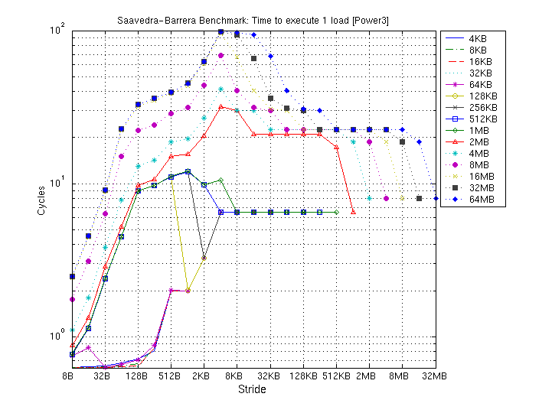
Memory Hierarchy on a Power3 (Seaborg)
Power3, 375 MHz
Array size
Mem: 396 ns
(132 cycles)
L2: 8 MB
128 B line
9 cycles
L1: 32 KB
128B line
.5-2 cycles
Notes:
CS267 Lecture 2

Slide 18
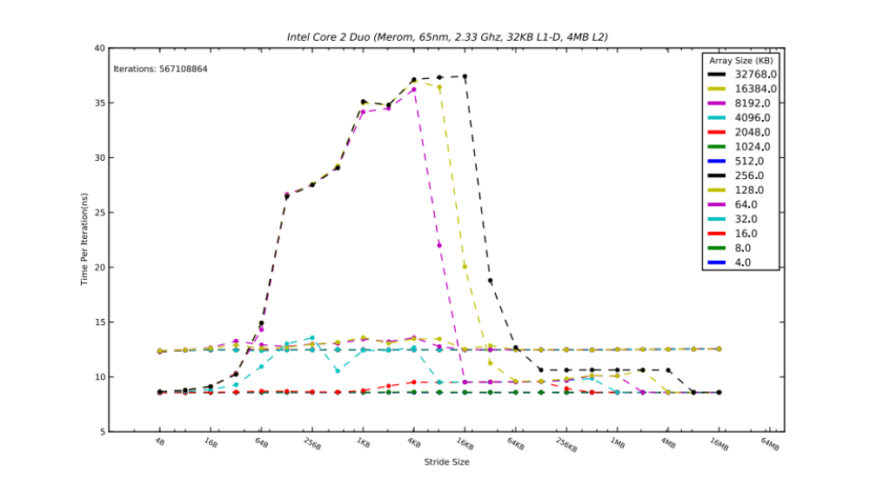
Memory Hierarchy on an Intel Core 2 Duo
Notes:
Recall ParLab poster session story
CS267 Lecture 2

Slide 19
Stanza Triad
Even smaller benchmark for prefetching
Derived from STREAM Triad
Stanza (L) is the length of a unit stride run
  while i < arraylength
  for each L element stanza
  A[i] = scalar * X[i] + Y[i]
  skip k elements
. . .
. . .
1) do L triads
2) skip k elements
3) do L triads
stanza
stanza
Source: Kamil et al, MSP05
Notes:
CS267 Lecture 2
Modern hardware does pattern recognition to try to figure out pattern, prefetch
(may or may not figure out pattern)
Experiment: Compare to k=0, no skipping, where pattern should be easy to recognize, so peak speed

Slide 20
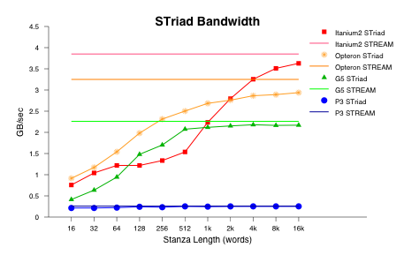
Stanza Triad Results
This graph (x-axis) starts at a cache line size (>=16 Bytes)
If cache locality was the only thing that mattered, we would expect
  Flat lines equal to measured memory peak bandwidth (STREAM) as on Pentium3
Prefetching gets the next cache line (pipelining) while using the current one
  This does not “kick in” immediately, so performance depends on L
  http://crd-legacy.lbl.gov/~oliker/papers/msp_2005.pdf
Notes:
CS267 Lecture 2
“Impact of modern memory subsystems on cache optimizations for stencil computations”
Kamil, Husbands, Oliker, Shalf, Yelick, 2005
Horizontal axis is L, fixed k
Do modern processor recognize context switches for doing prefetching?
Don’t know, need to ask Intel (class project: what are different patterns that are
recognized, do they match dwarfs?)

Slide 21
Lessons
Actual performance of a simple program can be a complicated function of the architecture
  Slight changes in the architecture or program change the performance significantly
  To write fast programs, need to consider architecture
    True on sequential or parallel processor
  We would like simple models to help us design efficient algorithms
We will illustrate with a common technique for improving cache performance, called blocking or tiling
  Idea: used divide-and-conquer to define a problem that fits in register/L1-cache/L2-cache
Notes:
CS267 Lecture 2
Companies have teams building machine specific libraries,
But can only handle small (but highly used) fraction of important algorithms

Slide 22
Outline
Idealized and actual costs in modern processors
Memory hierarchies
  Use of microbenchmarks to characterized performance
Parallelism within single processors
  Hidden from software (sort of)
  Pipelining
  SIMD units
Case study: Matrix Multiplication
  Use of performance models to understand performance
  Attainable lower bounds on communication
Notes:
CS267 Lecture 2

Slide 23
What is Pipelining?
Dave Patterson’s Laundry example: 4 people doing laundry
wash (30 min) + dry (40 min) + fold (20 min) = 90 min
Latency
6 PM
7
8
9
In this example:
  Sequential execution takes 4 * 90min = 6 hours
  Pipelined execution takes 30+4*40+20 = 3.5 hours
Bandwidth = loads/hour
BW = 4/6 l/h w/o pipelining
BW = 4/3.5 l/h w pipelining
BW <= 1.5 l/h w pipelining, more total loads
Pipelining helps bandwidth but not latency (90 min)
Bandwidth limited by slowest pipeline stage
Potential speedup = Number of pipe stages
Time
T
a
s
k
O
r
d
e
r
30
40
40
40
40
20
A
B
C
D
Notes:
CS267 Lecture 2

Slide 24
Example: 5 Steps of MIPS Datapath
Figure 3.4, Page 134 , CA:AQA 2e by Patterson and Hennessy
Instruction
Fetch
Instr. Decode
Reg. Fetch
Execute
Addr. Calc
Memory
Access
Write
Back
Next PC
IF/ID
ID/EX
EX/MEM
MUX
MEM/WB
Next SEQ PC
Next SEQ PC
Adder
4
Zero?
RS1
Reg File
Address
MUX
Memory
RS2
ALU
Data
Memory
MUX
MUX
Sign
Extend
Imm
WB Data
RD
RD
RD
Pipelining is also used within arithmetic units
  a fp multiply may have latency 10 cycles, but throughput of 1/cycle
Notes:
CS267 Lecture 2

Slide 25
SIMD: Single Instruction, Multiple Data
Scalar processing
  traditional mode
  one operation produces
  one result
SIMD processing
  with SSE / SSE2
  SSE = streaming SIMD extensions
  one operation produces
  multiple results
X
X
x3
x2
x1
x0
+
+
Y
Y
y3
y2
y1
y0
X + Y
X + Y
x3+y3
x2+y2
x1+y1
x0+y0
Slide Source: Alex Klimovitski & Dean Macri, Intel Corporation
Notes:
CS267 Lecture 2
Program needs to organized to have 4 summands side-by-side in memory for this to work.

Slide 26
SSE / SSE2 SIMD on Intel
SSE2 data types: anything that fits into 16 bytes, e.g.,
Instructions perform add, multiply etc. on all the data in this 16-byte register in parallel
Challenges:
  Need to be contiguous in memory and aligned
  Some instructions to move data around from one part of register to another
Similar on GPUs, vector processors (but many more simultaneous operations)
4x floats
2x doubles
16x bytes
Notes:
CS267 Lecture 2
Would hope compiler would recognize this, but not always possible.
You need to build data structure appropriately, eg
aligned on caches line boundaries, i.e. first word has enough trailing zeros in address

Slide 27
What does this mean to you?
In addition to SIMD extensions, the processor may have other special instructions
  Fused Multiply-Add (FMA) instructions:
  x = y + c * z
  is so common some processor execute the multiply/add as a single instruction, at the same rate (bandwidth) as + or * alone
In theory, the compiler understands all of this
  When compiling, it will rearrange instructions to get a good “schedule” that maximizes pipelining, uses FMAs and SIMD
  It works with the mix of instructions inside an inner loop or other block of code
But in practice the compiler may need your help
  Choose a different compiler, optimization flags, etc.
  Rearrange your code to make things more obvious
  Using special functions (“intrinsics”) or write in assembly ☹
Notes:
CS267 Lecture 2
HW1 will take you through this exercise *once*, for matmul,
rest of semester at higher level of abstraction
Not all compilers same, eg GCC and ICC have some different optimizations
Cheating on homework: don’t use –matmul flag on compiler!

Slide 28
Outline
Idealized and actual costs in modern processors
Memory hierarchies
  Use of microbenchmarks to characterized performance
Parallelism within single processors
Case study: Matrix Multiplication
  Use of performance models to understand performance
  Attainable lower bounds on communication
  Simple cache model
  Warm-up: Matrix-vector multiplication
  Naïve vs optimized Matrix-Matrix Multiply
    Minimizing data movement
    Beating O(n³) operations
    Practical optimizations (continued next time)
Notes:
CS267 Lecture 2

Slide 29
Why Matrix Multiplication?
An important kernel in many problems
  Appears in many linear algebra algorithms
    Bottleneck for dense linear algebra, including Top500
  One of the 7 dwarfs / 13 motifs of parallel computing
  Closely related to other algorithms, e.g., transitive closure on a graph using Floyd-Warshall
Optimization ideas can be used in other problems
The best case for optimization payoffs
The most-studied algorithm in high performance computing
Notes:
CS267 Lecture 2
Note: New world’s record for matmul, in theoretical sense,
Set by Berkeley postdoc Virginia Williams in Fall 2011,
No longer n^3 but smaller exponent; she got the smallest known
exponent so far (2.373)

Slide 30
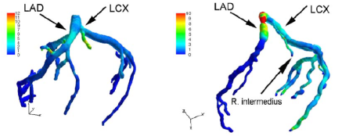
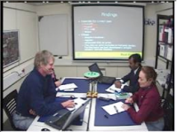

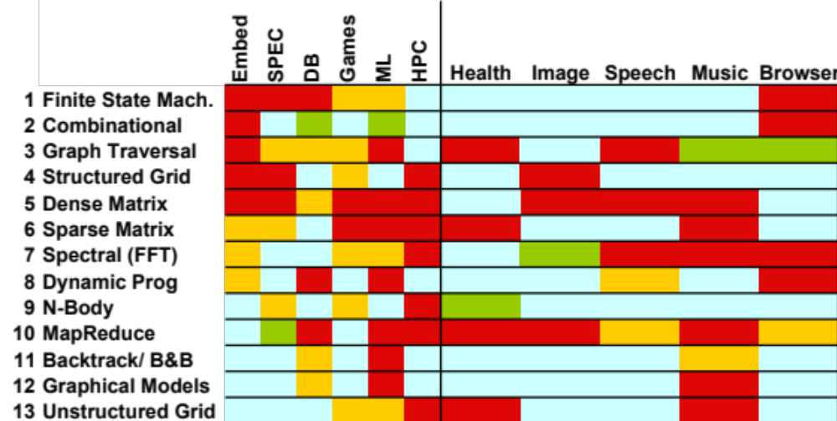

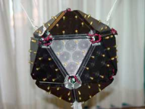
Motif/Dwarf: Common Computational Methods
(Red Hot → Blue Cool)
What do commercial and CSE applications have in common?
Notes:
Some people might subdivide, some might combine them together
Trying to stretch a computer architecture then you can do subcategories as well
Graph Traversal = Probabilistic Models
N-Body = Particle Methods, …

Slide 31
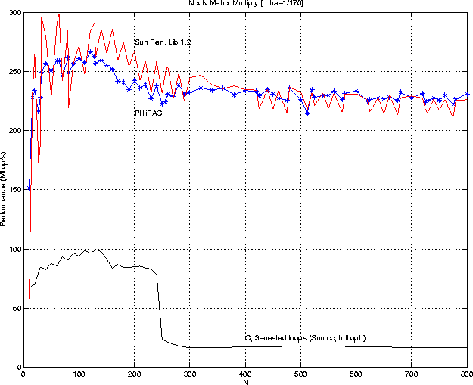
Matrix-multiply, optimized several ways
Speed of n-by-n matrix multiply on Sun Ultra-1/170, peak = 330 MFlops
Notes:
CS267 Lecture 2
Old machine, will show new ones too
Tell PhiPac story, then ATLAS

Slide 32
Note on Matrix Storage
A matrix is a 2-D array of elements, but memory addresses are “1-D”
Conventions for matrix layout
  by column, or “column major” (Fortran default); A(i,j) at A+i+j*n
  by row, or “row major” (C default) A(i,j) at A+i*n+j
  recursive (later)
Column major (for now)
Column major matrix in memory
Column major
Row major
0
5
10
15
0
1
2
3
1
6
11
16
4
5
6
7
2
7
12
17
8
9
10
11
3
8
13
18
12
13
14
15
4
9
14
19
16
17
18
19
Blue row of matrix is stored in red cachelines
cachelines
Figure source: Larry Carter, UCSD
Notes:
CS267 Lecture 2

Slide 33
Using a Simple Model of Memory to Optimize
Assume just 2 levels in the hierarchy, fast and slow
All data initially in slow memory
  m = number of memory elements (words) moved between fast and slow memory
  t_{m} = time per slow memory operation
  f = number of arithmetic operations
  t_{f} = time per arithmetic operation << t_{m}
  q = f / m average number of flops per slow memory access
Minimum possible time = f* t_{f} when all data in fast memory
Actual time
  f * t_{f} + m * t_{m} = f * t_{f} * (1 + t_{m}/t_{f} * 1/q)
Larger q means time closer to minimum f * t_{f}
  q ≥ t_{m}/t_{f} needed to get at least half of peak speed
Computational Intensity: Key to algorithm efficiency
Machine Balance: Key to machine efficiency
Notes:
CS267 Lecture 2
More levels of memory hierarchy follows by induction

Slide 34
Warm up: Matrix-vector multiplication
{implements y = y + A*x}
for i = 1:n
for j = 1:n
y(i) = y(i) + A(i,j)*x(j)
A(i,:)
=
+
*
y(i)
y(i)
x(:)
Notes:
CS267 Lecture 2
Compare model to real data, for matrix-vector multiply

Slide 35
Warm up: Matrix-vector multiplication
{read x(1:n) into fast memory}
{read y(1:n) into fast memory}
for i = 1:n
{read row i of A into fast memory}
for j = 1:n
y(i) = y(i) + A(i,j)*x(j)
{write y(1:n) back to slow memory}
m = number of slow memory refs = 3n + n²
f = number of arithmetic operations = 2n²
q = f / m ≈ 2
Matrix-vector multiplication limited by slow memory speed
Notes:
CS267 Lecture 2

Slide 36
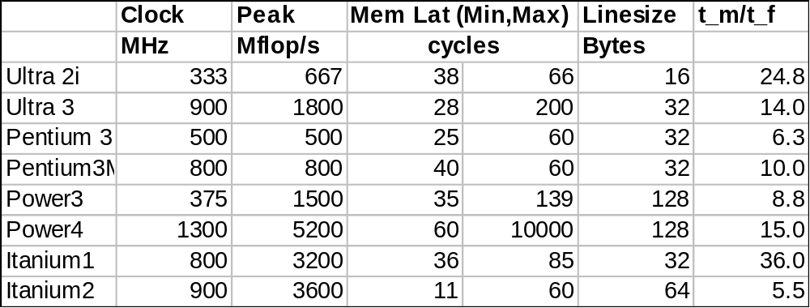
Modeling Matrix-Vector Multiplication
Compute time for nxn = 1000x1000 matrix
Time
  f * t_{f} + m * t_{m} = f * t_{f} * (1 + t_{m}/t_{f} * 1/q)
  = 2*n² * t_{f} * (1 + t_{m}/t_{f} * 1/2)
For t_{f} and t_{m}, using data from R. Vuduc’s PhD (pp 351-3)
  http://bebop.cs.berkeley.edu/pubs/vuduc2003-dissertation.pdf
  For t_{m} use minimum-memory-latency / words-per-cache-line
machine
balance
(q must
be at least
this for
½ peak
speed)
Notes:
CS267 Lecture 2
Why such different memory latency numbers? Different from before, min different from max?
Because they are measured by different benchmarks (Saavedra-Barrera, PMaCMAPS, Stream Triad.
See section 4.2.1, pp 102f of Vuduc’s thesis cited above.

Slide 37
Simplifying Assumptions
What simplifying assumptions did we make in this analysis?
  Ignored parallelism in processor between memory and arithmetic within the processor
    Sometimes drop arithmetic term in this type of analysis
  Assumed fast memory was large enough to hold three vectors
    Reasonable if we are talking about any level of cache
    Not if we are talking about registers (~32 words)
  Assumed the cost of a fast memory access is 0
    Reasonable if we are talking about registers
    Not necessarily if we are talking about cache (1-2 cycles for L1)
  Memory latency is constant
Could simplify even further by ignoring memory operations in X and Y vectors
  Mflop rate/element = 2 / (2* t_{f} + t_{m})
Notes:
CS267 Lecture 2
If memory and arithmetic overlap, use max(f * t_f + m * t_m) instead of sum; similar result
Last line: simplify
#flops/secs = 2n^2 / (2n^2 * t_f + n^2 * t_m)

Slide 38
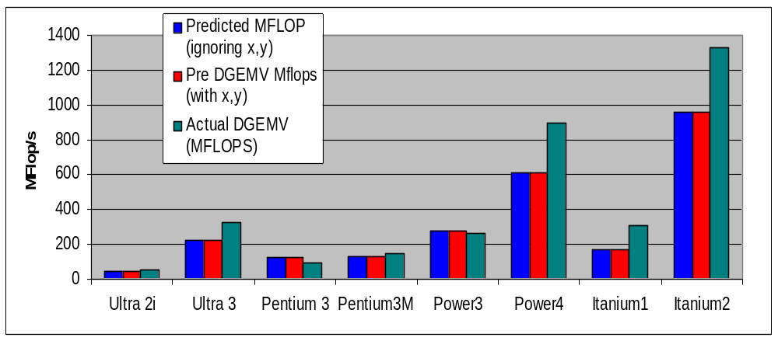
Validating the Model
How well does the model predict actual performance?
  Actual DGEMV: Most highly optimized code for the platform
Model sufficient to compare across machines
But under-predicting on most recent ones due to latency estimate
Notes:
CS267 Lecture 2
Latency overestimate may be due to missing effect of prefetching
Takeaway: simple performance model enough to understand basic performance of algorithms,
how to design betters ones.
We showed you complicated truth, but will mostly use simple model going forward.

Slide 39
Naïve Matrix Multiply
{implements C = C + A*B}
for i = 1 to n
for j = 1 to n
for k = 1 to n
C(i,j) = C(i,j) + A(i,k) * B(k,j)
Algorithm has 2*n³ = O(n³) Flops and operates on 3*n² words of memory
q potentially as large as 2*n³ / 3*n² = O(n)
C(i,j)
C(i,j)
A(i,:)
=
+
*
B(:,j)
Notes:
CS267 Lecture 2

Slide 40
Naïve Matrix Multiply
{implements C = C + A*B}
for i = 1 to n
{read row i of A into fast memory}
for j = 1 to n
{read C(i,j) into fast memory}
{read column j of B into fast memory}
for k = 1 to n
C(i,j) = C(i,j) + A(i,k) * B(k,j)
{write C(i,j) back to slow memory}
C(i,j)
C(i,j)
A(i,:)
=
+
*
B(:,j)
Notes:
CS267 Lecture 2
(do counting of reads/writes, summarize on next slide)

Slide 41
Naïve Matrix Multiply
Number of slow memory references on unblocked matrix multiply
m = n³ to read each column of B n times
+ n² to read each row of A once
+ 2n² to read and write each element of C once
= n³ + 3n²
So q = f / m = 2n³ / (n³ + 3n²)
≈ 2 for large n, no improvement over matrix-vector multiply
Inner two loops are just matrix-vector multiply, of row i of A times B
Similar for any other order of 3 loops
C(i,j)
C(i,j)
A(i,:)
=
+
*
B(:,j)
Notes:
CS267 Lecture 2
Outermost loop is i: inner two loops multiply row i of A times B
Outermost loop is j: inner two loops multiply A times col j of B
Outermost loop is k: inner two loops do rank-one update of C

Slide 42
Matrix-multiply, optimized several ways
Speed of n-by-n matrix multiply on Sun Ultra-1/170, peak = 330 MFlops
Notes:
CS267 Lecture 2
Tell PHiPAC story “Portable HIgh Performance ANSI C”

Slide 43
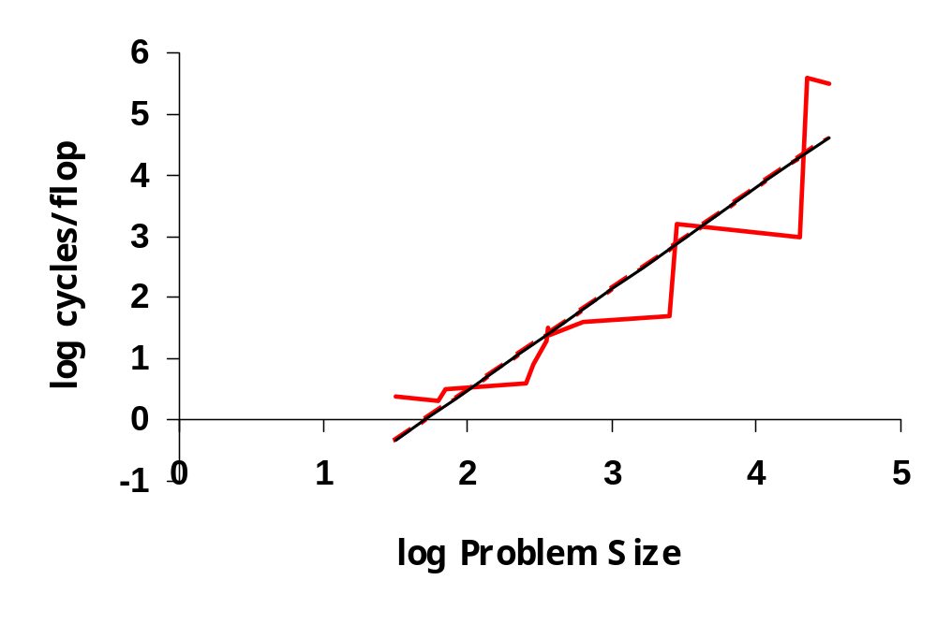
Naïve Matrix Multiply on RS/6000
12000 would take
1095 years
T = N^{4.7}
Size 2000 took 5 days
O(N³) performance would have constant cycles/flop
Performance looks like O(N^{4.7})
Slide source: Larry Carter, UCSD
Notes:
CS267 Lecture 2

Slide 44
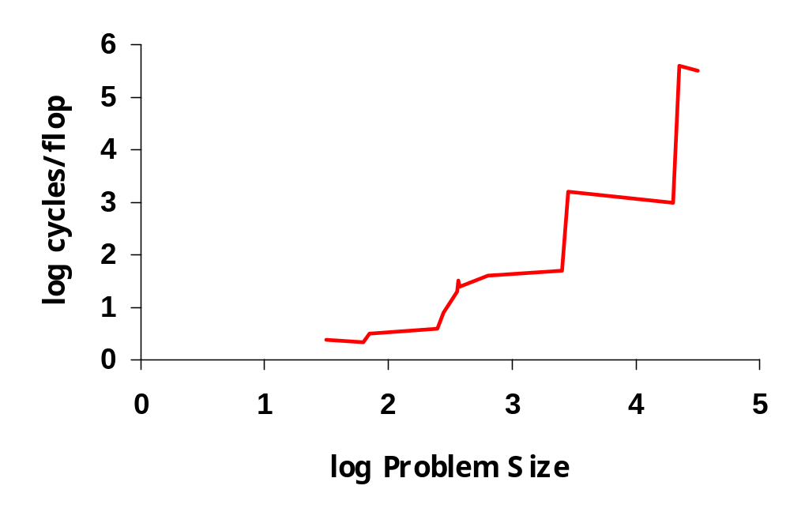
Naïve Matrix Multiply on RS/6000
Page miss every iteration
TLB miss every
iteration
Cache miss every
16 iterations
Page miss every 512 iterations
Slide source: Larry Carter, UCSD
Notes:
CS267 Lecture 2
When cache (or TLB or memory) can’t hold entire B matrix, there will be a miss on every line.
When cache (or TLB or memory) can’t hold a row of A, there will be a miss on each access

Slide 45
Blocked (Tiled) Matrix Multiply
Consider A,B,C to be N-by-N matrices of b-by-b subblocks where b=n / N is called the block size
for i = 1 to N
for j = 1 to N
{read block C(i,j) into fast memory}
for k = 1 to N
{read block A(i,k) into fast memory}
{read block B(k,j) into fast memory}
C(i,j) = C(i,j) + A(i,k) * B(k,j) {do a matrix multiply on blocks}
{write block C(i,j) back to slow memory}
C(i,j)
C(i,j)
A(i,k)
=
+
*
B(k,j)
Notes:
CS267 Lecture 2

Slide 46
Blocked (Tiled) Matrix Multiply
Recall:
m is amount memory traffic between slow and fast memory
matrix has nxn elements, and NxN blocks each of size bxb
f is number of floating point operations, 2n³ for this problem
q = f / m is our measure of algorithm efficiency in the memory system
So:
m = N*n² read each block of B N³ times (N³ * b² = N³ * (n/N)² ⁼ N*n²)
+ N*n² read each block of A N³ times
+ 2n² read and write each block of C once
= (2N + 2) * n²
So computational intensity q = f / m = 2n³ / ((2N + 2) * n²)
≈ n / N = b for large n
So we can improve performance by increasing the blocksize b
Can be much faster than matrix-vector multiply (q=2)
Notes:
CS267 Lecture 2

Slide 47
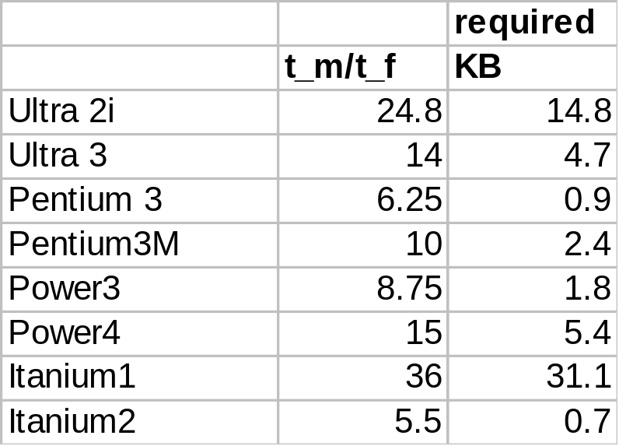
Using Analysis to Understand Machines
The blocked algorithm has computational intensity q ≈ b
The larger the block size, the more efficient our algorithm will be
Limit: All three blocks from A,B,C must fit in fast memory (cache), so we cannot make these blocks arbitrarily large
Assume your fast memory has size M_{fast}
3b² ≤ M_{fast}, so q ≈ b ≤ (M_{fast}/3)^{1/2}
To build a machine to run matrix multiply at 1/2 peak arithmetic speed of the machine, we need a fast memory of size
M_{fast} ≥ 3b² ≈ 3q² = 3(t_{m}/t_{f})²
This size is reasonable for L1 cache, but not for register sets
Note: analysis assumes it is possible to schedule the instructions perfectly
Notes:
CS267 Lecture 2
Assumes double precision (8 byte words) in table

Slide 48
Limits to Optimizing Matrix Multiply
The blocked algorithm changes the order in which values are accumulated into each C[i,j] by applying commutativity and associativity
  Get slightly different answers from naïve code, because of roundoff - OK
The previous analysis showed that the blocked algorithm has computational intensity:
q ≈ b ≤ (M_{fast}/3)^{1/2}
There is a lower bound result that says we cannot do any better than this (using only associativity, so still doing n³ multiplications)
Theorem (Hong & Kung, 1981): Any reorganization of this algorithm (that uses only associativity) is limited to q = O( (M_{fast})^{1/2} )
  #words moved between fast and slow memory = Ω (n³ / (M_{fast})^{1/2} )
Notes:
CS267 Lecture 2

Slide 49
Communication lower bounds for Matmul
Hong/Kung theorem is a lower bound on amount of data communicated by matmul
  Number of words moved between fast and slow memory (cache and DRAM, or DRAM and disk, or …) = Ω (n³ / M_{fast}^{1/2})
Cost of moving data may also depend on the number of “messages” into which data is packed
  Eg: number of cache lines, disk accesses, …
  #messages = Ω (n³ / M_{fast}^{3/2})
Lower bounds extend to anything “similar enough” to 3 nested loops
  Rest of linear algebra (solving linear systems, least squares…)
  Dense and sparse matrices
  Sequential and parallel algorithms, …
More recent: extends to any nested loops accessing arrays
Need (more) new algorithms to attain these lower bounds…

Slide 50
Review of lecture 2 so far (and a look ahead)
Applications
  How to decompose into well-understood algorithms (and their implementations)
Algorithms (matmul as example)
  Need simple model of hardware to guide design, analysis: minimize accesses to slow memory
  If lucky, theory describing “best algorithm”
    For O(n³) sequential matmul, must move Ω(n³/M^{1/2}) words
Layers
Software tools
  How do I implement my applications and algorithms in most efficient and productive way?
Hardware
  Even simple programs have complicated behaviors
  “Small” changes make execution time vary by orders of magnitude

Slide 51
Basic Linear Algebra Subroutines (BLAS)
Industry standard interface (evolving)
  www.netlib.org/blas, www.netlib.org/blas/blast--forum
Vendors, others supply optimized implementations
History
  BLAS1 (1970s):
    vector operations: dot product, saxpy (y=α*x+y), etc
    m=2*n, f=2*n, q = f/m = computational intensity ~1 or less
  BLAS2 (mid 1980s)
    matrix-vector operations: matrix vector multiply, etc
    m=n^2, f=2*n^2, q~2, less overhead
    somewhat faster than BLAS1
  BLAS3 (late 1980s)
    matrix-matrix operations: matrix matrix multiply, etc
    m <= 3n^2, f=O(n^3), so q=f/m can possibly be as large as n, so BLAS3 is potentially much faster than BLAS2
Good algorithms use BLAS3 when possible (LAPACK & ScaLAPACK)
  See www.netlib.org/{lapack,scalapack}
  More later in course
Notes:
CS267 Lecture 2

Slide 52
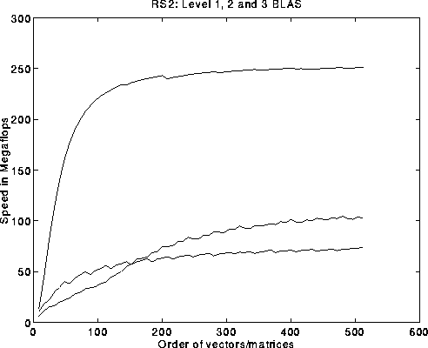
BLAS speeds on an IBM RS6000/590
Peak speed = 266 Mflops
Peak
BLAS 3
BLAS 2
BLAS 1
BLAS 3 (n-by-n matrix matrix multiply) vs BLAS 2 (n-by-n matrix vector multiply) vs BLAS 1 (saxpy of n vectors)
Notes:
CS267 Lecture 2

Slide 53
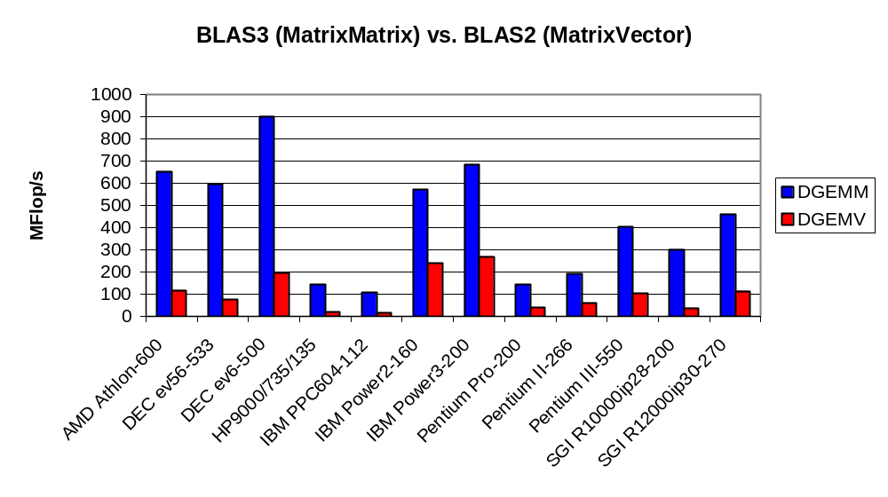
Dense Linear Algebra: BLAS2 vs. BLAS3
BLAS2 and BLAS3 have very different computational intensity, and therefore different performance
Data source: Jack Dongarra
Notes:
CS267 Lecture 2
Benchmark showing results for large square matrices

Slide 54
What if there are more than 2 levels of memory?
Need to minimize communication between all levels
  Between L1 and L2 cache, cache and DRAM, DRAM and disk…
The tiled algorithm requires finding a good block size
  Machine dependent
  Need to “block” b x b matrix multiply in inner most loop
    1 level of memory ⇒ 3 nested loops (naïve algorithm)
    2 levels of memory ⇒ 6 nested loops
    3 levels of memory ⇒ 9 nested loops …
Cache Oblivious Algorithms offer an alternative
  Treat nxn matrix multiply as a set of smaller problems
  Eventually, these will fit in cache
  Will minimize # words moved between every level of memory hierarchy – at least asymptotically
  “Oblivious” to number and sizes of levels
Notes:
CS267 Lecture 2

Slide 55
Recursive Matrix Multiplication (RMM) (1/2)
A₁₁ A₁₂ A₂₁ A₂₂
C = = A · B = ·
=
True when each A_{ij} etc 1x1 or n/2 x n/2
For simplicity: square matrices with n = 2^{m}
  Extends to general rectangular case
C₁₁ C₁₂ C₂₁ C₂₂
B₁₁ B₁₂ B₂₁ B₂₂
A₁₁·B₁₁ + A₁₂·B₂₁ A₁₁·B₁₂ + A₁₂·B₂₂ A₂₁·B₁₁ + A₂₂·B₂₁ A₂₁·B₁₂ + A₂₂·B₂₂
func C = RMM (A, B, n)
if n = 1, C = A * B, else
{ C₁₁ = RMM (A₁₁ , B₁₁ , n/2) + RMM (A₁₂ , B₂₁ , n/2)
C₁₂ = RMM (A₁₁ , B₁₂ , n/2) + RMM (A₁₂ , B₂₂ , n/2)
C₂₁ = RMM (A₂₁ , B₁₁ , n/2) + RMM (A₂₂ , B₂₁ , n/2)
C₂₂ = RMM (A₂₁ , B₁₂ , n/2) + RMM (A₂₂ , B₂₂ , n/2) }
return

Slide 56
Recursive Matrix Multiplication (2/2)
func C = RMM (A, B, n)
if n=1, C = A * B, else
{ C₁₁ = RMM (A₁₁ , B₁₁ , n/2) + RMM (A₁₂ , B₂₁ , n/2)
C₁₂ = RMM (A₁₁ , B₁₂ , n/2) + RMM (A₁₂ , B₂₂ , n/2)
C₂₁ = RMM (A₂₁ , B₁₁ , n/2) + RMM (A₂₂ , B₂₁ , n/2)
C₂₂ = RMM (A₂₁ , B₁₂ , n/2) + RMM (A₂₂ , B₂₂ , n/2) }
return
A(n) = # arithmetic operations in RMM( . , . , n)
= 8 · A(n/2) + 4(n/2)² if n > 1, else 1
= 2n³ … same operations as usual, in different order
M(n) = # words moved between fast, slow memory by RMM( . , . , n)
= 8 · M(n/2) + 4(n/2)² if 3n² > M_{fast} , else 3n²
= O( n³ / (M_{fast} )^{1/2} + n² ) … same as blocked matmul
Don’t need to know M_{fast} for this to work!

Slide 57
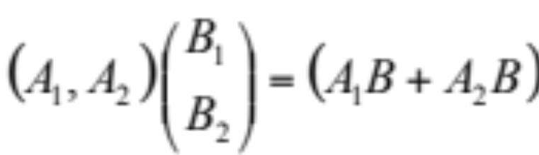
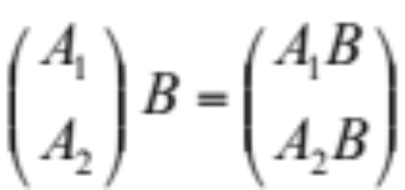
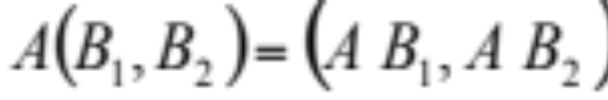
Recursion: Cache Oblivious Algorithms
The tiled algorithm requires finding a good block size
Cache Oblivious Algorithms offer an alternative
  Treat nxn matrix multiply set of smaller problems
  Eventually, these will fit in cache
Cases for A (nxm) * B (mxp)
Case1: m>= max{n,p}: split A horizontally:
Case 2 : n>= max{m,p}: split A vertically and B horizontally
Case 3: p>= max{m,n}: split B vertically
Attains lower bound in O() sense
1
2
Case 2
Case 1
Case 3
Notes:
CS267 Lecture 2

Slide 58
Experience with Cache-Oblivious Algorithms
In practice, need to cut off recursion well before 1x1 blocks
  Call “micro-kernel” on small blocks
Implementing a high-performance Cache-Oblivious code is not easy
  Careful attention to micro-kernel is needed
Using fully recursive approach with highly optimized recursive micro-kernel, Pingali et al report that they never got more than 2/3 of peak. (unpublished, presented at LACSI’06)
Issues with Cache Oblivious (recursive) approach
  Recursive Micro-Kernels yield less performance than iterative ones using same scheduling techniques
  Pre-fetching is needed to compete with best code: not well-understood in the context of Cache-Oblivious codes
More recent work on CARMA (UCB) uses recursion for parallelism, but aware of available memory, very fast (later)
Unpublished work, presented at LACSI 2006
Notes:
CS267 Lecture 2

Slide 59
Recursive Data Layouts
A related idea is to use a recursive structure for the matrix
  Improve locality with machine-independent data structure
  Can minimize latency with multiple levels of memory hierarchy
There are several possible recursive decompositions depending on the order of the sub-blocks
This figure shows Z-Morton Ordering (“space filling curve”)
See papers on “cache oblivious algorithms” and “recursive layouts”
  Gustavson, Kagstrom, et al, SIAM Review, 2004
Advantages:
the recursive layout works well for any cache size
Disadvantages:
The index calculations to find A[i,j] are expensive
Implementations switch to column-major for small sizes
Notes:
CS267 Lecture 2

Slide 60
Strassen’s Matrix Multiply
The traditional algorithm (with or without tiling) has O(n³) flops
Strassen discovered an algorithm with asymptotically lower flops
  O(n^{2.81})
Consider a 2x2 matrix multiply, normally takes 8 multiplies, 4 adds
  Strassen does it with 7 multiplies and 18 adds
Let M = m11 m12 = a11 a12 b11 b12
m21 m22 = a21 a22 b21 b22
Let p1 = (a12 - a22) * (b21 + b22) p5 = a11 * (b12 - b22)
p2 = (a11 + a22) * (b11 + b22) p6 = a22 * (b21 - b11)
p3 = (a11 - a21) * (b11 + b12) p7 = (a21 + a22) * b11
p4 = (a11 + a12) * b22
Then m11 = p1 + p2 - p4 + p6
m12 = p4 + p5
m21 = p6 + p7
m22 = p2 - p3 + p5 - p7
Extends to nxn by divide&conquer
Notes:
CS267 Lecture 2

Slide 61
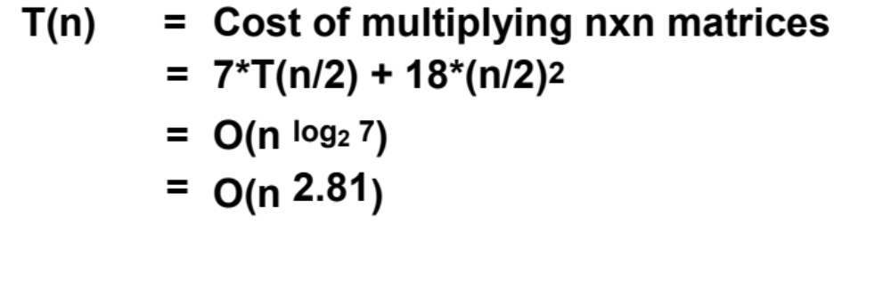
Strassen (continued)
Asymptotically faster
  Several times faster for large n in practice
  Cross-over depends on machine
  “Tuning Strassen's Matrix Multiplication for Memory Efficiency”, M. S. Thottethodi, S. Chatterjee, and A. Lebeck, in Proceedings of Supercomputing '98
Possible to extend communication lower bound to Strassen
  #words moved between fast and slow memory = Ω(n^{log2 7} / M^{(log2 7)/2 – 1} ) ~ Ω(n^{2.81} / M^{0.4} ) (Ballard, D., Holtz, Schwartz, 2011, SPAA Best Paper Prize)
  Attainable too, more on parallel version later
Notes:
CS267 Lecture 2
World record due to Winograd and Copperfield
Very complicated algorithm
Needs unrealistically enormous matrices

Slide 62
Other Fast Matrix Multiplication Algorithms
World’s record was O(n ^{2.376...} )
  Coppersmith & Winograd, 1987
New Record! 2.376 reduced to 2.373
  Virginia Vassilevska Williams, UC Berkeley & Stanford, 2011
Lower bound on #words moved can be extended to (some) of these algorithms
Possibility of O(n^{2+ε}) algorithm!
  Cohn, Umans, Kleinberg, 2003
Can show they all can be made numerically stable
  D., Dumitriu, Holtz, Kleinberg, 2007
Can do rest of linear algebra (solve Ax=b, Ax=λx, etc) as fast , and numerically stably
  D., Dumitriu, Holtz, 2008
Fast methods (besides Strassen) may need unrealistically large n
Notes:
CS267 Lecture 2
Virginia Vassilevskaya Williams: 2.373 in Fall 2011
Possible class projects either
try existing parallel 2.5D strassen on other architectures
try other algorithms like Bini (exponent = log_12 1000 = ?)
experimental and theoretical studies of numerical stability

Slide 63
Tuning Code in Practice
Tuning code can be tedious
  Lots of code variations to try besides blocking
  Machine hardware performance hard to predict
  Compiler behavior hard to predict
Response: “Autotuning”
  Let computer generate large set of possible code variations, and search them for the fastest ones
  Field started with CS267 homework assignment in mid 1990s
    PHiPAC, leading to ATLAS, incorporated in Matlab
    We still use the same assignment
  We (and others) are extending autotuning to other dwarfs / motifs
Still need to understand how to do it by hand
  Not every code will have an autotuner
  Need to know if you want to build autotuners
Notes:
Naïve code on Hopper runs at 2% of peak
Will hand you blocked code, 7x faster, so 14% of peak
Another 6x is possible, so 84% of peak, using these techniques
CS267 Lecture 2

Slide 64
Search Over Block Sizes
Performance models are useful for high level algorithms
  Helps in developing a blocked algorithm
  Models have not proven very useful for block size selection
    too complicated to be useful
      See work by Sid Chatterjee for detailed model
    too simple to be accurate
      Multiple multidimensional arrays, virtual memory, etc.
  Speed depends on matrix dimensions, details of code, compiler, processor
Notes:
CS267 Lecture 2

Slide 65
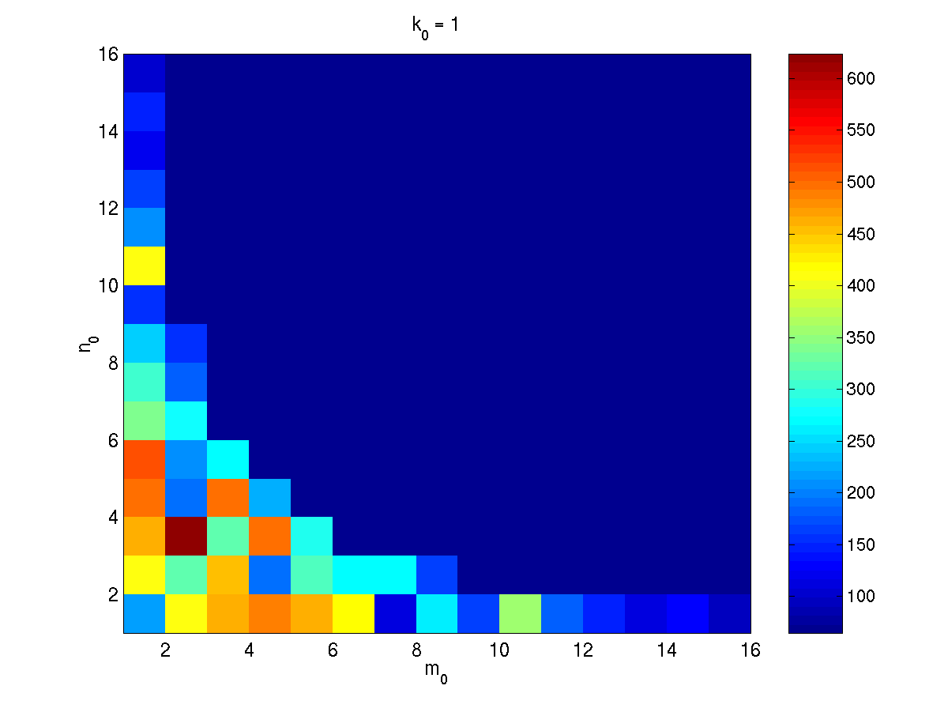
What the Search Space Looks Like
Number of columns in register block
Number of rows in register block
A 2-D slice of a 3-D register-tile search space. The dark blue region was pruned.
(Platform: Sun Ultra-IIi, 333 MHz, 667 Mflop/s peak, Sun cc v5.0 compiler)
Notes:
CS267 Lecture 2

Slide 66
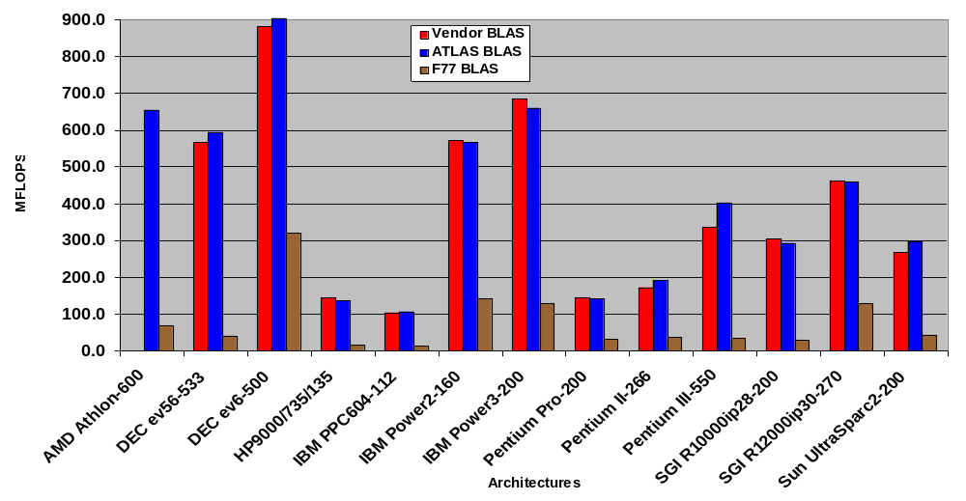
ATLAS (DGEMM n = 500)
Source: Jack Dongarra
ATLAS is faster than all other portable BLAS implementations and it is comparable with machine-specific libraries provided by the vendor.
Notes:
CS267 Lecture 2
Square matrices, in set of high dimensional data
Don’t need to do autotuning in HW1, but students have

Slide 67
Optimizing in Practice
Tiling for registers
  loop unrolling, use of named “register” variables
Tiling for multiple levels of cache and TLB
Exploiting fine-grained parallelism in processor
  superscalar; pipelining
Complicated compiler interactions (flags)
Hard to do by hand (but you’ll try)
Automatic optimization an active research area
  ParLab: parlab.eecs.berkeley.edu
  BeBOP: bebop.cs.berkeley.edu
    Weekly group meeting Mondays 1pm
  PHiPAC: www.icsi.berkeley.edu/~bilmes/phipac
  in particular tr-98-035.ps.gz
  ATLAS: www.netlib.org/atlas
Notes:
CS267 Lecture 2

Slide 68
Removing False Dependencies
Using local variables, reorder operations to remove false dependencies
a[i] = b[i] + c;
a[i+1] = b[i+1] * d;
false read-after-write hazard
between a[i] and b[i+1]
float f1 = b[i];
float f2 = b[i+1];
a[i] = f1 + c;
a[i+1] = f2 * d;
With some compilers, you can declare a and b unaliased.
Done via “restrict pointers,” compiler flag, or pragma)
Notes:
CS267 Lecture 2
Details on class web page
Compiler can’t prove that a[i] and b[i+1] can’t overlap, so instructions can be done in parallel

Slide 69
Exploit Multiple Registers
Reduce demands on memory bandwidth by pre-loading into local variables
while( … ) {
*res++ = filter[0]*signal[0]
+ filter[1]*signal[1]
+ filter[2]*signal[2];
signal++;
}
float f0 = filter[0];
float f1 = filter[1];
float f2 = filter[2];
while( … ) {
*res++ = f0*signal[0]
+ f1*signal[1]
+ f2*signal[2];
signal++;
}
also: register float f0 = …;
Example is a convolution
Notes:
CS267 Lecture 2
Make sure compiler know filter[i] is constant to avoid memory accesses
Sometimes helps to declare as register

Slide 70
Loop Unrolling
Expose instruction-level parallelism
float f0 = filter[0], f1 = filter[1], f2 = filter[2];
float s0 = signal[0], s1 = signal[1], s2 = signal[2];
*res++ = f0*s0 + f1*s1 + f2*s2;
do {
signal += 3;
s0 = signal[0];
res[0] = f0*s1 + f1*s2 + f2*s0;
s1 = signal[1];
res[1] = f0*s2 + f1*s0 + f2*s1;
s2 = signal[2];
res[2] = f0*s0 + f1*s1 + f2*s2;
res += 3;
} while( … );
Notes:
CS267 Lecture 2
All in parallel: f0*s1 + f1*s2, f0*s2 while waiting for s0, since s1 and s2 available
then: f2*s0, f1*s0, f0*s0, after s0 arrives
then: f2*s1, f1*s1, after s1 arrives
then: f2*s2, after s2 arrives

Slide 71
Expose Independent Operations
Hide instruction latency
  Use local variables to expose independent operations that can execute in parallel or in a pipelined fashion
  Balance the instruction mix (what functional units are available?)
f1 = f5 * f9;
f2 = f6 + f10;
f3 = f7 * f11;
f4 = f8 + f12;
Notes:
CS267 Lecture 2
First two lines in parallel, then next two
An autotuner could generate all permutations, pick fastest

Slide 72
Copy optimization
Copy input operands or blocks
  Reduce cache conflicts
  Constant array offsets for fixed size blocks
  Expose page-level locality
  Alternative: use different data structures from start (if users willing)
    Recall recursive data layouts
Original matrix
(numbers are addresses)
Reorganized into
2x2 blocks
0
4
8
12
0
2
8
10
1
5
9
13
1
3
9
11
2
6
10
14
4
6
12
13
3
7
11
15
5
7
14
15
Notes:
CS267 Lecture 2
This is one of the optimizations that Atlas performs that PhiPAC does not.

Slide 73
Locality in Other Algorithms
The performance of any algorithm is limited by q
  q = “computational intensity” = #arithmetic_ops / #words_moved
In matrix multiply, we increase q by changing computation order
  increased temporal locality
For other algorithms and data structures, even hand-transformations are still an open problem
  Lots of open problems, class projects
Notes:
CS267 Lecture 2

Slide 74
Summary of Lecture 2
Details of machine are important for performance
  Processor and memory system (not just parallelism)
  Before you parallelize, make sure you’re getting good serial performance
  What to expect? Use understanding of hardware limits
There is parallelism hidden within processors
  Pipelining, SIMD, etc
Machines have memory hierarchies
  100s of cycles to read from DRAM (main memory)
  Caches are fast (small) memory that optimize average case
Locality is at least as important as computation
  Temporal: re-use of data recently used
  Spatial: using data nearby to recently used data
Can rearrange code/data to improve locality
  Goal: minimize communication = data movement
Notes:
CS267 Lecture 2
Develop simple mental models of complex hardware,
Minimize data movement between all parts of memory

Slide 75
Class Logistics
Homework 0 posted on web site
  Find and describe interesting application of parallelism
  Due Feb 7
  Could even be your intended class project
Homework 1 posted on web site
  Tuning matrix multiply
  Due Feb 19
Please fill in on-line class survey
  We need this to assign teams for Homework 1

Slide 76
Some reading for today (see website)
Sourcebook Chapter 3, (note that chapters 2 and 3 cover the material of lecture 2 and lecture 3, but not in the same order).
"Performance Optimization of Numerically Intensive Codes", by Stefan Goedecker and Adolfy Hoisie, SIAM 2001.
Web pages for reference:
  BeBOP Homepage
  ATLAS Homepage
  BLAS (Basic Linear Algebra Subroutines), Reference for (unoptimized) implementations of the BLAS, with documentation.
  LAPACK (Linear Algebra PACKage), a standard linear algebra library optimized to use the BLAS effectively on uniprocessors and shared memory machines (software, documentation and reports)
  ScaLAPACK (Scalable LAPACK), a parallel version of LAPACK for distributed memory machines (software, documentation and reports)
Tuning Strassen's Matrix Multiplication for Memory Efficiency Mithuna S. Thottethodi, Siddhartha Chatterjee, and Alvin R. Lebeck in Proceedings of Supercomputing '98, November 1998 postscript
Recursive Array Layouts and Fast Parallel Matrix Multiplication” by Chatterjee et al. IEEE TPDS November 2002.
Many related papers at bebop.cs.berkeley.edu
Notes:
CS267 Lecture 2

Slide 77
Extra Slides

Slide 78
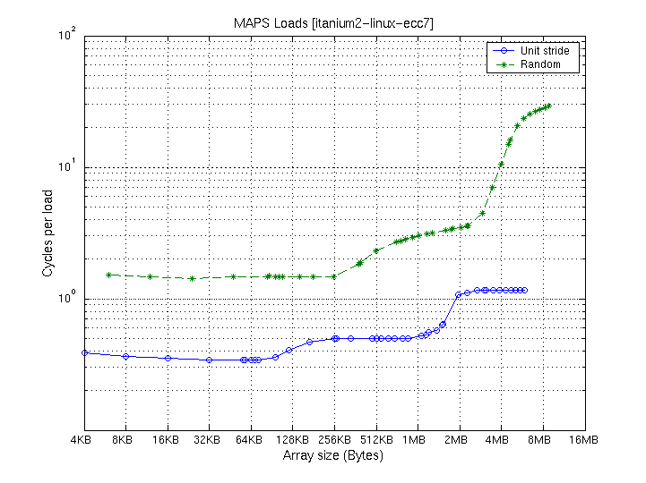
Memory Performance on Itanium 2 (CITRIS)
Itanium2, 900 MHz
Array size
Mem:
11-60 cycles
L3: 2 MB
128 B line
3-20 cycles
L2: 256 KB
128 B line
.5-4 cycles
L1: 32 KB
64B line
.34-1 cycles
Uses MAPS Benchmark: http://www.sdsc.edu/PMaC/MAPs/maps.html
Notes:
CS267 Lecture 2

Slide 79
Proof of Communication Lower Bound on C = A*B (1/6)
Proof from Irony/Tishkin/Toledo (2004)
  We’ll need it for the communication lower bound on parallel matmul
Think of instruction stream being executed
  Looks like “ … add, load, multiply, store, load, add, …”
  We want to count the number of loads and stores, given that we are multiplying n-by-n matrices C = A*B using the usual 2*n³ flops, possibly reordered assuming addition is commutative/associative
    It actually isn’t associative in floating point, but close enough
  Assuming that at most M words can be stored in fast memory
Outline:
  Break instruction stream into segments, each containing M loads and stores
  Somehow bound the maximum number of adds and multiplies that could be done in each segment, call it F
  So F · # segments ≥ 2·n³ , and # segments ≥ 2·n³ / F
  So # loads & stores = M · #segments ≥ M ·2 ·n³ / F

Slide 80
Proof of Communication Lower Bound on C = A*B (2/6)
Given segment of instruction stream with M loads & stores, how many adds & multiplies (F) can we do?
  At most 2M entries of C, 2M entries of A and/or 2M entries of B can be accessed
Use geometry:
  Represent 2·n³ operations by n x n x n cube
  One n x n face represents A
    each 1 x 1 subsquare represents one A(i,k)
  One n x n face represents B
    each 1 x 1 subsquare represents one B(k,j)
  One n x n face represents C
    each 1 x 1 subsquare represents one C(i,j)
  Each 1 x 1 x 1 subcube represents one C(i,j) += A(i,k) * B(k,j)

Slide 81
Proof of Communication Lower Bound on C = A*B (3/6)
k
“C face”
Cube representing
C(1,1) += A(1,3)*B(3,1)
C(2,3)
C(1,1)
B(3,1)
A(1,3)
j
B(1,3)
A(2,1)
“B face”
i
“A face”

Slide 82
Proof of Communication Lower Bound on C = A*B (4/6)
Given segment of instruction stream with M load & stores, how many adds & multiplies (F) can we do?
  At most 2M entries of C, and/or of A and/or of B can be accessed
Use geometry:
  Represent 2·n³ operations by n x n x n cube
  One n x n face represents A
    each 1 x 1 subsquare represents one A(i,k)
  One n x n face represents B
    each 1 x 1 subsquare represents one B(k,j)
  One n x n face represents C
    each 1 x 1 subsquare represents one C(i,j)
  Each 1 x 1 x 1 subcube represents one C(i,j) += A(i,k) * B(k,j)
If we have at most 2M “A squares”, 2M “B squares”, and 2M “C squares” on faces, how many cubes can we have?

Slide 83
Proof of Communication Lower Bound on C = A*B (5/6)
k
x
“C shadow”
y
z
y
j
z
“B shadow”
x
“A shadow”
i
(i,k) is in “A shadow” if (i,j,k) in 3D set
(j,k) is in “B shadow” if (i,j,k) in 3D set
(i,j) is in “C shadow” if (i,j,k) in 3D set
Thm (Loomis & Whitney, 1949)
# cubes in 3D set = Volume of 3D set
≤ (area(A shadow) * area(B shadow) *
area(C shadow)) ^{1/2}
# cubes in black box with
side lengths x, y and z
= Volume of black box
= x*y*z
= (#A□s * #B□s * #C□s )^{1/2}
= ( xz * zy * yx)^{1/2}

Slide 84
Proof of Communication Lower Bound on C = A*B (6/6)
Consider one “segment” of instructions with M loads and stores
There can be at most 2M entries of A, B, C available in one segment
Volume of set of cubes representing possible multiply/adds ≤ (2M · 2M · 2M)^{1/2} = (2M) ^{3/2} ≡ F
# Segments ≥ 2n³ / F
# Loads & Stores = M · #Segments ≥ M · 2n³ / F = n³ / (2M)^{1/2}
Parallel Case: apply reasoning to one processor out of P
  # Adds and Muls = 2n³ / P (assuming load balanced)
  M= n² / P (each processor gets equal fraction of matrix)
  # “Load & Stores” = # words communicated with other procs ≥ M · (2n³ /P) / F= M · (2n³ /P) / (2M) ^{3/2} = n² / (2P)^{1/2}

Slide 85
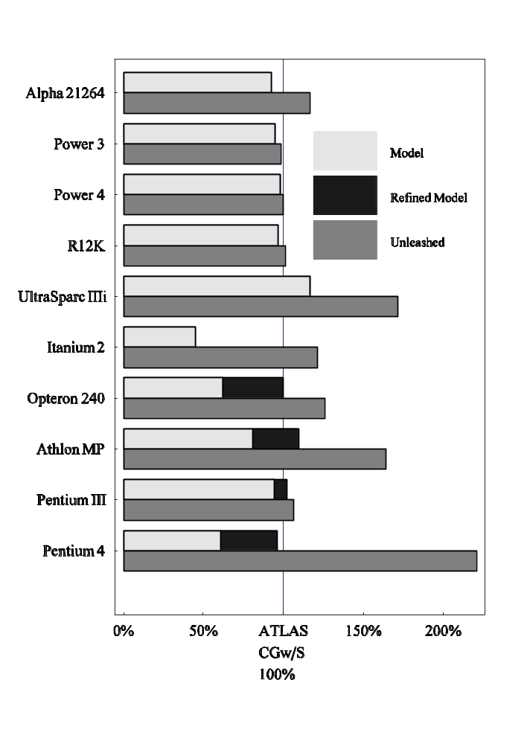
Experiments on Search vs. Modeling
Study compares search (Atlas) to optimization selection based on performance models
Ten modern architectures
Model did well on most cases
  Better on UltraSparc
  Worse on Itanium
Eliminating performance gaps: think globally, search locally
  -small performance gaps: local search
  -large performance gaps:
  refine model
Substantial gap between ATLAS CGw/S and ATLAS Unleashed on some machines
Source: K. Pingali. Results from IEEE ’05 paper by K Yotov, X Li, G Ren, M Garzarán, D Padua, K Pingali, P Stodghill.
Notes:
CS267 Lecture 2

Slide 86
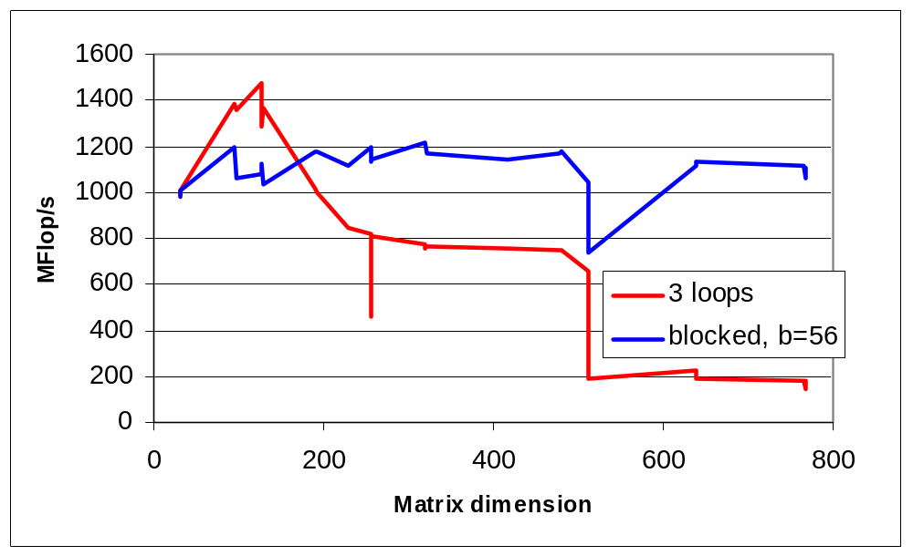
Tiling Alone Might Not Be Enough
Naïve and a “naïvely tiled” code on Itanium 2
  Searched all block sizes to find best, b=56
  Starting point for next homework
Notes:
CS267 Lecture 2

Slide 87
Minimize Pointer Updates
Replace pointer updates for strided memory addressing with constant array offsets
f0 = *r8; r8 += 4;
f1 = *r8; r8 += 4;
f2 = *r8; r8 += 4;
f0 = r8[0];
f1 = r8[4];
f2 = r8[8];
r8 += 12;
Pointer vs. array expression costs may differ.
Some compilers do a better job at analyzing one than the other
Notes:
CS267 Lecture 2

Slide 88
Summary
Performance programming on uniprocessors requires
  understanding of memory system
  understanding of fine-grained parallelism in processor
Simple performance models can aid in understanding
  Two ratios are key to efficiency (relative to peak)
  computational intensity of the algorithm:
    q = f/m = # floating point operations / # slow memory references
  machine balance in the memory system:
    t_{m}/t_{f} = time for slow memory reference / time for floating point operation
Want q > t_{m}/t_{f} to get half machine peak
Blocking (tiling) is a basic approach to increase q
  Techniques apply generally, but the details (e.g., block size) are architecture dependent
  Similar techniques are possible on other data structures and algorithms
Now it’s your turn: Homework 1
  Work in teams of 2 or 3 (assigned this time)
Notes:
CS267 Lecture 2

Slide 89
Questions You Should Be Able to Answer
What is the key to understand algorithm efficiency in our simple memory model?
What is the key to understand machine efficiency in our simple memory model?
What is tiling?
Why does block matrix multiply reduce the number of memory references?
What are the BLAS?
Why does loop unrolling improve uniprocessor performance?
Notes:
CS267 Lecture 2

Slide 90
Recursive Data Layouts
Blocking seems to require knowing cache sizes – portable?
A related (recent) idea is to use a recursive structure for the matrix
There are several possible recursive decompositions depending on the order of the sub-blocks
This figure shows Z-Morton Ordering (“space filling curve”)
See papers on “cache oblivious algorithms” and “recursive layouts”
Advantages:
the recursive layout works well for any cache size
Disadvantages:
The index calculations to find A[i,j] are expensive
Implementations switch to column-major for small sizes
Notes:
CS267 Lecture 2

