Slide 1
TEAM_CS PROTOTYPE MILESTONE
Prototype
Beta
Alpha
SungMin Moon/ChunMook Kim/Chanill Hwang

Slide 2
Contents
Game Features
Changed Elements
Game Demo
Future Plan

Slide 3

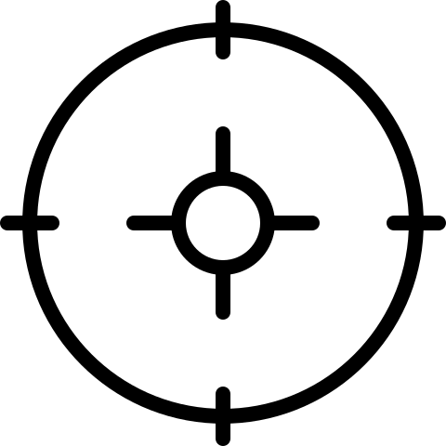


Game Feature
2D Side Scroll
Shooting
Game
Many
Weapons

Slide 4
Changed Elements
Control
Before: Only Key Board
After: Key Board + Mouse
Item Features
Item is dropped when enemies die
Item restores player health

Slide 5
DEMO

Slide 6


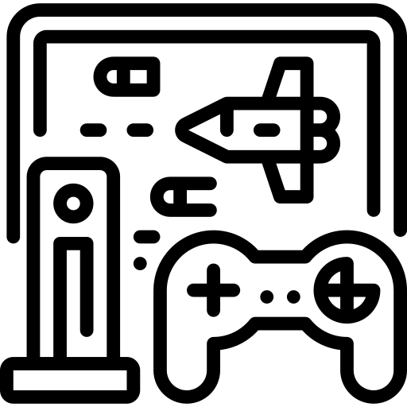
Future Plan
Deciding a Theme
UI Adjustments
Additional
Features & Effects

Slide 7
Thank you for listening!

