Slide 1
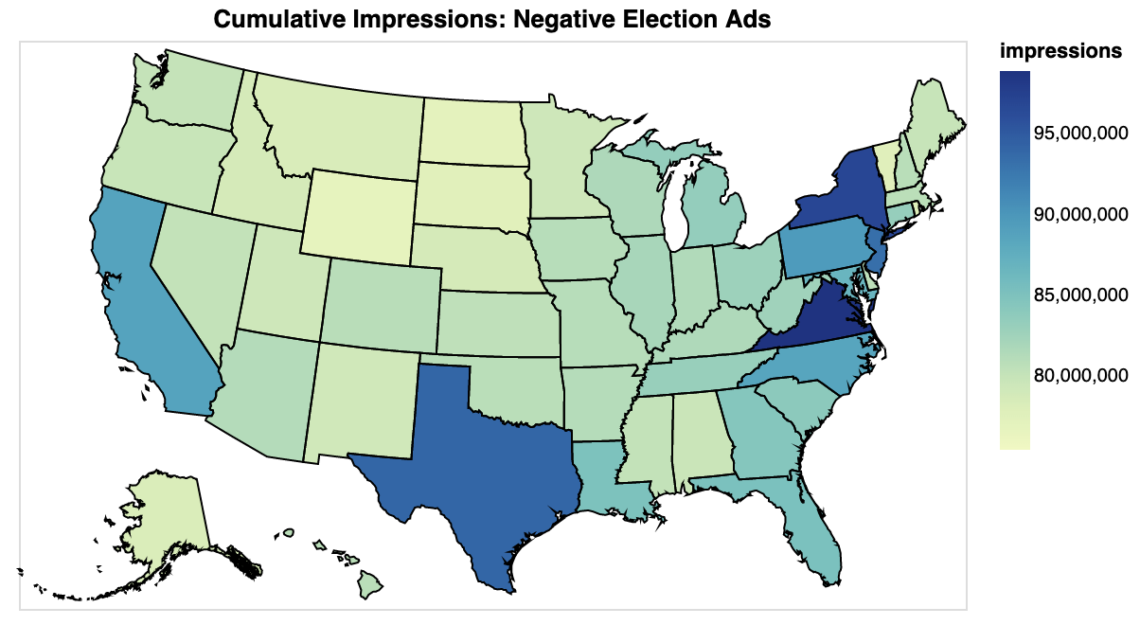
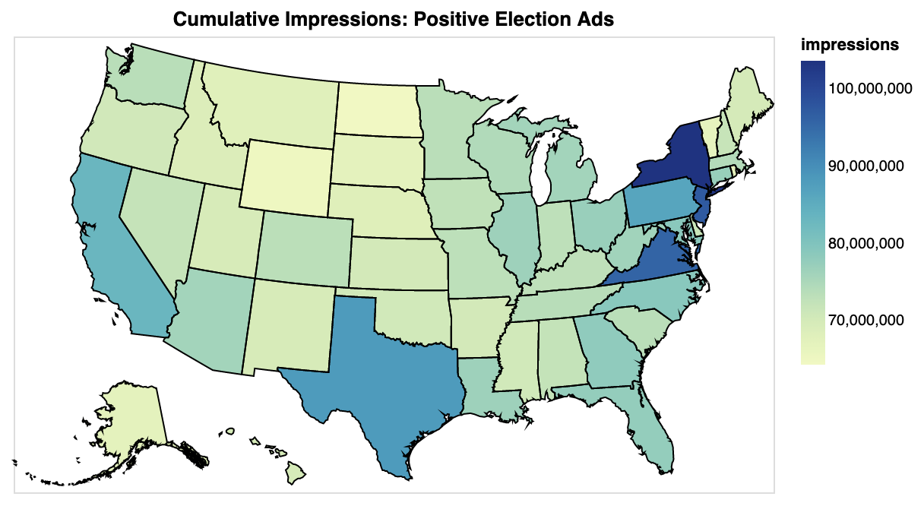



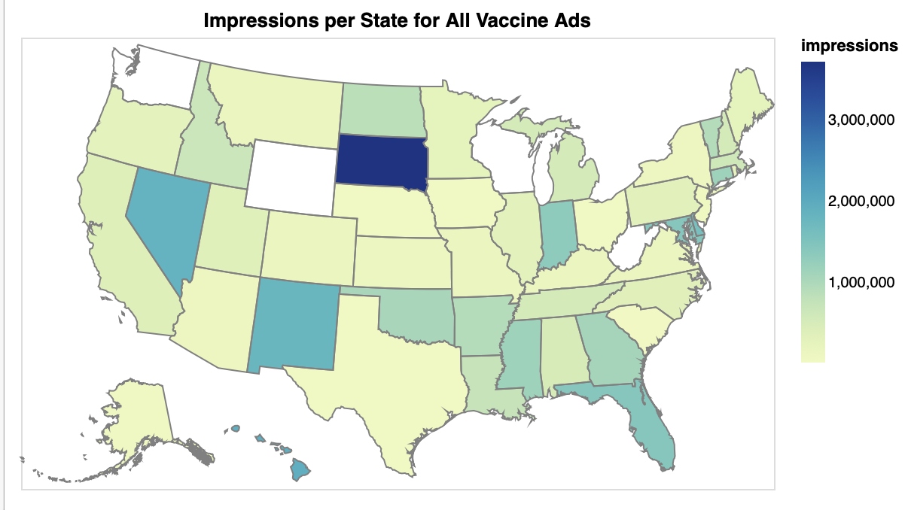
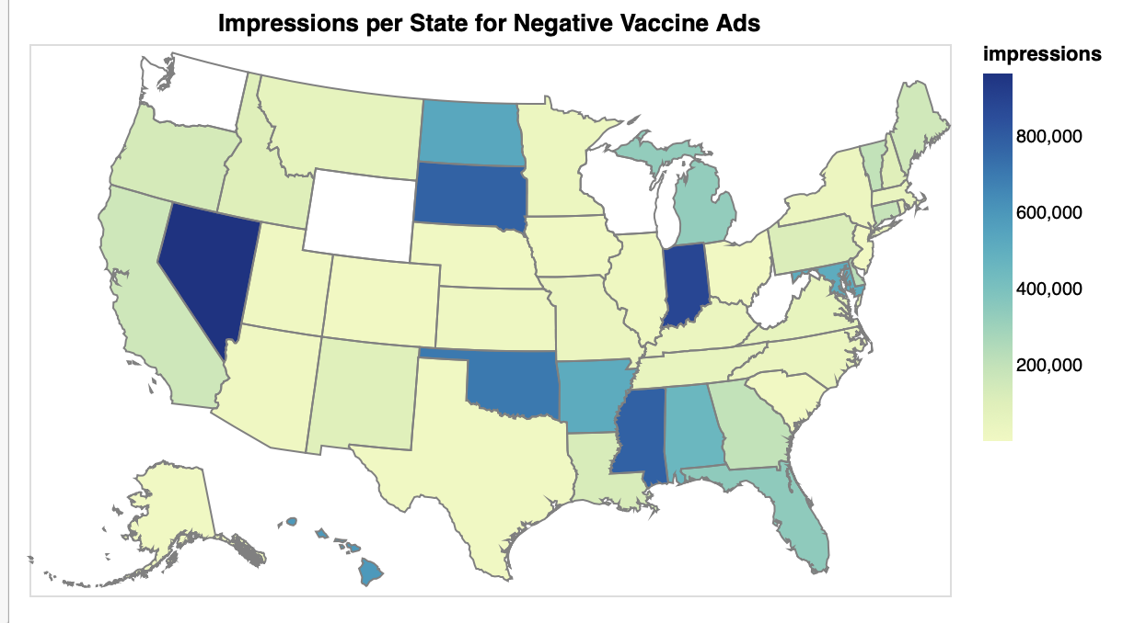


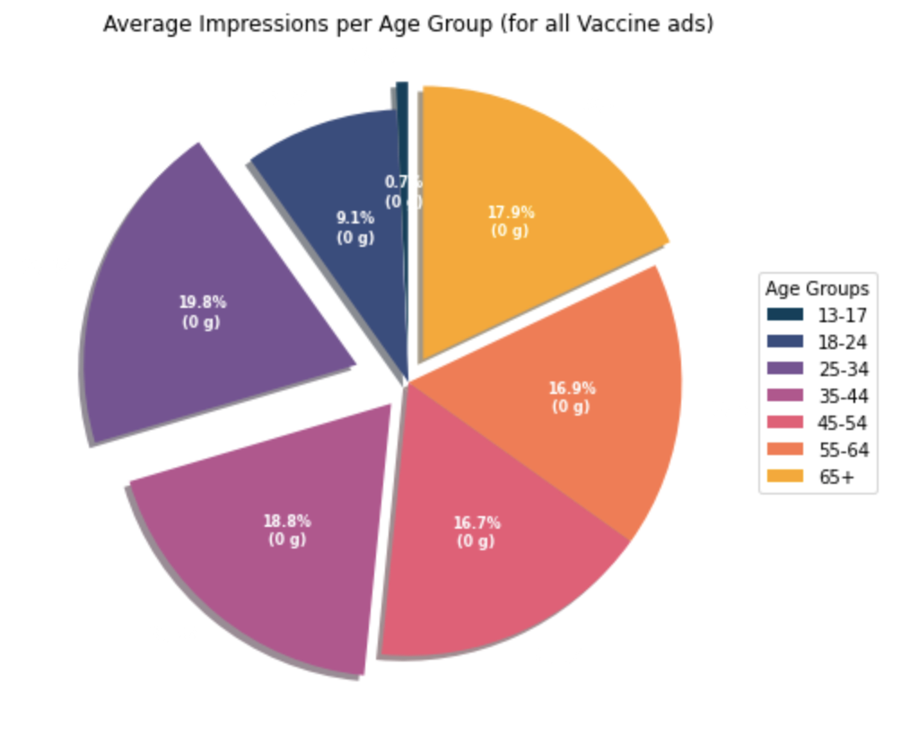
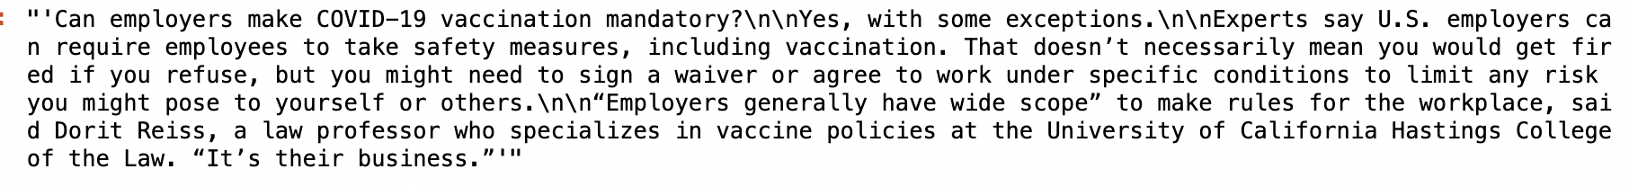
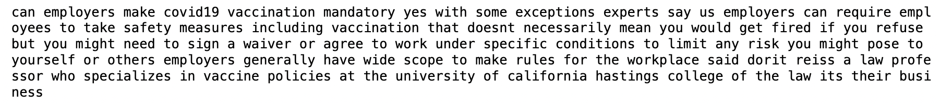
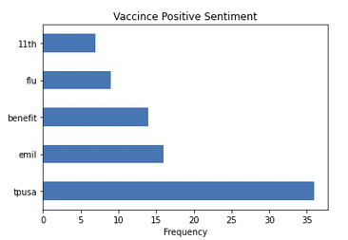
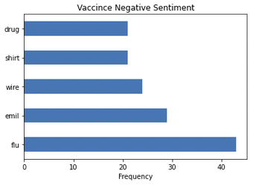
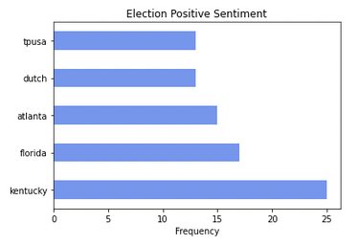
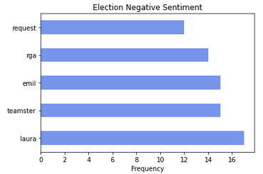
An In-Depth Exploration of Facebook Ads Data
Chaninder Rishi, Emily Chen, Josh Puray, Rohith Pillai
University of California San Diego Data Science Project Showcase
Introduction
Analysis
Despite there being over 3000+ ads per dataset the frequencies of the most common TF-IDF words are quite low. Suggesting that ads with similar sentiment scores don't share many common TF-IDF words despite having similar sentiment scores and the same key words.
Challenges
Using Facebook's Ads Library API our goal was to analyze political ads containing specific keywords during the durations of 2020-21 to discern something about misinformation (our overarching topic). With this goal in mind, our project is centered around primarily EDA of this data. Over our analysis, the data science techniques used for our EDA include usage of pretrained models to obtain sentiment, viz development, hypothesis testing, text analysis, and basic machine learning (linear regression).
Inferential Analysis with BERT
Linear Regression Analysis
Access to API
Facebook's additional authorization check took a few weeks for us to receive
Trouble understanding API to extract features that would be relevant to our analysis
Using a pre-trained BERT model, we classified Facebook ads based on positive and negative sentiments within the ad description. We drew ads from samples based on key words, such as "election" and "vaccine".
For this dataset, we developed a multiple linear regression model with the goal of using an ads runtime and spend to predict the number of impressions that it will get. First, we visualized the raw data by performing bivariate analysis using the columns of the dataset.
As you can see in the visualizations above, there are no patterns we can see in the data, especially none that we can use to perform regression on. The visualizations below show some of the same graphs after applying a log transformation on the relevant columns.
The data now looks much more suitable for a regression model. After building a regression model to predict impression using the ad runtime and spend, our model had a r-squared score of 0.43 and a RMSE (root mean square error) of 1.67.
Dataset
Incredibly messy dataset: many duplicates, many missing, text was very hard to clean up as ad descriptions sometimes had emojis, foreign languages, and gibberish. Affected sentiment classification and text analysis
BERT
Numerous issues encountered with BERT for downloading on our systems (wasn't compatible with M1 chip). Additionally, inability to vet BERT's correctness in determining sentiment was a challenge we could not fix.
The visualizations above are the cumulative number of impression per state, for both negative and positive ads with "election" as a key word. Impressions look similar between negative and positive election ads, with states like New York, Texas, California, Virginia having a high number of impression between both types of ads.
The maps above are choropleth visualizations of the impressions per state (1) for all positive ads and (2) for negative ads with "vaccine" as the key word.
The pie chart above shows the average number of impressions per age group for all vaccine ads.
Data Cleaning
Conclusion
1) The resulting p-value of 0.017 from hypothesis test on negative election ads between left and right wing states allows us to reject the null hypothesis and conclude that the proportions of negative election ads in left and right wing are not similar.
On the other hand, the resulting p-value of 0.582 from the hypothesis test of negative vaccine ads between left and right wing states fails to reject the null hypothesis. Thus, we conclude that these proportions of negative ads in left and right wing ads are similar.
2) Looking at the TF-IDF frequency there is a clear difference between the most common TF-IDF words for positive and negative sentiment. However, due to the nature of the data this type of analysis will not be very useful. Ads have many different topics and there is too much variability despite sharing similar sentiment and the same key words.
3) While our linear regression model works well, when taking the antilog to produce confidence intervals for predictions, the range of predictions is large. This is due to the log transformation we performed. However, there is a clear (albeit weak) correlation that exists. Maybe with more features (such as information about the poster page), the correlation will be better and variability will be less.
Overall, our project was an incredible learning experience as we were granted a deeper look into how facebook ads were delivered across the country, as well as were able to break open into the descriptive text in different ads and analyze text further. Our project's EDA and inferential analysis could be useful as a starting step in understanding the vast spread of misinformation during the period 2020-21 on this platform, which is our overarching intention behind the project.
Ad Descriptions:
Standardized ad body descriptions by lowercasing and removing all punctuation and stop words (English and Spanish). Words were lemmatized, converted different inflections of a word to the root word, so that they can all be analyzed as a single term.
Furthermore, any words containing the key words like: "#", ".com", ".org", ".gov", "www." were removed as they would affect the outcome of the TF-IDF analysis.
Data preparation for ML and Sentiment Classification:
Ads with the same description but different delivered locations were grouped together into a single row and numerical values were summed together to get the cumulative values across all delivered ads. This made the dataset smaller and made it a cleaner process to perform Machine Learning.
Results
Term Frequency – Inverse Document Frequency (TF-IDF) Analysis
We conducted a two-tailed two-sample proportion z-test of negative ads in left wing and right wing states. The party affiliation of the state was determined based on what party the state's electoral college voted for during the 2020 Presidential Election. Once again, the ads were draw from a sample of ads under the keywords "election" and "vaccine", with the significance level of 0.05.
Using statsmodel proportion_ztest, we first input the proportions of negative ads for the right and left wing states. For election ads, there were 27,323 negative ads sent to right wing states, with 65,623 total ads sent to right wing states. On the other hand, there were 29,535 negative ads sent to left wing states, and 72,032 total ads sent to left wing states. This resulted in a z-score of 2.385 and a p-value of 0.017.
A similar test was done with vaccine ads. There were 37,398 negative ads sent to right wing states, and a total of 63,620 ads sent to right wing states. There were 38,660 negative ads sent to left wing states, and a total number of 65,936 ads sent to left wing states. This resulted in a z-score of 0.551 and p-value of 0.582.
TF-IDF finds the most important words in a document, relative to the collection of documents. It gives words scores that evaluates the words used compared to words used in the entire dataset.
For the models below we created two different datasets for "Vaccine" & "Election" and separated them by positive and negative sentiment, determined through BERT. Then the TF-IDF was collected for each ad in their sentiment category. Then frequencies of these words were collected in order to determine the most common and important words across these ads with similar sentiment rating.
Interpreting the ML model:
Since we log transformed both our dependent and independent variables, we can interpret the coefficients we got as being the percent increase in the dependent variable for every 1% increase in the independent variable. Our coefficients are 0.31505594 and 1.12647059 (corresponding to runtime and spend respectively). Our r-squared score of 0.43 suggests that model is a weak fit to our data. Additionally, our RMSE is 1.67.

