Slide 1
T+服务端构架

Slide 2
逻辑架构
表现层
HTML5
CSS3
Bootstrap
Jquery(DOM,AJAX)
AngularJS(MVC,DI)
REST(get,post,put,delete)
Cross-Cutting
应用层
Hosting
Application
IoC
Bootstrapper
依赖注入
Self Hosting
AOP
Modules
序列化
HttpHandler(IIS)
Log
Authentication
Context
领域层
Cache
Domain Models
Services
WorkOfUnit Interface
Repository Interface
Exception
基础设施层
Repository Provider
WorkOfUnit Provider
ORM
DAO
DataBase

Slide 3
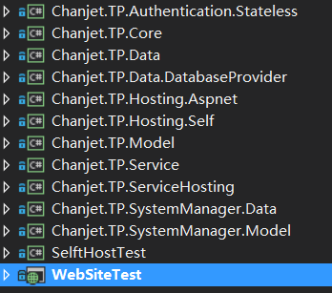
组件依赖
Chanjet.TP.Core
Chanjet.TP.Hosting.Self
Chanjet.TP.Authentication.Stateless
Chanjet.TP.LogAdapter
Chanjet.TP.Hosting.Aspnet
Chanjet.TP.ServiceApplication
Chanjet.TP.CacheAdapter
Chanjet.TP.Service
Chanjet.TP.Model
Chanjet.TP.Data
Chanjet.TP.***.Service
Chanjet.TP.***.Model
Chanjet.TP.***.Data
依赖
Chanjet.TP.Data.DataBaseProvider

Slide 4
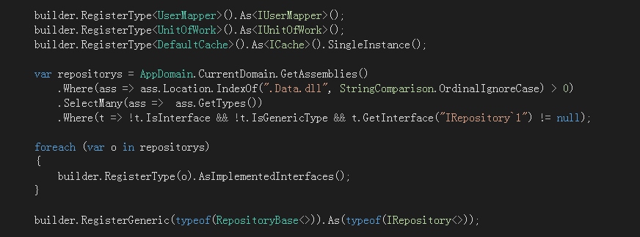
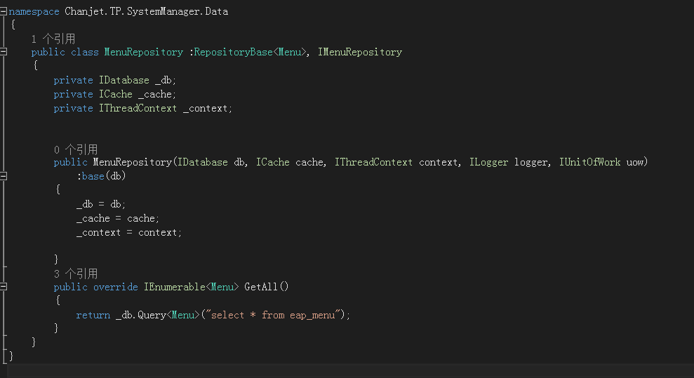
依赖注入

Slide 5
AOP
日志
异常
Service
Service
Service
缓存策略
事务
Repository
Repository
Repository
Model
Model
Model

Slide 6
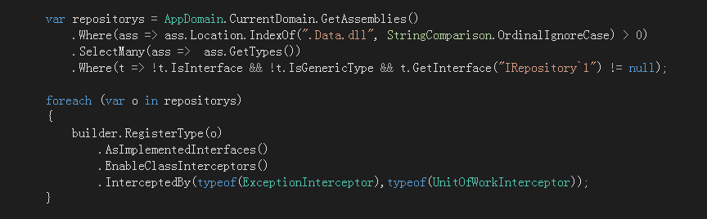
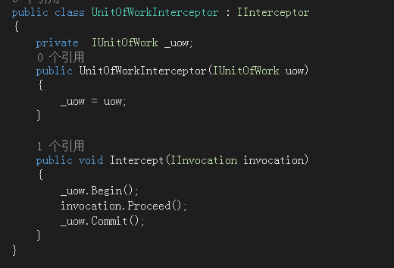
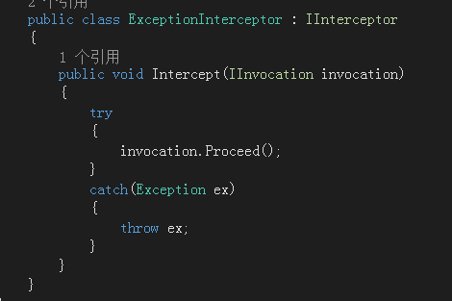
AOP实现实例

Slide 7
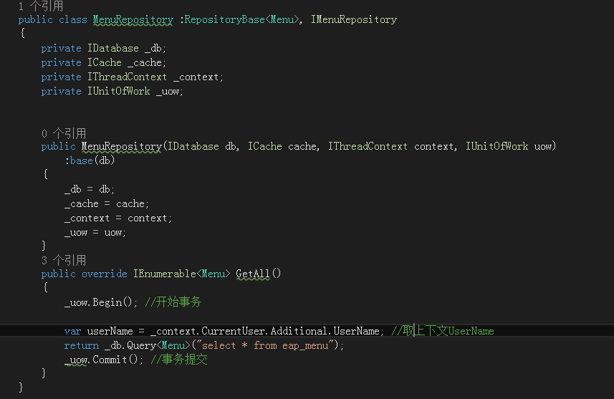
简单事务,线程上下文

Slide 8
对应
JS
CSS
BE
Data
Page
前端框架
DTO
Model
Control
Dblayer
IoC
UIP
DTOPresister
Hosting
AOP
DataStruct
Cache
Modules
Log
Inteterface
Service
Service
BP

Slide 9
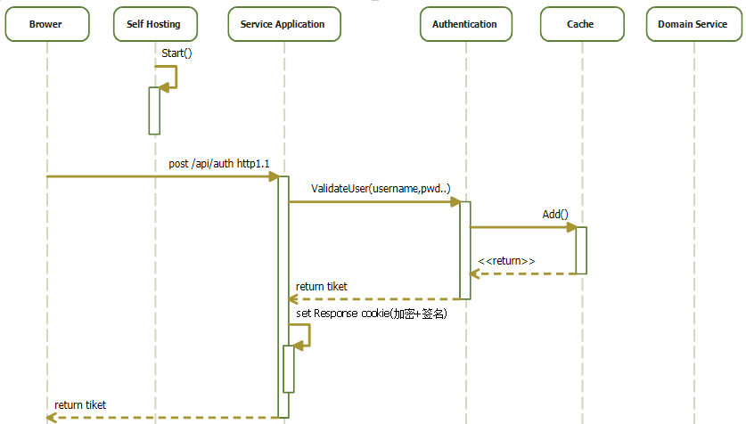
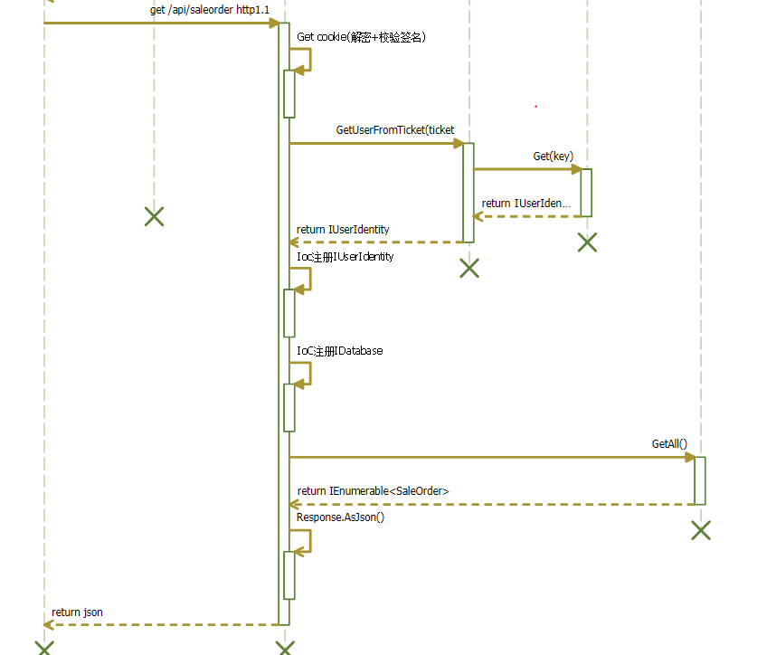
无状态认证

