Slide 1
Linux Project: A Moving Camera
Members: Kurt Trentch & Kar Lap Chan

Slide 2
Project Description
A pointable camera
A web interface that can control the camera
A gallery that can display previously taken pictures

Slide 3
Implementation
Camera:
The camera is placed on the boom, in this case a pencil was used
This boom is attached to a pair of servos that allow for movement of the camera
Raspberry Pi:
A Raspberry Pi is used to control the camera and servos
It controls the servos through a breakout board
It does this through a Flask server which serves a web interface that allows the camera to be controlled and shows previous pictures

Slide 4
Components: Front End of Web Interface
HTML, CSS, and JavaScript along with inline code used by Flask allows for the control of the camera as well as a gallery display
The interface page shows the most recent picture as well as the controls for the camera, where the user can either enter angles manually or click on a crosshair and vertical bar
The main page links to the gallery, which links back to the main page and displays all previously taken pictures with inline Flask code that scans the image directory

Slide 5
Components: Back End of Web Interface
A Flask server that facilities data between the web interface and the servos/camera
Takes in the angles to use, which are processed and given to the servos
Processing involves transforming the 360° maximum horizontal angle and 90° maximum vertical angle into angles usable by the servos which can only rotate 180°, as shown in the next slide
Taken photos are placed in the directory the gallery script reads from

Slide 6
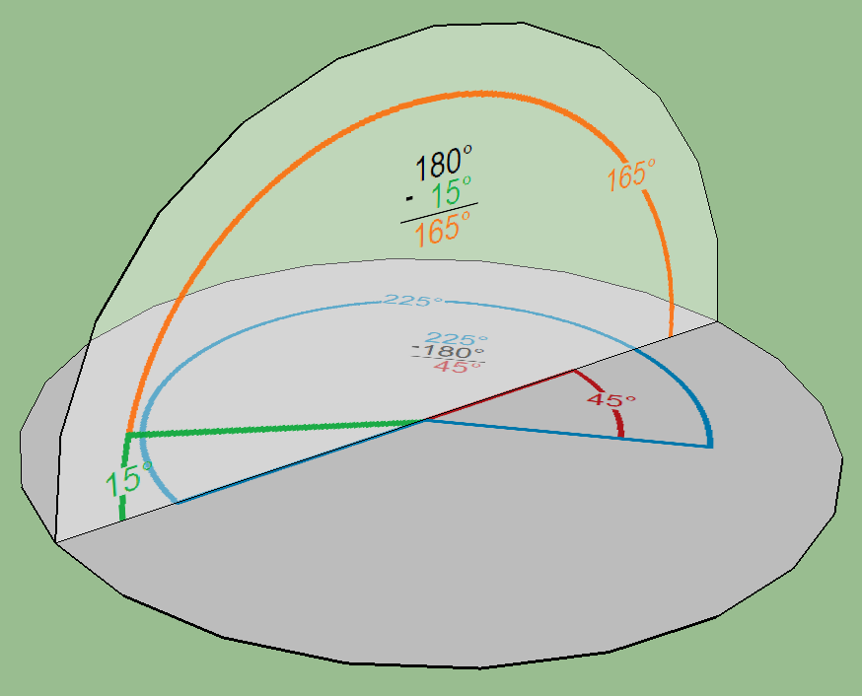
Angle Processing
If the horizontal angle is less than or equal to 180°, no changes needed
If it’s greater than 180°, the real angle used is (angle - 180°) and the vertical angle becomes (180° - angle), and the taken picture must be flipped vertically and horizontally
In this example, 225° and 15° become 45° and 165°

Slide 7
Components: Hardware
Hot glue was used to attach the horizontal rotation servo to the wooden base, the vertical rotation servo to the horizontal rotation servo, and the boom to the vertical rotation servo
Crazy glue was needed to attach the camera to the boom
Wooden base prevented tipping and the rotation making the whole thing turn itself
Raspberry Pi with breakout board controlled servos and camera

Slide 8
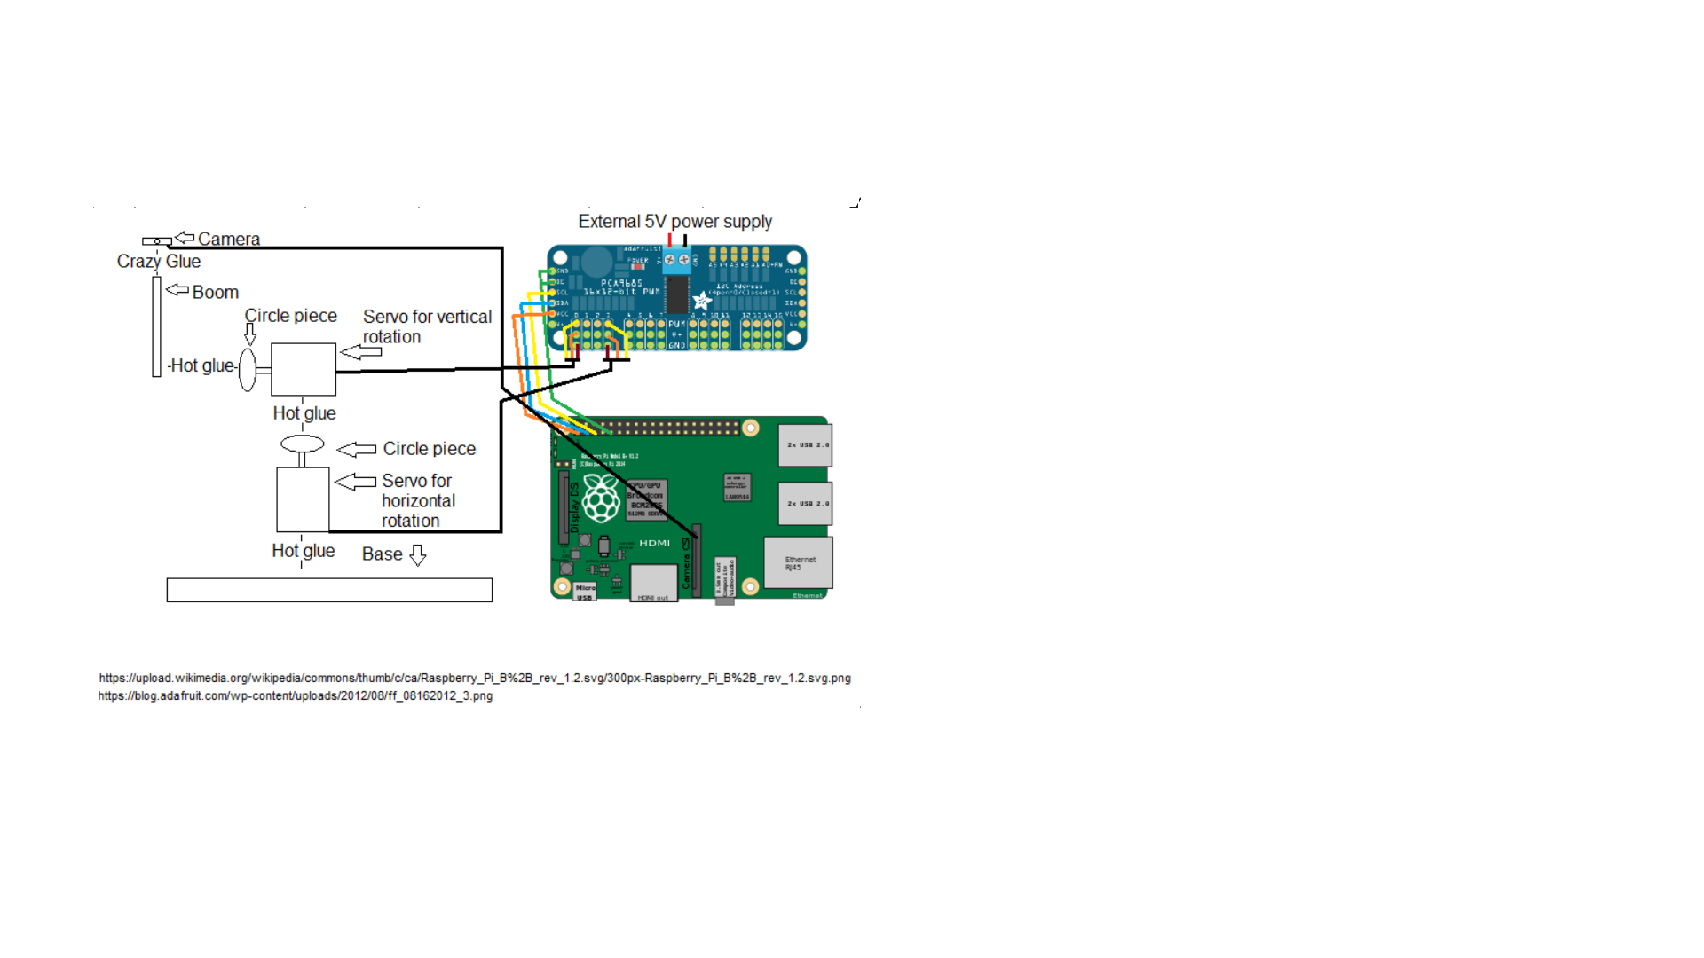
Materials
How to Set Up
Raspberry Pi
2 Standard Servos
Circular Attachments for Servos
PCA9685 Breakout Board
Raspberry Pi Camera
Long Ribbon Cable for Camera
Boom (Pencil)
Weighted Base (Flat Wood)
Hot Glue
Crazy Glue

Slide 9
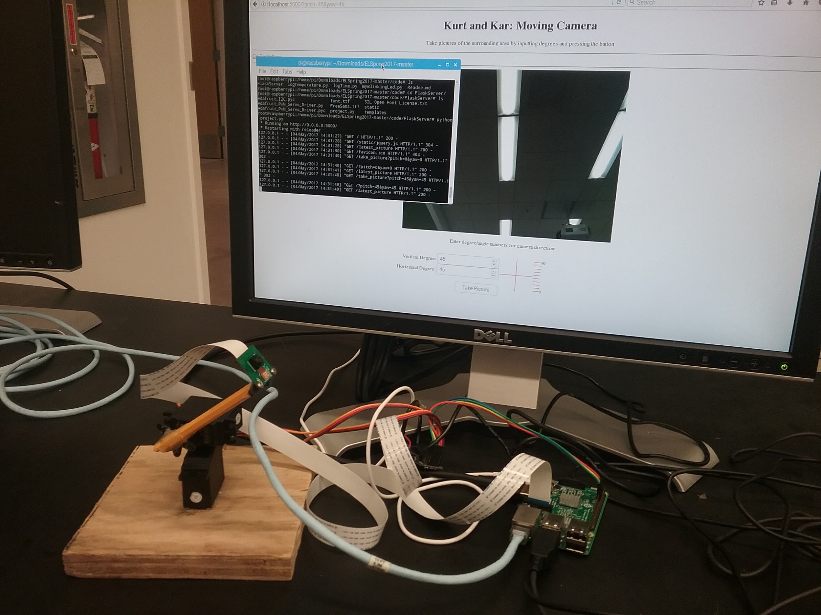
Assembled Project

Slide 10
Challenges
Camera attachment to boom
Soldering problems
Finding the proper wiring format of the breakout board
The need for different servos instead of the initial continuous rotation servos

Slide 11
Members and Contributions
Kurt Trentch: Hardware assembling (soldering, wiring), code for interfacing with hardware, changes and additions to Flask server code/web pages, integrating hardware code with Flask server code, project testing
Kar Lap Chan: Flask Server code and setting up the Flask environment, HTML/CSS for web pages, project testing

Slide 12
End

