Slide 1
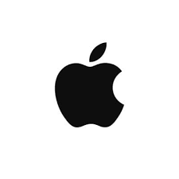
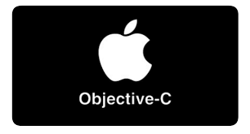
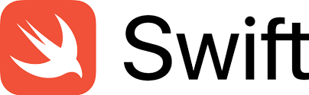

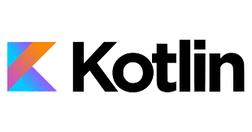
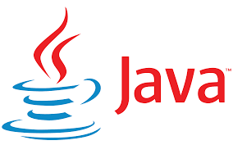
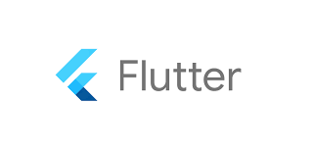
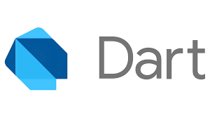
Mobile Application Program Language

Slide 2
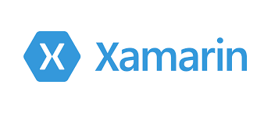
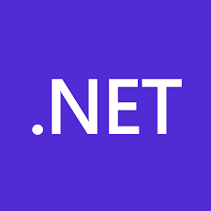
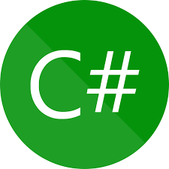
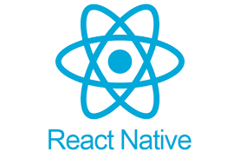
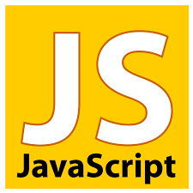
Mobile Application Program Language

Slide 3

Desktop Application Program Language

Slide 4
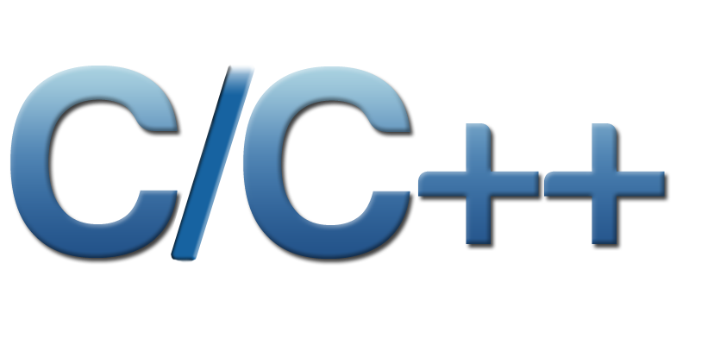

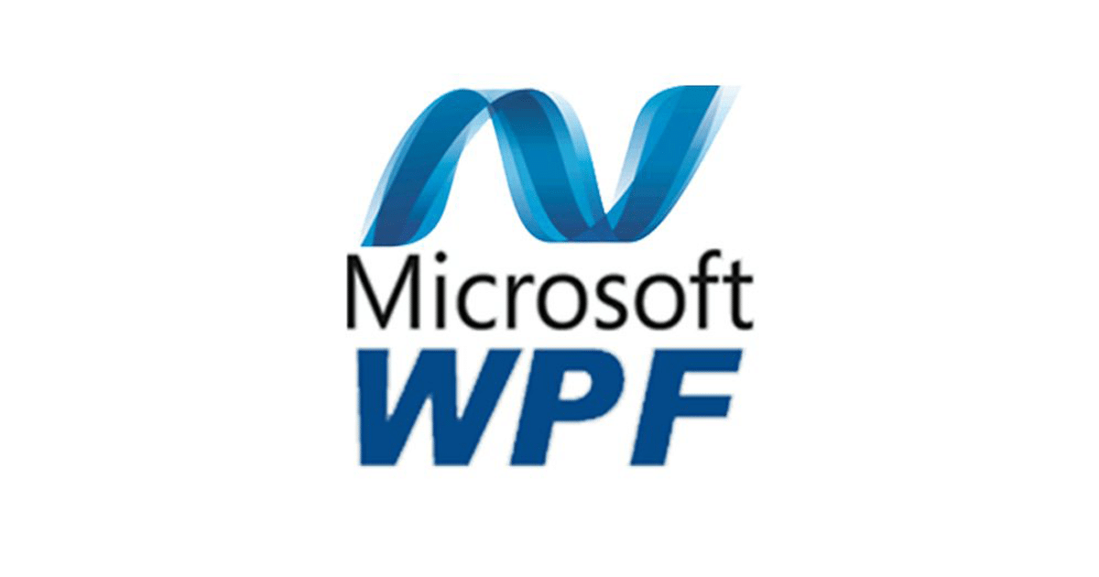
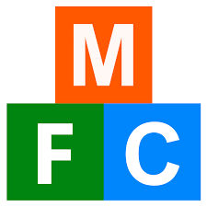
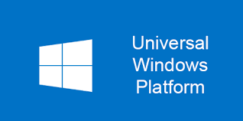
Desktop Application Program Language

Slide 5
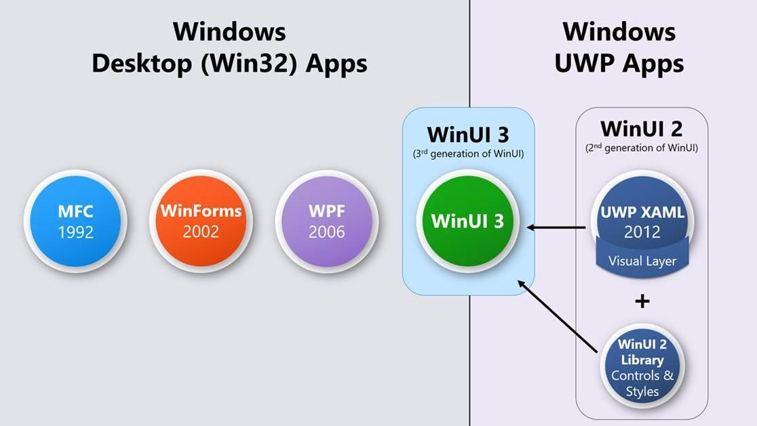
Desktop Application Program Language

Slide 6
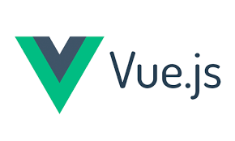
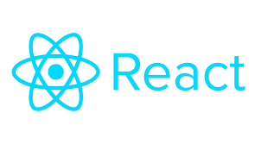
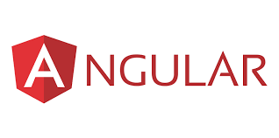

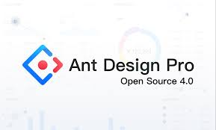
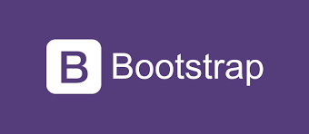
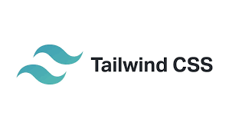
Web Application Program Language
JS Framework
CSS Framework

Slide 7
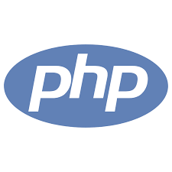

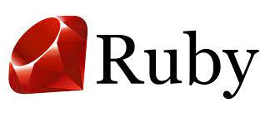
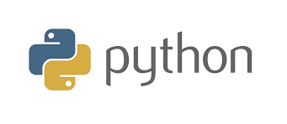

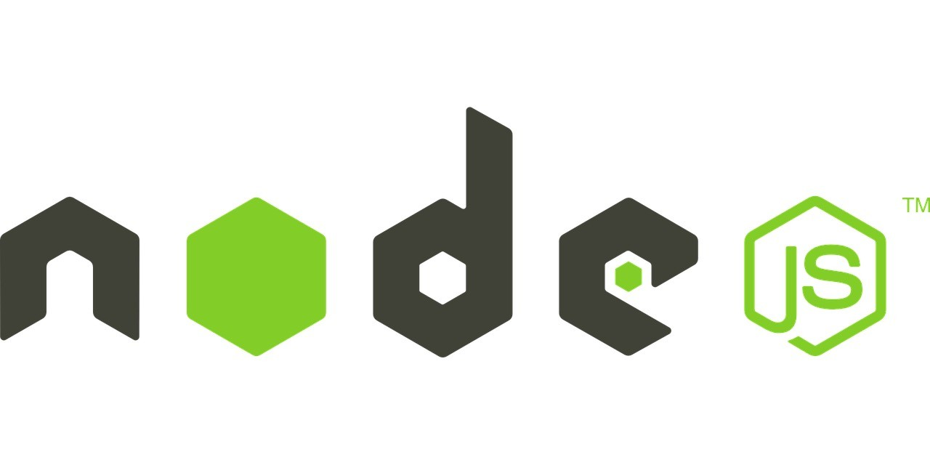
Backend Service

Slide 8
Backend Service
MVC Framework
Distributed Queue
RabbitMQ/ActiveMQ/Kafka, etc
Package Management Tool
Maven / Npm /Pip /Nuget, etc
Distributed Storage
Hbase / MongoDB / Apache Cassandra, etc
ORM Framework = Object Related Mapping
Distributed Cache
Redis / Memcached, etc
RPC = Remote Procedure Call （REST / Soap）
Distributed Transaction/Lock
2PC/3PC/TCC/Seata, etc
https://nordicapis.com/whats-the-difference-between-rpc-and-rest/
Distributed Calculate
MapReduce / Spark, etc
theory
CAP/ACID/DDD/Micro-Services/Sample Three Layer Design/AD 5High, etc

Slide 9
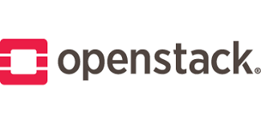
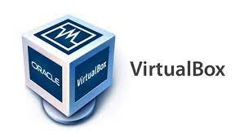
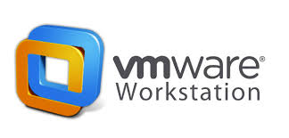
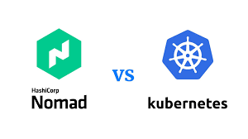
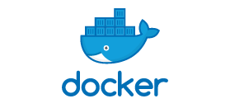
Infra & DevSecOps
Virtual Technology
Container Technology

Slide 10
Infra & DevSecOps
Case Management System :
Springboot + Mysql
Document Management System :
Nodejs + MongoDB

