Slide 1
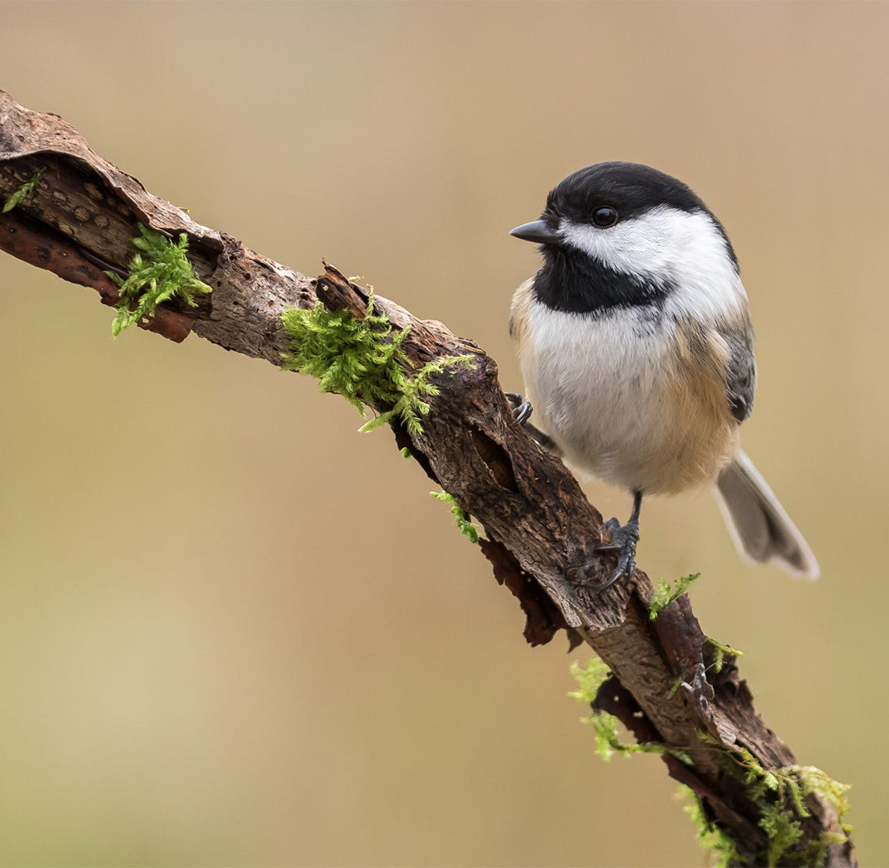
Group 4 Class Project #2
Karyn Brehmeyer
Charles Hanks
Isaac Johnson

