Slide 1
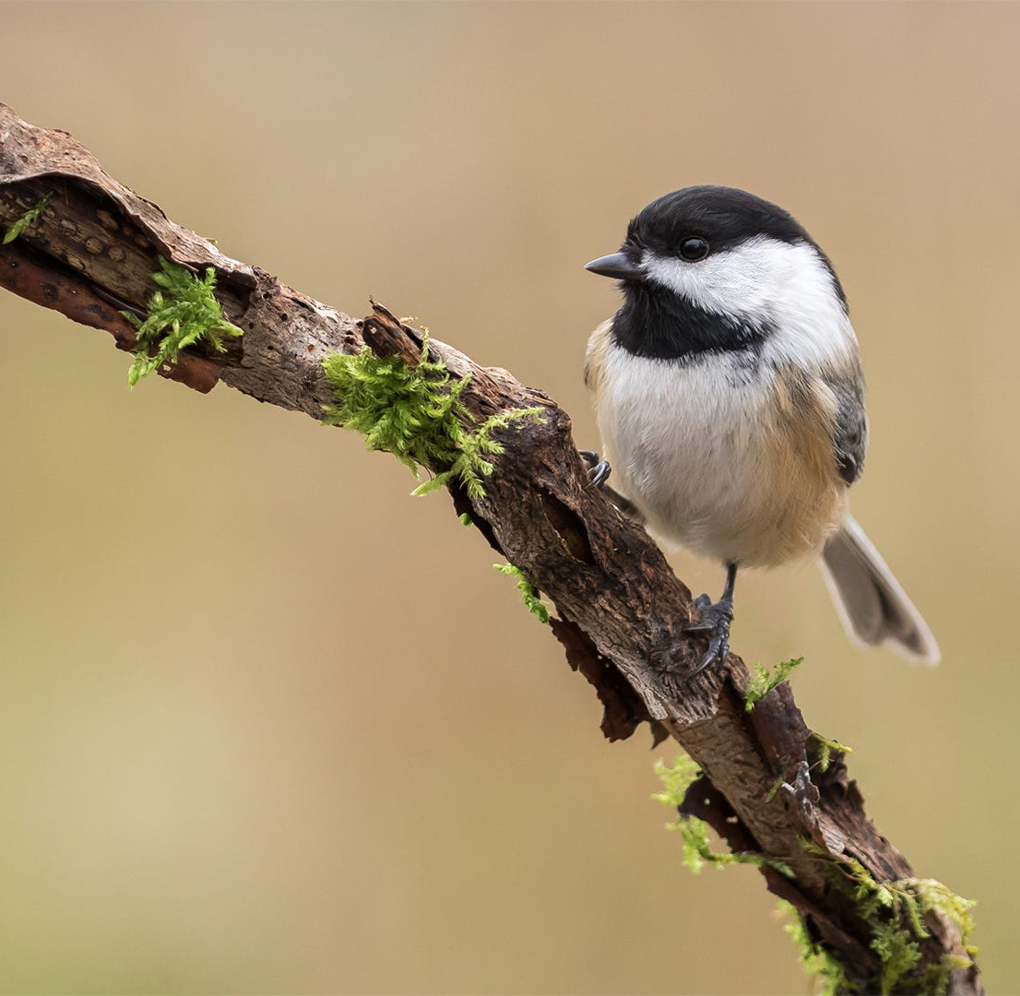
Group 4 Class Project #2
Karyn Brehmeyer
Charles Hanks
Isaac Johnson

Slide 2
Background Info
test

Slide 3
Goals of Study
What was the overall time to solving the problems (lever pulling, paper ripping, and persistence & repeatability) for chickadees?
What covariates/characteristics were most closely predictive of whether a chickadee figured out the problems?

Slide 4
Data and Methodology

Slide 5
Results/Analysis

Slide 6
Conclusions
In conclusion, we found a trend in rural birds for dominants to outperform subordinates in a lever-pulling task, which may be explained by adults outperforming younger birds. Moreover, we found that rural birds were slightly more persistent in the paper-ripping task compared to birds from urbanised areas. Individual performance and persistence were not repeatable across tasks, and the traits defining the most innovative and persistent individuals in each task were not consistent, pointing to the need for experimental assessments on the effect of task characteristics on the repeatability of problem-solving performance and persistence. Overall, our findings suggest that different individual and ecological characteristics may facilitate innovative behaviour in different ecological contexts.

