Slide 1
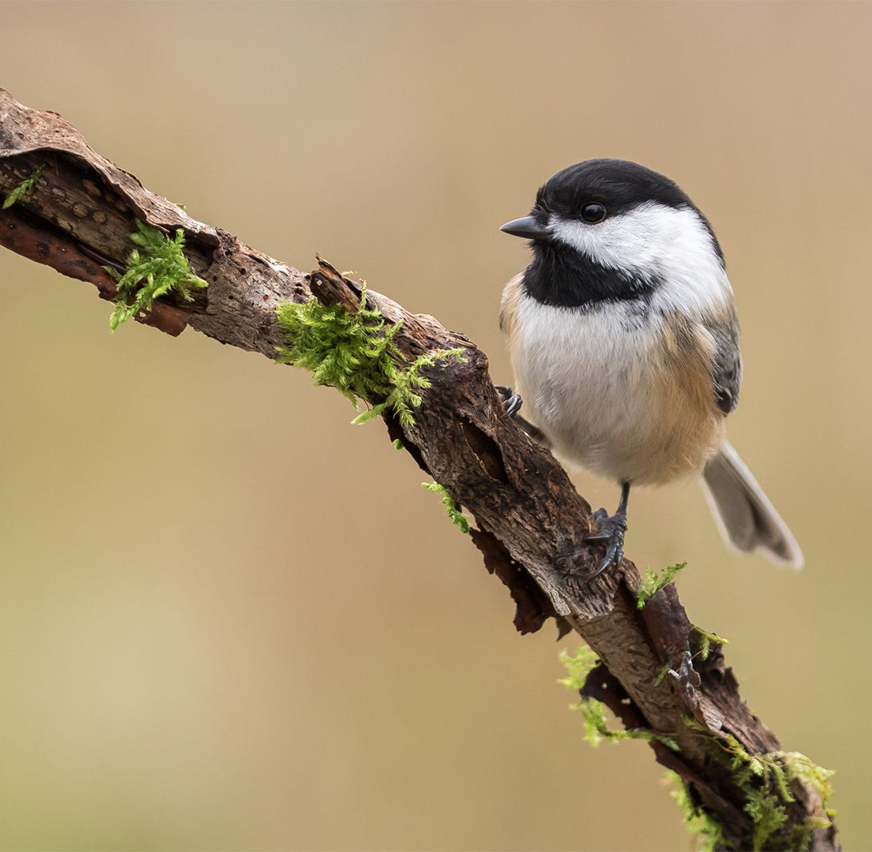
Group 4 Class Project #2
Karyn Brehmeyer
Charles Hanks
Isaac Johnson

Slide 2
Background Info
Black capped chickadees are small, non-migratory birds found in the northern United States and Canada. They live in both rural and urban environments, and eat mostly insects and seeds. These birds have a high level of neuro-flexibility, for example:
Every autumn Black-capped Chickadees allow brain neurons containing old information to die, replacing them with new neurons so they can adapt to changes in their social flocks and environment even with their tiny brains. (https://www.allaboutbirds.org/guide/Black-capped_Chickadee/overview#)

Slide 3
Why was the Study done?
How innovative are chickadees at solving problems? What are the traits of birds who are the best at solving problems?
Animal innovation, which would be the use of novel behaviors to meet challenges, play a role in the evolution of animals. The study birds were presented with a simple puzzle for a food reward.
Some studies have found no relationship between novelty responses and problem-solving performance, suggesting that these traits can vary independently in some species

Slide 4
Goals of Study
What was the overall time to solving the problems for chickadees?
What covariates/characteristics were most closely predictive of whether a chickadee figured out the problems?
This study compares the problem-solving innovation rate by the effect of dominance rank, exploratory personality, and the urbanization of the capture sites, which were located in and around Ottowa, Canada.

Slide 5
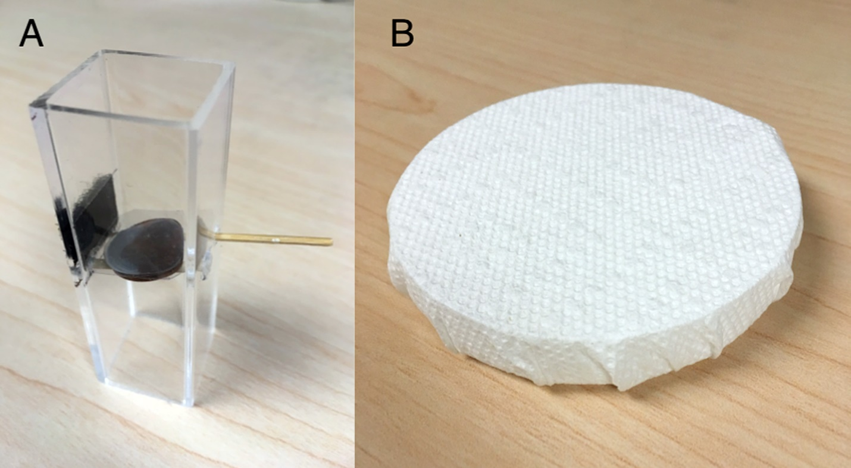
Data and Methodology
2 trials: lever and paper, here’s what they were tested on… lever pulling, paper ripping, and persistence & repeatability)

Slide 6
Data and Methodology
How was the data collected?
What data was collected?
response variables
covariates and/or factors
What were the experimental/observational units? 2 experiments measured in seconds
What was the sample size? 70 birds total

Slide 7
Sample image of lever and paper shredding tests:

Slide 8
Results/Analysis

Slide 9
Results/Analysis

Slide 10
Conclusions
In conclusion, we found a trend in rural birds for dominants to outperform subordinates in a lever-pulling task, which may be explained by adults outperforming younger birds. Moreover, we found that rural birds were slightly more persistent in the paper-ripping task compared to birds from urbanized areas. Individual performance and persistence were not repeatable across tasks, and the traits defining the most innovative and persistent individuals in each task were not consistent, pointing to the need for experimental assessments on the effect of task characteristics on the repeatability of problem-solving performance and persistence. Overall, our findings suggest that different individual and ecological characteristics may facilitate innovative behavior in different ecological contexts.

