Slide 1
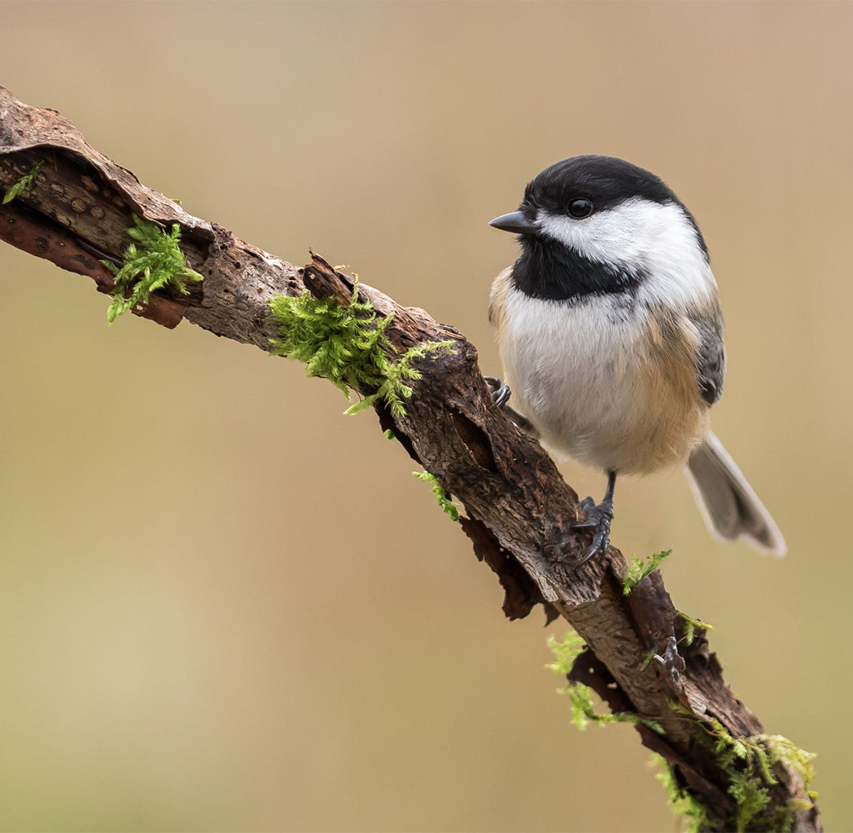
Group 4 Class Project #2
Karyn Brehmeyer
Charles Hanks
Isaac Johnson

Slide 2
Background Info
Black capped chickadees are small, non-migratory birds found in the northern United States and Canada. They live in both rural and urban environments, and eat mostly insects and seeds. These birds have a high level of neuro-flexibility, for example:
Every autumn Black-capped Chickadees allow brain neurons containing old information to die, replacing them with new neurons so they can adapt to changes in their social flocks and environment even with their tiny brains. (https://www.allaboutbirds.org/guide/Black-capped_Chickadee/overview#)

Slide 3
Why was the Study done?
How innovative are chickadees at solving problems? What are the traits of birds who are the best at solving problems?
Animal innovation, which would be the use of novel behaviors to meet challenges, play a role in the evolution of animals. The study birds were presented with a simple puzzle for a food reward.
Some studies have found no relationship between novelty responses and problem-solving performance, suggesting that these traits can vary independently in some species

Slide 4
Goals of Study
What was the overall time to solving the problems for chickadees? (lever pulling, paper ripping, and persistence & repeatability)
What covariates/characteristics were most closely predictive of whether a chickadee figured out the problems?
This study compares the problem-solving innovation rate by the effect of dominance rank, exploratory personality, and the urbanization of the capture sites, which were located in and around Ottowa, Canada.

Slide 5
Data and Methodology
We investigated the effects of dominance rank, exploratory tendency, and urbanization on the individual problem-solving performance of wild-caught black-capped chickadees (Poecile atricapillus) using two distinct foraging tasks.
From October to December 2016, a maximum of 12 birds were captured weekly using mist nets from one of seven sites in and around Ottawa, Ontario, and a total sample size of 65 birds were used in the study.
Urban sites were urban parks surrounded by houses and located no more than 10 km from down- town Ottawa, and rural sites were forested areas in a rural landscape at least 25 km from down- town.
Birds were categorized as juvenile (bird born in the previous spring) or adult (more than one year old) by inspecting the shape and wear of their tail feathers

Slide 6
Data and Methodology
We coded individuals that failed to solve during the experiment as censored observations, since we do not know their true latency to solve (right censored)
There was a total of 65 birds in the dataset
In the lever pulling task: 27 birds were censored
In the paper ripping task: 31 birds were censored
We are dealing with a low sample size
Omitted persistency?

Slide 7
Data and Methodology
2 trials: lever and paper, here’s what they were tested on… lever pulling, paper ripping, and persistence & repeatability)
The lever-pulling task consisted of a small Perspex tube in which two wax worms were held on top of a platform supported by a lever
Birds were required to pull the lever completely out of the tube, causing the food reward to fall out. (measured in seconds)
The paper-ripping task consisted of the bottom half of a Petri dish, containing seeds and mealworms, wrapped with white paper towel
This task was solved when a bird ripped a hole through the paper that was big enough to extract a seed or worm. (measured in seconds)

Slide 8
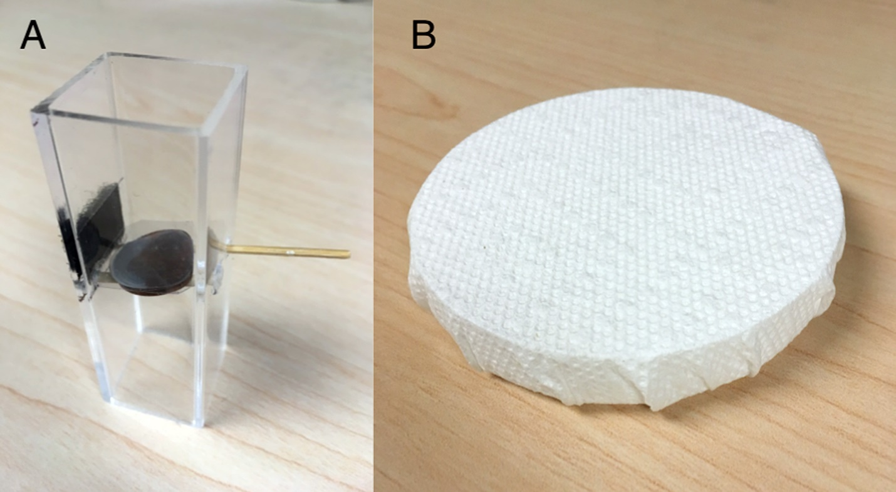
Sample image of lever and paper shredding tests:

Slide 9
Data and Methodology

Slide 10
Data and Methodology

Slide 11
Data and Methodology

Slide 12
Data and Methodology

Slide 13
Results/Analysis
Lever task:
50% of the birds completed the task in about 1300 seconds (or 21 min)
The adults outperformed the juveniles
The more dominant birds outperformed than the less dominant
38 out of 65 birds solved the lever problem

Slide 14
Results/Analysis

Slide 15
Results/Analysis

Slide 16
Results/Analysis

Slide 17
Results/Analysis

Slide 18
Results/Analysis

Slide 19
Results/Analysis

Slide 20
Results/Analysis

Slide 21
Results/Analysis

Slide 22
Results/Analysis
Paper Shredding task:
50% of the birds completed the task in about 5900 seconds (or 98 min)
The more dominant birds completed this task faster
The more exploratory birds outperformed the less exploratory
The rural birds outperformed the urban birds
The adults performed better at this task initially up to a point, given enough time the juveniles had a higher completion rate
Only 29 out of 60 birds solved this task
There are not enough observations in each group to create parametric curve on how dominance affects ability to rip paper to get at tasty worms

Slide 23
Results/Analysis

Slide 24
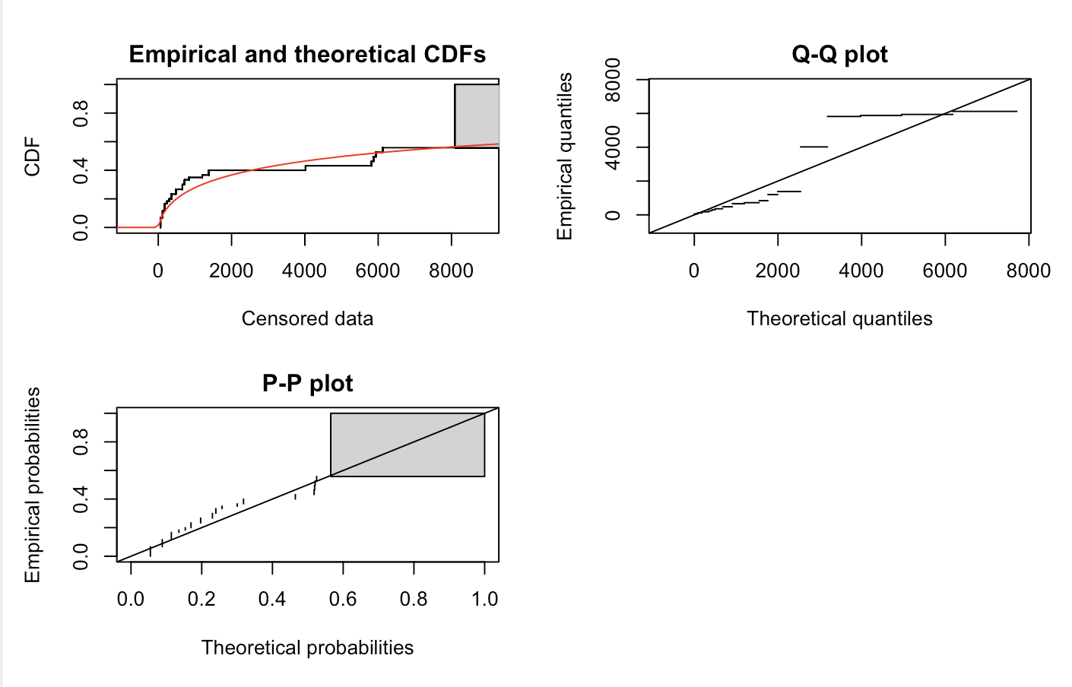
Results/Analysis

Slide 25
Results/Analysis

Slide 26
Results/Analysis

Slide 27
Results/Analysis

Slide 28
Results/Analysis

Slide 29
Results/Analysis

Slide 30
Conclusions
We found a trend that the more dominant birds and adults performed better overall for both tasks
For the paper ripping task, we also saw higher performance for the rural birds, and those who were more exploratory
Individual performance and persistence were not repeatable across tasks, and the traits defining the most innovative and persistent individuals in each task were not consistent, pointing to the need for experimental assessments on the effect of task characteristics on the repeatability of problem-solving performance and persistence.
Overall, our findings suggest that different individual and ecological characteristics may facilitate innovative behavior in different ecological contexts.
This was an observational study so we can show associations, but not show a causal result

