Slide 1
Introduction to Oop with c++
OOP244 – Nargis Khan

Slide 2
outline
About Me
Course outline
Types of Programming Language
Introduction to C++
Quiz
Workshop

Slide 3
About me
Dr. Nargis Khan
Office: Microsoft Teams
nargis.khan@senecacollege.ca

Slide 4
Course outline
Course website
https://scs.senecac.on.ca/~oop244/
Blackboard

Slide 5
Kinds of programming language
Imperative
Declarative

Slide 6
imperative
Telling the machine what to do
Statement oriented language
A statement is a syntactic unit that express some action to be carried out
age = age + 5;
Every statement changes the machine state
A variable represents a storage location in the computer memory
The value of variables (content of memory ) at any given point is called the program’s state
Example: C,C++,Java, MatLab, Assembly language etc.
Notes:
Imperative programming is a paradigm of computer programming in which the program describes a sequence of steps that change the state of the computer. Unlike declarative programming, which describes "what" a program should accomplish, imperative programming explicitly tells the computer "how" to accomplish it. Programs written this way often compile to binaryexecutables that run more efficiently since all CPUinstructions are themselves imperative statements

Slide 7
Imperative
IMPERATIVE
STRUCTURAL
PROCEDURAL
C,C++, Go, Fortran, Pascal, ALGOL
OBJECT-ORIENTED
C++, Java, C#, Swift, Smalltalk
Notes:
A procedural language is a computer programming language that follows, in order, a set of commands. They make use of functions, conditional statements, and variables to create programs that allow a computer to calculate and display a desired output. Object oriented : an interaction of functions between participating objects ex: morning recipe
Structural: Makes extensive use of subroutine (functions), block structure, for, while (control statements)
Structured programming is a program written with only the structured programming constructions: (1) sequence, (2) repetition, and (3) selection. Sequence.

Slide 8
Object-oriented
Breaks down a programming task into objects
Objects expose behavior (method) and data (members/attributes)
Notes:
The design method used in procedural programming is called Top Down Design. This is where you start with a problem (procedure) and then systematically break the problem down into sub problems (sub procedures).
One alternative to procedural programming is object oriented programming. Object oriented programming is meant to address the difficulties with procedural programming. In object oriented programming, the main modules in a program are classes, rather than procedures. The object-oriented approach lets you create classes and objects that model real world objects.

Slide 9
declarative
Telling the machine what to achieve
SQL,HTML,XML etc.

Slide 10
C ++
C++ is a multi paradigm programming language
Imperative
Structural
Procedural
Object-Oriented

Slide 11
C Code
#include <stdio.h>
int main(void)
{
printf("Welcome to Object-Oriented\n");
return 0;
}

Slide 12
C++ Procedural
#include <cstdio> --→pre processor directive
using namespace std; -→standard library
int main ( ) {
printf("Welcome to Object-Oriented\n");
//return 0 is not necessary compiler automatically add.
}
File extension is .cpp
<cstdio> instead of <stdio.h>

Slide 13
C/C++
C has no object-oriented support.

Slide 14
C++ OOP
// A Language for Complex Applications
// welcome.cpp
//
// To compile on linux: g++ welcome.cpp
// To run compiled code: a.out
//
// To compile on windows: cl welcome.cpp
// To run compiled code: welcome
//
#include <iostream>
using namespace std;
int main ( ) {
cout << "Welcome to Object-Oriented" << endl;
}
Notes:
using: You are going to use it
namespace: To use what? A namespace
std: The std namespace (where features of the C++ Standard Library, such as string or vector, are declared).
After you write this instruction, if the compiler sees string it will know that you may be referring to std::string, and if it sees vector, it will know that you may be referring to std::vector. (Provided that you have included in your compilation unit the header files where they are defined, of course.)
If you don't write it, when the compiler sees string or vector it will not know what you are refering to. You will need to explicitly tell it std::string or std::vector, and if you don't, you will get a compile error.

Slide 15
namespaces
Scope
A namespace is a scope for the entities that it encloses
To avoid naming conflict
Each part of application within its own namespace
Scoping variables within each namespace
Define a namespace:
namespace identifier {
}
Notes:
space for movement or activity; opportunity for operation:

Slide 16
Namespaces…
// A program to demonstrate need of namespace
int main()
{
int value;
value = 0;
double value; // Error here
value = 0.0;
}
namespace english {
int x = 2;
// ...
}
namespace french{
int x = 3;
// ...
}

Slide 17
Expose entities
In line
english::x++;
french::x--;
Expose an identifier to current namespace
using french::x;
x++; // increments french::x but not english::x
All identifier to current namespace
using namespace english;
x++; // increments english::x but not french::x
Notes:
Scope resolution operator.
When you make a call to using namespace <some_namespace>; all symbols in that namespace will become visible without adding the namespace prefix.
E.g. if you add using namespace std; you can write just cout instead of std::cout when calling the operator cout defined in the namespace std.

Slide 18
Name space -example
// Creating namespaces #include <iostream> using namespace std; namespace ns1 { int value() { return 5; } } namespace ns2 { const double x = 100; double value() { return 2*x; } } int main() { // Access value function within ns1 cout << ns1::value() << '\n’; // Access value function within ns2 cout << ns2::value() << '\n'; // Access variable x directly cout << ns2::x << '\n'; return 0; }

Slide 19
Input - output
cout is the library object that represents the standard output device
endl is the manipulator end of line + flush the buffer
cin is the library object that represents the standard input device
<< is the operator that inserts data into the object on its left-side operand
>> is the operator that extracts data from the object on its left-side operand

Slide 20
Example: input-output
#include <iostream>
using namespace std;
int main() {
int i;
cout << "Enter an integer : ";
cin >> i;
cout << “You entered “ << i << endl;
}

Slide 21
Type Safety
C compilers are more tolerant of type errors than C++ compilers. For example, a C compiler will accept the following code, which may cause a segmentation fault at run-time
#include <stdio.h>
void foo();
int main(void) {
foo(-25); }
foo(char x[]) { printf("%s", x);} /*ERROR */
#include <stdio.h>
void foo(char x[]);
int main(void) {
foo(-25); }
void foo(char x[])
{ printf("%s", x); }
In C++ all prototypes list their parameter types, which has forced all C++ compilers to check for argument/parameter type mismatches at compile-time.
Notes:
We can fix this easily. If we include the parameter type in the prototype as shown on top, the compiler will check for an argument/parameter type mismatch and issue an error message like that shown on the right:
Function argument assignment between types "char*" and "int" is not allowed.

Slide 22
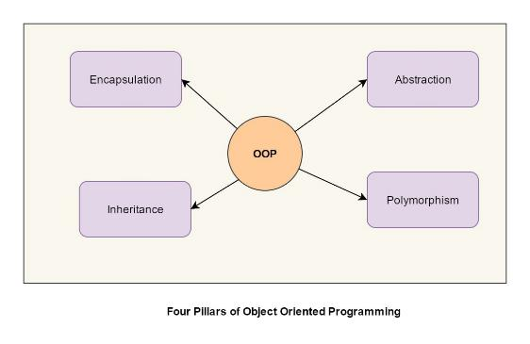
Object terminology
Object oriented programming
Abstraction
Encapsulation
Inheritance
Polymorphism

Slide 23
abstraction
One of the most essential and important feature of object oriented programming in C++
Data abstraction refers to providing only essential information about the data to the outside world, hiding the background details or implementation
Example:
A real life example of a man driving a car.
Notes:
The man only knows that pressing the accelerators will increase the speed of car or applying brakes will stop the car but he does not know about how on pressing accelerator the speed is actually increasing, he does not know about the inner mechanism of the car or the implementation of accelerator, brakes etc in the car. This is what abstraction is.

Slide 24
Abstraction
Abstraction using Classes:
We can implement Abstraction in C++ using classes.
Class helps us to group data members and member functions using available access specifiers.
A Class can decide which data member will be visible to outside world and which is not.

Slide 25
Abstraction
Abstraction in Header files
For example, consider the pow() method present in math.h header file.
Abstraction using access specifiers
Access specifiers are the main pillar of implementing abstraction in C++. We can use access specifiers to enforce restrictions on class members.
Members declared as public in a class, can be accessed from anywhere in the program.
Members declared as private in a class, can be accessed only from within the class. They are not allowed to be accessed from any part of code outside the class.
Notes:
Whenever we need to calculate power of a number, we simply call the function pow() present in the math.h header file and pass the numbers as arguments without knowing the underlying algorithm according to which the function is actually calculating power of numbers.

Slide 26
classes
User defined data types
Structure of similar objects.
Objects have similar structure but possibly different states.
Example
Books
Notes:
A class is a user defined blueprint or prototype from which objects are created. It represents the set of properties or methods that are common to all objects of one type

Slide 27
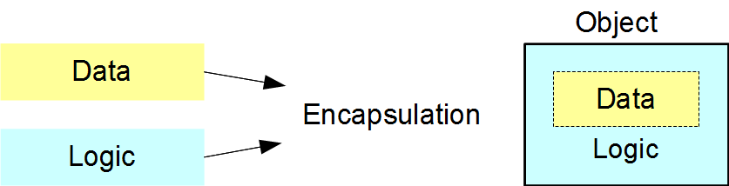
encapsulation
Primary concept of OOP
Integration of data and logic within a class
Interface between implementation and any client
Example:
cout << “OOP”;
Notes:
A class definition declares the variables and the function prototypes. The variables store each object's data and the functions contain the logic that operates on that data. Clients access objects through calls to these functions without knowledge of the data stored within the objects or the logic that manipulates that data.
cout refers to the standard output object. Its class defines how to store the object's data in memory and how to control the operations that work with that data. The << operator copies the string to the output object without exposing any of the implementation details. As client programmers, we only see the interface that manages the output process.
A well-encapsulated class hides all implementation details within itself. The client does not see the data that the class' object stores within itself or the logic that it uses to manage its internal data. The client only sees a clean and simple interface to the object.

Slide 28
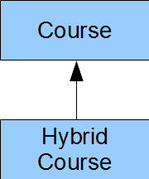
inheritance
one class inherits the structure of another class

Slide 29
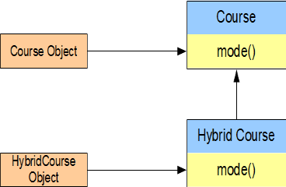
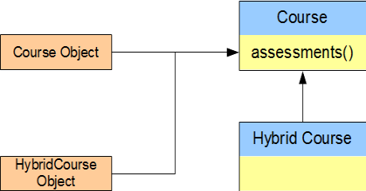
Polymorphism
A single interface provides multiple implementations
Polymorphic programming allows us to minimize the duplication of code amongst objects that belong to the same inheritance hierarchy.
Notes:
C++ polymorphism means that a call to a member function will cause a different function to be executed depending on the type of object that invokes the function. ... You have different classes with a function of the same name, and even the same parameters, but with different implementations.

Slide 30
Next Quiz
Welcome to Object-Oriented
Modular Programming
Object Terminology
Types, References and Overloading
Dynamic Memory

Slide 31
Next workshop
Workshop 1

