Slide 1
Narrow-Channel Effect via Conformal Mapping
Reproduction & finite-difference verification of Li, Hong, Cheng & Chan (1990),
semi-recessed field-oxide MOSFETs
scripts/narrow_semi_recessed/ — E:\claude\RAG

Slide 2
The Physical Problem
Semi-recessed field-oxide isolation — narrow-channel MOSFETs
• Field oxide of thickness tᶠ sits beside the gate; recess depth t₁ controls how far the oxide extends down the sidewall.
• Fully-recessed (t₁ = tᶠ−tᵍ) and non-recessed (t₁→0) structures are the SAME model at limiting t₁ — no separate formula needed.
• Channel depletion depth t_d vs. recess depth t₁ sets the regime:
– Case I (t_d < t₁): depletion stays inside the sidewall → inverse narrow-width effect (ΔVth < 0)
– Case II (t_d > t₁): depletion spills laterally under the field oxide, a quarter-circle “wing” of radius W_c = t_d−t₁ → conventional effect (ΔVth > 0)
• Goal: solve ∇²φ = 0 in the oxide cross-section to get the sidewall/lateral flux that sets Vth(W).
Li, Hong, Cheng & Chan (1990), IEEE TED 37(3), pp. 692-701

Slide 3
Why Conformal Mapping
Turning a messy 2-D corner geometry into a solvable strip problem
• Laplace's equation ∇²φ=0 is solved on a semi-infinite half-strip (the field-oxide cross-section) with mixed Dirichlet boundary data on 4 edges.
• The map u+iv = cos[π(ix−y)/tᶠ] sends this half-strip onto the upper half-plane, where the same BVP becomes a classical Poisson-kernel / Schwarz-integral problem.
• Boundary values transform into a Fourier series in n; truncating at n≈200–1000 terms gives the sidewall flux Φ_swl (Case I) or Φ_swl+Φ_lat (Case II) to 6 significant figures.
• This flux directly gives the series coefficients A, B (Case I) or A′, B′ (Case II) that feed the threshold-voltage formula:
– Vth(W) = φ_ms + 2φ_f(1+a/W)/(1+b/W) + (Q′/Cox)/(1+b/W), a=2tᵍ(B−A), b=−2tᵍA
Li, Hong, Cheng & Chan (1990), IEEE TED 37(3), pp. 692-701

Slide 4
Verification: More Than Dimensional Analysis
The paper's transcribed series (Eq. 11/17) did not survive independent scrutiny
• Dimensional analysis alone caught two real transcription issues: a unit-inconsistent prefactor in A, and a missing ½ factor in sin(nktᵍ) — fixed.
• But fixing both was NOT sufficient: an independent finite-difference (FD) solve of the actual boundary-value problem (5-point Laplacian, sparse solve) still disagreed with the corrected series — even B, whose prefactor was never ambiguous, was off by ~2×.
• The FD solver itself was validated two ways, independent of Eq. 11/17:
– Sharp-step analytic limit (t_d,tᵍ→0): FD converges to a hand-derived closed form as the BVP simplifies (-0.4930 → -0.4659, vs. analytic -0.4652).
– Case I / Case II boundary continuity (t_d→t₁): two independently-coded BVPs agree in the shared limit — this check caught and fixed a real bug in the Case II lateral-wing flux integration bounds.
• Conclusion: FD solve is used as verified ground truth throughout; the root cause of the remaining series discrepancy is flagged as unresolved, not force-fit.
Li, Hong, Cheng & Chan (1990), IEEE TED 37(3), pp. 692-701

Slide 5
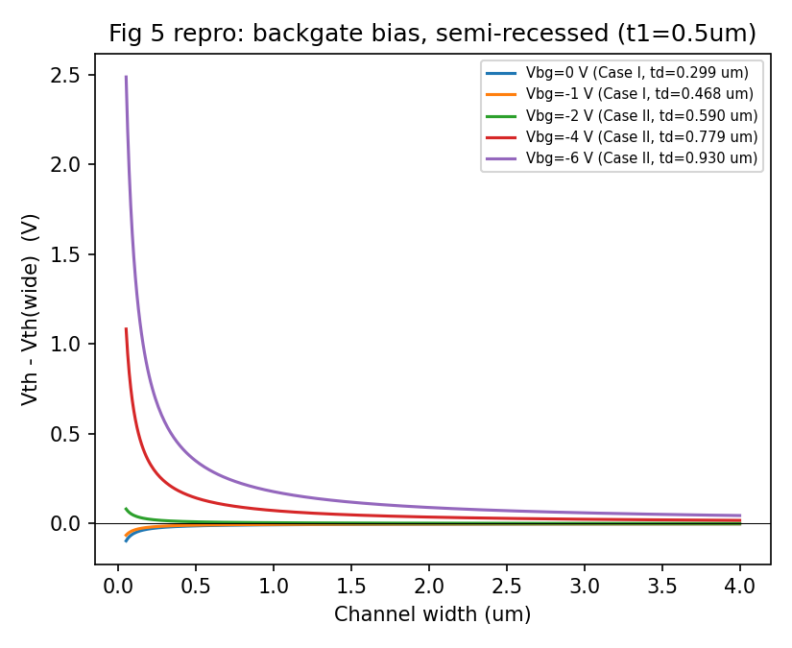
Reproduced Result: Case I / Case II Split (Fig. 5)
• Vbg = 0, −1 V → Case I: ΔVth < 0 (inverse narrow-width effect, deepens as W shrinks)
• Vbg = −2, −4, −6 V → Case II: ΔVth > 0 (conventional effect)
• Case grouping matches the paper's own Fig. 5 legend exactly, bias-by-bias.
Li, Hong, Cheng & Chan (1990), IEEE TED 37(3), pp. 692-701

Slide 6
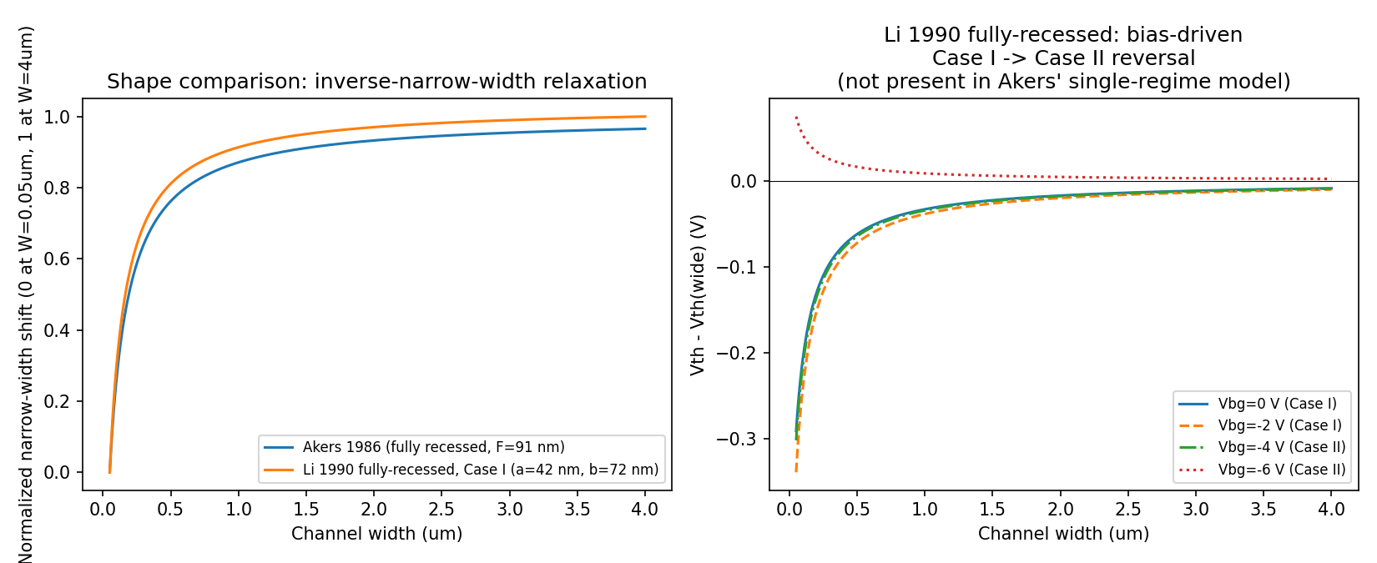
Cross-Check Against Akers (1986)
• Fully-recessed limit: FD-verified a=42.3 nm, b=71.8 nm vs. Akers' fringing length F=91 nm — same order of magnitude, independent derivations.
• Li et al. additionally predicts a bias-driven Case I → Case II sign reversal that Akers' single-regime model cannot represent.
Li, Hong, Cheng & Chan (1990), IEEE TED 37(3), pp. 692-701

Slide 7
Takeaways
• Model reproduced end-to-end: 8 paper figures (Figs. 5–12), all matching qualitative trends and Case I/II groupings from the source figures.
• Rigor beyond pattern-matching: dimensional analysis found 2 bugs; an independent FD solve, cross-validated two separate ways, found the fixes were still incomplete and supplied a trustworthy ground truth.
• Consequence for numbers: fully-recessed length scales revised from the (flawed-series) a=103 nm/b=124 nm to the FD-verified a=42.3 nm/b=71.8 nm.
• Open item: the exact remaining error in the transcribed Eq. 11/17 series is not isolated — reported as unresolved rather than papered over.
• Full technical report: narrow_channel_semi_recessed_report.pdf (11 pp.) — this deck is a condensed companion.
Li, Hong, Cheng & Chan (1990), IEEE TED 37(3), pp. 692-701

