Slide 1
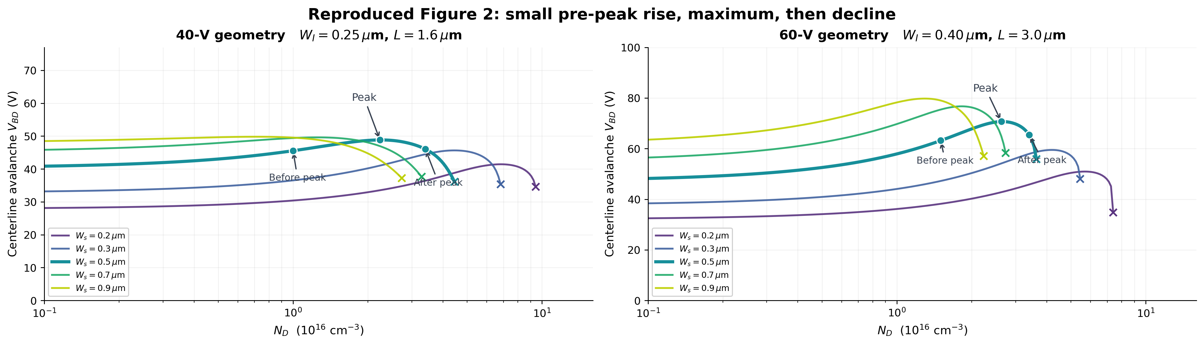
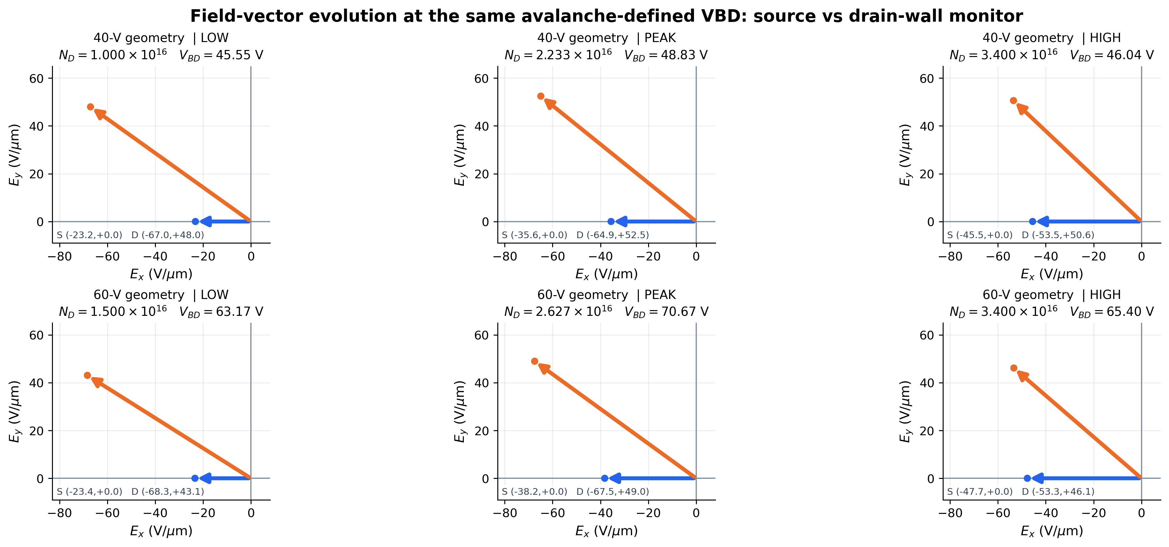
GREEN-FUNCTION BREAKDOWN | REVISED FIGURE 2
Source report geometry families · 300 K centerline avalanche · no curve fitting
1 VBD versus doping: gradual rise before the maximum
Ws = 0.50 µm • 40-V geometry: 45.55 → 48.83 → 46.04 V • 60-V geometry: 63.17 → 70.67 → 65.40 V
2 Actual Ex–Ey vectors at those avalanche voltages
Blue = source centerline (0,0); orange = drain-side wall monitor (L−0.10 µm, Ws). These are local vectors, not verified global avalanche hotspots.
Source: uploaded Green_Function_Breakdown_Report (8).pdf, Fig. 2 & Eqs. in §§4–6. The avalanche criterion differs from the earlier 2D peak-Ec study.
Notes:
Figure 2 from the user-provided Green_Function_Breakdown_Report (8).pdf is a 300 K centerline van Overstraeten-de Man avalanche calculation, not a global 2D peak-critical-field criterion. The reproduction here computes the full source Green-function eigenseries, centered avalanche integrals and matching field vectors at source (0,0) and drain-side monitoring location (L-0.10 um,a), not physical hotspots. No empirical fitting to Figure 2 curve values. The half width Ws=0.5 um case is highlighted.

