Slide 1
Raw dies vs Interpolate vs Extrapolate
Left: the raw measured dies only (no fill) — exactly what was tested.
Middle: interpolate (fill within ~4 chips of a die; grey beyond).
Right: extrapolate (nearest-fill the whole wafer).
Colours = each parameter's spec zones (red / yellow / green).

Slide 2
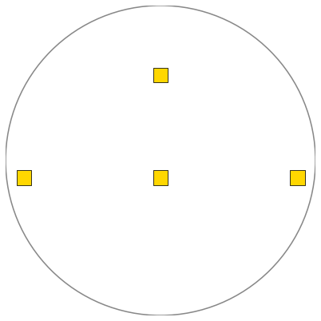


B6CA_S8 1month param=IG_N.HV_MIN lot 1E633888 W02 4 dies / lot map 5 spec [-15, -9]
Raw dies (no fill)
Interpolate
Extrapolate

Slide 3
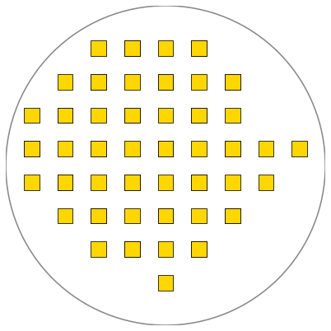

C5SOI_from 22 Aug to 30 Sep-2026-09-30-025436-820 param=VBD_MIS_C lot PF639531 W18 65 dies / lot map 46 spec [31.4, 60.1]
Raw dies (no fill)
Interpolate
Extrapolate

Slide 4
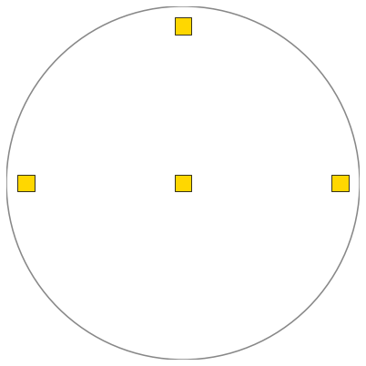

IGBT3HV_8 1month param=RS_S1___4500V lot VA625807 W08 4 dies / lot map 5 spec [4.55, 9.45]
Raw dies (no fill)
Interpolate
Extrapolate

Slide 5
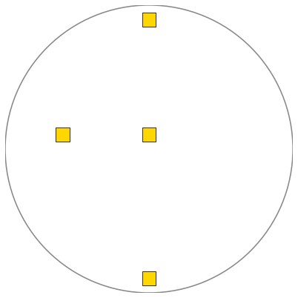

IGBT4 1month param=GK.RC_M1/N+ lot VA646546 W19 4 dies / lot map 5 spec [0, 120]
Raw dies (no fill)
Interpolate
Extrapolate

Slide 6
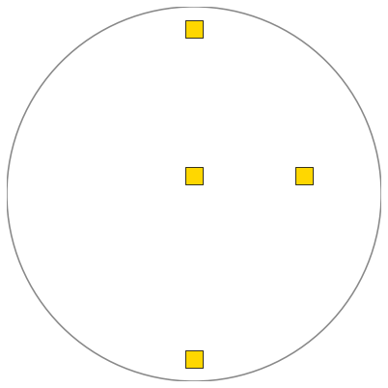

SFET3_100_8 1month param=DVT_VD__10U_100 lot 1F639745 W09 4 dies / lot map 10 spec [-0.5, 0.1]
Raw dies (no fill)
Interpolate
Extrapolate

Slide 7
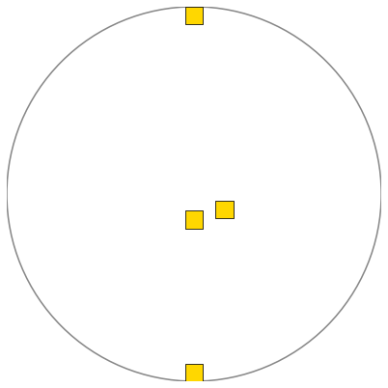
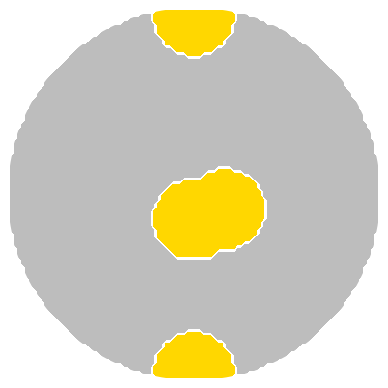
SPT5_60V_8 1month param=ISAT_P.HV.POWER__2.5/60 lot 1E622890 W14 4 dies / lot map 10 spec [-0.00017, -7e-05]
Raw dies (no fill)
Interpolate
Extrapolate

