Slide 1
An Erratum in Zhang et al. (IEEE T-ED 2009)
The “Eᵢ = 681 V/µm” claim is a text typo — proven, with the correct value derived and plotted
“Field Enhancement for Dielectric Layer of HV Devices on SOI”, IEEE T-ED 56(10), p.2329
ENDIF reproduction — verification note

Slide 2
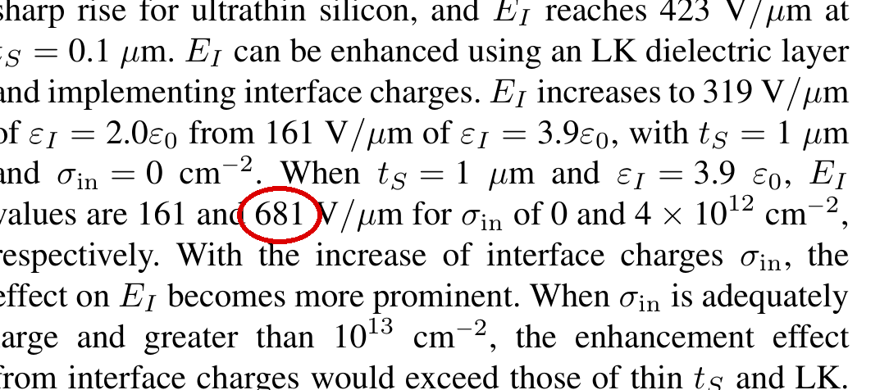
The claim, and the equation that governs it
Governing equation (displacement continuity, eq.11):
Eᵢ = εₛ·Eₛ,ᴄ/εᵢ + q·σᵢₙ/εᵢ
Only two terms: a field term and a charge term. Both divide by the SAME εᵢ.
With εᵢ = 3.9ε₀:
field term = εₛ·Eₛ,ᴄ/εᵢ = 161 V/µm
charge term = q·(4×10¹²)/(3.9ε₀) = 186 V/µm
Eᵢ = 161 + 186 = 347 V/µm
→ 681 is 2× too large.
Paper: “tₛ=1µm, εᵢ=3.9ε₀ → Eᵢ = 161 and 681 V/µm for σᵢₙ = 0 and 4×10¹² cm⁻²”

Slide 3
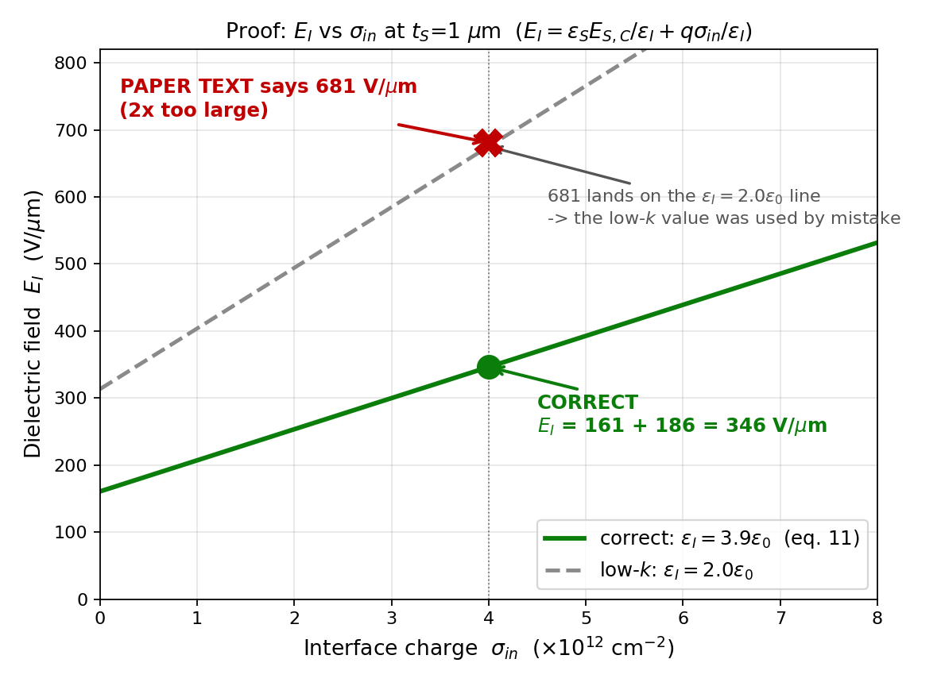
Proof: plot Eᵢ vs σᵢₙ — 681 sits on the WRONG line
Read the plot:
● Green line = correct εᵢ=3.9ε₀.
At σᵢₙ=4×10¹² it gives 347 V/µm.
✖ Red X = the paper's 681.
It lands exactly on the dashed
εᵢ=2.0ε₀ (low-k) line.
So 681 was computed with the low-k
permittivity, not the stated 3.9ε₀.
(To reach 681 at 3.9ε₀ you would
need σᵢₙ ≈ 11×10¹², not 4.)

Slide 4
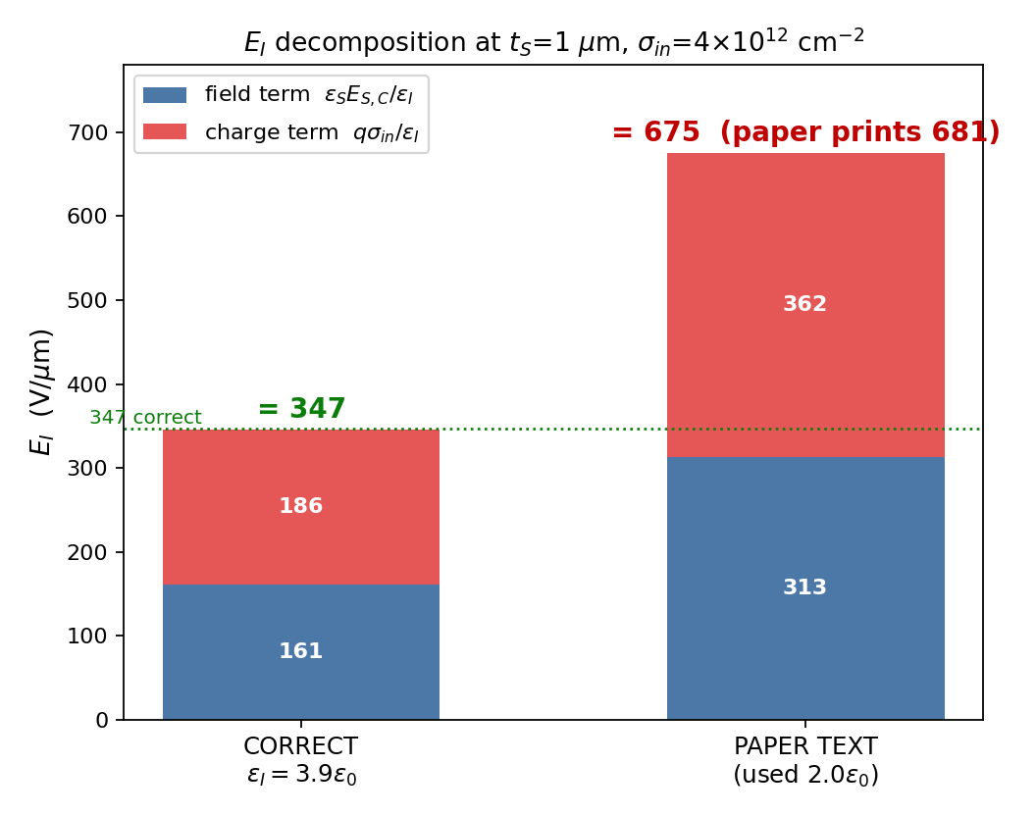
Correct value 347 V/µm — confirmed three independent ways
1. Direct from eq.(11)
161 + 186 = 347 V/µm (left bar).
2. The paper's own Vʙ,ᴠ agrees
Same paragraph: Vʙ,ᴠ = 348 → 719 V (eq.13,
reproduced exactly). ΔV = 371 V over tᵢ=2µm
→ ΔEᵢ = 186 V/µm → Eᵢ = 347 (not 681).
3. The paper's own Fig.3(a) agrees
σᵢₙ=4 curve at tₛ=1 reads ~35×10⁵ V/cm
(~350 V/µm). 681 would be on the σᵢₙ=10 curve.
All three give ~347 — the paper's own numbers
contradict its own 681.

Slide 5
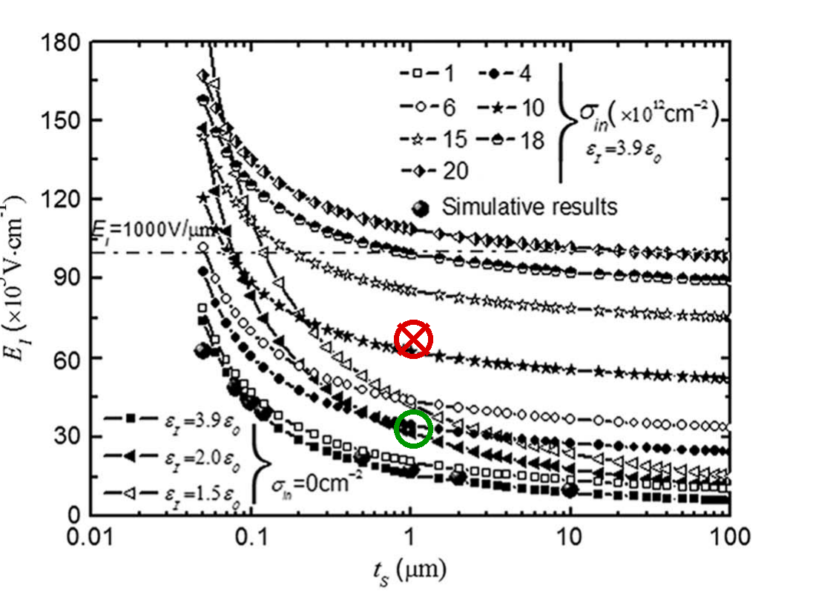
Root cause: the low-k εᵢ was carried over by mistake
The sentence just before discusses the LOW-K case (εᵢ = 2.0ε₀). Using that εᵢ in BOTH terms:
Eᵢ = εₛ·Eₛ,ᴄ/2.0ε₀ + q·(4×10¹²)/(2.0ε₀)
= 319 + 362 = 681 V/µm
319 is the paper's own rounded low-k Eᵢ (σᵢₙ=0). So both terms used 2.0ε₀ while the sentence states 3.9ε₀.
→ A copy/paste of the low-k permittivity into the interface-charge example. Physics is fine; only the printed number is wrong.
Paper's Fig.3(a): ○ 347 (correct) vs ✖ 681 (on the wrong curve).

Slide 6
Verdict
✓ The paper's TEXT has a typo: Eᵢ(σᵢₙ=4×10¹², εᵢ=3.9ε₀) = 347 V/µm, not 681.
✓ The paper's EQUATIONS and FIGURES are correct and mutually consistent — eq.(11), eq.(13), Fig.3(a), Fig.4 and Vʙ,ᴠ=719 V all agree on 347.
✓ Origin identified and plotted: the low-k εᵢ=2.0ε₀ was used instead of 3.9ε₀ (681 = 319 + 362).
→ A copy-editing slip, not a physics error. The reproduction matches every other number in the paper exactly.
Proof code: code/verify_681.py · code/proof_plot.py

