Slide 1
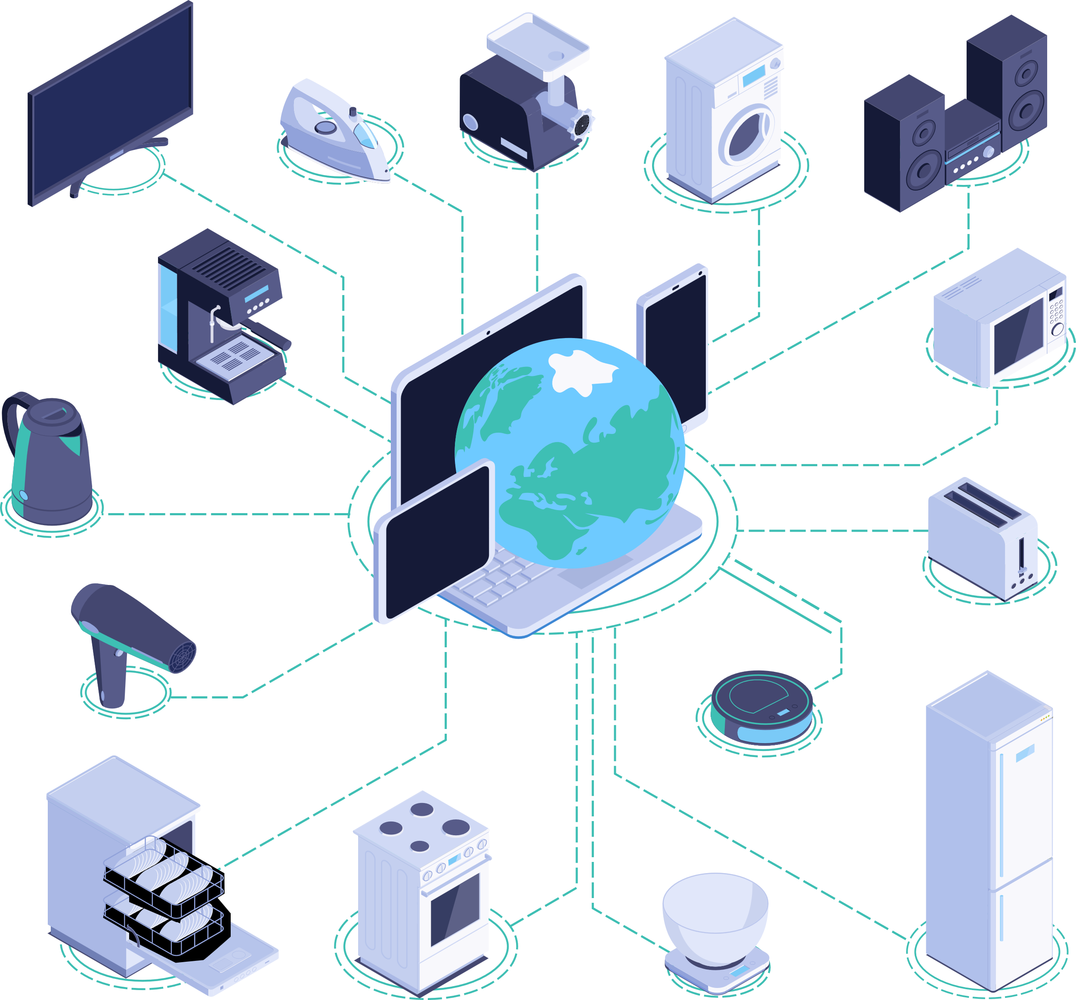
IoT-Based Smart Parking System
A Smart Solution for Efficient Parking Guidance
Presented by: Dev Sindhu, Manal Ahmed
Mentors: Manoj Kumar, Channappa N Kalahal

Slide 2
Introduction
Parking in crowded areas is challenging due to inefficient guidance systems.
IoT-based smart parking guidance system using Arduino, Raspberry Pi, and sensors.
Implements Dijkstra’s algorithm for optimal slot allocation.
Displays real-time data via a web interface.

Slide 3
Problem Statement
Issues in conventional parking systems:
Lack of real-time slot availability updates.
Increased congestion and fuel consumption.
No guidance for optimal parking slot selection.
Need for an automated system to minimize time, effort, and fuel wastage.

Slide 4
Existing Solutions
Manual Parking Systems: Inefficient, requiring human monitoring.
Basic Sensor-Based Parking Systems: Detects availability but lacks real-time path guidance.
Smart Parking Apps: Some require user input but do not integrate real-time sensor data.

Slide 5
Proposed Solution
IoT-based smart parking system using:
Ultrasonic sensors for slot detection.
Arduino Uno for data collection.
Raspberry Pi for processing and shortest path calculation.
Flask-based web interface for real-time monitoring.

Slide 6
System Architecture
Sensor Module (Arduino Uno): Reads sensor data and transmits binary status.
Processing Module (Raspberry Pi):
Executes Dijkstra’s algorithm for optimal pathfinding.
Updates web interface with available slots.
Web Interface: Displays real-time parking slot availability and navigation guidance.

Slide 7
Implementation
1. Data Collection:
Arduino scans parking slots and sends data.
2. Path Calculation:
Dijkstra’s algorithm determines shortest path.
3. Web Dashboard:
Flask server hosts real-time updates.
JavaScript & AJAX ensure dynamic slot updates.
CSS & Bootstrap enhance user experience.

Slide 8
Results and Discussion
Successfully detects and updates slot availability in real time.
Shortest path calculation dynamically adjusts.
Web interface provides seamless user interaction and visualization.
Users can manually select slots if preferred.

Slide 9
Drawbacks
Reliance on stable internet connection for real-time updates.
Sensor limitations in extreme weather conditions.
Potential hardware costs for large-scale deployment.

Slide 10
Conclusion & Future Work
Conclusion:
IoT-based smart parking reduces congestion and improves efficiency.
Real-time updates and shortest path guidance enhance user experience.
Future Enhancements:
Cloud-based storage for historical parking data.
Mobile app integration for better accessibility.
AI-based predictive analytics for demand estimation.

Slide 11
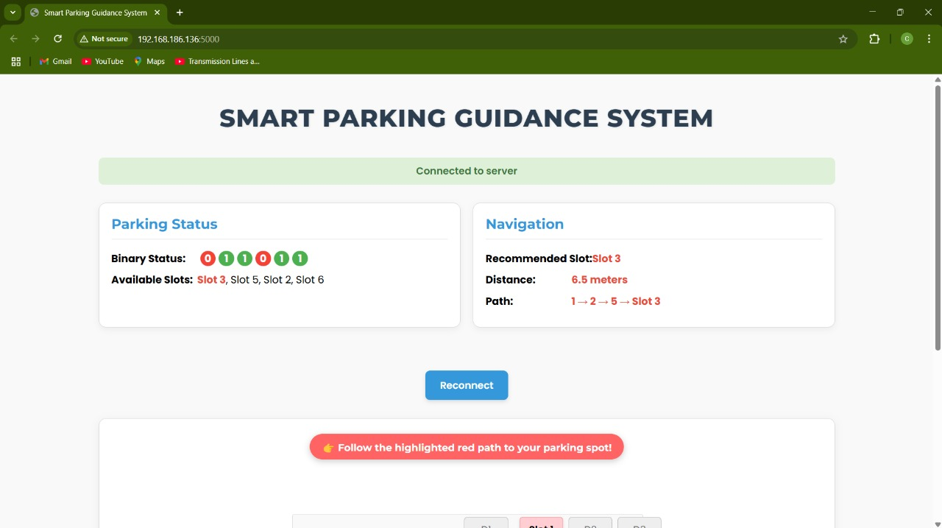
Following are the visuals of our Software Interface

Slide 12
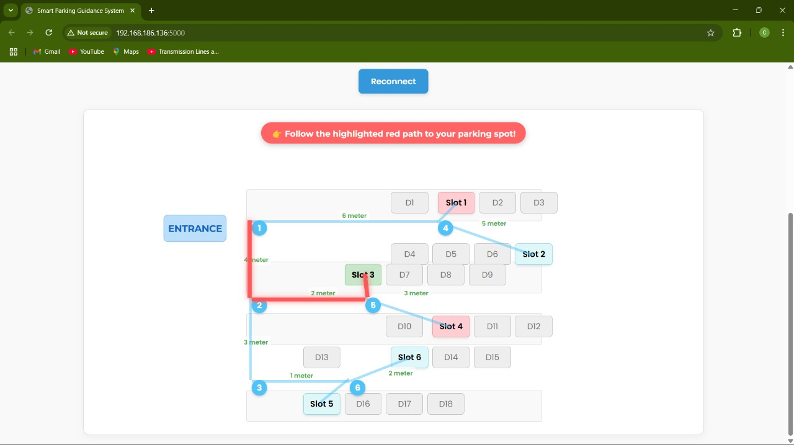

Slide 13
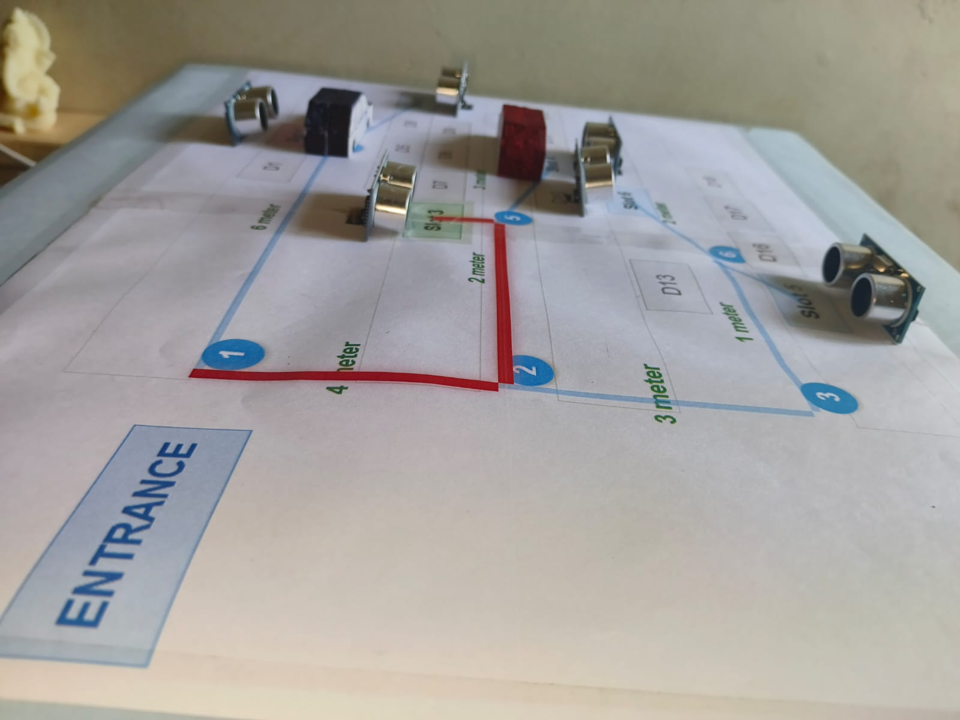
Following are the visuals of our Hardware Implementation

Slide 14
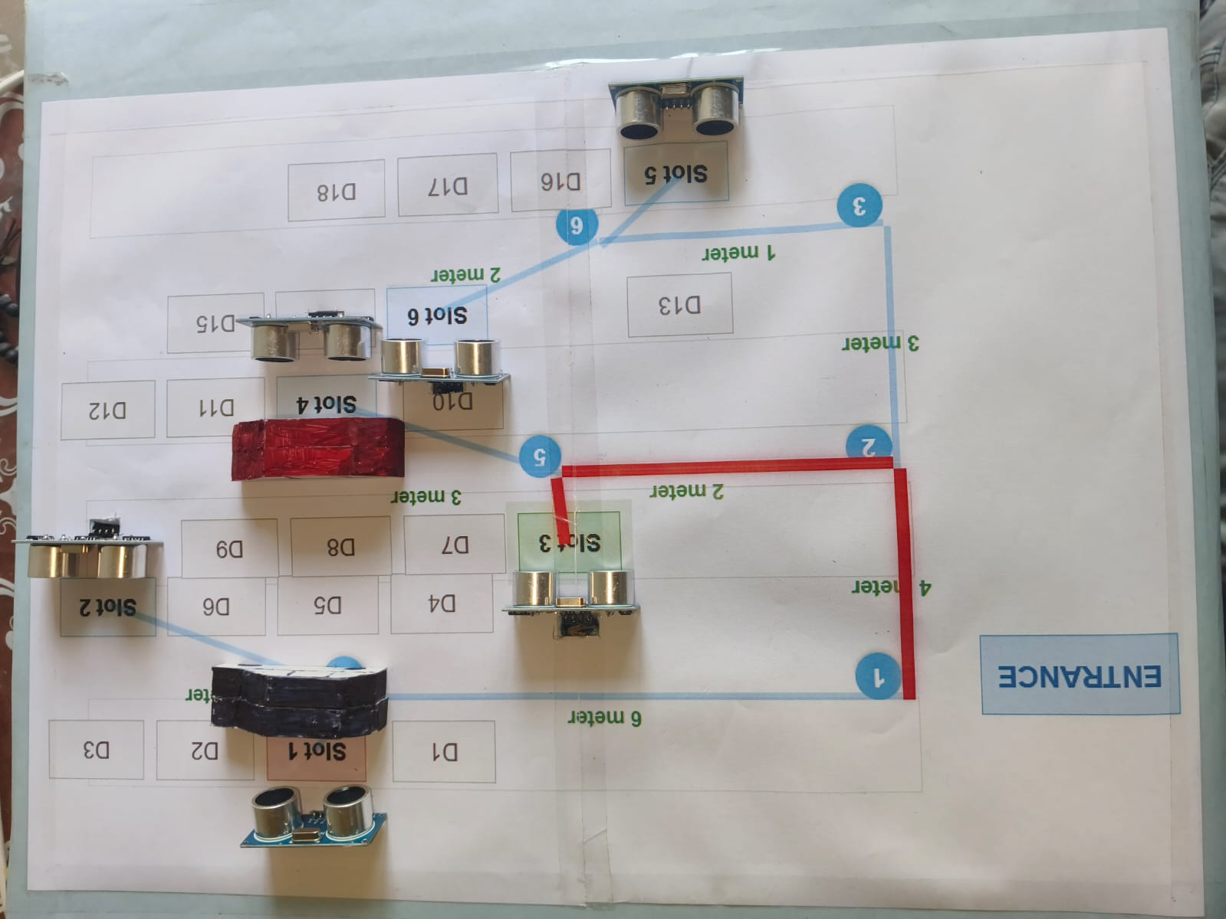

Slide 15
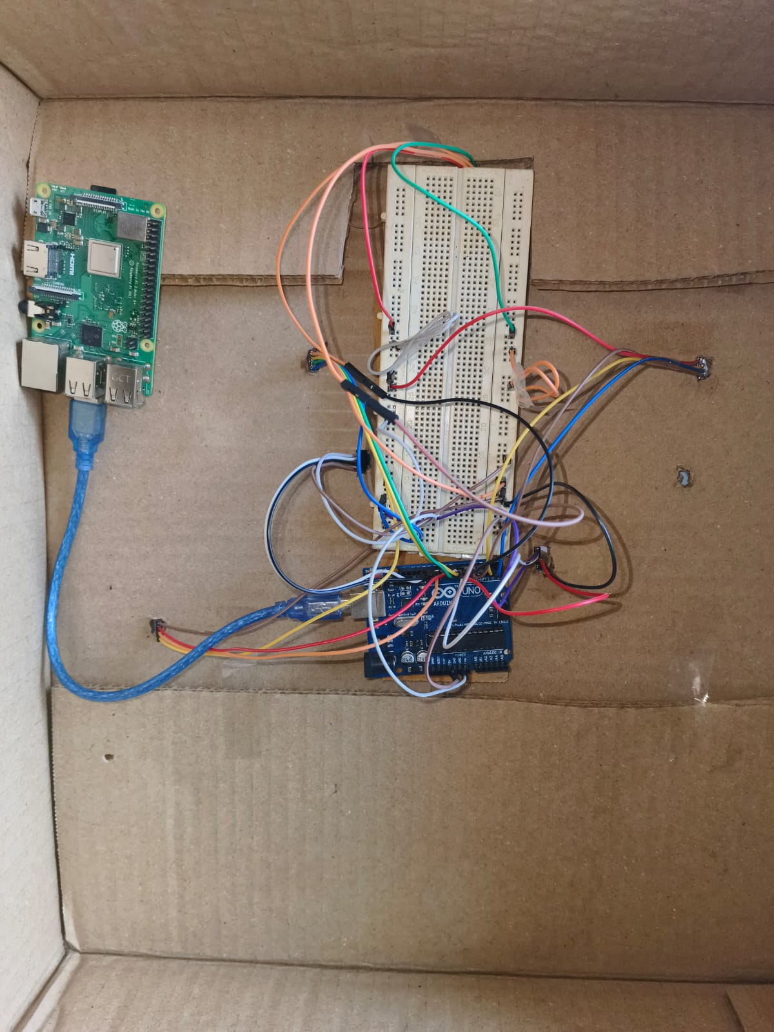
Glimpse of how the internal circuit of the Smart Parking System Looks

Slide 16
THANK YOU

