Slide 1
Secure data hiding in images using steganography
CAPSTONE PROJECT
Presented By: CHANNABASAVA REDDY T
College Name: University of Visvesvaraya College of Engineering
Department : M.Tech in CyberSecurity

Slide 2
OUTLINE
Problem Statement
Technology used
Wow factor
End users
Result
Conclusion
Git-hub Link
Future scope

Slide 3
Problem Statement
Develop a robust steganographic method for securely embedding confidential data within digital images without compromising the image quality or revealing the presence of hidden information. Ensure that the embedded data is protected against unauthorized access and extraction, maintaining confidentiality and integrity. Maintain the visual quality of the host image, ensuring that the modifications made for data hiding are imperceptible to the human eye.

Slide 4
Technology used
Open CV
Python Idel 3.13.2
Windows Version 7/10/11 etc..
Tkinter

Slide 5
Wow factors
Combine traditional steganography with advanced encryption algorithms (e.g., AES, RSA) to enhance data security before embedding it in images.
Support for various image formats (JPEG, PNG, BMP, etc.) and the ability to hide data in different types of media (audio, video) for broader applicability.
Develop an intuitive graphical user interface (GUI) that simplifies the process of embedding and extracting data, making it accessible to non-technical users.
Ensure that the application runs seamlessly on multiple platforms (Windows, macOS, Linux) to reach a wider audience.

Slide 6
End users
Cybersecurity Professionals
Ethical Hackers
Forensics Examiners
Government Agencies
Intelligence Services

Slide 7
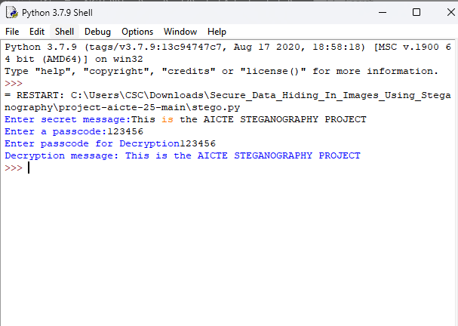
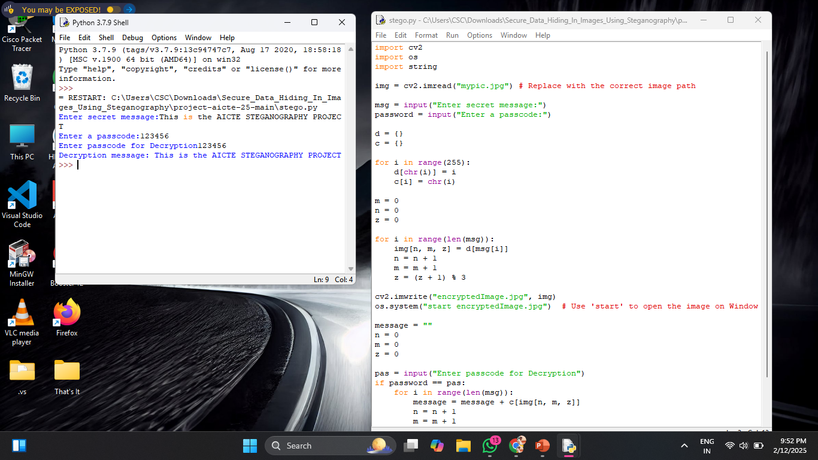
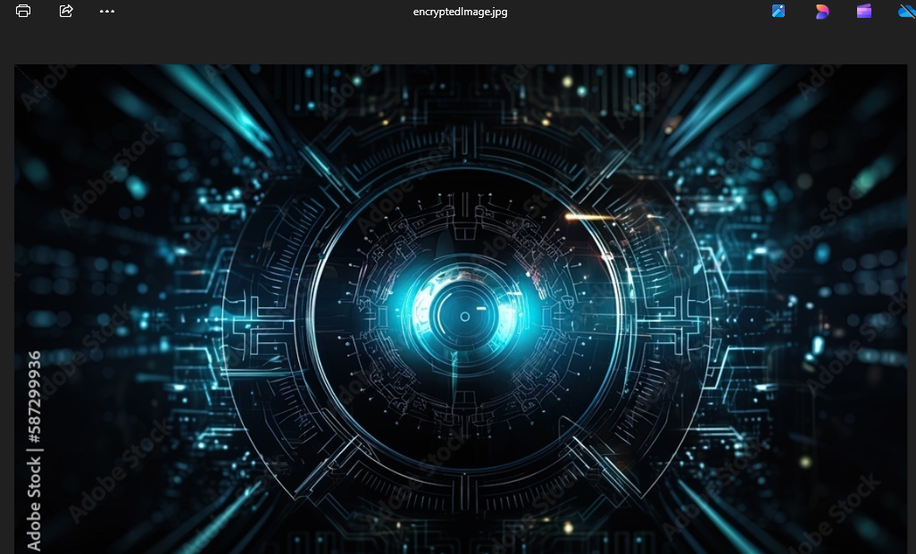
Results
Output >
Screenshot 1
Encrypted image

Slide 8
Conclusion
The project on secure data hiding in images using steganography addresses the critical need for confidentiality and integrity in digital communications. By developing a robust and efficient steganographic method, we have successfully tackled the challenges outlined in our problem statement, including data security, image quality, capacity, robustness, and detection resistance.

Slide 9
GitHub Link
https://github.com/channabasavareddy/Secure-data-hiding-in-images-using-steganography.git

Slide 10
Future scope(optional)
The field of steganography is continually evolving, and there are numerous avenues for future development and research. Extend the project to support not only images but also audio, video, and text files, allowing for a broader range of applications in multimedia steganography. Develop real-time communication tools that incorporate steganography for secure messaging, enabling users to send hidden messages within regular communication channels (e.g., chat applications, emails).

Slide 11
THANK YOU

