Slide 1
DSA MINI PROJECT
STEINER TREE
Channamallikarjuna(181IT212)
P.Narendra(181IT229)
Jayakrishnan B(181IT120)
Shivaprasad Nayak(181IT149)

Slide 2
INTRODUCTION
The Steiner tree problem is a generalization of two other famous combinatorial optimization problems: the (non-negative) shortest path problem and the minimum spanning tree problem. If a Steiner tree problem in graphs contains exactly two terminals, it reduces to finding the shortest path.
On the other hand, all vertices are terminals, the Steiner tree problem in graphs is equivalent to the minimum spanning tree. However, while both the non-negative shortest path and the minimum spanning tree problem are solvable in polynomial time, the decision variant of the Steiner tree problem in graphs is NP-complete.
The Steiner tree problem in graphs has applications in circuit layout or network design. However, practical applications usually require variations, giving rise to a multitude of Steiner tree problem variants.

Slide 3
PROBLEM DEFINITION
Given an undirected graph with non-negative edge weights and a subset of vertices (terminals), the Steiner Tree in graph is an MST “T” of minimum weight that contains all given terminals (but may include additional vertices).

Slide 4
DISCUSSION
Steiner tree often arises in network design and wiring layout problems. Suppose we are given a set of sites that must be connected by wires as cheaply as possible.
The minimum Steiner tree describes the way to connect them using the smallest path.
Analogous problems arise in designing networks of water pipes or heating ducts in buildings. Similar considerations also arise in VLSI circuit layout, where we seek to connect a set of sites to ground under constraints such as material cost, signal propagation time, or reducing capacitance.

Slide 5
How many points do you have to connect?
The Steiner tree of a pair of vertices is simply the shortest path between them. The Steiner tree of all the vertices, when S=V, simply defines the minimum spanning tree of G. Despite these special cases, the general minimum Steiner tree problem is NP-hard and remains so under a broad range of restrictions.

Slide 6
Is the input a set of geometric points or a distance graph?
Geometric versions of Steiner tree take as input a set of points, typically in the plane, and seek the smallest tree connecting the points. A complication is that the set of possible intermediate points is not given as part of the input but must be deduced from the set of points. These possible Steiner points must satisfy several geometric properties, which can be used to reduce the set of candidates down to a finite number. For example, every Steiner point will have degree exactly three in a minimum Steiner tree, and the angles formed between any two of these edges will be exactly 120 degrees.

Slide 7
Spanning Tree vs Steiner Tree
Minimum Spanning Tree is a minimum weight tree that spans through all vertices.
If given subset (or terminal) vertices is equal to set of all vertices in Steiner Tree problem, then the problem becomes Minimum Spanning Tree problem. And if the given subset contains only two vertices, then it shortest path problem between two vertices.
Finding out Minimum Spanning Tree is polynomial time solvable, but Minimum Steiner Tree problem is NP Hard and related decision problem is NP-Complete.

Slide 8
Applications of Steiner Tree
Any situation where the task is minimize cost of connection among some important locations like VLSI Design, Computer Networks, etc.
In optimizing the area of Very Large Scale Integrated (VLSI) layouts, circuit interconnections should generally be realized with minimum total interconnect. several variations of the corresponding fundamental Steiner minimal tree (SMT) problem, where a given set of pins is to be connected using minimum total wirelength. Steiner trees are important in global routplications such as phylogenetic tree reconstruction in biology , network ing and wire-length estimation , as well as in various non-VLSI aprouting , and civil engineering, among many other areas .

Slide 9
contd...
In modern deep-submicron VLSI layout other criteria often dominate the routing objectives, such as path lengths, skew, density, inductance, manufacturability, electromigration, reliability, noise, power, non-Hanan topologies, signal integrity, three-dimensionality, alternate models, and various combinations and tradeoffs of these . However, large non-critical nets are still common in modern designs.

Slide 10
Contd…
A broader overview of the field of computer-aided design of VLSI is given by several textbooks on this subject. Given a set P of n pins i.e.terminals of a signal net, we seek to interconnect these points using a minimal total amount of wire. This objective arises in VLSI minimum-area global routing, since VLSI minimum-spacing design rules induce an essentially linear relationship between wirelength and wiring area. When all wires are “point-to-point”, with no intermediate junctions other than points of P, the optimum solution is a minimum spanning tree (MST) over P, denoted as MST(P). However, we can usually introduce intermediate junctions, called Steiner points, in connecting the points of P.

Slide 11
Shortest Path based Approximate Algorithm
Since Steiner Tree problem is NP-Hard, there are no polynomial time solutions that always give optimal cost. Therefore, there are approximate algorithms to solve the same. Below is one simple approximate algorithm.
1) Start with a subtree T consisting of
one given terminal vertex
2) While T does not span all terminals
a) Select a terminal x not in T that is closest
to a vertex in T.
b) Add to T the shortest path that connects x with T

Slide 12
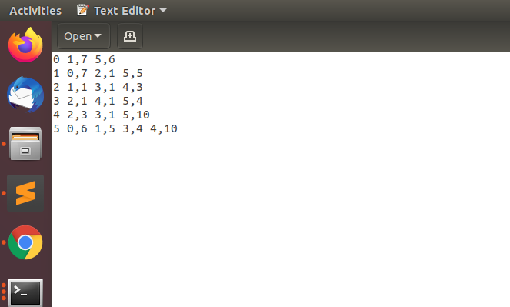
RESULTS
for the input

Slide 13
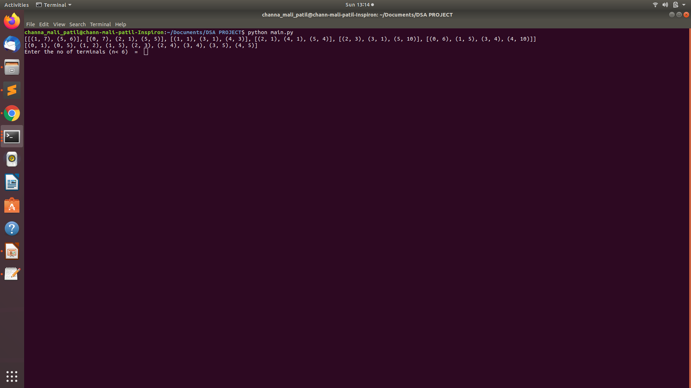
Running the program

Slide 14
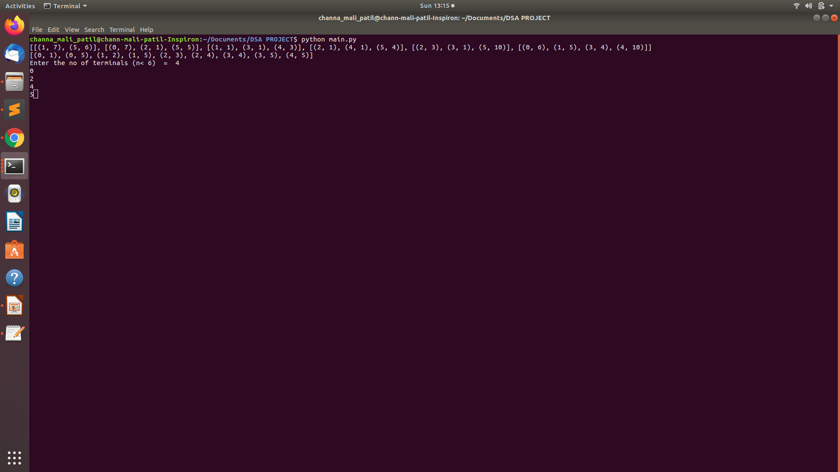
Entering number of Terminals

Slide 15
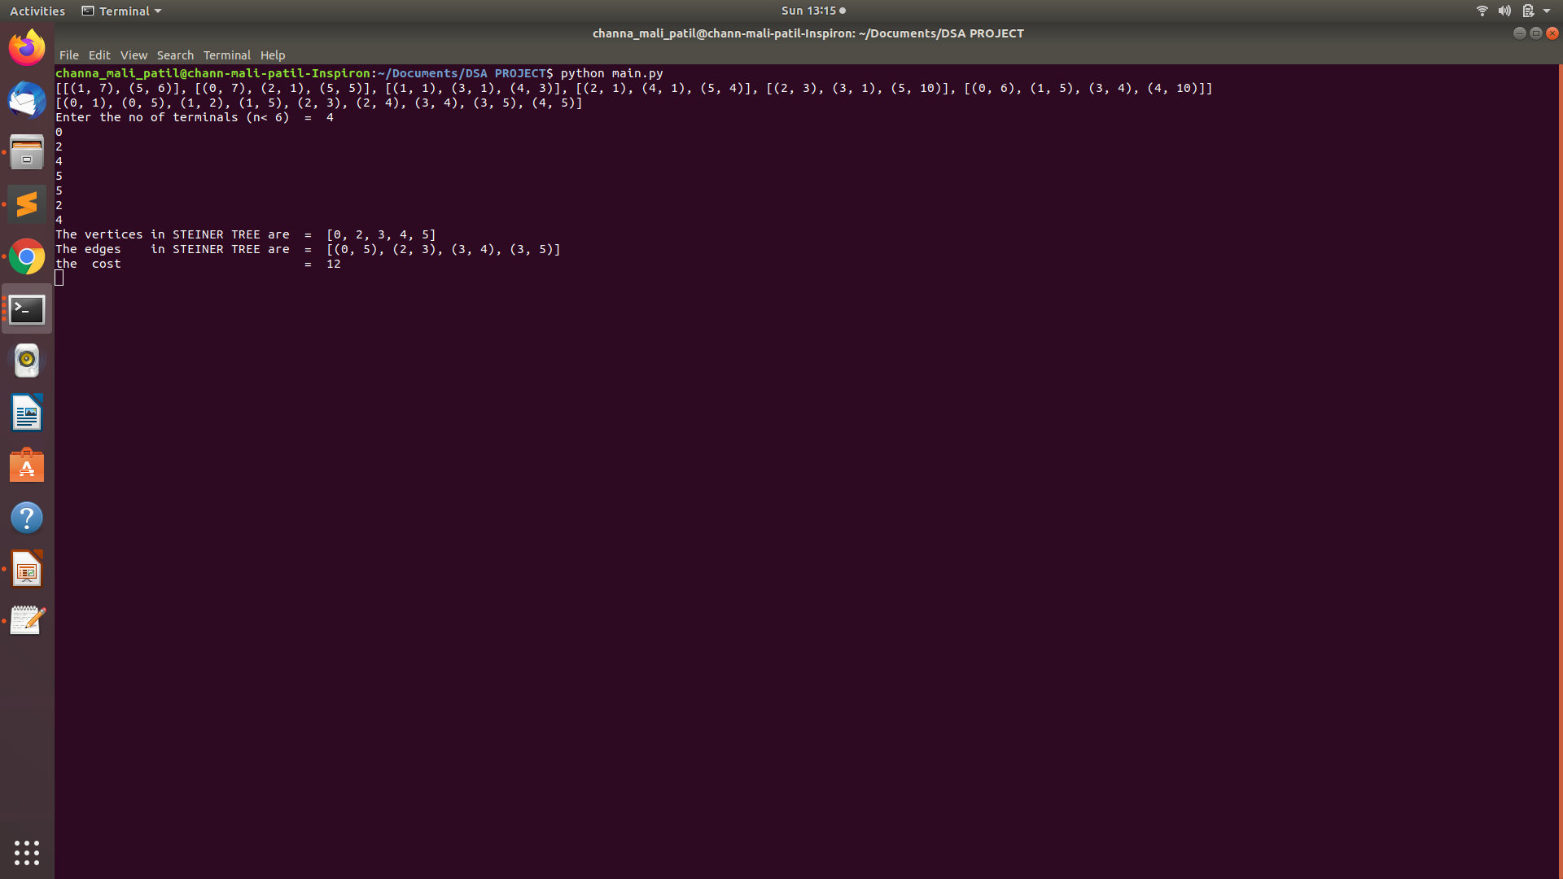
OUTPUT

Slide 16
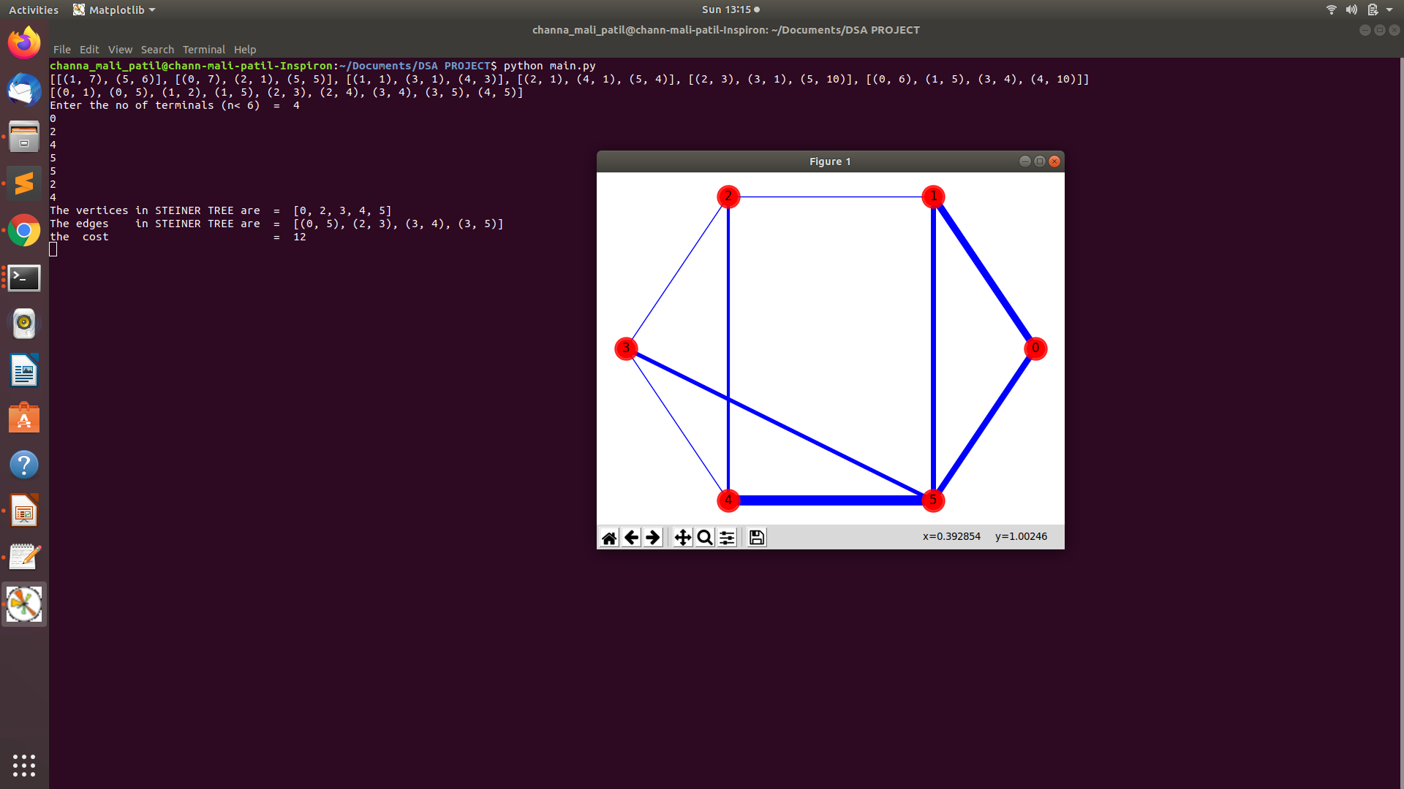
INPUT GRAPH

Slide 17
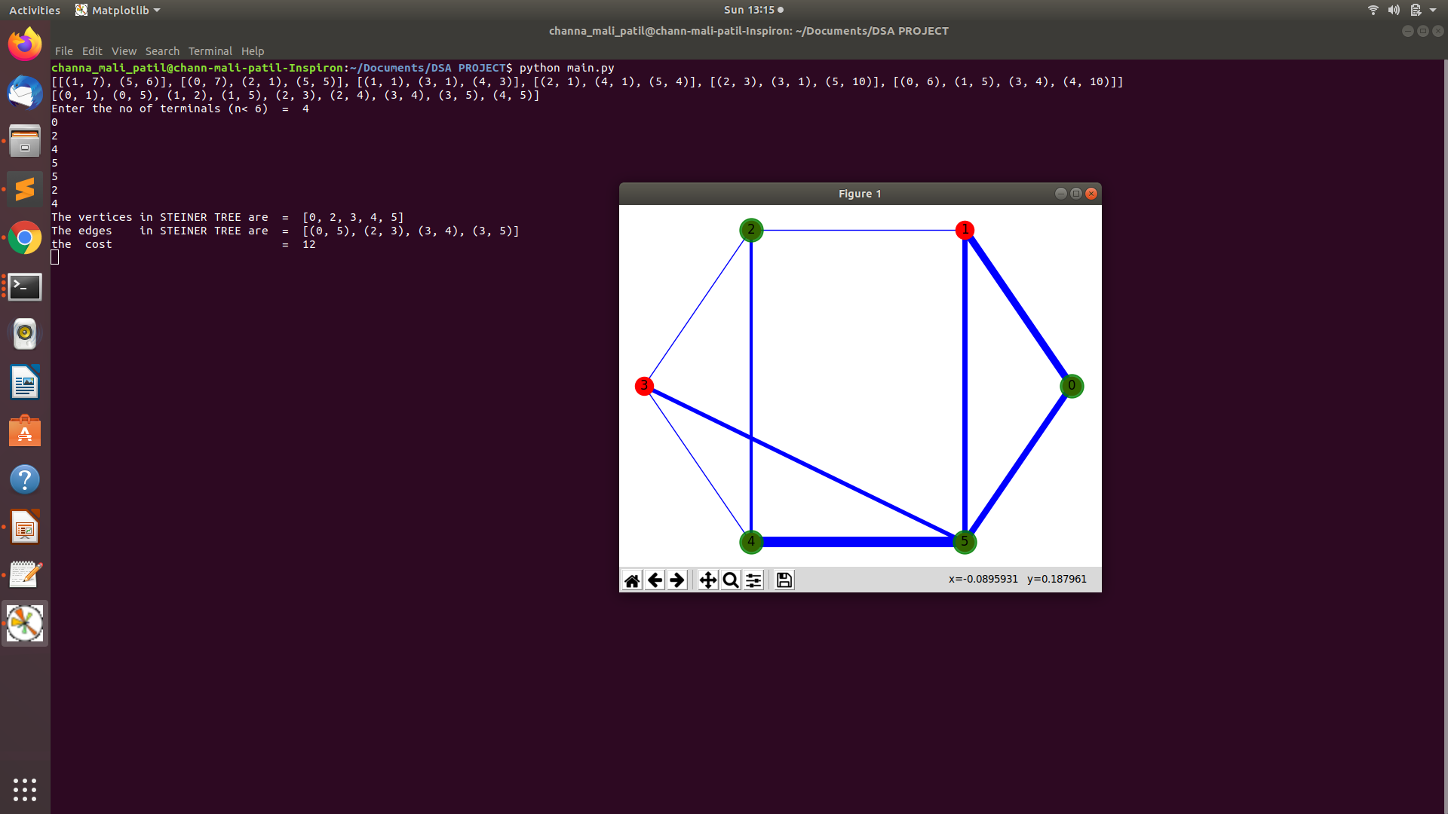
TERMINALS
Nodes in green color are terminals.
And nodes in red color are non-terminals.

Slide 18
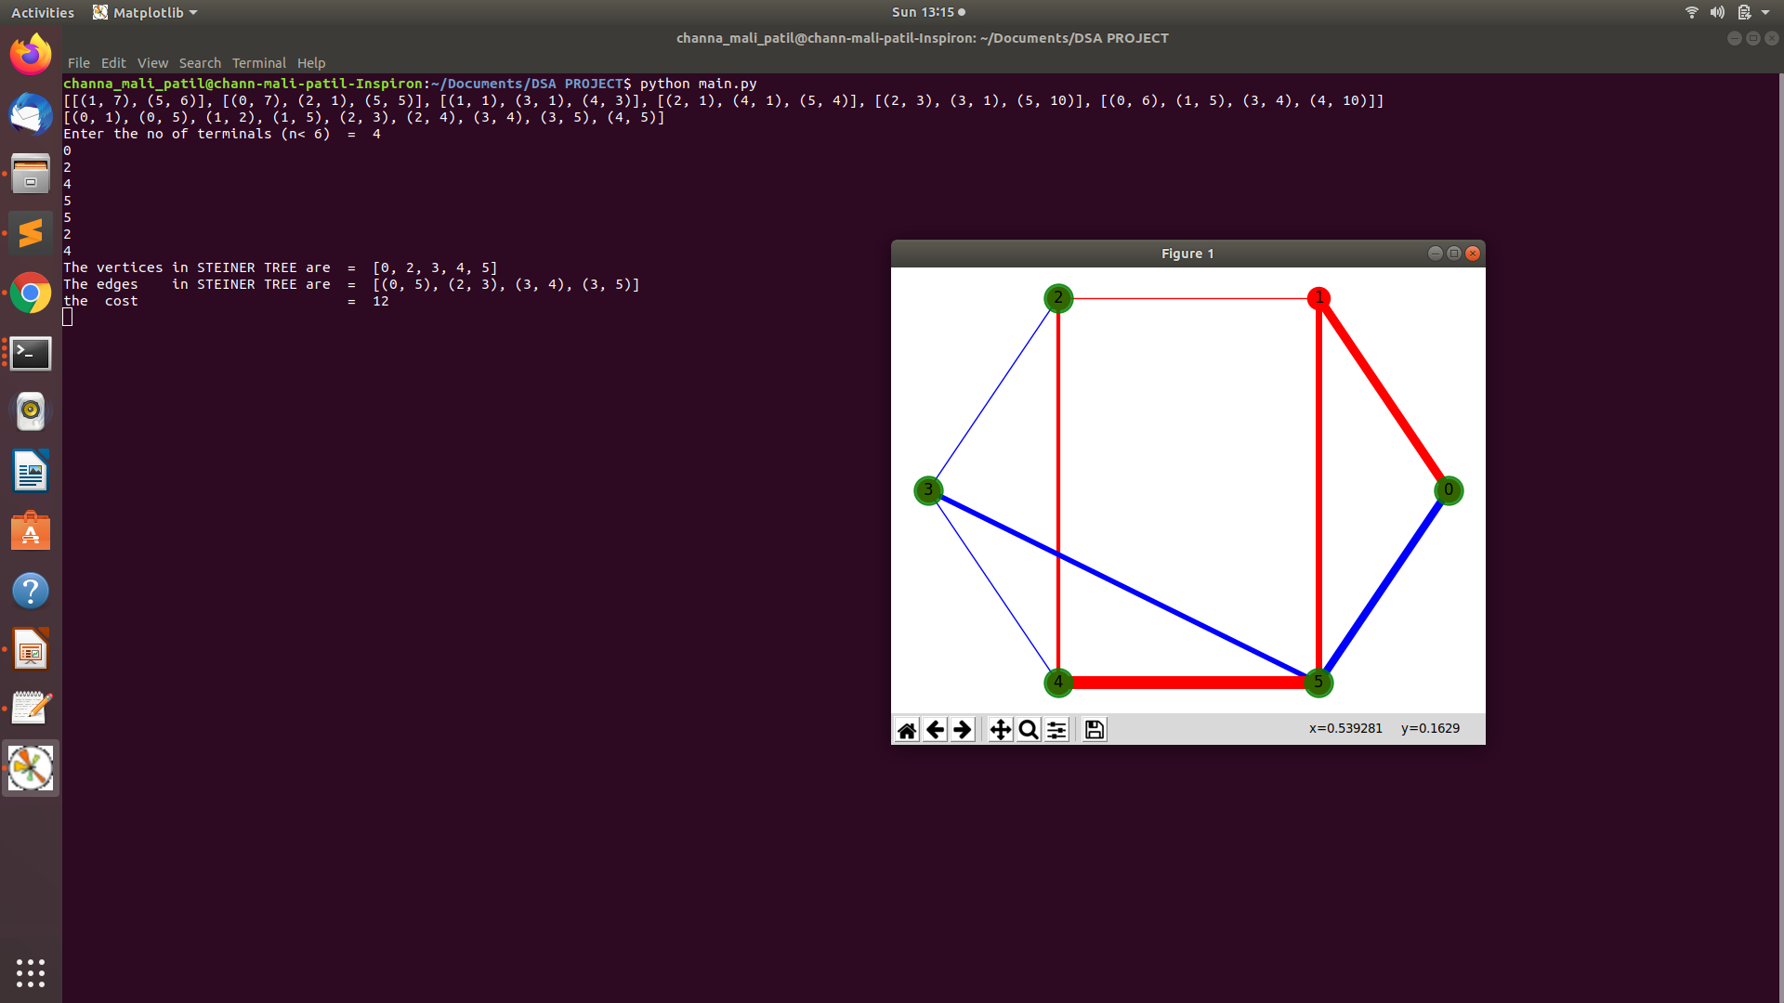
STEINER TREE ON ORIGINAL GRAPH
The blue edges show the steiner tree.

Slide 19
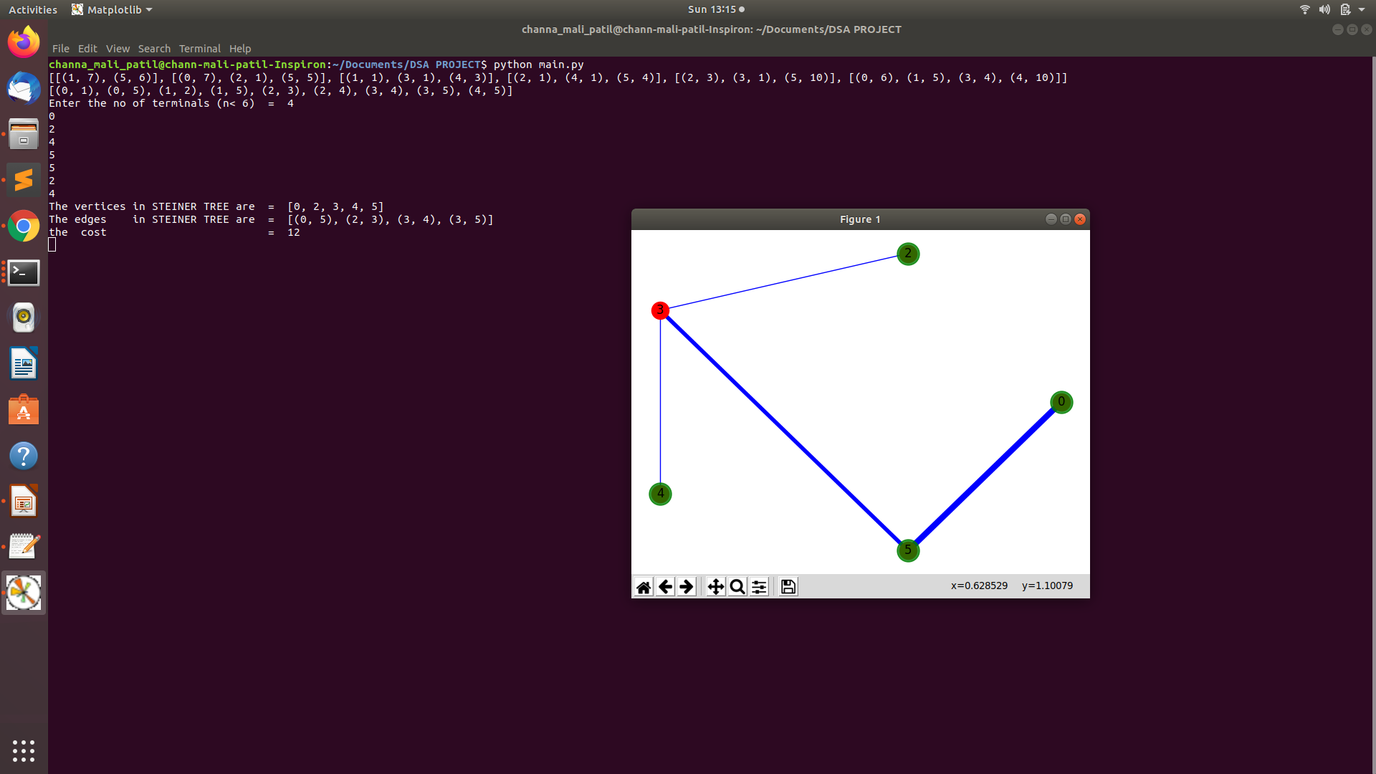
Final steiner tree output.
The green are terminal.
Red are non-terminals.

Slide 20
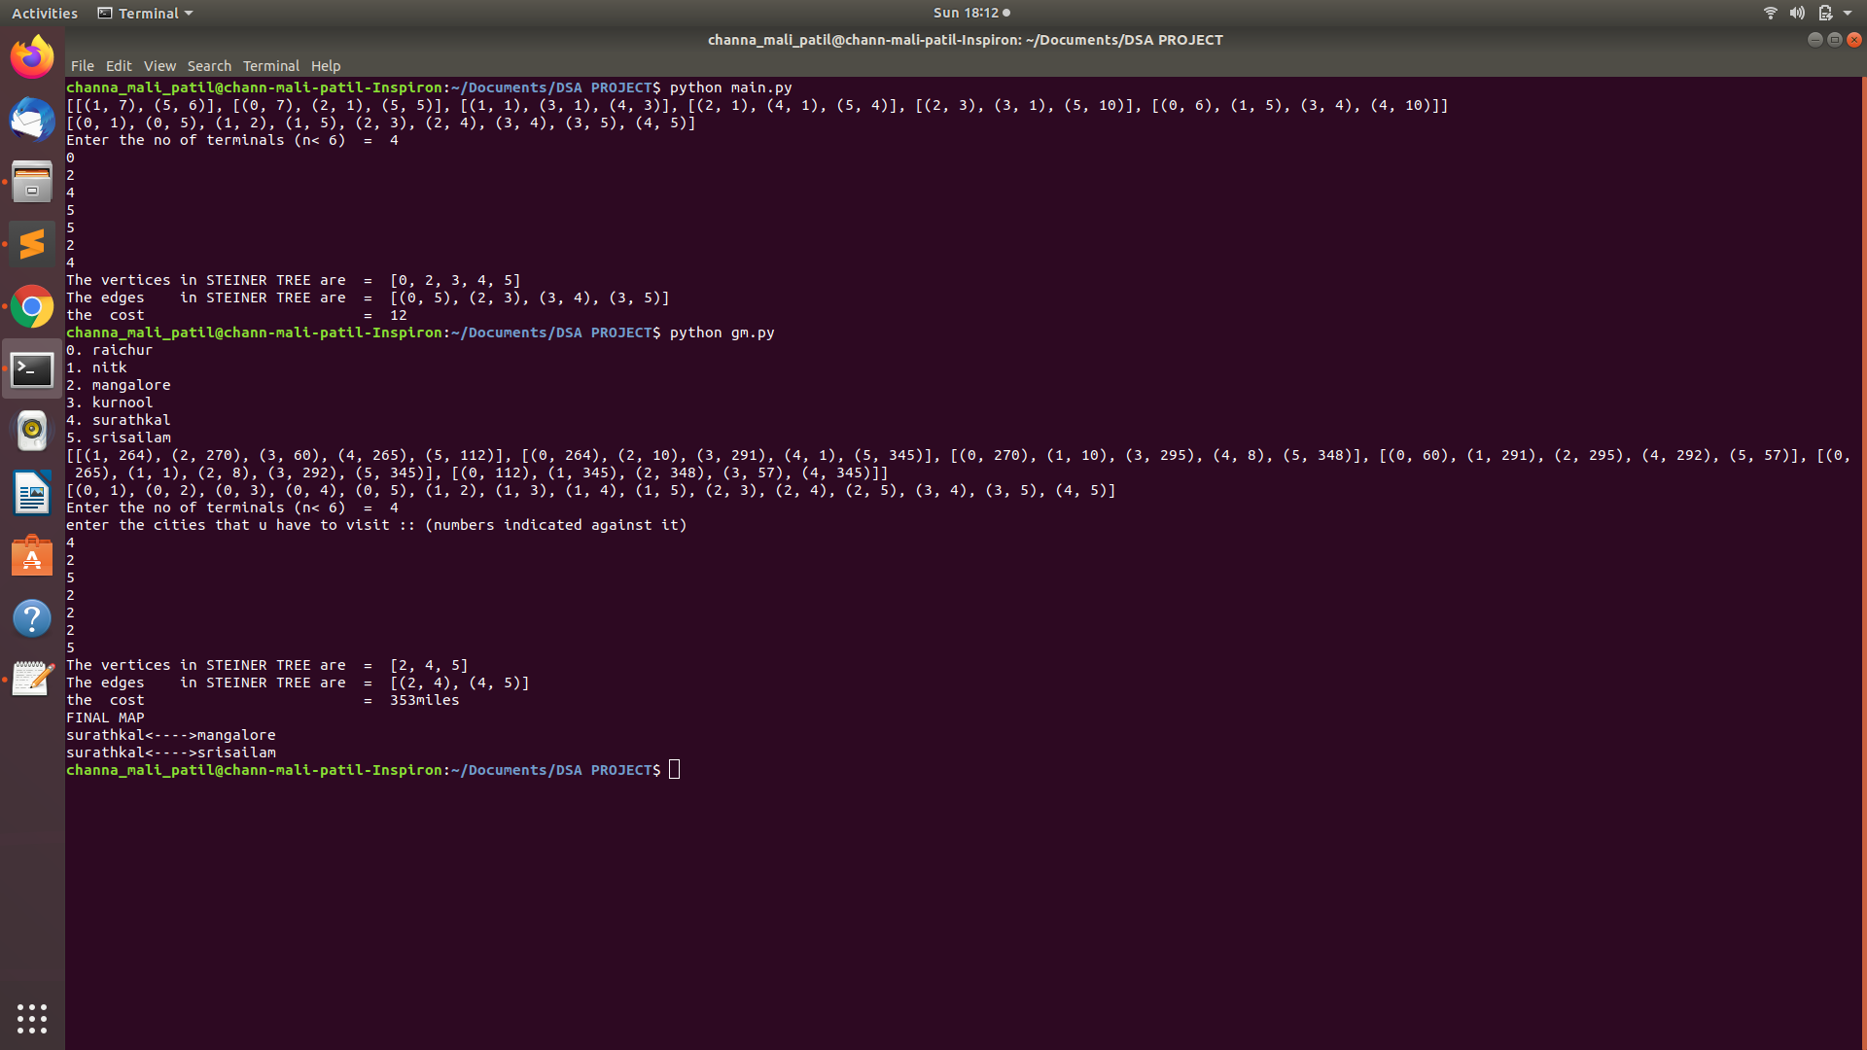
Application example Output

Slide 21
THANK YOU

