Slide 1

Go, change the world
RV College of
Engineering
ELECTRONIC DIFFERENTIAL FOR ELECTRIC VEHICLES
DTL Phase I Presentation
Chetan
Mallikarjun A L
Karthik P Shetty
Channaveeragouda MP
1RV21EC050
1RV21EC091
1RV21EC077
1RV21EC048
Mentor : Anusha A L
Designation : Associate Professor
Department of Electronics and Communication Engineering
*
Department of ECE
1

Slide 2


Go, change the world
RV College of
Engineering
EMPATHY PHASE
*
Department of ECE
2

Slide 3
Go, change the world
RV College of
Engineering
Introduction
An Electronic Differential, also known as an electronic limited-slip differential (e-LSD) or electronic differential control, is an advanced automotive technology designed to optimize the distribution of torque (rotational force) between a vehicle's wheels, particularly in situations where traction might be compromised. Unlike traditional mechanical differentials, which use purely mechanical components to manage torque distribution, electronic differentials integrate sensors, computers, and actuators to achieve more precise control over wheel spin and power delivery.
*
Department of ECE
3

Slide 4
Go, change the world
RV College of
Engineering
Enhanced Traction Control
Precise Torque Distribution
Dynamic Adaptability
Reduced Understeer and Oversteer
Customizable Driving Modes
Compatibility with ADAS
Optimized EV Performance
Advantages
of E-differential
over mechanical differential
*
Department of ECE
4

Slide 5

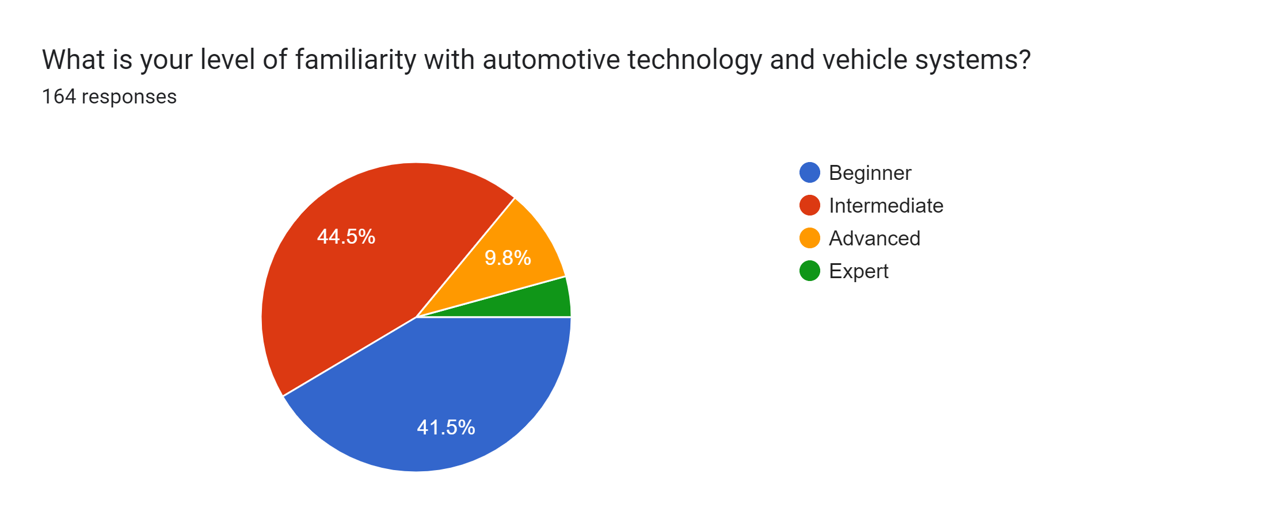
Go, change the world
RV College of
Engineering
People’s responses and suggestions on our project
*
Department of ECE
5

Slide 6
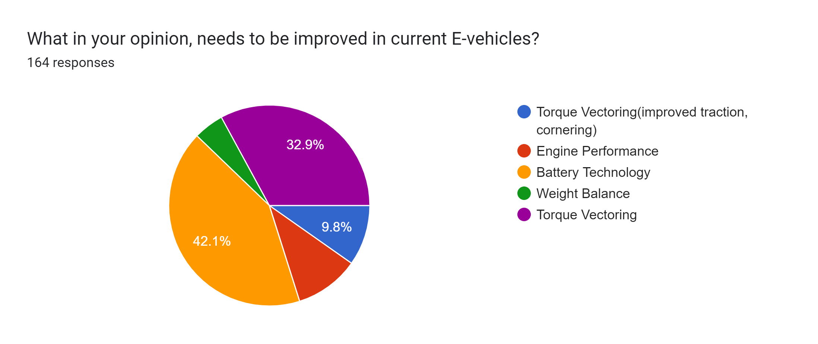
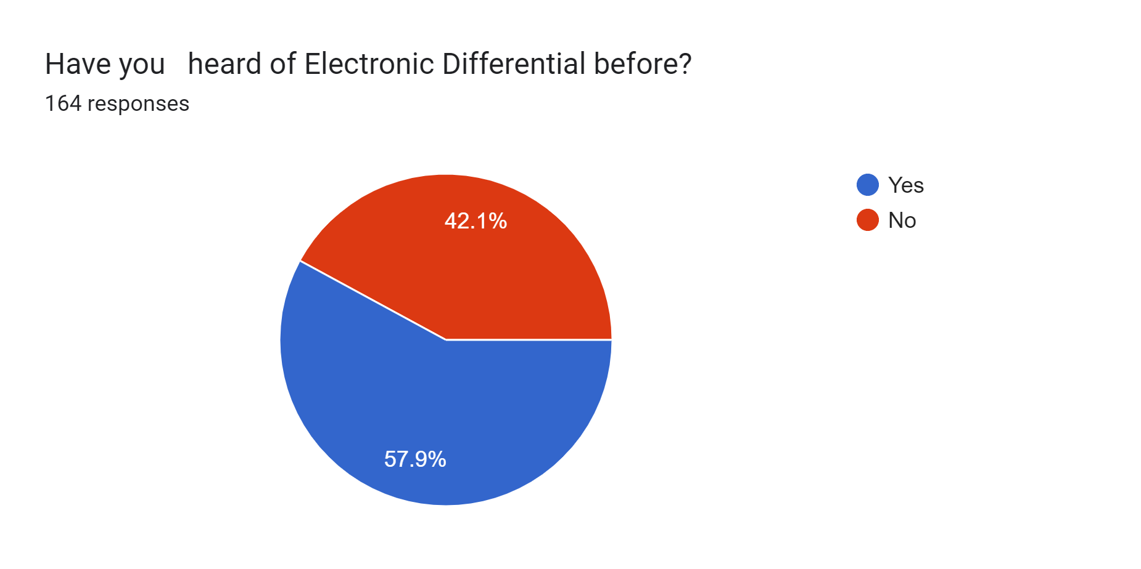
Go, change the world
RV College of
Engineering
*
Department of ECE
6

Slide 7
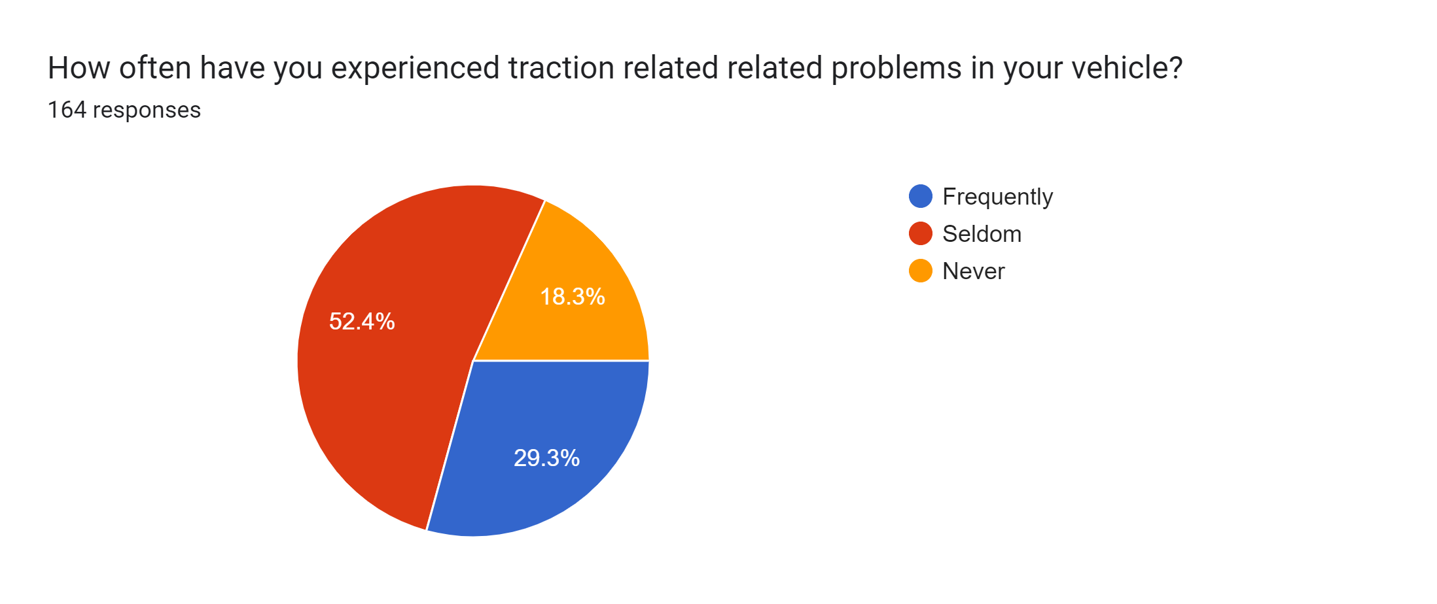
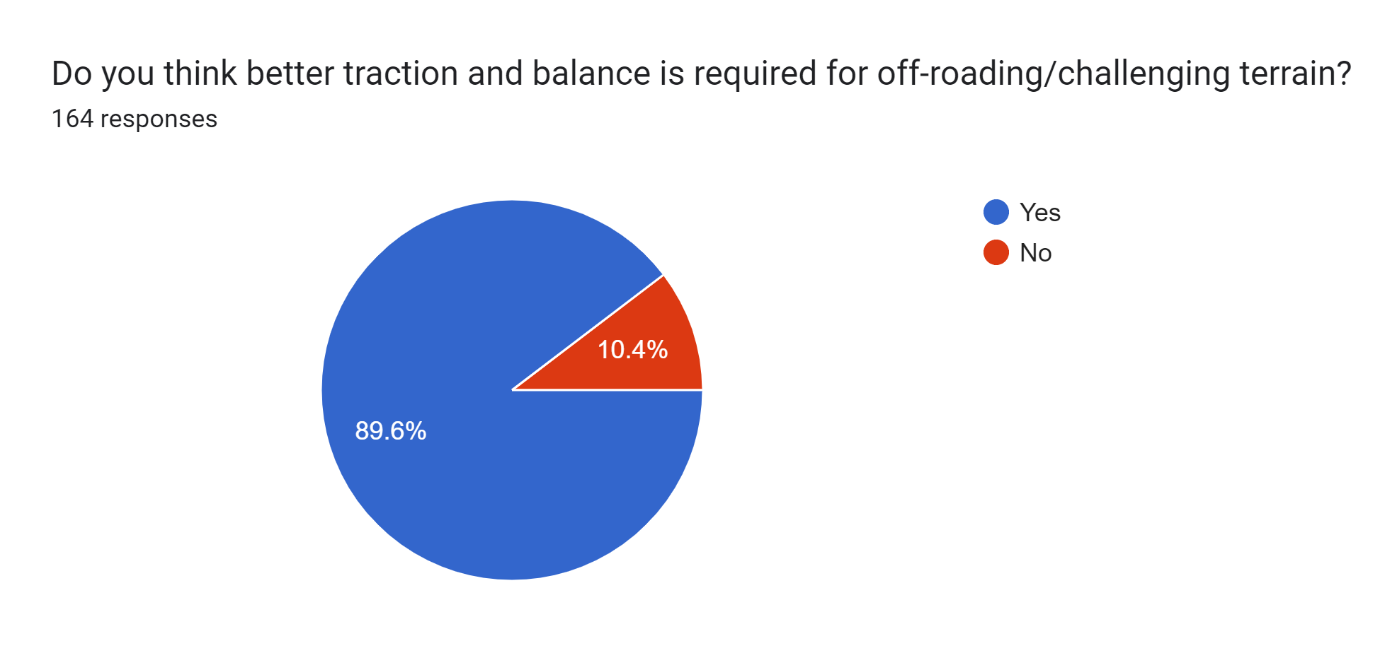
Go, change the world
RV College of
Engineering
*
Department of ECE
7

Slide 8
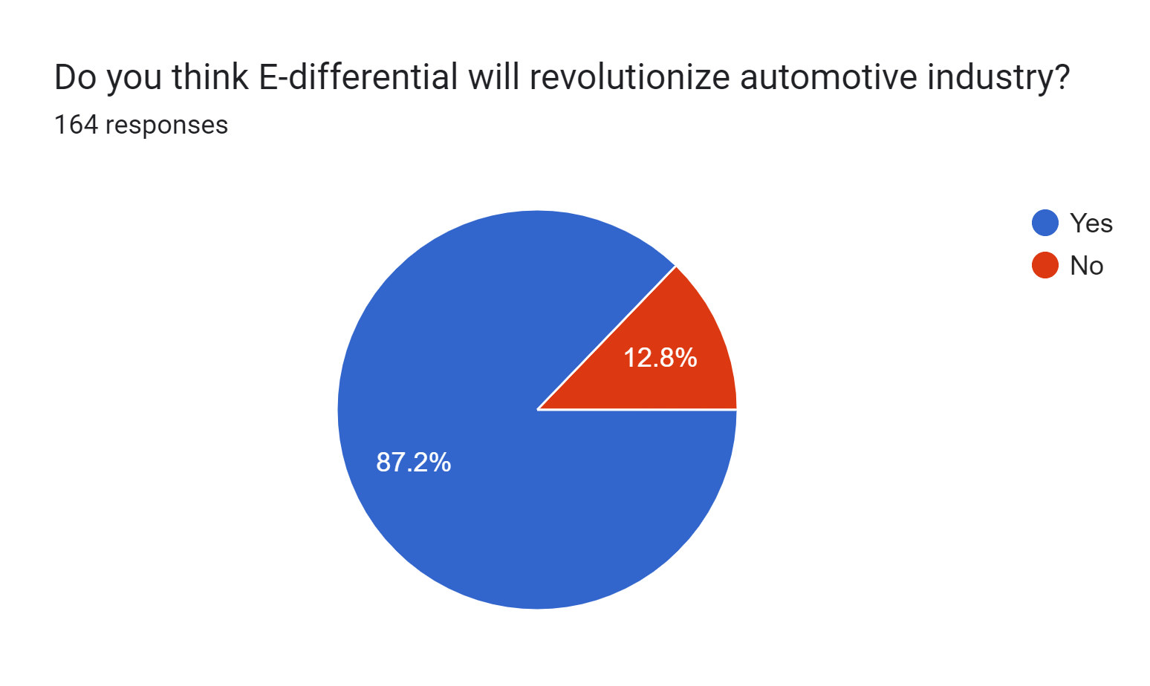
Go, change the world
RV College of
Engineering
*
Department of ECE
8

Slide 9
Go, change the world
RV College of
Engineering
Suggestions
If my suggestion is actually read, I would be very much interested in contributing to this development. I don't know the means to reach out to you but if you can connect with me through the mail I am pretty much interested in understanding the problems and contributing to find a solution as well. My suggestion would be mostly wasteful until you text me back what are the issues you are facing currently.
Making use of e-diff for carbwalk like hummer or sliding motion which could help in easy turning in ghats and sliding on off road vehicles which could help to avoid obsticals just by sliding left or right instead of taking back and struggling to turn . This could also reduce the turning radius of even bigger vehicles .proper optimisation of e diff could help in easy overtaking and use e- diff for braking
*
Department of ECE
9

Slide 10
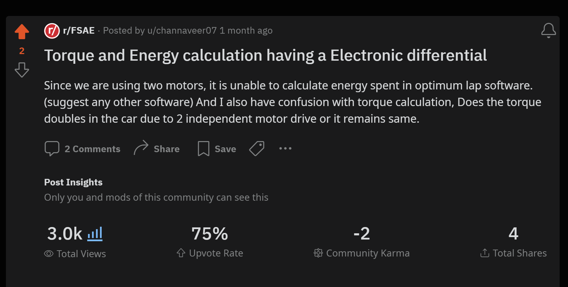
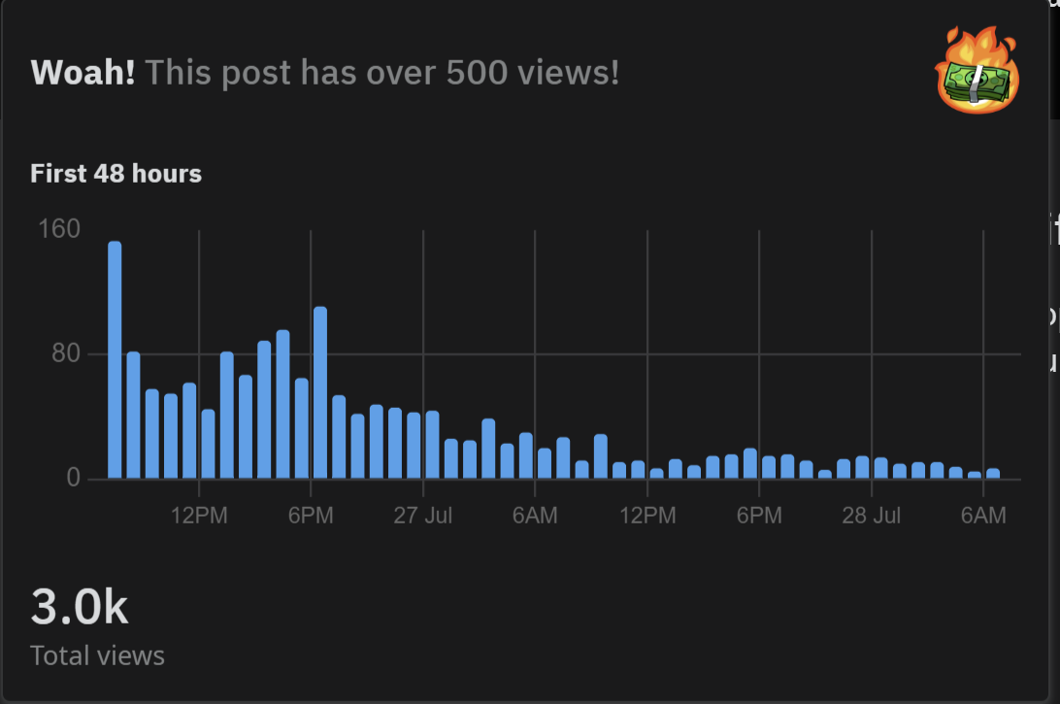
Go, change the world
RV College of
Engineering
Guidance from FSAE experts
*
Department of ECE
10

Slide 11
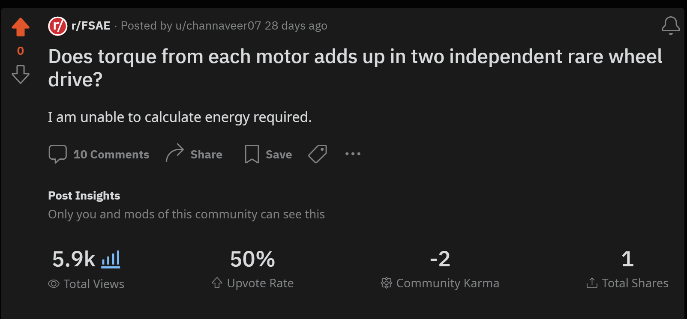
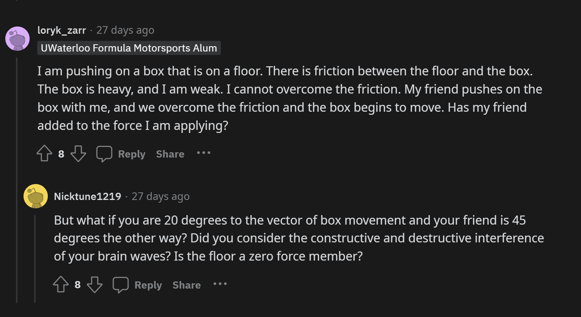
Go, change the world
RV College of
Engineering
*
Department of ECE
11

Slide 12

Go, change the world
RV College of
Engineering
DEFINE PHASE
*
Department of ECE
12

Slide 13
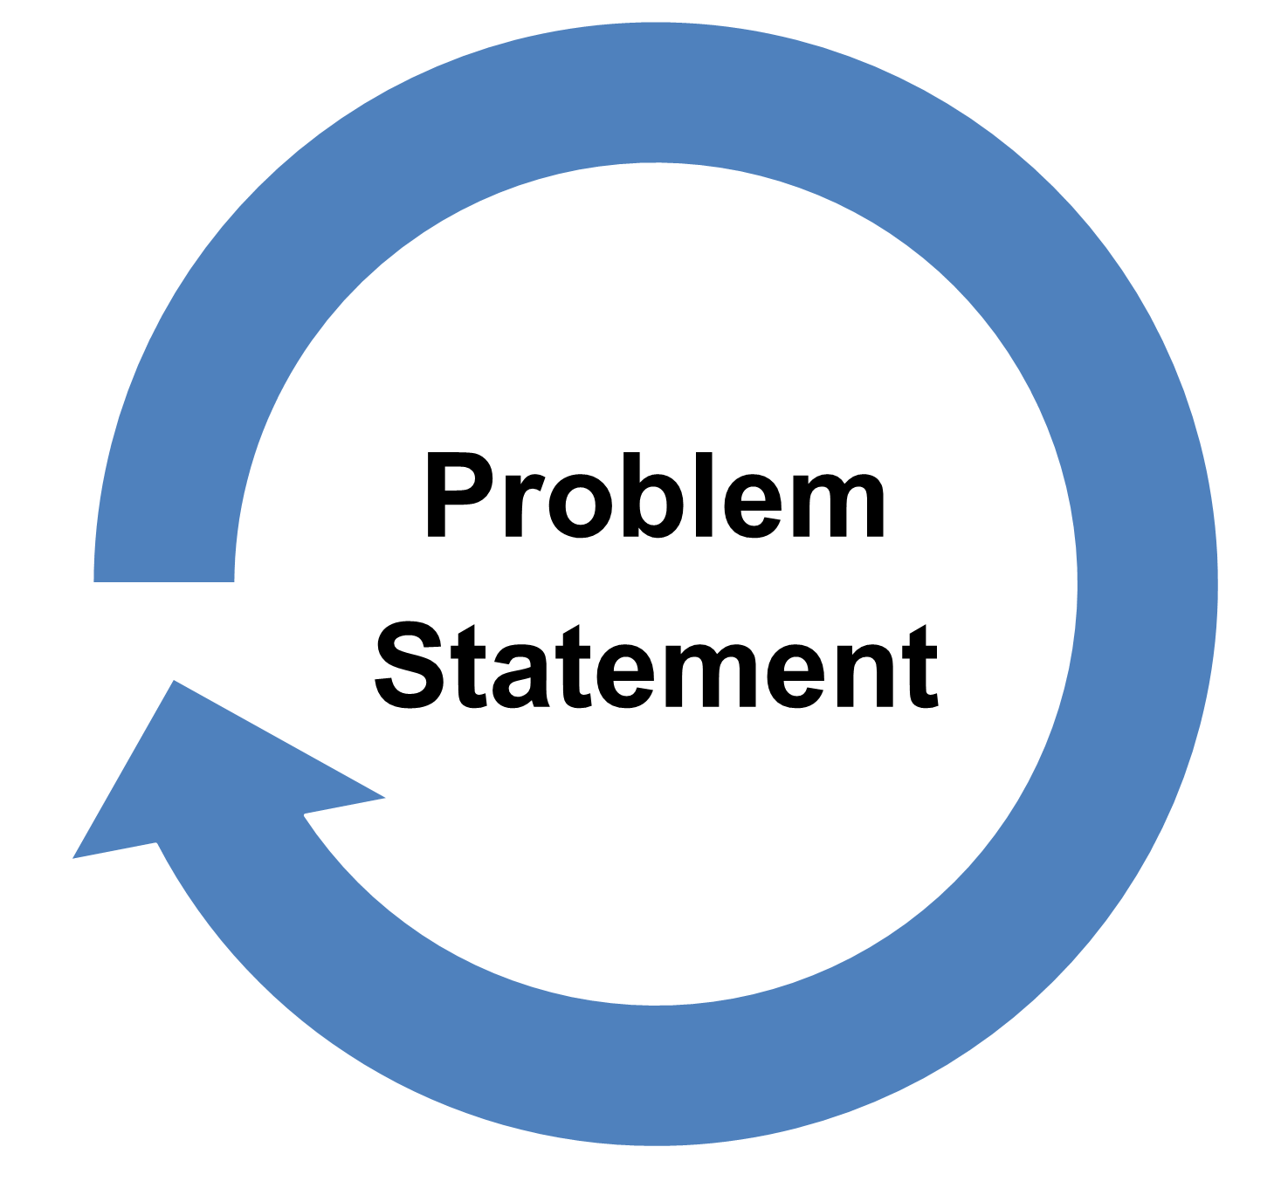
Go, change the world
RV College of
Engineering
“Design an electronic differential system to optimize torque distribution between the wheels of a vehicle, enhancing stability and control during turns.”
*
Department of ECE
13

Slide 14
Go, change the world
RV College of
Engineering
Objectives
Derive equations for the angular velocity: The equations for angular velocity is derived based on the concept of centripetal force. The equations represent angular velocity in terms of throttle and steering angle along with physical parameter of vehicle.
Mathematical Modelling: Develop a SIMULINK model for the derived equations and simulate the output i.e the speed of each motor at different throttle and steering angle.
Develop Final Model: The final model consists of a virtual steering and throttle using Arduino cloud to control the physical model of an E-vehicle. Wheel Encoders are used to verify the speed of each wheel.
*
Department of ECE
14

Slide 15
Go, change the world
RV College of
Engineering
Using an electronic differential in electric vehicles (EVs) instead of a traditional mechanical differential can offer several benefits to Society
Drivers and Vehicle Owners:
i. Improved Performance
ii. Enhanced Safety
iii. Customizable Driving Modes
q Automotive Manufacturers:
i. Technological Leadership
ii. Brand value
Environmental Impact:
i. Efficient Power Distribution
ii. Reduced Tire Wear
*
Department of ECE
15

Slide 16
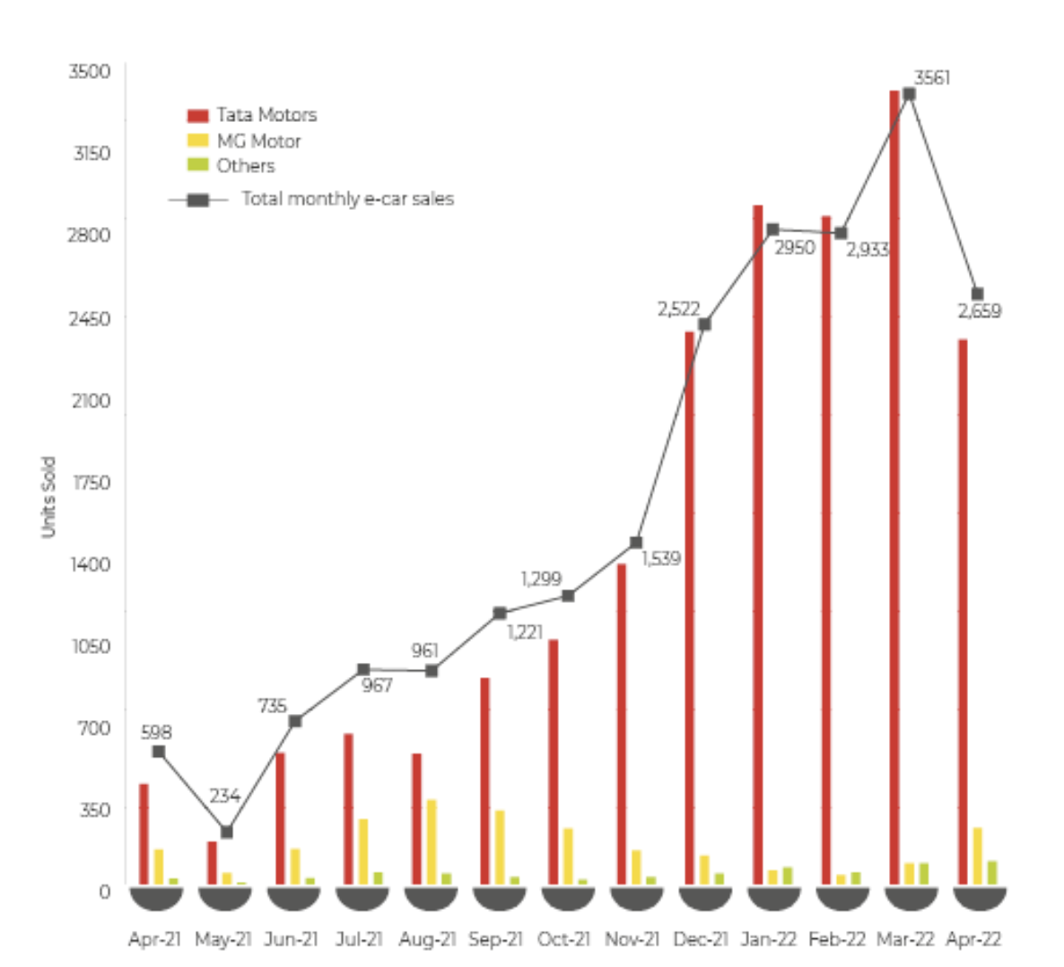
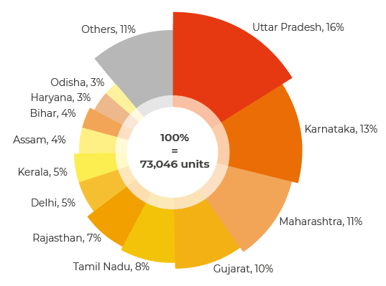
Go, change the world
RV College of
Engineering
Growth of Electrical Vehicles in India
Fig.1 Growth of Electrical Vehicles in India Financial Year-2022
*
Department of ECE
16

Slide 17

Go, change the world
RV College of
Engineering
IDEATION PHASE
*
Department of ECE
17

Slide 18
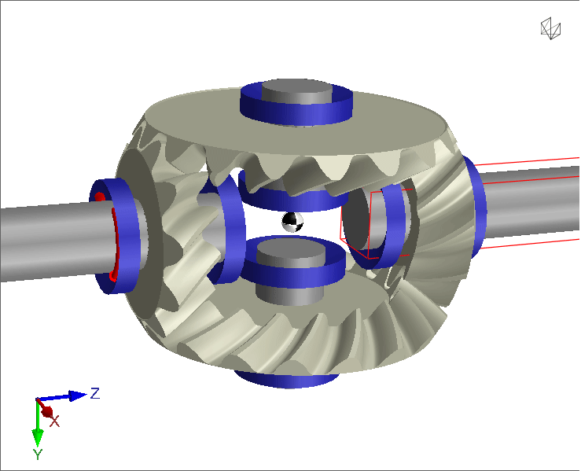
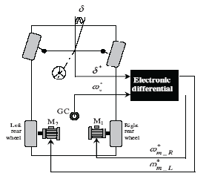
Go, change the world
RV College of
Engineering
IDEATION:
To develop an e-differential model that plays key role in delivering necessary angular velocity to different wheels.
The aim is to replace bulky mechanical differentials and provide faster turning mechanism in vehicles
Along with which reduce the power consumption as E-Diff use low power microcontrollers.
This phase is the journey through the simulation work along with the progress in hardware department.
Fig.2 Mechanical Differential
Fig.3 Electronic Differential
*
Department of ECE
18

Slide 19
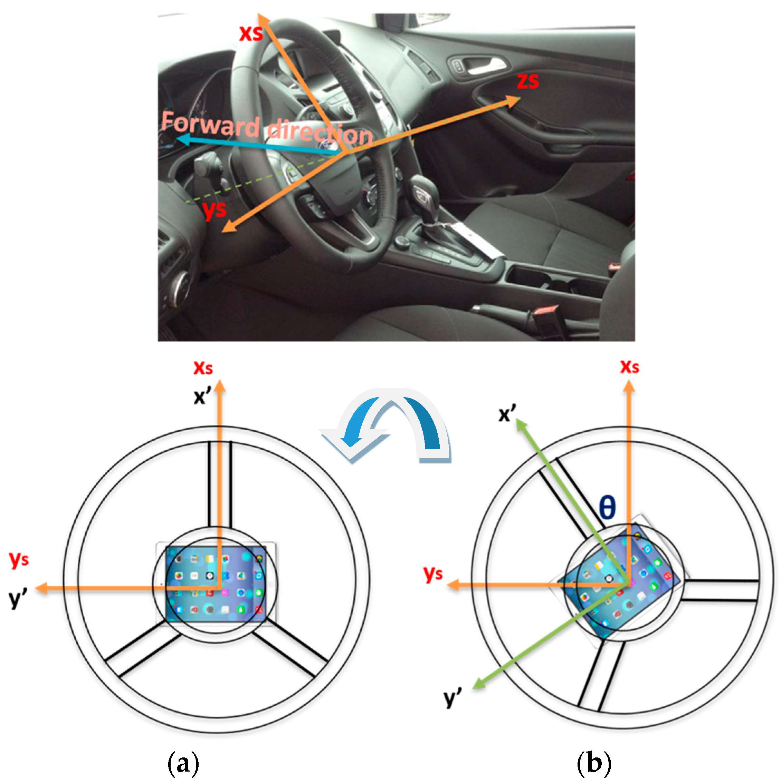
Go, change the world
RV College of
Engineering
The following equations are used to calculate the angular velocity to be given to the Wheels based on steering angle
ωl=ωv(1+d/2l * tan(ϴ))
ωr=ωv(1-d/2l * tan(ϴ))
ωl , ωr - Angular velocity of left and right wheel respectively
ωl - Throttle
d – Distance between two rear wheels
l – Distance between front and rear wheel
Fig.4 Steering Angle
*
Department of ECE
19

Slide 20
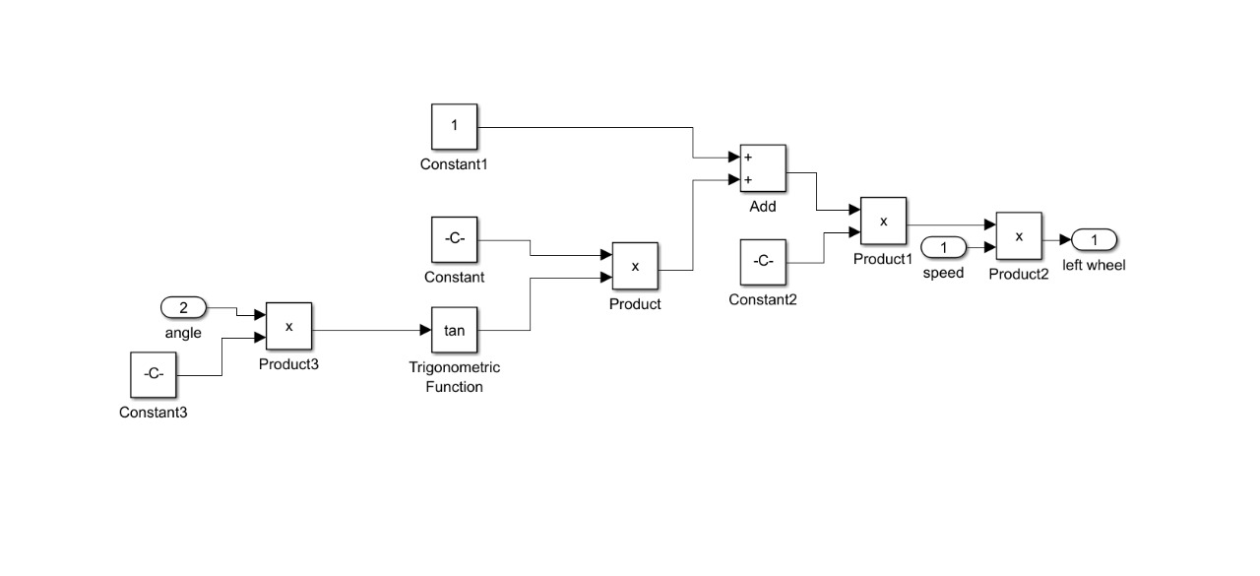
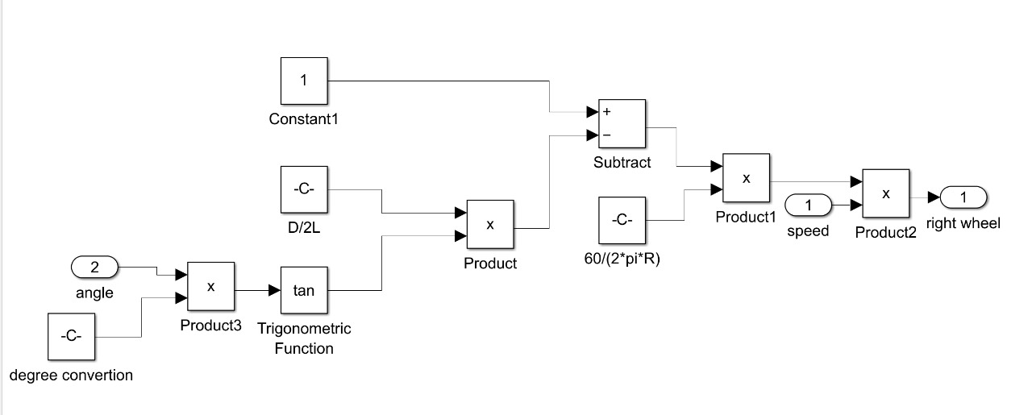
Go, change the world
RV College of
Engineering
MATLAB simulation model:
SIMULINK MODEL FOR LEFT AND RIGHT WHEEL CONTROL
Fig.5 Simulink model for left wheel control
Fig.6 Simulink model for Right wheel control
*
Department of ECE
20

Slide 21
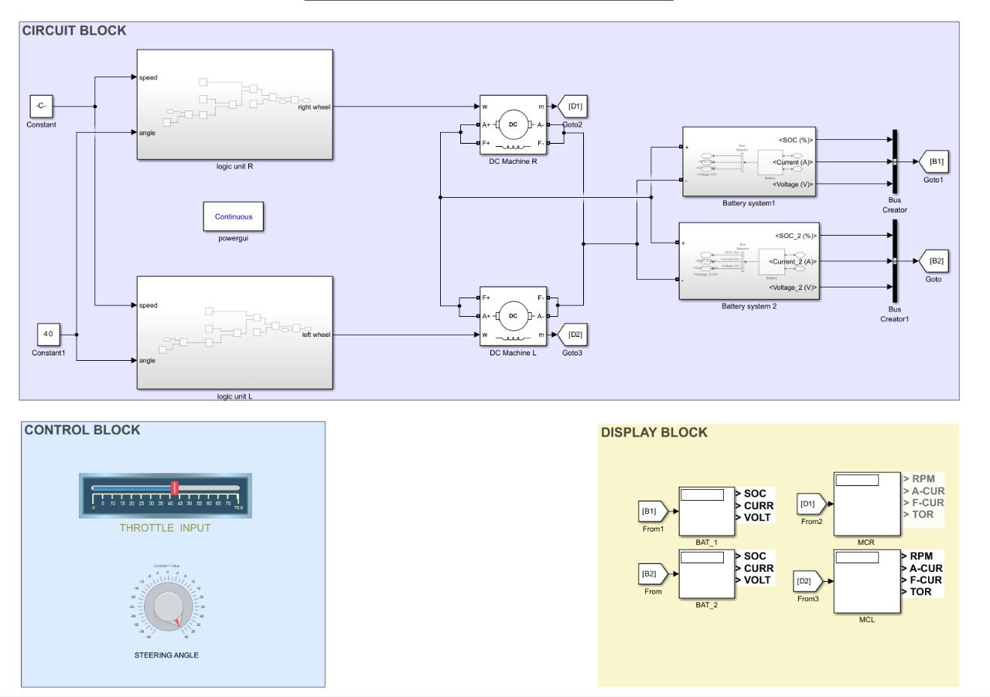
Go, change the world
RV College of
Engineering
FINAL SIMULINK MODEL
*
Fig.7 Simulink model for E-differential
21

Slide 22
Go, change the world
RV College of
Engineering
ARDUINO IOT CLOUD
LEFT MOTOR
CONTROL UNIT
WHEEL ENCODER
ωl=ωv(1+d/2l * tan(ϴ))
ωr=ωv(1-d/2l * tan(ϴ))
STEERING ANGLE
WHEEL ENCODER
RIGHT MOTOR
THROTTLE
*
Fig.7 Block diagram for proposed model
22

Slide 23
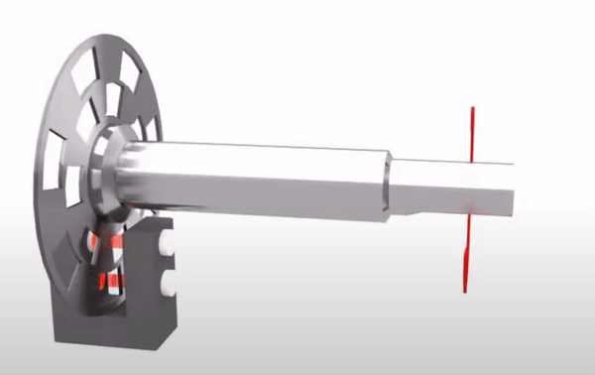
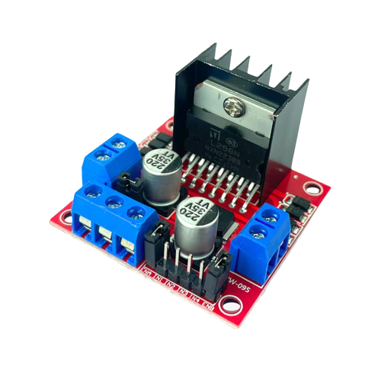
Go, change the world
RV College of
Engineering
Encoders : used in wheels, often referred to as "wheel encoders" or "rotary wheel encoders," are devices that measure the rotational motion and position of a wheel
MOTOR DRIVER: The L298 is a dual full-bridge motor driver integrated circuit (IC) commonly used to control the speed and direction of DC motors and stepper motors in robotics and automation applications.
Fig.8 Encoders
*
Department of ECE
23
Fig.9 Motor driver

Slide 24
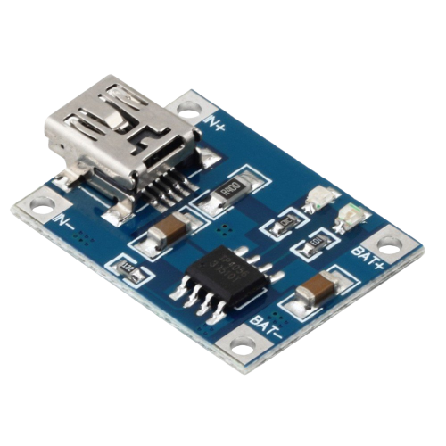
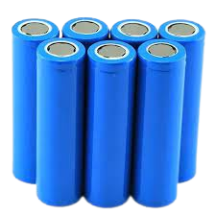
Go, change the world
RV College of
Engineering
CHARGING MODULE : The TP4056 charging module is a compact device that charges lithium-ion or lithium-polymer batteries efficiently and safely, with features like constant current and voltage charging, protection against overcharging, and LED indicators for charging status.
Li-ION BATTERY: The 18650 lithium-ion battery is a cylindrical cell format often used in various electronic devices, including laptops and power banks. Its specifications typically include a nominal voltage of 3.7V, capacity ranging from around 1500mAh to over 3500mAh, and a rechargeable design
Fig.10 Charging module
*
Department of ECE
24
Fig.11 Li-ion battery

Slide 25
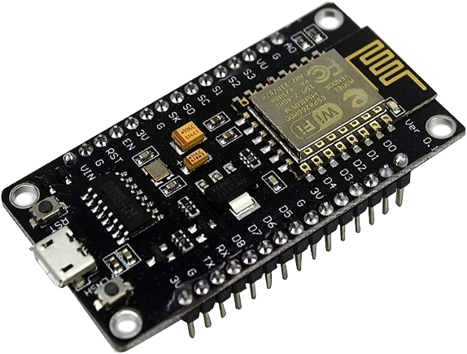
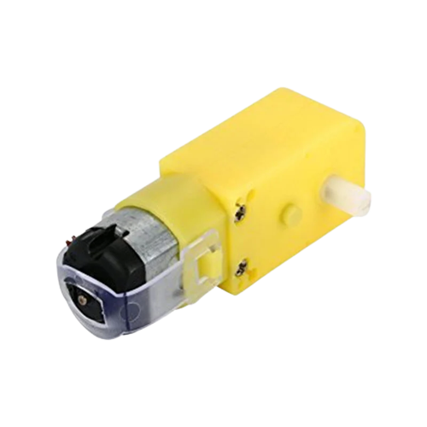
Go, change the world
RV College of
Engineering
ESP8266 :The ESP8266 is a Wi-Fi-enabled microcontroller module used for IoT and embedded applications. It enables wireless communication, sensor integration, web server hosting, and IoT device control.
DC MOTOR :A DC geared motor is a combination of a DC motor and a gearbox, providing controlled torque and speed output. It's used in various applications like robotics and automation to convert electrical energy into mechanical motion with adjustable speed and power.
Fig.12 ESP8266
Fig.13 DC Motor
*
Department of ECE
25

Slide 26
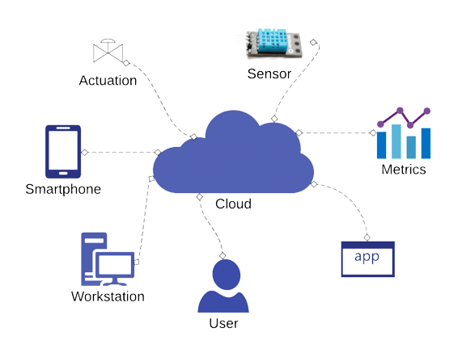

Go, change the world
RV College of
Engineering
Using Arduino Cloud Platform To Control signal
Fig.14 Arduino Cloud Platform To Control signal
*
Department of ECE
26

Slide 27

Go, change the world
RV College of
Engineering
PROTOTYPE
*
Department of ECE
27

Slide 28
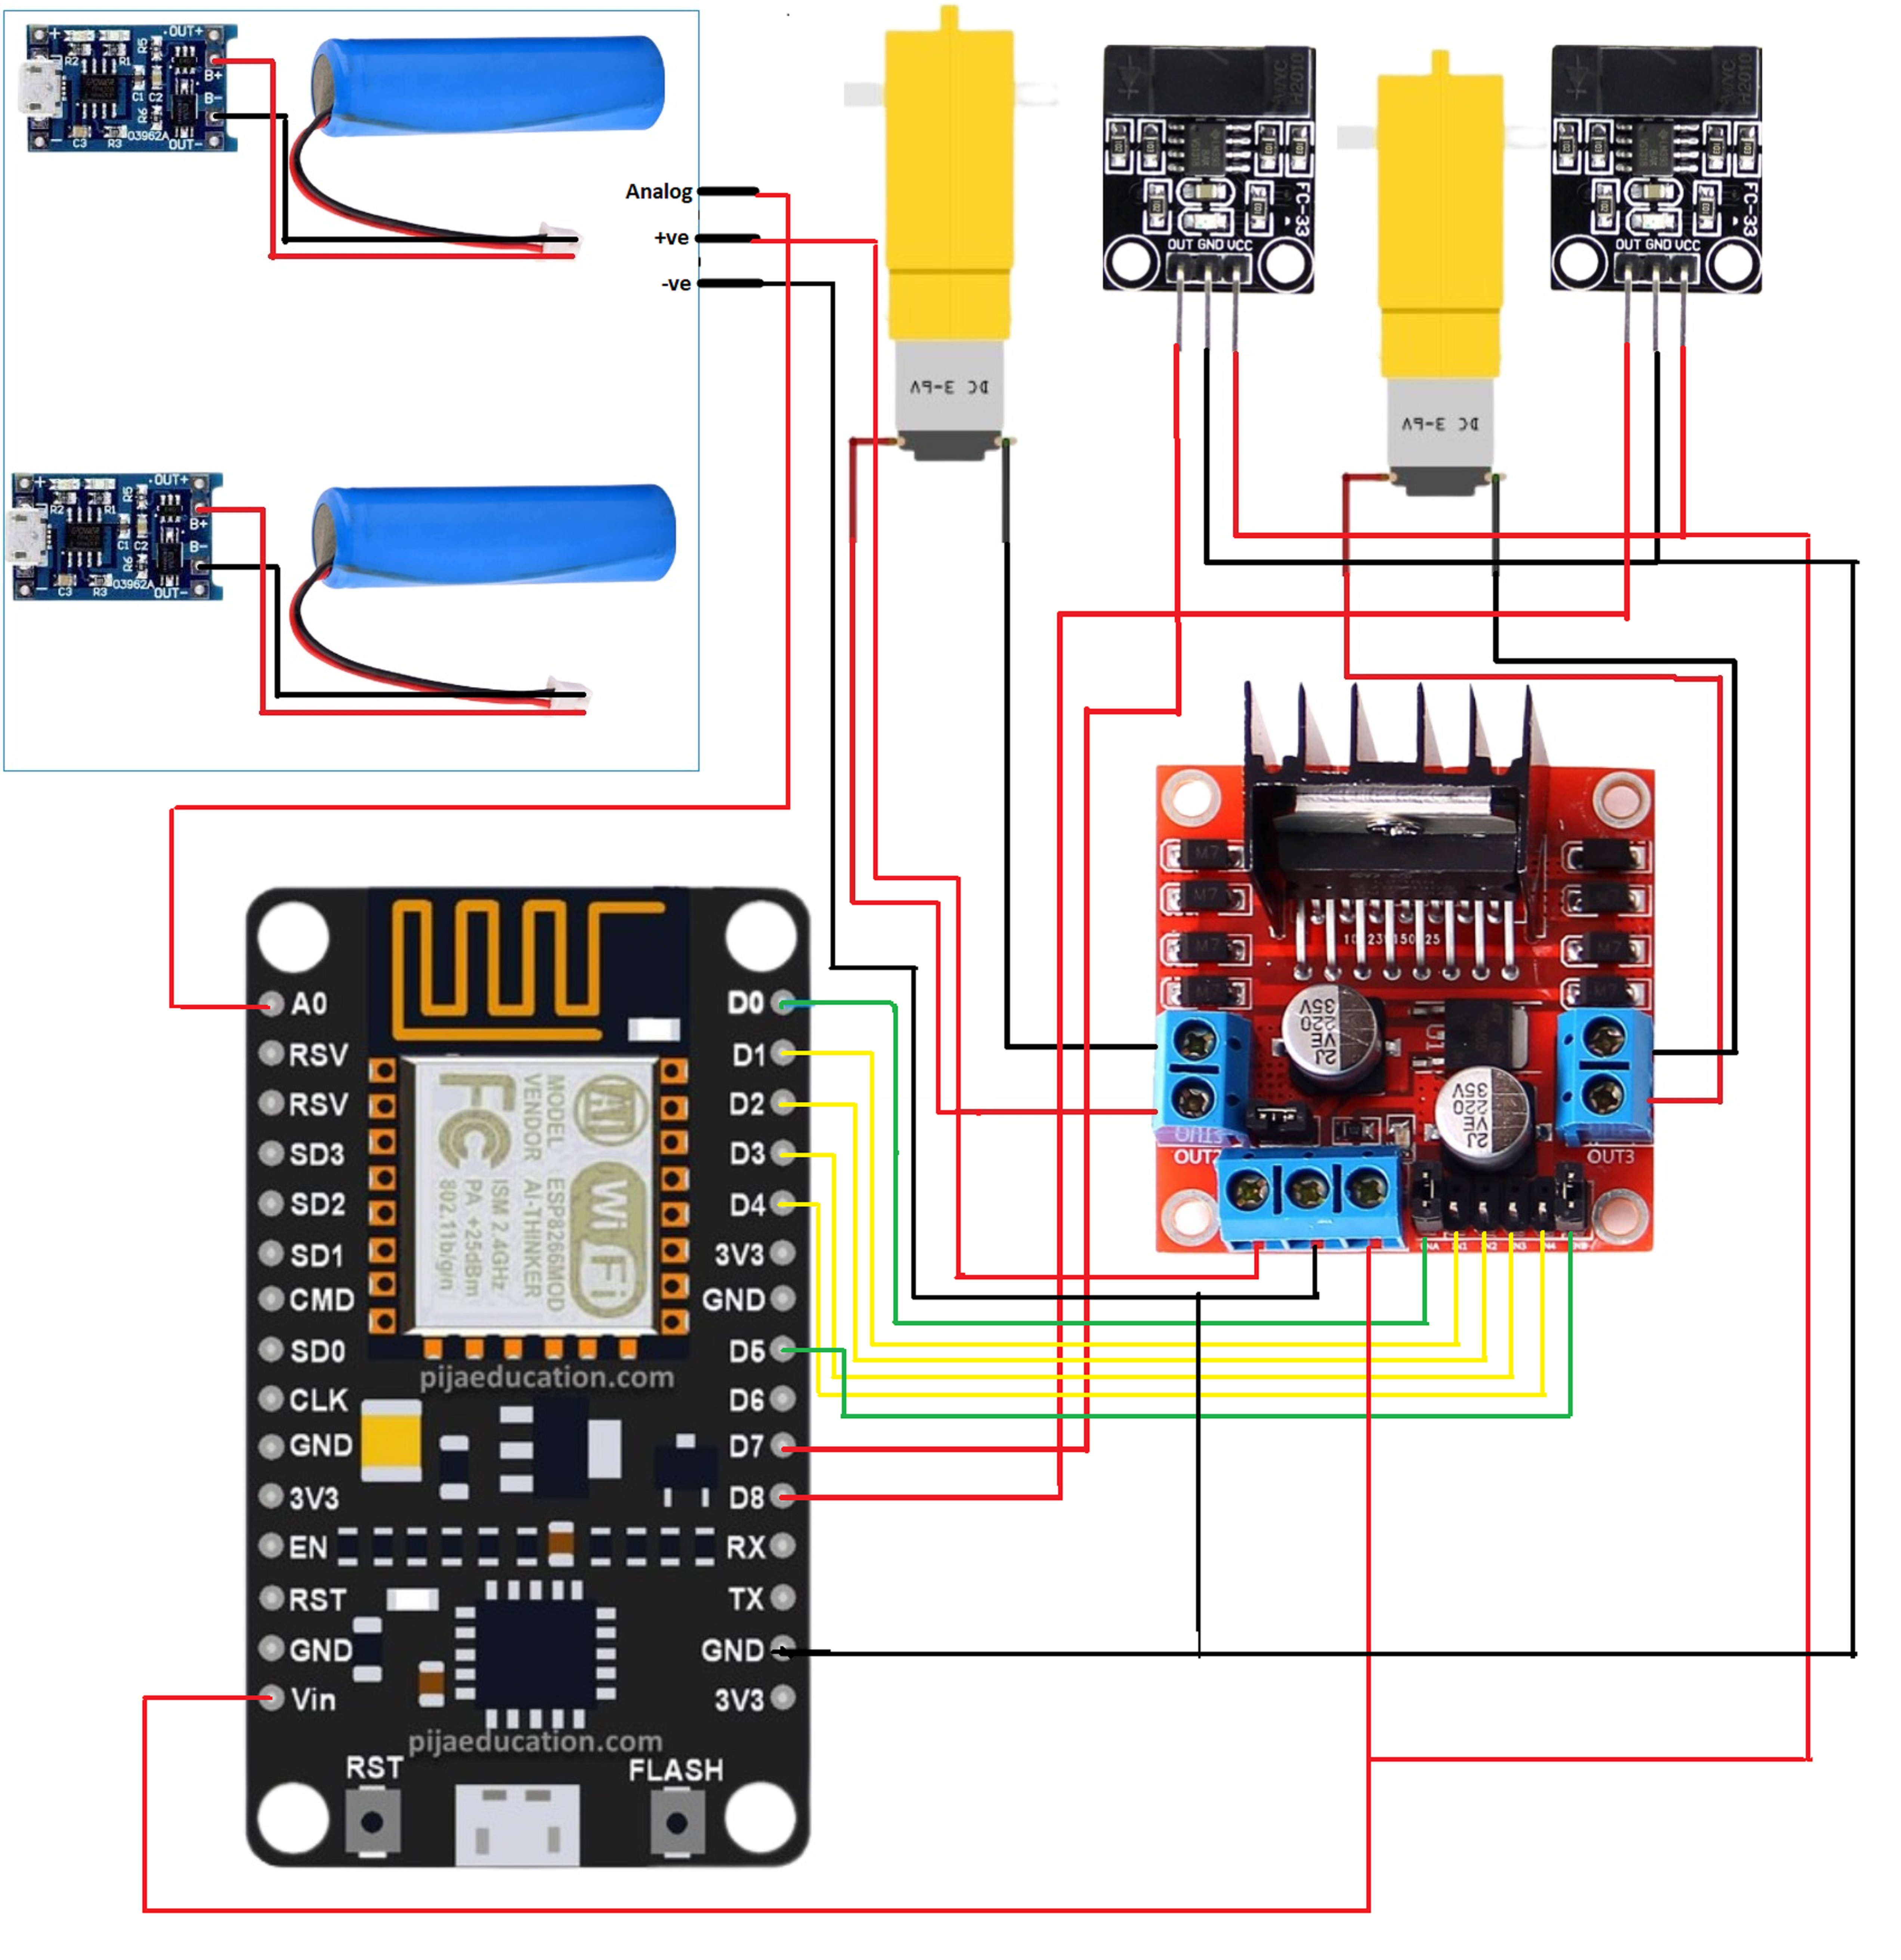
Go, change the world
RV College of
Engineering
Fig.15 Wiring diagram
*
Department of ECE
28

Slide 29
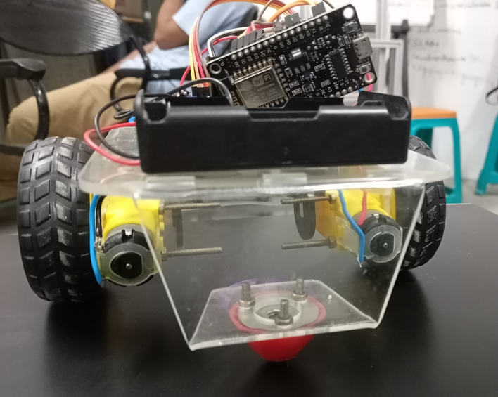
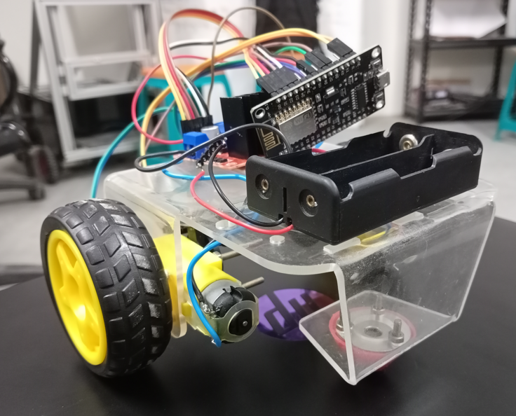
Go, change the world
RV College of
Engineering
*
Department of ECE
29

Slide 30
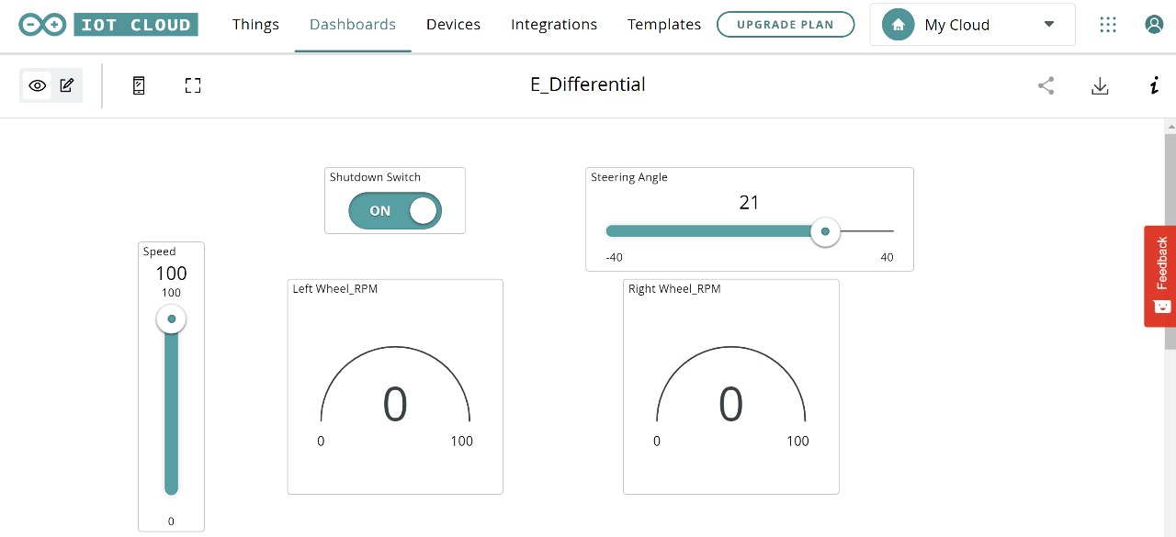
Go, change the world
RV College of
Engineering
Fig.16 Dashboard interface of Arduino cloud
*
Department of ECE
30

Slide 31
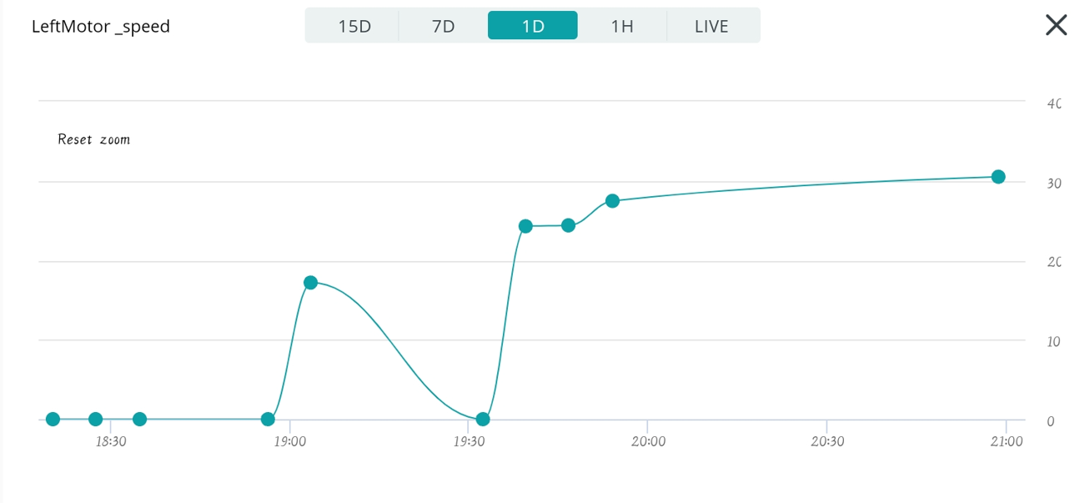
Go, change the world
RV College of
Engineering
Fig.17 Left motor speed
*
Department of ECE
31

Slide 32
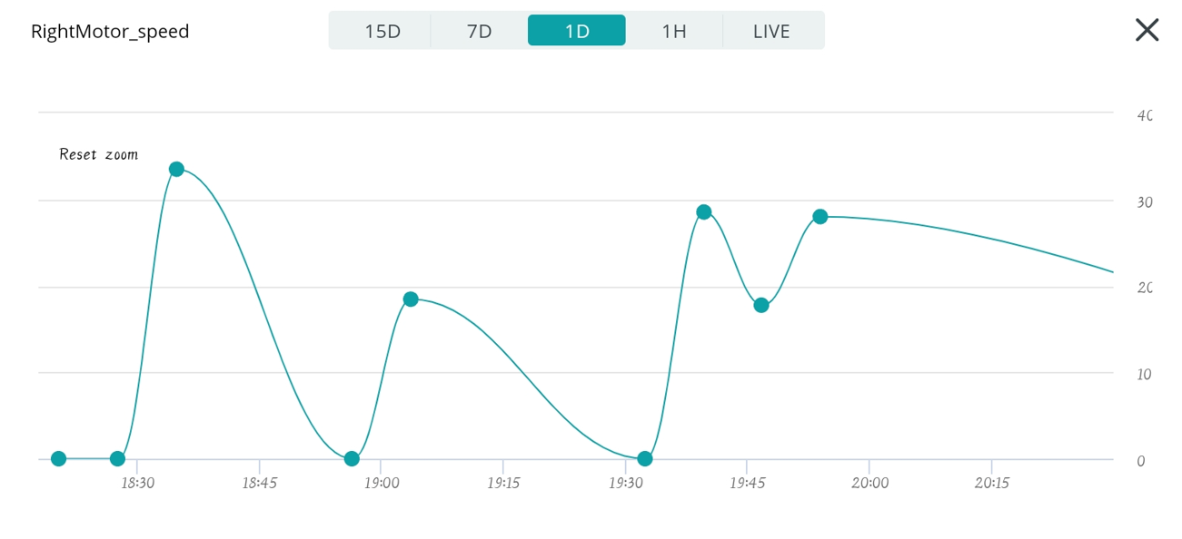
Go, change the world
RV College of
Engineering
Fig.18 Right motor speed
*
Department of ECE
32

Slide 33
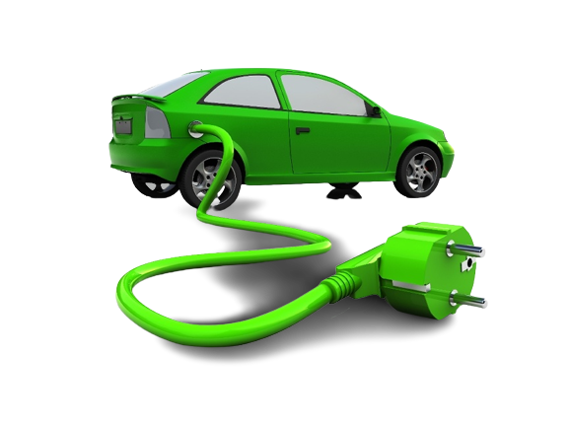
Go, change the world
RV College of
Engineering
Thank You
*
Department of ECE
33

