Slide 1

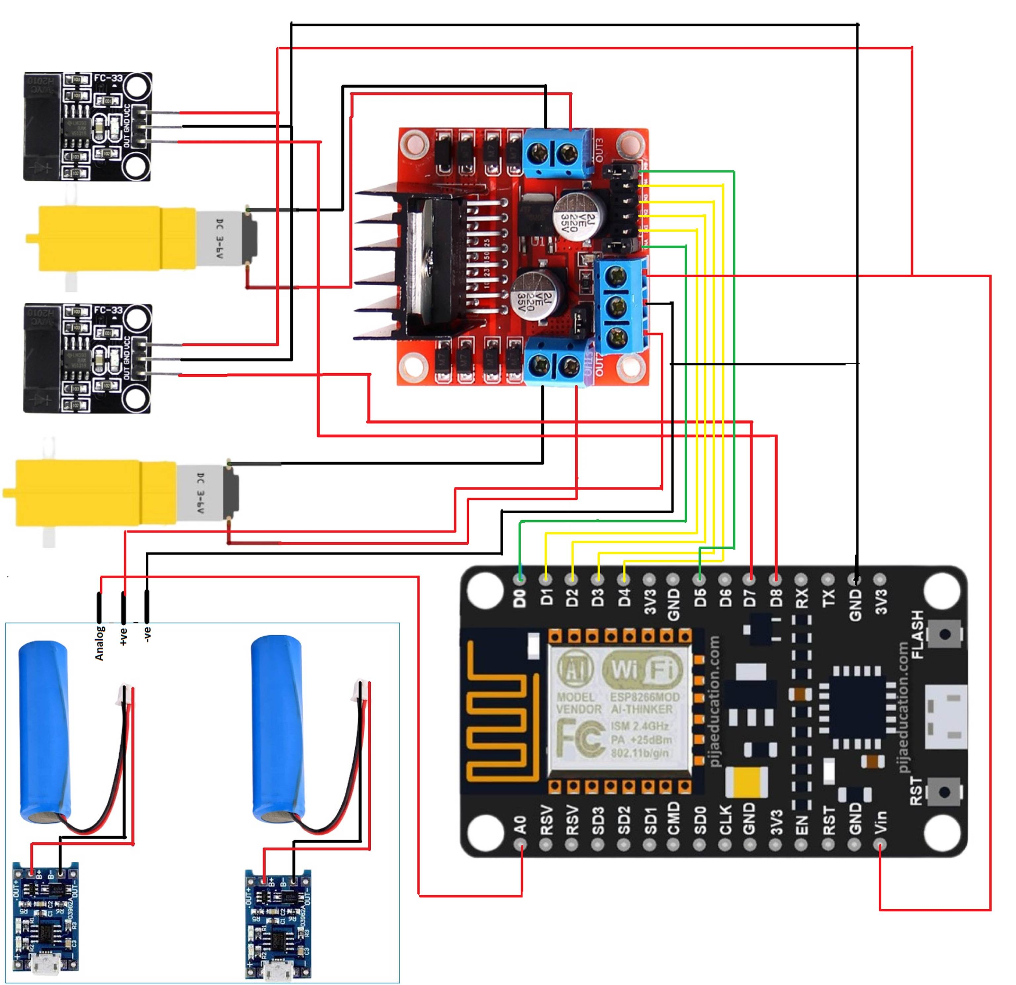
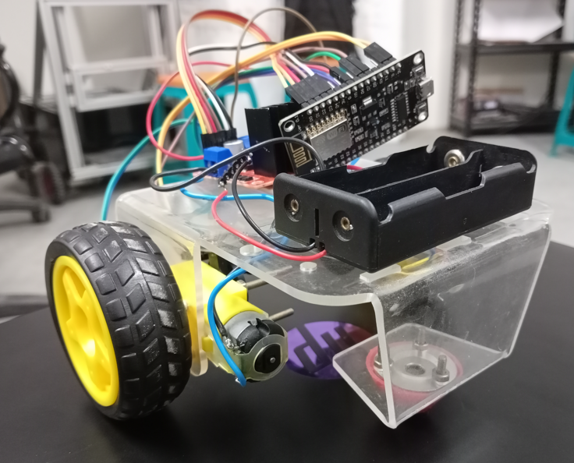
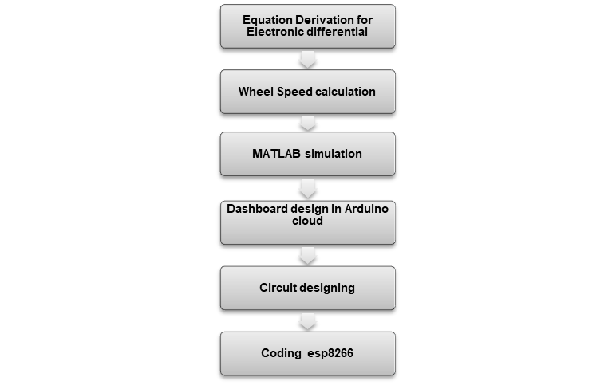
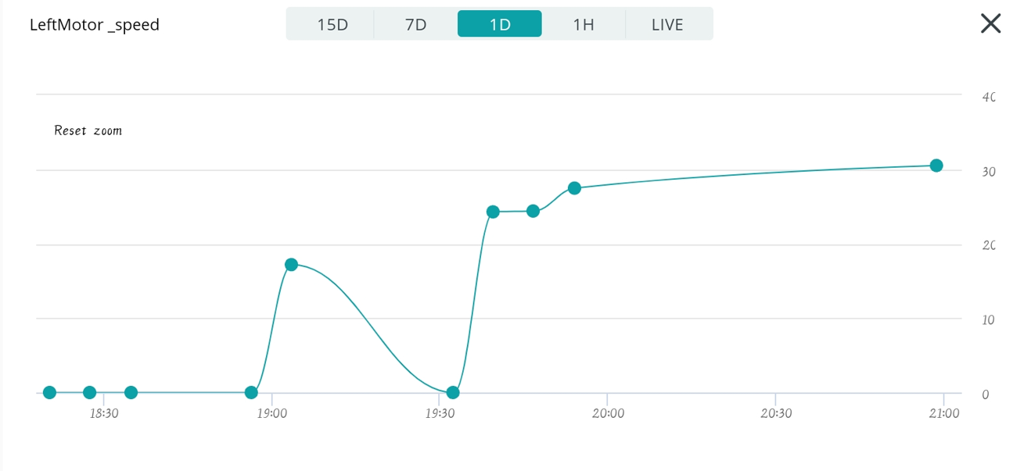
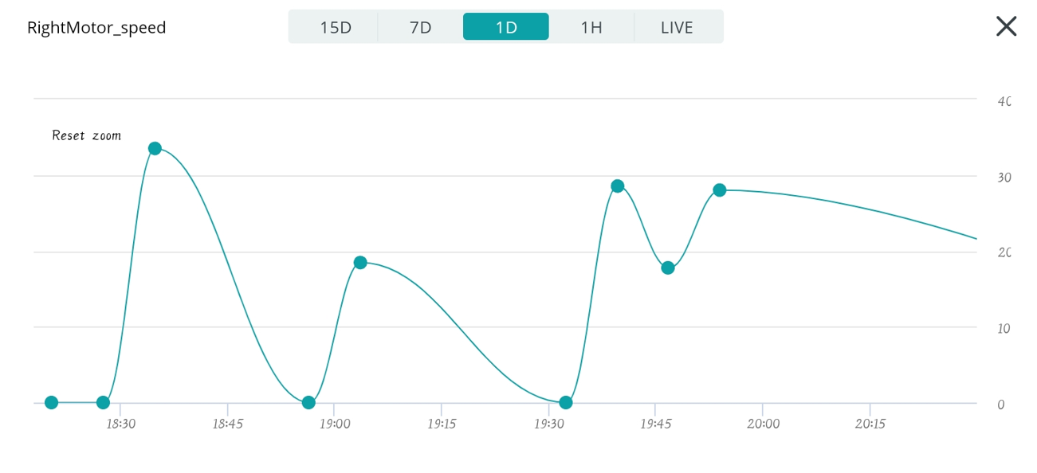
DESIGN OF AN ELECTRONIC DIFFERENTIAL FOR E-VEHICLES
DTL Guide: Prof. Anusha L S (Assistant Professor ,Department of ECE)
R.V. College of Engineering, Bangalore-59
1) ABOUT THE PROJECT
4) OBJECTIVE OF PROJECT
6) WIRING DIAGRAM
9) CONCLUSION
Development of an Electronic Differential
An electronic differential project is a cutting-edge endeavor focused on creating an advanced control system for vehicles.
Instead of traditional mechanical differentials, this project employs sensors, software algorithms, and actuators to precisely distribute power between a vehicle's wheels.
By adapting torque distribution in real-time, it enhances vehicle stability, handling, and traction, especially during cornering and challenging driving conditions.
Enhance Vehicle Performance: Improve a vehicle's handling, stability, and overall performance by replacing or augmenting mechanical differentials with an electronic control system.
Optimize Traction Control: Develop a system that can distribute power between wheels with precision, preventing wheel spin and improving traction on various road surfaces, including slippery or uneven terrain.
Reduce Mechanical Wear: Minimize wear and tear on vehicle components, such as tires, by ensuring that power is distributed evenly and efficiently among the wheels.
The development of the Electronic Differential (e-Differential) system marks a significant milestone in automotive engineering, poised to redefine the way vehicles navigate a diverse range of driving scenarios.
Through an intricate fusion of cutting-edge sensor technology and dynamic control algorithms, the e-Differential prototype has showcased its remarkable ability to intelligently distribute torque in real-time, ensuring optimal traction and stability.
This breakthrough promises to revolutionize vehicle dynamics, transcending the limitations of conventional mechanical differentials.
2) TOOLS AND TECHNOLOGIES USED IN PROTOTYPING
Fig2: Wiring Diagram
HARDWARE /SOFTWARE COMPONENTS | MODEL | SPECIFICATIONS
Microcontroller | ESP8266 | The ESP8266 is a Wi-Fi-enabled microcontroller module used for IoT and embedded applications. It enables wireless communication, sensor integration, web server hosting, and IoT device control.
Encoders | LLC3782TT | Encoders used in wheels, often referred to as "wheel encoders" or "rotary wheel encoders," are devices that measure the rotational motion and position of a wheel​.
Motor driver | L298 | The L298 is a dual full-bridge motor driver integrated circuit (IC) commonly used to control the speed and direction of DC motors .
Motor | Geared DC Motor | A DC geared motor is a combination of a DC motor and a gearbox, providing controlled torque and speed output
Arduino Cloud |  | Arduino Cloud is a user-friendly platform enabling remote control and monitoring of Arduino-based projects from any location
7) RESULTS
10) REFERENCES
[1] A.M.Guillermo, H.D.A.Cristian, B.Guillermo, G.Guillermo, “A neighbourhood electric vehicle with electronic differential traction control”, Proc. 34th Annual Conf. IEEE Ind. Electron., IEEE-IECON’08, Orlando (USA), pp. 2757-2763, 10-13 Nov. 2008.
[2] R.P. de Castro, H.S.Oliveira, J.R.Soares, N.M.Cerqueira, R.E.Araujo, “A new FPGA based control system for electrical propulsion with electronic differential”, Proc. IEEE European Conf. Power Electronics and Applications, IEEE-EPE’07, Aalborg (Denmark), pp. 1-10, 2-5 Sept. 2007.
[3] Y.E.Zhao, J.W.Zhang, X.Q.Guan, “Modelling and simulation of electronic differential system for an electric vehicle with two-motor-wheel drive”, Conf. Proc. IEEE Intelligent Vehicles Symposium, Xi'an (China), pp. 1209 – 1214, 3-5 June 2009.
[4] A. Draou, “Electronic differential speed control for two in-wheels motors drive vehicle”,Proc. IEEE 4th Intl. Conf. Power Engg. Energy Elect. Drives, IEEE-POWERENG’13,Istanbul (Turkey), pp. 764-769, 13-17 May 2013.
[5] F.Chunyun, R.Hoseinnezhad, R. Jazar, A.Bab-Hadiashar, S.Watkins, “Electronic differential design for vehicle side-slip control”, Proc. IEEE Intl. Conf. Control, Automation and Information Sciences, IEEE-ICCAIS’12, Ho Chi Minh (Vietnam), pp. 306-310, 26-29 Nov. 2012.
[6] H.Kahveci, H.I.Okumus, M.Ekici, “An electronic differential system using fuzzy logic speed controlled in-wheel brushless dc motors”, Proc. IEEE 4th Intl. Conf. Power Engg. 22Energy Elect. Drives, IEEE-POWERENG’13, Istanbul (Turkey), pp. 881-885, 13-15 May 2013.
5) METHODOLOGY
.
Fig.2 Final Prototype
Fig.5 Left motor speed
3) PROBLEM STATEMENT
The conventional mechanical differentials in vehicles often face limitations in distributing torque effectively between the wheels, especially in scenarios with varying traction conditions. This can lead to reduced maneuverability, traction loss, and compromised stability, particularly in off-road, slippery, or high-performance driving situations. To address these challenges, there is a pressing need for an advanced electronic differential system that can intelligently manage torque distribution between wheels in real-time
Fig.4 Right motor speed
8) APPLICATIONS
ωr=ωv(1-d/2l * tan(ϴ))
Electric and Hybrid Vehicles: Electronic differentials are crucial in electric and hybrid vehicles, where precise control of torque distribution between individual wheels is essential for efficient energy management and maintaining vehicle stability.
Agricultural Machinery: Tractors and other agricultural equipment use electronic differentials to optimize power distribution to the wheels, ensuring efficient operation and preventing wheel slippage when working in fields.
Construction and Mining Equipment: Large construction vehicles, such as bulldozers and excavators, loaders, employ electronic differential systems to improve their ability to navigate rugged terrains, maximize traction, and enhance safety.
ωl=ωv(1+d/2l * tan(ϴ))
ωl , ωr - Angular velocity of left and right wheel respectively
ωl - Throttle
d – Distance between two rear wheels
l – Distance between front and rear wheel
TEAM MEMBERS BIOGRAPHY
Team Members’ Name USN
Channaveeragouda 1RV21EC048
Chetan 1RV21EC050
Karthik P Shetty 1RV21EC077
Mallikarjuna A L 1RV21EC094
Branch: Electronics and Communication Engineering
Semester : 4TH (2nd Year)

