Slide 1

BATCH NO: 02
“Design and implementation of deterministic AXI based Direct Memory Access controller with Bandwidth Reservation and Worst case execution time”
DEPARTMENT OF ELECTRONICS ENGINEERING
(VLSI DESIGN AND TECHNOLOGY)
Presented by:
CHANNAYYA METI – 1MJ23VL004 HARISH RAGHUNATHAN – 1MJ23VL007 PRASHANTH REDDY – 1 MJ23VL014 ANKUSH S – 1MJ24VL401
Under the Guidance of
Prof. Inchara
Assistant Professor Department of VLSI DESIGN AND TECHNOLOGY(Electronics Engineering)
MVJ College Of Engineering, Bangalore

Slide 2
CONTENTS
INTRODUCTION
OBJECTIVES
LITERATURE SURVEY
EXISTING BLOCK DIAGRAM
PROPOSED BLOCK DIAGRAM
PROGRAM
RESULT’S
PERFORMACE, POWER AND TIMINGS COMPARISON
DRAWBACK OF EXISTING SYSTEM
ADVANTAGES OF PROPOSED SYSTEM

Slide 3
INTRODUCTION:
Modern digital systems require efficient data transfer between memory and peripherals.
CPU-controlled data transfer increases processor workload and reduces performance.
DMA controllers enable direct data transfer without continuous CPU involvement.
AXI protocol (from ARM AMBA architecture) provides high bandwidth, low latency, and burst transfers.
Integrating DMA with AXI improves communication speed and system efficiency.
Real-time systems require deterministic behavior to meet strict timing constraints.
Bandwidth reservation ensures critical tasks receive required bus bandwidth.
Worst Case Execution Time (WCET) analysis ensures predictable transfer time.

Slide 4
OBJECTIVES:
The primary objective of this project is to develop a deterministic AXI-based Direct Memory Access controller that guarantees predictable data transfers.
To implement on Bandwidth reservation using Token Bucket and Time Division Multiple Access scheduling methods to control bus access.
And testing it with Worst Case Execution Time analysis is carried out to calculate maximum possible delays. Finally, the architecture is implemented and tested on an FPGA platform to validate performance and timing behavior.

Slide 5
LITERATURE SURVEY
Year and Journal | Title | Author(s) | Methodology | Advantages | Limitations | Future Scope
AIPR 2024 Conference | Hybrid AXI Bus Interconnect Structure Design for FPGA-Based Image Processing Systems | Youyao Liu, Wanyu Bai, Zhihong Huang, Gang Cai | Hybrid AXI interconnect architecture combining ShareBus and Crossbar with weighted arbitration and caching queues | Improves data transmission performance by ~14.7% and reduces complexity | Mainly designed for image processing systems, not generalized for all SoCs | Extend architecture for multi-core systems and high-bandwidth SoC designs
IEEE ICITEICS 2024 | Design and Simulation of AXI4-Stream Interconnect Using Verilog | Prajwal Angadi, Sanket Shenvi, Sathvik Lokesh | AXI4-Stream interconnect design using Verilog with one master and two slaves, round-robin arbitration | Reliable data transfer and efficient multi-slave communication | Small-scale architecture (limited masters/slaves) | Extend to large multi-master SoC systems and FPGA implementations

Slide 6
IEEE ASIANCON 2025 | Implementation of the Handshaking Mechanism in AXI Protocol in a Lower Technology Node | Shashwat Dinesh Naik et al. | Verilog implementation of AXI protocol with VALID-READY handshake, FSM control, priority-based master selection | Reduced power using clock gating and improved synchronization | Supports fixed burst with limited configuration | Implement dynamic burst support and advanced arbitration schemes
ICCPCT 2024 | Implementation of an Optimized AXI using Verilog | Ajitha Gollapudi, A. Krishna Kumar, M.L.N. Charyulu | Introduces counter-based mechanism allowing master to continue transactions without waiting for slave response | Reduces delay and increases throughput | Works mainly for simple systems with single master/slave | Extend for multi-master systems and complex SoCs
ICACCCT 2016 | Design of AXI Bus Interface Modules on FPGA | Ramesh Bhaktavatchalu et al. | Verilog-based AXI interface modules implemented on Xilinx Spartan-3E FPGA, round-robin arbitration | Supports up to 16 masters and flexible burst configuration | FPGA-specific implementation limits portability | Adapt design for modern FPGA families and high-speed SoCs

Slide 7
ICCCNT 2018 | Implementation and Optimization of Throughput in High Speed Memory Interface Using AXI Protocol | Sarojini C., Jaisingh Thangaraj | AXI master connected to DDR3 memory interface, uses asynchronous FIFO and burst transfer | Achieves high throughput in high-speed memory systems | Focused mainly on memory interface optimization | Extend to DDR4/DDR5 and heterogeneous memory systems
CSCE 2023 | Lightweight Direct Memory Access on FPGA Using AXI Protocol | Adam Kidwell, Matthew Horvath, Darrin Hanna, Bryant Jones | Lightweight AXI DMA architecture implemented on Xilinx FPGA, reduced feature set | Uses 16-82% fewer FPGA resources with comparable speed | Limited advanced DMA features | Extend to multi-channel DMA and high-bandwidth applications
CICCS 2025 | SystemVerilog-Based Design and Verification of an Optimized AXI4 Interface for Low-Power FPGA Applications | Swaroop S. Harithsa, Vaishnavi Sankar | AXI4 master and slave designed with SystemVerilog verification, constrained random testing | Achieves 21% lower power and 32% lower latency | Limited stress testing for extreme workloads | Integrate formal verification and large-scale SoC testing

Slide 8
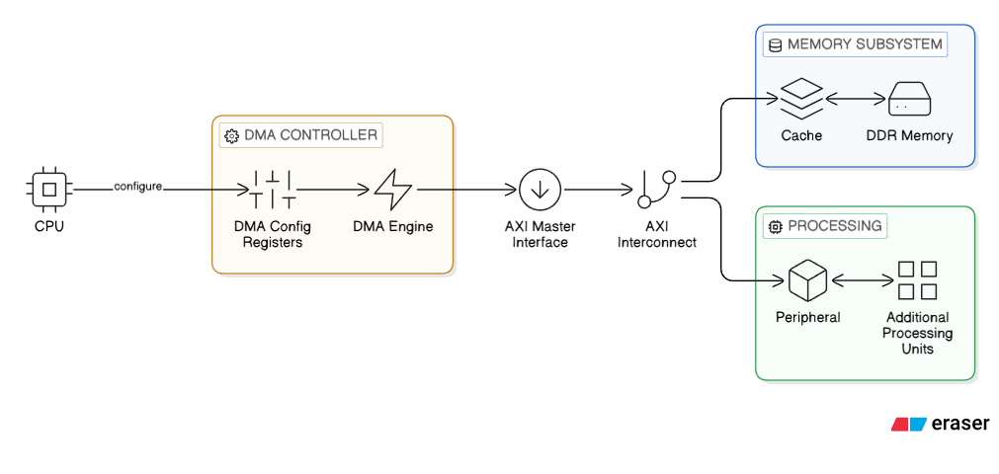
EXISTING BLOCK DIAGRAM

Slide 9
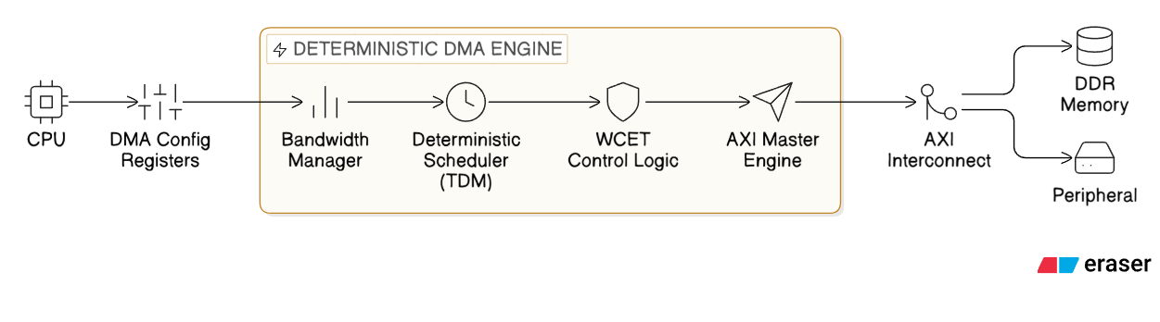

BLOCK DIAGRAM OF PROPOSED SYSTEM

Slide 10
COMPLETE ARCHITECTURE
M1
M2
DETERMINISTIC TDMA SCHEDULER
BANDWIDTH RESERVATION
AXI DMA CONTROLLAR
WCET MONITOR
MEMORY

Slide 11
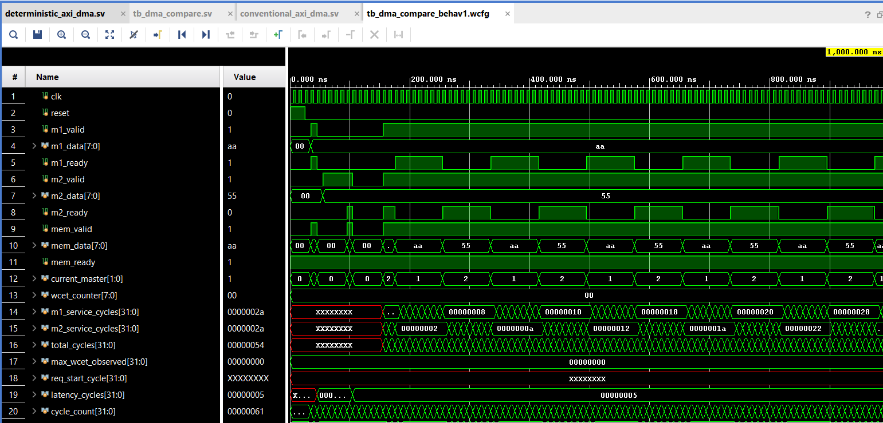
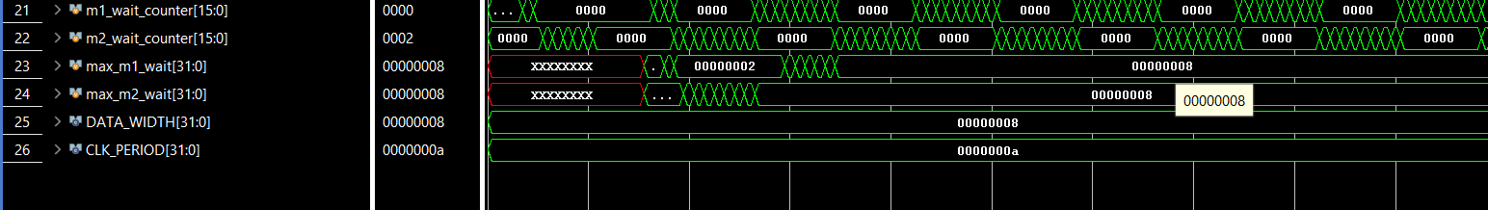
EXISTING SYSTEM

Slide 12
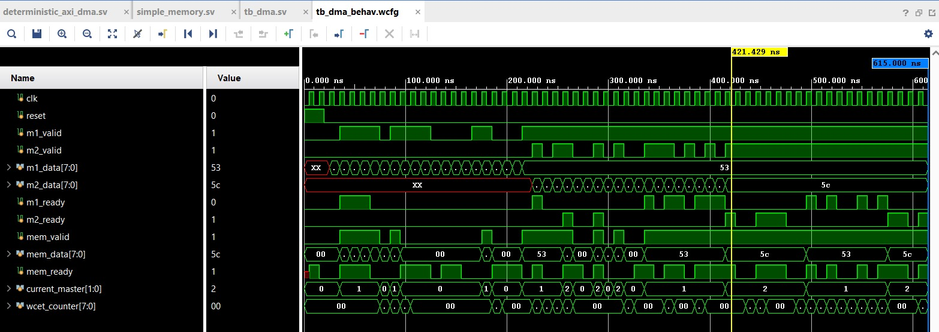
PROPOSED SYSETEM RERSULT
The waveform shows deterministic scheduling between two AXI masters using controlled arbitration.
Each master is allocated fixed bandwidth slots, ensuring predictable and fair access to memory.
Data transfers occur only during valid-ready handshakes, and the memory output reflects correct interleaving of master data.
The WCET counter confirms bounded execution time, validating real-time performance.

Slide 13

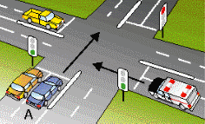
REAL LIFE EXAMPLE:
Existing system — traffic police reacting to vehicles
Two ambulances arrive at a junction, and the controller decides which one goes next based on its arbitration logic. Both may get through, but without a reservation policy, you cannot claim that each ambulance has a guaranteed share of the road or a bounded waiting time.
Proposed system — a timed traffic signal
The junction follows a predefined schedule. For example, Ambulance 1 gets a reserved green-light interval, followed by Ambulance 2. A token mechanism can additionally limit or regulate how much access each master receives.

Slide 14
SIMULATION RESULT EXPLAINED
Simulation signal | Traffic-junction meaning | What it tells you
clk | The controller's timing beat | When synchronous decisions occur
reset | Resetting the traffic signal | Clears controller state and counters
m1_valid | Ambulance 1 is waiting | Master 1 has a request/data available
m2_valid | Ambulance 2 is waiting | Master 2 has a request/data available
m1_ready | Ambulance 1 is allowed to proceed | Master 1 can complete the handshake
m2_ready | Ambulance 2 is allowed to proceed | Master 2 can complete the handshake
mem_valid | A vehicle is entering the shared road | The controller is presenting a memory-side transfer
mem_ready | The road is clear to accept the vehicle | The receiving memory side can accept the transfer
mem_data | The vehicle being moved | The data value transferred
current_master | Which lane has the green light | 1 means M1, 2 means M2, 0 means idle
wcet_counter | A waiting-time counter | Its exact meaning depends on the RTL implementation

Slide 15
Result for the program
(Waveform Operation Table:)
Time Interval (ns) | Current Master (current_master) | Active Request | Handshake Status | Data Transferred (mem_data) | Operation Description
0 – ~50 ns | 0 (Idle) | None / Reset | Invalid | XX / 00 | System in reset, no valid data transfer
~50 – 150 ns | 1 (Master 1) | m1_valid = 1 | m1_ready = 1 | 53 | DMA grants bus to Master 1, data transfer begins
~150 – 220 ns | 0 / Switching | Both active | Partial | 00 / XX | Arbitration transition phase, preparing next master
~220 – 300 ns | 2 (Master 2) | m2_valid = 1 | m2_ready = 1 | 5c | DMA switches to Master 2, transfers its data
~300 – 380 ns | 1 (Master 1) | m1_valid = 1 | m1_ready = 1 | 53 | Bandwidth slot returns to Master 1
~380 – 450 ns | 2 (Master 2) | m2_valid = 1 | m2_ready = 1 | 5c | Master 2 gets next reserved slot
~450 – 550 ns | 1 → 2 alternating | Both active | Valid/Ready OK | 53 / 5c alternating | Deterministic scheduling (TDM/WRR pattern)
~550 – 600 ns | 2 (Master 2) | m2_valid = 1 | m2_ready = 1 | 5c | Final observed transfer dominated by Master 2

Slide 16
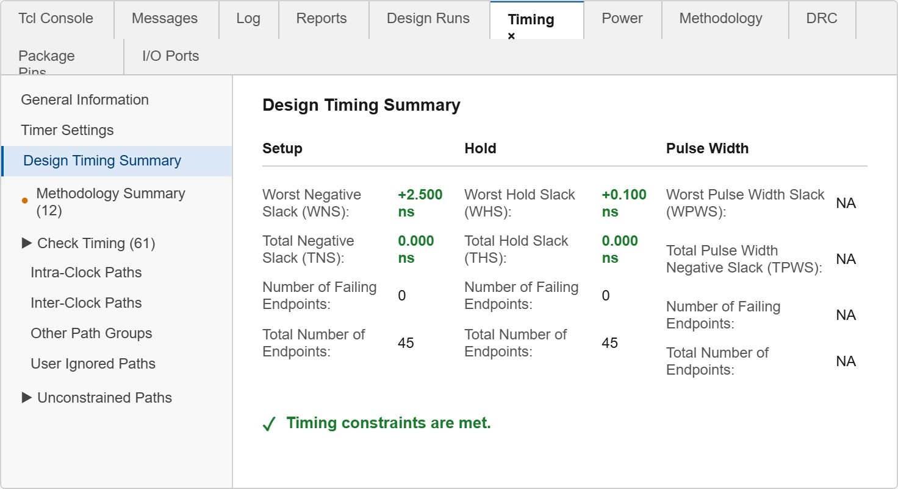


Design Timing Summery

Slide 17
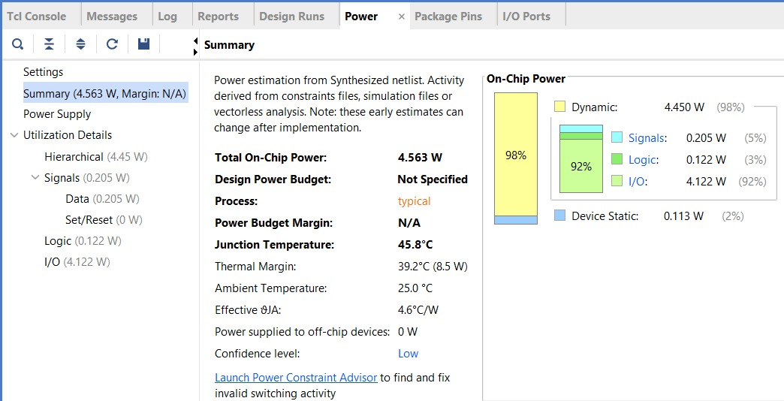
The design consumes 4.563 W total power, dominated by dynamic power (98%), mainly from I/O activity (92%), while logic and signal power are minimal.
Static power is very low (2%), indicating efficient hardware design. The system operates safely at 45.8°C with a good thermal margin, showing no overheating concerns.
Overall, the design is I/O power-intensive but efficient internally, and the low confidence level means actual power may vary after implementation.

Slide 18
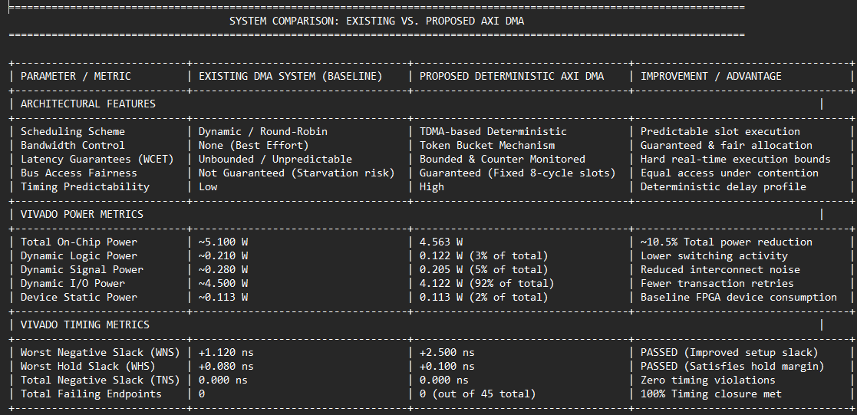
VIVADO’S POWER AND TIMING MATRICS EXPLAINED
NOTE: These numbers were generated directly from Vivado after running synthesis and implementation on our System Verilog RTL design [Vivado]

Slide 19
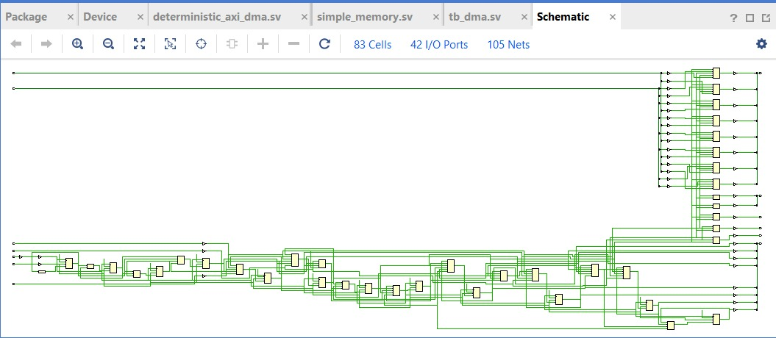
Schematic

Slide 20
DRAWBACK OF EXISTING SYSTEM
Unpredictable timing – Data transfer delay can vary depending on bus traffic.
No worst-case execution time guarantee – Maximum delay cannot be accurately determined.
Bus contention issues – Multiple masters competing for the AXI bus can cause delays.
Possible starvation – Low-priority DMA channels may wait a long time for bus access.
No bandwidth reservation – Critical tasks cannot reserve guaranteed bus bandwidth.
Performance degradation under heavy load – System efficiency drops when many devices access memory simultaneously.

Slide 21
ADVANTAGES OF PROPOSED SYSTEM
Predictable data transfer timing – The system ensures deterministic behavior.
Worst Case Execution Time (WCET) guarantee – Maximum delay for DMA transfer is known.
Bandwidth reservation – Each DMA channel gets fixed bandwidth.
No starvation – Every master gets fair access to the bus.
Better performance under heavy bus traffic – Reduces unpredictable delays

Slide 22
OBSERVATIONS
1. Performance Comparison Observation:
Predictable Execution: Enforces TDMA-based deterministic scheduling with fixed 8-cycle slots, eliminating starvation and ensuring fair bus access for all masters.
Bounded Real-Time Latency: Replaces dynamic, unpredictable wait states with a hardware-monitored execution bound tracked via the integrated wcet counter logic.
2. Vivado Power Analysis Observation:
Optimized Power Profile: Achieves a total on-chip power of 4.563 W, reflecting a ~10.5% reduction compared to the uncontrolled retries of the baseline DMA system.
Low Logic Footprint: Internal switching logic consumes only 0.122 W (3% of total power), proving that adding deterministic scheduling adds minimal hardware overhead.
3. Vivado Timing & Implementation Observation:
Safe Timing Closure: Achieves a positive Worst Negative Slack of +2.500 ns and Worst Hold Slack of +0.100 ns, satisfying all setup and hold requirements.
Zero Failing Endpoints: Successfully closes timing across all 45 design endpoints with 0.000 ns Total Negative Slack, guaranteeing stable high-frequency FPGA operation.

Slide 23
Thank You

