Slide 1



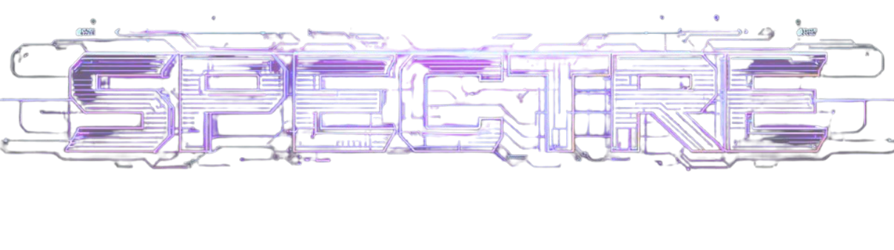
Neurobreath
Team Neurobreath
Real-Time Edge AI Lung Sound Anomaly Detection | HW-3

Slide 2

Problem Understanding
Edge detection: wheezes, crackles & stridor — zero cloud dependency
FPGA acceleration · low power · noise-resilient · no cloud
Early diagnosis: asthma, COPD, pneumonia — portable & accessible

Slide 3
Solution Overview
FPGA-accelerated edge AI for real-time lung anomaly detection — no cloud
Wearable acoustic sensor + FPGA continuously detects wheezes, crackles, stridor
Mobile app delivers real-time alerts, vitals dashboard & clinical insights

Slide 4
System Architecture /
Block Diagram
Mic → Filter → ADC → FPGA SoC → Classifier → App
Sound → Preprocess → FPGA Inference → Decision → App

Slide 5

Methodology / Workflow
1. Capture → 2. Filter → 3. ADC → FPGA
4. Breathing cycle detection & segmentation
5. Feature extraction (MFCCs) → 6. FPGA AI inference

Slide 6
Technology & Value Proposition
HW: MEMS Mic · FPGA SoC · Edge Controller · Wearable
Edge-first · FPGA · privacy-by-design · no cloud dependency

Slide 7
Methodology / Workflow — Logic Flow
Anomaly → Alert on app + log for clinician review
Normal → Update wellness dashboard with vitals
Clinician → Export & annotate waveform for review

Slide 8
Live Demo & Hardware Results
HW live: MEMS mic + FPGA · real-time classification running
Output: wheeze/crackle/normal labels · <50ms · on mobile app

Slide 9
Impact & Future Roadmap
Impact: 300M+ patients · early diagnosis · rural & accessible
Roadmap: Stethoscope → wearable → hospital IoT → clinical trials

Slide 10
Thank You
Team Neurobreath
Open for Questions & Discussion

