Slide 1

CYCLISTIC BIKE-SHARE
Rider Behavior & Trend (2026)
Presenter: Daravireak Chann
Notes:
Welcome everyone, and thank you, Lily and the executive team, for joining today. This presentation analyzes 12 months of Cyclistic trip data from 2026 to uncover how annual members and casual riders use our bikes differently. Based on these behavioral findings, we will share three targeted marketing recommendations to convert casual riders into annual members.

Slide 2
BUSINESS TASK & METHODOLOGY
Understanding Rider Differences Unlocks Membership Growth
KEY QUESTION
"How do annual members and casual riders use Cyclistic bikes differently?"
GOAL
Convert casual riders to annual members.
Data & Method
Data: 12 months of Cyclistic trip data.
Process: Cleaned and analyzed for rider patterns.
Tool: Visualized in Power BI, cleaned and processed data with python.
So what? Comparing 3.90M member rides and 2.11M casual rides reveals high-return conversion levers.
Notes:
Our primary business task is to answer how annual members and casual riders use Cyclistic bikes differently, with the clear marketing goal of converting casual riders into annual members. To build a reliable foundation, we examined 12 months of Cyclistic trip data totaling 6.01 million rides. The dataset was thoroughly cleaned, analyzed across time and bike types, and visualized in Power BI.

Slide 3
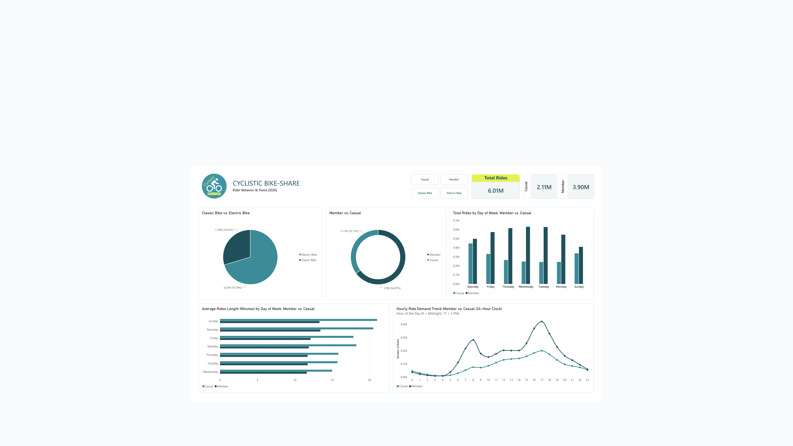
POWER BI DASHBOARD OVERVIEW
Annual Members Generate 64.87% of 6.01M Total Rides
6.01M
Total Rides (3.90M Member)
64.87%
Member Share (35.13% Casual)
70.39%
Electric Share (4.23M Rides)
So what? 2.11M casual trips (35.13%) represent a large, active audience for annual membership conversion.
Notes:
This Power BI dashboard gives a complete view of 6.01 million total rides recorded over the 12-month period. Annual members account for 3.90 million rides, or 64.87 percent, while casual riders represent 2.11 million rides, or 35.13 percent, and electric bikes make up 70.39 percent of all trips. With over two million casual trips already taking place, converting even a modest share of casual riders will drive substantial membership growth.

Slide 4
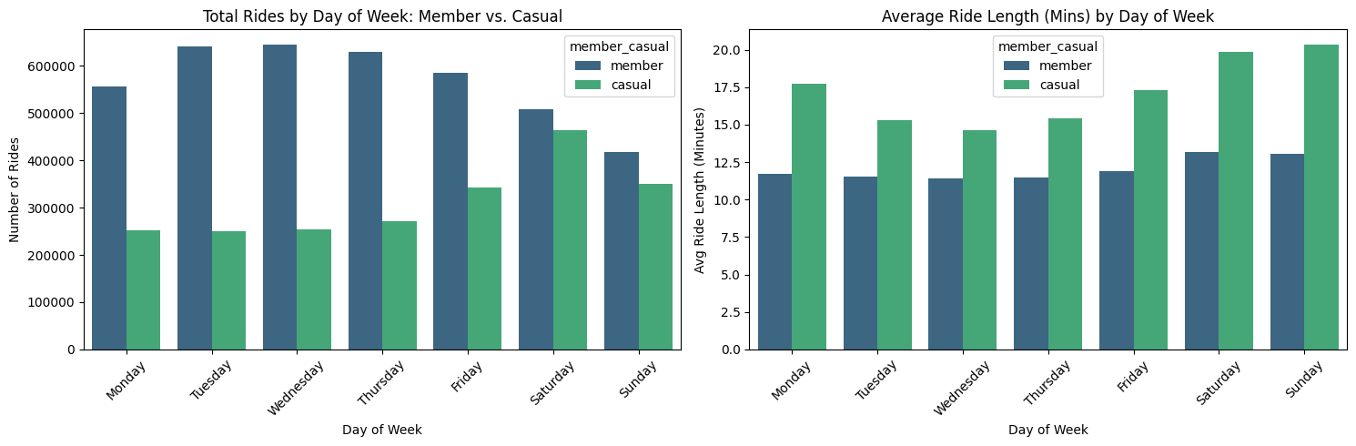
WEEKLY DEMAND PATTERN
Members Ride 2x More Mon-Thu; Casuals Peak on Saturday
0.45M Saturday Casual Peak
Weekday Gap: Members ride ~2x more Mon-Thu (0.55M-0.64M vs. 0.25M-0.27M), narrowing Friday.
Weekend Surge: Casual rides climb on weekends and peak Saturday (0.45M), nearly matching members (0.50M).
Strategy: Target casual riders with weekend membership offers when Saturday demand peaks.
Notes:
Weekly trip volume reveals a sharp contrast between weekday and weekend behavior. Annual members ride roughly twice as often as casual riders from Monday through Thursday, between 0.55 million and 0.64 million trips daily, before the gap narrows on Friday. Casual ridership climbs sharply on weekends and peaks on Saturday at about 0.45 million rides, nearly matching the 0.50 million member rides.

Slide 5
AVERAGE RIDE DURATION
Casual Riders Take Longer Rides in Time, Especially Weekends
20-21 Minutes Weekend Rides
Longer Rides in Time: Casuals average 15-18 min weekdays and 20-21 min Sat/Sun vs. 11.5-13 min for members (time, not distance).
Interpretation: Leisure and exploring vs. routine member trips.
So what? Show casual riders how membership lowers per-minute costs on longer weekend rides.
Notes:
When we examine average ride duration, casual riders consistently take longer rides in time than annual members on every day of the week. Casual rides average 15 to 18 minutes on weekdays and 20 to 21 minutes on Saturday and Sunday, compared to a steady 11.5 to 13 minutes for members. Because this metric captures longer rides in time rather than distance, it points toward leisure and city exploration versus short routine trips.

Slide 6
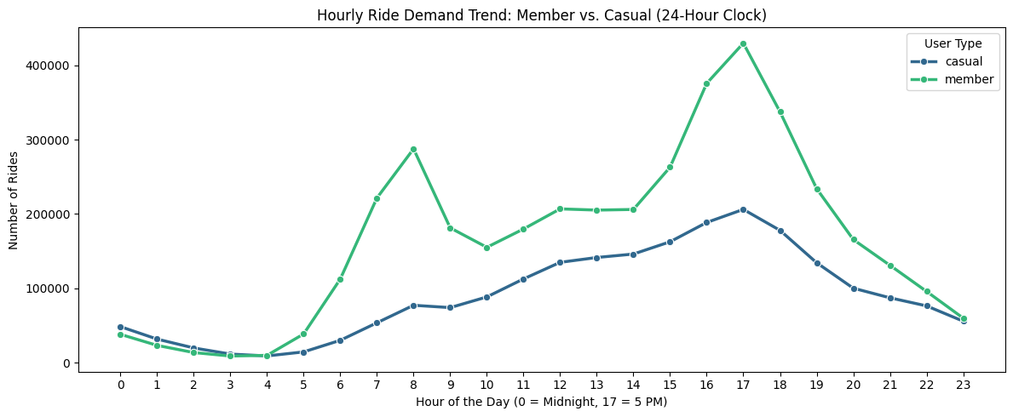
HOURLY DEMAND PATTERN (24-HOUR CLOCK)
Members Peak at Commute Hours; Casuals Ramp Steadily to 5 PM
Likely Usage Explanations
Member Peaks: 8 AM (0.29M) and 5 PM (0.42M) peaks with a 0.2M midday plateau suggest commuting.
Casual Ramp: Rises from 5 AM to a 5 PM peak (0.2M) and exceeds members 12-3 AM, suggesting leisure (likely explanations, not proven facts).
So what? Time digital ads and station promos for midday through the 5 PM casual peak.
Notes:
Hourly ride demand highlights two distinct daily rhythms, which we interpret as likely explanations rather than proven facts. Annual members peak sharply at 8 AM with about 0.29 million rides and 5 PM with about 0.42 million rides alongside a 0.2 million midday plateau, matching typical commuting hours. Meanwhile, casual rides climb steadily from 5 AM to a single 5 PM peak of about 0.2 million rides and slightly exceed member rides from midnight to 3 AM, consistent with leisure activity.

Slide 7
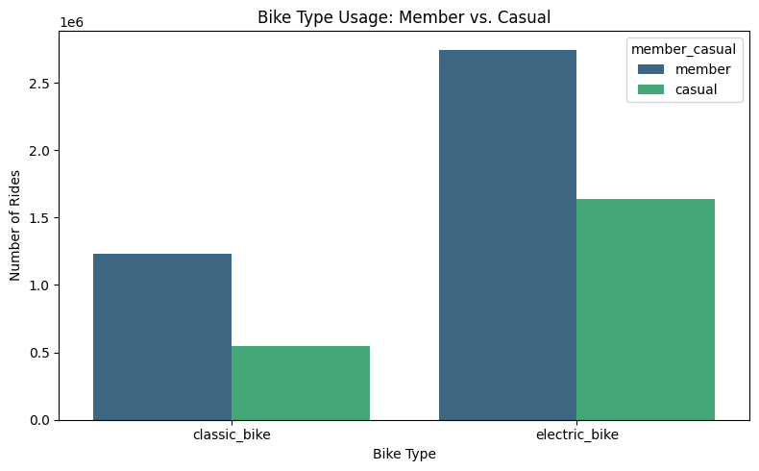
BIKE TYPE PREFERENCE
Electric Bikes Account for 70.39% of All Cyclistic Rides
4.23M Electric Rides (70.39%)
Fleet Split: Electric bikes drive 4.23M rides (70.39%) vs. 1.78M classic rides (29.61%).
Selling Point: E-bikes are popular with everyone, making electric perks a strong membership hook.
So what? Feature discounted e-bike unlocks as a headline annual membership benefit.
Notes:
Across the entire 6.01 million ride dataset, electric bikes dominate with 4.23 million rides, or 70.39 percent, compared to 1.78 million rides, or 29.61 percent, on classic bikes. Alongside our 3.90 million member rides and 2.11 million casual rides, high e-bike adoption shows that electric bikes are popular with everyone. Promoting e-bike perks as a core membership benefit therefore gives casual riders a strong incentive to convert.

Slide 8
Three Actions to Convert Casual Riders
Turning casual riders into annual members: each action is tied to the data and has a metric to track.
1
2
3
Launch a Weekend Membership Offer
Show Riders What They Could Save
Make E-Bikes a Member Perk
Promote a weekend or flexible plan to casual riders on the days they ride most.
Send in-app and email prompts after long rides comparing what they paid with membership cost.
Feature discounted e-bike unlocks as the headline membership benefit.
WHY (THE DATA)
WHY (THE DATA)
WHY (THE DATA)
Saturday casual rides peak at 0.45M, nearly matching members (0.50M).
Casual rides average 15–21 min vs. 11.5–13 min for members.
70.39% of all rides (4.23M) are on electric bikes.
METRIC TO TRACK
METRIC TO TRACK
METRIC TO TRACK
Weekend casual-to-member conversion rate.
Prompt click-through and sign-ups after long rides.
E-bike share of new member sign-ups.
Notes:
To convert casual riders into annual members, we recommend three actions, each tied to a pattern in our data. First, launch a weekend or flexible membership offer, because casual rides peak on Saturday at about 0.45 million, almost level with members. We would track the weekend conversion rate. Second, send in-app and email prompts after long rides that compare what the rider paid with the cost of membership, because casual riders average 15 to 21 minutes per ride against 11.5 to 13 for members. We would track click-through and sign-ups. Third, make discounted e-bike unlocks the headline member perk, because 70.39 percent of all rides are electric. We would track e-bike share among new sign-ups. Our next step is to pilot these offers and analyze seasonality and start-station data to target the campaigns.

