Slide 1
Optical Flow
Chao Duan, Xuan Yang

Slide 2
Basic idea
Correlation-based
optical flow
Differential-based and Dense optical flow
Optical Flow

Slide 3
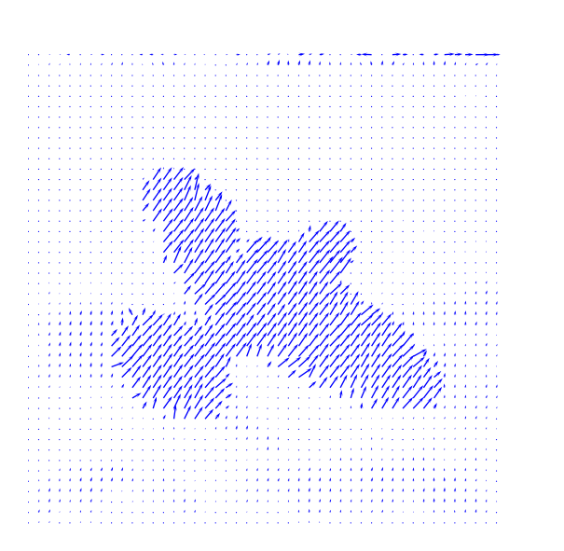
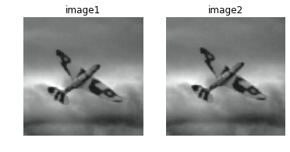
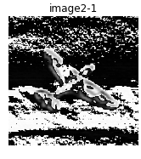
Basic idea
Motion detecting result
( original image1and image2 are captured from [1] )

Slide 4
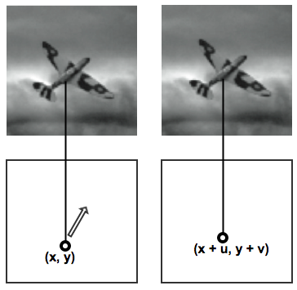
Basic idea
Important assumption
1. Constant brightness
2. Similar velocity for a block
3. Small displacement

Slide 5
Correlation-based

Slide 6
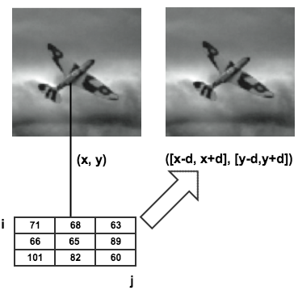
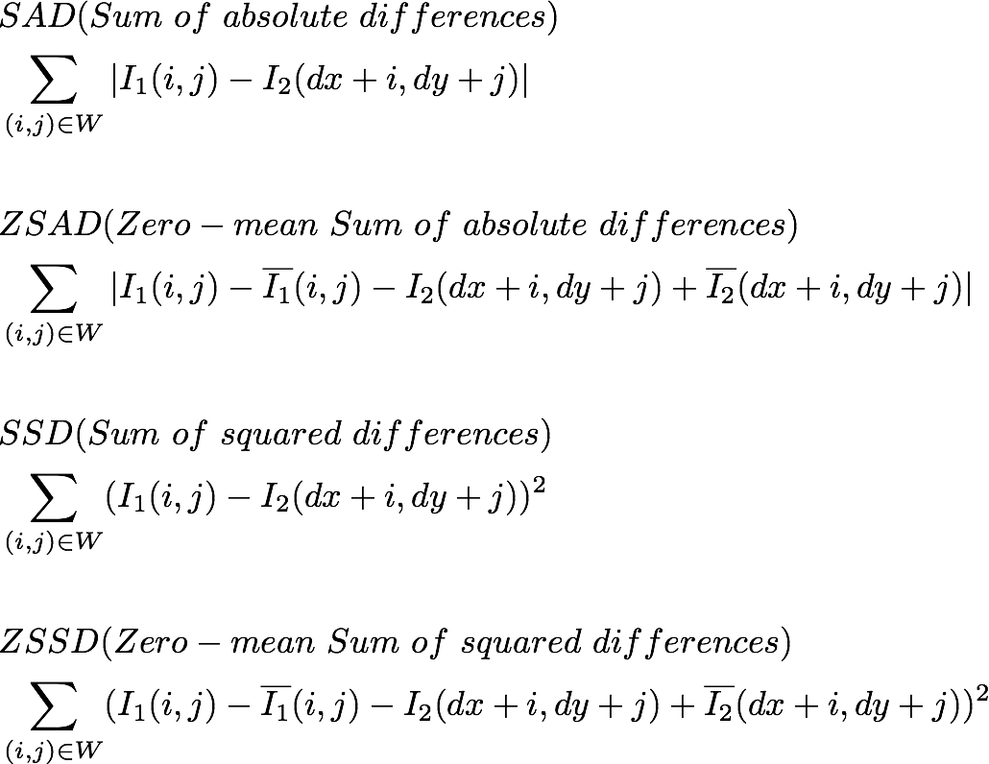

Correlation
Differences measure methods:

Slide 7
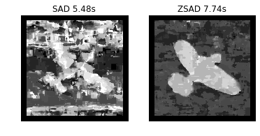
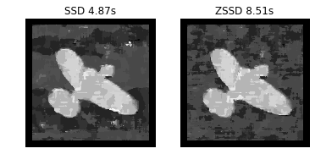
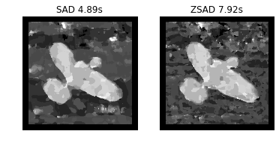
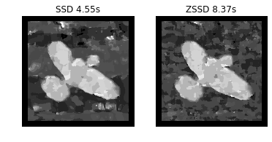
Correlation
No Gaussian filter:
With Gaussian filter:

Slide 8
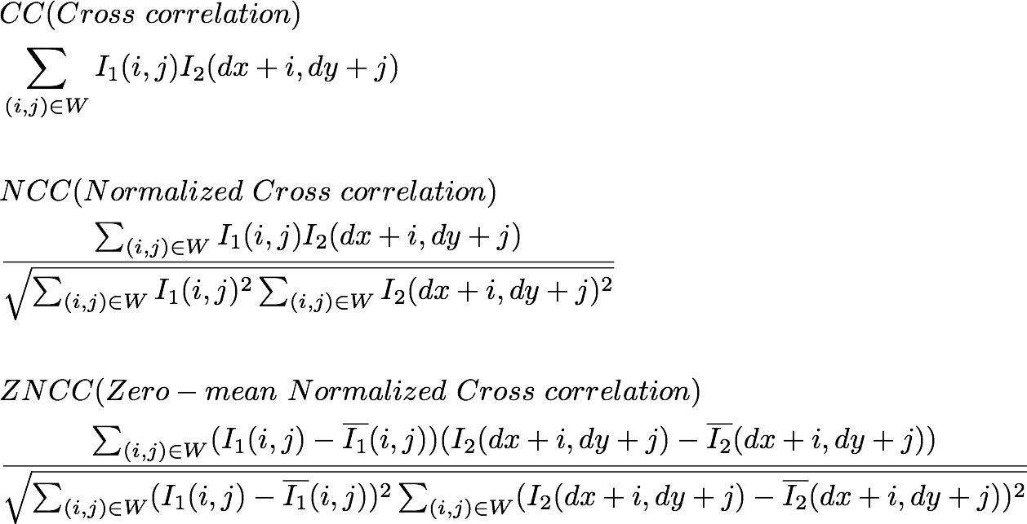
Correlation
Similarity measure methods:

Slide 9
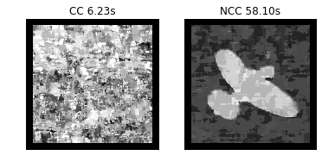
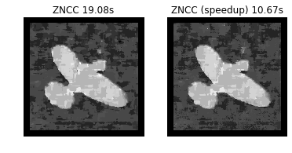
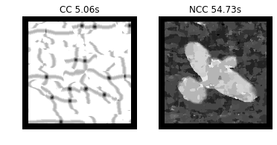

Correlation
No Gaussian filter:
With Gaussian filter:

Slide 10
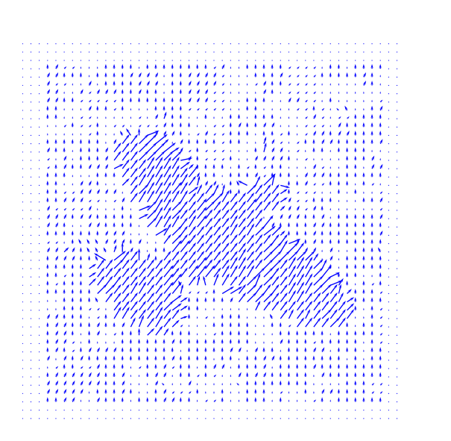
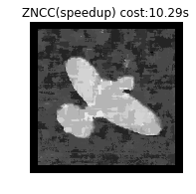
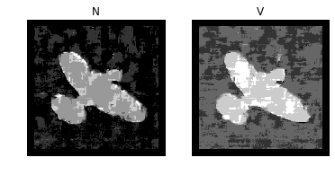
Belive me I am flying!

Slide 11
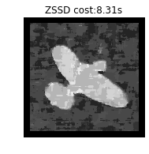
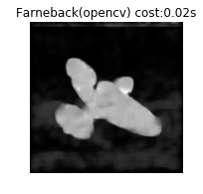
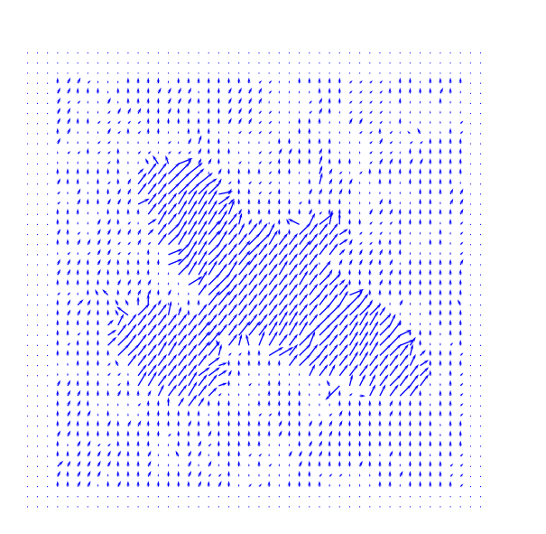
Comparison

Slide 12
Differencial-based
& Dense optical flow

Slide 13

Differencial-based Derive
Image brightness constancy[5]:
from a short interval t1 to t2, while an object may change position, the reflectivity and illumination will remain constant.
According to Taylor series expansion:
Notes:
For starter , lets see how the differencial-based optical flow derived. there’s an assumption that the image brightness remained asame for a short time changed. while an object may change position, the reflectivity and illumination will ramain consatant

Slide 14

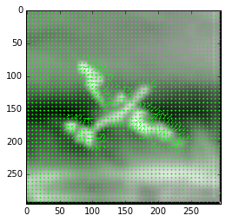



HORN & SCHUNCK METHOD[6]
use masks to calculate fx, fy,ft:
minimize
Notes:
smoothness consraint(the neighbouring points move with similar velocity) and the flow constraint (minimize the rate of change of optical flow )

Slide 15


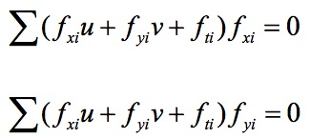
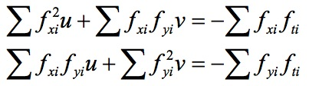

LUCAS & KANADE METHOD[6]
Notes:
Lucas&Kanade’s methods uses small windows (in my code, I used 3 by 3 window), and least squares method.
We need to find the difference between these two images and we need to get the vector to minimize the difference
However, we are more interenested in an other methods,

Slide 16
Gunnar Farneback method
Dense optical flow
A optimal method to track all the pixels in an image
Farneback method uses Polynomial Expansion to approximate the neighbors of a pixel[7].
Notes:
The Gunnar-Farneback algorithm was developed to produce dense Optical Flow technique results (that is, on a dense grid of points). The first step is to approximate each neighborhood of both frames by quadratic polynomials. Afterwards, considering these quadratic polynomials, a new signal is constructed by a global displacement. Finally, this global displacement is calculated by equating the coefficients in the quadratic polynomials' area.
About why we are interested in this method, lets see two demos

Slide 17
Demo with Dense techniques
Extract the moving object from the static background[8]
Gaussion filter
Get background with threshold
Track the moving object
findContours() in opencv
Speed up with numba!
Draw the rectangle edge of the moving object
Notes:
we used that on the real time video capture. first we used the g filter to smooth every frame of the video, which can make the vector of the flows more optimal
then we use the gf algorithm from opencv to get the flow vectors, but only kept the vectors which higher than the threshold. then we can seperate the object from the bg.
then the second demo is based on the first one.
turn the static bg into black and

Slide 18
Thanks

Slide 19
Reference
[1] Nixon M. Feature extraction & image processing[M]. Academic Press, 2008.
[2] Giachetti, A., Matching Techniques to Compute Image Motion, Image Vision Comput., 18(3), pp. 247–260, 2000
[3] Correlation based similarity measures-Summary, https://siddhantahuja.wordpress.com/tag/normalized-cross-correlation/
[4] Zero Mean Normalized Cross-Correlatio, https://martin-thoma.com/zero-mean-normalized-cross-correlation/#tocAnchor-1-2
[5] O'Donovan, Peter. "Optical flow: Techniques and applications." The University of Saskatchewan (2005).
[6] Coarse-to-fine Optical Flow, http://eric-yuan.me/coarse-to-fine-optical-flow/
[7] The Gunnar-Farneback optical flow, https://www.safaribooksonline.com/library/view/opencv-essentials/9781783984244/ch07s04.html
[8] SuganyaDevi, K., N. Malmurugan, and R. Sivakumar. "Efficient foreground extraction based on optical flow and SMED for road traffic analysis."International Journal of Cyber-Security and Digital Forensics (IJCSDF) 1.3 (2012): 177-182.

