Slide 1
Marr–Hildreth operator
Marr–Hildreth
edge detection
Xuan Yang and Chao Duan

Slide 2
Overview
Basic idea of edge detection
Second order & Laplacian
LoG operator(Marr-Hildreth operator)

Slide 3
Basic Idea of edge detection

Slide 4
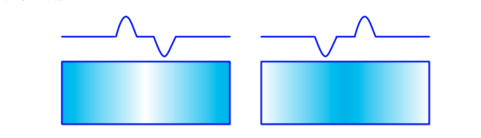


First order differentioation
For the vertical edges Ex:
Ref.: Edge detection, http://blog.csdn.net/xiaowei_cqu/article/details/7829481
Notes:
In an image, the edge is where pixels changed intensely. Look at these two images, the line shows the change of pixels. And we can use these two function to detect the h pixals change and v pixels change. Lots of 1 order operators derived from these basic idea, but 2 different. Before introduce laplacian, les see some different results of these two methods

Slide 5
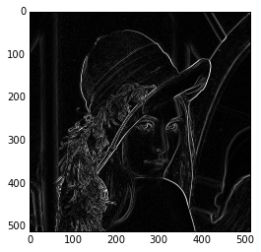

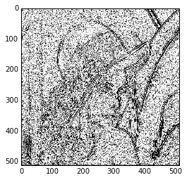
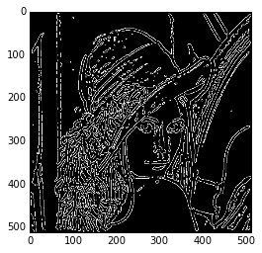
First order vs second order
prewitt
sobel
Laplacian without smoothed
Marr-H with 15x15 template
sigma = 2.3
Notes:
The second order operator can show more details of the image, the third one shows too much tho.
And to be more clearly.

Slide 6
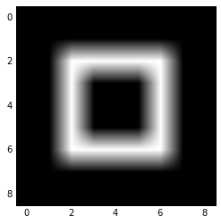
First order vs second order
Original
Notes:
size = 3, sigma = 0.8 What the edge looks like of this square?

Slide 7
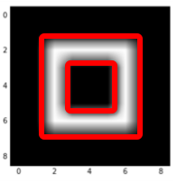
First order vs second order
Original
Notes:
So, les see which operator can show the edge like the red line

Slide 8
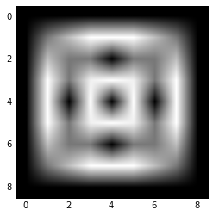

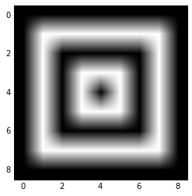
First order vs second order
Original
Prewitt
Sobel
Laplacian operator
Notes:
The results are obvoursly, we can see that the L operator shows the figure of red line perfectly

Slide 9
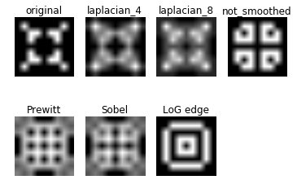
First order vs second order
Notes:
And the LoG operator looks really optimal in this even more complicated image
in addition,

Slide 10
The second order operator-------the Laplacian

Slide 11
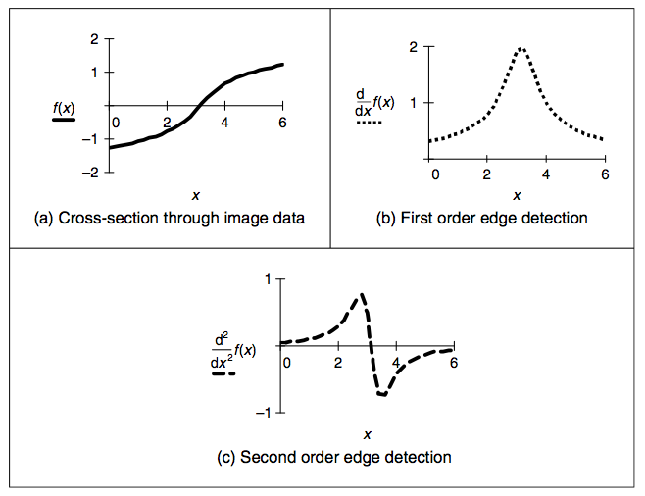
The Laplacian operator
first and second edge detection from [1]
Ref.: Nixon M. Feature extraction & image processing[M]. Academic Press, 2008.
Notes:
The sec operator is the gradient of the first one

Slide 12

The Laplacian operator
Notes:
According to the t expansion

Slide 13
The Laplacian operator

Slide 14
The Laplacian operator
Notes:
we can get the result of this function, which we can use to make the laplacian template

Slide 15


The Laplacian operator
Notes:
According to the coefficent of the function, we can write the template matrix

Slide 16
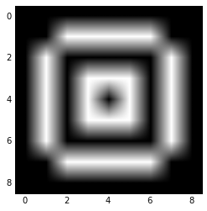
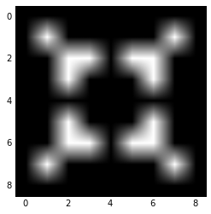
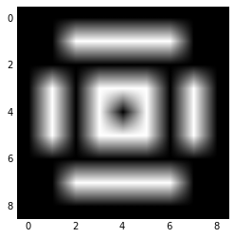
The Laplacian operator
(Different template with zero crossing)
Original
Notes:
the result of the template with 8 in it looks better. and this one is also more sensitive than the other one

Slide 17
The Laplacian operator
Laplacian without smoothed
Notes:
so we need to combain the l with g to get an optimal result,like this

Slide 18
The Laplacian operator
Laplacian without smoothed
Marr-H with 15x15 template
sigma = 2.3
Notes:
but how and why this method is optimal, now les invite channer to introduce to you the LoG operator

Slide 19


LoG operator

Slide 20
LoG operator (Marr-Hildreth operator)
Laplacian of Gaussian operator

Slide 21






Slide 22




Slide 23
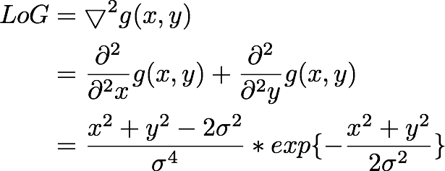

Slide 24
Zero Cross
first and second edge detection from [1]
Ref.: Nixon M. Feature extraction & image processing[M]. Academic Press, 2008.

Slide 25
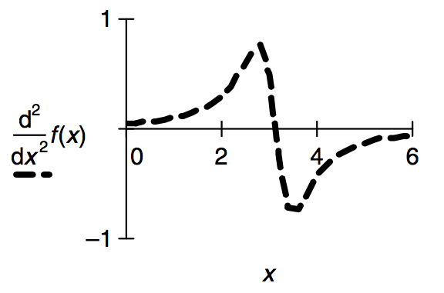
Zero Cross
It is hard to just get 0 in
our discrete image
second edge detection from [1]
Ref.: Nixon M. Feature extraction & image processing[M]. Academic Press, 2008.

Slide 26
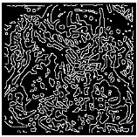
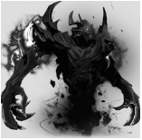
Comparison of LoG
Method | Time cost (s)
Gaussian+Laplasian | 0.7
LoG | 0.35
LoG

Slide 27
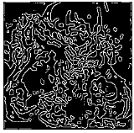
Comparison of LoG
Method | Time cost (s)
Gaussian+Laplasian | 0.7
LoG | 0.35
Fourier of LoG | 0.015
LoG
Fourier of LoG

Slide 28
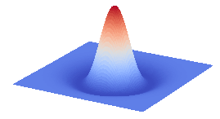
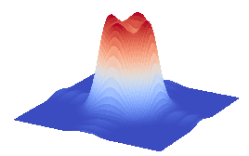

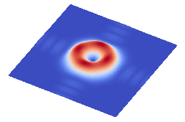
Fourier of LoG
Original Shape of LoG
Fourier Transform of LoG
side-looking
overlook
2D shape

Slide 29
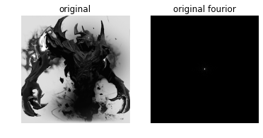
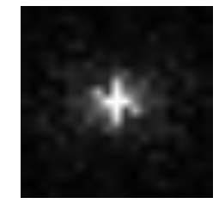
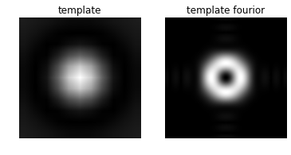
Zoom in and
Suppress DC component

Slide 30
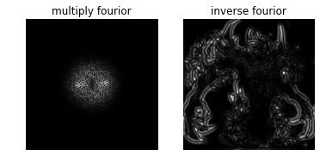
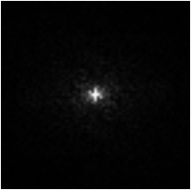

Slide 31
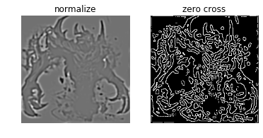

Slide 32
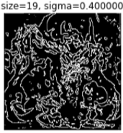
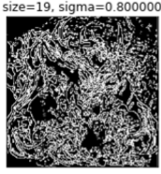
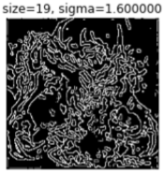
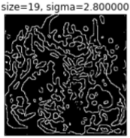
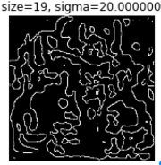




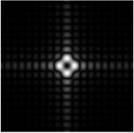
Influence of Sigma
Sigma increase

Slide 33
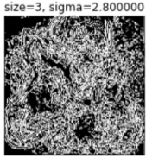
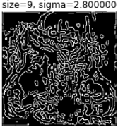
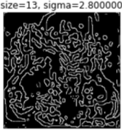
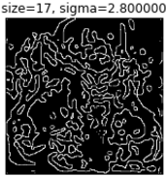
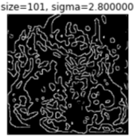
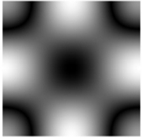
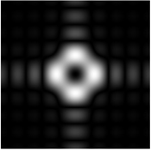



Influence of Size
Size increase

Slide 34
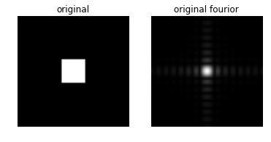
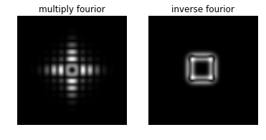
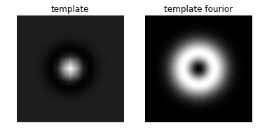
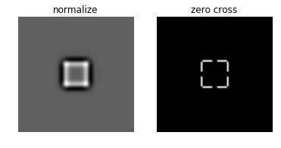
Simpler example, Fourier is extremely beautiful!

Slide 35
Thanks!
Any Question?

Slide 36
Reference list
[1] Nixon M. Feature extraction & image processing[M]. Academic Press, 2008.
[2] Edge detection, http://blog.csdn.net/xiaowei_cqu/article/details/7829481
[3] Laplacian of Gaussian (LoG), http://fourier.eng.hmc.edu/e161/lectures/gradient/node8.html
[4] Laplacian Operator, http://blog.csdn.net/wangxiaojun911/article/details/7420965
[5] Wang, Xin. "Laplacian operator-based edge detectors." Pattern Analysis and Machine Intelligence, IEEE Transactions on 29.5 (2007): 886-890.
[6] Sharifi, Mohsen, Mahmoud Fathy, and Maryam Tayefeh Mahmoudi. "A classified and comparative study of edge detection algorithms." Information Technology: Coding and Computing, 2002. Proceedings. International Conference on. IEEE, 2002.
[7] Haralick, Robert M. "Digital step edges from zero crossing of second directional derivatives." Pattern Analysis and Machine Intelligence, IEEE Transactions on 1 (1984): 58-68.

