Slide 1
Typed Architectures Architectural Support for Lightweight Scripting
Channoh Kim^{1†}
Jaehyeok Kim^{1†}
Sungmin Kim¹
Dooyoung Kim¹
Namho Kim²
Gitae Na¹
Young H. Oh¹
Hyeon Gyu Cho¹
Jae W. Lee²
¹Sungkyunkwan University, Korea
²Seoul National University, Korea
†Equal contributions
Notes:
[자신있게, 천천히, 또박또박, 화이팅! – Presenter view 안 보이면 이 교수에게 SOS]
Hello, everyone. ⬇ Welcome to my talk. I am Channoh Kim from Sungkyunkwan University.
Today, // I will talk about my work, // titled // Typed Architectures, // which provide architectural support for // lightweight scripting.
This work is done with my colleagues // at both // Sungkyunkwan University and Seoul National University.

Slide 2




Motivation (1): Today’s Scripting Languages
Already widely used in various application domains
JavaScript: Web clients and servers
Lua: Game programming
R: Statistical computing, data analytics
Python, PHP, Perl, Ruby, etc.
Becoming general-purpose programming platforms
Example: HTML5/JavaScript-based apps
Notes:
Today // scripting languages are // widely used // in various application domains.
For EXAMple, // JavaScript // is the default language // for programming the web, // enabling billions of web pages.
Lua // is a lightweight scripting language (랭귀지) // adopted for game programming // and writing plug-ins.
Python, PHP, Ruby, R, and Perl // are also popular // in various application domains.
These scripting languages // are becoming // general-purpose programming platforms.

Slide 3
Motivation (2): Today’s Scripting Languages
(+) High productivity
Dynamic type systems: flexible and extensible
High level of abstraction with powerful built-in functions
Object-oriented programming paradigm
Automatic memory management (e.g., garbage collection)
(-) Low efficiency
Primarily due to dynamic type systems
Example: usage of polymorphic “+” operation
Increasing instruction count and memory footprint
function add(a, b) { return a + b; }
add(1, 2); // (NUMBER::INT) 3
add(1.1, 2.2); // (NUMBER::DOUBLE) 3.3
add("a", "b"); // (STRING) “ab”
Notes:
Scripting languages // provide // productivity benefits // with a high level of abstraction // and powerful built-in functions.
HowE⬆ver, // scripting languages are // still // much slower // than native programming languages like // C.
And dynamic type checking is one of the major performance bottlenecks.
This code shows // the USages of bytecode ADD.
The plus operator is // polymorphic; // so, // it must be // properly guarded //
to invoke the correct version // of the operator function // depending on // the types of the operand.

Slide 4
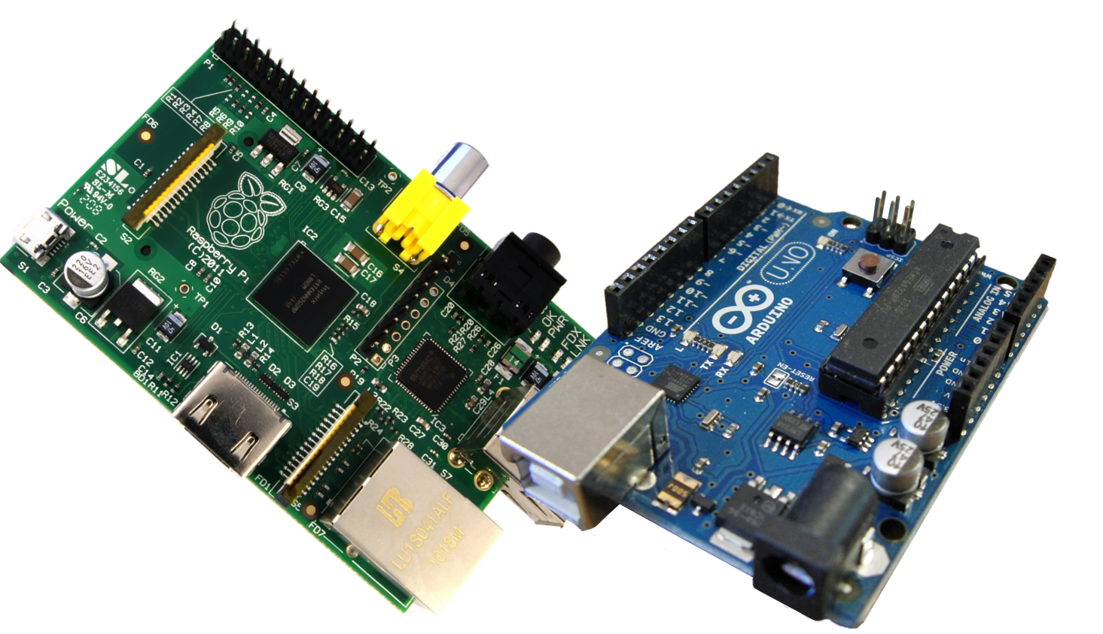
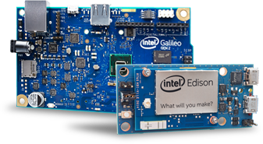
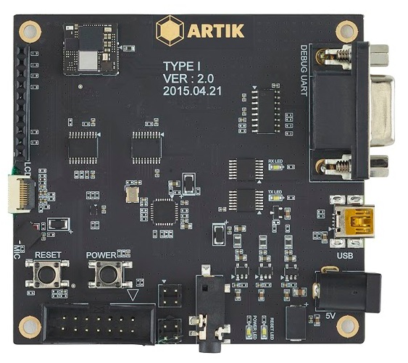
Motivation (3): Scripting on Emerging IoT Platforms
Emerging single-board computers for so-called DIY electronics
Arduino, Raspberry Pi, Intel Edison/Galileo, Samsung ARTIK, etc.
Platforms for emerging IoT applications: low cost, low power, small form factor
Scripting languages are too heavyweight for those platforms
Heavily resource constrained
Single-core
In-order pipeline
Low MHz
Small memory
Arduino and Raspberry Pi
Intel Galileo and Edison
Samsung ARTIK
Notes:
On the hardware front, // single-board computers have // RECently // emerged to enable // various IoT applications, // such as Arduino and Raspberry Pi.
These platforms are inexpensive, // consume little power, // and have small form factors, which are good.
HowE⬆ver, they have severe // resource constraints, //
because they typically use // a single-core // in-order pipeline // running at tens to hundreds of Mhz //
with limited memory // and storage space // and power budgets.

Slide 5
Motivation (4): Scripting Languages + Single-Board Computers
Productivity benefits for IoT programming
Ease of programming and testing
Natural support for event-driven programming models
Seamless client-server integration (e.g., using HTML5/JavaScript)
But, too slow on IoT platforms
JIT compilation: not viable due to severe resource constraints
VM interpreter: wastes CPU cycles for
Recurring cost of bytecode dispatch
Dynamic type checking
Boxing/unboxing objects
Garbage collection
Focus of this work
Notes:
What if // we run those scripting languages // on single board computers?
Certainly, // THERE are some productivity benefits //, such as
ease of programming and testing,
natural support for event-driven programming models, and
seamless client-server integration.
HowEver, //
**Again**, they are just too slow.
JIT compilation may **not** be viable // due to severe resource constraints.
In contrast, // VM interpreters have smaller resource footprints // but waste CPU cycles // for:
Bytecode dispatch
Dynamic type checking
Boxing/unboxing objects, // and
Garbage collection
<click> In this work, we focus on the second one, dynamic type checking.

Slide 6
Dynamic Type Checking (1)
Significant fraction of instructions are spent executing type guards
Profiled five most frequently used bytecodes in Lua
// from Lua interpreter
case ADD:
Value *rb = RB(Bytecode);
Value *rc = RC(Bytecode);
Number nb, nc;
if (isInt(rb) && isInt(rc)) {
ival(ra) = ival(rb)+ival(rc);
type(ra) = INT;
}
else if (toNumber (rb, &nb) &&
toNumber (rc, &nc)) {
fval(ra) = nb + nc;
type(ra) = FLT;
}
else {
/* do exception */
}
Notes:
Then, why // dynamic-type checking is // so slow?
This **C** code // shows // a simplified ADD bytecode // taken from the Lua interpreter.
Because the ADD operation // is polymorphic, // type guards, // must be EXecuted // to bind to the correct function. //
which are shown in gray.
<숨>
A sigNI-ficant fraction // of the instructions // are spent // executing type guards.
We count // the number of dynamic instructions per bytecode // for the five most frequently used bytecodes, with // different operand types.
As shown in this graph, // for these five bytecodes, //
the overhead of type guard // is sigNI-ficant, // which is shown in red.

Slide 7
Dynamic Type Checking (2)
// from Lua interpreter
case ADD:
Value *rb = RB(Bytecode);
Value *rc = RC(Bytecode);
Number nb, nc;
if (isInt(rb) && isInt(rc)) {
ival(ra) = ival(rb)+ival(rc);
type(ra) = INT;
}
else if (toNumber (rb, &nb) &&
toNumber (rc, &nc)) {
fval(ra) = nb + nc;
type(ra) = FLT;
}
else {
/* do exception */
}
Bytecode ADD
Load ival(RB)
Load type(RB)
type(RB) == INT
No
No
Yes
Load ival(RC)
Load type(RC)
type(RC) == INT
No
No
Yes
ival(RA) ← ival(RB) + ival(RC)
Store ival(RA)
Store type(RA)
Notes:
A dynamic type check // is composed of the following three operations:
<click> type tag extraction,
<click> tag checking
<click> and tag insertion.

Slide 8
Dynamic Type Checking (3)
Tag extraction
Extraction of an operand’s type tag
Tag checking
Checking the type tags to execute the correct version of the operator
Tag insertion
Storing the calculated value with type tag
Bytecode ADD
Load ival(RB)
Load type(RB)
ld a2 ← 0(s9)
lw a3 ← 8(s9)
li a4 ← INT
type(RB) == INT
bne a3,a4,isFlt_{RB}
No
No
Yes
Yes
No
Load ival(RC)
Load type(RC)
ld a5 ← 0(s10)
lw a6 ← 8(s10)
type(RC) == INT
bne a6,a4,isFlt_{RB}
No
No
Yes
Yes
No
ival(RA) ← ival(RB) + ival(RC)
add a5 ← a5, a2
Store ival(RA)
Store type(RA)
sd 0(s14) ← a5
sw 8(s14) ← a4
Notes:
The type tag // of an operand // should be extracted for // a given value // for type checking.
Tag extraction is // typically realized by // a load instruction, // which may be followed by // shift and mask instructions.
<click>
And then // tag checking examines // the types of input operands //and
dispatches // the correct version of the operator (오퍼레이터).
Typically, // this is realized by // multiple-type guards, // each of which // consists of // a type tag comparison // followed by a conditional branch.
<click>
Tag insertion // is an inverse operation // of type tag extraction.
When a new value is proDU-ced, // the type tag // must be stored // together with it.

Slide 9
Our Proposal: Typed Architectures
A high-efficiency, low-cost execution substrate for dynamic script languages
Key idea: Retaining high-level type information of a variable at an ISA level
Dynamic type checking in parallel with value calculation
Key results
Geomean (Max.) speedups: 14.1% (46.0%) for Lua, 11.7% (29.9%) for JavaScript
Incurs minimal hardware cost (1.6% area overhead)
Notes:
To accelerate // those three operations in hardware // we propose Typed Architecture, // a high-efficiency, //
low-cost execution substrate // for dynamic script languages.
The key idea is // to retain the high-level type information // of a variable // at an ISA level.
And then // type checking is performed // in parallel with value calculation // within the pipeline.
With Typed Architecture, // we achieve // sigNI-ficant speedups // for two production grade scripting 엔진스 (engines) // with minimal hardware cost.
[5:50]

Slide 10
Outline
Motivation and key idea
Typed Architecture
Component #1: Unified Register File
Component #2: Tagged ALU Instructions
Component #3: Tagged Memory Instructions
Table Access
Evaluation
Summary
Notes:
Let’s move on // the details of // the proposed architecture

Slide 11
Typed Architecture: Overview
Extending ISA
Unified register file
Tagged ALU instructions (Type Rule Table)
Tagged memory instructions (tag extraction/insertion)
Special-purpose registers
Three registers for flexible tag extraction and insertion; one for type miss handling
 | Value
R0
… | Register File
R30
R31
FPU
 | F/Ī | Type | Value
R0
… | Register File
R30
R31
ALU
1
Value
Data $
0
op | in1 | in2 | out | F/Ī
TRT
+ | INT | INT | INT | 0
+ | FLT | FLT | FLT | 1
Tag Extraction
/ Insertion Logic
Hit
F/Ī
F/Ī
Type
Type
Notes:
To support // dynamic-type checking // in hardware, // we extend // the baseline RISC ISA // with the following three components:
Unified register file
Tagged ALU instructions
and, tagged memory instructions
<click> We also add // four special-purpose registers // to flexibly support // multiple scripting languages.

Slide 12
Component #1: Unified Register File
Both integer and floating-point values stored in a unified register file
Each entry extended with two fields
Type field (8 bits): stores type encoding of the value
F/Ī (1 bit): indicates whether it is an integer (0) or floating-point (1) subtype
Bytecode ADD
// from Lua interpreter
case ADD:
Value *rb = RB(Bytecode);
Value *rc = RC(Bytecode);
Number nb, nc;
if (isInt(rb) && isInt(rc)) {
ival(ra) = ival(rb)+ival(rc);
type(ra) = INT;
}
else if (toNumber (rb, &nb) &&
toNumber (rc, &nc)) {
fval(ra) = nb + nc;
type(ra) = FLT;
}
else {
/* do exception */
}
ld a2 ← 0(s9)
lw a3 ← 8(s9)
li a4 ← INT
ld a2.v ← 0(s9.v)
lw a2.t ← 8(s9.v)
li a4.t ← INT
bne a3,a4,isFlt_{RB}
bne
a2.t,a4.t,isFlt_{RB}
No
Yes
No
Yes
No
No
ld a5 ← 0(s10)
lw a6 ← 8(s10)
ld a5.v ← 0(s10.v)
lw a5.t ← 8(s10.v)
 | F/Ī | Type | Value
R0 | R0.fi | R0.t | R0.v
R1
R2
… | Register File
R29
R30
R31
bne a6,a4,isFlt_{RB}
bne
a5.t,a4.t,isFlt_{RB}
No
Yes
No
Yes
No
No
add a5 ← a5, a2
add a5.v ← a5.v,a2.v
sd 0(s14) ← a5
sw 8(s14) ← a4
sd 0(s14.v) ← a5.v
sw 8(s14.v) ← a5.t
Notes:
Let me explain // the three components // one by one.
First, // we extend the register file // to hold both integer and floating-point values.
We called this // a unified register file.
And // each entry // is extended // with two fields, // a type field and a FI bit.
The type field // stores // the type encoding // of the value, and the FI bit // indicates // whether it is an integer // or a floating-point subtype.
<click>
This is // the original assembly for // bytecode ADD.
With the unified register file, // the code is transformed // like this. //
<click>
Now // each register has // both value and type fields, // which are denoted by .v and .t suffix, respectively.

Slide 13
Component #2: Tagged ALU Instructions (1)
Example: xadd r30 ← r30, r31 // for polymorphic ”+” operator
Case 1: R30 (Integer) + R31 (Integer)
Vaules dispatched to integer ALU and type checking performed in parallel (type hit)
FPU
 | F/Ī | Type | Value
R0
… | Register File
R30 | 0 | INT | 1
R31 | 0 | INT | 2
ALU
Value
(3)
1
Data $
0
op | in1 | in2 | out | F/Ī
TRT
+ | INT | INT | INT | 0
+ | FLT | FLT | FLT | 1
Tag Extraction
/ Insertion Logic
Hit
0
F/Ī (0)
INT
Type (INT)
R_{hdl}
1
NextPC
(PC+4)
PC+4
0
Notes:
The second component is tagged ALU instructions.
Let me take an example// of an xadd instruction // to implement // a polymorphic plus operator.
In Case 1, // let's assume // both source operands are // integers.
In this case, // the two source operands // are dispatched to // the integer ALU // based on //
the value of the F/I bit.
At the same time //
the type rule table is looked up // using the two source type tags, // which are integers in this case, //
and the opcode, which is add // as input.
Because it hits, // the output type and f/i bit // are retrieved from the type rule table.
At writeback stage // these fields // are written back // to the destination register // together with
the calculated value.

Slide 14
Component #2: Tagged ALU Instructions (2)
Example: xadd r30 ← r30, r31 // for polymorphic “+” operator
Case 2: R30 (Float) + R31 (Float)
Vaules dispatched to FP Unit and type checking performed in parallel (type hit)
FPU
FPU
 | F/Ī | Type | Value
R0
… | Register File
R30 | 1 | FLT | 1.1
R31 | 1 | FLT | 2.2
 | F/Ī | Type | Value
R0
… | Register File
R30 | 0 | INT | 1
R31 | 0 | INT | 2
ALU
ALU
Value
(3.3)
1
Value
(3)
Data $
0
Data $
op | in1 | in2 | out | F/Ī
TRT
+ | INT | INT | INT | 0
+ | FLT | FLT | FLT | 1
op | in1 | in2 | out | F/Ī
TRT
+ | INT | INT | INT | 0
+ | FLT | FLT | FLT | 1
Tag Extraction
/ Insertion Logic
Tag Extraction
/ Insertion Logic
Hit
1
0
F/Ī (1)
F/Ī (0)
FLT
INT
Type (FLT)
Type (INT)
R_{hdl}
R_{hdl}
1
1
NextPC
(PC+4)
0
NextPC
(PC+4)
PC+4
0
PC+4
Notes:
In Case 2, // let's assume // the two source registers // hold floating-point values.
In this case, // the two operands // are dispatched // to the floating-point unit // based on the value of the F/I bit.
Again, // the type rule table // is looked up // using the type tags // at the same time.
Because it hits, // the output type and f/i bit // are retrieved from the type rule table, //
to take // the fast path of execution.

Slide 15
Component #2: Tagged ALU Instructions (3)
Example: xadd r30 ← r30, r31 // for polymorphic “+” operator
Case 3: R30 (Integer) + R31 (Float)
PC is redicrected to the slow path pointed to by R_{hdl} (type miss)
FPU
FPU
 | F/Ī | Type | Value
R0
… | Register File
R30 | 0 | INT | 1
R31 | 1 | FLT | 2.2
 | F/Ī | Type | Value
R0
… | Register File
R30 | 1 | FLT | 1.1
R31 | 1 | FLT | 2.2
ALU
ALU
Value
1
Value
(3.3)
1
0
Data $
0
Data $
op | in1 | in2 | out | F/Ī
TRT
+ | INT | INT | INT | 0
+ | FLT | FLT | FLT | 1
op | in1 | in2 | out | F/Ī
TRT
+ | INT | INT | INT | 0
+ | FLT | FLT | FLT | 1
Tag Extraction
/ Insertion Logic
Tag Extraction
/ Insertion Logic
Miss
Hit
1
F/Ī
F/Ī (1)
FLT
Type
Type (FLT)
R_{hdl}
NextPC
(PC+4)
R_{hdl}
1
1
NextPC
(slowpath)
0
PC+4
0
PC+4
Notes:
In the last case, // let's assume // we add an integer // to a floating-point value.
In this case, // it misses at the type rule table, // which we call // type miss, // and
PC is redirected to the slow path // whose starting address // is stored at // the handler register, // or Rhdl.
The slow path // executes // this instruction in software.
It first converts // the integer value // to a floating-point value, // and then //
executes a floating-point add // along with // storing a type tag.

Slide 16
Component #2: Tagged ALU Instructions (4)
Setting the value of the type miss handler register (thdl)
Format: thdl .LABEL
Loads the starting address of the slow path (.LABEL) into R_{hdl}
FPU
 | F/Ī | Type | Value
R0
… | Register File
R30
R31
ALU
Value
1
Data $
0
op | in1 | in2 | out | F/Ī
TRT
+ | INT | INT | INT | 0
+ | FLT | FLT | FLT | 1
Tag Extraction
/ Insertion Logic
F/Ī
Type
R_{hdl}
1
NextPC
(PC+4)
PC+4
0
Notes:
We introduce // an instruction // to set // the value of the handler register, // called thdl.
thdl loads // the starting address of // the slow path // into the handler register.

Slide 17
Component #3: Tagged Memory Instructions (1)
Tagged memory instructions (tld/tsd)
Loads/stores a value with type tag
Special-purpose registers
R_{offset} (Offset Register): indicates which quad-word the tag will be extracted from
R_{shift} (Shift Amount Register): holds the starting position of type field
R_{mask} (Mask Register): holds 8-bit mask to extract 8-bit type tag
Bytecode ADD
tld a2 ← 0(s9)
tld a5 ← 0(s10)
thdl slowpath
xadd a5 ← a5, a2
No
No
Yes
tsd 0(s14) ← a5
Notes:
Finally, // we introduce // two new instructions // for memory operations, // tagged load and tagged store.
A tagged load // not only loads // a requested value // from memory // but also loads // its type tag and FI bit.
A tagged store works // similarly, // but // in the opposite direction.
To flexibly control // tag extraction and insertion, // we introduce three special-purpose registers.
Offset register, // which indicates // which quad-word // the tag will be extracted from.
Shift amount register, // which holds // the bit position // of the type field.
Mask register, // which holds // 8-bit mask // to extract an 8-bit type tag.
Those registers are // typically set // only once // at program launch.

Slide 18
Component #3: Tagged Memory Instructions (2)
Tagged load instruction
Example: tld a2 ← 0(s9)
Loads the value of a variable with its type tag
FPU
 | F/Ī | Type | Value
R0
… | Register File
R30
R31
Data $
ALU
64-bit
64-bit
1
Value
1
Value
Data $
0
op | in1 | in2 | out | F/Ī
TRT
+ | INT | INT | INT | 0
+ | FLT | FLT | FLT | 1
Tag Extraction
/ Insertion Logic
Tag extraction
>>
&
F/Ī
F/Ī
R_{shift}
R_{mask}
Type
Type
8
R_{hdl}
1
NextPC
(PC+4)
PC+4
0
Notes:
The data layout // for storing a tag-value pair // may vary // depending on the languages // and implementations.
Therefore, // we introduce // a programmable // tag extraction logic // to support multiple engines.
<click>
This logic // is implemented by // combining // shift and mask operations, // which is // configurable // using a mask register // and a shift amount register.
The tagged store instruction // uses // the same set of the registers // to store a value // together with its type tag.

Slide 19
Table Access (1)
// Table access example in JavaScript
arr = [1, 2, 3];
arr[0] = 0; // 0 (table update)
print(arr[0]); // 0 (table access)
Table access bytecodes
Lua: GETTABLE/SETTABLE
JavaScript (SpiderMonkey): GETELEM/SETELEM
Each bytecode consists of two parts:
Address calculation for the requested element
Element access/update with boundary checking
Notes:
Typed Architectures // also // provide support for // table access bytecodes.
This code shows // a simplified table access bytecode // from JavaScript.
<click>
Lua has // gettable and settable bytecodes // for table access, // and
SpiderMonkey JavaScript engine // has getelem and setelem // for it.
Each bytecode // consists of two parts, //
address calculation for // the requested element // and
element access or // update // with boundary checking.

Slide 20
Table Access (2)
GETTABLE
Transformed GETTABLE
lw a2 ← 8(s10)
li a4 ← TABLE
tld a2 ← 0(s10)
bne a2,a3,slow1
Yes
No
lw a4 ← 8(s10)
li a5 ← INTEGER
tld a4 ← 0(s9)
bne a4,a5,slow2
thdl slowpath
Yes
tchk a2, a4
No
No
/* get the address
* of pointer
*/
Yes
/* get the address
* of pointer
*/
Notes:
This slide shows // the transformed code // for table access // with typed architecture.
To do this, // we introduce // a new instruction, // which is called tchk.

Slide 21
Table Access (3)
Tag check instruction
Example: tchk a2, a4
Checks only type tags of two operands
FPU
 | F/Ī | Type | Value
R0
… | Register File
R30 | 0 | TAB | addr
R31 | 0 | STR | ”a”
ALU
1
Value
Data $
0
op | in1 | in2 | out | F/Ī
 | TAB | INT | TAB | 0
TRT
+ | INT | INT | INT | 0
+ | FLT | FLT | FLT | 1
Tag Extraction
/ Insertion Logic
Miss
F/Ī
Type
R_{hdl}
1
NextPC
(slowpath)
PC+4
0
Notes:
tchk // only looks up // the type rule table // without calculating // any output value.
If it hits, // the program proceeds // to the next instruction // which is the fast path.
If not, // it jumps to the slow path.

Slide 22
Topics Not Covered in This Presentation
Please refer to the paper for the following information:
Details of pipeline design
Code transformation for Lua and JavaScript
OS context switching
Legacy code execution
Detailed power and area analysis using synthesizable RTL
etc.
Notes:
Due to time constraints, // this presentation // does not cover // all aspects of our design // and evaluation.
This slide enumerates // some of these topics.
If you are interested, please refer to the paper // or find us // at the poster session.
[13:00]

Slide 23
Outline
Motivation and key idea
Typed Architecture
Evaluation
Methodology
Performance Results
Area and Power Overhead
Summary
Notes:
We now move on to the evaluation.
[13:30]

Slide 24
Evaluation Methodology (1): Evaluation Platform
Platform | Xilinx Zynq ZC706 FPGA
Processor | 64-bit RISC-V Rocket Core
Pipeline | Single-Issue In-Order, 50MHz Fetch/Decode/Execute/Mem/WB (5 stages)
Branch Predictor | 32B predictor (128-entry gshare) 62-entry, fully-associative BTB with LRU replacement policy 2-entry return address stack 2-cycle branch miss penalty
Caches | 16KB, 4-way, 1-cycle L1 I-cache 16KB, 4-way, 1-cycle L1 D-cache 8-entry I-TLB, 8-entry D-TLB 64B block size with LRU
Type Rule Table | 8-entry, 32B fully-associative table
Notes:
We use // FPGA // to evaluate Typed Architecture.
We use // the default parameters of // RISC-V Rocket Core.
which are summarized // in the table.

Slide 25
Evaluation Methodology (2): Workloads
Lua-5.3.0
47 distinct bytecodes
Modified bytecodes: ADD, SUB, MUL, GETTABLE, SETTABLE
SpiderMonkey-17.0 from FireFox (JavaScript)
229 distinct bytecodes
Modified bytecodes: ADD, SUB, MUL, GETELEM, SETELEM
JIT is disabled in both cases
Benchmarks
11 scripts for each from Computer Language Benchmarks Game*
* http://benchmarksgame.alioth.debian.org
Notes:
For workloads, // we use // two production-grade 스크립팅 엔진스 (scripting engines), // Lua and SpiderMonkey.
Lua has 47 distinct bytecodes.
We retarget // the five bytecodes of // ADD, SUB, MUL, GETTABLE, and SETTABLE.
We also use // SpiderMonkey // which is // the default JavaScript engine // for FireFox web browser.
SpiderMonkey has 229 bytecodes. and
We retarget the five bytecodes of them, // ADD, SUB, MUL, GETELEM, and SETELEM.
We turned off JIT in both cases.
We take 11 scripts for both engines // from the Computer Language Benchmarks Game.

Slide 26
Overall Speedups
Geomean speedups (reflecting post-camera-ready updates)
Lua: 9.9% → 14.1% (Max: 46.0% for fannkuch-redux)
JavaScript: 11.2% → 11.7% (Max: 29.9% for fannkuch-redux)
* [HPCA ’11] Checked Load: Architectural support for JavaScript type-checking on mobile processors
Notes:
We first show // the overall speedups // over // the out-of-the-box baseline // on FPGA.
We also // compare the results // with Checked Load, // a state-of-the-art // hardware-based // type-checking technique.
By the way, // we have // RECently fixed // a couple of performance bugs // in our RTL implementation, //
and report // the most // 업투데이트 넘버스 (up-to-date numbers)
For Lua, Typed Architecture achieves // a geomean speedup of // 14.1%
with a maximum speedup of 46% for fannkuch-redux.
For SpiderMonkey, Typed Architecture achieves // a geomean speedup of 11.7%
with a maximum speedup of // 29.9%// for fannkuch-redux.

Slide 27
Normalized Instructions
Instruction Count Reduction (%)
Reduction in dynamic instruction count
Lua: 12.9% (Max: 34.2% for fannkuch-redux)
JavaScript: 4.1% (Max: 10.0% for n-body)
Notes:
The two major sources of // performance improvements are // the reduction in // dynamic instruction counts // and
the reduction of // instruction cache miss rate.
As shown in this graph, // Typed Architecture // significantly // reduces // the dynamic instruction count //
by 12.9% for Lua // and 4.1% for JavaScript on average.

Slide 28
I-Cache Misses Per Kilo-Instructions (MPKI)
I-Cache miss rate (MPKI)
Significant reduction in I-cache miss rates (in MPKI)
Lua: k-nucleotide (2.4 → 0.5), ackermann (0.03 → 0.01)
JavaScript: random (14.3 → 8.1), spectral-norm (7.6 → 1.4)
Notes:
The second source of // performance improvements is // the reduction of // the instruction cache miss rate.
As shown in this graph, // there is a significant reduction in // instruction cache rates // for some benchmarks,
such as k-nucleotide and ackermann for Lua,
and random and spectral-norm for JavaScript.

Slide 29
Area and Energy Overhead (1)
Minimal area/power costs (at TSMC 40nm technology node)
Area overhead: 1.61% (mostly in Core)
Notes:
Finally, // we estimate the area and power overhead // by synthesizing our RTL model //
using the Synopsys Design Compiler // at TSMC 40nm technology.
The total area is // increased by // 1.61%, // with most of this // coming from // the core module.

Slide 30
Area and Energy Overhead (2)
Minimal area/power costs (at TSMC 40nm technology node)
Power overhead: 3.69% (mostly in Core and Data Cache)
EDP improvement: 20.6% (Lua), 17.1% (JavaScript)
Notes:
The power consumption // is increased by // 3.69%.
This leads to // EDP improvements // of 20.6% // and 17.1% // for Lua and JavaScript, // respectively.

Slide 31
Summary
Dynamic type checking is one of the major sources of inefficiency for scripting languages
Typed Architectures: Architectural support for efficient type checking
Retaining high-level type information at an ISA level
Supporting polymorphic instructions depending on types of operands
Flexibly applied to multiple scripting languages and engines
Typed Architectures accelerate production-grade VM interpreters
Geomean (Max.) speedups: 14.1% (46.0%) for Lua, 11.7% (29.9%) for JavaScript
EDP improved by 20.6% for Lua and 17.1% for JavaScript with only 1.6% area overhead at 40nm technology node
Notes:
In summary, // dynamic-type checking is // one of the major sources of inefficiency for // scripting languages.
To solve this problem, // we propose Typed Architectures, // which provide low-cost architectural support for //
efficient type checking.
With a minimal hardware cost, // we achieve // significant speedups // for two production grade // VM interpreters.
This concludes my talk, and thank you for your attention.
[17:00]

Slide 32
Q & A

Slide 33
Q1: Comparison against Checked Load [HPCA'11]
Checked Load ported on RISC-V RocketCore to run on FPGA
Limitations of Checked Load
Fixing type comparison instruction at compile time (“INT” value)
No support for polymorphic instructions, tag extraction and insertion
Not suitable for fixed-length RISC instructions
// Checked load instruction (Variable length instruction)
chklb Rd ← Rs, imm, INT
* [HPCA ’11] Checked Load: Architectural support for JavaScript type-checking on mobile processors
Notes:
This instruction shows a checked load instruction which loads a type value AND check whether it's an integer type.
As you can see, the type for comparison is fixed at compile time. So, this instruction performs poorly for floating-point workloads.
Furthermore, checked load doesn’t support for polymorphic instructions, tag extraction and insertion.
Type architecture can check types both integer and floating point at the same instruction via polymorphic instruction, which checked load can not
And also it is not suitable for fixed length RISC instructions.

Slide 34
Q2: Type Encoding in SpiderMonkey
sign
exponent
fraction
63
52
0
Exploits NaNs (Not-a-Number) in IEEE 754 FP format to represent Ints
sign: either 0 or 1 (1-bit)
exponent: all 1 bits (11-bits)
fraction: anything except all 0 bits (52-bits)
SpiderMonkey’s Type Encoding
1 | 1 | 1 | 1 | 1 | 1 | 1 | 1 | 1 | 1 | 1 | 1 | 1 | 0 | 0 | 0 | 1
INT (0x1fff1)
1 | 1 | 1 | 1 | 1 | 1 | 1 | 1 | 1 | 1 | 1 | 1 | 1 | 0 | 1 | 1 | 1
TAB (0x1fff7)
63
52
47
Notes:
SpiderMonkey exploits NaN values to represent non-floating point values, which look like this figure.
For example,
If the 64-bit value is not a NaN value, that means it is a floating point value.
However, for an Integer value, the lower 32 bits are used for value, and the 4-bit type field, which is colored in red, is set to 0001.
To extract the 4-bit type field for non-FP values, we use a NaN detection logic which is included in the tagged extraction and insertion logic.

Slide 35
Q3: Application to Higher Performance Core?
Possible.
However, in higher performance cores, other software techniques (like JIT) are also viable.
Notes:
Nothing stops us from applying our technique to higher-performance cores.
However, in higher performance core, other software techniques like JIT compilation are also viable, so we primarily target embedded platforms.

Slide 36
Q4: Why not JIT compilation?
Typed Architectures aim to complement, but not replace JIT.
JIT compilation can be applied on Typed Architectures.
But, in resource-constrained IoT platforms JIT may not be viable.
Also, effectiveness of JIT depends highly on a small number of hot methods dominating total execution time
Typed Architectures augment JIT in terms of the applicability.
Notes:
Our work aims to complement the JIT compiler, but not replace it.
JIT compilation can be applied on Typed Architectures.
resource constraint
Even if JIT is feasible, the effeteness of JIT depends on a small number of hot methods dominating total execution time.
Therefore, Typed architecture augment JIT in terms of the applicability. 어플리커빌리티

Slide 37
Q5: Performance of fannkuch-redux, n-sieve, and spectral-norm (1)
Significant reduction in dynamic instruction count
Table access-heavy workloads (using GETELEM and SETELEM bytecodes)
High type hit rates → bypasses complex if-chains in table access bytecodes
Notes:
Those benchmarks achieve great performance for the following reasons.
First, they use a lot of table access bytecodes with high type hit rates.
Second, we bypass complex if-chains in table access bytecodes in our implementation

Slide 38
Q5: Performance of fannkuch-redux, n-sieve, and spectral-norm (2)
Branch miss rate (MPKI)
Reduction in branch miss rates (in MPKI)
Lua: 23.68 → 16.61
JavaScript: 33.67 → 28.03
Notes:
The another source of // performance improvements // for these programs // is the reduction of // the branch miss rate.
As shown in this graph, // there is a reduction in // the miss rate of MPKI // for both Lua and JavaScript.

Slide 39
Q6: Post-camera-ready Updates
Fixed two performance bugs in our RTL implementation
Removes unnecessary bubbles for floating point calculation
Increases type hit rates (eliminating false type misses)
No correctness issues
Notes:
We fix two performance bugs in our RTL implementation.
First, we removes unnecessary bubbles for floating point calculation.
Second, we increase type hit rates by eliminating false type misses
which can be occurred when a load-use instruction pair causes a cache miss.
Not that there are no correctness issues.

Slide 40
Q7: Primitive Types of Lua and JavaScript
Primitive types
Lua: nil, boolean, number, string, function, userdata, thread, and table
JavaScript: boolean, null, undefined, number, string, symbol, and object
number type is internally magaged as either Integer and Float.
May be applicable to other types (such as boolean and string)
But difficult for function, userdata, thread, etc.
Notes:
This slide shows the primitive types of Lua and JavaScript.
And the number type includes both integer and float.
We choose the number and table type, because they easily can be implemented on our proposed architecture.
We also may extend other types, such as Boolean and String.
However, it may difficult for some other types.

Slide 41
Q8: What if tag field requires more than 8 bits?
8-bit type tag support 256 distinct types
In observation, it can accommodate most engines.
If necessary we can re-encode type values to fit in 8 bits
Notes:
The proposed 8-bit type tag can support up to 256 distinct types.
We believe it can accommodate most engines by re-encoding the type values to fit in 8 bits if necessary.

Slide 42
Q9: Application to Other Scripting Languages
Typed architecture is flexible enough to be applicable to other scripting languages and implementations.

Slide 43
Q10: Polymorphic Instructions with Integer and FP Source Operands
Currently, handled in the slow path
Type conversion is needed (Integer to FP) before the operation

Slide 44
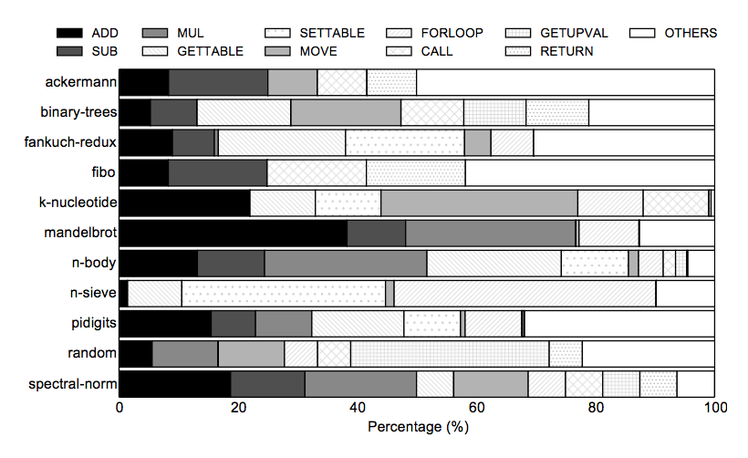
Q11: Breakdown of dynamic bytecodes in Lua
5 most frequently used bytecodes account for a majority of total bytecode count. (ADD, SUB, MUL, GETTABLE, SETTABLE)

Slide 45
Q13: Why Not Python Instead of Lua?
Lua
Having a simpler type system and easier to understand
Easier to build for RISC-V on FPGA
Stay tuned!

Slide 46
Q14: Controling Garbage Collection (GC)
We wanted to measure performance of the mutator (main code).
GC performance depends on many factors (heap size, GC algorithm, etc.) that are orthogonal to our work.
Lua: GC turned off
SpiderMonkey (JavaScript): GC turned on (No easy way to turn off)
GC does NOT occur frequently in our benchmarks, so only marginal impact.
Notes:
We want to measure the execution time of script which does not include GC time.
It's because GC performans depends heavily on many factors, such as heap size, GC algorithm, which are orthogonal (올*쏘*고널) to our work.
GC is NOT frequently occurred in our benchmark suite, so its performance impact is minimal.

Slide 47
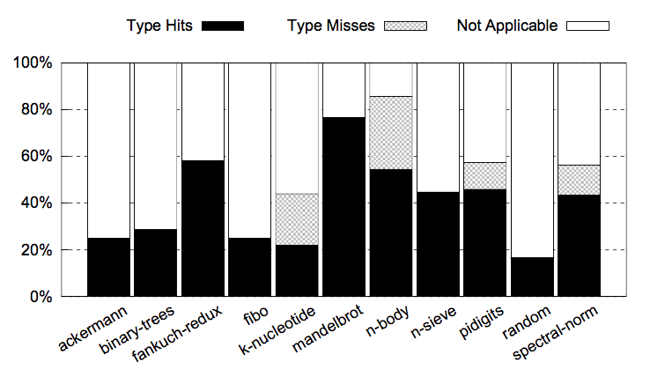
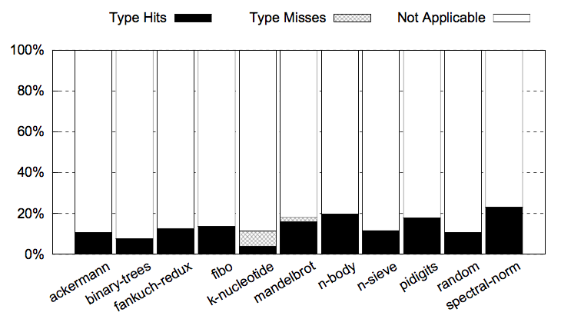
Q15: Type Hit and Miss Rates
Lua
JavaScript
Notes:
This graph shows the type hit and miss rates // normalized to dynamic bytecode count // for Lua and SpiderMonkey.

Slide 48
Q16: Three Major Sources of Performance Improvement
Reduction in dynamic instruction count
For integer addition, dynamic instruction count is reduced from 10 to 5.
Reduction in instruction cache miss
Reduction in branch miss
Notes:
There are three sources of performance improvement.
First, the reduction in dynamic instruction count.
As shown in this figure, the dynamic instruction count is reduced from 10 to 5 for integer addition.
And because of this, the instruction cache miss and branch miss are also reduced.

Slide 49
Q17: Using Newest Version of SpiderMonkey
Failed to cross-compile using RISC-V toolchain

Slide 50
Q18: 40nm Technology Node? Why Not 10nm?
Good enough to evaluate the area and power overhead

Slide 51
Q20: IoT Benchmarks

