Slide 1
Short-Circuit Dispatch Accelerating Virtual Machine Interpreters on Embedded Processors
Channoh Kim†
Sungmin Kim†
Hyeon Gyu Cho
Dooyoung Kim
Jaehyeok Kim
Young H. Oh
Hakbeom Jang
Jae W. Lee
Sungkyunkwan University, Korea
†Equal contributions
June 20th 2016
ISCA-43, Seoul, Korea

Slide 2




Motivation (1): Today’s Scripting Languages
Already widely used in various application domains
JavaScript, Lua, Python, R, Ruby, PHP, etc.
Enabling many complex, production-grade applications
[+] High productivity
High level of abstraction, flexible type systems, automatic memory management, etc.
[-] Low efficiency
Dynamic type checking, interpretation/JIT overhead, garbage collection, etc.

Slide 3
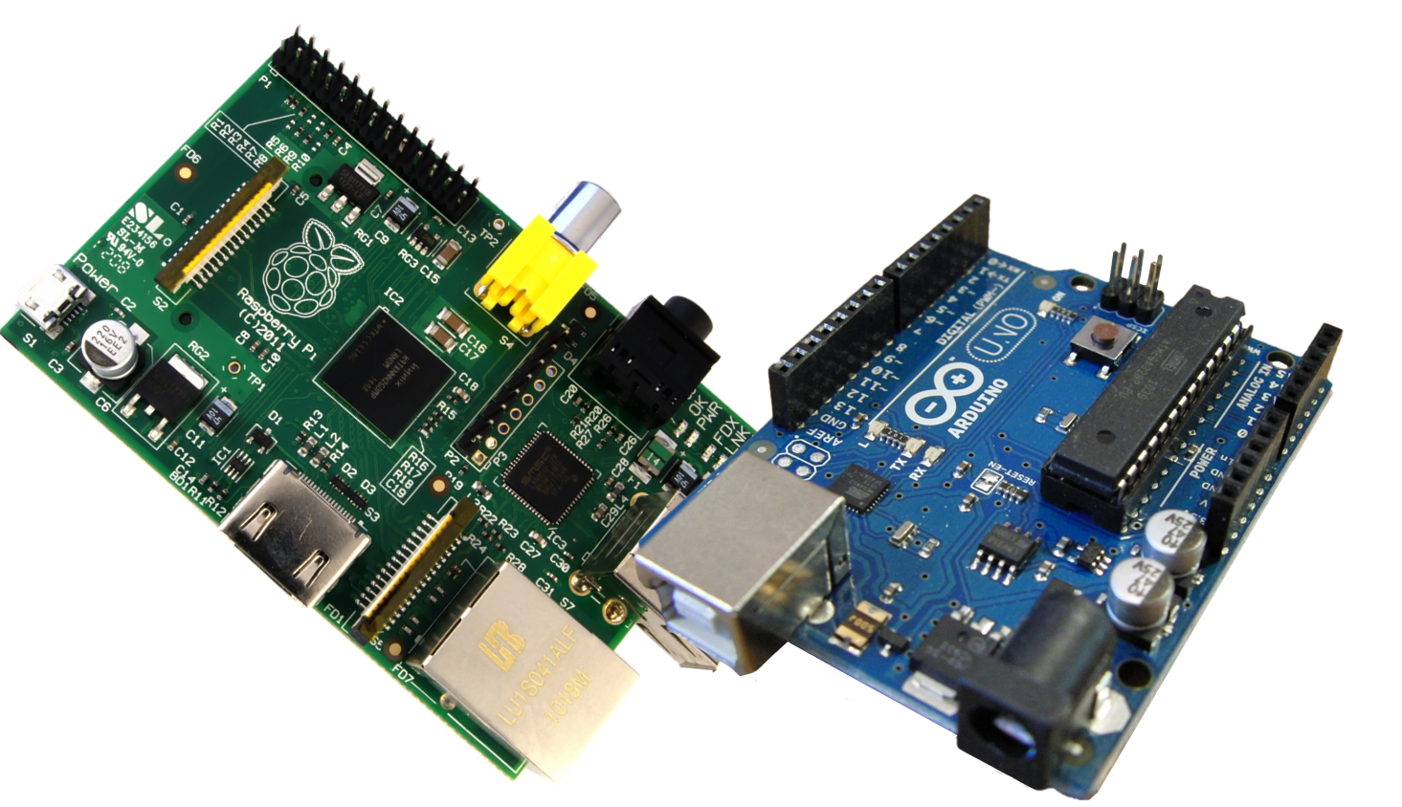
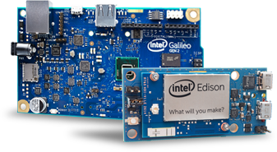
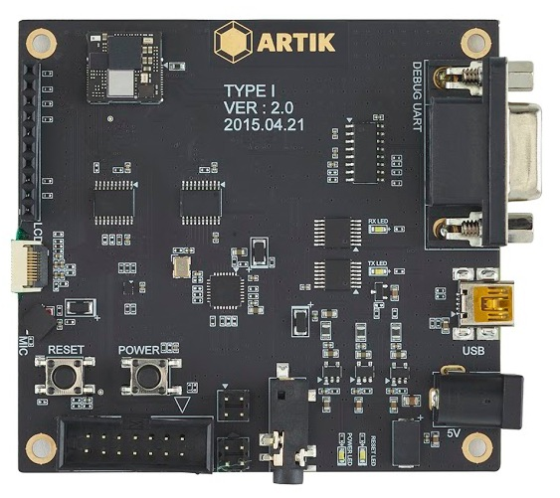
Motivation (2): Emerging Single-Board Computers
Emerging single-board computers for so-called DIY electronics
Arduino, Raspberry Pi, Intel Edison/Galileo, Samsung ARTIK, etc.
Platforms for emerging IoT applications
[+] Low cost, low power, small form factor
[-] Severe resource constraints
Single-core, in-order pipeline running at low frequency
Limited memory/storage space and power budget
Arduino and Raspberry pi
Intel Galileo and Edison
Samsung ARTIK

Slide 4
Motivation (3): Scripting Languages + Single-Board Computers
Productivity benefits for IoT programming
Ease of programming and testing
Natural support for event-driven programming model
Seamless client-server integration (e.g., using HTML5/JavaScript)
But, too slow on IoT platforms
JIT compilation: not viable due to severe resource constraints
VM interpreter: wastes CPU cycles for
Recurring cost of bytecode dispatch
Dynamic type checks
Boxing/unboxing objects
Garbage collection
Focus of this work

Slide 5
Motivation (4): Sources of Inefficiency in Bytecode Dispatch Loop
Bytecode dispatch in VM interpreters
Uses significant # of dynamic instructions
Examples on x86-64*: Python (16-25%), JavaScript (27%), CLI (33%)
Two main sources of inefficiency
Hard-to-predict indirect jump
Redundant computation
Bytecode decoding
Bound check
Target address calculation
for (;;) {
Bytecode bc = *(VM.pc++);
int opcode = bc & mask;
// interpreter-specific
// bookkeeping code (omitted)
switch (opcode) {
case: LOAD
do_load(RA(bc),RB(bc));
break;
case: ADD
...
default:
error();
}
}
* [CGO’15] Rohou et al., Branch Prediction and the Performance of Interpreters: Don’t Trust Folklore.

Slide 6
Our Proposal: Short-Circuit Dispatch (SCD)
SCD: Architectural support for fast bytecode dispatch in VM* interpreters
Key idea: Using part of BTB space as efficient, SW-managed bytecode jump table
Upon bytecode fetch, BTB is looked up using the bytecode (instead of PC) as key
If hits: short-circuited to the correct bytecode handler If not: falls back to the original slow path
Key results
Eliminates most of branch mispredictions and redundant computation
Incurs minimal hardware cost (0.7%)
* Meant for high-level language VMs (as in “JVM”), but not for system virtualization (as in “VMware”)

Slide 7
Outline
Motivation and key idea
Short-Circuit Dispatch (SCD)
SCD Design
ISA extension
Example walk-through
Design issues
Evaluation
Summary

Slide 8
SCD Design (1): Canonical Dispatch Loop
for (;;) {
Bytecode bc = *(VM.pc++);
int opcode = bc & mask;
switch (opcode) {
case: LOAD
do_load(RA(bc),RB(bc));
break;
case: ADD
...
default:
error();
}
}
Fetch a bytecode
Decode
Bound-check
redundant
computation
Jump address calculation
Jump
Execute the bytecode

Slide 9
SCD Design (2): Overview
Extend BTB to support two entry types
Bytecode jump table entries (JTEs)
Conventional BTB entries
SCD-augmented dispatch loop
Fetch bytecode and extract opcode
Look up BTB using the opcode
if hits: go to <fastpath>
else: go to <slowpath>
Fetch a bytecode
Fetch &
extract opcode
Look up BTB
<slowpath> no
Hit?
Decode
yes <fastpath>
Bound-check
Jump address calculation
Jump
Jump and update
Execute the bytecode

Slide 10
SCD Design (3): Overview
Five instructions
<inst>.op (.op suffix): extracts an opcode from the value of <inst>
bop (branch-on-opcode): looks up BTB using the opcode for fast dispatch
jru (jump-register-with-jte-update): jumps and updates BTB with a new JTE
jte_flush and set_mask: bookkeeping instructions (please refer to the paper)
Three registers
Rop (Opcode register): holds an opcode to dispatch
Rmask (Mask register): holds a 32-bit mask to extract an opcode
Rbop-pc (BOP-PC register): holds the PC value of bop instruction

Slide 11
ISA Extension (1): <inst>.op
<inst>.op suffix
Update Rop with the value of <inst>
Rop ← <inst> & Rmask
Fetch & extract opcode
Look up BTB
Fetch:
...
lw s11 ← 0(a5)
<slowpath> no
Hit?
Decode
yes <fastpath>
lw.op s11 ← 0(a5)
value of <inst>
Bound-check
0x3f
Rmask
Jump address calculation
Jump and update
s11
Rop
e.g., ADD r0 r0 r1
Opcode(ADD)
Execute the bytecode

Slide 12
ISA Extension (2): bop
bop (branch-on-opcode)
Look up BTB using the opcode as key
If hits, PC ← BTB[Rop]
else, PC ← PC + 4
Fetch & extract opcode
Look up BTB
<slowpath> no
Hit?
Decode
yes <fastpath>
B T B
Bound-check
bop?
Target address
BTB entry
BTB entry
BTB entry
BTB entry
J
0
0
0
0
Jump address calculation
PC
key
1 0
Jump and update
Rop
Target (ADD)
1
Opcode(ADD)
Execute the bytecode
J: JTE bit

Slide 13
ISA Extension (3): jru
jru (jump-register-with-jte-update)
Jump-register & insert a new JTE into BTB
PC ← Rsrc, BTB[Rop] ← Rsrc
Fetch & extract opcode
Look up BTB
Jump:
jr a5
<slowpath> no
jru a5
Hit?
※ a5 == Target (ADD)
Decode
yes <fastpath>
B T B
Bound-check
bop?
Target address
BTB entry
BTB entry
BTB entry
BTB entry
J
0
0
0
0
Jump address calculation
PC
key
1 0
Jump and update
Rop
Target (ADD)
1
Opcode(ADD)
Execute the bytecode
J: JTE bit

Slide 14
Example Walk-through
Script
Bytecodes
B T B
a = 1
LOAD r0 #1
miss
J | Target address
0 | BTB entry
0 | BTB entry
0 | BTB entry
0 | BTB entry
b = 2
LOAD r1 #2
hit
a = a + b
ADD r0 r0 r1
miss
1
Target (LOAD)
1
Target (LOAD)
1
1
1
Target (LOAD)
Target (LOAD)
Target (LOAD)
c = 3
LOAD r2 #3
hit
1
1
1
Target (ADD)
Target (ADD)
Target (ADD)
a = a + c
ADD r0 r0 r2
hit
J: JTE bit
SCD eliminates two source of inefficiency in dispatch loop
Branch mispredictions
Redundant computation (if it hits in the BTB)

Slide 15
Topics Not Covered in this Presentation
Please refer to the paper for the following information:
Details of pipeline design
Conflict reduction between BTB entries and JTEs
OS context switching
Multiple jump tables
Evaluation against the state-of-the-art software/hardware techniques
Evaluation on higher-performance core (Cortex-A8 class)
Detailed power and area analysis using synthesizable RTL
etc.

Slide 16
Outline
Motivation and key idea
Short-Circuit Dispatch
Evaluation
Methodology
Performance Results on Simulator
Performance Results on FPGA
Area and Power Consumption
Summary

Slide 17
Evaluation Methodology (1): Two Evaluation Platforms
 | Gem5 Simulator | FPGA
ISA | 64-bit Alpha | 64-bit RISC-V v2
Pipeline | Single-Issue In-Order, 1GHz Fetch1/Fetch2/Decode/Execute (4 stages) | Single-Issue In-Order, 50MHz Fetch/Decode/Execute/Mem/WB (5 stages)
Branch Predictor | Tournament predictor 512-entry (global); 128-entry (local) 256-entry, 2-way BTB with RR replacement policy 8-entry return address stack 3-cycle branch penalty | 32B predictor (128-entry gshare) 62-entry, fully-associative BTB with LRU replacement policy 2-entry return address stack 2-cycle branch miss penalty
Caches | 16KB, 2-way, 2-cycle L1 I-cache 32KB, 4-way, 2-cycle L1 D-cache 10-entry I-TLB, 10-entry D-TLB 64B block size with LRU | 16KB, 4-way, 1-cycle L1 I-cache 16KB, 4-way, 1-cycle L1 D-cache 8-entry I-TLB, 8-entry D-TLB 64B block size with LRU

Slide 18
Evaluation Methodology (2): Workloads
Lua-5.3.0
47 bytecodes
35 native instructions for dispatch
No JIT supported, GC turned off
SpiderMonkey-17.0 (JavaScript)
229 bytecodes
29 native instructions for dispatch
Both GC and JIT turned off
Benchmarks
11 scripts for each from Computer Language Benchmarks Game*
* http://benchmarksgame.alioth.debian.org

Slide 19
Overall Speedups on Simulator
19.9%
14.1%
Geomean speedups
Lua: 19.9% (Max: 38.4% for mandelbrot)
JavaScript: 14.1% (Max: 37.2% for fannkuch-redux)

Slide 20
Branch MPKI on Simulator
Branch misprediction rate (MPKI)
Reduction in branch misprediction rate (in MPKI)
Lua: 15.0 → 4.4
JavaScript: 18.9 → 13.6

Slide 21
Instruction Counts on Simulator
Normalized instruction counts
Reduction in dynamic instruction count
Lua: 10.2% (Max: 15.4% for random)
JavaScript: 9.6% (Max: 15.9% for fannkuch-redux)

Slide 22
Overall Speedups on FPGA
12.0%
Geomean speedup
Lua: 12.0% (Max: 22.7% for mandelbrot)

Slide 23
Area and Energy Consumption
0
0
BTB
Others
Minimal area/power costs (at 40nm technology node)
Area overhead: 0.72% (0.59% by BTB)
Power overhead: 1.09% (0.90% by BTB) → EDP improvement: 24.2%

Slide 24
Summary
Two main sources of inefficiency in bytecode dispatch loop
Hard-to-predict indirect jump
Redundant computation for decode, bound check, and target address calculation
Short-Circuit Dispatch (SCD) effectively eliminates both
Low-cost architectural support for fast bytecode dispatch
Using part of BTB as efficient, software-managed bytecode jump table
SCD accelerates production-grade VM interpreters
Geomean (Maximum) speedups: 19.9% (38.4%) for Lua, 14.1% (37.2%) for JavaScript
24.2% EDP improvement with only 0.72% area overhead at 40nm technology node

Slide 25
Q & A

Slide 26
Sensitivity Study: Small Size of BTB
Lua
JavaScript
The number of BTB size
Significantly outperforms the default(256) even with a small BTB size (64)

Slide 27
Sensitivity Study: Max Cap of JTEs
Lua
JavaScript
Maximum cap on the number of JTEs
Capping the maximum number of JTEs in the BTB is not much effected.
However, some benchmarks get better performance (e.g., n-sieve).

Slide 28
SCD vs. VBBI (HW) vs. Jump Threading (SW) (1)
Overall speedups over baseline

Slide 29
SCD vs. VBBI (HW) vs. Jump Threading (SW) (2)
Normalized instruction count
Branch Miss Rate

Slide 30
SCD vs. VBBI (HW) vs. Jump Threading (SW) (3)
I-Cache Miss Rate

Slide 31

SCD vs. VBBI (HW) vs. Jump Threading (SW)
Speedups
Normalized Instructions

