Slide 1

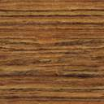


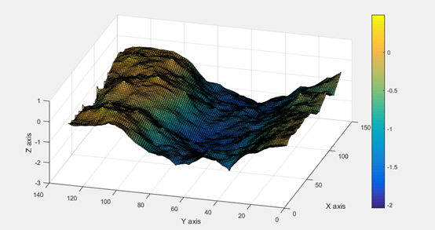

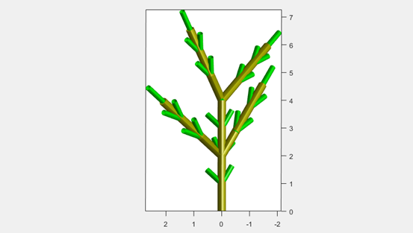

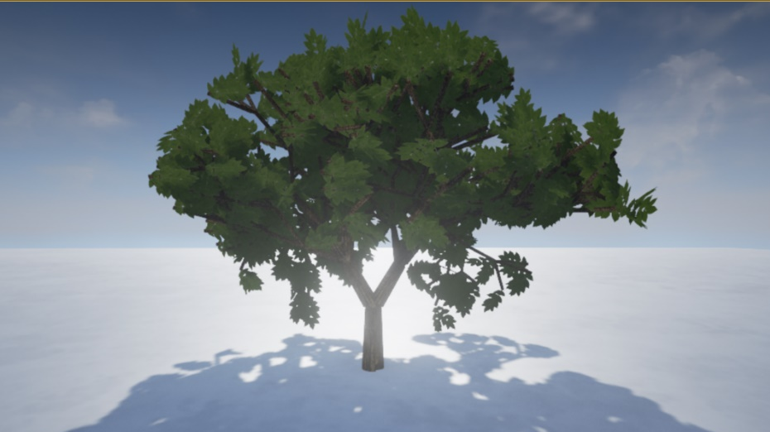

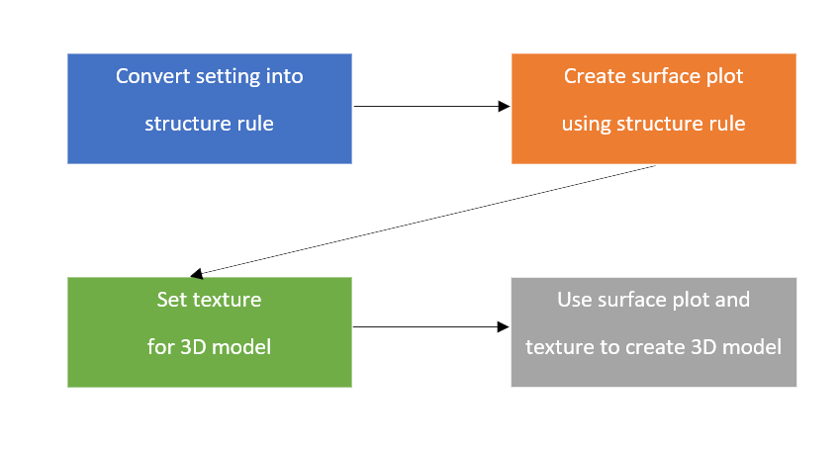

Department of Computer Engineering
(Computer Engineering)
3D Virtual modelling by using natural fractal
Chanol Pearachpatra¹, Thanit Wongmasa² and Jirasak Sittigorn³
This project has been made for education, application and developing to create 3D virtual modelling with creating natural model by fractal. We use the fractal equation to create 3D objects that have pattern and also use it as a base of many objects in 3D virtual world. The simple steps to do are starting with create the pattern by equation loop and then showing by plotting in to the 3D world scale. The executing and showing the result are done by 3D-modelling developing software “UNREAL ENGINE”. In the moment that this project was made, the latest version is UNREAL ENGINE. Moreover, this project will represent for using as a library that accomplish with UNREAL ENGINE for easy-to- use and fast creating.
First experiment, create surface of 3D model using Diamond Square Algorithm. As shown in Figure 1
Second experiment, create tree structure using Lindenmayer System. As shown in Figure 2
Third experiment, create tree using our library in UNREAL ENGINE. As shown in Figure 3
Figure 1 Result of surface created using Diamond Square Algorithm
Nowadays virtual reality development process that create 3D model is created by moulding new 3D model. In following process using long developing time to create same type of model but different in texture and model structure (e.g. 2 models of palm tree should be different but it still palm tree). According to demand of time saving and make 3D model more realistic we made a library in UNREAL ENGINE that creating model by fractal algorithm that we can found in natural model structure to define type of 3D model and create various of 3D model under following rule.
Figure 2 Result of create tree structure using Lindermayer System
In this project we develop library for creating 3D model using UNREAL ENGINE which is developer tool for creating 3D virtual reality game.
In our library separate into 4 processes. First convert library setting into structure rule for 3D object. Second use structure rule to create 3D surface plot object that represent 3D model. Next set texture for 3D model. Last use 3D surface plot and texture from previous step to create 3D object.
In process which convert setting into structure rule and creating 3D surface plot we use Deterministic Lindenmayer System for define rule to create model, Diamond Square Algorithm for randomize surface and Phyllotaxis Algorithm for specify rotation of model.
Figure 3 Result of create tree using our library
From the experiment that creating tree structure using fractals we realize that we can separate type of tree by using rule and we can create every natural creation from rule that repeatedly use. But sometimes we need uncountable of rule to define model.
[1] Martz, P. 1996. Generating Random Fractal Terrain. [Online]. Available: http://www.gameprogrammer.com/fractal.html
[2] Owens, A. Cieslak, M. Hart, J. Bockhoff, R. Prusinkiewicz, P. 2016. “Modeling Dense Inflorescences.” ACM Transactions on Graphics 35(4)
[3] Prusinkiewicz, P. and Lindenmayer, A. 1990. The Algorithmic Beauty of Plants. New York: Springer-Verlag.
[4] Turner, M. 1998. Modelling Nature with Fractals. [Online]. Available: https://plus.maths.org/content/modelling-nature-fractals
E-mail: 56010304@kmitl.ac.th¹, 56010578@kmitl.ac.th ²

