Slide 1
Advanced Hardware Design
PROCESSOR 51
Final Project Report

Slide 2
INDEX
Design Block Diagram

Slide 3
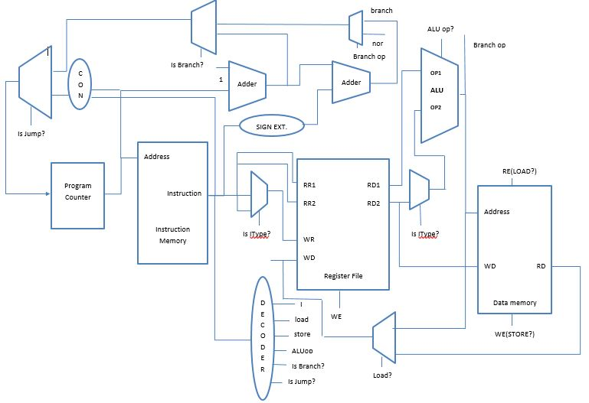
Block Diagram of Processor 51

Slide 4
Program Counter
It points to the address of the next instruction to be executed.
It is a 32- bit register, acting as a flip-flop, incrementing its value every clock cycle.
As soon as it executes the halt instruction, it stops incrementing.

Slide 5
Instruction Memory
It stores instructions(machine codes) to be executed.
It obtains the address as an input from the Program Counter and gives the instruction as the output written at the specified address.
The size of the instruction memory is____

Slide 6
Arithmetic Logic Unit (ALU)
It is responsible for all computations in the processor. It performs logical, arithmetic, shift and branch operations.
Logical instructions such as and, or, etc., arithmetic instructions such as add, subtract, etc., shift left and right and branch instructions as branch if equal, if not equal, etc. are implemented by the ALU.
The inputs to the ALU are obtained from the register file from which we obtain 2 operands, and the instruction from the instruction memory which selects which instruction to be implemented, if it is a R-type instruction. In case of an I-type instruction, one of the inputs is obtained from the register file, other is obtained from the instruction memory which contains the information on which I-type instruction needs to be implemented and a 16-bit immediate value. For J-type instructions, one of the inputs is obtained from register file, the other input is obtained from the instruction memory which is a 26-bit immediate value and a 6-bit value which determines that it is a J-type instruction.
The output of the ALU is a 32-bit result. For branch instructions, it acts as a comparator.

Slide 7
Decoder
The input to the decoder unit is a 32-bit instruction from the instruction memory.
With the first 6 bits of the instruction, it determines the type of instruction and the flags are generated.

Slide 8
Register File
The input to the register file are 2 5-bit inputs obtained from the instruction which determines which register needs to be used, another 5-bit input deciding in what register, the values need to be written, a 32-bit input for the value of the particular register and a Write Enable signal to select if you need to write or read from the register file.
The output of the register file is 32-bit data of Rs and Rt registers which is used by the ALU.

Slide 9
ALU Block Diagram
32 BIT DATA
ADD
OR
BLT
11 TO 1
MUX
32 BIT DATA
SUB
SHR
BEQ
AND
SHL
BNE
32 BIT DATA
NOR

Slide 10
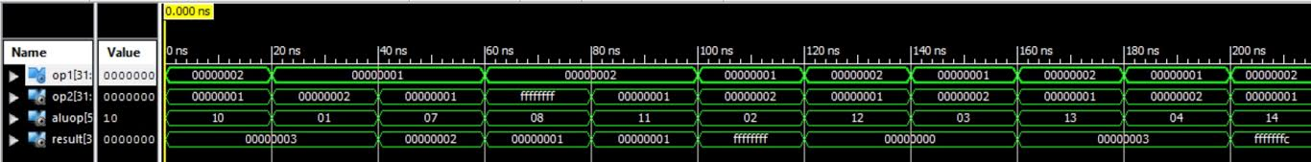
ALU SIMULATION SCREENSHOT
Instruction | Operand 1 | Operand 2 | Result
add | 00000002 | 00000001 | 00000003
addi | 00000001 | 00000002 | 00000003
lw | 00000001 | 00000001 | 00000002
Sw | 00000002 | ffffffff | 00000001
sub | 00000002 | 00000001 | 00000001
Subi | 00000001 | 00000002 | ffffffff
And | 00000002 | 00000001 | 00000000
Andi | 00000001 | 00000002 | 00000000
Or | 00000002 | 00000001 | 00000003
ori | 00000001 | 00000002 | 00000003
nor | 00000002 | 00000001 | fffffffc

Slide 11
Decoder Unit
1 to 7 Decoder
Halt flag
Jump Instruction
Instruction 32
Branch Instruction
AluOp
Store Instruction
Load Instruction
IType

Slide 12
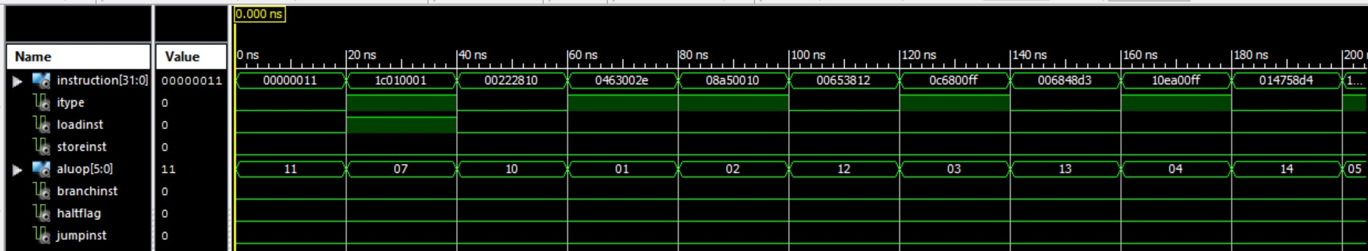
Decoder Simulation

Slide 13
Sample Program 1
ADDI R1, R0, 7 // R1 = 7
ADDI R2, R0, 8 // R2 = 8
ADD R3, R1, R2 // R3 = R1 + R2 =15
HAL // HALT

Slide 14
Sample Program 1 Machine Code:
00000100000000010000000000000111 00000100000000100000000000001000 00000000010000010001100000010000 11111100000000000000000000000000

Slide 15
Simulation of Sample Program 1:

Slide 16
Sample Program 2
ADDI R1, R0, 2 // R1=2
ADDI R3, R0, 10 // R3=10D (D=Decimal)
ADDI R4, R0, 14 // R4=14D
ADDI R5, R0, 2 // R5=2
SW R4, 2(R3) // 14D is stored in Data memory location 12D
SW R3, 1(R3) // 10D is stored in Data memory location 11D
SUB R4, R4, R3
SUBI R4, R0, 1
AND R4, R2, R3
ANDI R4, R2, 10
OR R4, R2, R3
LW R2, 1(R3) // R2=10D (Loaded back from memory)
ORI R4, R2, 10
NOR R4, R2, R3
SHL R4, R2, 10
SHR R4, R2, 10
BEQ R5, R0, -2
BLT R5, R4, 0
BNE R5, R4, 0 JMP 20
HAL

Slide 17
Sample Program 2 Machine Code:
00000100000000010000000000000010 00000100000000110000000000001010 00000100000001000000000000001110 00000100000001010000000000000010 00100000011001000000000000000010 00100000011000110000000000000001 00000000011001000010000000010001 00001000000001000000000000000001 00000000011000100010000000010010 00001100010001000000000000001010 00000000011000100010000000010011 00011100011000100000000000000001 00010000010001000000000000001010 00000000011000100010000000010100 00010100010001000000000000001010 00011000010001000000000000001010 00101000000001011111111111111110 00100100100001010000000000000000 00101100100001010000000000000000 00110000000000000000000000010100 11111100000000000000000000000000

Slide 18
Simulation of Sample Program 2:

Slide 19
RC 5 Encryption Assembly Code
encrypt_start:sub r0, r0, r0 //flush register 0
lw r0, r1, 24 //Din value is stored in 36 = A
lw r0, r2, 80 //first value of skey, S[0] is stored in r2
add r1, r2, r1 //Now r1 has value of A_pre=A+ S[0]
lw r0, r2, 25 //Din value is stored in 37 = B
lw r0, r3, 81 //second value of S[1]
add r2, r3, r2 // Now r2 has the value of B_pre=B+S[1]
sub r3, r3, r3 //flush register 3, to be used as a max value of i
addi r0, r3, D // Load counter register r3 with 13 as a blt counter will be run
sub r31, r31, r31
addi r31, r31, 1 //initialise i with 1
sub r30, r30, r30 //flush r30
addi r30, r30, 81 // initialise corresoding to the memory position of s[1]
encryption:nor r1, r1, r4 //A'
nor r2, r2, r5 //B'
and r1, r5, r6 //AB'
and r2, r4, r7 //A'B
or r6, r7, r4 // A xor B in r4
shl r2, r5, 1B // shift left 'B' by 27 bits
shr r5, r5, 1B // shift right 'B' by 27 bits. Now, r5 has the rotate amount
sub r7, r7, r7 //rotation aide counter
beq r5, r7, don't rotate for A
sub r6, r6, r6// assign the left shift register as r6
sub r9, r9, r9// assign the right shift register as r9
add r0, r4, r6
add r0, r4, r9

Slide 20
RC 5 Encryption Assembly Code
shift_1:shl r6, r6, 1 //shift A XOR B by 1 bit
addi r7, r7, 1
blt r7, r5, shift_1 //keep on shifting left untill it is equal to shift amount
sub r8, r8, r8 //rotation aide counter
sub r10, r10, r10
addi r10, r10, 20
sub r10, r5, r11 //store 32-rotate amount in r11
shift_2:shr r9, r9, 1 //shift A XOR B by 1 bit
addi r8, r8, 1
blt r8, r11, shift_2 //keep on shifting right untill it is equal to 32-shift amount
or r6, r9, r4 //A XOR B <<<< B
don't rotate for A: addi r30, r30, 1
lw r30, r20, 0 // load Skey values for A
add r4, r20, r1 //Final value of A
nor r1, r1, r4 //A'
nor r2, r2, r5 //B'
and r1, r5, r6 //AB'
and r2, r4, r7 //A'B
or r6, r7, r4 // B xor A in r4
shl r1, r5, 1B // shift left 'A' by 27 bits
shr r5, r5, 1B // shift right 'A' by 27 bits. Now, r5 has the rotate amount
sub r7, r7, r7 //rotation aide counter
beq r5, r7, don't rotate for B

Slide 21
RC 5 Encryption Assembly Code
sub r6, r6, r6// assign the left shift register as r6
sub r9, r9, r9// assign the right shift register as r9
add r0, r4, r6
add r0, r4, r9
shift_3:shl r6, r6, 1 //shift B XOR A by 1 bit
addi r7, r7, 1
blt r7, r5, shift_3 //keep on shifting left untill it is equal to shift amount
sub r8, r8, r8 //rotation aide counter
sub r10, r10, r10
addi r10, r10, 20
sub r10, r5, r11 //store 32-rotate amount in r11
shift_4:shr r9, r9, 1 //shift A XOR B by 1 bit
ddi r8, r8, 1
blt r8, r11, shift_4 //keep on shifting right untill it is equal to 32-shift amount
or r6, r11, r4 //B XOR A <<<< A
don't rotate for B:addi r30, r30, 1
lw r30, r21, 0 // load Skey values for A
add r4, r21, r2 //Final value of B
addi r31, r31, 1
blt r31, r3, encryption
sw r0, r1, 64 //store the upper half of encrypted output in 100
sw r0, r2, 65 //store the upper half of encrypted output in 101
hal //Encryption over

Slide 22
RC 5 Encryption Machine Code
X"00000011",X"1C010024",X"1C020080",X"1C030025",X"1C040081",X"00220890",X"00641090",X"00631891",
X"0403000D",X"03FFF811",X"07FF0001",X"03DEF011",X"07DE0081",X"00212094",X"00422894",X"00253092",
X"00443892",X"00C72093",X"1445001B",X"18A5001B",X"00E73811",X"28A7000F",X"00C63011",X"01294811",
X"00043010",X"00044810",X"14C60001",X"04E70001",X"24E5FFFD",X"010847D1",X"014A57D1",X"054A0020",
X"01455811",X"19290001",X"05080001",X"250BFFFD",X"00C927D3",X"07DE0001",X"1FD40000",X"00940810",
X"00212014",X"00422814",X"00253012",X"00443812",X"00C72013",X"1425001B",X"18A5001B",X"00E73811",
X"28A7000F",X"00C63011",X"01294811",X"00043010",X"00044810",X"14C60001",X"04E70001",X"24E5FFFD",
X"010847D1",X"014A57D1",X"054A0020",X"01455811",X"19290001",X"05080001",X"250BFFFD",X"00C927D3",
X"07DE0001",X"1FD50000",X"00951010",X"07FF0001",X"27E3FFC8",X"20010064",X"20020065",X"FC000000",

Slide 23
RC 5 ENCRYPTION SIMULATION

Slide 24
RC 5 Decryption Assembly code
decrypt_start: sub r0, r0, r0 //flush register 0
lw r0, r1, 26 //Din value is stored in 38 = A
lw r0, r2, 27 //Din value is stored in 39 = B
sub r29, r29, r29
addi r29, r29, 1
sub r3, r3, r3 //flush register 3, to be used as a counter
addi r0, r3, C // Load counter register r3 with 12 as a blt counter will be run
sub r31, r31, r31
addi r31, r31, 1 //initialise i with 1
sub r30, r30, r30 //flush r30
addi r30, r30, 99 // initialise corresoding to the memory position of S[25]
decryption: lw r30, r21, 0 // load Skey values for B
sub r2, r21, r17 //B-S[2i+1]
subi r30, r30, 1 //2i
shl r1, r5, 1B // shift left 'A' by 27 bits
shr r5, r5, 1B // shift right 'A' by 27 bits. Now, r5 has the rotate amount
sub r7, r7, r7 //rotation aide counter
beq r5, r7, don't rotate for B
sub r6, r6, r6// assign the left shift register as r6
sub r9, r9, r9// assign the right shift register as r9
add r0, r17, r6
add r0, r17, r9

Slide 25
RC 5 Decryption Assembly code
shift_5:shr r6, r6, 1 //shift B-S[2i+1] by 1 bit
addi r7, r7, 1
blt r7, r5, shift_5 //keep on shifting right untill it is equal to shift amount
sub r8, r8, r8 //rotation aide counter
sub r10, r10, 10
addi r10, r10, 20
sub r10, r5, r11 //store 32-rotate amount in r11
shift_6:shl r9, r9, 1 //shift B-S[2i+1] by 1 bit
addi r8, r8, 1
blt r8, r11, shift_6 //keep on shifting right untill it is equal to 32-shift amount
or r6, r9, r17 //B-S[2i+1] <<<< A
don't rotate for B:nor r1, r1, r4 //A'
nor r17, r17, r5 //(B-S[2i+1])'
and r1, r5, r6 //A(B-S[2i+1])'
and r17, r4, r7 //A'(B-S[2i+1])
or r6, r7, r2 // B-S[2i+1] <<<< A XOR A (Final value of B)
lw r30, r20, 0 // load Skey values for A
sub r1, r20, r18 //A-S[2i]
subi r30, r30, 1 //2i+1 for next cycle
shl r2, r5, 1B // shift left 'B' by 27 bits
shr r5, r5, 1B // shift right 'B' by 27 bits. Now, r5 has the rotate amount
sub r7, r7, r7 //rotation aide counter
beq r5, r7, don't rotate for A
sub r6, r6, r6// assign the left shift register as r6
sub r9, r9, r9// assign the right shift register as r9
add r0, r18, r6
add r0, r18, r9

Slide 26
RC 5 Decryption Assembly code
shift_7:shr r6, r6, 1 //shift A-S[2i] by 1 bit
addi r7, r7, 1
blt r7, r5, shift_7 //keep on shifting right untill it is equal to shift amount
sub r8, r8, r8 //rotation aide counter
sub r10, r10, 10
addi r10, r10, 20
sub r10, r5, r11 //store 32-rotate amount in r11
shift_8:shl r9, r9, 1 //shift A-S[2i] by 1 bit
addi r8, r8, 1
blt r8, r11, shift_6 //keep on shifting right untill it is equal to 32-shift amount
or r6, r9, r18 //A-S[2i] <<<< B
don't rotate for A: nor r2, r2, r4 //B'
nor r18, r18, r5 //(A-S[2i])'
and r2, r5, r6 //(A-S[2i])'B
and r18, r4, r7 //A-S[2i])B'
or r6, r7, r1 // A-S[2i]) <<<< B XOR B (Final value of A)
subi r3, r3, 1
blt r0, r3, decryption
lw r0, r26, 80//r26=S[0]
lw r0, r28, 81//r28=S[1]
sub r1, r26, r1//r1=A-S[0]
sub r2, r28, r2//r1=B-S[1]
sw r0, r1, 64 //store the upper half of encrypted output in 102
sw r0, r2, 65 //store the upper half of encrypted output in 103
hal

Slide 27
RC5 DECRYPTION MACHINE CODE
X"00000011",X"1C010026",X"1C020027",X"03BDE811",X"07BD0001",X"00631811",X"0403000C",X"03FFF811",
X"07FF0001",X"03DEF011",X"07DE0099",X"00000091",X"1FD50000",X"00558811",X"0BDE0001",X"1425001B",
X"18A5001B",X"00E73811",X"28A7000F",X"00C63011",X"01294811",X"00113010",X"00114810",X"18C60001",
X"04E70001",X"24E5FFFD",X"010847D1",X"014A57D1",X"054A0020",X"01455811",X"15290001",X"05080001",
X"250BFFFD",X"00C98FD3",X"002127D4",X"02312FD4",X"002537D2",X"02243FD2",X"00C717D3",X"1FD40000",
X"00349011",X"0BDE0001",X"1445001B",X"18A5001B",X"00E73811",X"28A7000F",X"00C63011",X"01294811",
X"00123010",X"00124810",X"18C60001",X"04E70001",X"24E5FFFD",X"010847D1",X"014A57D1",X"054A0020",
X"01455811",X"15290001",X"05080001",X"250BFFFD",X"00C997D3",X"004227D4",X"02522FD4",X"004537D2",
X"02443FD2",X"00C70FD3",X"08630001",X"2403FFC8",X"1C1A0080",X"1C1C0081",X"003A0891",X"005C1091",
X"20010064",X"20020065",X"FC000000",

Slide 28
RC 5 DECRYPTION SIMULATION

