Slide 1



CINEVERSE
Web Application
MVP 1
CLIENT: Marketing Line of business, xyz corporation
BDAT1004 Final Project

Slide 2
About the team
Chanpreet Kaur
Project Role: Developer
Experience: Automation Analyst Co-op, TD Bank (Sept’22 – Present)
Responsibilities:
Design, develop and test software applications and systems
Create and maintain the front-end and back-end of the software
Troubleshoot and debug issues in the software
Work closely with other team members, such as the project manager, business analyst, and data analyst, to ensure the software meets the project's requirements and specifications
Stay up to date with new technologies and programming languages that could be beneficial to the project

Slide 3
About the team
Dyutita Juneja
Project Role: Developer
Responsibilities:
Gather and analyze business requirements from stakeholders
Develop use cases, functional requirements, and other documentation to describe the project's requirements and specifications
Work with the project manager and development team to ensure the software meets the business requirements
Conduct user acceptance testing to ensure the software meets the needs of stakeholders
Serve as a liaison between the business stakeholders and the development team

Slide 4
About the team
Sangeeta Gollapalli
Project Role: Project Manager
Responsibilities:
Develop and oversee the project plan, including timelines and budgets
Communicate with stakeholders to ensure the project meets their expectations and requirements
Coordinate with team members to ensure everyone is on track and meeting their deadlines
Manage project risks and resolve issues as they arise
Track and report on project progress and performance
Ensure the project is delivered on time, within budget, and to the satisfaction of stakeholders

Slide 5
About the team
Kritika Verma
Project Role: Data Analyst
Responsibilities:
Identify and acquire relevant data for the project
Analyze and clean data to ensure accuracy and completeness
Develop data models and schemas to organize and structure the data
Design and develop databases to store and manage the data
Work with the development team to ensure the software can access and use the data effectively
Continuously monitor and analyze the data to identify insights and trends that could be useful to the project.

Slide 6



Tools/ Technologies used
Python
Cloud SQL
Flask
HTML
Google Charts

Slide 7
Business reasons for cineverse
Welcome to our website, where we've gathered the top 250 movies on IMDb to help you develop your marketing strategies! As a marketing agency, you know that staying on top of the latest trends and insights is crucial for success. That's why we've put together this list of popular movies that can help you stay in tune with the cultural zeitgeist and understand the stories that resonate with audiences.
From action-packed blockbusters to thought-provoking dramas, our list spans a range of genres and styles that can inspire your next campaign. By studying the themes and characters in these movies, you can gain a deeper understanding of what motivates people and how to connect with them on an emotional level. And by analyzing the visual styles and techniques used by the filmmakers, you can develop your own creative strategies for your clients.
But our website isn't just a resource for movie recommendations. It's also a community of like-minded creatives who are passionate about storytelling and marketing. You can share your thoughts and insights with other members, collaborate on projects, and even find potential collaborators for your next campaign.
So go ahead, explore our website and discover how the power of cinema can help you elevate your marketing game. And if you have any questions or ideas, don't hesitate to reach out to us. We're always here to help you succeed.

Slide 8
Please click here to enter the cineverse!

Slide 9
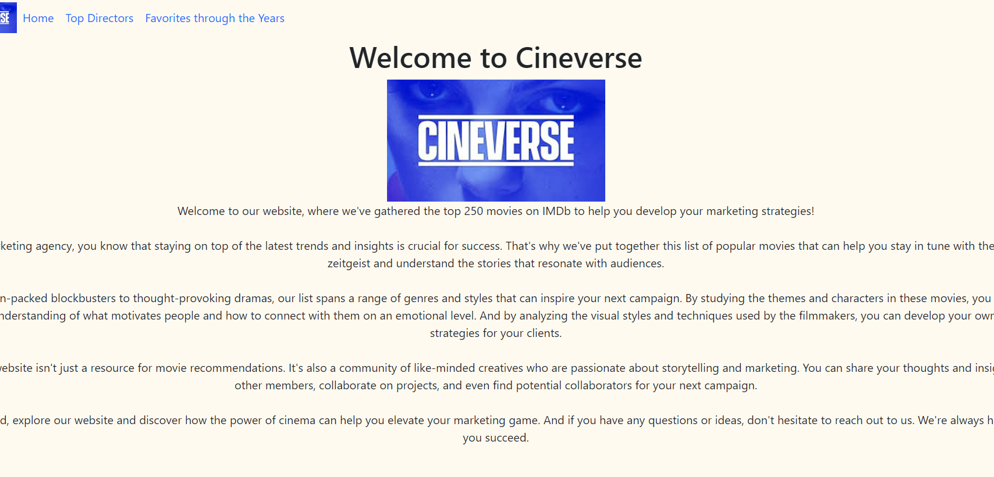
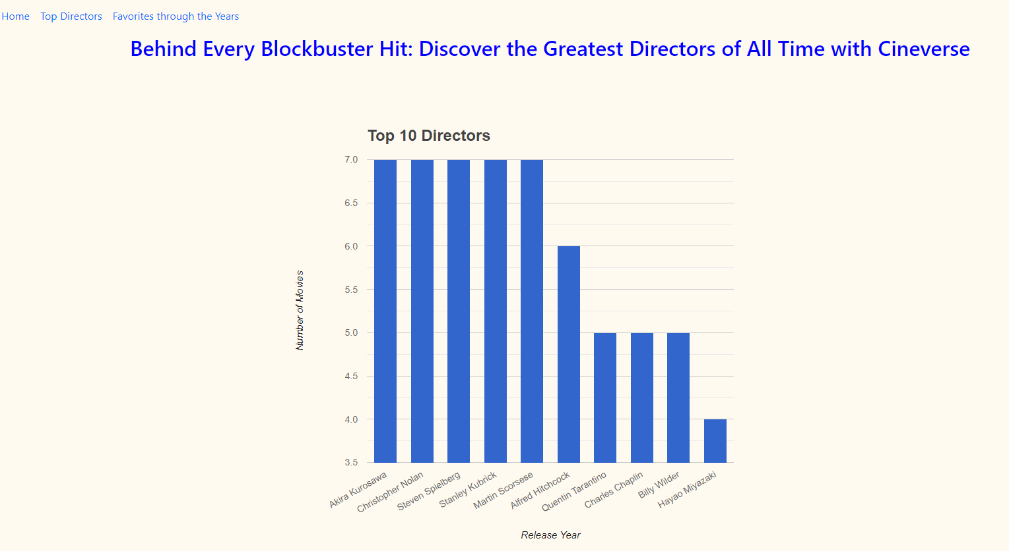
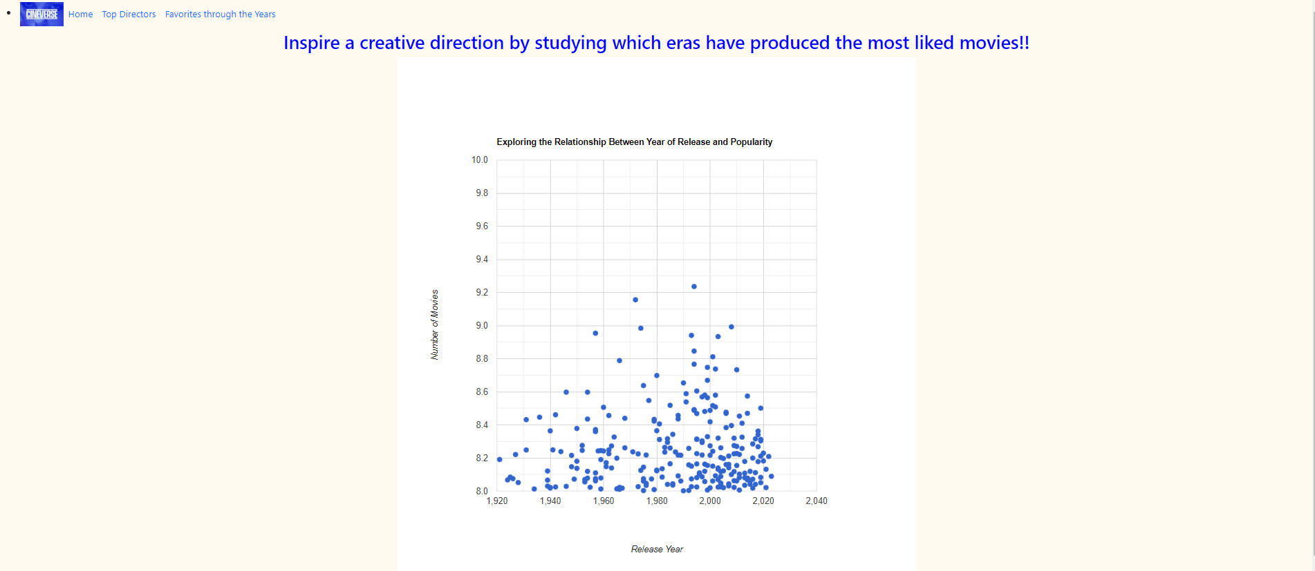
The Web Pages

Slide 10
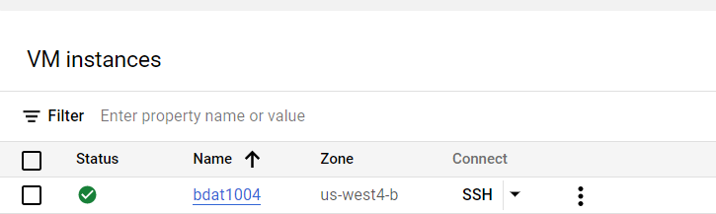
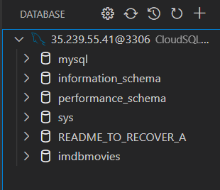
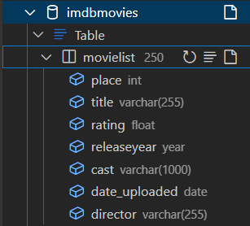
Google cloud sql instance
Database & tables
(Screen capture from Vs code)

Slide 11
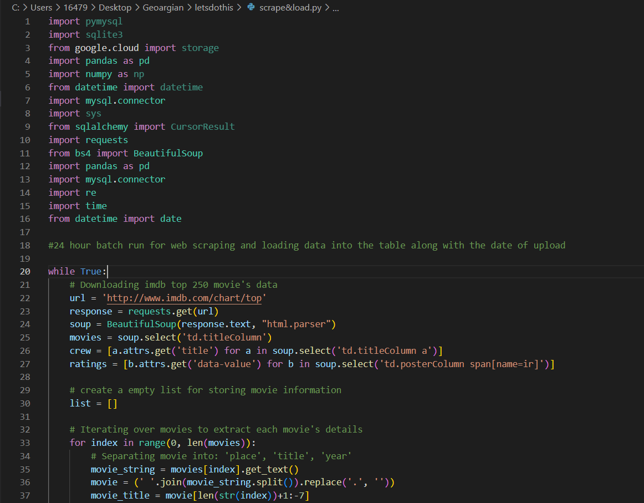
Script for Web Scraping data & storing it
The script uses several Python packages, including pymysql, sqlite3, google.cloud, pandas, numpy, datetime, mysql.connector, sys, sqlalchemy, requests, bs4, and re.
The while loop in the script is set to run every 24 hours (time.sleep(86400)) to periodically scrape the IMDb top 250 movies list and update the database table with the new data.

Slide 12
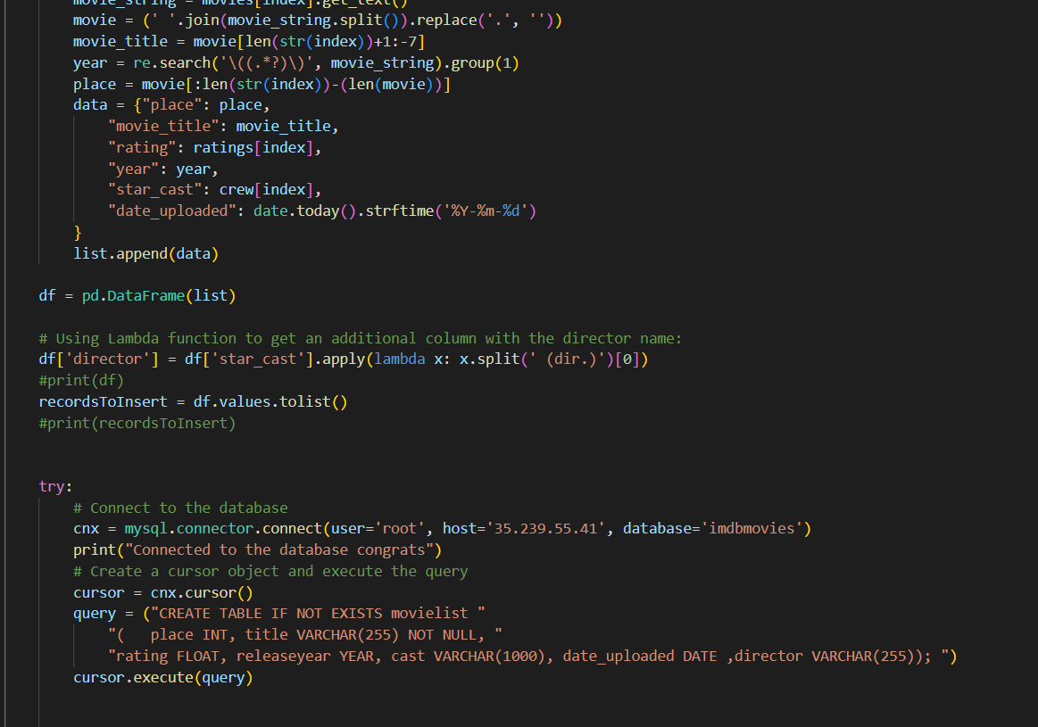
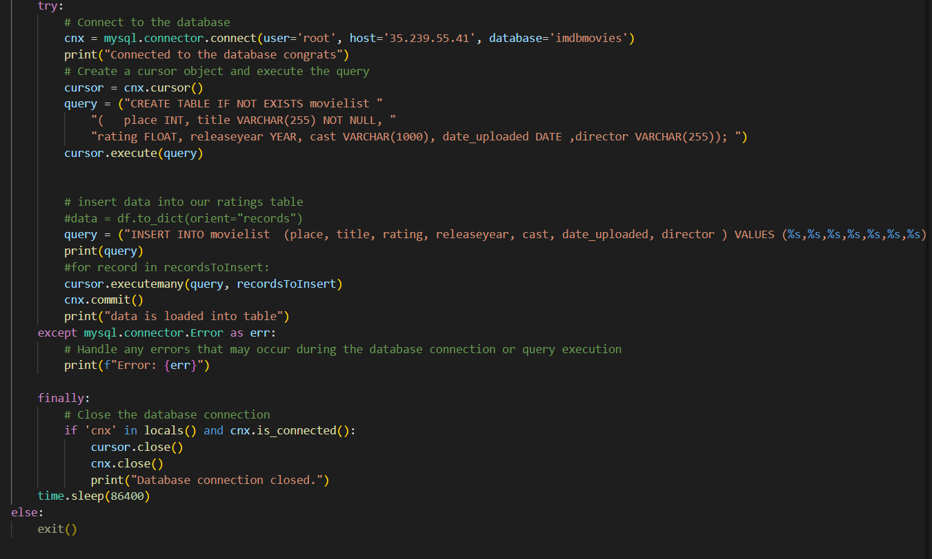
The script first uses the requests and BeautifulSoup packages to scrape the IMDb website and extract the movie title, release year, rating, star cast, and director for each movie in the top 250 list. It then converts this data into a pandas DataFrame, adds a new column with the director name using a lambda function, and stores the DataFrame records in a list.
The try block in the code is used for error handling. In this case, it attempts to connect to the MySQL database using the mysql.connector module, creates a cursor object, and executes a query to create a new table named "movielist" if it does not already exist. It then inserts the movie data into the "movielist" table.
If there are any errors during the execution of the code within the try block, the except block will be executed, and the error will be printed to the console. The purpose of using the try-except block is to catch any exceptions or errors that may occur during the database connection or query execution, and handle them in a controlled manner, instead of causing the program to crash.

Slide 13
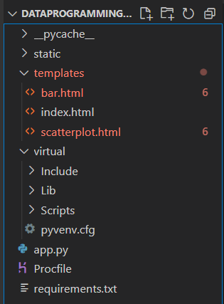
Folder Structure for the web application
Framework: Flask
Server-side code: Python
Client-side code: JavaScript
Data Visualizations: Google Chart

Slide 14
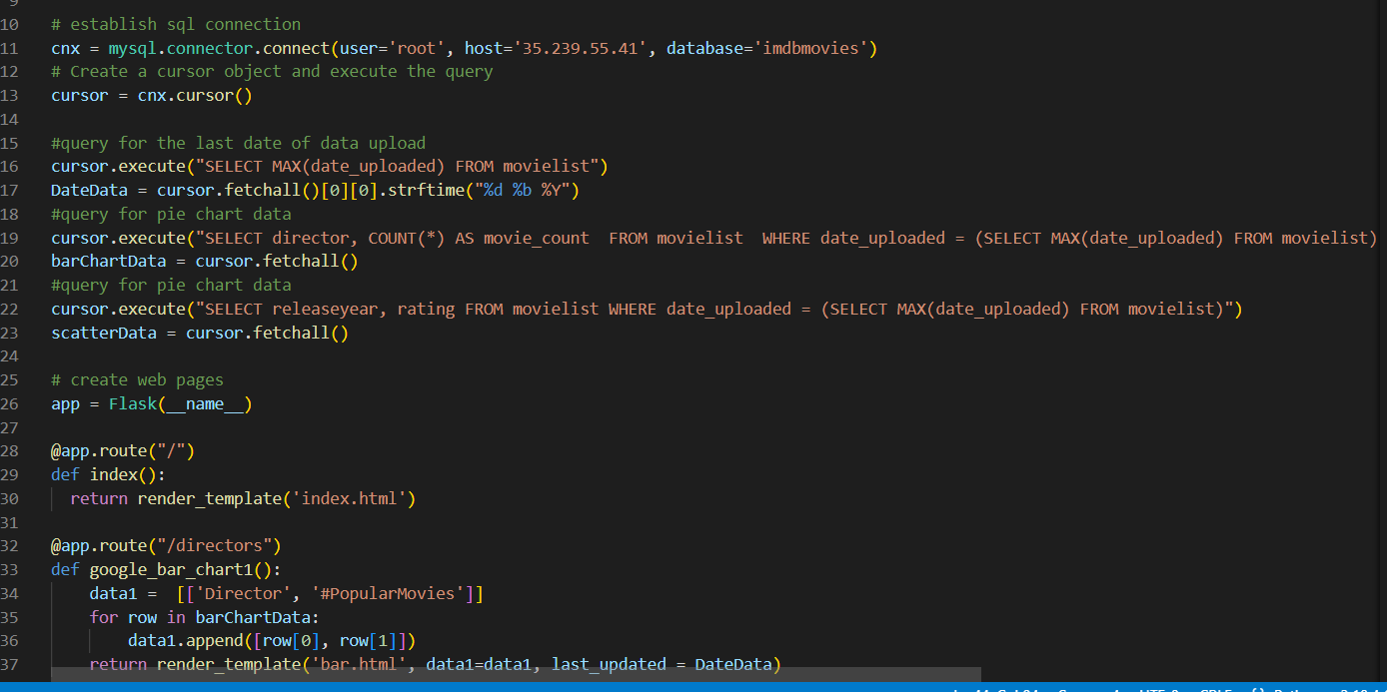
Python flask web application
The first part of the code establishes a connection to the database and executes three SQL queries to retrieve data for three chart types: a bar chart showing the top 10 directors with the most popular movies, a scatter plot showing the relationship between the release year and rating of movies,

Slide 15
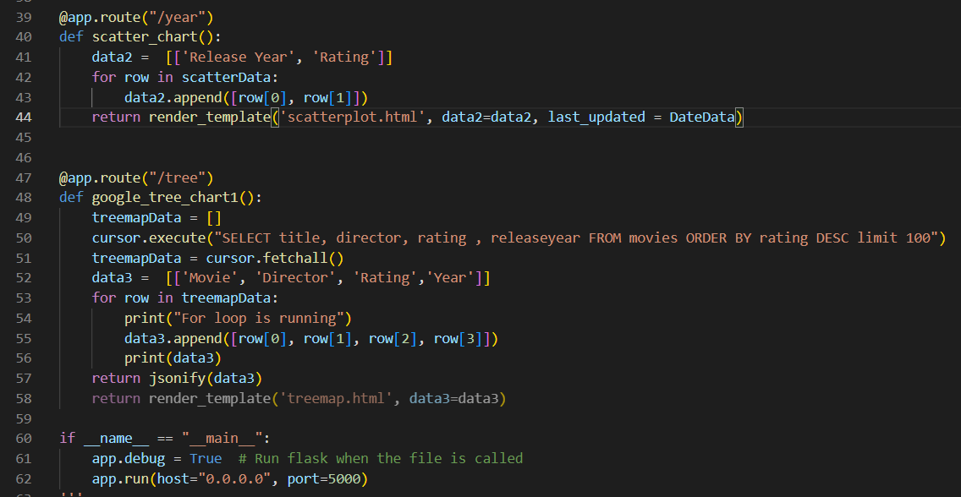
The second part of the code defines three routes for each chart type and creates web pages using HTML templates. Each route retrieves the data from the corresponding SQL query and passes it to the HTML template as a variable. The last_updated variable is also defined using the first SQL query and passed to all three HTML templates to display the date when the data was last updated.
Finally, the app.run() function is called to start the Flask web application on the local host with port 5000. By accessing each of the three routes in the web browser, the user can see the three different types of charts displaying movie data.

Slide 16
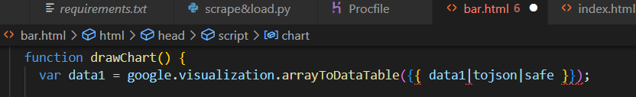
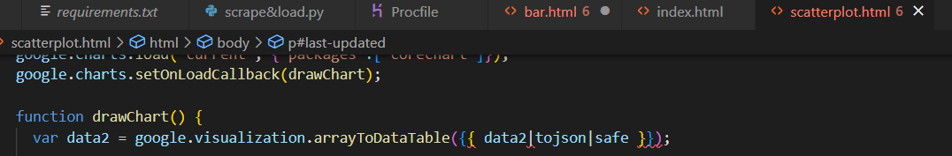
This is a JavaScript function that uses the Google Charts API to draw a bar chart. The function takes the data1 variable as input, which is a two-dimensional array of data representing the values to be plotted in the chart. The google.visualization.arrayToDataTable() function converts this data into a format that can be used by the Google Charts API.
The {{ data1|tojson|safe }} code is a Jinja2 template that inserts the value of the data1 variable into the JavaScript code. The tojson filter converts the data1 variable to a JSON string, which can be parsed by the Google Charts API. The safe filter ensures that the string is not automatically escaped by Jinja2, which could cause errors in the JavaScript code.

Slide 17
Thank you!
We look forward to collaborating with you on future projects

