Slide 1
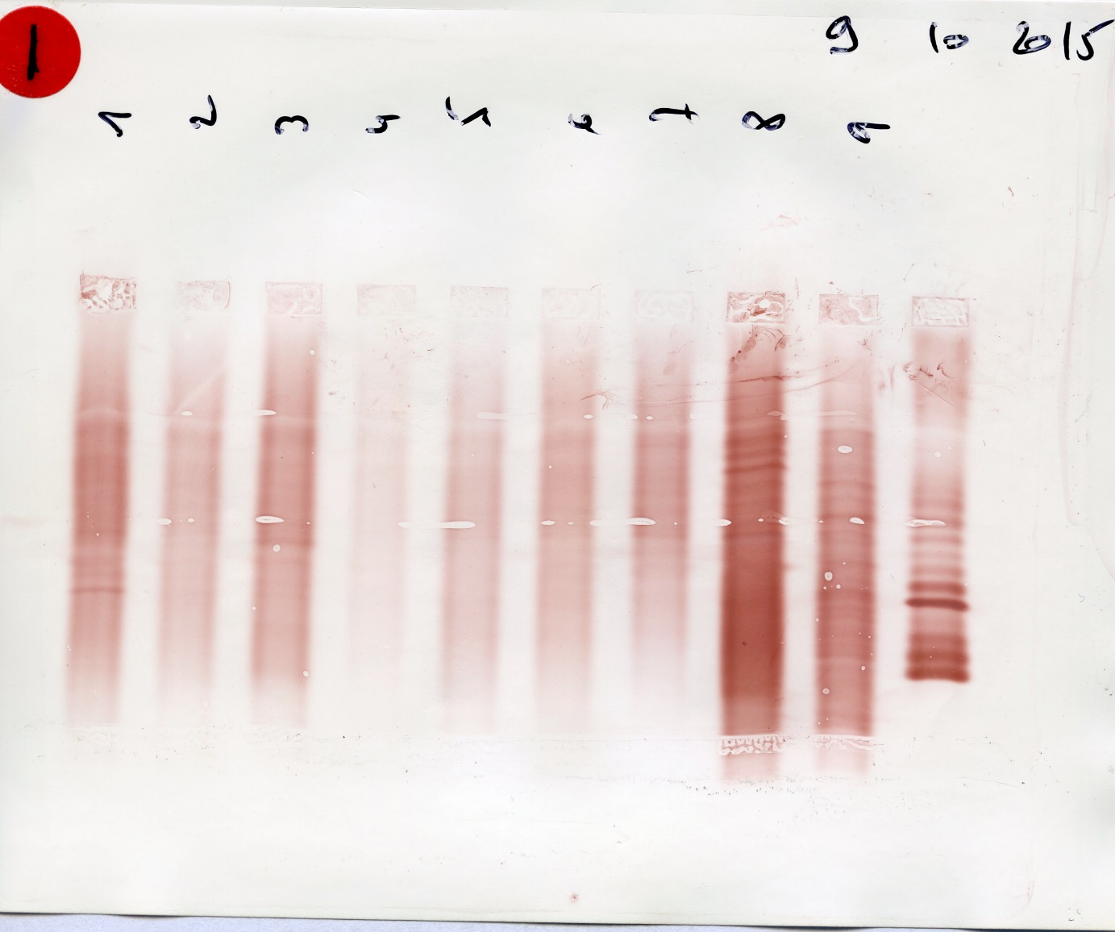
Analyse des profils 1 à 5

Slide 2
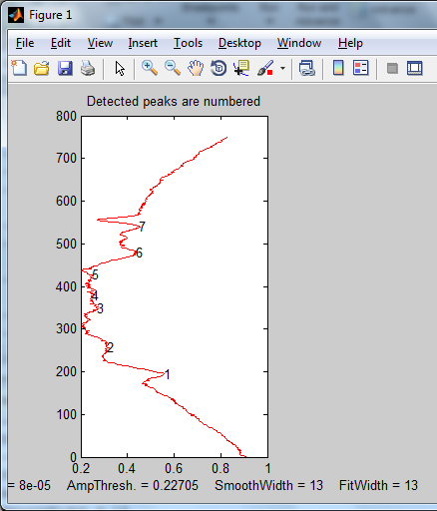

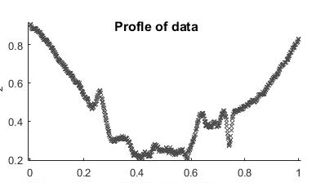
SoftFindPeak
OLIGo 1-
Elapsed time is 0.048868 seconds.
SlopeThreshold = 8e-05
AmpThreshold = 0.22705
SmoothWidth = 13

Slide 3
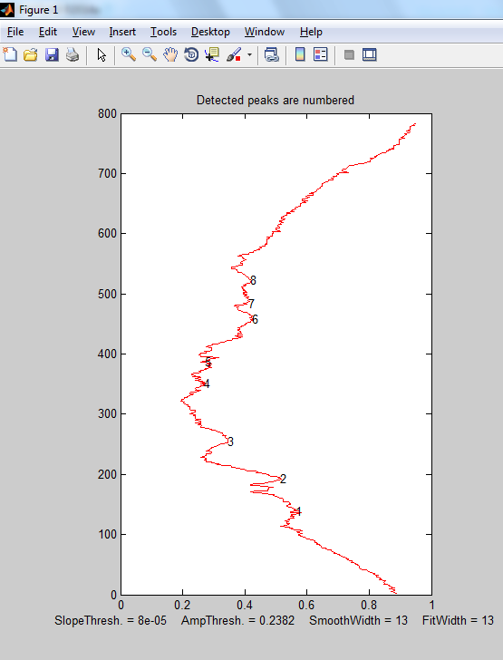

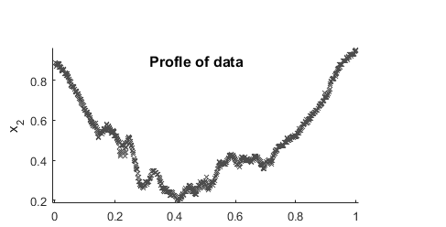
OLIGO 2
SoftFindPeak
Elapsed time is 0.050068 seconds.
SlopeThreshold = 8e-05
AmpThreshold = 0.2382
SmoothWidth = 13
FitWidth = 13

Slide 4
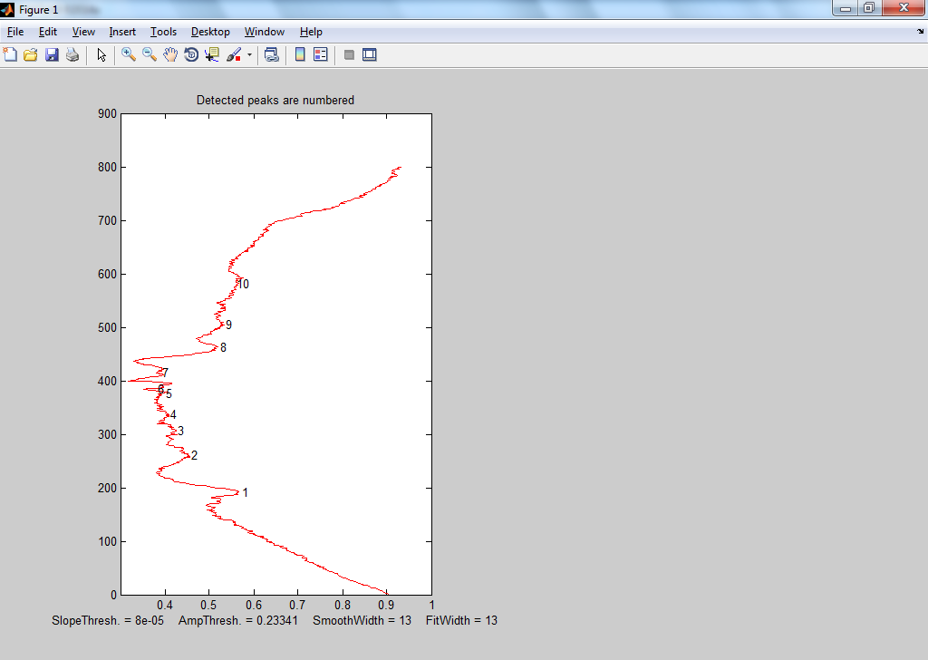

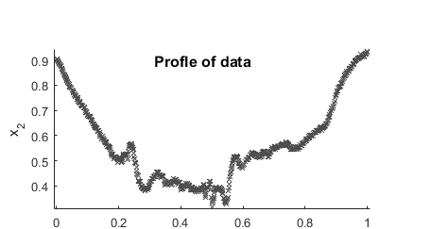
SoftFindPeak
Elapsed time is 0.052068 seconds.
SlopeThreshold = 8e-05
AmpThreshold = 0.23341
SmoothWidth = 13
FitWidth = 13

Slide 5
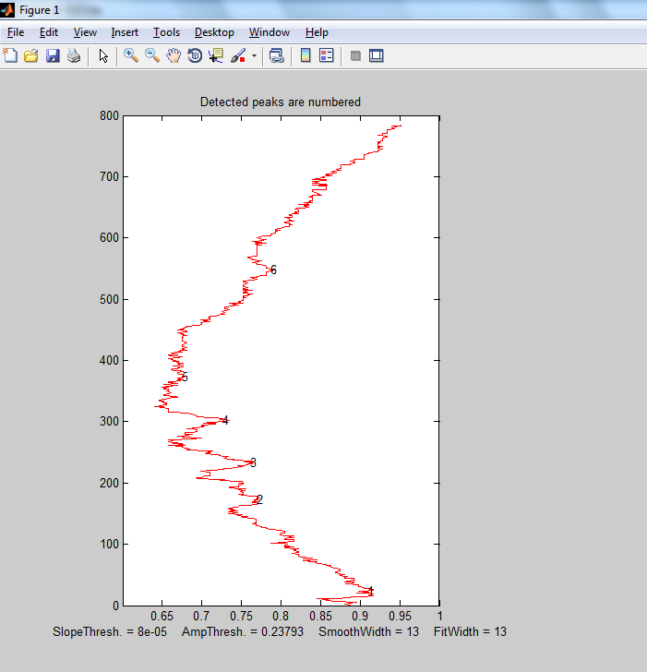

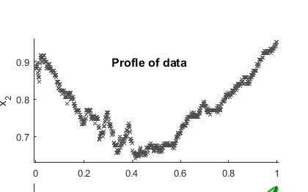
SoftFindPeak
Elapsed time is 0.048364 seconds.
SlopeThreshold = 8e-05
AmpThreshold = 0.23793
SmoothWidth = 13
FitWidth = 13

Slide 6
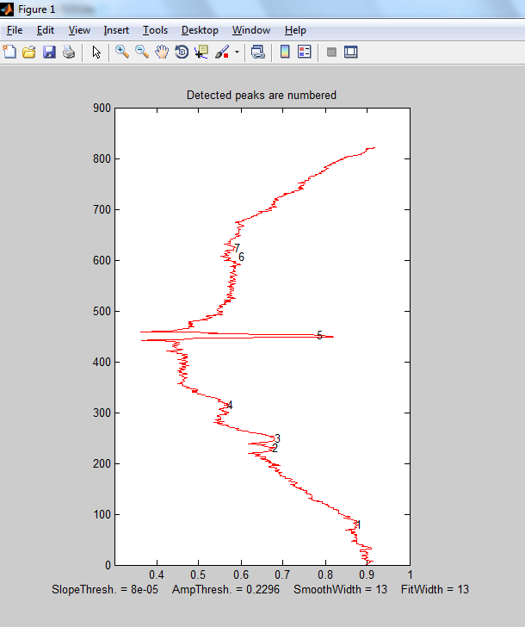

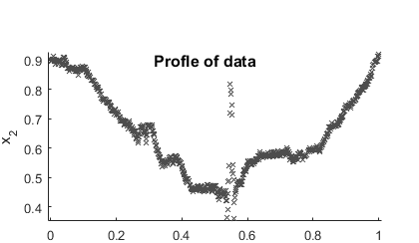
OLIGO 5
Elapsed time is 0.049213 seconds.
SlopeThreshold = 8e-05
AmpThreshold = 0.2296
SmoothWidth = 13
FitWidth = 13

Slide 7
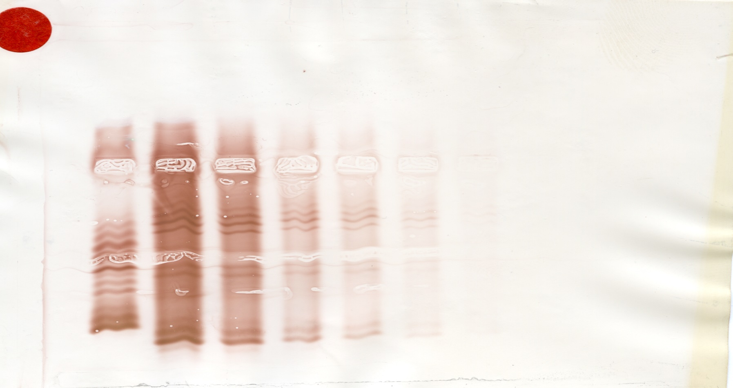
Analyse des profils 1 à 6

Slide 8
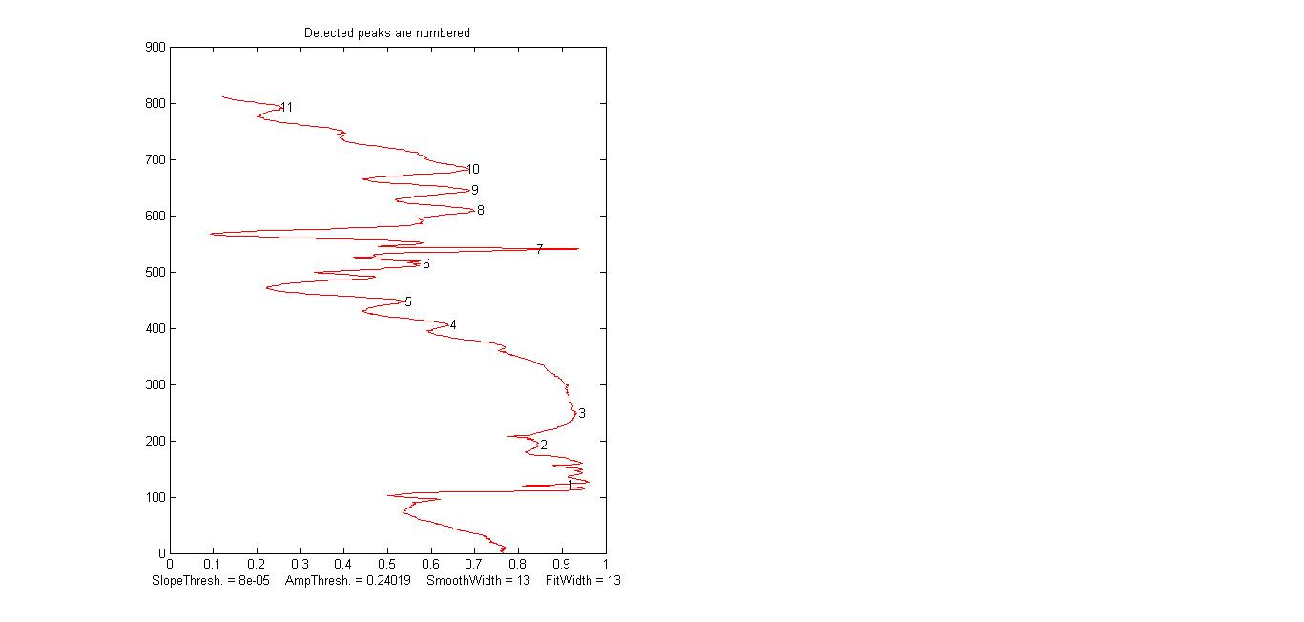

Sebia 1
SlopeThreshold = 8e-05
AmpThreshold = 0.24019
SmoothWidth = 13
FitWidth = 13
Speed = 101 Peaks Per Second

Slide 9
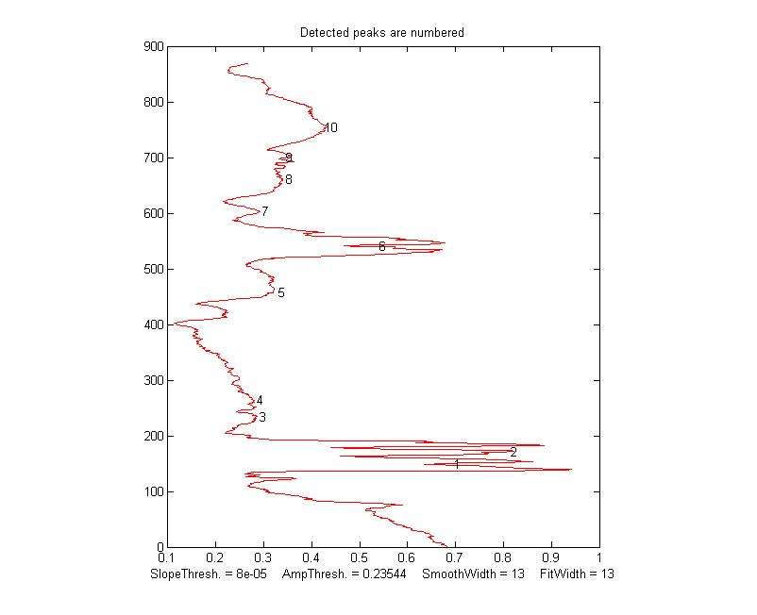

Sebia 2
SlopeThreshold = 8e-05
AmpThreshold = 0.23544
SmoothWidth = 13
FitWidth = 13

Slide 10
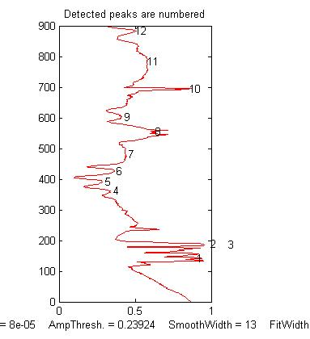

Sebia 3
SlopeThreshold = 8e-05
AmpThreshold = 0.23924
SmoothWidth = 13
FitWidth = 13

Slide 11
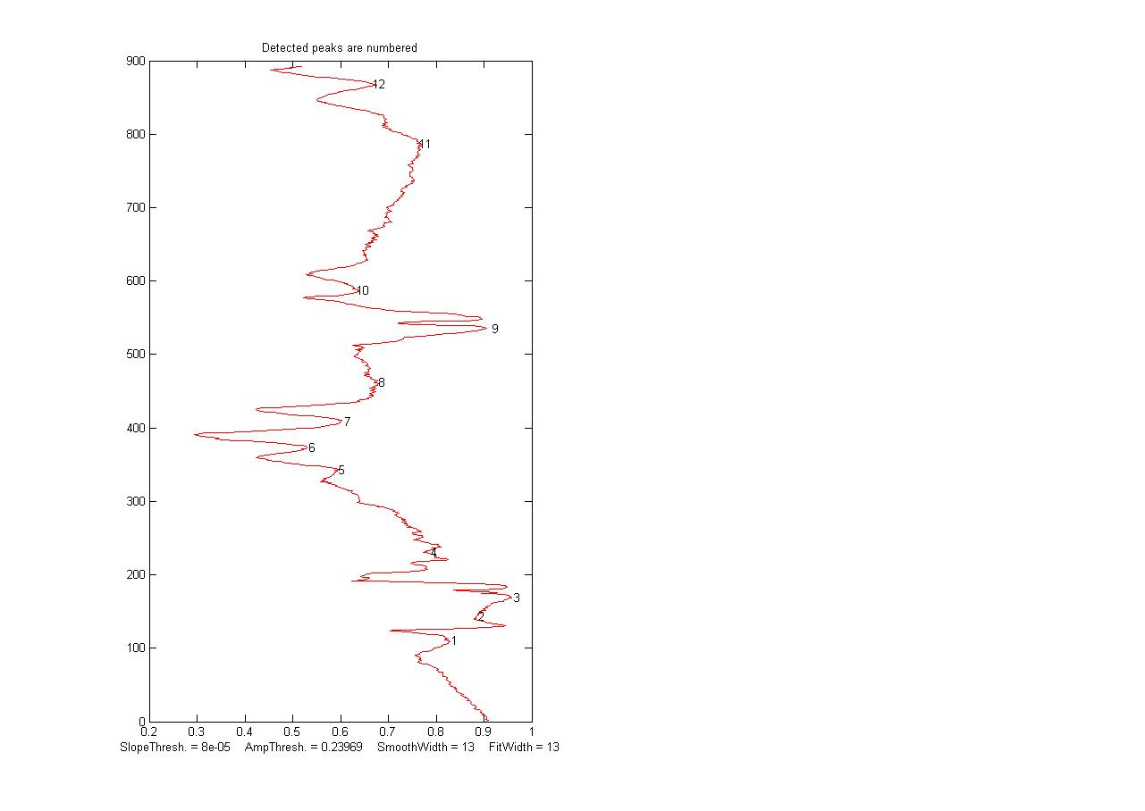

Sebia 4
SlopeThreshold = 8e-05
AmpThreshold = 0.23969
SmoothWidth = 13
FitWidth = 13
Speed = 154 Peaks Per Second

Slide 12
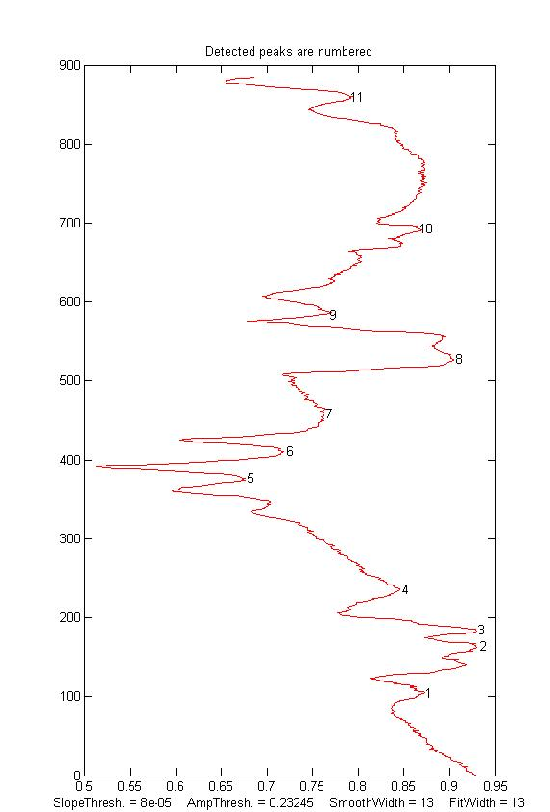

Sébia5
SlopeThreshold = 8e-05
AmpThreshold = 0.23245
SmoothWidth = 13
FitWidth = 13

Slide 13
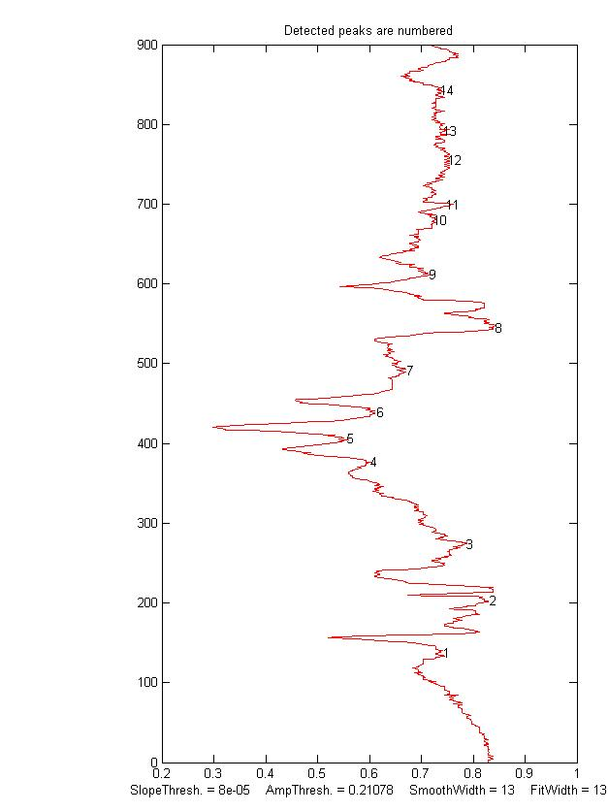

Sebia5
SlopeThreshold = 8e-05
AmpThreshold = 0.21078
SmoothWidth = 13
FitWidth = 13

