Slide 1
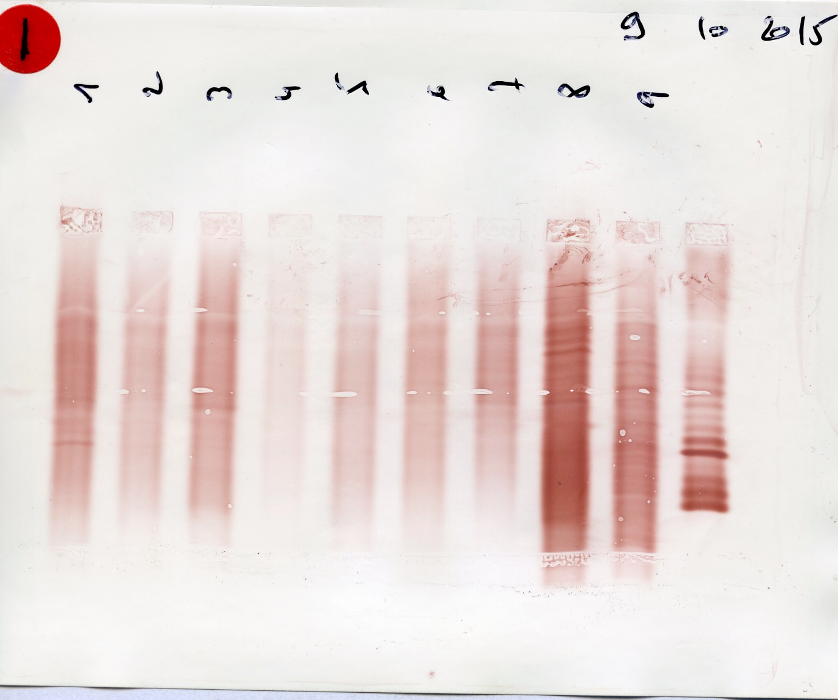
Analyse des profils 1 à 5

Slide 2
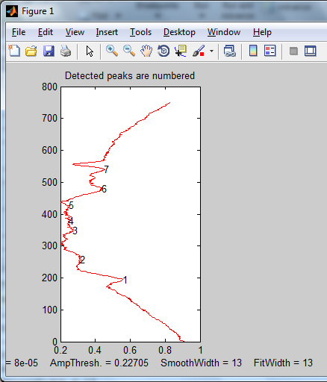

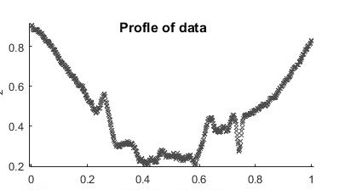
SoftFindPeak
OLIGo 1-
Elapsed time is 0.048868 seconds.
SlopeThreshold = 8e-05
AmpThreshold = 0.22705
SmoothWidth = 13

Slide 3
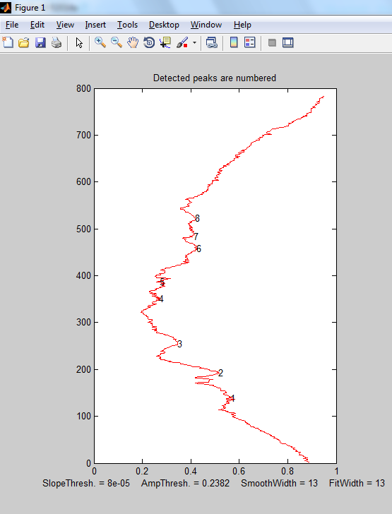

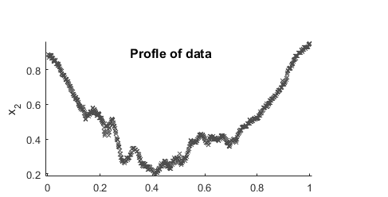
OLIGO 2
SoftFindPeak
Elapsed time is 0.050068 seconds.
SlopeThreshold = 8e-05
AmpThreshold = 0.2382
SmoothWidth = 13
FitWidth = 13

Slide 4
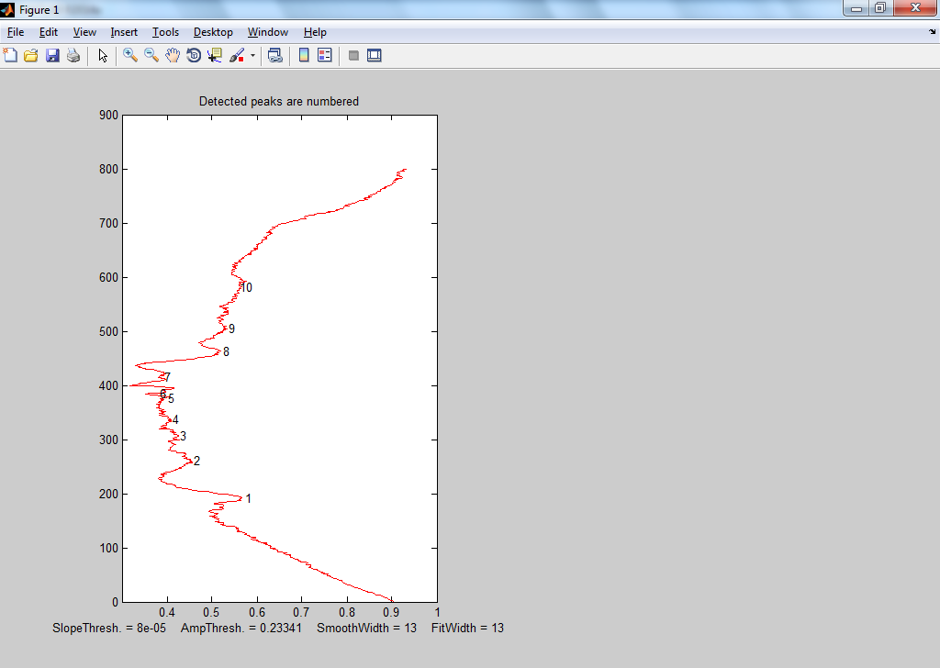

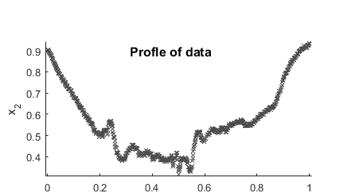
SoftFindPeak
Elapsed time is 0.052068 seconds.
SlopeThreshold = 8e-05
AmpThreshold = 0.23341
SmoothWidth = 13
FitWidth = 13

Slide 5
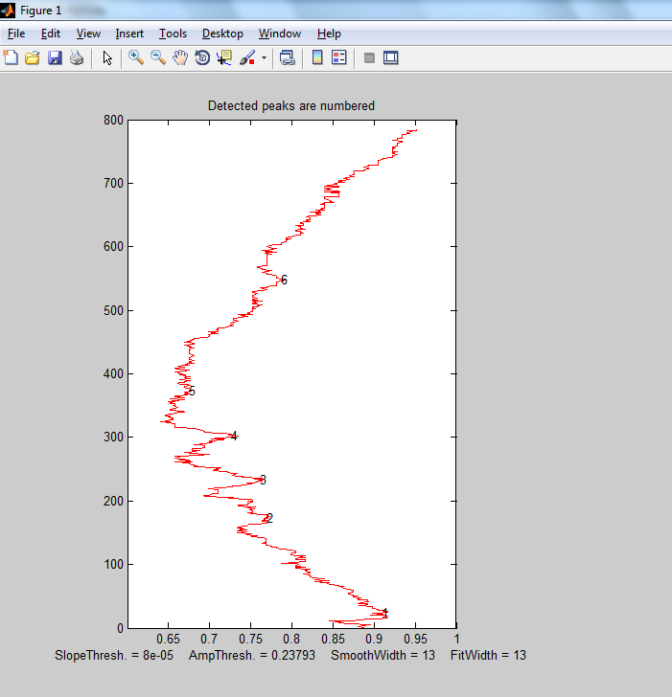

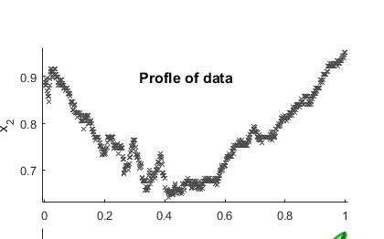
SoftFindPeak
Elapsed time is 0.048364 seconds.
SlopeThreshold = 8e-05
AmpThreshold = 0.23793
SmoothWidth = 13
FitWidth = 13

Slide 6
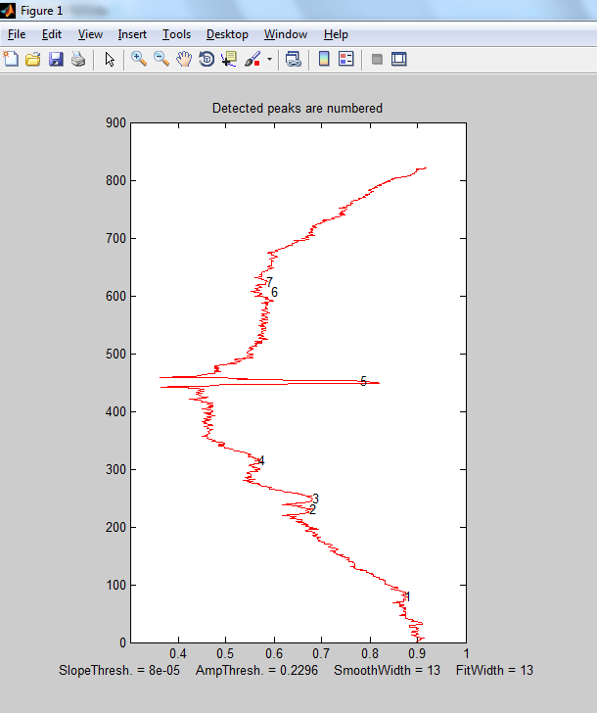

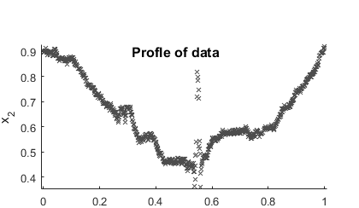
OLIGO 5
Elapsed time is 0.049213 seconds.
SlopeThreshold = 8e-05
AmpThreshold = 0.2296
SmoothWidth = 13
FitWidth = 13

