Slide 1

RT 524 Digital Agriculture
MINI Project
on
QR based product usage: Client-Server Architecture
Presented by:
Anshuman Gosh(25415001)
Chansa Raingam(254154003)
Mtech, SART,IIT guwahati

Slide 2

Project overview
The QR Verification System is a web-based application developed using LAMP Sandbox environment.
It allows users to submit QR codes either:
Manually (by entering QR ID)
By uploading QR image files
The system stores QR details along with:
User information
Timestamp
Verification status
It provides a basic framework for tracking and managing QR-based data.

Slide 3
Objective
Develop a user-friendly QR-based system to record and store QR code data securely with automatic timestamping.
Build a foundational platform that can be extended for future verification and approval processes.

Slide 4
Methodology
🔹 Technologies Used:
LAMP Sandbox (Endor)
PHP
HTML & CSS
MySQL (phpMyAdmin)
Browser-based environment to run Apache, PHP, and MySQL without installation
Database used to store QR information with timestamp
Used to design and style the user interface
Used for backend processing and storing QR data
Apache
Manages request–response between browser and PHP

Slide 5
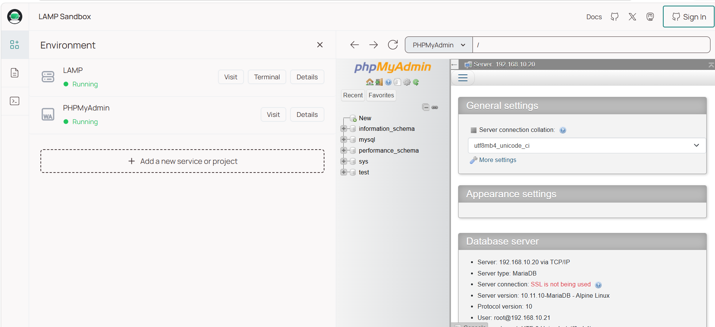
🔹 Steps of Execution:
1. System set up:
Use LAMP sandbox(endor) as local server
Components: Linux, Apache, MySQL, phpMyAdmin

Slide 6
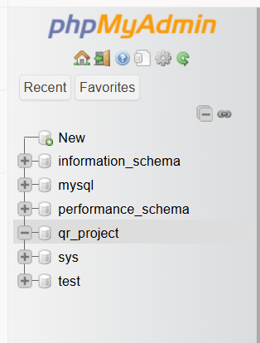
Database Design:
Create database qr_project using phpMyAdmin

Slide 7
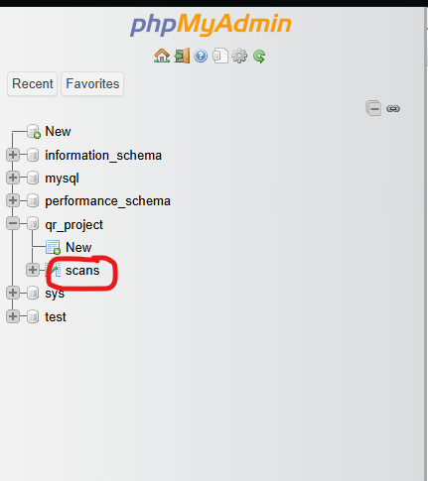
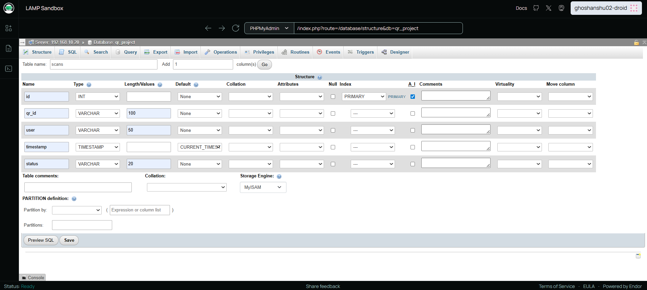
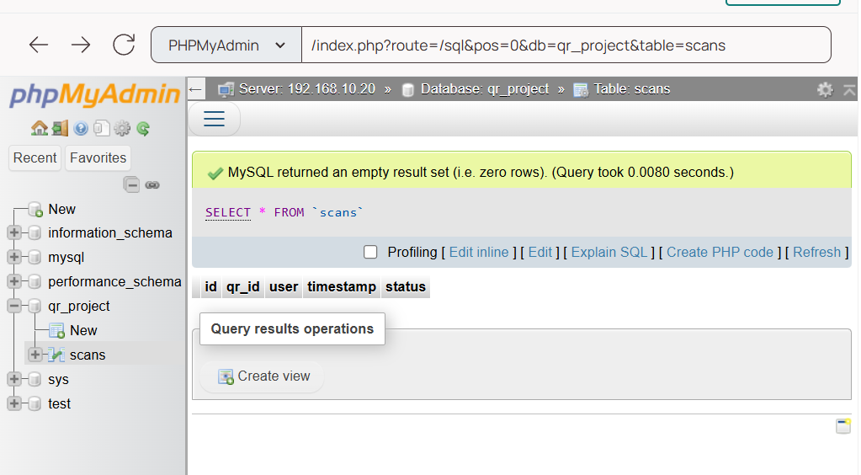
Create table scans with fields:
id (Primary Key)
qr_id
user
timestamp
status
Name | Type | Extra
id | INT | Index (PRIMARY) + AUTO_INCREMENT (A_I)
qr_id | VARCHAR(100)
user | VARCHAR(50)
timestamp | TIMESTAMP | Default (CURRENT_TIMESTAMP)
status | VARCHAR(20)

Slide 8
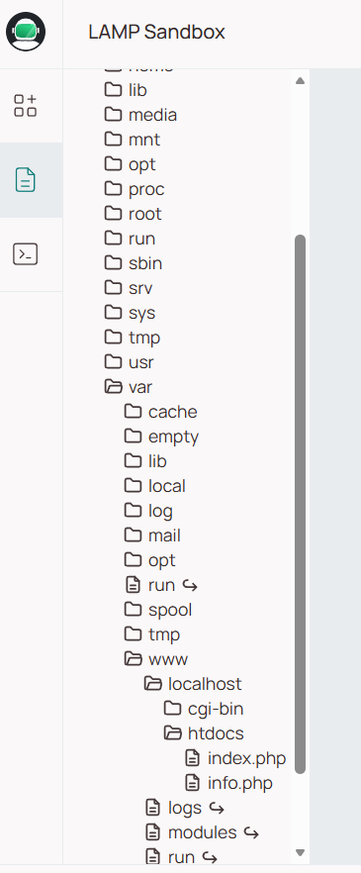
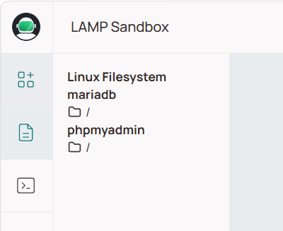
3. Develop index.php interface :
Frontend(HTML)
Backend(PHP)

Slide 9
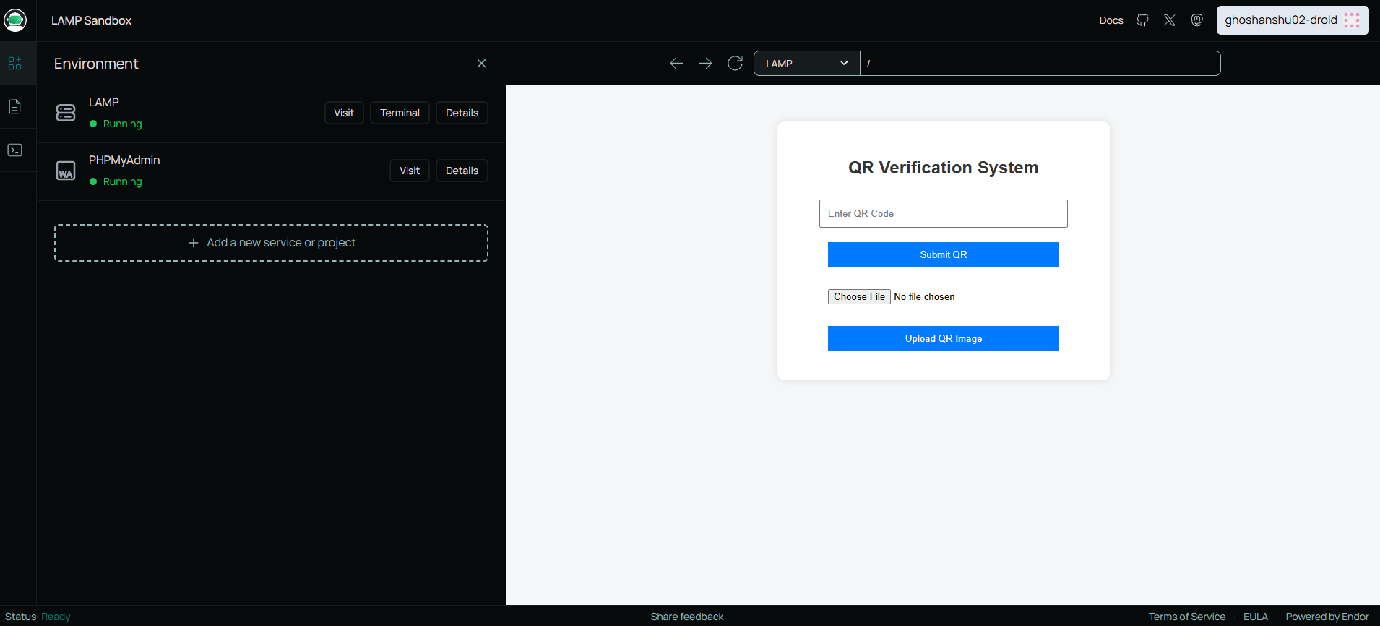
Browser(client)
System work flow
HTML form(Frontend UI)
HTTP request(post method)
Apache server(LAMP)
PHP backend processing
My SQL database
Response
Browser display

Slide 10
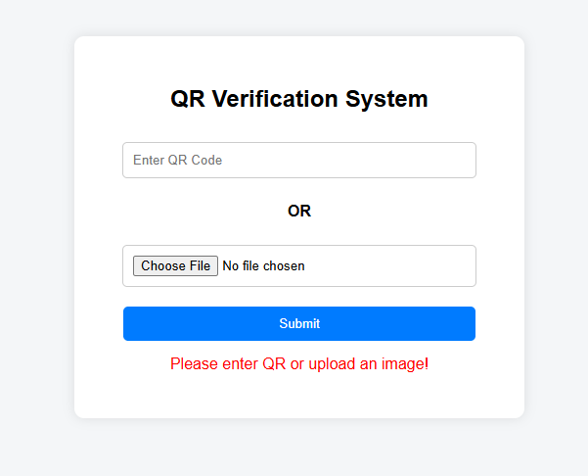
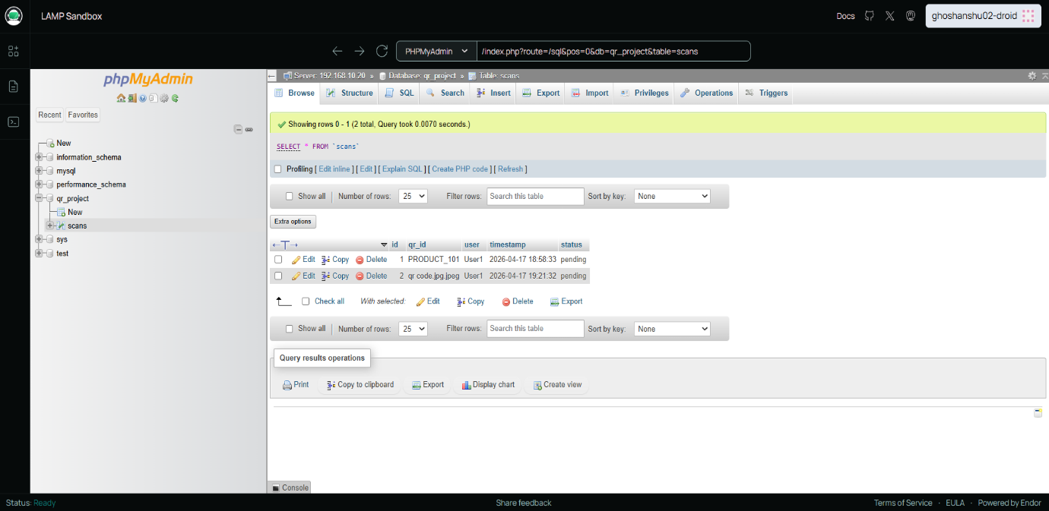
Result
Successfully created a working QR submission system
Users can:
Enter QR codes manually
Upload QR image files
Data is stored in database with:
Unique ID
Timestamp
Status (pending)
System runs on local server using LAMP

Slide 11
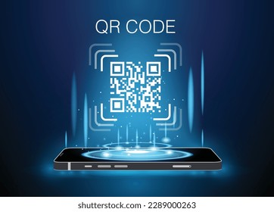
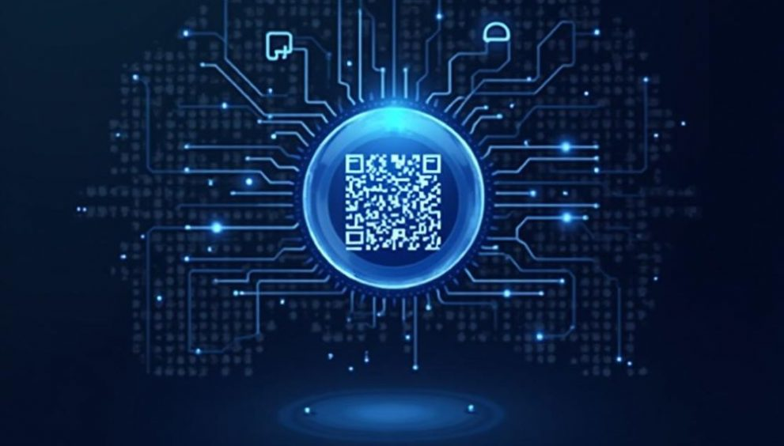

Future Scope
Add QR code scanning using mobile camera
Implement admin panel for approval/rejection
Improve QR image decoding instead of using filename
Add user authentication (login system)

Slide 12
Conclusion
The project demonstrates a basic implementation of a QR-based tracking system
It successfully integrates frontend and backend using LAMP stack
The system is functional but has scope for improvement

Slide 13
THANK YOU

