Slide 1
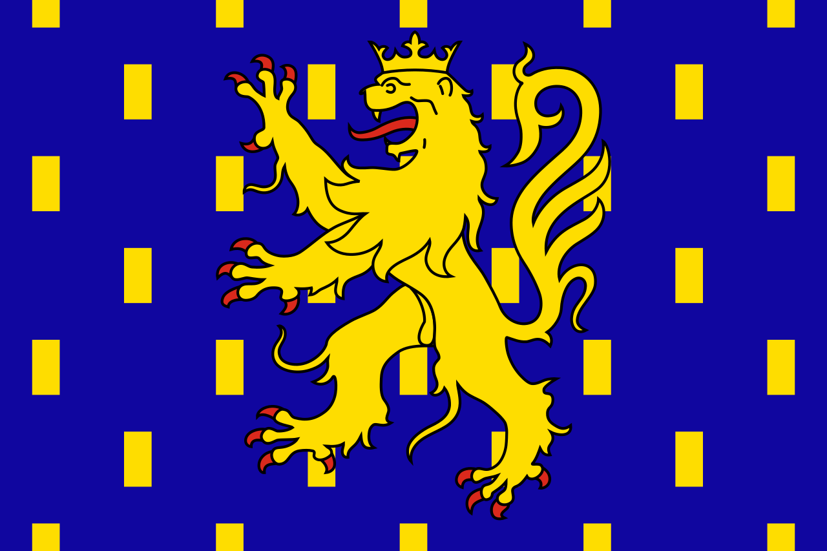
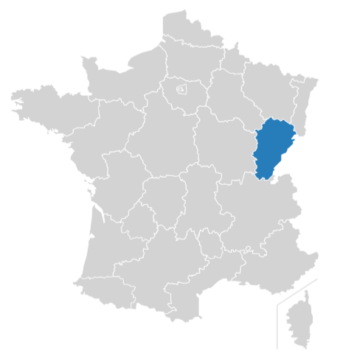
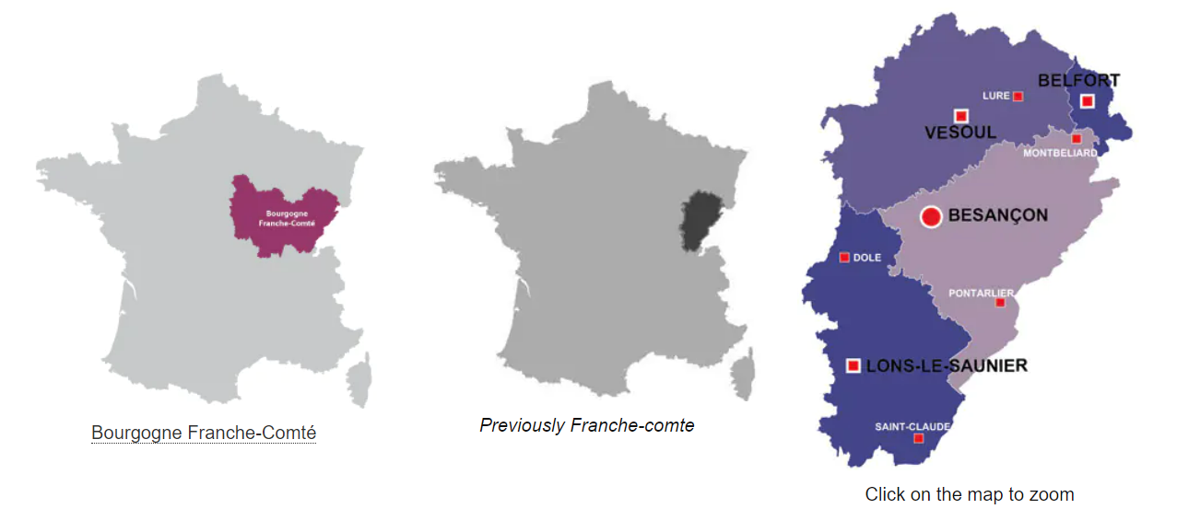
Franche-Comté
Franche-Comte is over at the eastern side of France and it borders Switzerland. Overall, the region accounts for around 2% of the total French population whereas the surface area is only 3% of the surface area France.
Chanse Syres
The region formed part of Burgundy about 8 centuries ago, the region refused homage to the German King and successfully broke away renaming the region Franc-Comté meaning “free Count” and the name of the region was born, Franche-Comté meaning “free country.”

Slide 2

Flag of Franche-Comté
It is this: "Azure billetty a lion rampant crowned or armed and langued gules“
The flag was assigned to the province by Jacques Meurgey in his Notice historique sur les blasons des anciennes provinces de France (Historical note on the coats of arms of the ancient French provinces, 1941).
Capital of Franche Compte: Besançon
See video to learn more

Slide 3
History of Franche-Comté (histoire de la franche-comet)
The region became part of the Roman Empire, after Julius Caesar's victory over the Gauls around 52 B.C. It was then later settled by the Burgundians and, in 534 A.D., conquered by the Franks.
The Gauls then conquered and inhabited Franche-Comté. Franche-Comté was known as the County of Burgundy, but not for long.
German Emperor Friedrich Barbarossa inherited Franche-Comté in 1155 then in 1295, King of France Philip the Handsome purchased the County of Burgundy and granted it to his son, Philip the Tall.
In 1384, Philip the Bold, son of King John the Good, who had already been granted the Duchy of Burgundy as his apanage, married the heir of the County and unified it with the Duchy.
In 1477, the last Duke of Burgundy, Charles the Bold, died and his enemy, King of France Louis XI, invaded Franche-Comté.

Slide 4
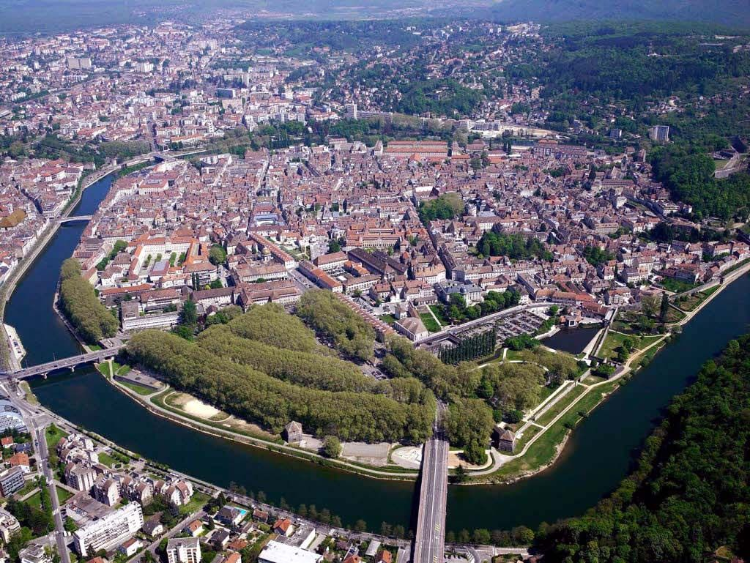
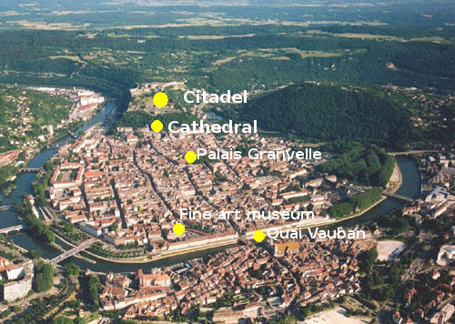
Cities of Franche-Compté
Besançon
The capital of Franche Comté is Besançon. This is also the biggest city in the Franche-Comté region.
Current population of Franche-Comté: Estimated at 1,146,000
Franc-Comtis is the regional language and is a dialect of Langue d'Oïl that is spoken by a minority of people.
Within this region you will find four departments: the Haute-Saone, Jura, Doubs, and Territory de Belfort. The four territories have their own capital.
Besancon is located close to the border with Switzerland

Slide 5
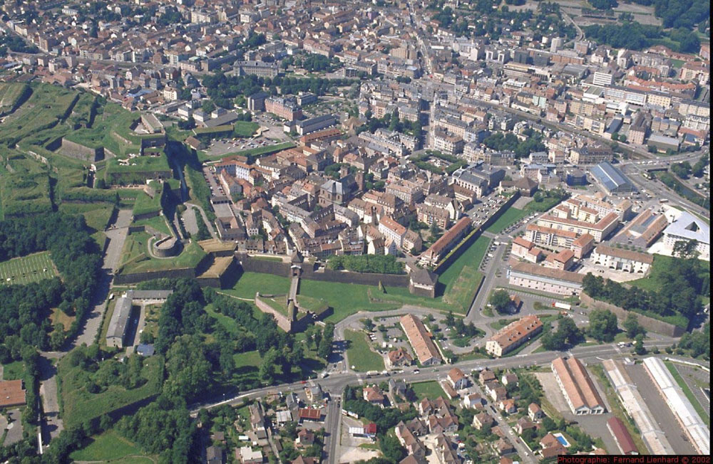
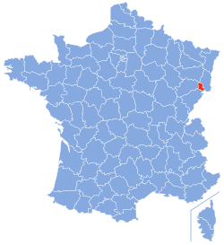
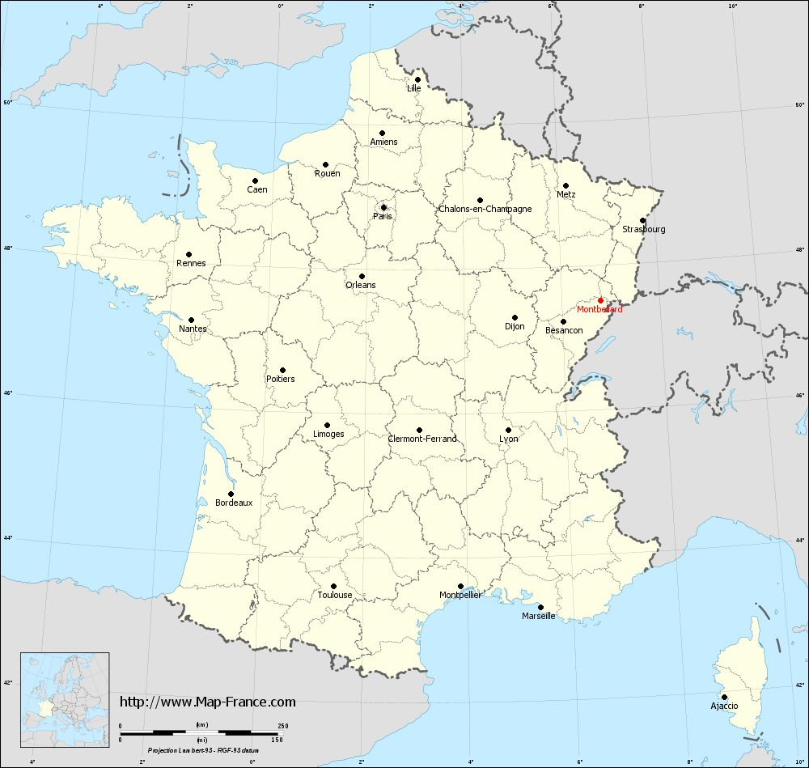
The next biggest cities are Belfort, montbeliard, dole, Lons-le-Saunier, and Pontarlier. All of these cities have around 25,000 people.
Belfort is the little red area here.
Montbeliard is right below
Belfort

Slide 6
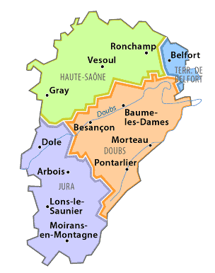
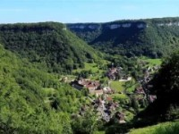
Cities
Ici, vous pouvez voir les villes de franche comte. Encore divisé en quatre districts. Vous voyez doubs, jura, haute-saône, terr de belfort.

Slide 7


Attraits et tourisme à Franche-Compte
The Université of Franche-Comté
Fromage: Comté est tres populaire
Comté is a creamy local variety of Gruyère, and is the region's signature cheese! We have a unique thing there. Comté or Morbier cheese.
Vineyards and wine
Franche-Comté is also the only region in the world to produce 5 different types of quality wines: Vin rouge, vin blanc, vin jaune, vin rosé, and vin de paille.
(franche comte produit cinq vins, franche comte produit cinq types de vins différents. Vin rouge, vin blanc, vin jaune, vin rosé, and vin de paille.)
Skiing
Il y a plusieurs endroits pour skier en france comte. Métabief, les rousses, Prémanon. il y a des montagnes et de la neige en franche comte.

Slide 8
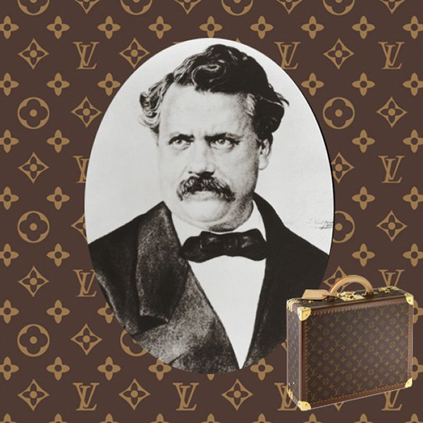
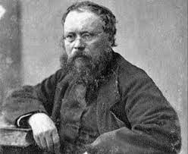
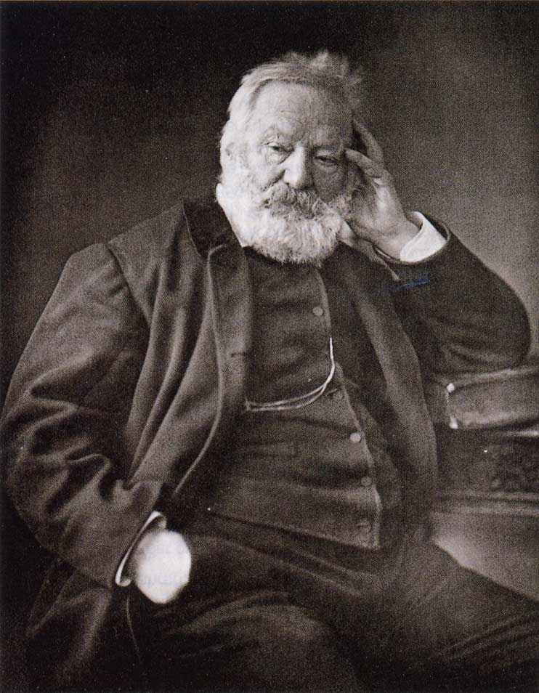
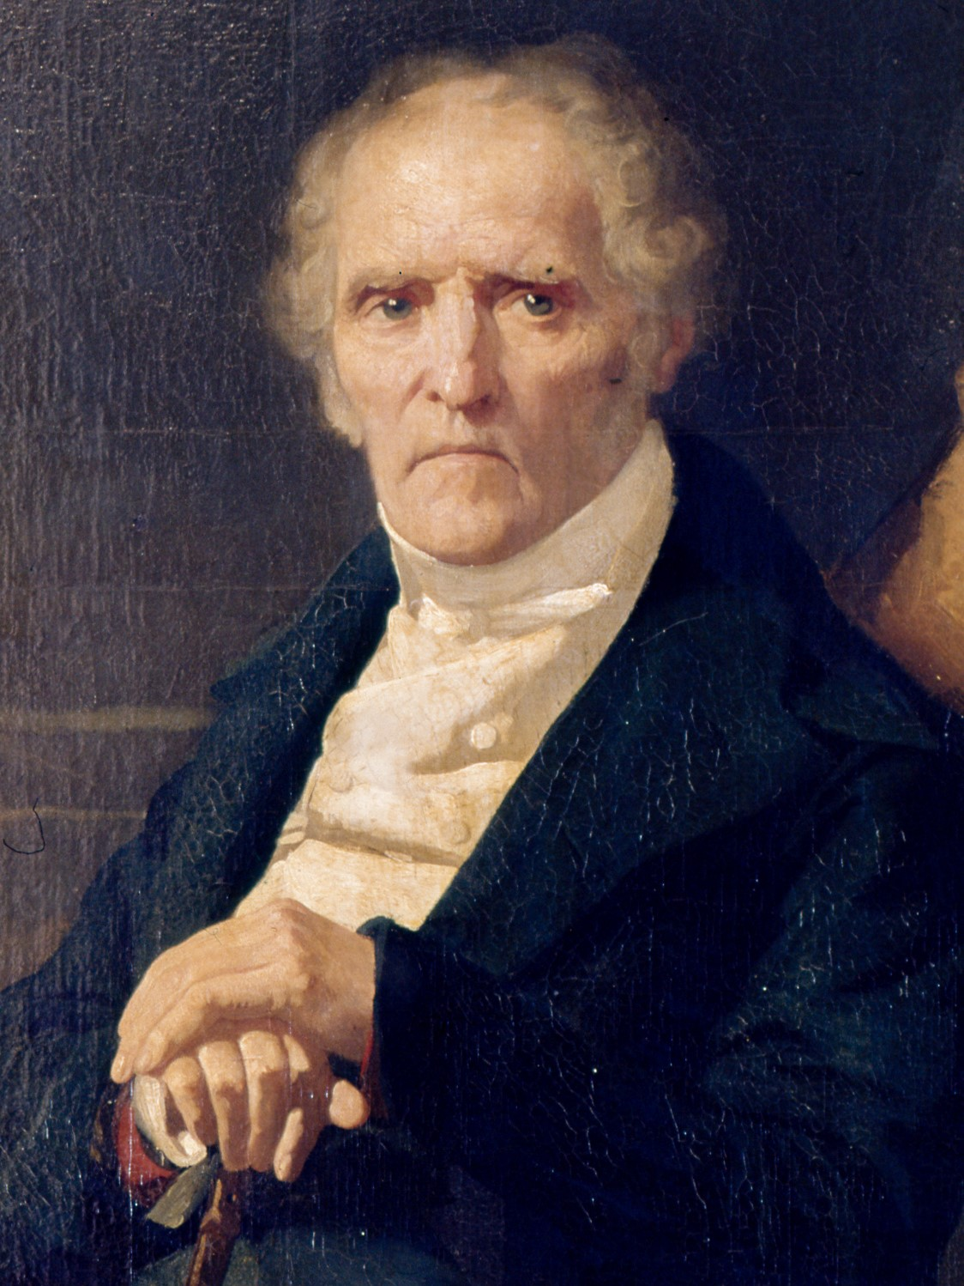
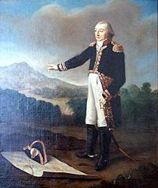
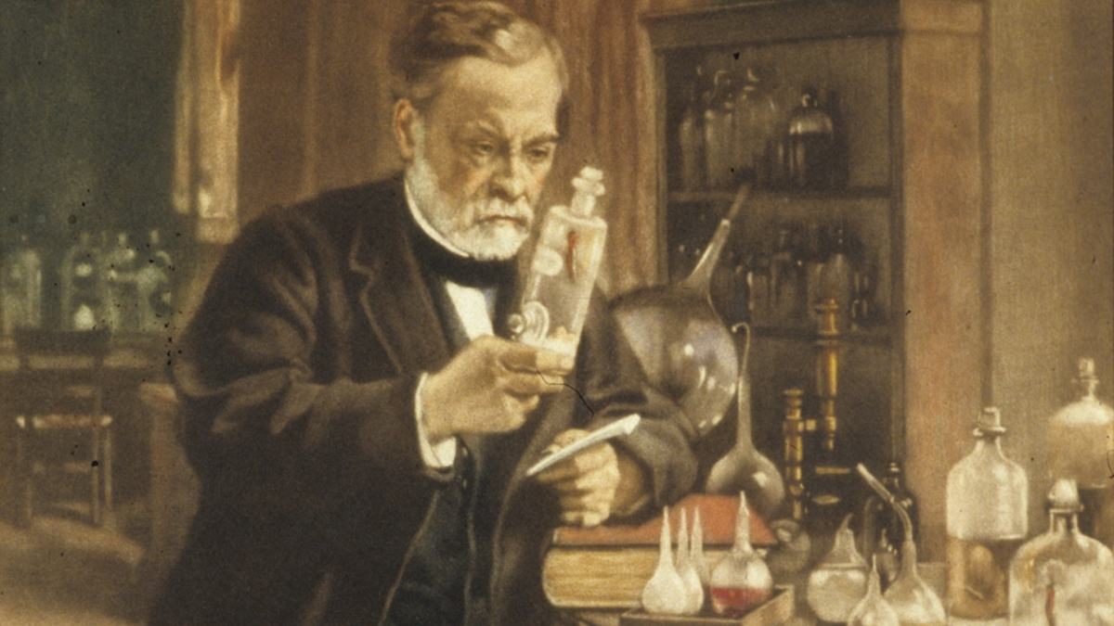
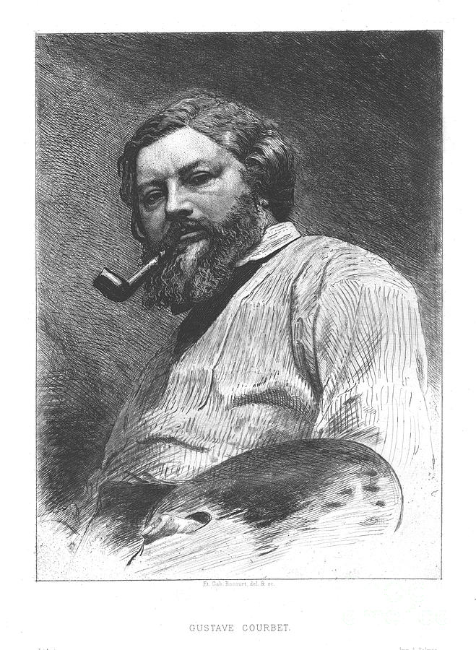
People Born from the Franche-Compte Region
Louis Vuitton (1821-1892)
French fashion designer and businessman
Victor Hugo(1802-1885)
Victor-Marie Hugo was a French poet, novelist, essayist, playwright, and dramatist of the Romantic movement
Pierre-Joseph Proudhon
(1809-1865)
Socialist, Politician, Philosopher, Economist.
Charles Fourier..
(1772-1837)
French philosopher and influential socialist thinker
Louis Pasteur
(1822-1895)
was a French chemist and microbiologist
Jean Baptiste Alexandre Strolz
(1771-1841) French general during the Napoleonic wars
Gustave Courbet (1819-1877)
Painter

Slide 9
Sources
Franche-Comté | Belle France
Franche-Comté Region of France | Regions of France (regions-of-france.com)
Franche-Comté (Traditional province, France) (crwflags.com)
Facts on Franche-Comte Province of France (placesinfrance.com)
Franche-Comte | History, Culture, Geography, & Map | Britannica
Franche-Comte: a guide to France's secret corner | CN Traveller
Franche-Comté (thegoodlifefrance.com)
Franche-Comté - Wikipedia

Slide 10
Sources (Continued)
Louis Pasteur – Wikipedia
Pierre-Joseph Proudhon – Wikipedia
Victor Hugo – Wikipedia
Jean Baptiste Alexandre Strolz – Wikipedia
Gustave Courbet – Wikipedia
Charles Fourier – Wikipedia
Louis Vuitton (designer) – Wikipedia
Franche-comte region of France, all the information you need (france-pub.com)

